Slide 1
R-Ladies Gaborone Launch
November 6, 2021

Slide 2
library(dplyr) rladies_global %>% filter(city == ‘Gaborone')

Slide 3
Overview
Brief: R-Ladies Global
Insight about R-Ladies Nairobi
R-Ladies Gaborone – Steps towards building to R community
How to get involved in the R community
Brief: R for Data Science

Slide 4
Acknowledge
Shannon Pileggi
Vebash Naidoo
Paloma Rojas-Saunero
Shel Kariuki

Slide 5
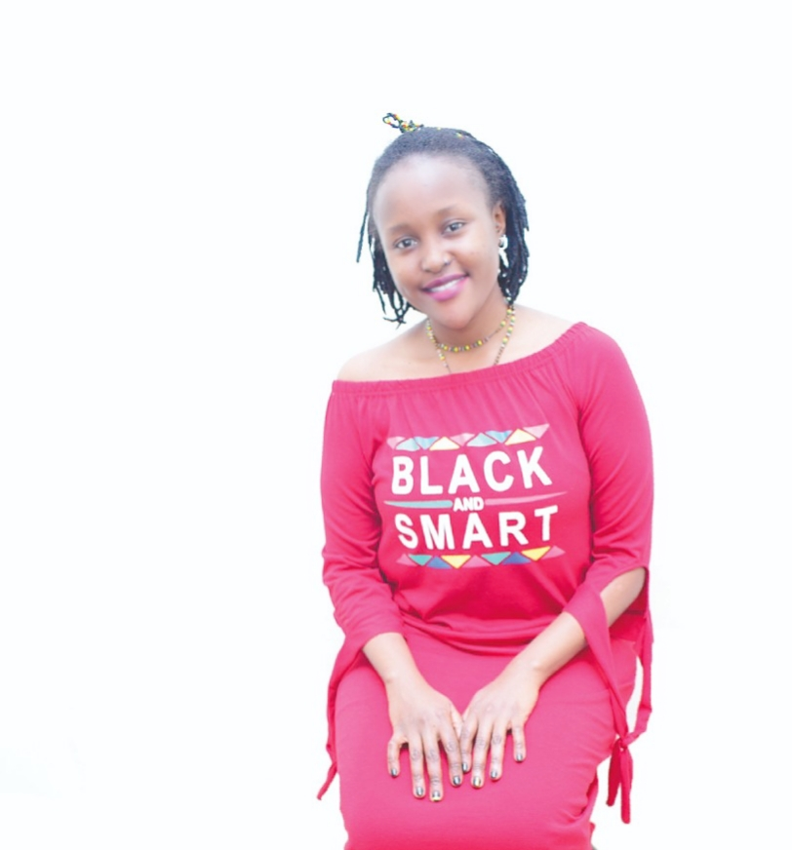
Hello!
I am Njoki Njuki
A second-year student at Hasselt University, pursuing MSc Statistics and Data Science specialising in Biostatistics.
I am also a trainer of Data Management and Analysis, and Basic Statistics at Training Center in Communication, located at the University of Nairobi.
I am the organiser of R-Ladies Nairobi (part of the R-Ladies Global).
I also love reading books, blogs about advances in scientific research. Currently part of a book club under R4DS community studying the “R for Data Science” book.
Let’s connect via:
Twitter: @lucy_njokinjuki
LinkedIn: Njoki Njuki Lucy: https://www.linkedin.com/in/lucy-njoki/
Email: lucynjokinjuki@gmail.com
Notes:
Add contacts details

Slide 6
R-Ladies Global
A world-wide organization with a mission to promote gender diversity in the R community.
The R community suffers from underrepresentation in every role from users, leaders, developers, conference speakers, educators.
Brief history:
R-Ladies was founded in October 1, 2012 by Gabriella de Quirezo
First meetup was placed in San Francisco, California (United States)
R-Ladies Global was born and the grant was awarded in September 2016.
R-Ladies has grown to 212 chapters in 60 countries with 80493 members
As a chapter of R-Ladies Global, we are guided with the code of conduct provided.
To participate in R-Ladies community:
Join the R-Ladies directory here
Slack channel here

Slide 7
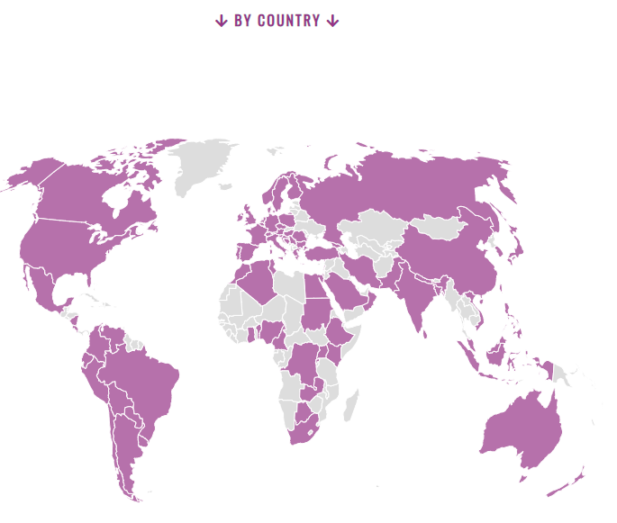
For more information about R-Ladies Global: https://rladies.org/

Slide 8
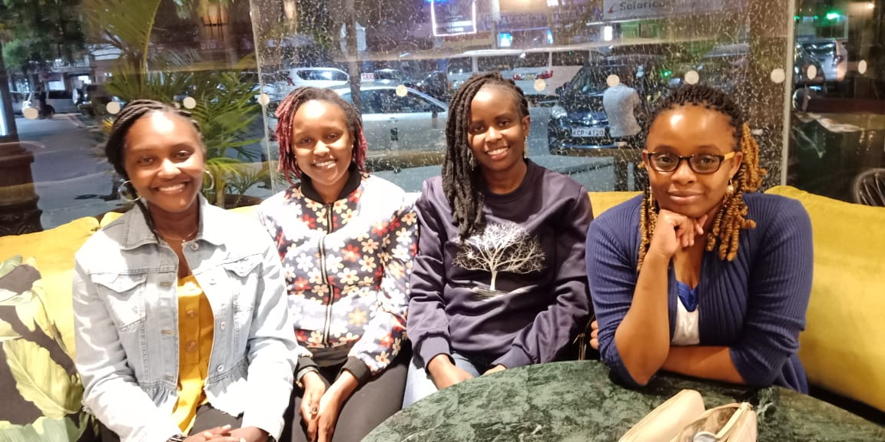
Brief About R-Ladies Nairobi
Currently celebrating our first anniversary: https://www.meetup.com/rladies-nairobi/events/281445553/
Teamwork and Organization
Communication
👉Lifelong friendship
Collaboration with other chapters & Nairobi R User Group
Maggie, Njoki, Faith, Shel
Notes:
Add link to the meet up

Slide 9
R-Ladies Gaborone – Steps towards building to R Community
Worry not about the number of participants at the start, rather have a workable plan of what you want to achieve as a chapter!
Use the R-Ladies directory, #rstats, #TidyTuesday, conferences, book clubs to look for trainers/ speakers.
Again, small steps make significant differences in the long run.
Swahili saying: “Kidogo kidogo hujaza kibaba!”

Slide 10
How to get involved in the R community?
#TidyTuesday – Created by Dr. Thomas Mock
Great way to learn and practice on known skills
See what others have done
Asking help – R Community is very friendly
RStudio Community: https://community.rstudio.com/
GitHub
Stackoverflow
#Rstats
R4DS Slack channel
Answering Questions!
Participating in the R conferences:
useR!
RStudio
R/Medicine
Can apply for diversity scholarship
Pet Projects:
I created a simple shiny app to track how the Covid-19 epidemic was evolving in Kenya: https://lucy-njoki-njuki.shinyapps.io/trial12covidtrends/?_ga=2.19698296.1976740036.1635787982-565198700.1635787982
Learnt from participating in R-Ladies Capetown meetup!
Submitted a shiny app in the R Shiny contest 2021: age-structured explicit SEIR model: https://community.rstudio.com/t/age-structured-stochastic-seir-modelling-covid-19-pandemic-in-kenya-shiny-contest-submission/104837
Learning process
Networking:
I at least interact with 2 to 3 persons each conference. Very important to build your network!
Participate in meetups. Check out all meetups happening worldwide hosted by different R-Ladies chapters: https://www.meetup.com/pro/rladies/

Slide 11
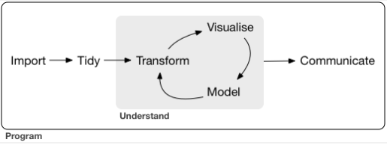
R For Data Science
DS is a discipline that allows us to turn raw data into understanding, insight, and knowledge.
R software can be used to do DS.
A good book to read by Dr. Hadley Wickham & Dr. Garrett Grolemund: https://r4ds.had.co.nz/index.html
Join the R4DS community: https://www.rfordatasci.com/
Book clubs – Great way to learn with a team.
Under guidance of awesome mentors such as Jon Harmon!
Source: R for DS book: DS process

Slide 12
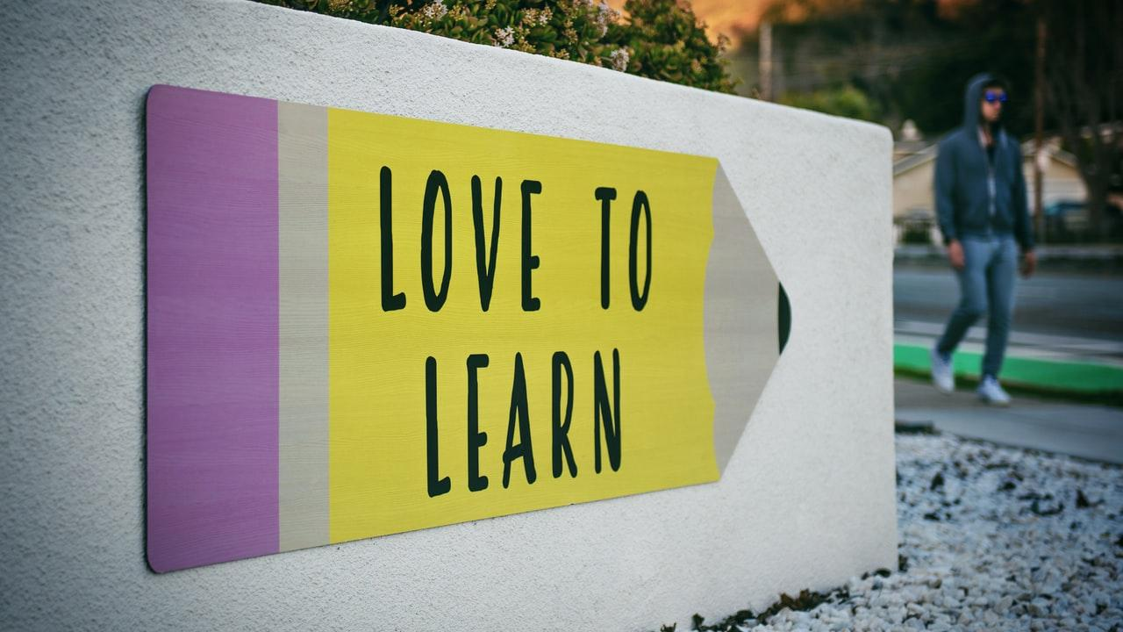
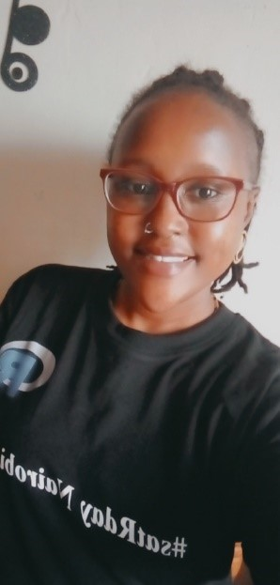
Thank you!!

