Slide 1
The Co-existence of Patent Pools
Stefan Lobin, Uwe Walz
Geothe University Frankfurt, Goethe University Frankfurt and LIF-SAFE
Discussant: Lucy Xiaolu Wang
University of Massachusetts Amherst; MPI - innovation; CCHE
21st Annual International Industrial Organization Conference 2023.4.23

Slide 2
Main message and contribution
Research question:
What are the main determinants of co-existing patent pools?
Approach: theoretical modeling
Vertically segmented mkt w/ homogeneous/heterogeneous downstream firms
Results: coexist & competing pools allows market segmentation
co-existing pools in equilibrium always dominate a common pool
Contribution: the first analysis on co-existing patent pools!
Suggestions: ideas on motivation/interpretation and model extensions

Slide 3
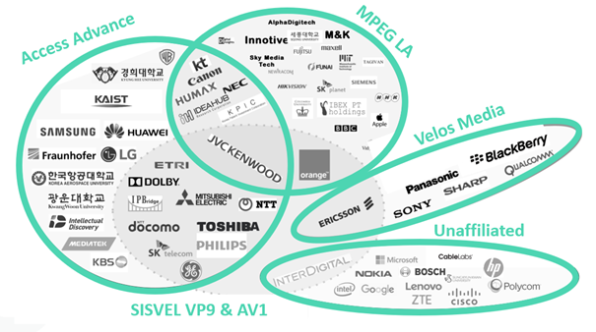
Co-existing patent pools are common & very important!
BUT very understudied!!!
Source: https://www.iam-media.com/article/who-leading-the-vvc-technology-race
Notes:
Another relevant source to check: https://rethinkresearch.biz/articles/third-vvc-patent-pool-probable-as-world-digests-mpeg-la-terms/
Would be nice to mention market size to emphasize the economic significance.

Slide 4
Some big picture antitrust questions
Patent pools as joint marketing agreements: a key theme is to design “info-free” requirements to guarantee that pools improve welfare
Restoring competition (static environment)
Addressing tacit collusion (repeated games)
Standardization: price regulation (standard essential patents)
Antitrust IP guidelines: European Commission (2004), Japanese Fair Trade Commission (2005), and US DOJ (2007). DOJ example:
Info light: allows independent licensing; grantback provisions; …
Info intensive: pool includes only “essential” patents (w/o substitutes); …
Understanding all existing Qs with co-existing patent pools is hard!
Nuances: relationship btw pools and the coverage of patents within a pool

Slide 5
1. Tie closer with antitrust issues in patent pools
Q1: the paper excludes the case of perfect substitutes and abstract away from the relationships of patents in the pool (and across pools)
V’>0, V’’<0 has a good capture of “more is better” (not perfect substitute), and diminishing return to patents; yet may not capture which patents are more valuable (standard essential), which are useful for high-tech pools
Depends on downstream technologies needs, the relationships of pool can also vary
Ideas: 1) can potentially replace V to V-e to use e as an essentiality parameter, where e~[0,V], where e closer to V means more complementary patents; 2) may want to consider V(N₁+N₂-n) to use n to proxy for complementarity btw pools (n ~ [0, min{N₁,N₂]), the idea may extent to common ownership.
Q2: the model predicts all standalone firms would have incentives to join a pool, & abstract away from independent licensing by firms in the pool
Independent licensing is often considered collusion shield in repeated interactions (Rey-Tirole, 2019), among others (e.g., price cap)
Ideas: 1) would be helpful to add a discussion on indept licensing ; 2) maybe another paper on theoretical determinants of firm’s participation decisions

Slide 6
2. Potential empirical tests in tech patent pools
It would be great to enrich theoretical predictions with observations
Policy discussions usually center around individual pool designs, and do we miss anything important when ignoring the welfare benefits from co-existing pools?
Ideas: can interpret theoretical predictions with empirical observations in early co-existing pools, e.g., MPEG-2, DVD 3C & 6C pools (link: https://www.justice.gov/atr/chapter-3-antitrust-analysis-portfolio-cross-licensing-agreements-and-patent-pools)
Test the prediction using empirical data? (esp. if can expand to N pools)
Ideas: Data on Technology Standards, Industry Consortia, and Innovation has data on many pools launched for different technologies (link: https://www.law.northwestern.edu/research-faculty/clbe/innovationeconomics/data/technologystandards/)
Ideas on empirical measures of complementarity across patents
Ex ante: listed as standard essential by SSOs, not continuation patents
Ex post: litigation (PACER/Docket Navigator/USPTO litigation data -2016)

Slide 7
Final thoughts
Very interesting topic, lots of fruit for thought
Key takeaway: pools should be differentiated by size & downstream firms should have sufficiently dispersed technologies
Main thoughts: tie the motivation closer with antitrust and tech pool current issues, with future extensions & empirical tests!
Already very polished. Looking forward to the final version!

