Slide 1
Marketing Authorization and Strategic Patenting: Evidence from Pharmaceuticals
Dennis Byrski¹ and Lucy Xiaolu Wang^{2,1,3}
¹ Max Planck Institute for Innovation and Competition
² University of Massachusetts Amherst
³ Canadian Centre for Health Economics
AEA “tech. and innovation” lightening round session, 2025.1.5

Slide 2
Drugs save lives, but too costly with many patents!
Patent systems are designed to promote innovation (Mansfield 1986; Lakdawalla 2018), but strategic patenting limits drug access (EC 2009)
E.g., evergreening (extends length) and fencing (extends breadth)
Trade-off: static efficiency vs. R&D incentives -> debates on patentability
US Supreme Court cases: Mayo 2012, Myriad Genetics 2013
This paper: how info disclosure in market authorization (MA) affect follow-on patenting (Trial docs disclosed can function as new “prior arts”)
Patent B
Innovation B
Innovation A
Patent A
Product A
cited by
(forward citation)
Patent C
Innovation C
?
EPO “gold standard” examination quality (Chien 2018), patent citation: follow-on patenting
Notes:
Mayo v. Prometheus (2012): adjust drug dosage based on metabolite levels – not patent-eligible;
Association for Molecular Pathology v. Myriad Genetics, Inc. (2013): naturally occur genes are not patent eligible.

Slide 3
Research Question:
Q: How does marketing authorization of a new drug (new NME) affect follow-on innovation building upon focal drug?
Intuitively, follow-on patenting can go either way (an empirical Q):
More: “Time to explore other new indications and expand the market!”
Less: “Time to lay flat and relax, as profit is coming in our way!”
Same: “I cannot decide, so maybe just good to patent as usual?”
Exploit the authorization of new drugs to the (EU/EEA) market, utilize the variation in approval lags (that do not differ by ex-ante patent char.)
Examine how a drug’s marketing authorization affects the rate & direction on follow-on patenting by firms (selves, related parties, others)
Notes:
EEA = European Union member states, Iceland, Liechtenstein, and Norway.

Slide 4
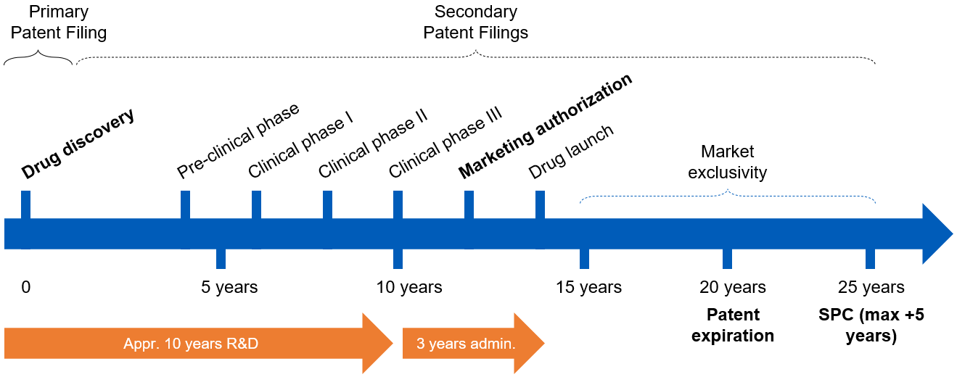

The Drug Development Process in EU (EEA)
In European Economic Area (EU+Iceland, Liechtenstein, Norway), originators submit applications for market authorization to European Medicines Agency (/national)
verifies safety, efficacy, quality; drugs can then be sold for approved indications
Market exclusivity: firms hold exclusive right to market/sell a patented drug

Slide 5
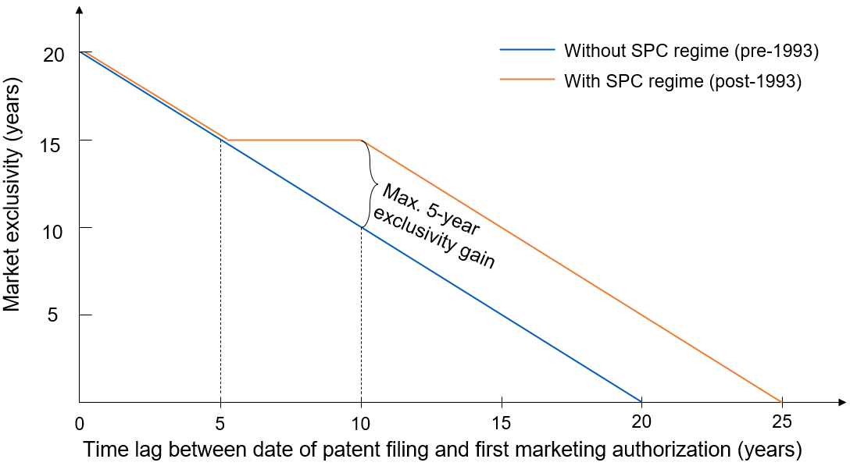
EU Patent Term Extension (SPC Regime)
Supplementary Protection Certificates (SPC) regime, 1993- : extension capped at 5 years; market exclusivity constant for patents w/ 5-10 years’ approval lag
SPC term (≤5 years)= date of 1st MA in EEA – filing date of basic patent – 5
analysis

Slide 6
It takes a long & uncertain time to develop a drug…
Pre-clinical phase
Market authorization
Clinical phase III
Clinical phase II
Patent filing
Clinical phase I
Drug launch
Late MA
(long lag)
0
5 years
10 years
15 years
20 years
Early MA
(short lag)
0
5 years
10 years
15 years
20 years
Approval lag cannot be predicted perfectly at the time of the patent ﬁling: whether/when the drug will be on the market (à la Gilchrist 2016)
Scientific uncertainty & organizational factors: finance, M&A, $, licensing, …
Data: 1) patent-drug linkage: SPC data from DPMA; 2) patent data on primary patents from EPO PATSTAT, family level patent info; 3) drug data: Cortellis, link by family id; 4) crosswalk diseases w WHO ICD-9.

Slide 7
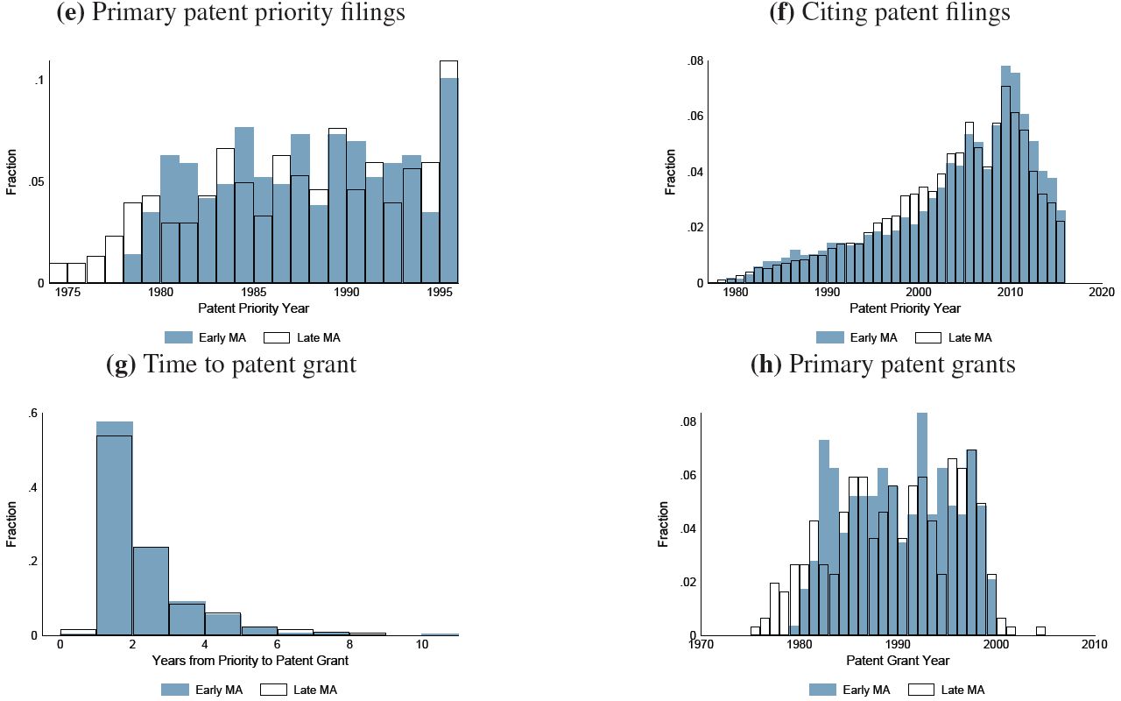
Distribution of characteristics (split by median MA)
Patents with early vs. late MA (split approval lag at median: 10 years) are similar regarding priority time, time span at the patent offices (time to patent grant), similar technological nature (e.g., ICD-9, complexity, resubmissions), and similar ex-ante drug, disease, and patent characteristics (t-test across many metrics).

Slide 8
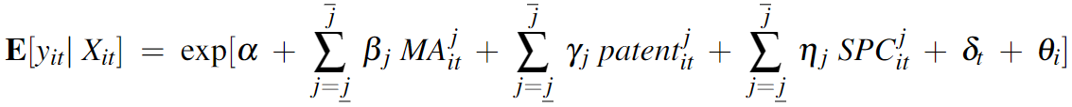
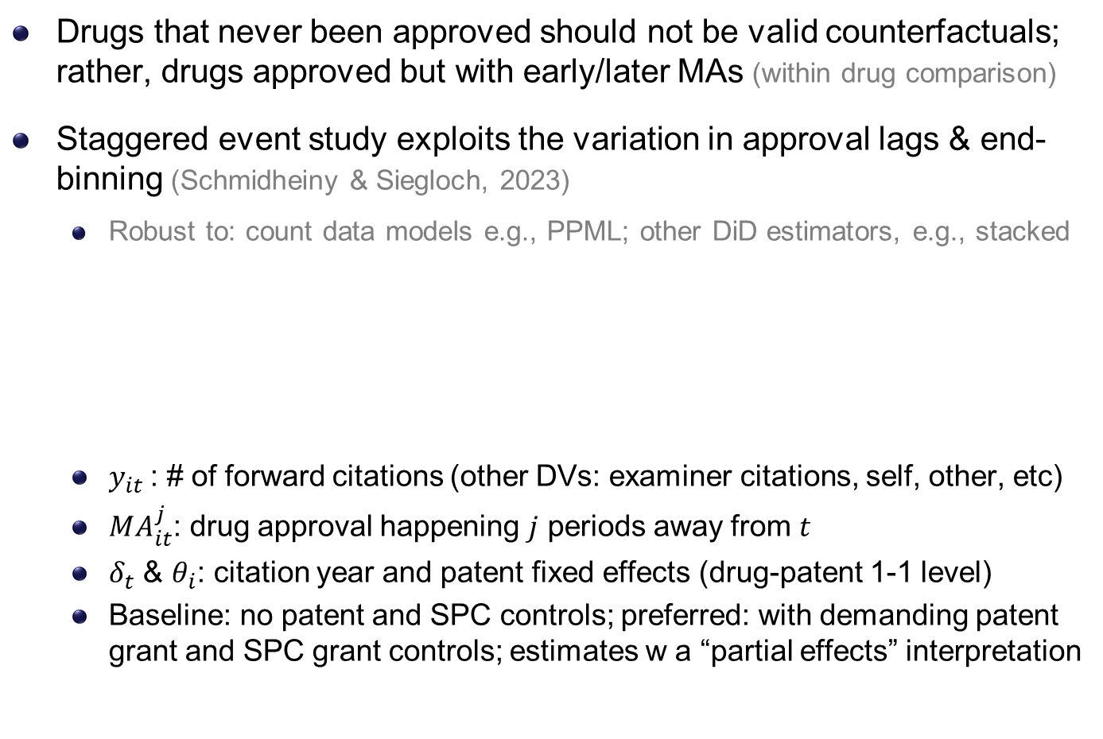
Empirical Strategy: Event Studies (à la S&S 2023)
Drugs that never been approved should not be valid counterfactuals; rather, drugs approved but with early/later MAs (within drug comparison)
Staggered event study exploits the variation in approval lags & end-binning (Schmidheiny & Siegloch, 2023)
Robust to: count data models e.g., PPML; other DiD estimators, e.g., stacked
$y_{it}$: # of forward citations (other DVs: examiner citations, self, other, etc)
$MA_{it}^{j}$: drug approval happening $j$ periods away from $t$
$δ_{t}$ & $θ_{i}$: citation year and patent fixed effects (drug-patent 1-1 level)
Baseline: no patent and SPC controls; preferred: with demanding patent grant and SPC grant controls; estimates w a “partial effects” interpretation

Slide 9
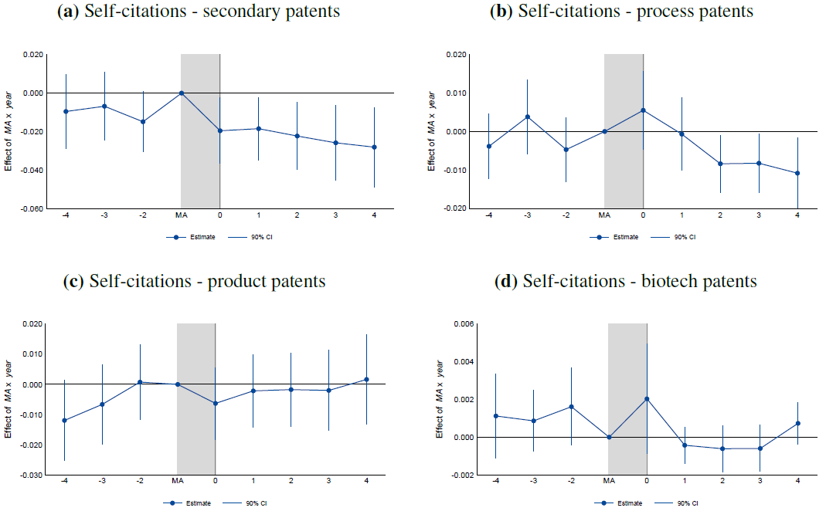
Market Authorization & self-citations: by type of patent
(e.g., new formulations, new dosage forms, new drug combinations, or new use)
(e.g., new manufacturing process)
(e.g., new products (derivatives), new macromolecule)
(e.g., biological product/process patents)

Slide 10
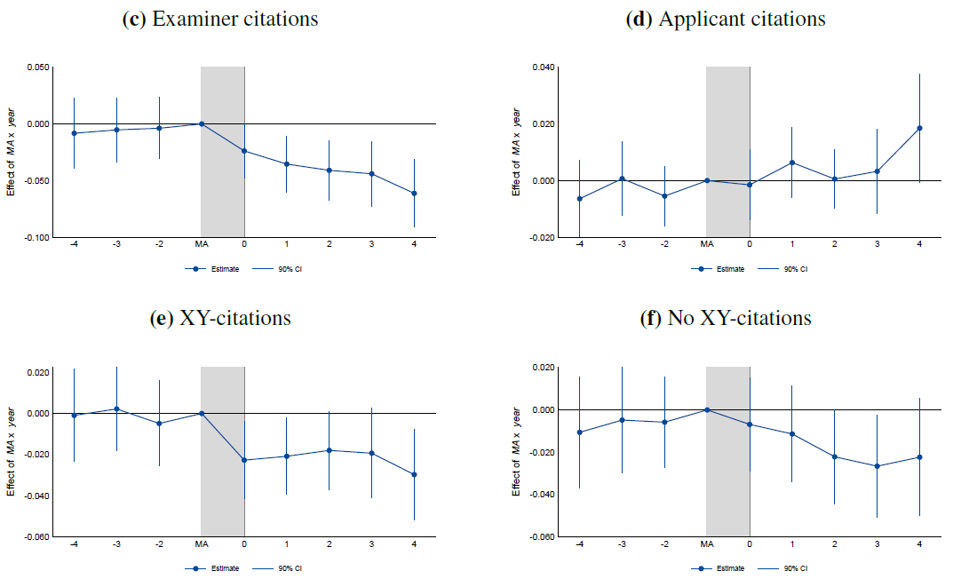
Marketing authorization & self-citations: by source/type
Self-citations added by examiners (high quality)
Self-citations added by applicants
X/Y-ref.: suggest legally “weak” patents as they increase the likelihood of a post-grant validity challenge (Wagner & Wakeman, 2016)
(X: a single prior patent doc can undermine the novelty/inventiveness of claimed invention; Y: do so in combination w/ other docs)

Slide 11
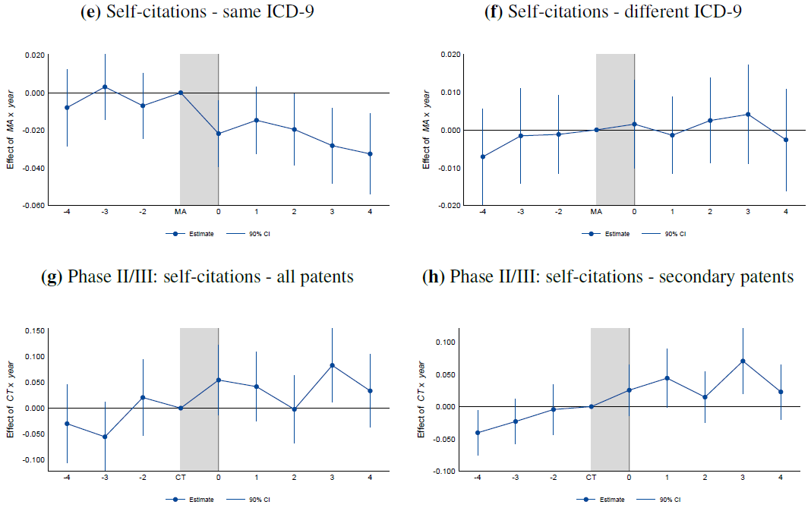
MA & self-citations: by disease; & placebo events
Same disease area/indication as approved drug
Explore new treatment options for a focal drug
Use end of phase II/start of phase III as a major milestone event to test the mechanism (disclosure/enforceability)
Others’ citations broadly follow a similar pattern, but with about 2 years lags

Slide 12
Robustness Checks, Conclusion, & Discussion
Market exclusivity & incentives for competitive entry:
earlier MA -> longer market exclusivity -> + competitive entry -> under-est.
Strategy: Zoom in a subset with constant ME due to a kink in SPC regime
Unobserved quality: if + unobserved value w/ – approval lag -> upward bias
Strategy: instrumental variable approach (IV: time-to-phase I)
Field of application: whether results are driven by a few disease areas
Strategy: leave-one-out ICD-9 disease area specific analyses
We find that strategic follow-on patenting decreases after a drug’s market authorization, when follow-on drug patents are harder to obtain
More drop for less novel patents; No change in meaningful patents
Empirical test indicates it’s harder to obtain enforceable patents post-MA
Policy implications: leveraging existing regulatory disclosure requirements may provide a practical approach to improving patent examination without changing formal patentability standards

Slide 13
Megaprojects, Digital Platforms, & Productivity: Evidence from the Human Brain Project
Ann-Christin Kreyer¹ and Lucy Xiaolu Wang^{2,1,3}
¹ Max Planck Institute for Innovation and Competition
² University of Massachusetts Amherst
³ Canadian Centre for Health Economics
AEA “tech. and innovation” lightening round session, 2025.1.5

Slide 14

Background and Research Question
Declining productivity in biomedical science (Bloom et al. 2020); AI showed potential in life sciences (e.g., drug development).
But integrating AI with lab science is not always easy
This paper: how does a ten-year megaproject affect AI-brain sciences?
Launched in 2013, the HBP aims to advance brain science in 10 years
with €1B grants & AI-powered research infrastructure
Research Q: How does the HBP affect the rate and direction of R&D?
How does accessing to the HBP network matter across research types & career stages? More collaboration/interdisciplinary/novel output?

Slide 15
Conceptual Considerations
Q: How does the HBP affect the rate and direction of research publications? (in neurosciences/AI/joint)
Ideas are harder to get. Large teams w complementary skills can help (Jones 2009). But large teams can be inefficient & non-creative
Moral hazard with credit sharing (Che & Yoo 2001)
Intuitively, productivity can go different ways (an empirical Q):
More: “Time to explore new areas and expand the network!”
Less: “Time to take more risks and invest in new yet slower areas!”
Similar: “Time to change $ source, but I still only have 24 hours/day!”
Q: quantity, quality; network expansion; career/gender; topic areas
Notes:
Less pubs bc (1) adjustment time to learn new knowledge , (2) multidisciplinary teams require more coordination Systematically capturing brain simulation and other topics w/ pubs as immediately shareable knowledge

Slide 16
Data & Measures
Data: HBP audited reports, official sites, online forum, CORDIS, Scopus
Details on 639 individual researchers actively participated in the HBP (2013-2020) from about 180 institutions in 20+ countries
Full publication record of these HBP individuals and control group
Matching-based control pool and corresponding research profiles
Aggregate to individual-year panel for main analyses
Measures: publications, citations, text-based research topic areas
# of publications, # pubs as the first or last authors
# of pubs in top CS outlets, # of pubs top neuroscience journals
# of coauthors, # of citations
# of pubs by topic groups, and # pubs by topics and journal quality
Topic classification: use neural, prompt-based, LLMs (GPT3.5turbo/4)
Neurobiology, neurotechnology, AI-robotics, clinical focus, others
In-progress: annotation & fine-tuning using GPT4o-mini, cross-validation
Notes:
Large teams develop while small teams disrupt

Slide 17
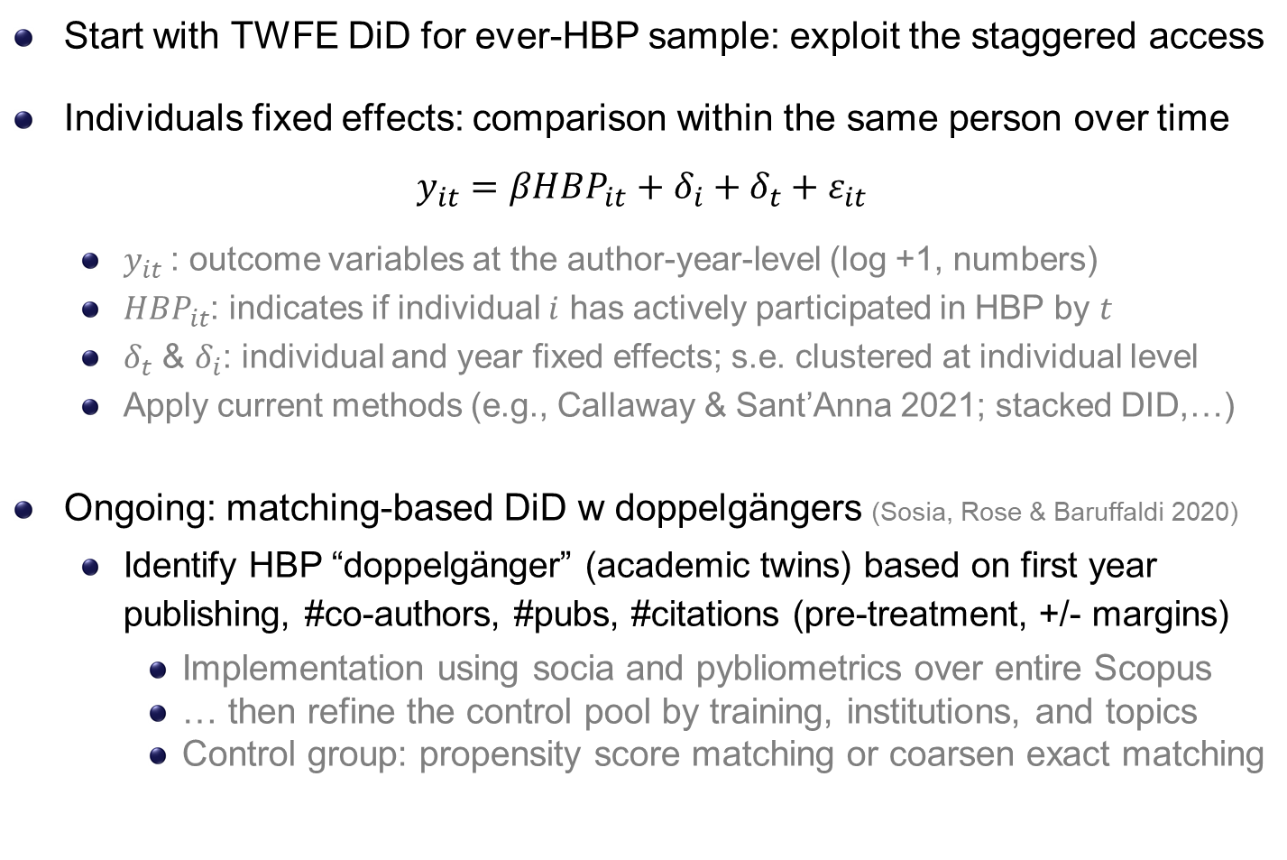
Methods: TWFE, staggered & matching-based DiD
Start with TWFE DiD for ever-HBP sample: exploit the staggered access
Individuals fixed effects: comparison within the same person over time
$$y_{it}=βHBP_{it}+δ_{i}+δ_{t}+ε_{it}$$
$y_{it}$: outcome variables at the author-year-level (log +1, numbers)
$HBP_{it}$: indicates if individual $i$ has actively participated in HBP by $t$
$δ_{t}$ & $δ_{i}$: individual and year fixed effects; s.e. clustered at individual level
Apply current methods (e.g., Callaway & Sant’Anna 2021; stacked DID,…)
Ongoing: matching-based DiD w doppelgängers (Sosia, Rose & Baruffaldi 2020)
Identify HBP “doppelgänger” (academic twins) based on first year publishing, #co-authors, #pubs, #citations (pre-treatment, +/- margins)
Implementation using socia and pybliometrics over entire Scopus
… then refine the control pool by training, institutions, and topics
Control group: propensity score matching or coarsen exact matching
Notes:
Lag in pubs:
the fields we are talking about are very fast (you will see that later, 4 pubs per year on averge)
Lags would underestimate the effect
We are doing the standard approach of the literature
No additional controls for the benchmark model b/c new DID lit cautions against additional controls as they may be affected by the policy -> standard strategy is not to control any X but do so later in robustness checks
Pub-level: we want to know how individuals are affected and thus what the direct effect of such a project is
- Inidviduals w/ more pubs get more weights in estimation results and we would not want that

Slide 18
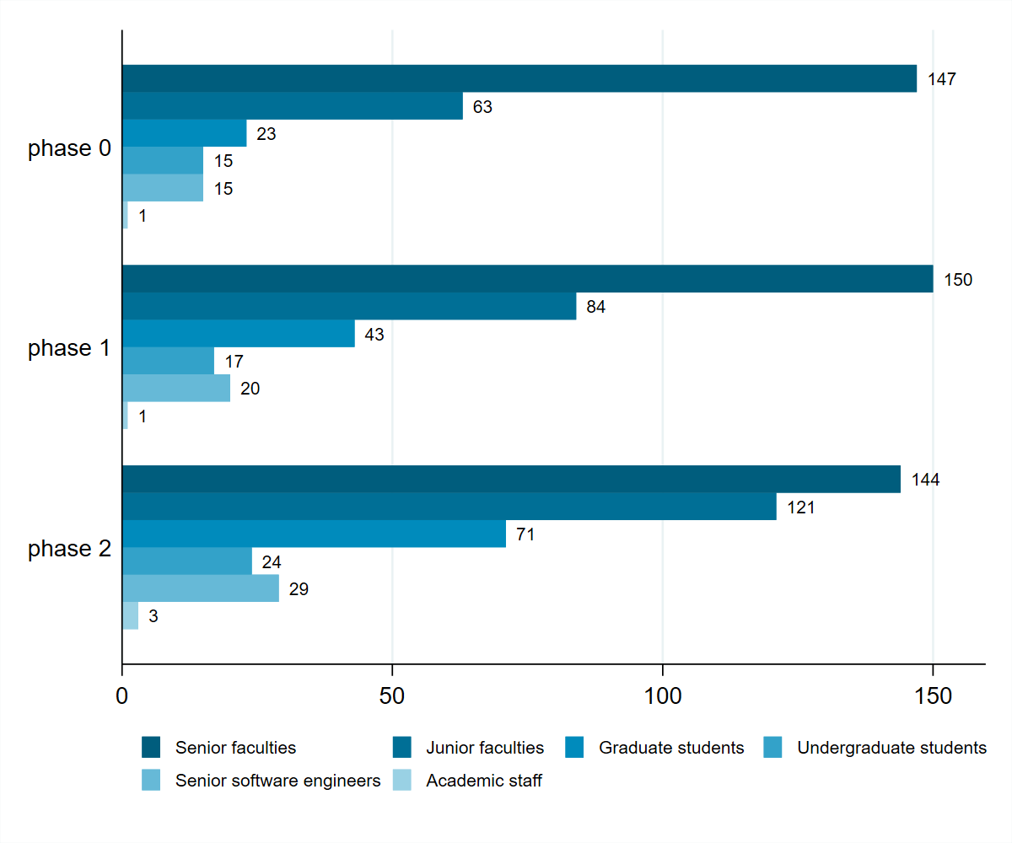
Descriptive: participants by phase & seniority level
Notes:
Manually collected!

Slide 19
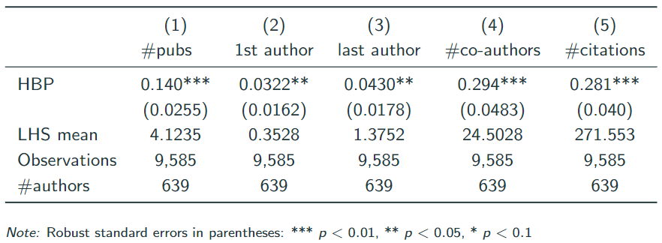
Results: author-year panel, log DV
Do researchers actively engaged in the HBP produce more work?
Researchers show a higher productivity and receive more citations after HBP participation (note: w/ individual fixed effects)
Participation in the HBP expands researchers’ networks (# of distinct co-authors per author-year in revealed publications)

Slide 20
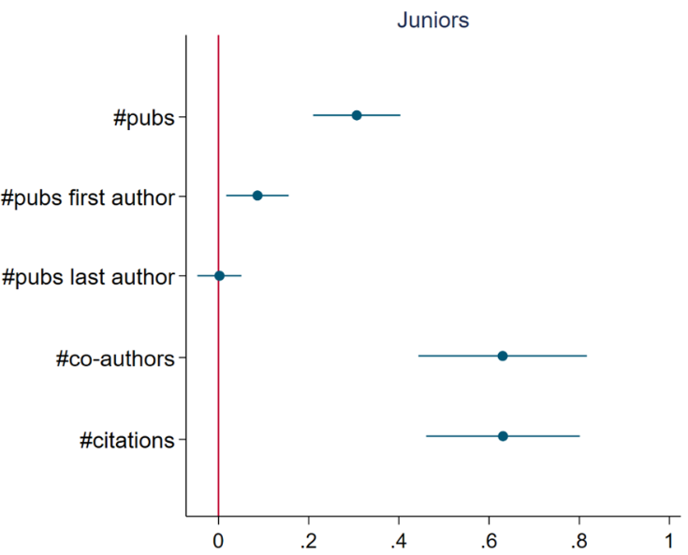
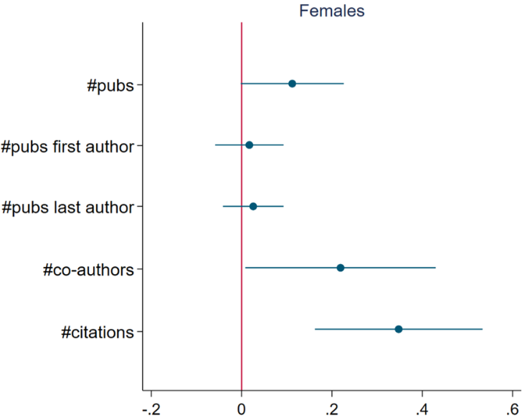
Junior/female subsample: author-year, 2008-2022
Does the HBP’s impact differ by researchers’ career stage and gender
Juniors (junior faculties and graduate students) benefit the most from the HBP research infrastructure and collaboration
Female researchers experience a significant productivity increase
Notes:
Juniors when starting in HBP
If asked
When looking at seniors we see that they also publish more but the coeff. Is much smaller.

Slide 21
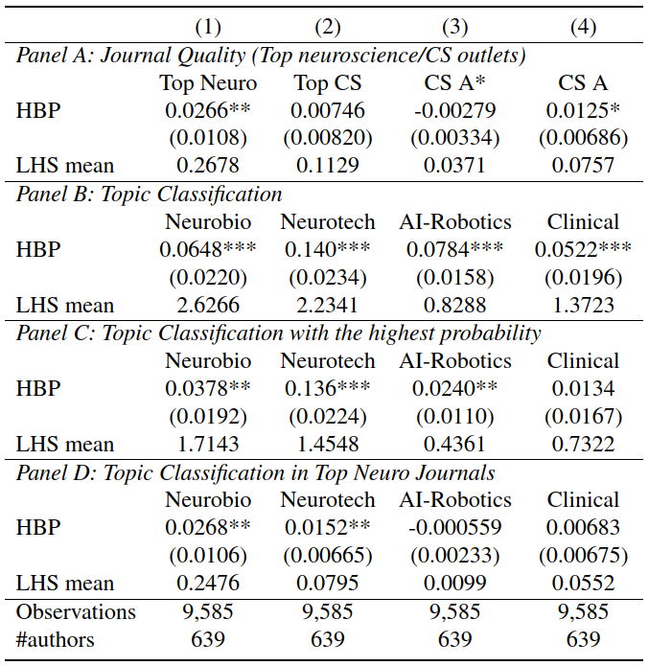
Results by journal quality and topic areas
Higher probability of publishing in top neuroscience journals.
Increased probability of publishing esp. in topics of neurotechnology.

Slide 22
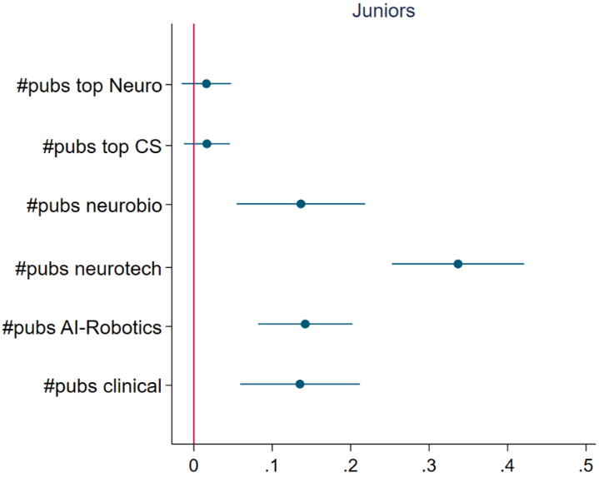
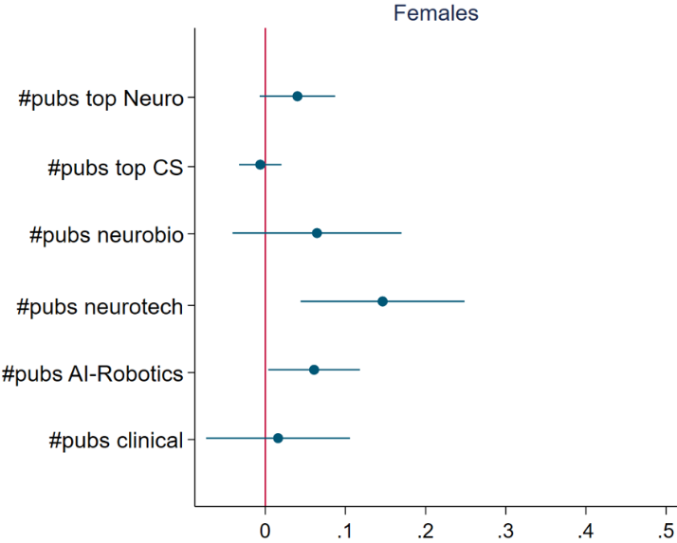
Junior/female quality: author-year, 2008-2022
Juniors increases research across topics, especially neurotech areas
Female yield more top neuro research, & more in neurotech/AI areas

Slide 23
Conclusion & Discussion
The HBP appear to yield positive synergy among AI-neuroscience scholars, and pushed more high-quality interdisciplinary research
Active involvement in the HBP appears to increase productivity and citations, esp. for juniors and (to a lesser extent) female researchers.
Researchers have a higher likelihood of publishing in top neuro journals, esp. within the area of AI-neuro intersection: neurotechnology
Scholars benefit regardless of their affiliated country at the beginning of HBP participation, more for German, Italian, & Belgian-based scholars
Some evidence that a combination of training and expanded network at the beginning of one’s career is most crucial for productivity gains
Lots of work-in-progress, aim to release a draft by summer 2025!
Thank you! Contact: xiaoluwang@umass.edu; ann-christin.kreyer@ip.mpg.de

