Slide 1
Megaprojects, Digital Platforms, & Productivity: Evidence from the Human Brain Project
Ann-Christin Kreyer¹ and Lucy Xiaolu Wang^{2,1,3}
¹ Max Planck Institute for Innovation and Competition
² University of Massachusetts Amherst
³ Canadian Centre for Health Economics
AEA “tech. and innovation” lightening round session, 2025.1.5

Slide 2

Background and Research Question
Declining productivity in biomedical science (Bloom et al. 2020); AI showed potential in life sciences (e.g., drug development).
But integrating AI with lab science is not always easy
This paper: how does a ten-year megaproject affect AI-brain sciences?
Launched in 2013, the HBP aims to advance brain science in 10 years
with €1B grants & AI-powered research infrastructure
Research Q: How does the HBP affect the rate and direction of R&D?
How does accessing to the HBP network matter across research types & career stages? More collaboration/interdisciplinary/novel output?

Slide 3
Conceptual Considerations
Q: How does the HBP affect the rate and direction of research publications? (in neurosciences/AI/joint)
Ideas are harder to get. Large teams w complementary skills can help (Jones 2009). But large teams can be inefficient & non-creative
Moral hazard with credit sharing (Che & Yoo 2001)
Intuitively, productivity can go different ways (an empirical Q):
More: “Time to explore new areas and expand the network!”
Less: “Time to take more risks and invest in new yet slower areas!”
Similar: “Time to change $ source, but I still only have 24 hours/day!”
Q: quantity, quality; network expansion; career/gender; topic areas
Notes:
Less pubs bc (1) adjustment time to learn new knowledge , (2) multidisciplinary teams require more coordination Systematically capturing brain simulation and other topics w/ pubs as immediately shareable knowledge

Slide 4
Data & Measures
Data: HBP audited reports, official sites, online forum, CORDIS, Scopus
Details on 639 individual researchers actively participated in the HBP (2013-2020) from about 180 institutions in 20+ countries
Full publication record of these HBP individuals and control group
Matching-based control pool and corresponding research profiles
Aggregate to individual-year panel for main analyses
Measures: publications, citations, text-based research topic areas
# of publications, # pubs as the first or last authors
# of pubs in top CS outlets, # of pubs top neuroscience journals
# of coauthors, # of citations
# of pubs by topic groups, and # pubs by topics and journal quality
Topic classification: use neural, prompt-based, LLMs (GPT3.5turbo/4)
Neurobiology, neurotechnology, AI-robotics, clinical focus, others
In-progress: annotation & fine-tuning using GPT4o-mini, cross-validation
Notes:
Large teams develop while small teams disrupt

Slide 5
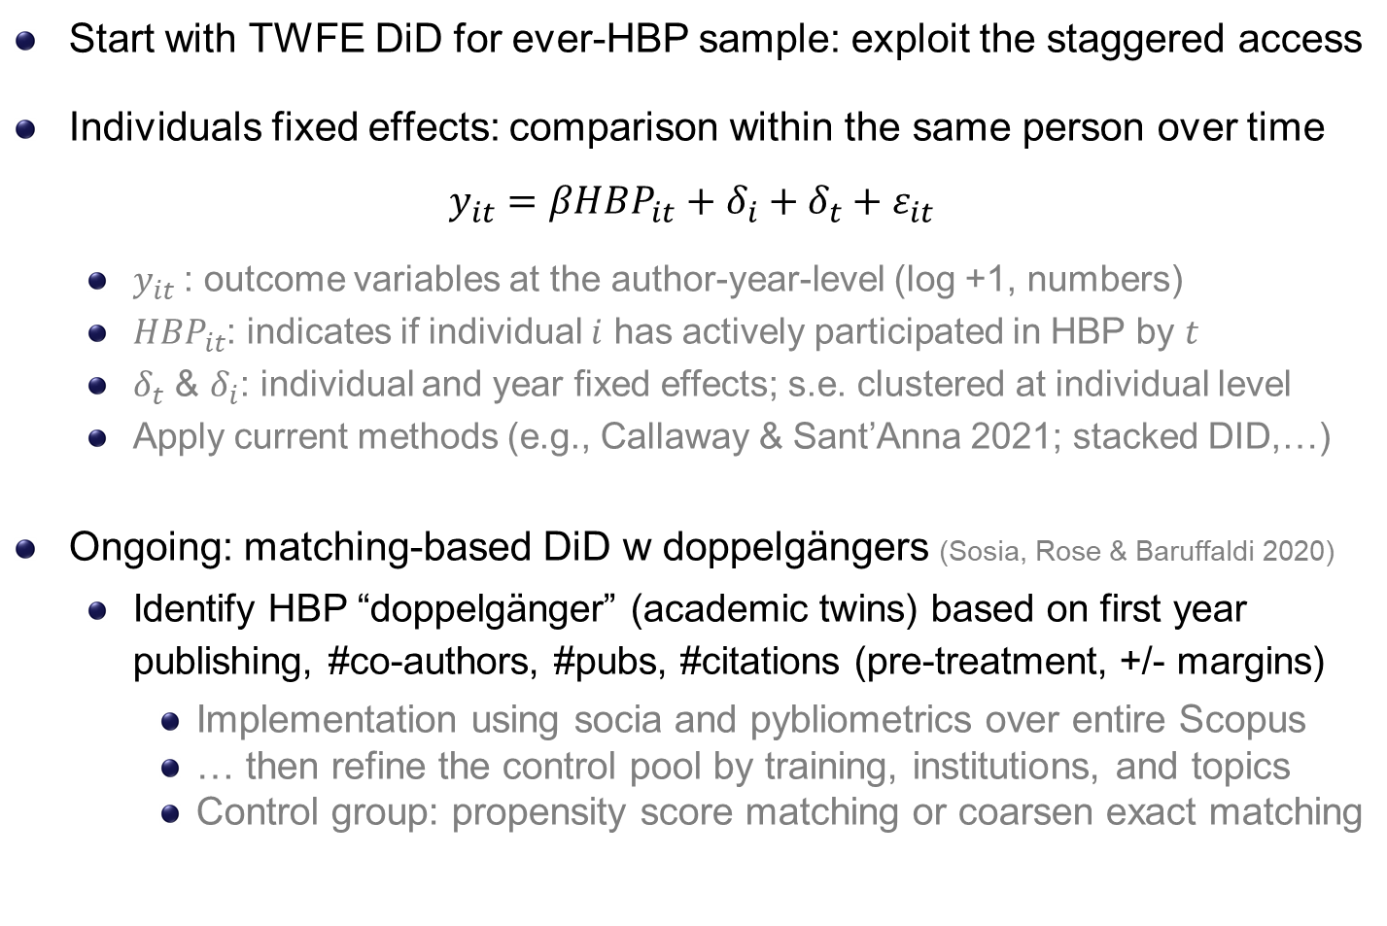
Methods: TWFE, staggered & matching-based DiD
Start with TWFE DiD for ever-HBP sample: exploit the staggered access
Individuals fixed effects: comparison within the same person over time
$$y_{it}=βHBP_{it}+δ_{i}+δ_{t}+ε_{it}$$
$y_{it}$: outcome variables at the author-year-level (log +1, numbers)
$HBP_{it}$: indicates if individual $i$ has actively participated in HBP by $t$
$δ_{t}$ & $δ_{i}$: individual and year fixed effects; s.e. clustered at individual level
Apply current methods (e.g., Callaway & Sant’Anna 2021; stacked DID,…)
Ongoing: matching-based DiD w doppelgängers (Sosia, Rose & Baruffaldi 2020)
Identify HBP “doppelgänger” (academic twins) based on first year publishing, #co-authors, #pubs, #citations (pre-treatment, +/- margins)
Implementation using socia and pybliometrics over entire Scopus
… then refine the control pool by training, institutions, and topics
Control group: propensity score matching or coarsen exact matching
Notes:
Lag in pubs:
the fields we are talking about are very fast (you will see that later, 4 pubs per year on averge)
Lags would underestimate the effect
We are doing the standard approach of the literature
No additional controls for the benchmark model b/c new DID lit cautions against additional controls as they may be affected by the policy -> standard strategy is not to control any X but do so later in robustness checks
Pub-level: we want to know how individuals are affected and thus what the direct effect of such a project is
- Inidviduals w/ more pubs get more weights in estimation results and we would not want that

Slide 6
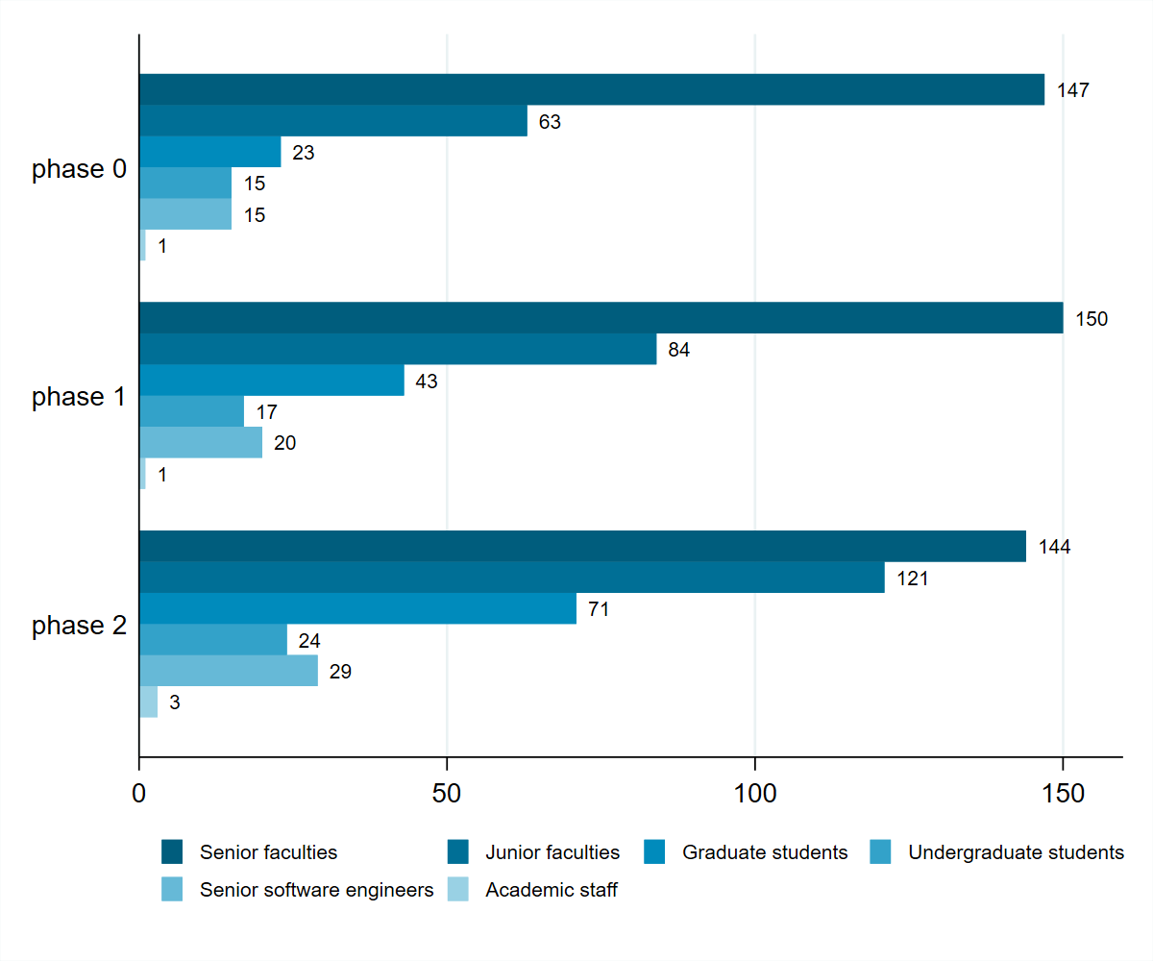
Descriptive: participants by phase & seniority level
Notes:
Manually collected!

Slide 7
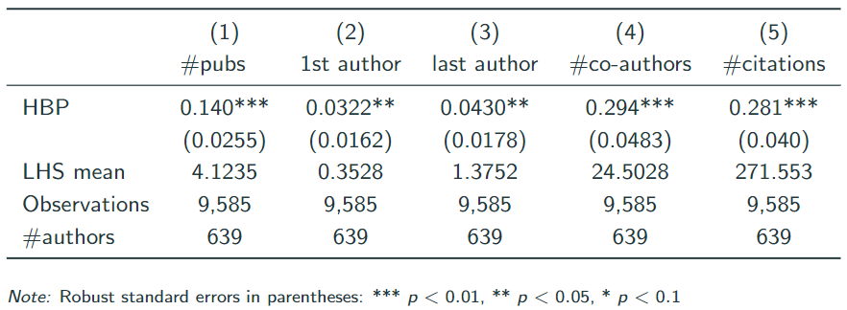
Results: author-year panel, log DV
Do researchers actively engaged in the HBP produce more work?
Researchers show a higher productivity and receive more citations after HBP participation (note: w/ individual fixed effects)
Participation in the HBP expands researchers’ networks (# of distinct co-authors per author-year in revealed publications)

Slide 8
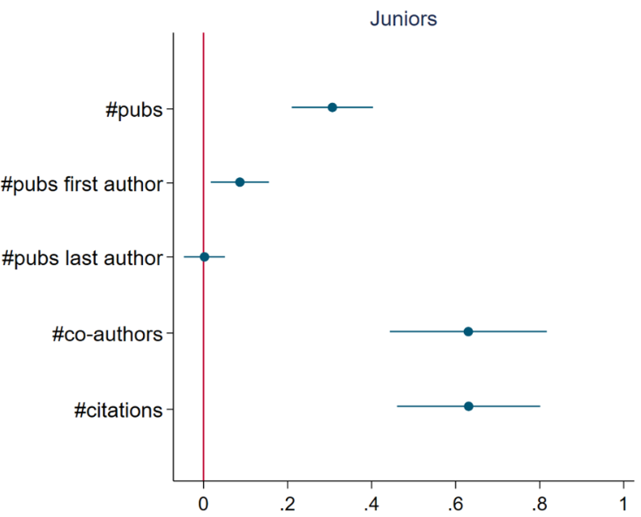
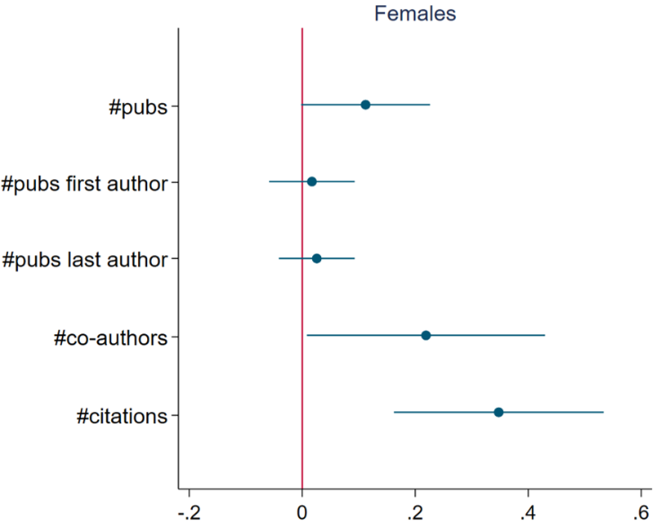

Junior/female subsample: author-year, 2008-2022
Does the HBP’s impact differ by researchers’ career stage and gender
Juniors (junior faculties and graduate students) benefit the most from the HBP research infrastructure and collaboration
Female researchers experience a significant productivity increase
Notes:
Juniors when starting in HBP
If asked
When looking at seniors we see that they also publish more but the coeff. Is much smaller.

Slide 9
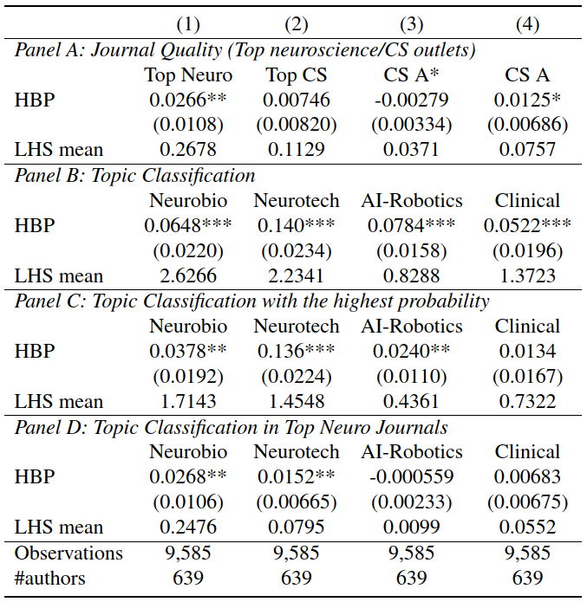
Results by journal quality and topic areas
Higher probability of publishing in top neuroscience journals.
Increased probability of publishing esp. in topics of neurotechnology.

Slide 10
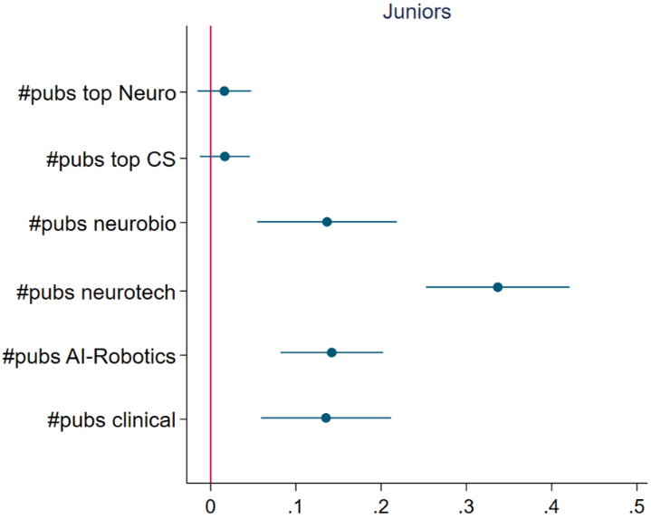
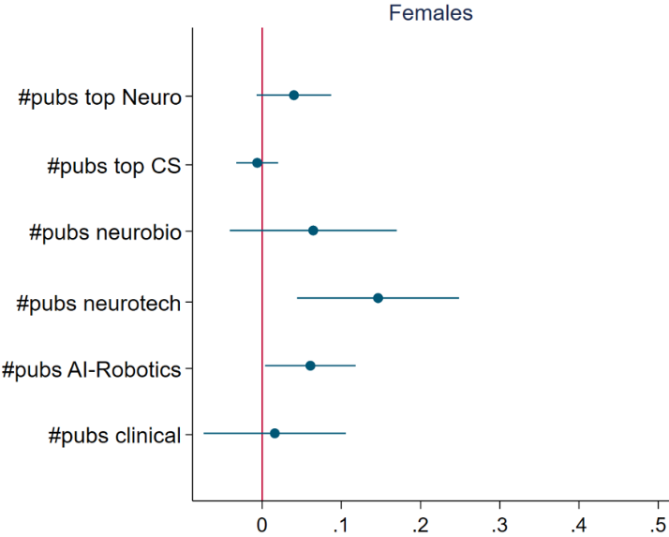
Junior/female quality: author-year, 2008-2022
Juniors increases research across topics, especially neurotech areas
Female yield more top neuro research, & more in neurotech/AI areas

Slide 11
Conclusion & Discussion
The HBP appear to yield positive synergy among AI-neuroscience scholars, and pushed more high-quality interdisciplinary research
Active involvement in the HBP appears to increase productivity and citations, esp. for juniors and (to a lesser extent) female researchers.
Researchers have a higher likelihood of publishing in top neuro journals, esp. within the area of AI-neuro intersection: neurotechnology
Scholars benefit regardless of their affiliated country at the beginning of HBP participation, more for German, Italian, & Belgian-based scholars
Some evidence that a combination of training and expanded network at the beginning of one’s career is most crucial for productivity gains
Lots of work-in-progress, aim to release a draft by summer 2025!
Thank you! Contact: xiaoluwang@umass.edu; ann-christin.kreyer@ip.mpg.de

