Slide 1
Marketing Authorization and Strategic Patenting: Evidence from Pharmaceuticals
Dennis Byrski¹ and Lucy Xiaolu Wang^{2,1,3}
¹ Max Planck Institute for Innovation and Competition
² University of Massachusetts Amherst
³ Canadian Centre for Health Economics
AEA “tech. and innovation” lightening round session, 2025.1.5

Slide 2
Drugs save lives, but too costly with many patents!
Patent systems are designed to promote innovation (Mansfield 1986; Lakdawalla 2018), but strategic patenting limits drug access (EC 2009)
E.g., evergreening (extends length) and fencing (extends breadth)
Trade-off: static efficiency vs. R&D incentives -> debates on patentability
US Supreme Court cases: Mayo 2012, Myriad Genetics 2013
This paper: how info disclosure in market authorization (MA) affect follow-on patenting (Trial docs disclosed can function as new “prior arts”)
Patent B
Innovation B
Innovation A
Patent A
Product A
cited by
(forward citation)
Patent C
Innovation C
?
EPO “gold standard” examination quality (Chien 2018), patent citation: follow-on patenting
Notes:
Mayo v. Prometheus (2012): adjust drug dosage based on metabolite levels – not patent-eligible;
Association for Molecular Pathology v. Myriad Genetics, Inc. (2013): naturally occur genes are not patent eligible.

Slide 3
Research Question:
Q: How does marketing authorization of a new drug (new NME) affect follow-on innovation building upon focal drug?
Intuitively, follow-on patenting can go either way (an empirical Q):
More: “Time to explore other new indications and expand the market!”
Less: “Time to lay flat and relax, as profit is coming in our way!”
Same: “I cannot decide, so maybe just good to patent as usual?”
Exploit the authorization of new drugs to the (EU/EEA) market, utilize the variation in approval lags (that do not differ by ex-ante patent char.)
Examine how a drug’s marketing authorization affects the rate & direction on follow-on patenting by firms (selves, related parties, others)
Notes:
EEA = European Union member states, Iceland, Liechtenstein, and Norway.

Slide 4
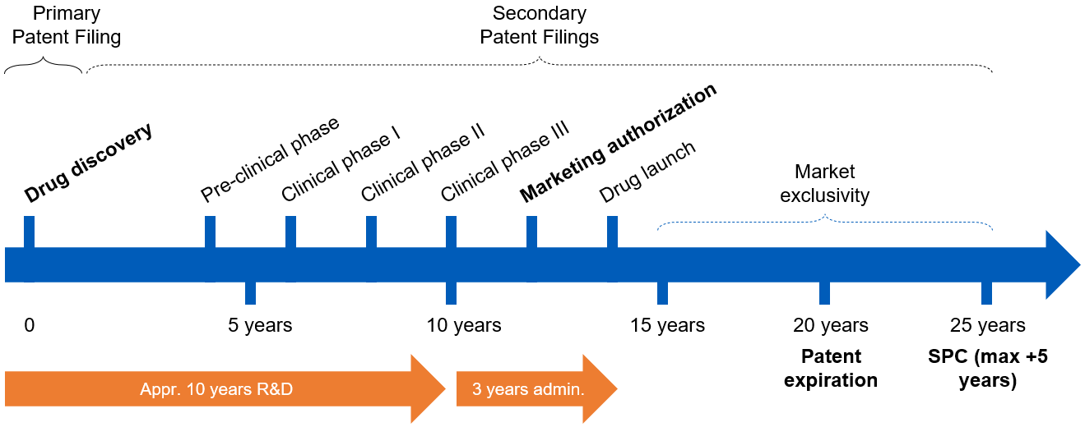

The Drug Development Process in EU (EEA)
In European Economic Area (EU+Iceland, Liechtenstein, Norway), originators submit applications for market authorization to European Medicines Agency (/national)
verifies safety, efficacy, quality; drugs can then be sold for approved indications
Market exclusivity: firms hold exclusive right to market/sell a patented drug

Slide 5
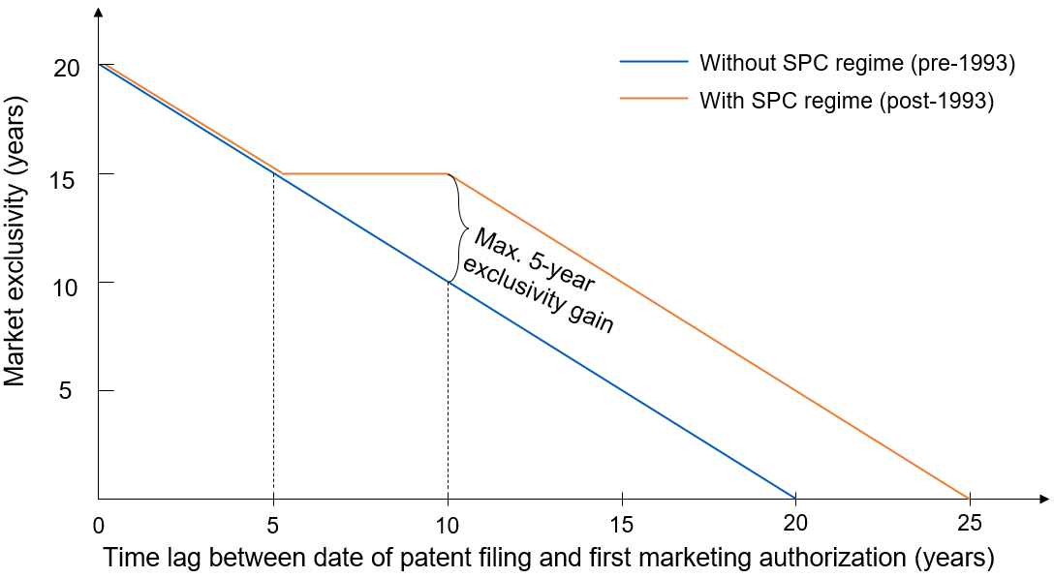
EU Patent Term Extension (SPC Regime)
Supplementary Protection Certificates (SPC) regime, 1993- : extension capped at 5 years; market exclusivity constant for patents w/ 5-10 years’ approval lag
SPC term (≤5 years)= date of 1st MA in EEA – filing date of basic patent – 5
analysis

Slide 6
It takes a long & uncertain time to develop a drug…
Pre-clinical phase
Market authorization
Clinical phase III
Clinical phase II
Patent filing
Clinical phase I
Drug launch
Late MA
(long lag)
0
5 years
10 years
15 years
20 years
Early MA
(short lag)
0
5 years
10 years
15 years
20 years
Approval lag cannot be predicted perfectly at the time of the patent ﬁling: whether/when the drug will be on the market (à la Gilchrist 2016)
Scientific uncertainty & organizational factors: finance, M&A, $, licensing, …
Data: 1) patent-drug linkage: SPC data from DPMA; 2) patent data on primary patents from EPO PATSTAT, family level patent info; 3) drug data: Cortellis, link by family id; 4) crosswalk diseases w WHO ICD-9.

Slide 7
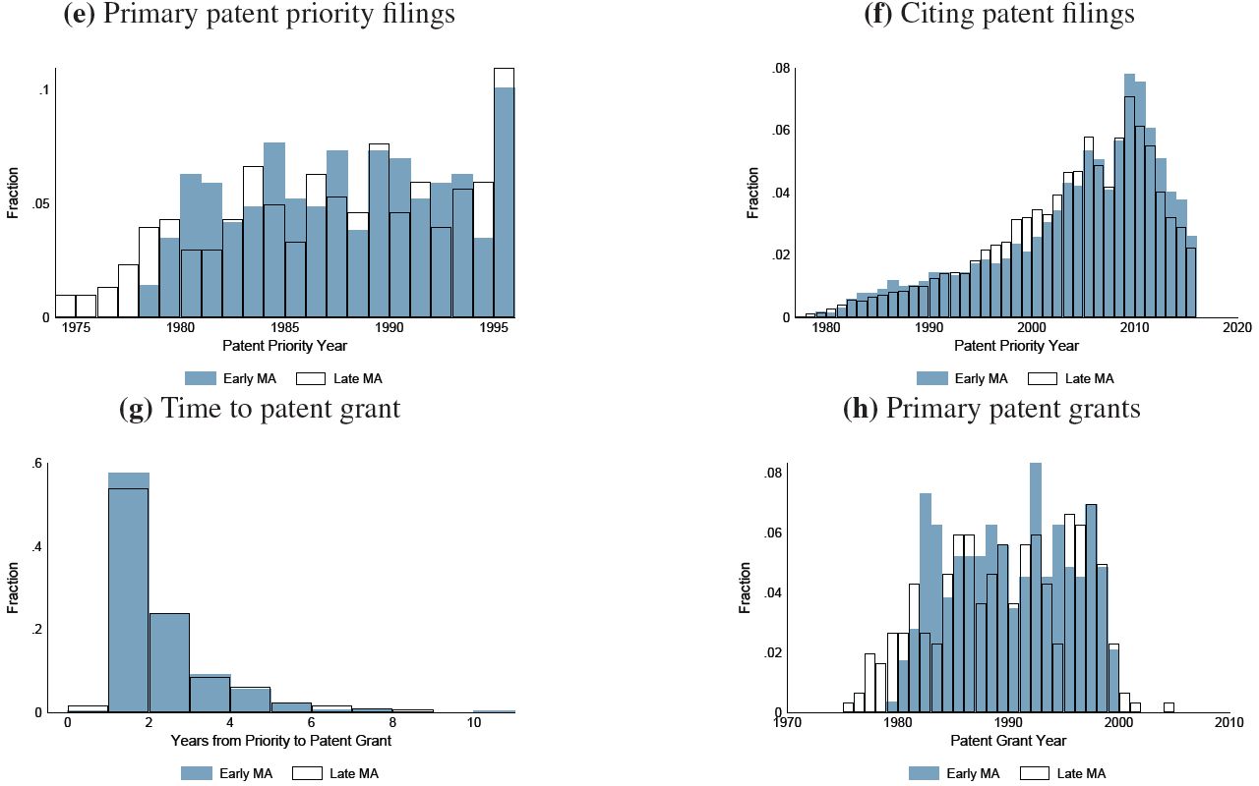
Distribution of characteristics (split by median MA)
Patents with early vs. late MA (split approval lag at median: 10 years) are similar regarding priority time, time span at the patent offices (time to patent grant), similar technological nature (e.g., ICD-9, complexity, resubmissions), and similar ex-ante drug, disease, and patent characteristics (t-test across many metrics).

Slide 8
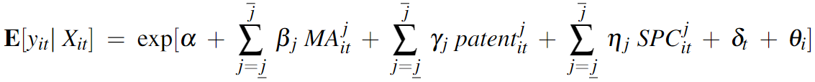
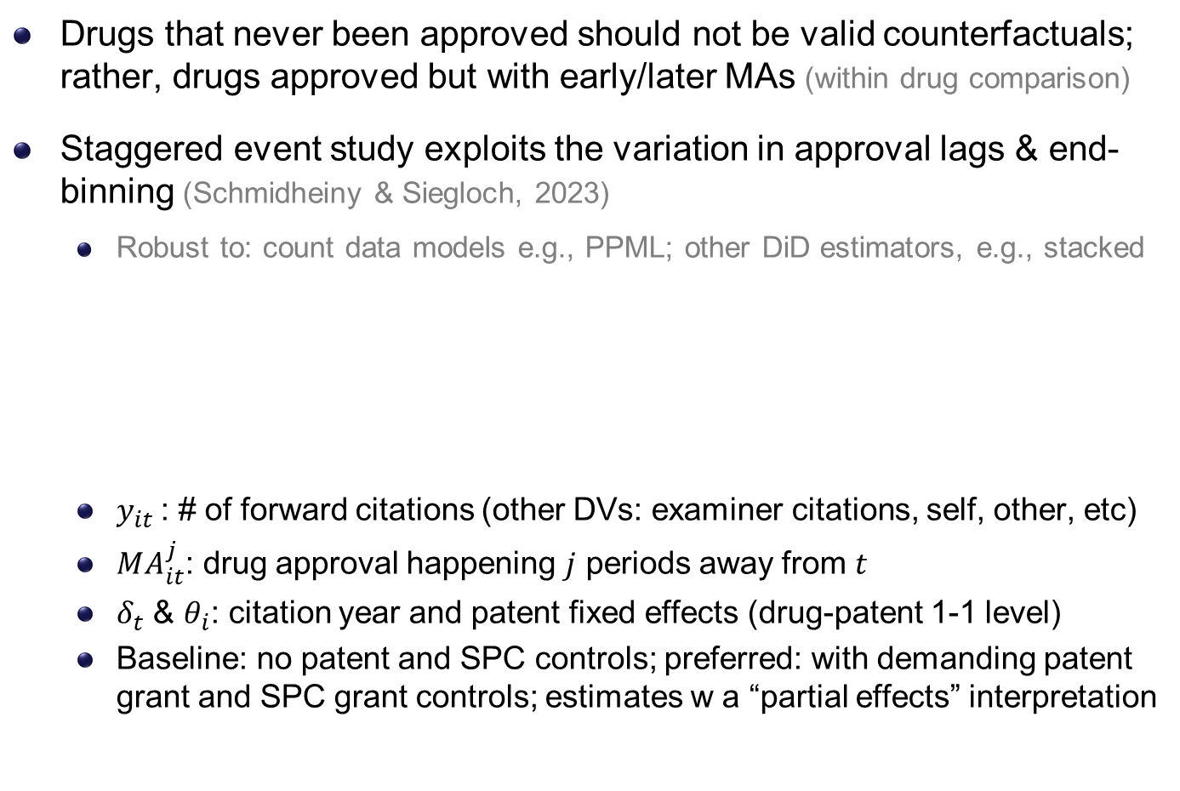
Empirical Strategy: Event Studies (à la S&S 2023)
Drugs that never been approved should not be valid counterfactuals; rather, drugs approved but with early/later MAs (within drug comparison)
Staggered event study exploits the variation in approval lags & end-binning (Schmidheiny & Siegloch, 2023)
Robust to: count data models e.g., PPML; other DiD estimators, e.g., stacked
$y_{it}$: # of forward citations (other DVs: examiner citations, self, other, etc)
$MA_{it}^{j}$: drug approval happening $j$ periods away from $t$
$δ_{t}$ & $θ_{i}$: citation year and patent fixed effects (drug-patent 1-1 level)
Baseline: no patent and SPC controls; preferred: with demanding patent grant and SPC grant controls; estimates w a “partial effects” interpretation

Slide 9
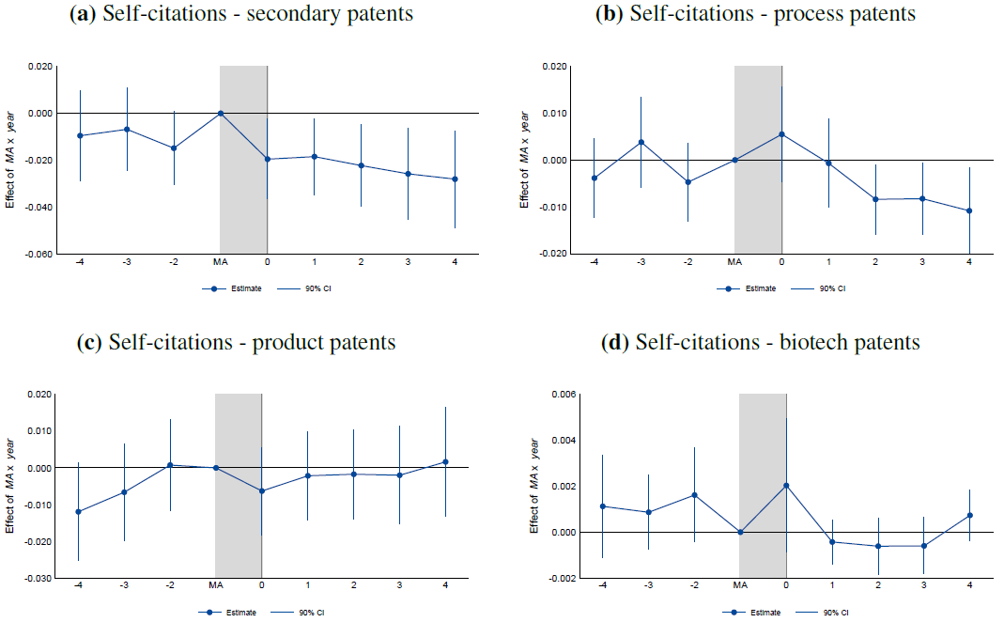
Market Authorization & self-citations: by type of patent
(e.g., new formulations, new dosage forms, new drug combinations, or new use)
(e.g., new manufacturing process)
(e.g., new products (derivatives), new macromolecule)
(e.g., biological product/process patents)

Slide 10
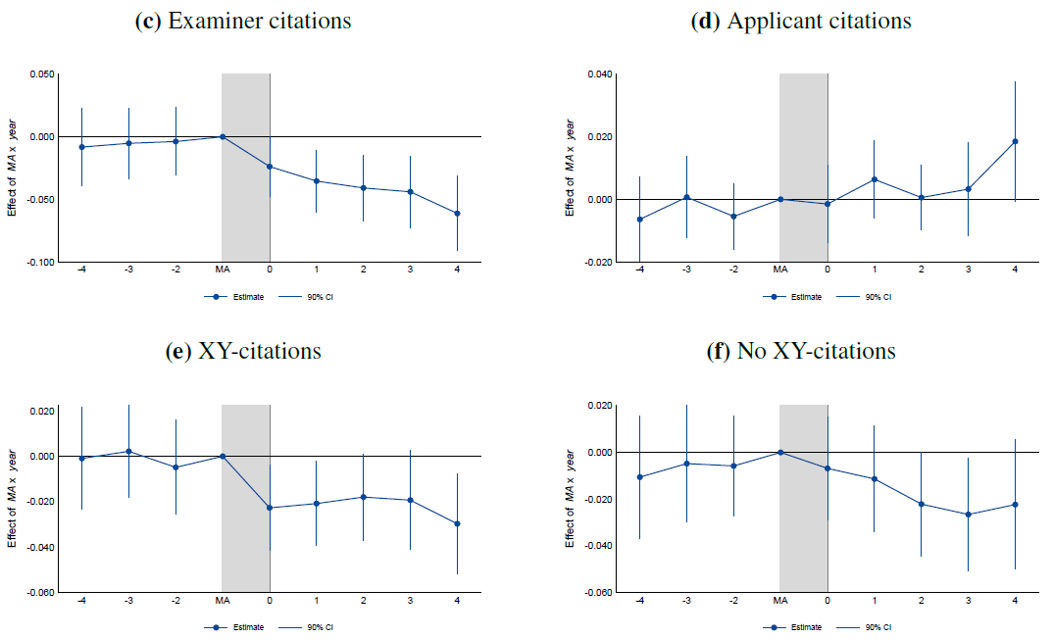
Marketing authorization & self-citations: by source/type
Self-citations added by examiners (high quality)
Self-citations added by applicants
X/Y-ref.: suggest legally “weak” patents as they increase the likelihood of a post-grant validity challenge (Wagner & Wakeman, 2016)
(X: a single prior patent doc can undermine the novelty/inventiveness of claimed invention; Y: do so in combination w/ other docs)

Slide 11
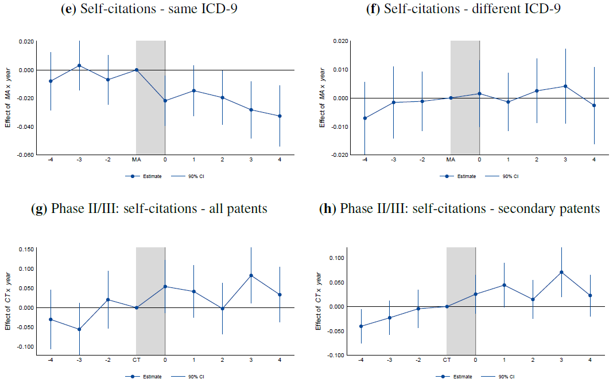
MA & self-citations: by disease; & placebo events
Same disease area/indication as approved drug
Explore new treatment options for a focal drug
Use end of phase II/start of phase III as a major milestone event to test the mechanism (disclosure/enforceability)
Others’ citations broadly follow a similar pattern, but with about 2 years lags

Slide 12
Robustness Checks, Conclusion, & Discussion
Market exclusivity & incentives for competitive entry:
earlier MA -> longer market exclusivity -> + competitive entry -> under-est.
Strategy: Zoom in a subset with constant ME due to a kink in SPC regime
Unobserved quality: if + unobserved value w/ – approval lag -> upward bias
Strategy: instrumental variable approach (IV: time-to-phase I)
Field of application: whether results are driven by a few disease areas
Strategy: leave-one-out ICD-9 disease area specific analyses
We find that strategic follow-on patenting decreases after a drug’s market authorization, when follow-on drug patents are harder to obtain
More drop for less novel patents; No change in meaningful patents
Empirical test indicates it’s harder to obtain enforceable patents post-MA
Policy implications: leveraging existing regulatory disclosure requirements may provide a practical approach to improving patent examination without changing formal patentability standards

