Slide 1
Health IT Diffusion and Physician Density
Jason Huh¹ Jianjing Lin² and Lucy Xiaolu Wang^{2,3,4}
¹ Rensselaer Polytechnic Institute
² University of Massachusetts Amherst
³ Max Planck Institute for Innovation and Competition
⁴ Canadian Centre for Health Economics
CSSI seminar, UMass Amherst
2026.4.17

Slide 2
Rising US HIT investments enables automation
The US allocated over $30 billion to health IT adoption (e.g., EHR)
Health Information Technology for Economic and Clinical Health (HITECH) Act and indirect provisions in Affordable Care Act (ACA)
Extensive research on HIT impact on quality and cost
But: limited understanding of HIT impact on physician density
Focus: Computerized Provider Order Entry (CPOE), an advanced HIT and the key component of HITECH Meaningful Use (MU) criteria
E-enter treatment orders, integrate patient info and clinical guidelines, and communicate with pharmacy, laboratory, and other departments
In contrast, basic HIT systems, e.g., clinical decision systems, store patient data in digital database and provide clinical treatment support
Research question: How does advanced HIT adoption affect aggregate hospital-based (HB) physician density at the county level?
# physicians per 100k population, financial measures, patient care volume

Slide 3
Research Question:
Q: How does advanced HIT adoption affect aggregate hospital-based physician density at the county level?
Intuitively, aggregate physician rate can go either way (empirical Qs):
More: “Time to hire more physicians to take full advantage of HIT!”
Less: “Time to automate and reduce docs (recover costs from HIT)!”
Same: “Docs come and go, on the net things may stay similar?”
Exploit the county-level sharp adoption of advanced HIT (CPOE)
Show how the plausibly exogenous HIT diffusion patterns affect county-level HB physician per 100k pop, the heterogeneity by specialties, physician career stage, physician shortage area status
Test financial mechanism and downstream impact on care utilization
Notes:
EEA = European Union member states, Iceland, Liechtenstein, and Norway.

Slide 4
Preview of Methods and Results
Methods:
Event-study approach à la East et al. (AER 2023), leveraging the sharp increase in adoption rates to separate sample into treatment and control groups
Here: use sharp increase in county-level advanced HIT adoption rate
Compare HB physicians per 100k in counties with rapid diffusion vs controls
Use De Chaisemartin & d’Haultfoeuille (2024) as our main DiD estimator
Robust to other DiD estimators, continuous D, count data Y, other specifications
Main results:
11.1% increase in county-level HB physicians per 100k post HIT adoption
Effects primarily driven by medical and surgical specialties
Stronger effects among early-career docs and in areas with doc shortages
Physicians (hospitals) in treated counties received higher payments (profits)
Increased outpatient surgeries in counties w/ moderate pre-period volumes

Slide 5
Literature and Contribution
The impact of Health IT: new evidence on how HIT automation affect aggregate physician labor density (high-skilled labor), and how the effects vary by specialty, career stage, shortage area status, and care utilization.
(Miller & Tucker, 2011; Agha, 2014; Dranove et al., 2014; McCullough and Snir, 2010; McCullough et al., 2016; Freedman et al., 2018; Lu et al., 2018; Greenwood et al., 2019; Wang, 2021; Wang & Bloch, 2023; Lin & Olson, 2024; Glenn, 2026)
Physician labor supply: new technological angle that combines market-driven incentives and policy-led changes in the past decades, and study how digital technologies affect physicians, hospitals, and care provisions.
(Baker & Royalty, 2000; Garthwaite, 2012; Buchmueller et al., 2016; Falcettoni, 2018; Kulka & McWeeny, 2018; Neprash et al., 2018; Huh, 2021; Curto & Bhole, 2022; Huh & Lin 2024; Khoury et al., 2024)
Policy implications and relevant insights for managerial practices. HIT investment can attract physicians, expand access to care (reduce disparity in access), while sustaining providers’ financial health.

Slide 6
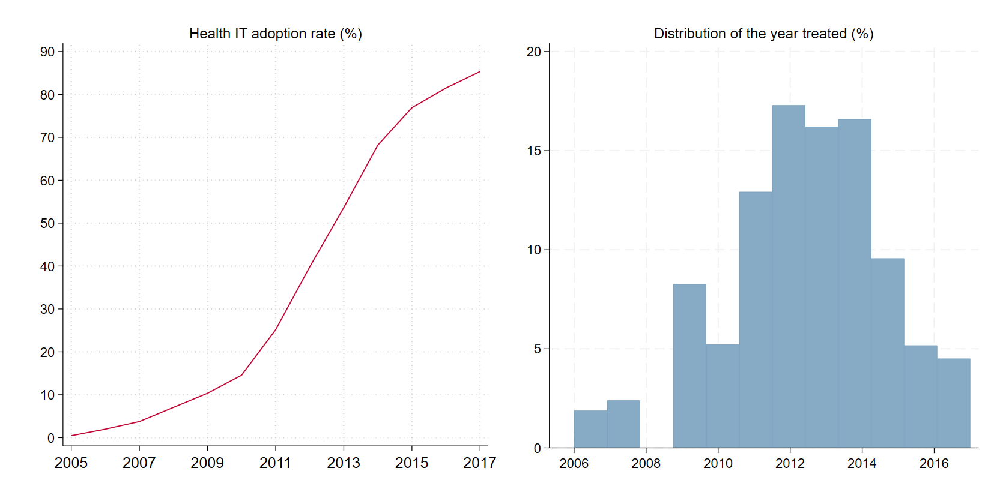
Institutional context and HIT adoption trends
Electronic health records (EHRs), the core component of HIT, were invented in 1970s but saw limited adoption until the 2000s. We focus on hospital HIT.
2010s: widespread hospital HIT adoption, driven by federal incentives
2009 HITECH Act provides incentive payments for HIT meaningful use (MU); ACA indirect incentives (initiatives/provisions) require/facilitate HIT use.
Notes:
Mayo v. Prometheus (2012): adjust drug dosage based on metabolite levels – not patent-eligible;
Association for Molecular Pathology v. Myriad Genetics, Inc. (2013): naturally occur genes are not patent eligible.

Slide 7
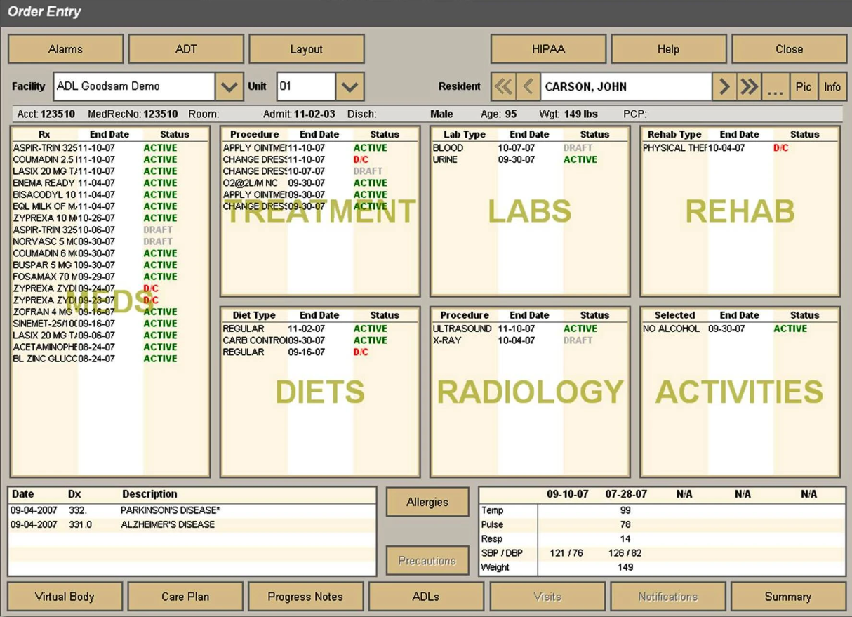

HIT adoption measures: CPOE & its functionality
Computerized Provider Order Entry (CPOE): advanced HIT, automation
Enable providers to electronically enter medication, laboratory, and radiology orders, often with built-in clinical decision support tools, core in MU criteria
Unlike other HIT component, CPOE directly structures patient data to align with coding and billing requirements, esp. relevant when payment matters

Slide 8
Conceptual Considerations
Local physician density (per 100k pop) is affected by aggregating individual location choices and broader market dynamics.
Hospitals’ perspectives:
HIT investment can affect strategic hiring of docs to fully leverage technology
Esp in geo-areas with moderate but growing demand for medical services
If increase patient throughput, boost revenue -> can hire/retain more docs
Physicians’ perspectives
Response to HIT diffusion may vary by specialty, career stage, tech-savviness
HIT can be a pull factor for early-career physicians adapted to digital tech
Patients’ perspectives
HIT can make access to services more convenient with faster scheduling
can seek elective procedures earlier and easier (limited sorting within county)

Slide 9



Data Construction
Physician supply data: Area Health Resources Files (AHRF)
Hospital-based (HB) physicians: non-federal MDs under hospital contracts providing direct patient care, measured as rate per 100k county population
Specialty categorization: medical, surgical, general practitioners, others
Health IT adoption data: Healthcare Information and Management Systems Society (HIMSS) Analytics Database
Records basic and advanced HIT adoption by hospitals, including CPOE
County-level adoption rate weighted by capacity (hospital beds)
Medicare provider and service data: CMS Medicare physician & other practitioners by provider and service dataset (available starting 2013)
Market structure and profit data: Healthcare Provider Cost Reporting Information System (HCRIS), CMS; calculate hospital HHI and profit
Sample: ~2,394 US counties during 2006-2018 outcome years matched with one-year lagged HIT adoption (excl. 2009 b/c missing AHRF data)

Slide 10
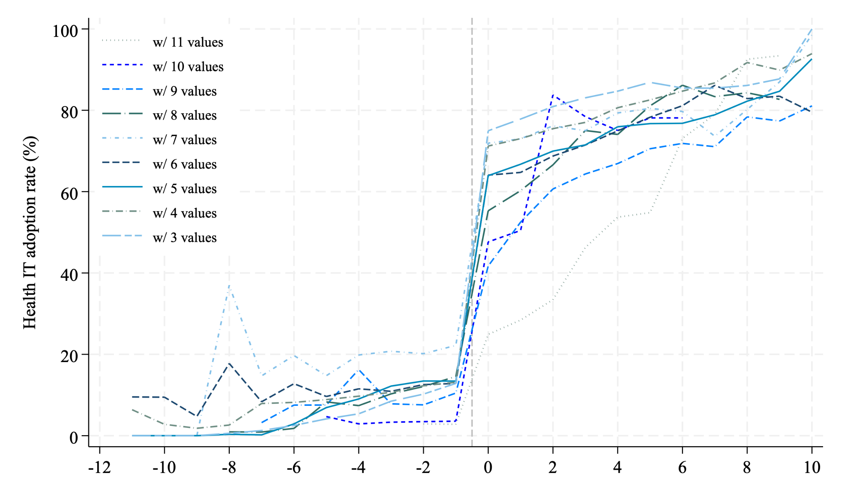

HIT treatment measure: sharp jumps in HIT rates
Define treatment/control group à la the strategy in East et al. (AER 2023)
Identify the sharpest jump in year $τ$ (roughly = if 0$→$ +, or $↑$100+% at $τ$)
Notes:
Median time-to-approval in our sample: 10 years

Slide 11
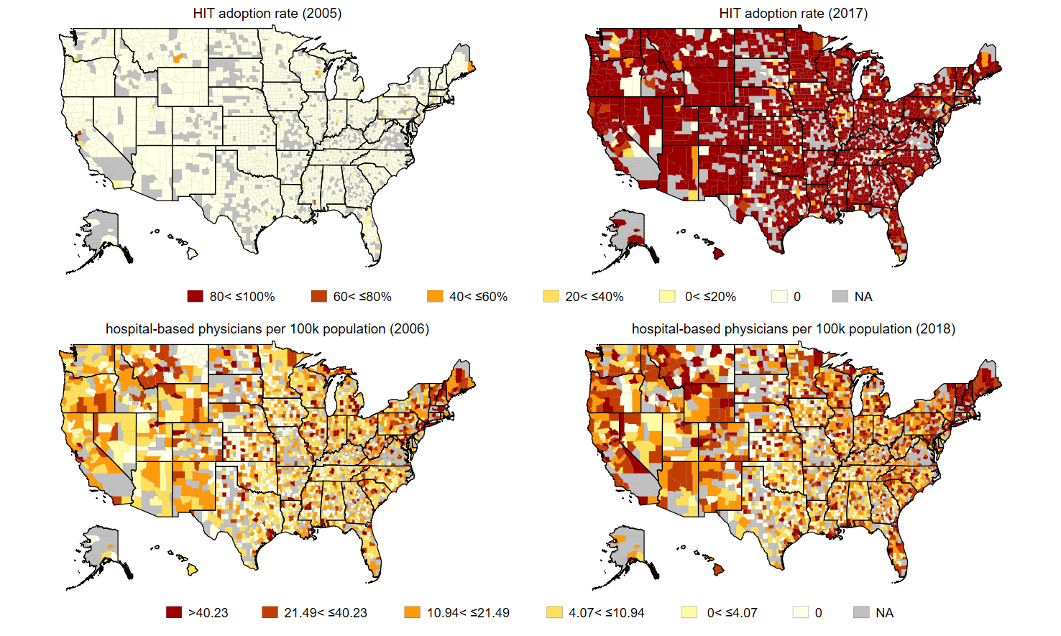
Geographic variation in HIT and physician supply
Outcome periods 2006-2018 with one-year lagged HIT 2005-2017
pre-T sum stats

Slide 12
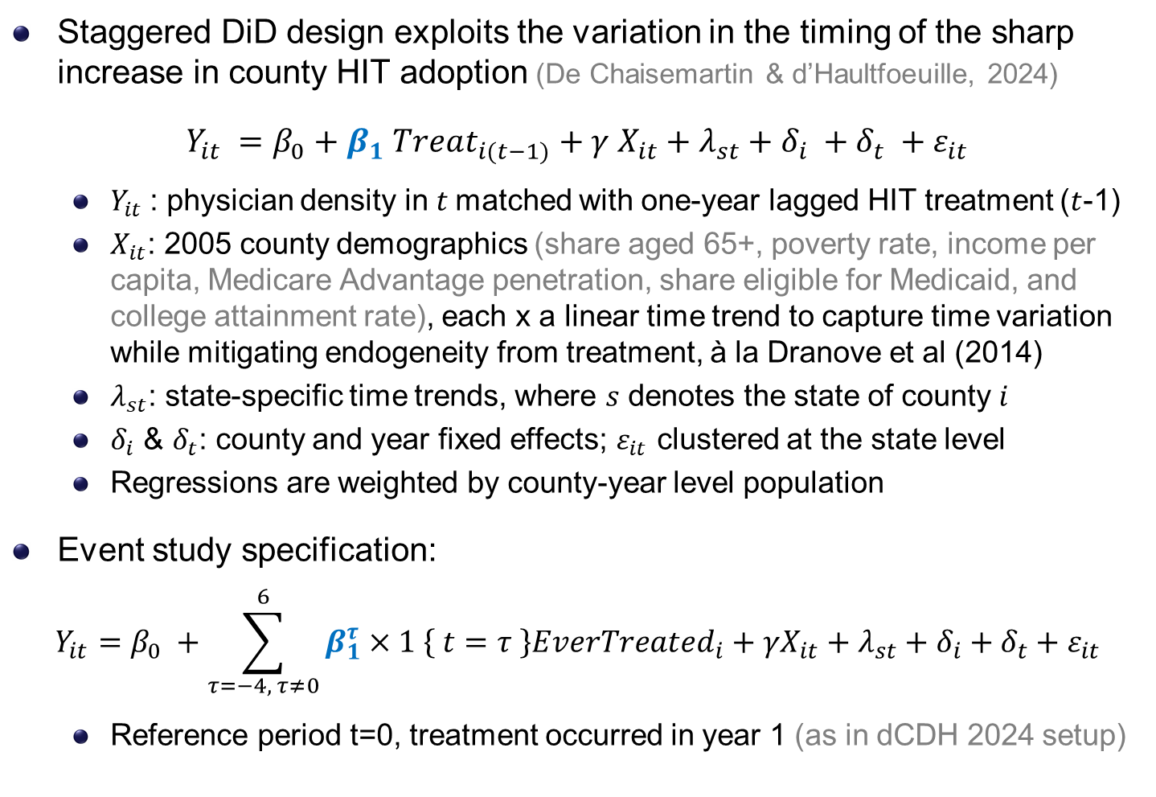
Empirical strategy: dynamic DiD & event studies
Staggered DiD design exploits the variation in the timing of the sharp increase in county HIT adoption (De Chaisemartin & d’Haultfoeuille, 2024)
$Y_{it} =β_{0}+β_{1} Treat_{i(t−1)}+γ X_{it}+λ_{st}+δ_{i} +δ_{t} +ε_{it}$
$Y_{it}$: physician density in $t$matched with one-year lagged HIT treatment ($t$-1)
$X_{it}$: 2005 county demographics (share aged 65+, poverty rate, income per capita, Medicare Advantage penetration, share eligible for Medicaid, and college attainment rate), each x a linear time trend to capture time variation while mitigating endogeneity from treatment, à la Dranove et al (2014)
$λ_{st}$: state-specific time trends, where $s$ denotes the state of county $i$
$δ_{i}$ & $δ_{t}$: county and year fixed effects; $ε_{it}$ clustered at the state level
Regressions are weighted by county-year level population
Event study specification:
$$Y_{it}=β_{0} +\sum_{τ=−4, τ≠0}^{6}{β_{1}^{τ}×1 \left\{ t=τ \right\}EverTreated_{i}}+γX_{it}+λ_{st}+δ_{i}+δ_{t}+ε_{it}$$
Reference period t=0, treatment occurred in year 1 (as in dCDH 2024 setup)

Slide 13
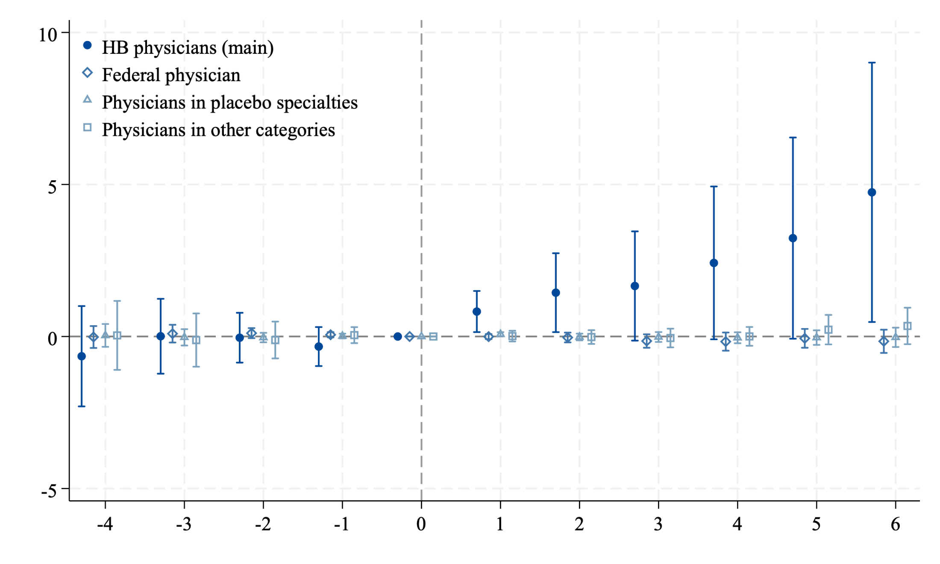
HIT diffusion & HB physician: main results
Main outcome: HB physicians per 100k pop. vs. three falsification groups
employed by the federal gov (e.g., Army, Navy, Air Force, VA, PH)
those not provide patient care but work in research/teaching/admin.
dermatology, aerospace med., forensic pathology, med genetics, occupational meds, nuclear meds, PH & general preventive med.

Slide 14
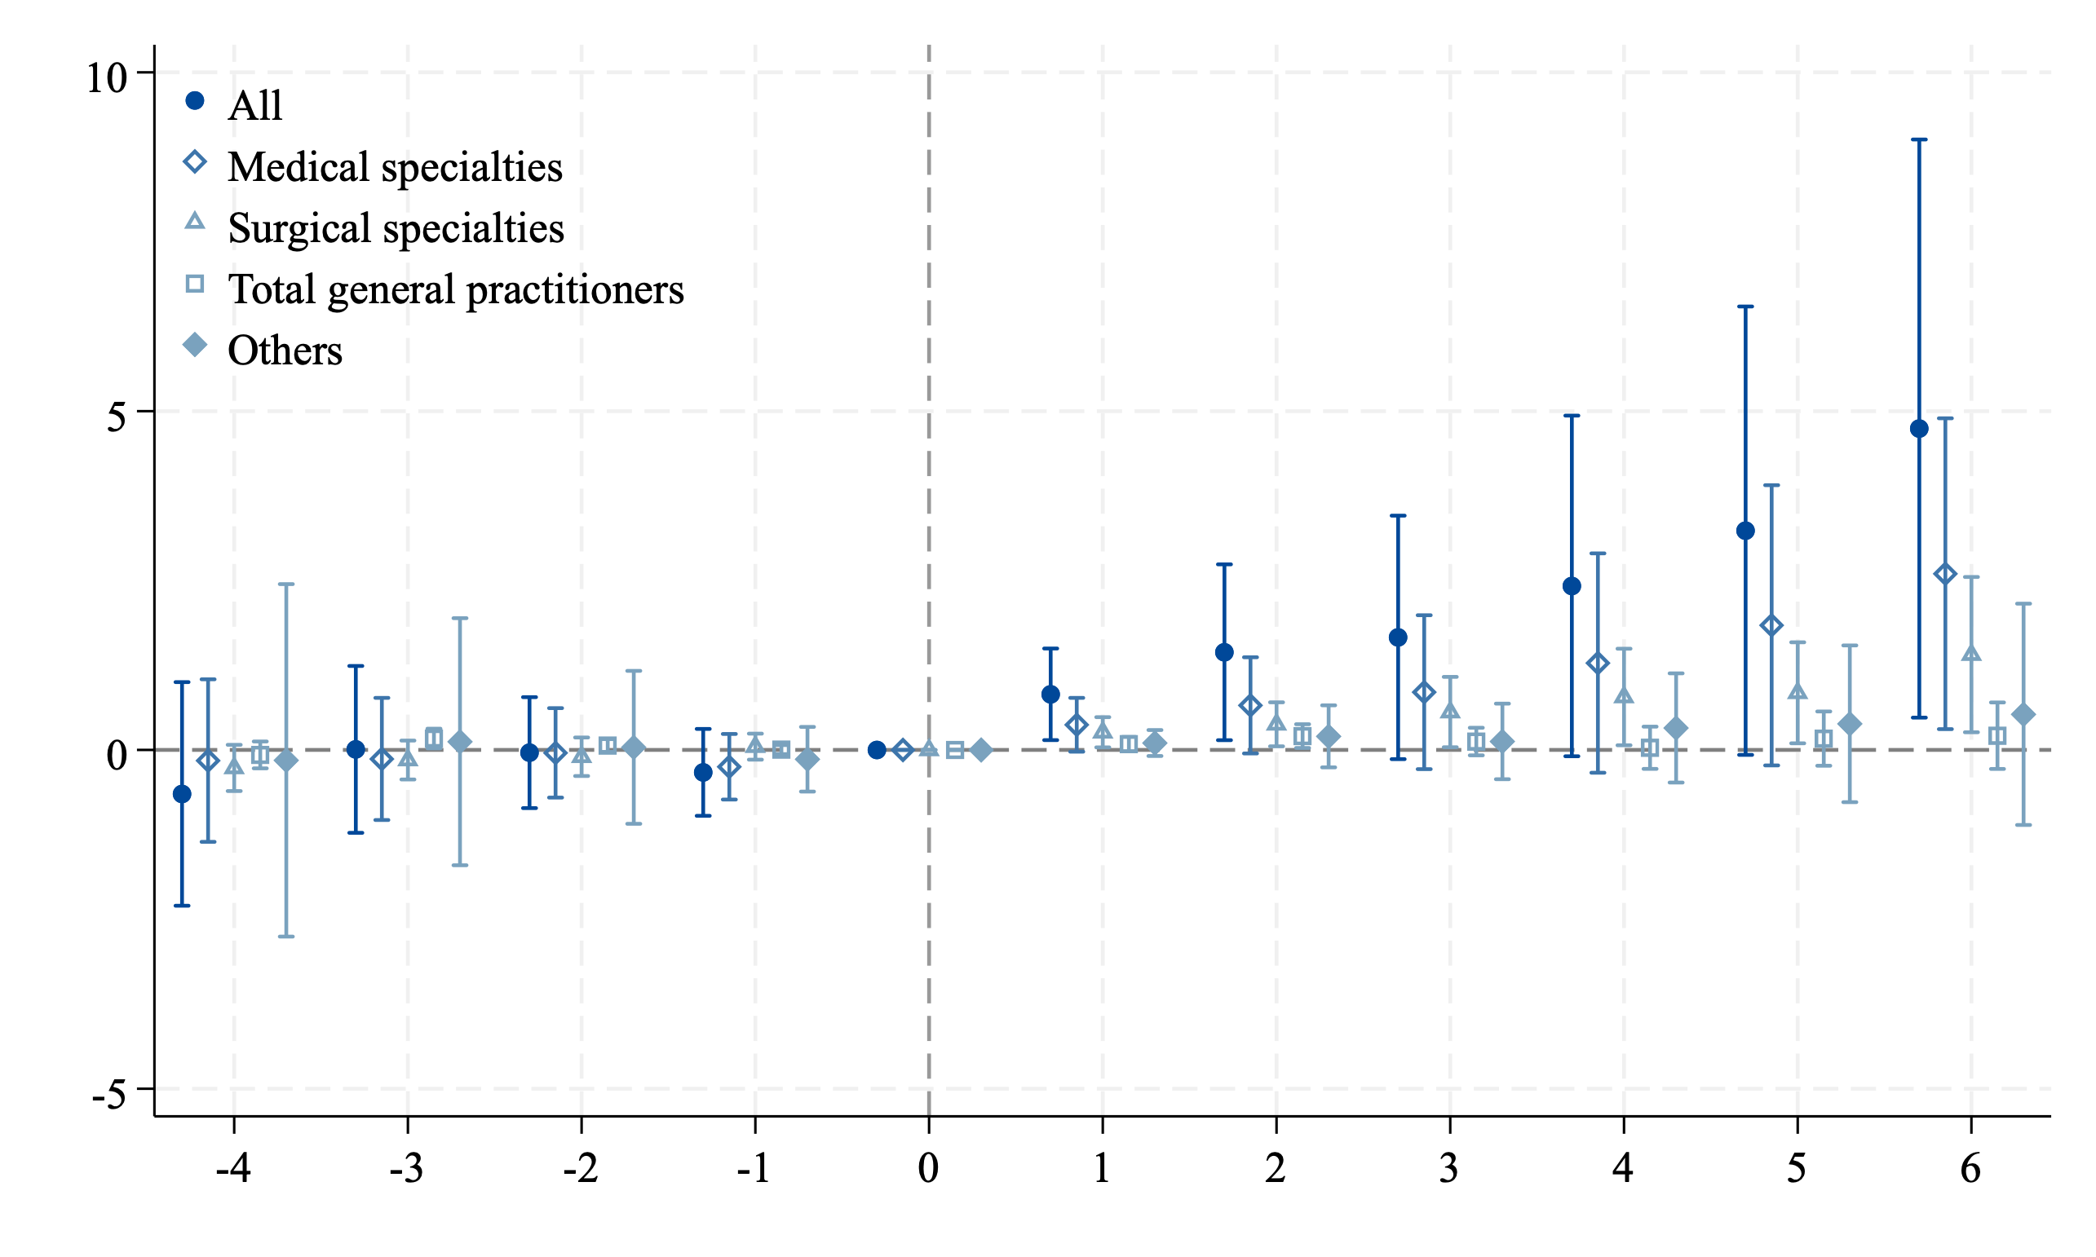
Heterogeneity cross-specialty within HB physicians
Medical: allergy and immunology, cardiovascular disease, gastroenterology, internal medicine (general, subspecialties), pediatrics (general, subspecialties, cardiology), pulmonary disease.
Surgical: colon/rectal surgery, general surgery, neurological surgery, obstetrics-gynecology (general, subsp.), ophthalmology, orthopedic surgery, otolaryngology, plastic surgery, thoracic surgery, urology
Total GP: general practice, family medicine (general subspecialties)
Others: anesthesiology, radiology, diagnostic radiology, emergency med., general preventive med., neurology, pathology (anatomic/clinical), physical medicine/rehabilitation, radiation oncology, transplant surgery, vascular med., other specialties, unspecified.

Slide 15
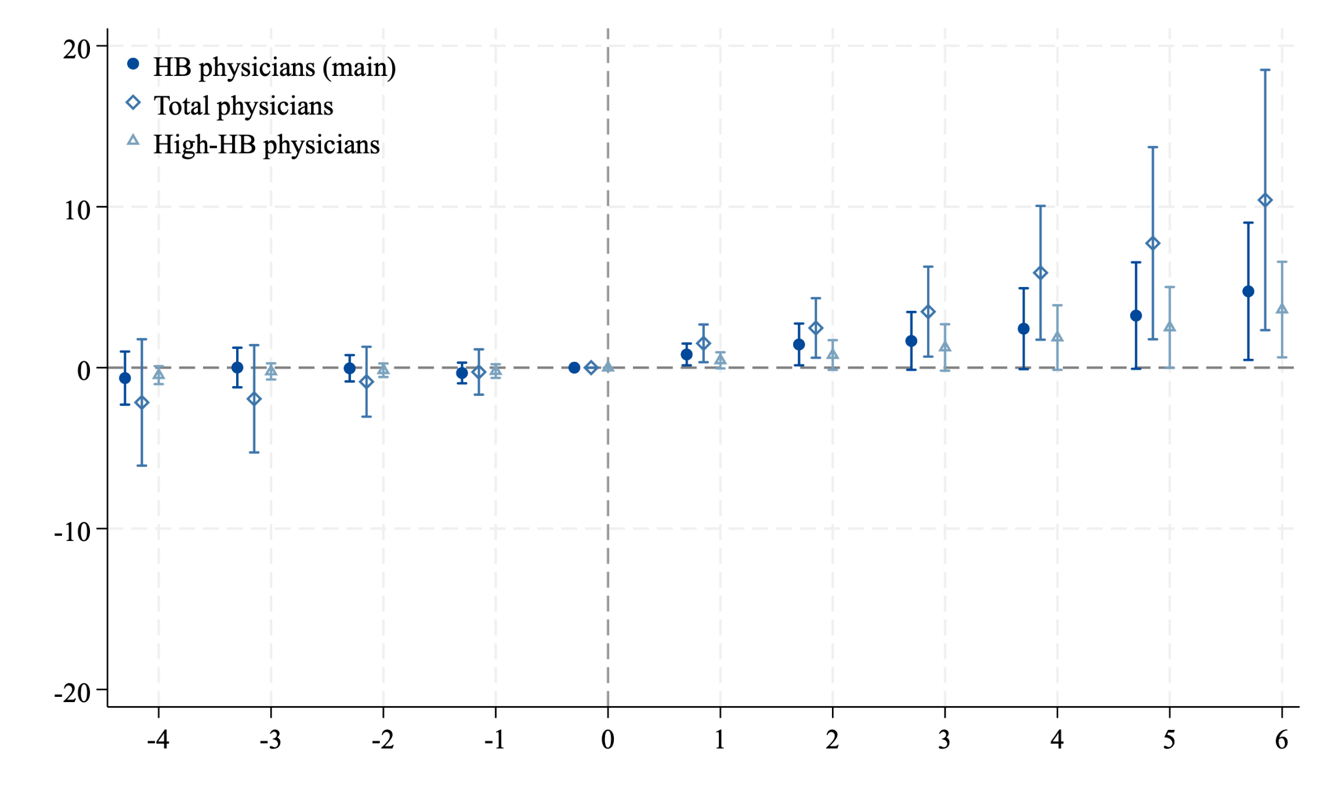
Expanded firm boundary or higher total doc density?
matched DiD
HRR level analysis

Slide 16
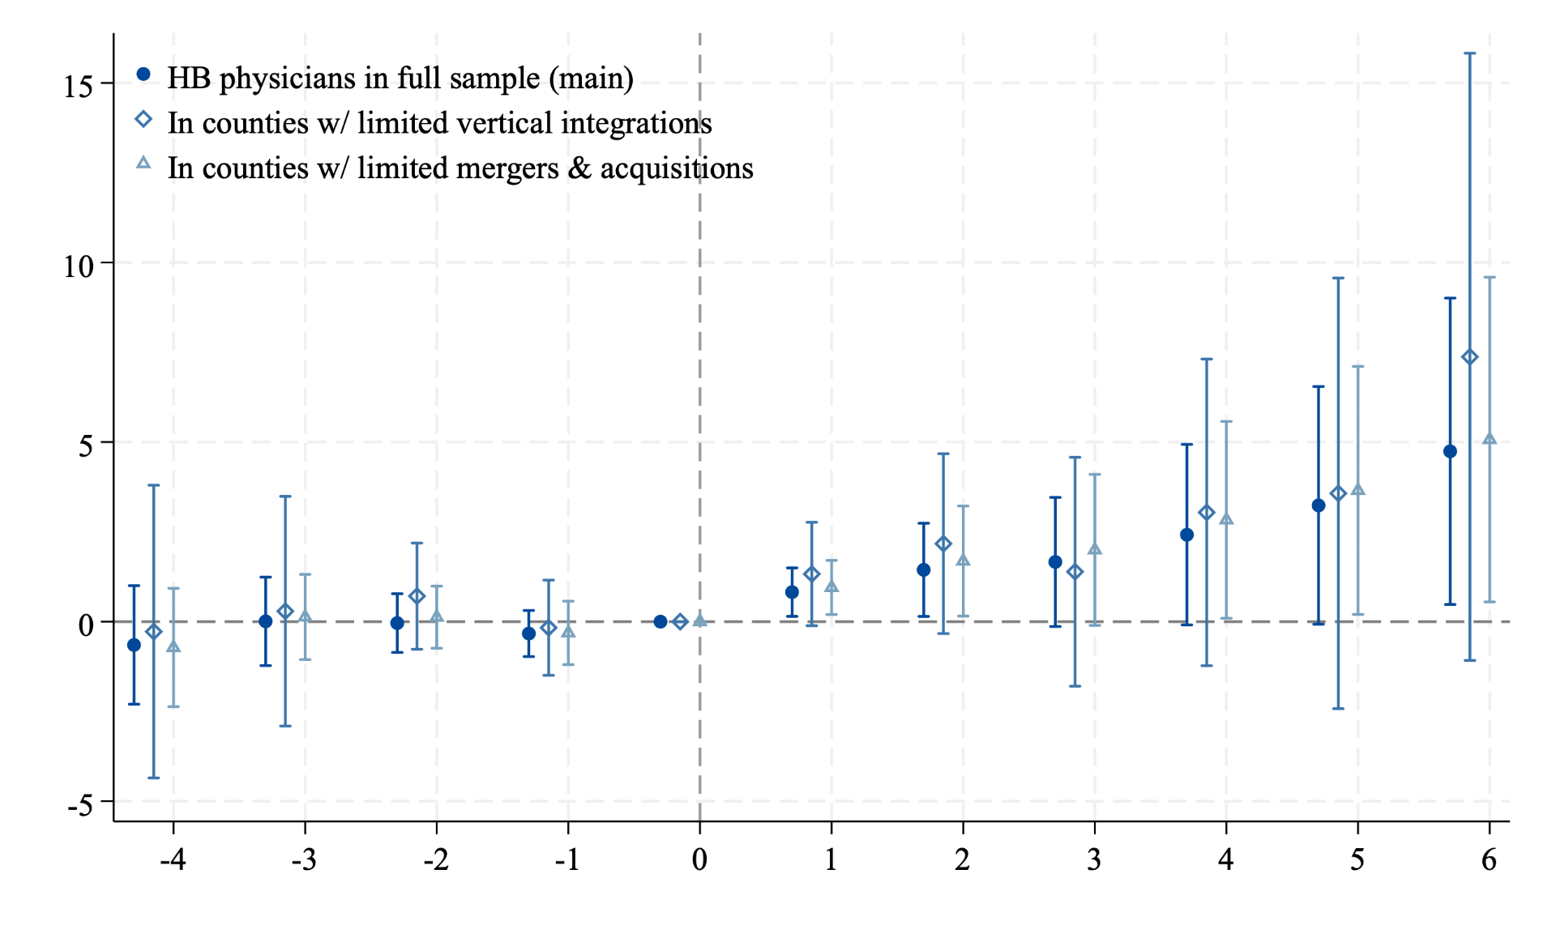
HIT Diffusion or Physician Practice Consolidation?
Health systems acquire physician practices to get more patients (Baker et al., 2016)
Systems, w greater financial & tech capacities, often adopt HIT early (Agha 2014)
We identify health system that experienced a merger & acquisition (M&A), if the # hospitals within the system increased in a given year compared to the previous year.
a vertical integration (VI), if the # ambulatory care units in the system increased…

Slide 17
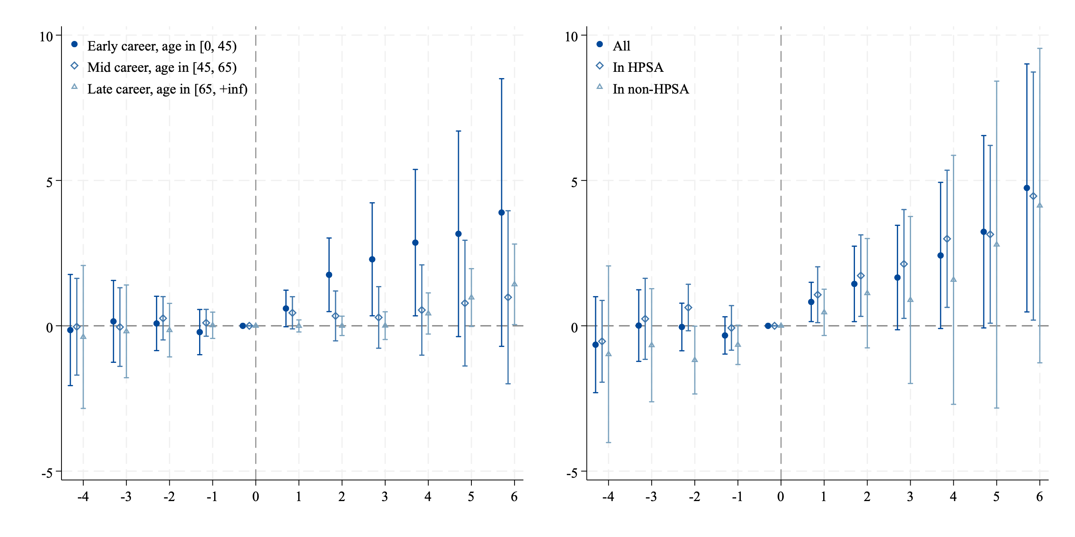
Heterogeneity by Physician Age & Shortage Status
Early-career (under 45), mid-career (45-64), late-career (65+), total docs
by Health Professional Shortage Area (HPSA) designation status
A county is ever-HPSA if at least part of the county was ever designated as having a shortage of primary care practitioners.

Slide 18
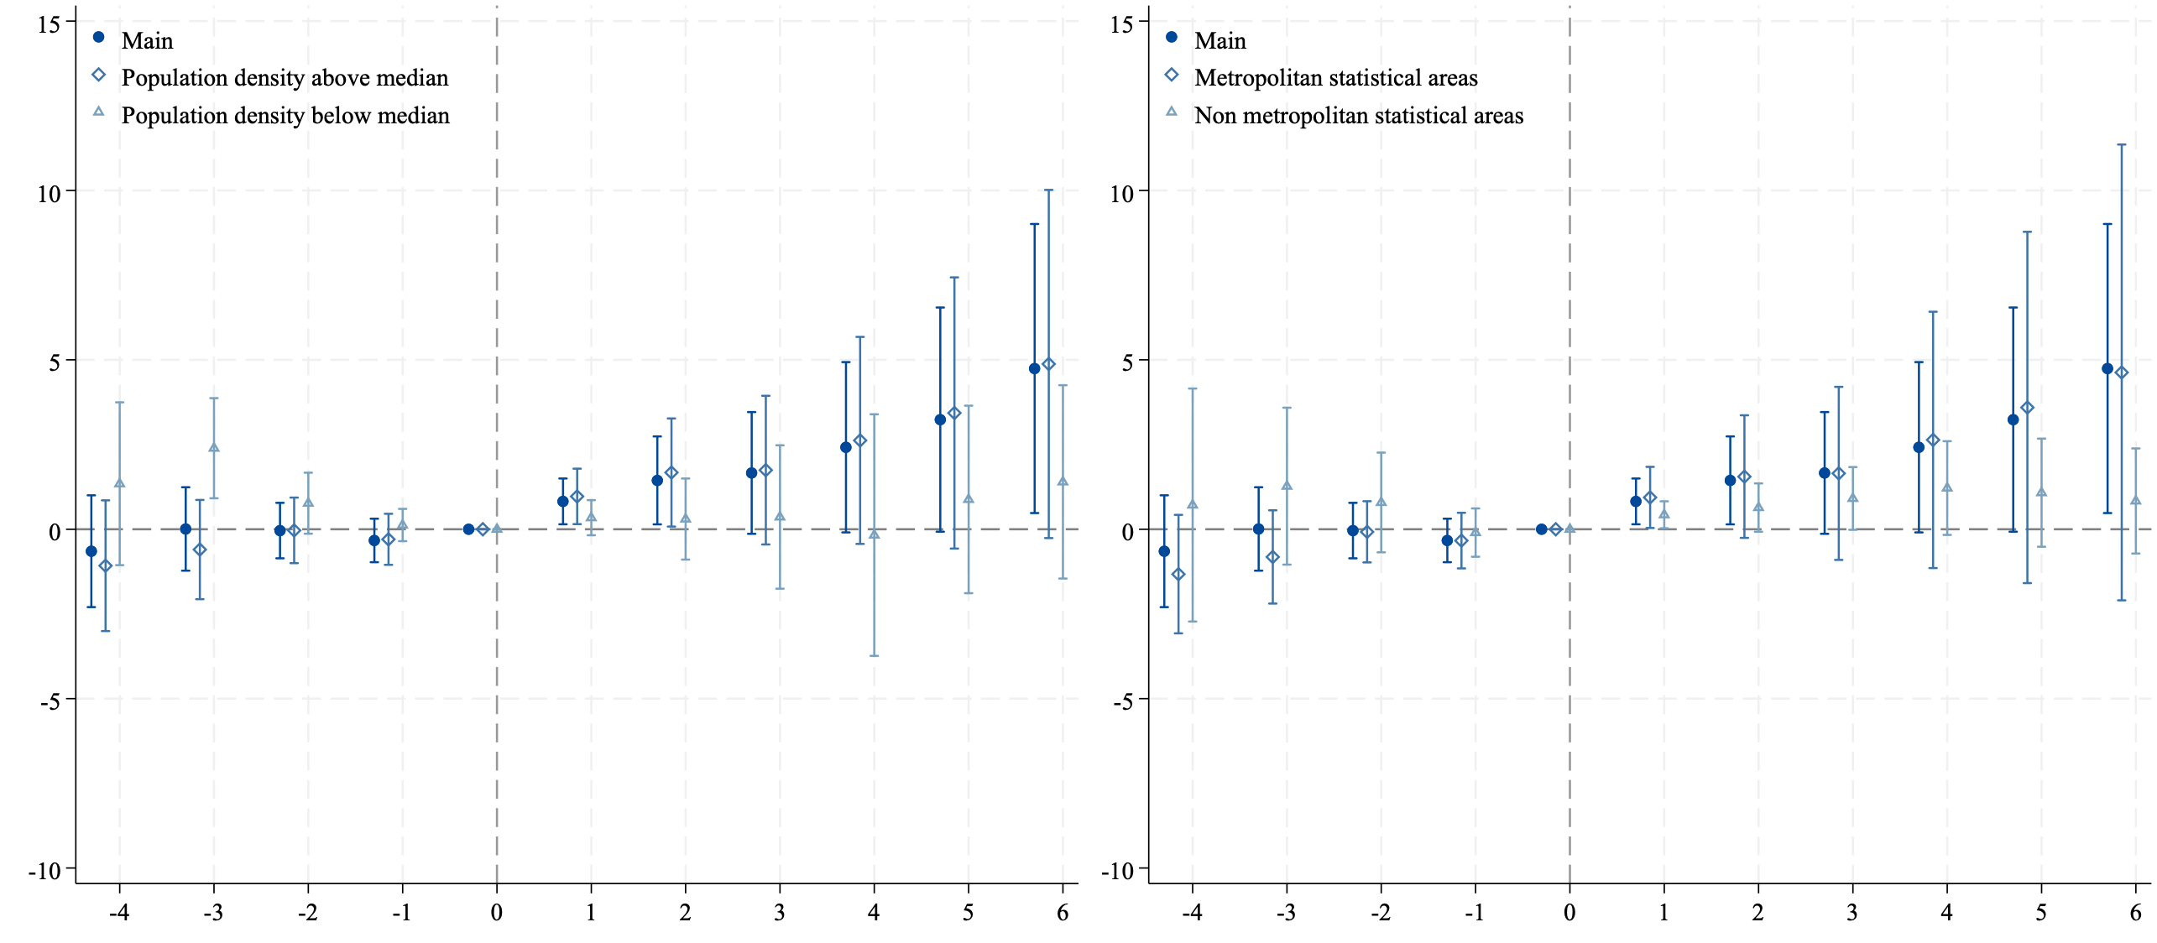
Heterogeneity by Rural/Urban (by pop density, MSA)

Slide 19
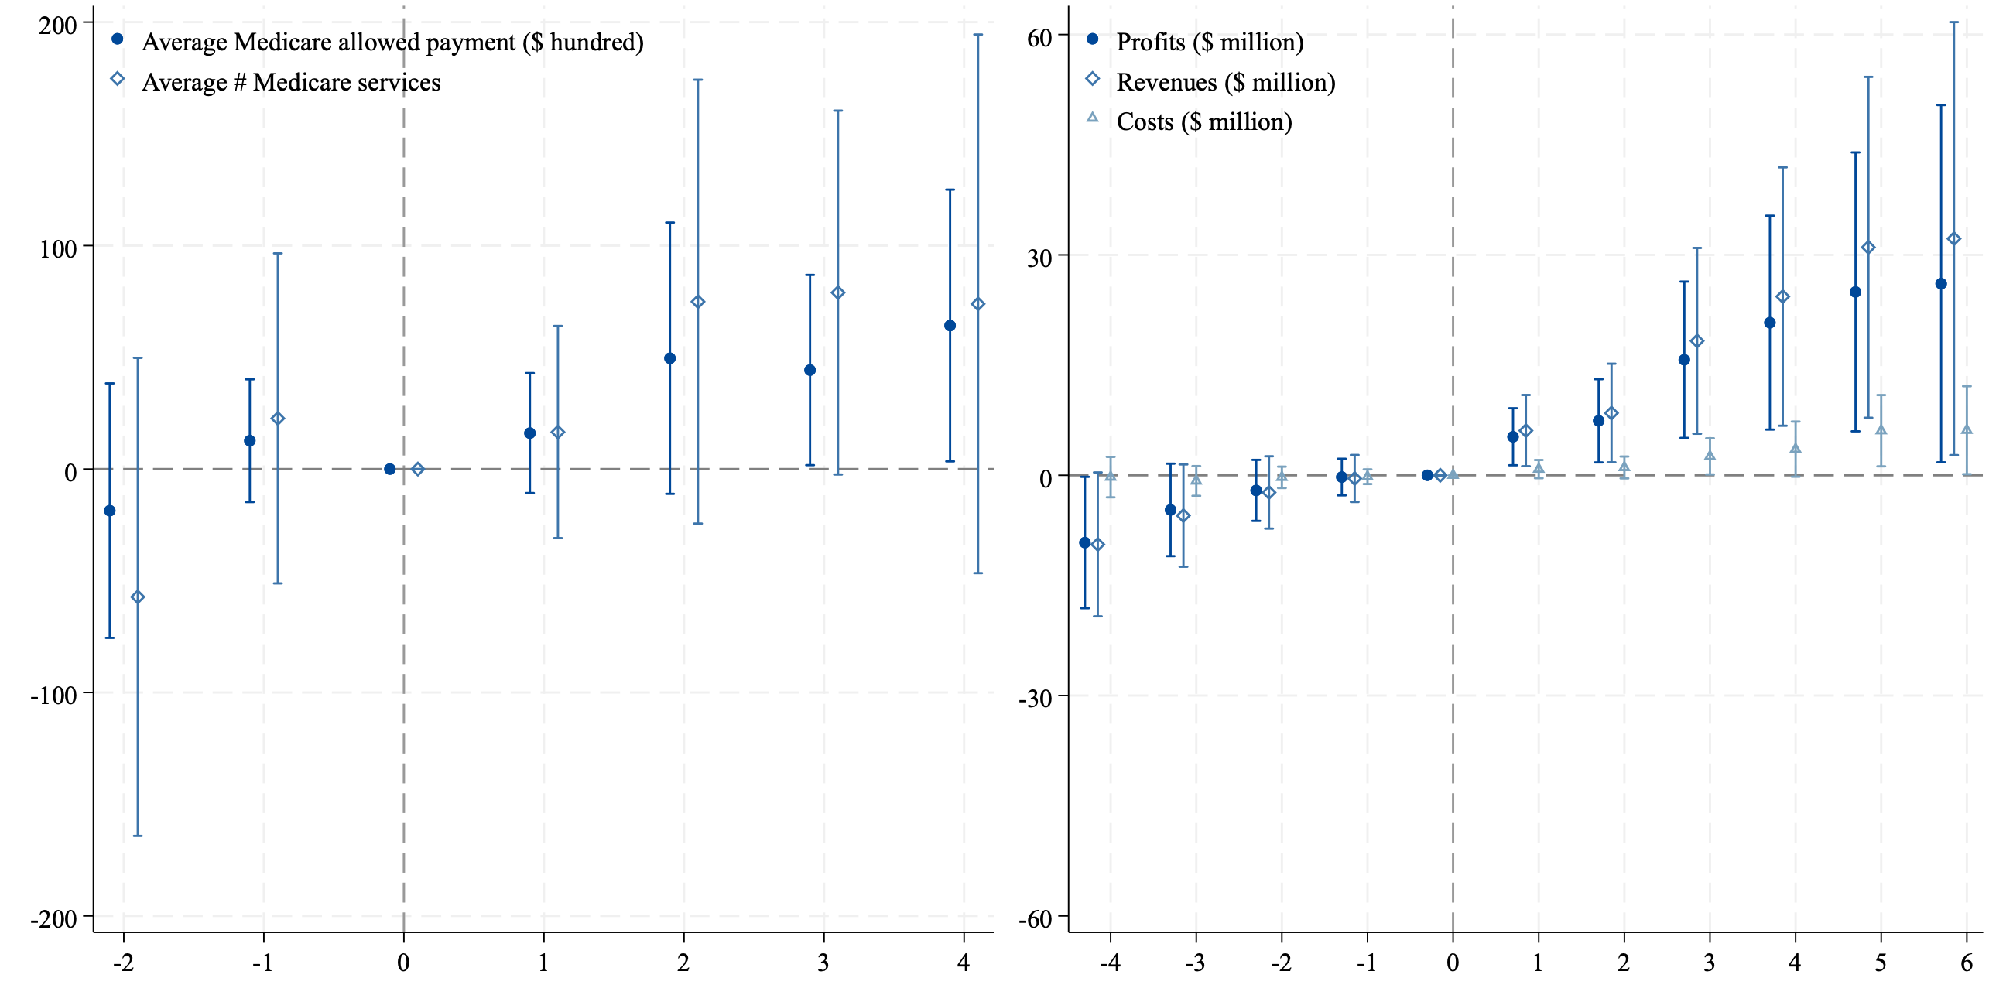
Potential Mechanism: the Financial Impact of HIT
Is it worth it financially? We use proxies for physician/hospital’s performance:
[per physician] avg Medicare-allowed amounts (incl. Medicare payments, patient deductibles and coinsurance, and 3rd-party contributions), avg # of Medicare services
[hospital] average hospital profit, revenue, and cost within each county

Slide 20
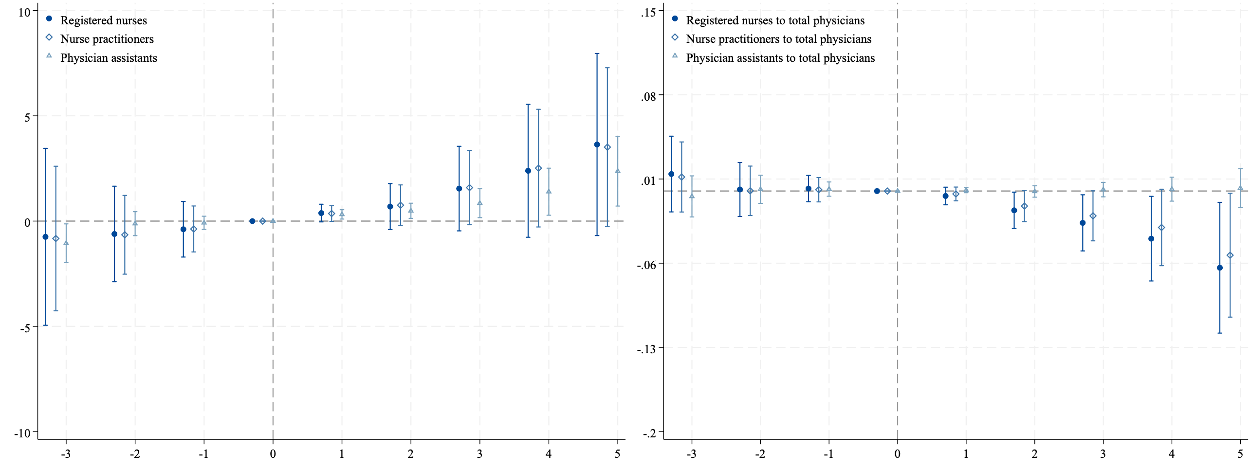
HIT and Physician Extenders: rates and ratios
PA-to-physician ratio remains similar; nurse-to-physician ratio declined, consistent w HIT automated routine charting tasks, freeing nurses to offer more direct patient care

Slide 21
Heterogeneity by utilization: doc supply & care vol.
Knowing that $ goes up. Given the interplay between provider capacity and service demand, how about patient care utilization post treatment?
Specifically, whether care utilization responses to HIT diffusion vary by pre-period local care utilization levels?
Tested across all utilization measures available, note that:
Outpatient elective surgeries has the highest profit margins, thus are where we expect highest increases in docs/vols (extensive, intensive margin)
Inpatient surgery volume may not respond, but more HB docs are still good
Others: ED visits, outpatient visits and Medicare inpatient discharges
Pre-period utilization matters: competition, disease mix, growth potential

Slide 22
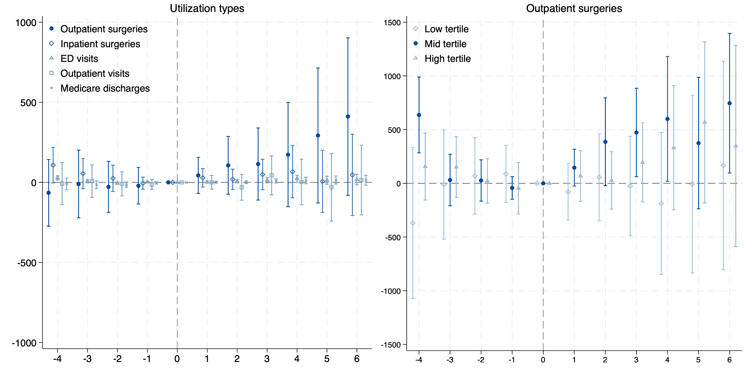
Heterogeneity by utilization (pre-T p.c. Medicare tertile)
Separate tertiles based on pre-treatment care utilization, measured by standardized, risk-adjusted per capita Medicare costs in 2006

Slide 23
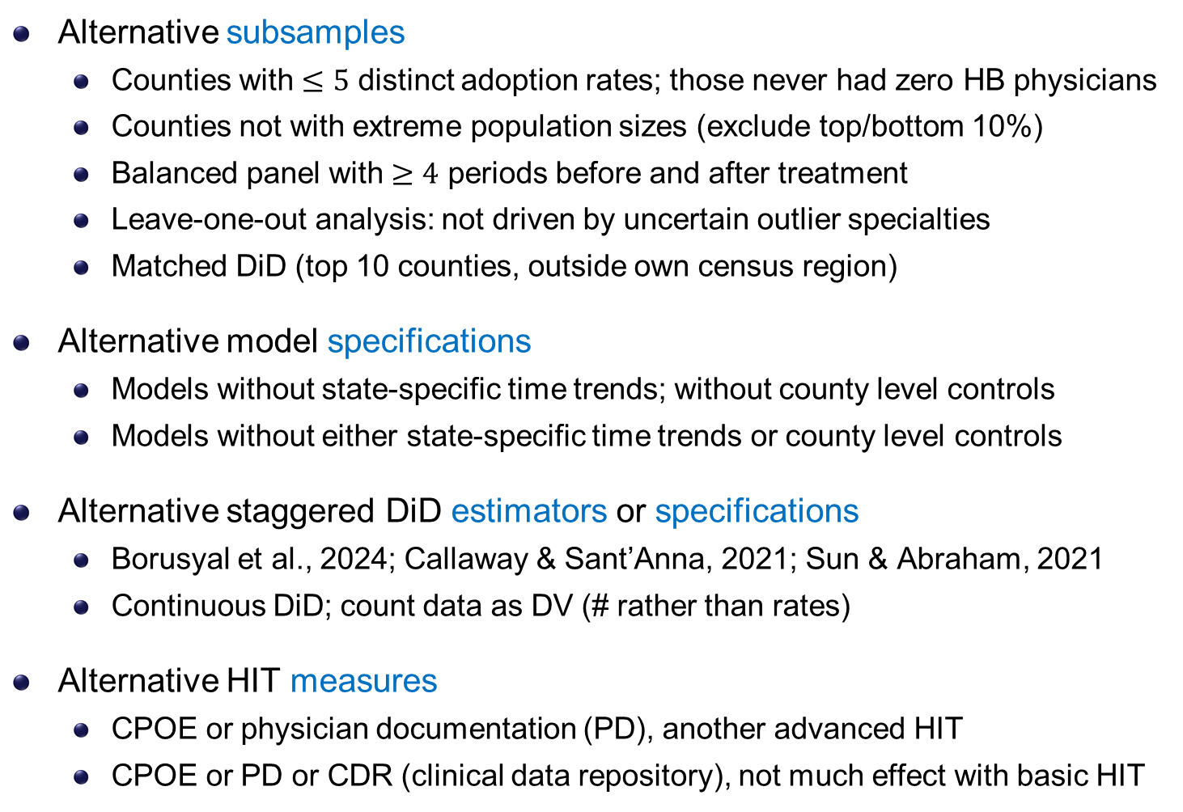
Robustness checks
Alternative subsamples
Counties with $≤5$ distinct adoption rates; those never had zero HB physicians
Counties not with extreme population sizes (exclude top/bottom 10%)
Balanced panel with $≥4$ periods before and after treatment
Leave-one-out analysis: not driven by uncertain outlier specialties
Matched DiD (top 10 counties, outside own census region)
Alternative model specifications
Models without state-specific time trends; without county level controls
Models without either state-specific time trends or county level controls
Alternative staggered DiD estimators or specifications
Borusyal et al., 2024; Callaway & Sant’Anna, 2021; Sun & Abraham, 2021
Continuous DiD; count data as DV (# rather than rates)
Alternative HIT measures
CPOE or physician documentation (PD), another advanced HIT
CPOE or PD or CDR (clinical data repository), not much effect with basic HIT
subsample
drop-1-out
match-DD
specifications
estimators
cont. DD
count DV
measures

Slide 24
Limitations and Future Work
Analyses based on aggregate data
☺ mitigate concerns about patient sorting (limited sorting at county level)
☹ limit our ability to disentangle changes at the physician level (e.g., senior to junior doc replacements, PCP vs specialists, roles, interoperability, …)
Focus on digital tech but not fully capture physical med tech (data limit)
comprehensive controls mitigate concerns that other tech drive the results
Not directly link with downstream health outcomes: HIT or docs?
HIT is one element within broader, team-based care delivery process
We demonstrate there can be direct and indirect effects via physician supply

Slide 25
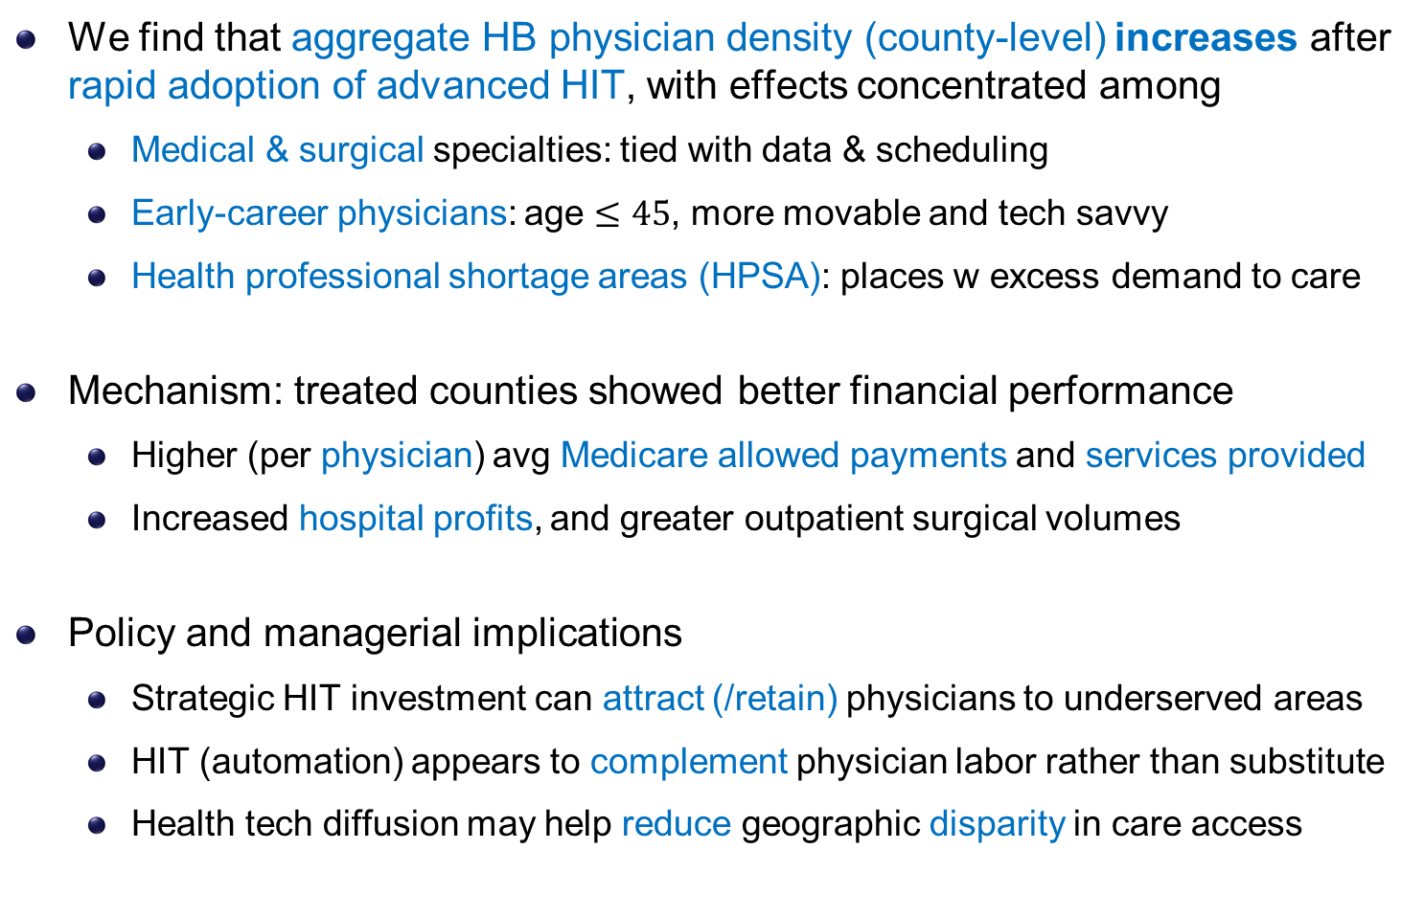
Conclusion & Discussion
We find that aggregate HB physician density (county-level) increases after rapid adoption of advanced HIT, with effects concentrated among
Medical & surgical specialties: tied with data & scheduling
Early-career physicians: age $≤45$, more movable and tech savvy
Health professional shortage areas (HPSA): places w excess demand to care
Mechanism: treated counties showed better financial performance
Higher (per physician) avg Medicare allowed payments and services provided
Increased hospital profits, and greater outpatient surgical volumes
Policy and managerial implications
Strategic HIT investment can attract (/retain) physicians to underserved areas
HIT (automation) appears to complement physician labor rather than substitute
Health tech diffusion may help reduce geographic disparity in care access

Slide 26

Health IT Diffusion and Physician Labor Density
Jason Huh (RPI), Jianjing Lin (UMass Amherst), Lucy X Wang (UMass Amherst; MPI; CCHE)
Emails: huhj2@rpi.edu, jianjinglin@umass.edu, xiaoluwang@umass.edu

Slide 27
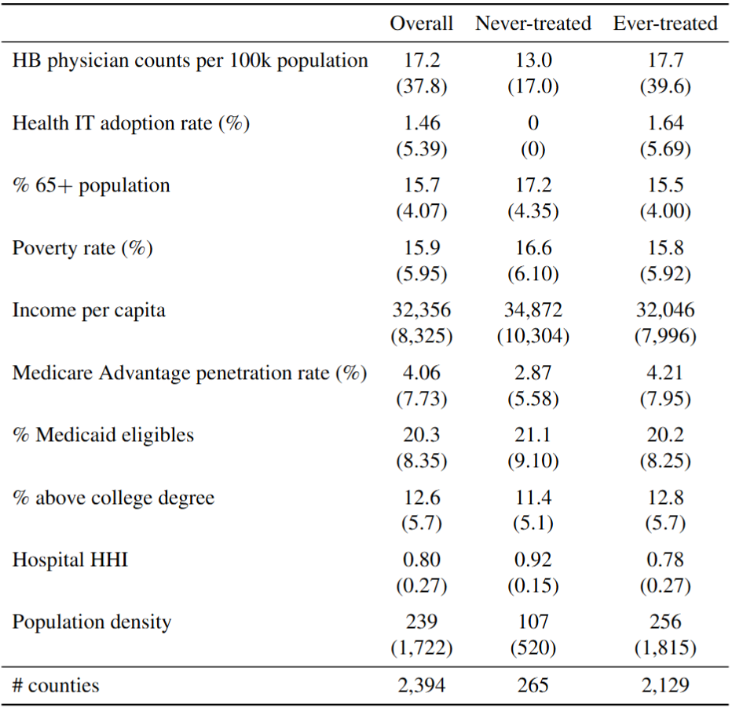
Summary statistics in pre-treatment period
back
Notes:
Our primary patents do not fall into one ICD-9 disease category: congenital anomalies

Slide 28
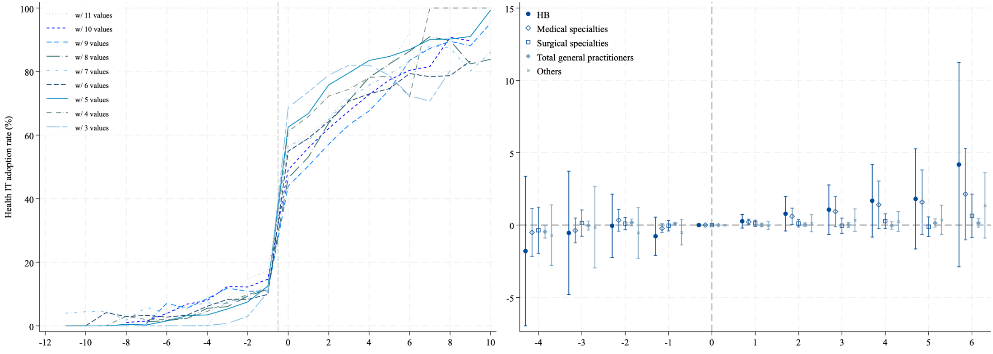
Hospital Referral Region (HRR) level analysis
back

Slide 29
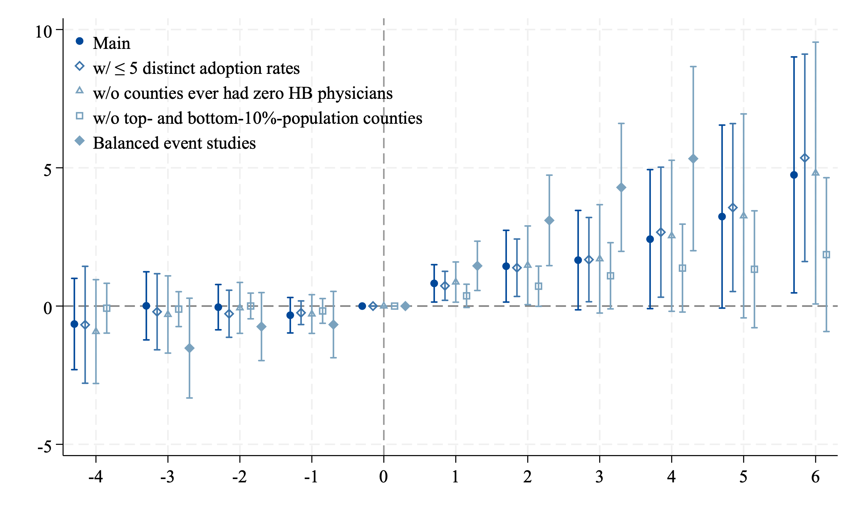
Robustness check: subsample sensitivity checks
back

Slide 30
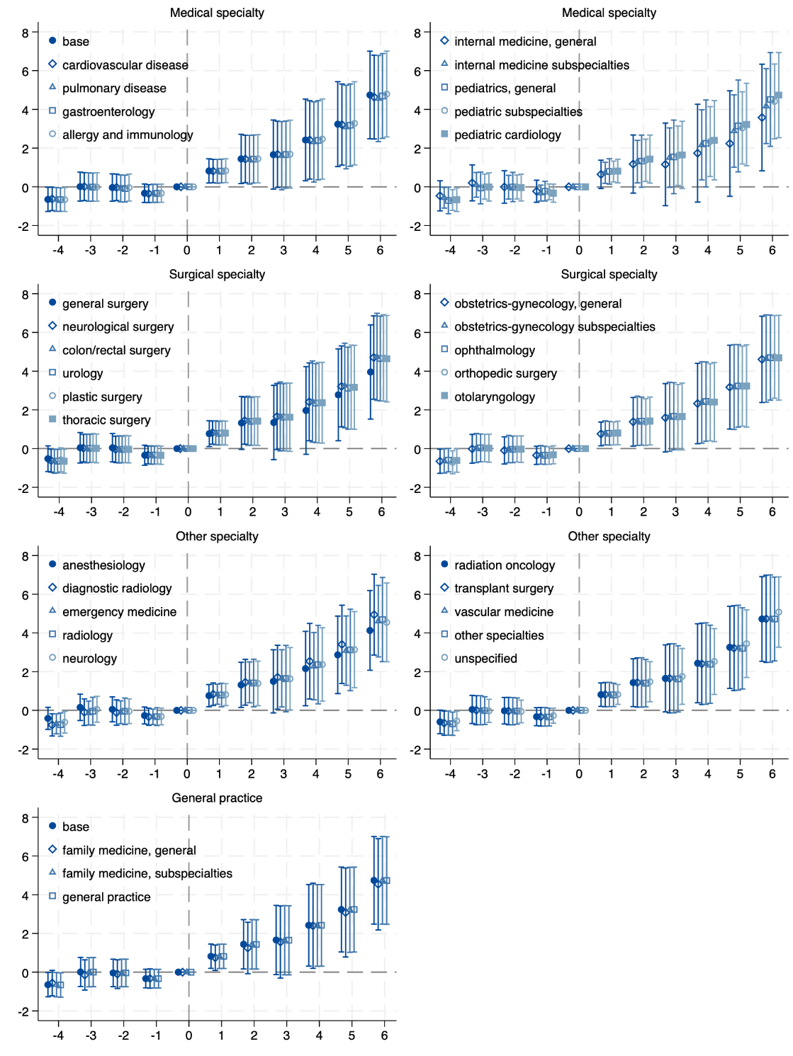
Leave-one-out analysis by specialty
back

Slide 31
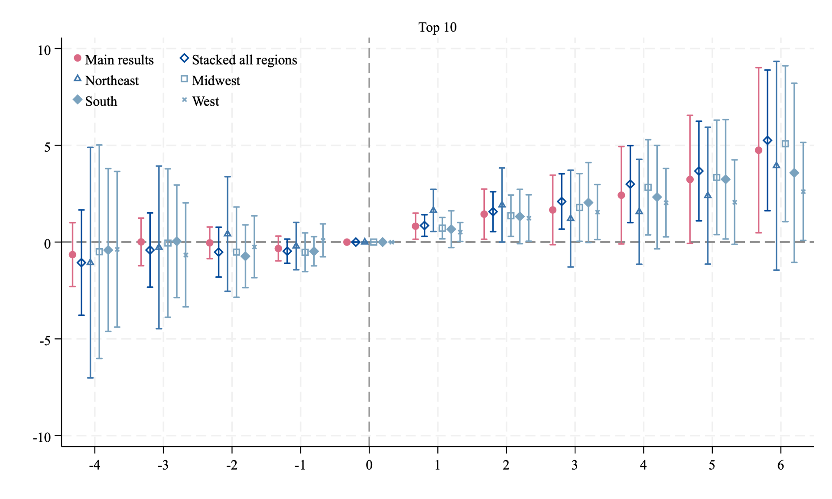
Matched-DiD: overall stacked & by census region
method à la Deryugina et al. (2018 AEJ) and identify the top 10 control counties for each ever-treated county, based on the following county characteristics in 2000-2004: HB physician density, annual % change in HB physician density, Medicare advantage penetration rate, % 65+ population, income per capita, and unemployment rate. We then further restrict the control counties to be far enough (≥300 miles and in a different census region from the focal county).
back (main)
back (robust)

Slide 32
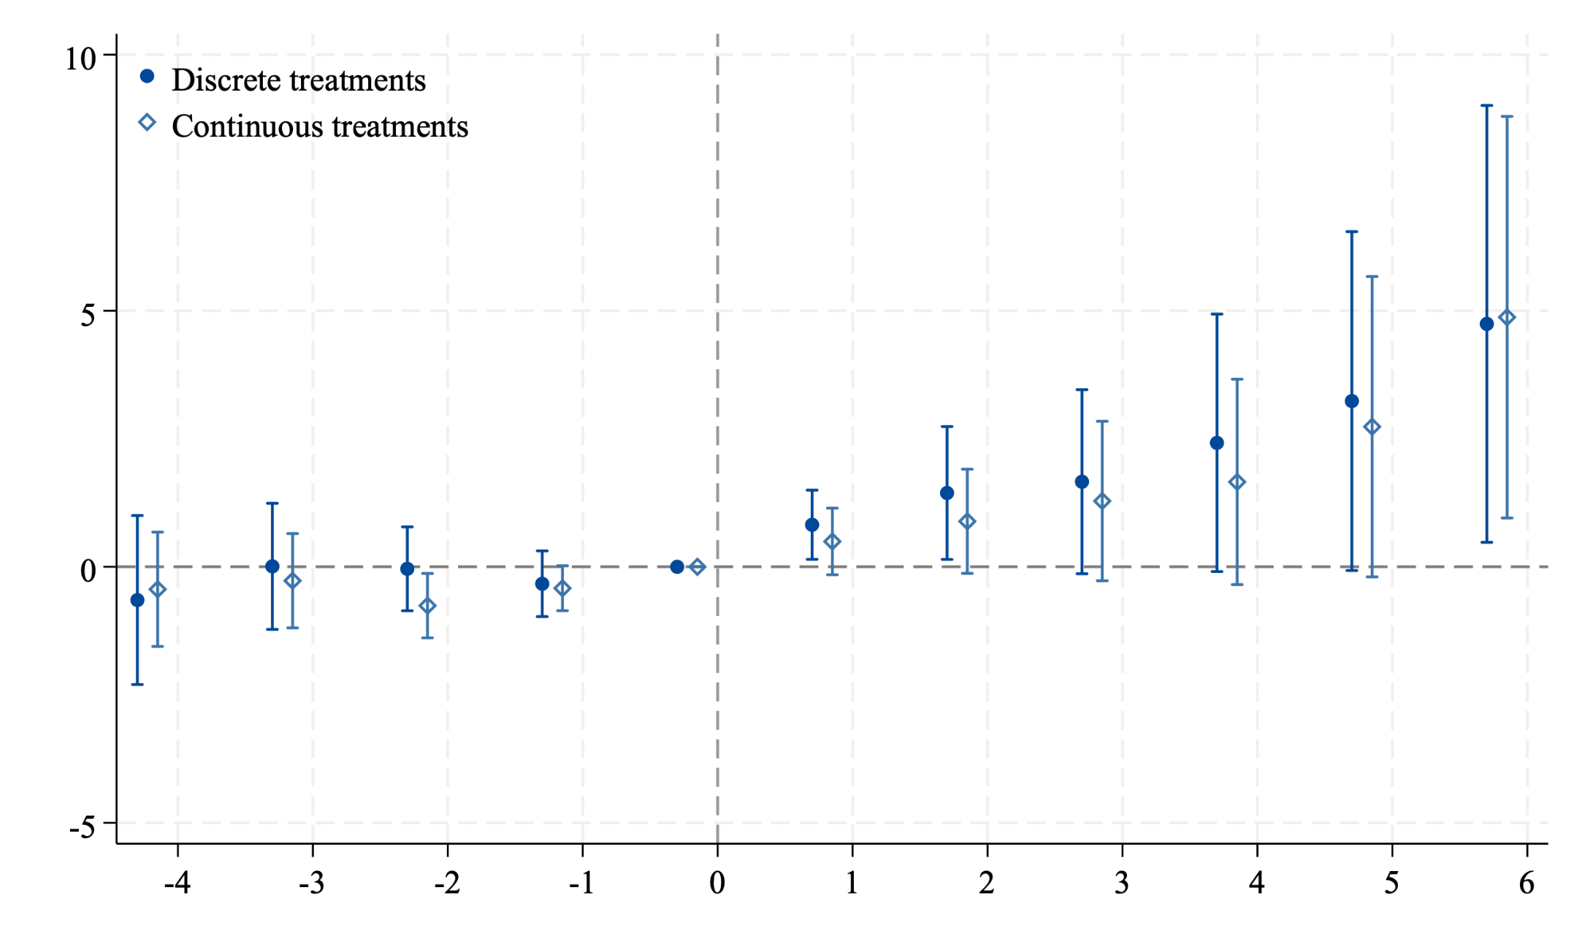
Discrete vs continuous HIT adoption treatment
The estimated ATE from a continuous DiD estimation approach is 2.72** (1.35), compared to our main estimates under discrete DiD of 2.16** (1.04).
back

Slide 33
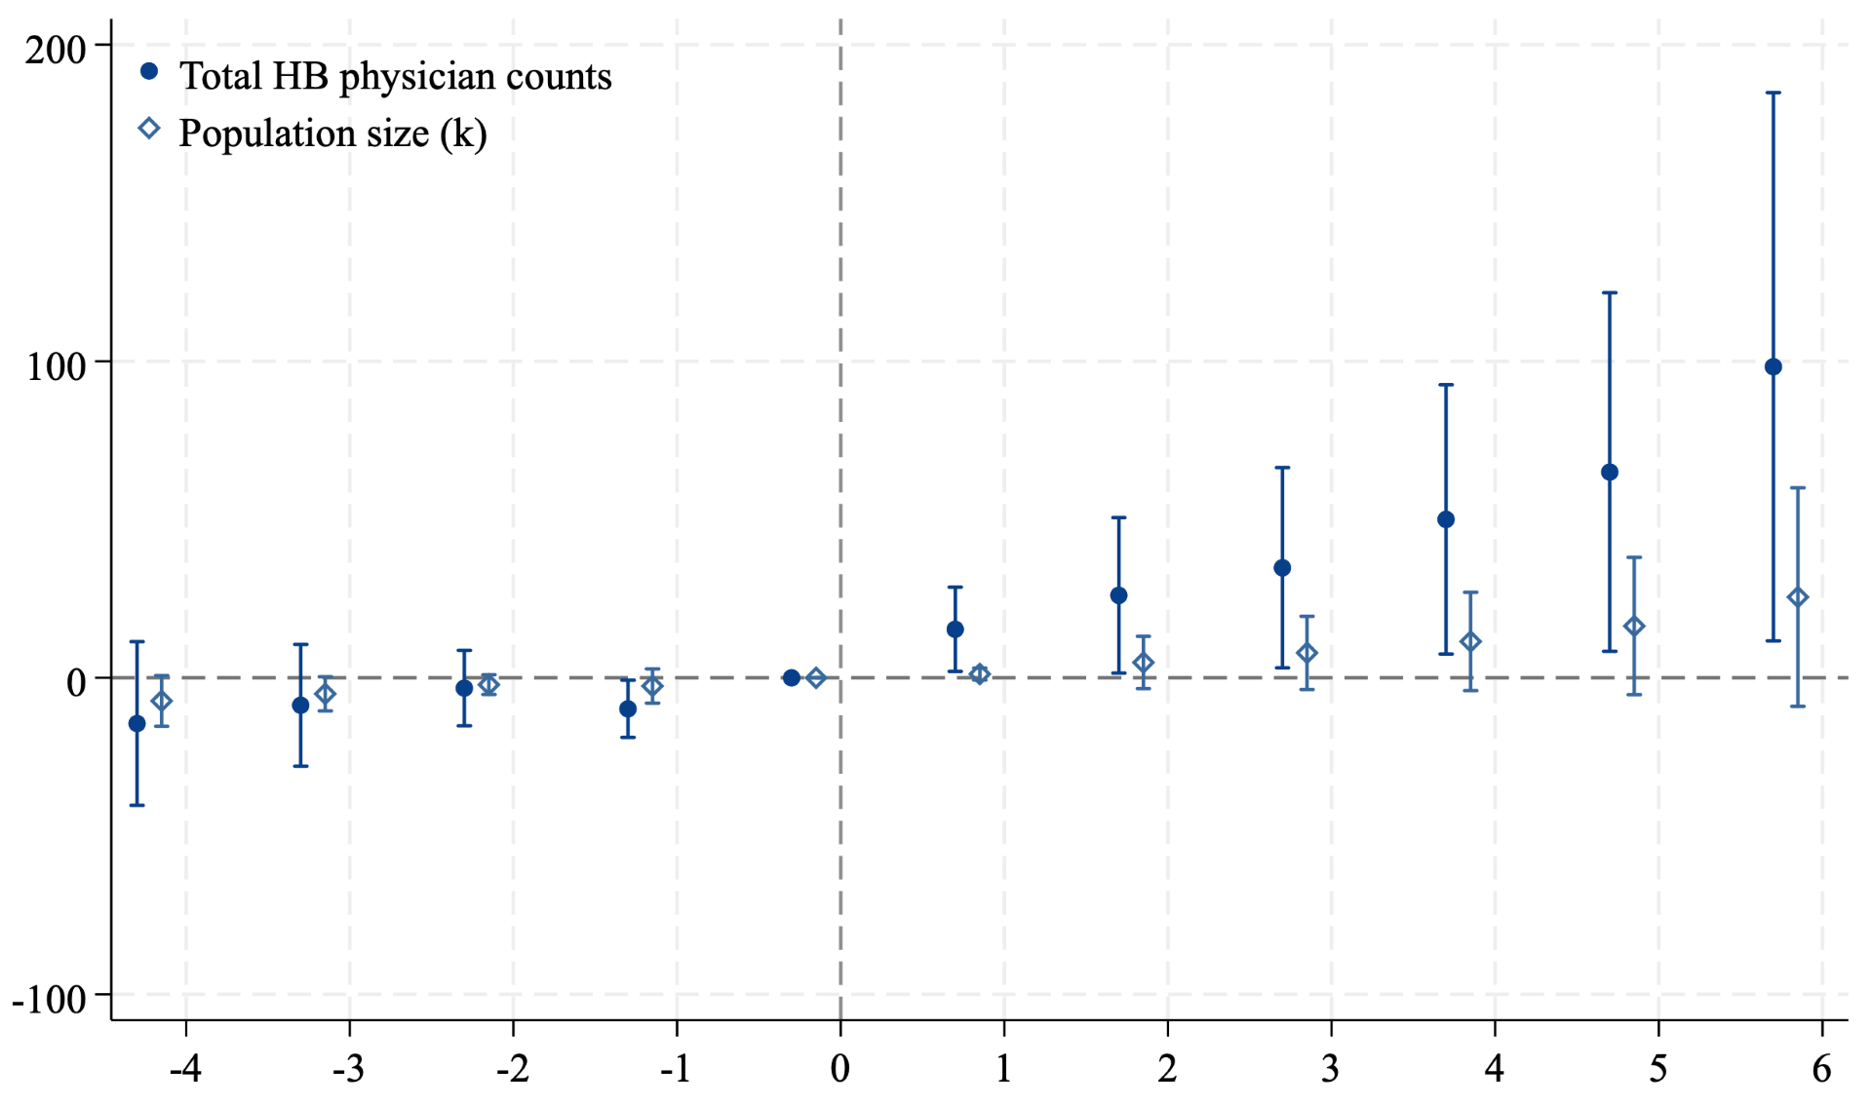
Count data DVs for main results (num./denom.)
back

Slide 34
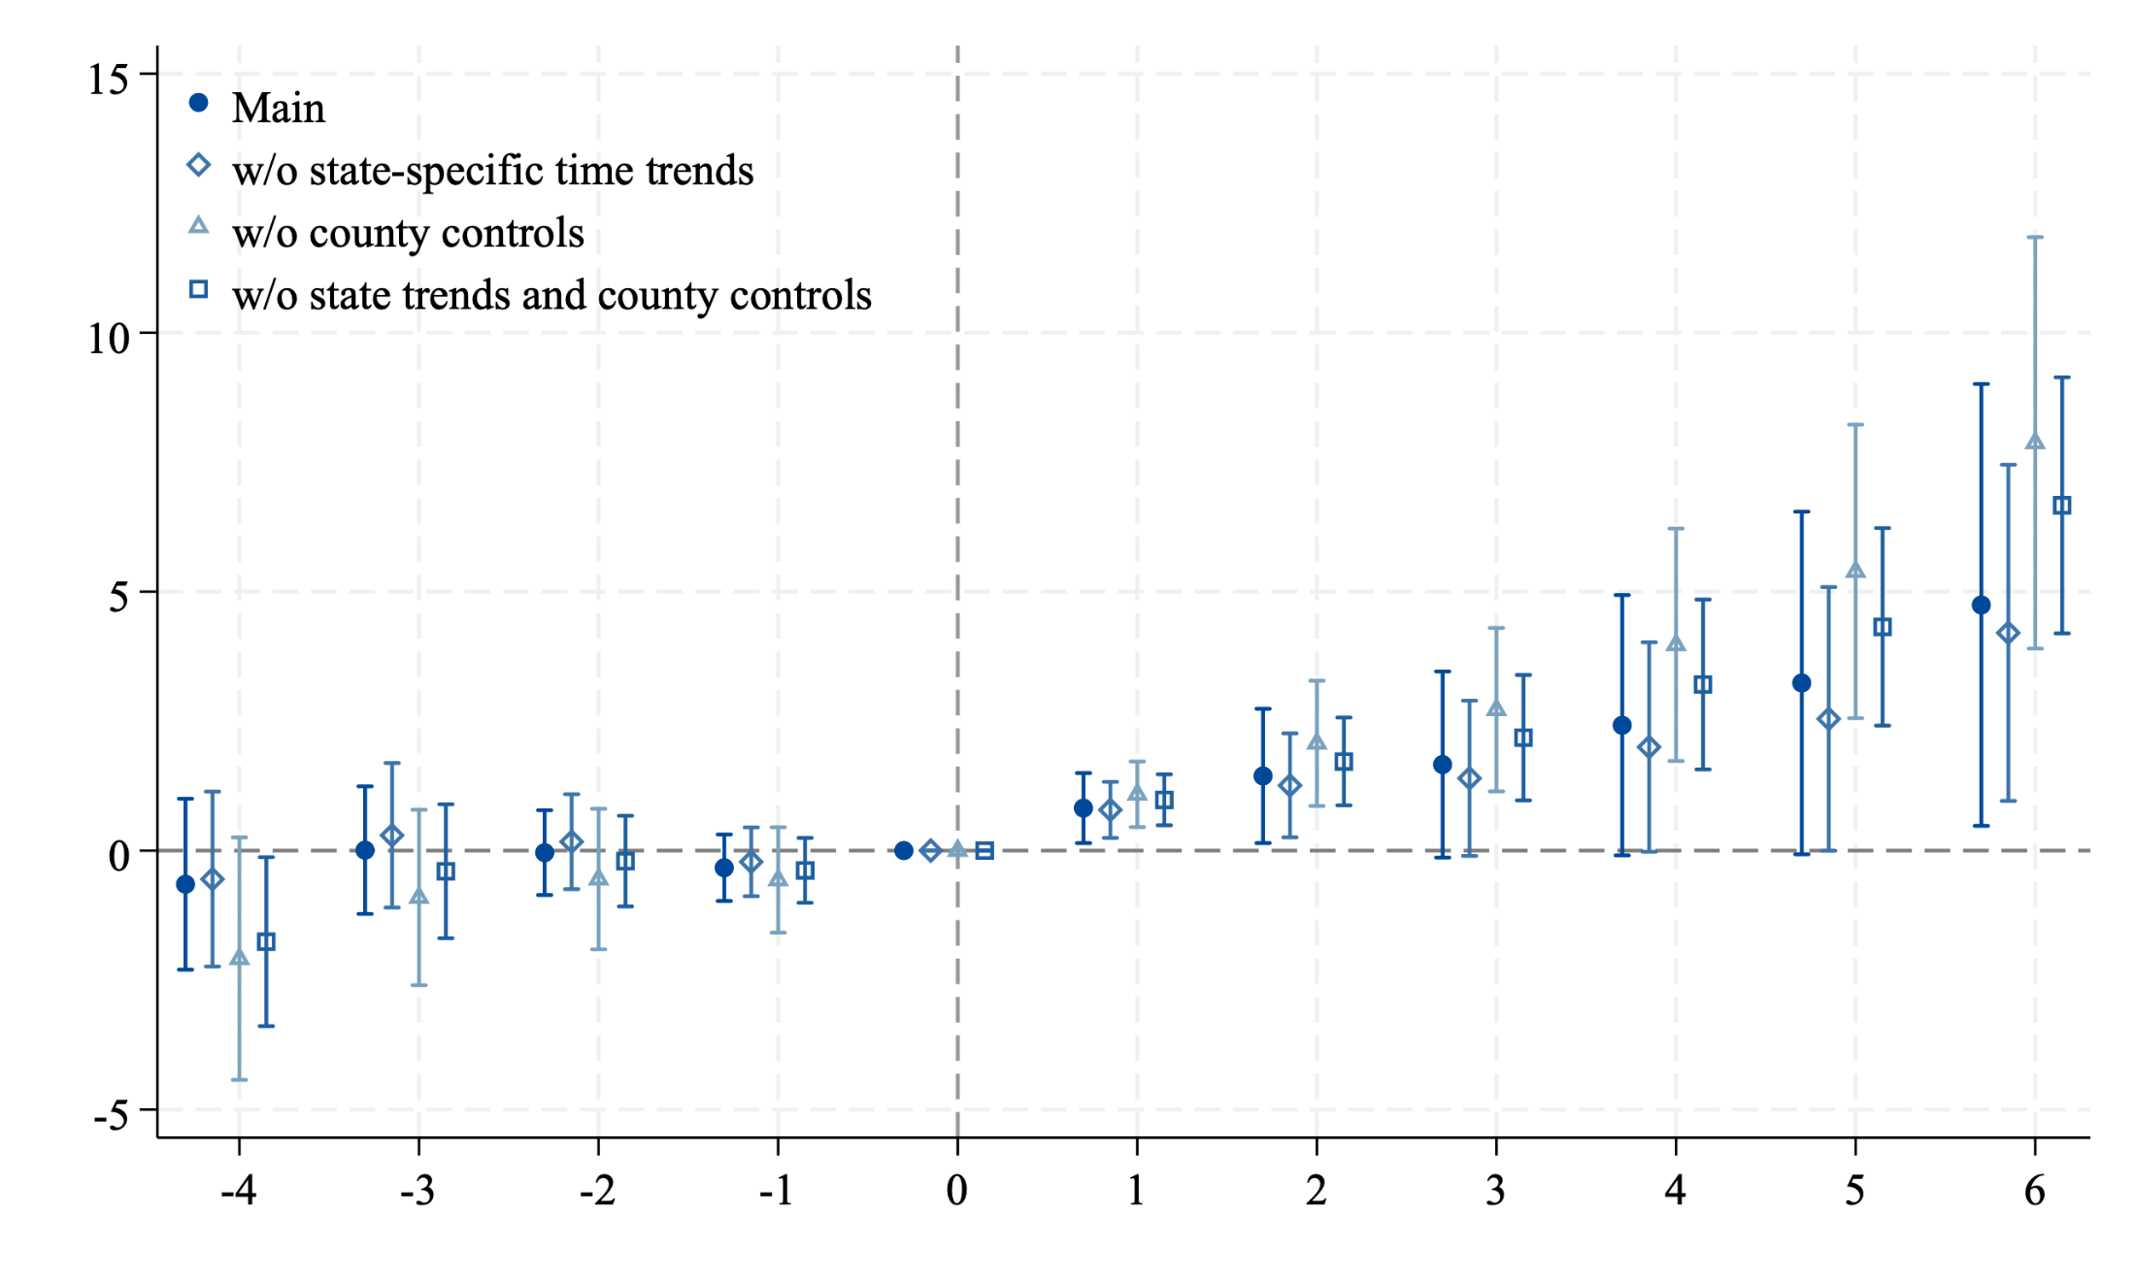
Robustness check: specification checks
Note the main specification always include state-specific time trends and a set of county-level observables in 2005 each times a linear time trend.
back

Slide 35
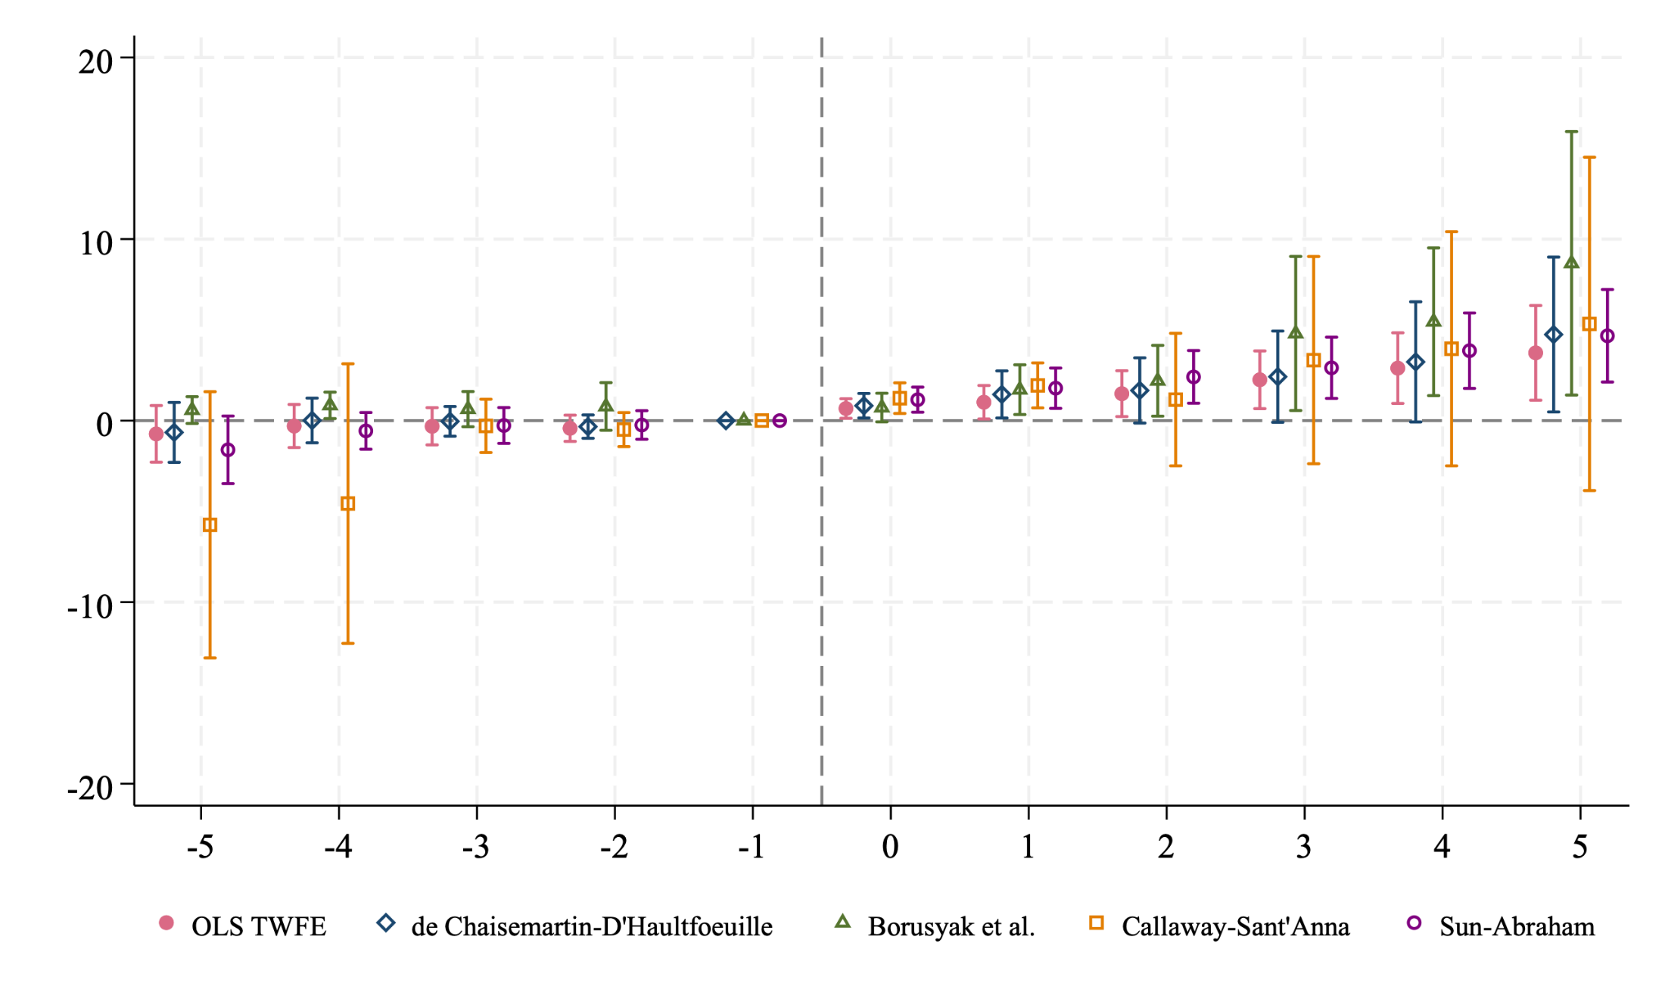
Alternative DiD estimators for the main outcome
All estimators use t=-1 as the reference except Borusyak et al., which uses the earliest period as the baseline period.
back

Slide 36
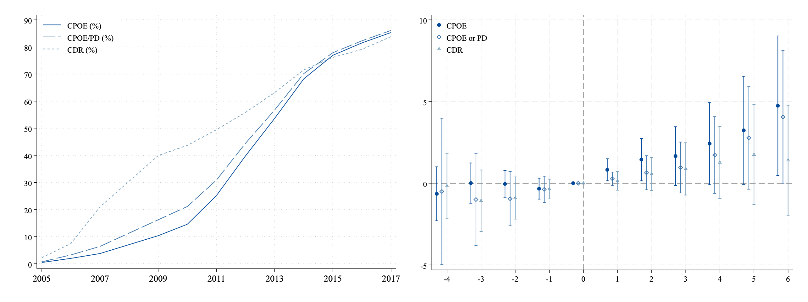
Alternative HIT measures: CPOE/PD adoption
Alt. HIT adoption measures: county-level sharp adoption of either CPOE or physician documentation (PD) – another advanced HIT component (noted in Dranove et al., 2014) but not core for HITECH act MU criteria.
Clinical Data Repository (CDR), in contrast, is a basic HIT w/ limited functions
back

