Slide 1
Marketing Authorization and Strategic Patenting: Evidence from Pharmaceuticals
Dennis Byrski¹ and Lucy Xiaolu Wang^{2,1,3}
¹ Max Planck Institute for Innovation and Competition
² University of Massachusetts Amherst
³ Canadian Centre for Health Economics
ASHEcon, 2024.6.17

Slide 2
Drugs save lives, but too costly with many patents!
The patent system is designed to promote innovation (more private returns), esp. important for drugs (Mansfield 1986; Lakdawalla 2018)
But strategic patenting can be welfare-reducing: originators earn supra-competitive profits & limit access to drugs (European Commission 2009)
E.g., evergreening (extends length) and fencing (extends breadth)
But ex ante incentives are important to long-term R&D (Budish et al 2015)
The tradeoff between static efficiencies and ex ante R&D incentives has evoked debates on rising patentability standards (not only for drugs)
US Supreme Court cases: Mayo 2012, Myriad Genetics 2013
This paper: EPO “gold standard” examination quality (Chien 2018) + info disclosure in market authorization that affect follow-on patenting
Trial docs disclosed can function as new “prior arts” (EP Board of Appeal)
Notes:
Mayo v. Prometheus (2012): adjust drug dosage based on metabolite levels – not patent-eligible;
Association for Molecular Pathology v. Myriad Genetics, Inc. (2013): naturally occur genes are not patent eligible.

Slide 3
Patents, Products, and Cumulative Innovation
patent scope
Patent B
Innovation B
Innovation A
Patent A
Product A
cited by
(forward citation)
Patent C
Innovation C
?
patent length
Longer patent terms spur entry of non-infringing product imitations, broader claims deter them (Gilchrist 2016; Izhak et al 2020)
Subsequent entry or imitation after drug approval ≠ subsequent patenting
There is little systematic evidence on how the market authorization of a product alter the incentives for cumulative innovation/patenting
For originators, vertically related parties, others
For strategic versus innovative follow-on innovation

Slide 4
Research Question:
Q: How does marketing authorization of a new drug (new NME) affect follow-on innovation building upon focal drug?
Intuitively, follow-on patenting can go either way (an empirical Q):
More: “Time to explore other new indications and expand the market!”
Less: “Time to lay flat and relax, as profit is coming in our way!”
Same: “I cannot decide, so maybe just good to patent as usual?”
Exploit the authorization of new drugs to the (EU/EEA) market
Show how the focal drug patents with varying approval lags (do not) differ concerning ex-ante patent and drug characteristics
Examine how a drug’s approval affects the rate and direction on how firms (selves, related parties, others) conduct follow-on innovations
Notes:
EEA = European Union member states, Iceland, Liechtenstein, and Norway.

Slide 5
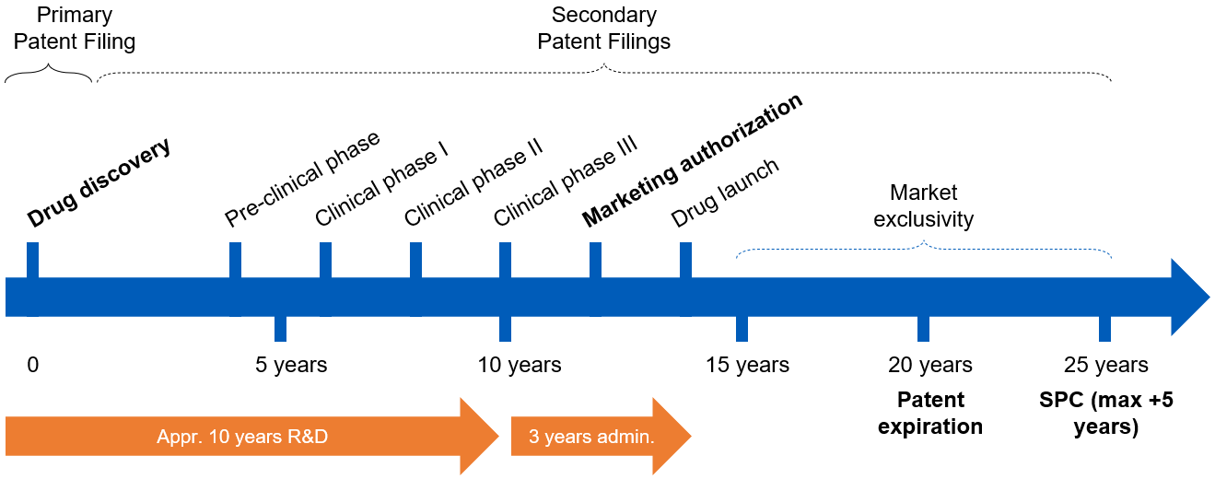

The Drug Development Process in EU (EEA)
In European Economic Area (EU+Iceland, Liechtenstein, Norway), originators submit applications for market authorization to European Medicines Agency (/national)
verifies safety, efficacy, quality; drugs can then be sold for approved indications
Market exclusivity: firms hold exclusive right to market/sell a patented drug

Slide 6
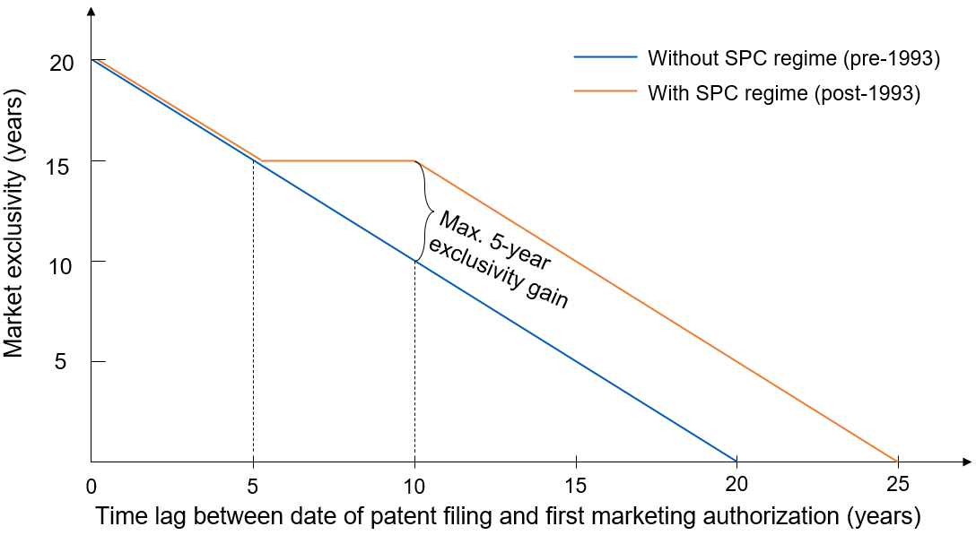
EU Patent Term Extension (SPC Regime)
Supplementary Protection Certificates (SPC) regime, 1993- (our sample): patent term extension is capped at 5 years, so market exclusivity can be seen as constant for patents w/ 5-10 years’ approval lag
SPC term (≤5 years)= date of 1st MA in EEA – filing date of basic patent – 5
analysis

Slide 7
It takes a long & uncertain time to develop a drug…
Pre-clinical phase
Market authorization
Clinical phase III
Clinical phase II
Patent filing
Clinical phase I
Drug launch
Late MA
(long lag)
0
5 years
10 years
15 years
20 years
Early MA
(short lag)
0
5 years
10 years
15 years
20 years
Approval lag cannot be predicted perfectly at the time of the patent ﬁling: whether/when the drug will be on the market (à la Gilchrist 2016)
Scientific uncertainty: drug R&D process is highly uncertain & non-linear
e.g., mRNA technology was viewed as non-promising for decades until Covid
e.g. (small molecule drugs w long lags): Prozac, Lipitor, Plavix, Gleevec, …
Organizational factors: mergers & acquisitions, $, licensing, transfer, …
Meanwhile, the patent system rewards “first-to-file” as the patent owner
Firms often file patents once a molecule of $-interest is vaguely identified
Strategic delay of MA is costly: later product entry (lost 1st-mover advantage)

Slide 8



Data Construction: primary patent-drug dyadic data
Patent-drug linkage: data on primary patent covering an NME (new molecular entity) and the approved drug from public registers.
SPC data from the German Patent Office – i.e., Deutsches Patent- und Markenamt (DPMA): originator specifies the core (basic) patent for a drug
Restrictions: 1) exclude patents filed 20+ years before data collection (1997+); 2) only keep SPCs on the 1st drug rel. to primary patents (unique patent family-drug links)
Approval lag: lag btw original filing date of focal drug’s primary patent (priority date) and the 1st EU market authorization (allow 5+ years post approval periods)
Patent data: patent info on the primary patents from EPO PATSTAT
Link via appl_no w patent info at patent family level; EPO search report
Drug data: Cortellis, link by patent family id, tag pharma cites; categorize product, process, 2ndary patents; crosswalk conditions w WHO ICD-9 code

Slide 9
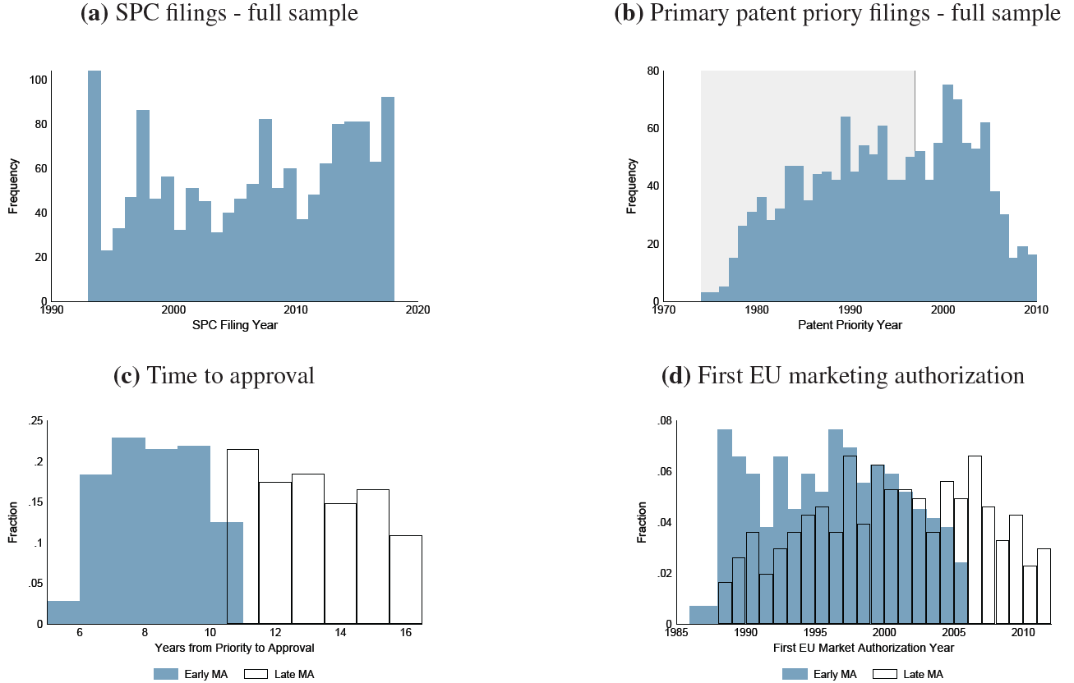
Samples: full/restricted, early/late MA sample split
590 unique patent-drug links
Notes:
Median time-to-approval in our sample: 10 years

Slide 10
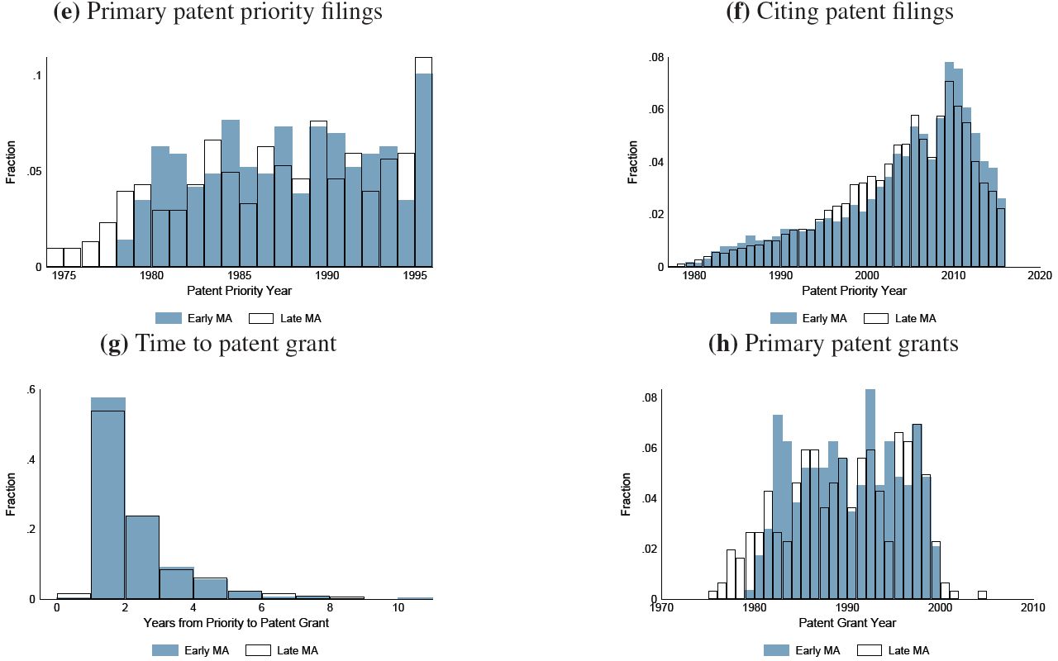
Distribution of timing-related variables
Patents with early vs. late MA (split approval lag at median: 10 years) are similar regarding priority time, time span at the patent offices (time to patent grant), similar technological nature (e.g., ICD-9, complexity, resubmissions), and similar ex-ante drug, disease, and patent characteristics (t-test across many metrics).

Slide 11
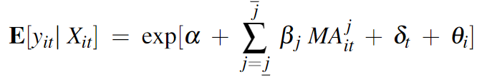
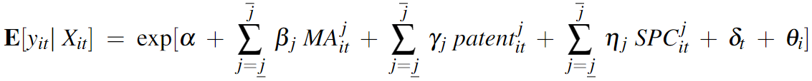
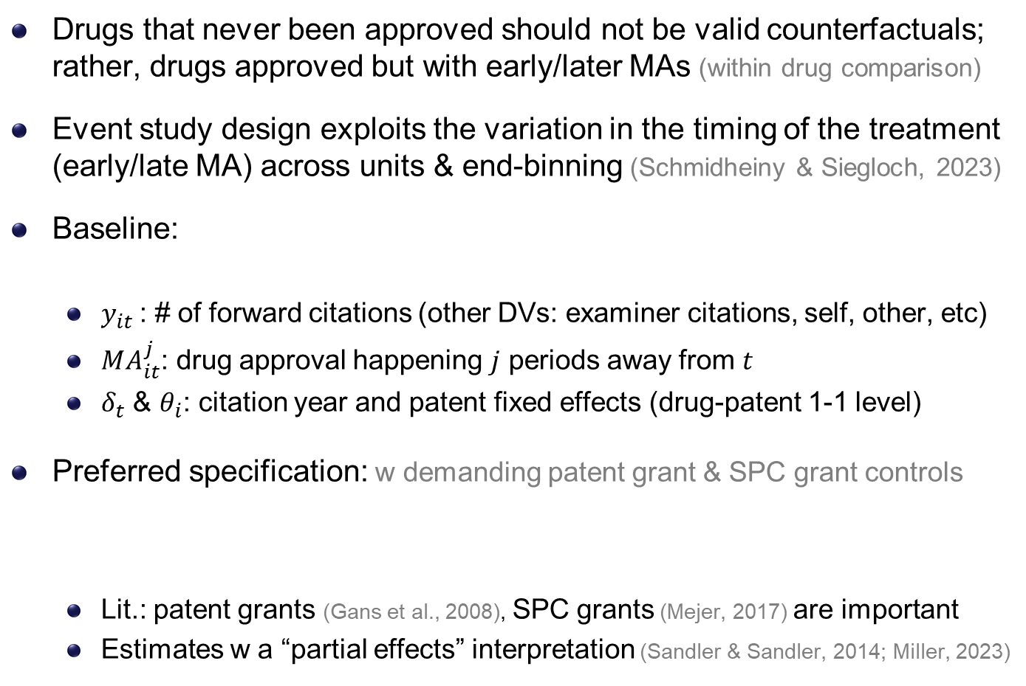
Empirical Strategy: Event Studies (à la S&S 2023)
Drugs that never been approved should not be valid counterfactuals; rather, drugs approved but with early/later MAs (within drug comparison)
Event study design exploits the variation in the timing of the treatment (early/late MA) across units & end-binning (Schmidheiny & Siegloch, 2023)
Baseline:
$y_{it}$: # of forward citations (other DVs: examiner citations, self, other, etc)
$MA_{it}^{j}$: drug approval happening $j$ periods away from $t$
$δ_{t}$ & $θ_{i}$: citation year and patent fixed effects (drug-patent 1-1 level)
Preferred specification: w demanding patent grant & SPC grant controls
Lit.: patent grants (Gans et al., 2008), SPC grants (Mejer, 2017) are important
Estimates w a “partial effects” interpretation (Sandler & Sandler, 2014; Miller, 2023)

Slide 12
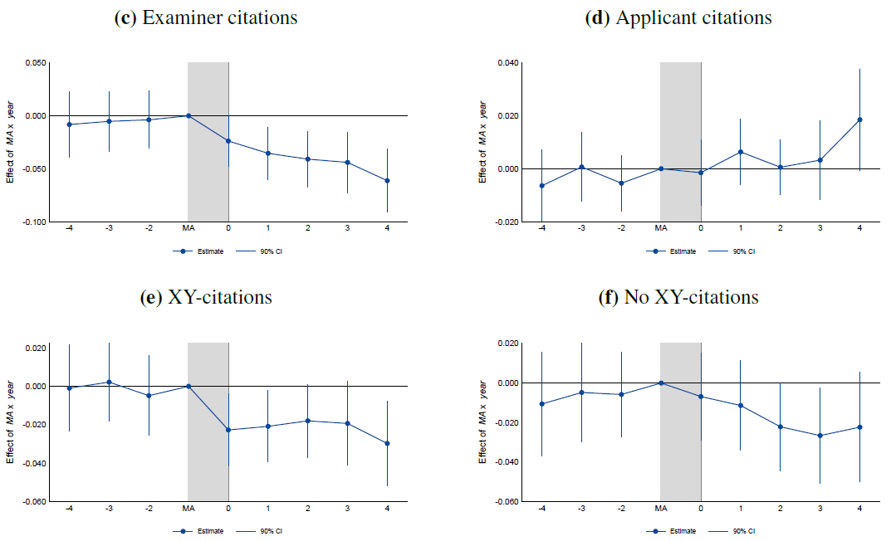
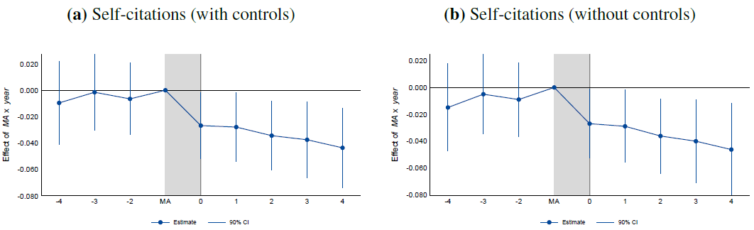
Marketing authorization & self-citations: by source/type
Self-citations added by examiners (high quality)
Self-citations added by applicants
XY-ref.: suggest legally “weak” patents as they increase the likelihood of a post-grant validity challenge (Wagner & Wakeman, 2016)
(X: a single prior patent doc can undermine the novelty/inventiveness of claimed invention; Y: do so in combination w/ other docs)
Controls: patent grant, SPC grant (eliminated uncertainty in obtaining them)
Similar patterns, then keep preferred specification (with controls) afterwards.

Slide 13
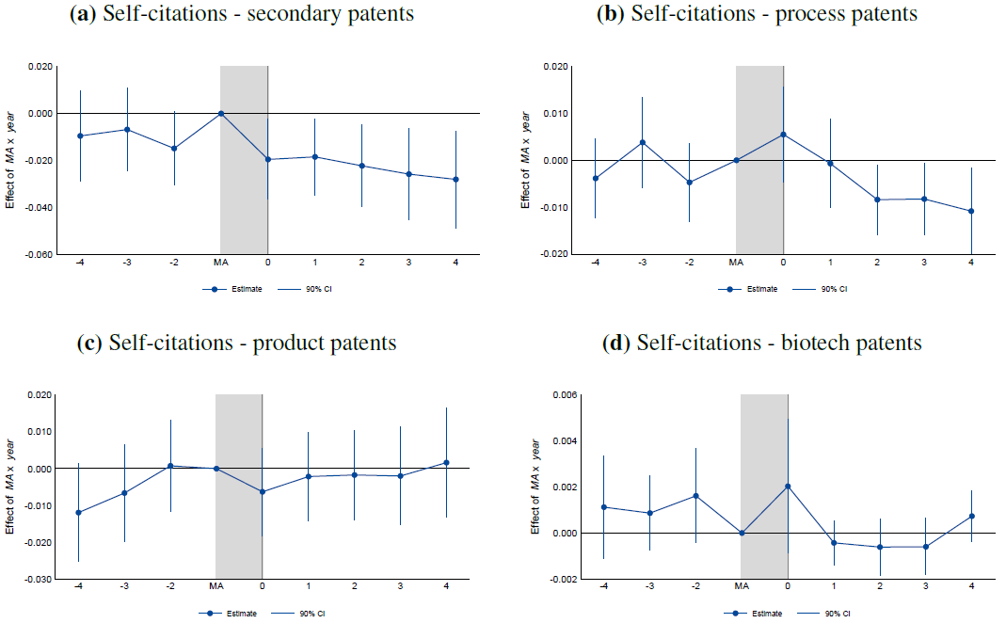
Market Authorization & self-citations: by type of patent
(e.g., new formulations, new dosage forms, new drug combinations, or new use)
(e.g., new manufacturing process)
(e.g., new products (derivatives), new macromolecule)
(e.g., biological product/process patents)

Slide 14
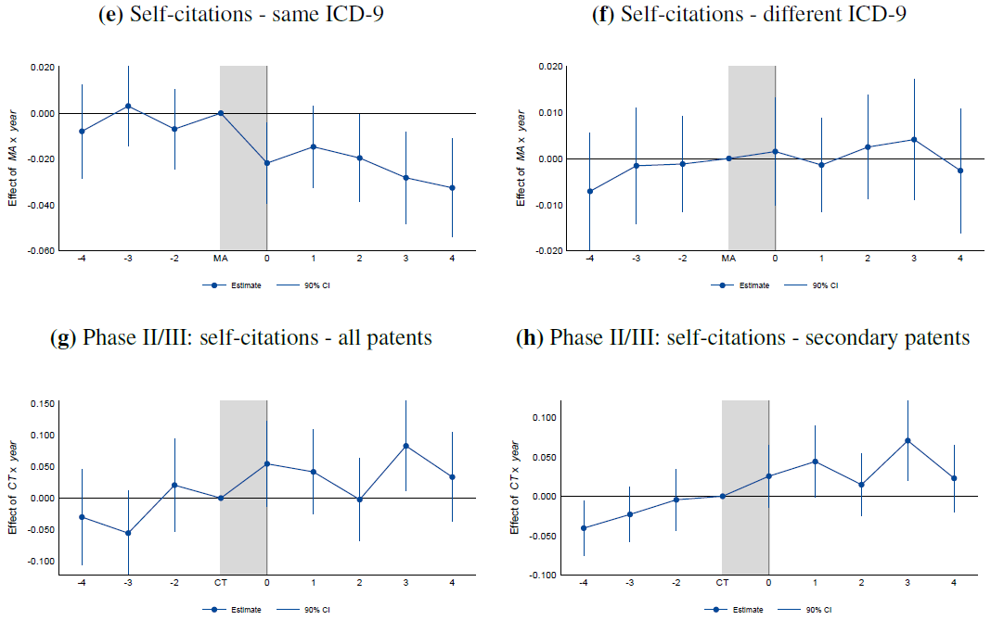
MA & self-citations: by disease; & placebo events
Same disease area/indication as approved drug
Explore new treatment options for a focal drug
Use end of phase II/start of phase III as a major milestone event to test the mechanism (disclosure/enforceability)

Slide 15
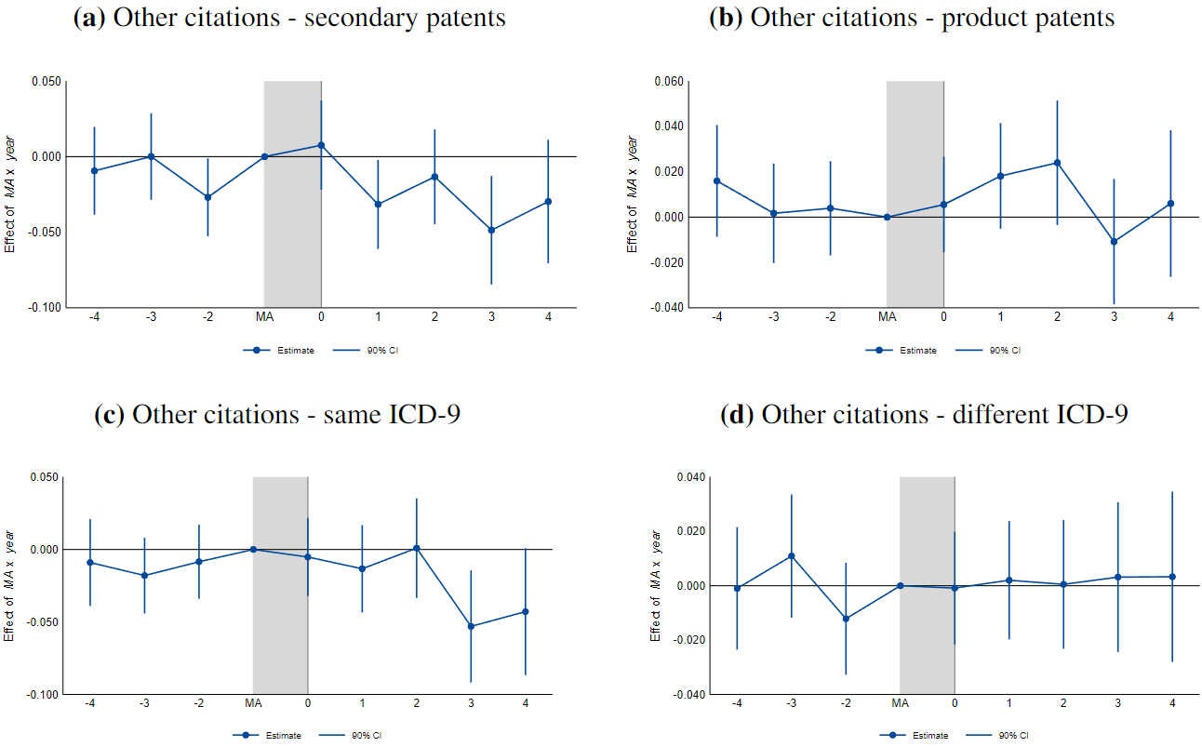
MA & other parties’ forward citations: big picture

Slide 16
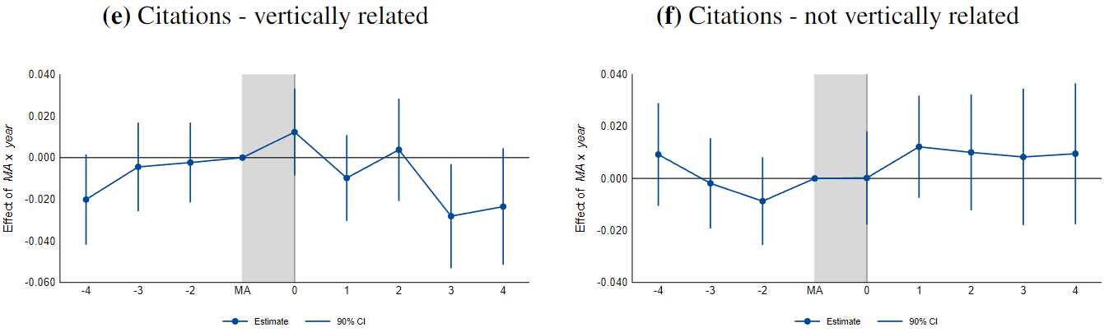
MA & other citations: by vertical relationship
The originator is likely to have several collaborators when developing an NME and executing clinical trials.
Follow-on patenting and innovation activities surrounding the focal drug are often conducted by different parties.
Generic firms file for a substantial number of secondary patents to protect their own exclusivity when generic entry happens (Howard, 2007)
(presumably vertically related via observed clinical collaboration)

Slide 17
Additional Analysis and Robustness Checks
To rule out alternative factors that might explain the decrease in forward citations due to drug approvals, such as
Market exclusivity & incentives for competitive entry:
Given the fixed primary patent term (20 years from filing), earlier MA -> longer market exclusivity, can + competitive entry & certain innovation
If early MA -> more competition -> incentive to file 2ndary patent, then we underestimate the magnitude of the net post-MA reduction in patenting
Strategy: Zoom in a subset with constant ME due to a kink in SPC regime
Unpredictable delays in approval: If more valuable drugs were approved earlier, this would introduce upward bias into our event study estimates
Strategy: instrumental variable approach (IV: time-to-phase I)
Field of application: whether effects are driven by unobserved differences in disease categories, as secondary patents are more relevant for some therapeutic areas, e.g., depressants (Abd et al., 2015)
Strategy: leave-one-out ICD-9 disease area specific analyses

Slide 18
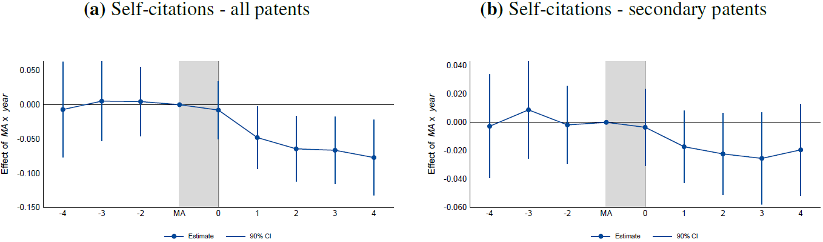
Market Exclusivity & Incentives for Competitive Entry
Strategy: exploit the discontinuity (kink) in market exclusivity extensions provided by the SPC system: uniform total ME (15 years) for focal inventions authorized 5-10 years from priority dates
Here ME is indept of the approval lag (constant incentives for competitive entry)
Results: robust to this restriction and some point estimates become slightly larger, supporting the notion that the true effects are larger
Some estimates are less precise given the drop of sample size
SPC fig

Slide 19
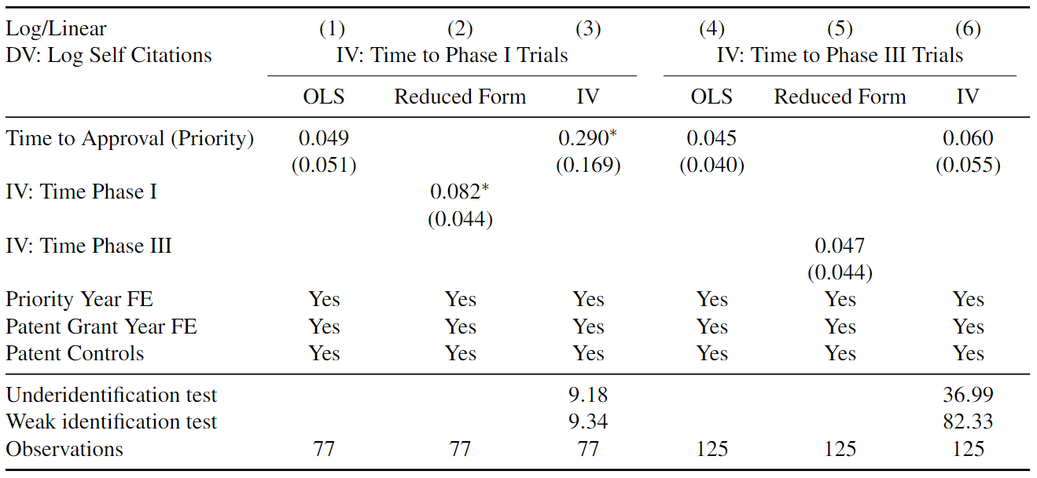
Unpredictable Delays in Approval: IV estimation
IV approach: time from patent filing to the beginning of phase 1 trial (IV) is the most random part able to predict the whole lag (à la Gilchrist 2016)
cross-sectional data using the total # of self-cites as Y, IV (file to 1st trial) for the time to approval; IV estimates > OLS (oppos. to the worry of upward bias)
Results suggest our event study estimates are conservative (likely l.b.)

Slide 20
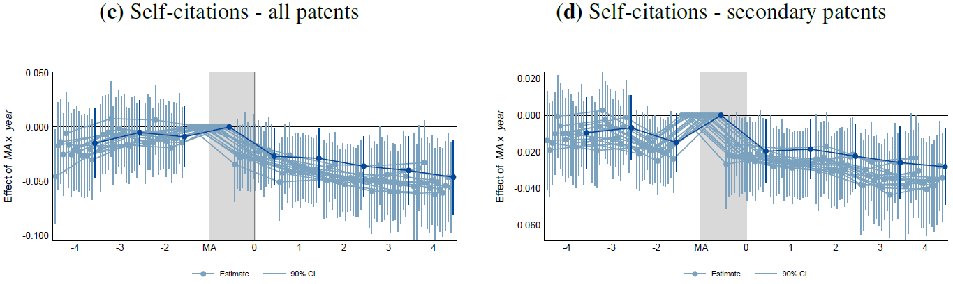
Field of Application: leave-one-out ICD-9 analysis
Concern: differences in unobservables can yield other dynamics not captured by patent-drug fixed effects
Strategy: estimate leave-one-out event studies separately for each of the 16 ICD-9 disease categories
Results & conclusion: similar patterns; strategic patenting behaviors are not driven by various incentives across drug types

Slide 21
Conclusion & Discussion
We find that strategic follow-on patenting decreases after a drug’s market authorization, when follow-on drug patents are harder to obtain
More reductions for less novel patents: secondary/process patents, patents target the same disease areas, by firms themselves & related parties
Not much change in meaningful follow-on patenting: product patents, patents target different disease areas, and biotech patents
Self-citation drops are most pronounced in high-quality citations: novelty-threating citations (XY citations) and examiner-added citations
Empirical test indicates enforcement channel (harder to achieve patentability/obtain enforceable patents for follow-on drugs)
Our results have implications to patentability standards: product market related info (prior art) disclosure raises the bar for subsequent novelty/ inventiveness, and can reduce marginal follow-on drug patents
Complementing “ex ante regulation” suggestions to give examiners more time (Frakes & Wasserman, 2023), regulatory data disclosure in the drug approval process can spur more valuable, enforceable patents

Slide 22
Backup slides

Slide 23
Literature and Contribution
Secondary patents: examine the relationship btw market authorization and follow-on patenting (of different types & by different parties)
(Lemley & Moore 2004; Amin & Kesselheim 2012; Sampat & Shadlen 2017; Hemphill & Sampat 2011; Frakes & Wasserman 2023; Gupta 2023)
Intellectual property institutions and follow-on innovation: leverage novel European institutional details and rich drug-patent dyadic data
(European Commission 2009; Hemphill & Sampat 2013; Sternitzke 2013; Galasso & Schankerman 2015; Gaessler et al. 2023; Sampat & Williams 2019)
Firm innovation strategies: how downstream product events intertwine with upstream patenting behaviors in a heavily regulated industry
(Acemoglu & Linn 2004; Arcidiacono et al 2013; Budish et al. 2015; Dubois et al 2015; Gaessler & Wagner 2020; Kyle & McGahan 2012; Wang 2022)
Policy implication: ex ante regulation, self-adjustment, & patent quality

Slide 24
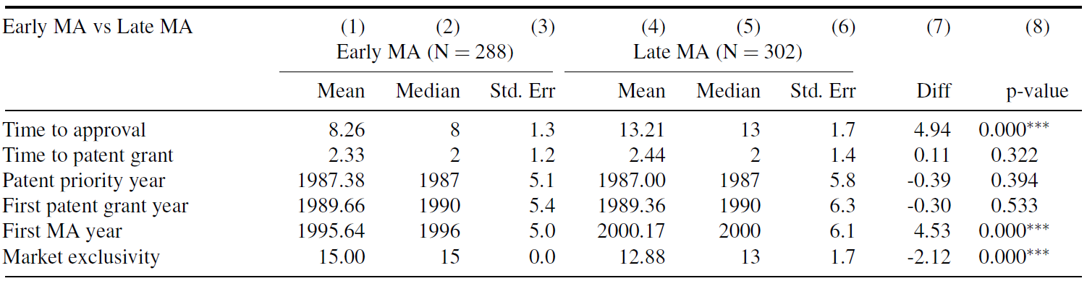
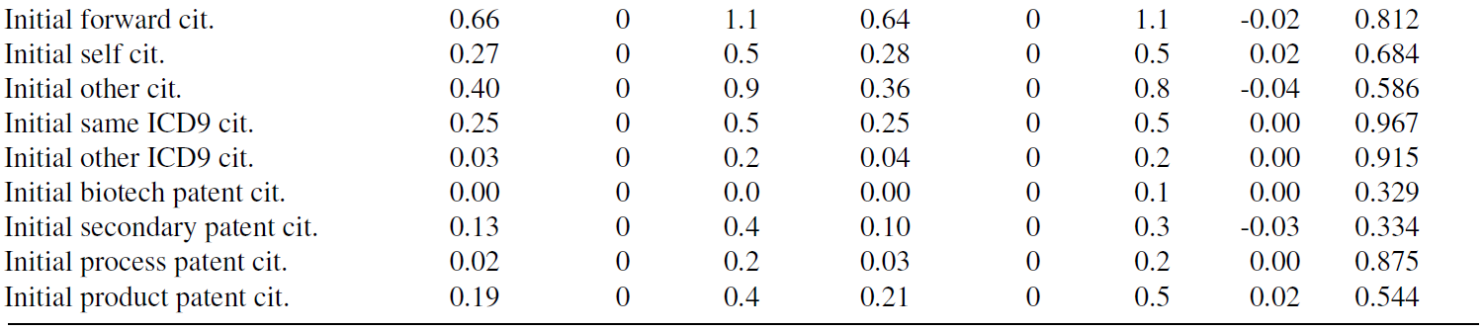
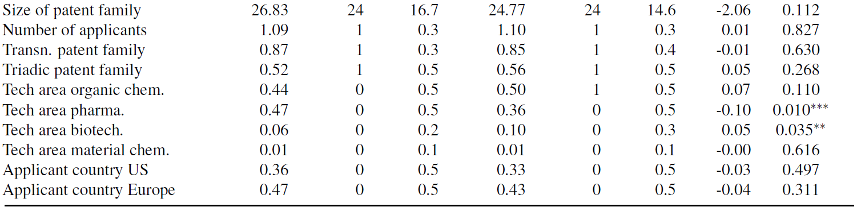
Similar Ex-Ante Drug & Patent Characteristics

Slide 25
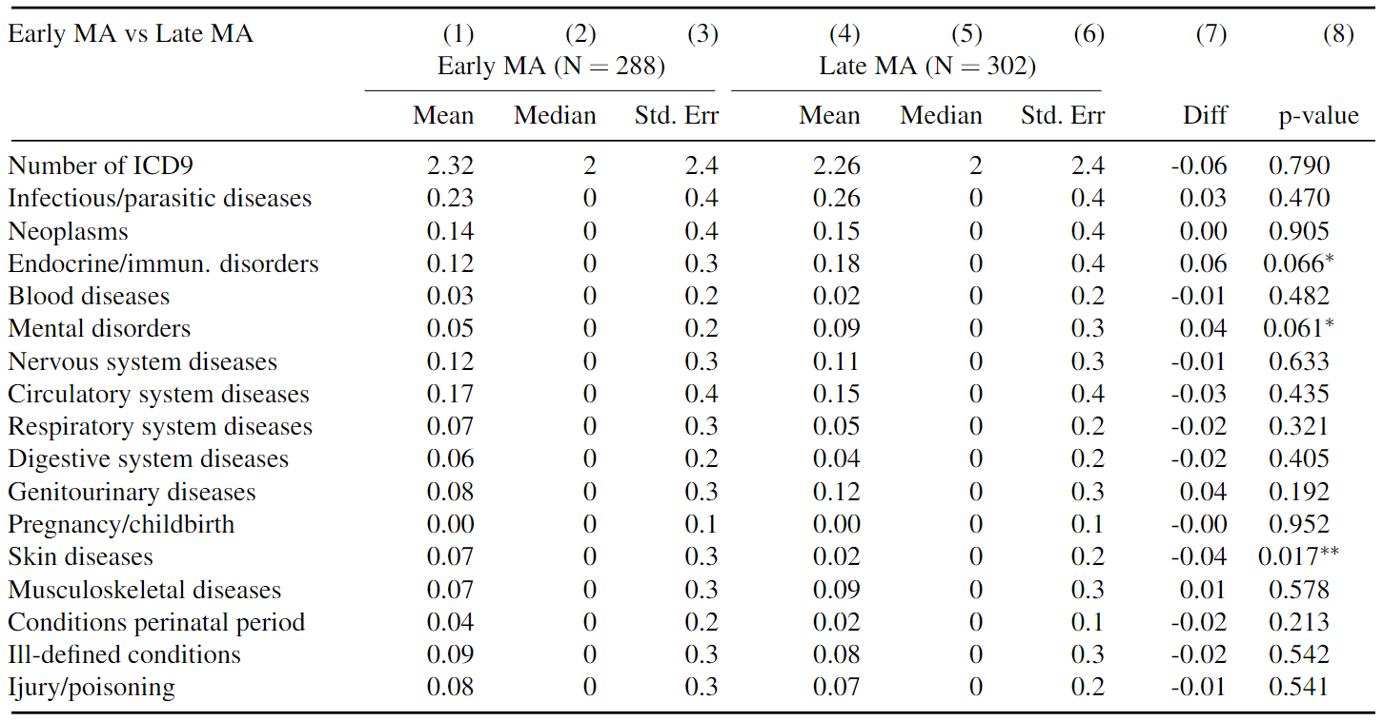
Mean comparison – similar disease characteristics
Similar early/late MA mean by ICD-9 categories (& leave-one-out analyses)
Small size diff in 1) early: endocrine/immun. & mental disorders; 2) *late: skin diseases
Notes:
Our primary patents do not fall into one ICD-9 disease category: congenital anomalies

Slide 26
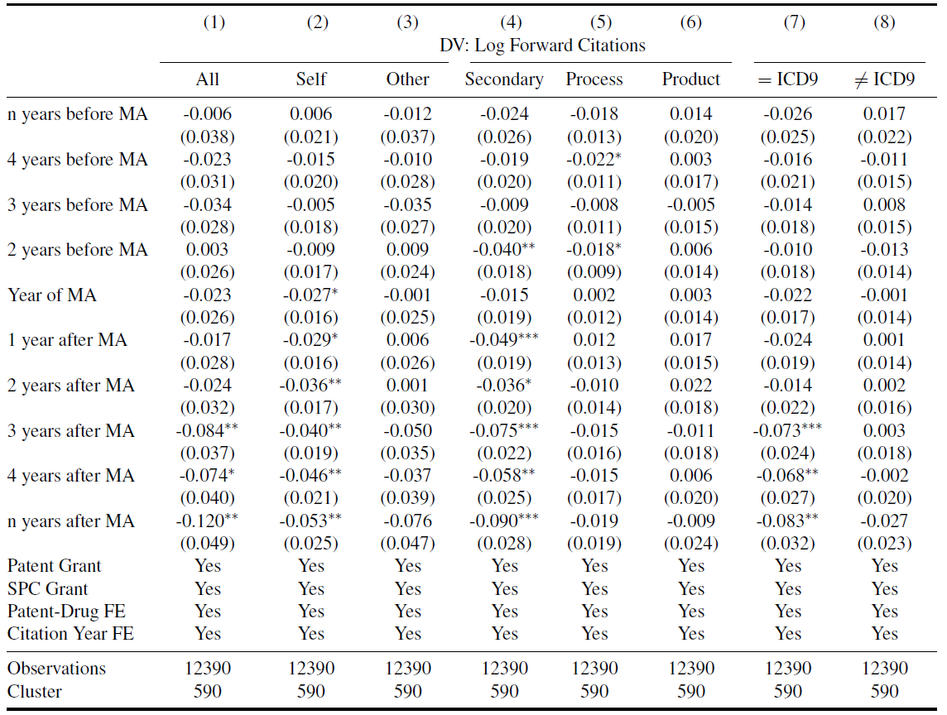
MA and forward citations: results summary

