Slide 1
Optimal Push, Pull, and Failure Funding for Global Health
David Ridley, Peng Sun, and Chenxi Xu
Fuqua School of Business, Duke University
Discussant: Lucy Xiaolu Wang
University of Massachusetts Amherst; MPI - innovation; CCHE
ASHEcon 2025.6.24

Slide 2

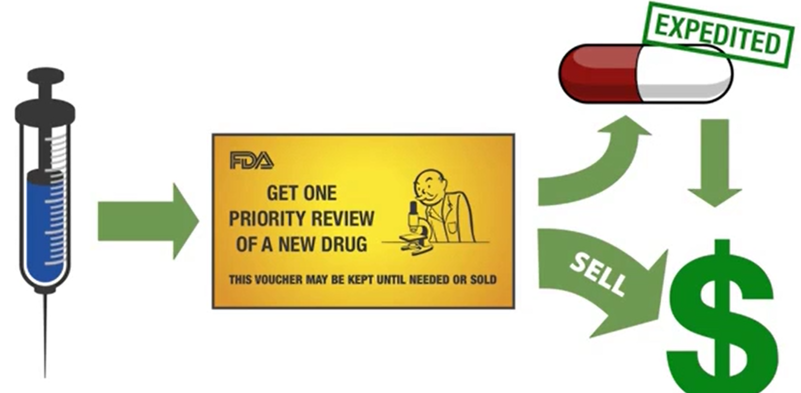
From the Parent of the Priority Review Voucher

Slide 3
Main message and contribution
Research question:
How should we use a mixture of push, push, and insurance (failure funding) to tackle different global health challenges?
Approach: principal-agent models with meaningful calibration
Max social welfare when mitigate adverse selection & moral hazard; econ+OR
Results: different optimal policies by {profit, consumer welfare}
Contribution: 1st study to model & calibrate the optimal mix of push, pull, and insurance (under adverse selection & moral hazard)
1st to show that reward only failure is optimal for drugs w medium $ value

Slide 4
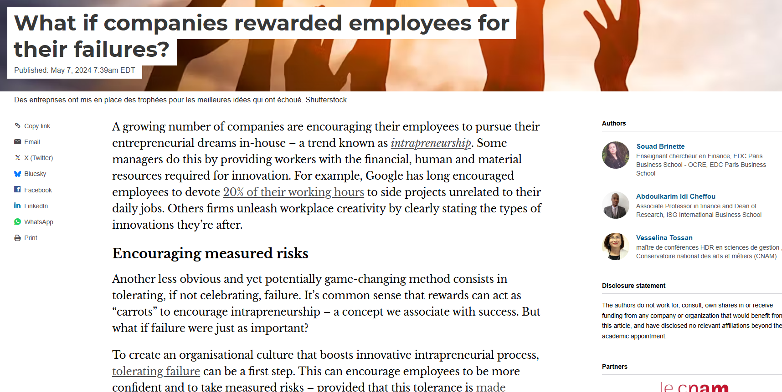
https://theconversation.com/what-if-companies-rewarded-employees-for-their-failures-229357

Slide 5
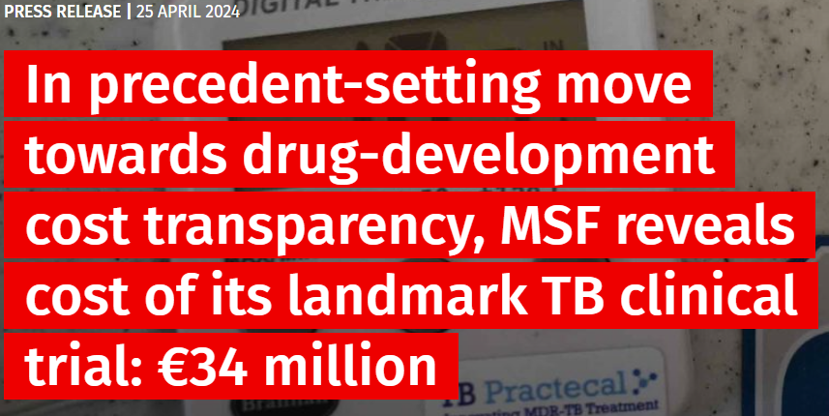
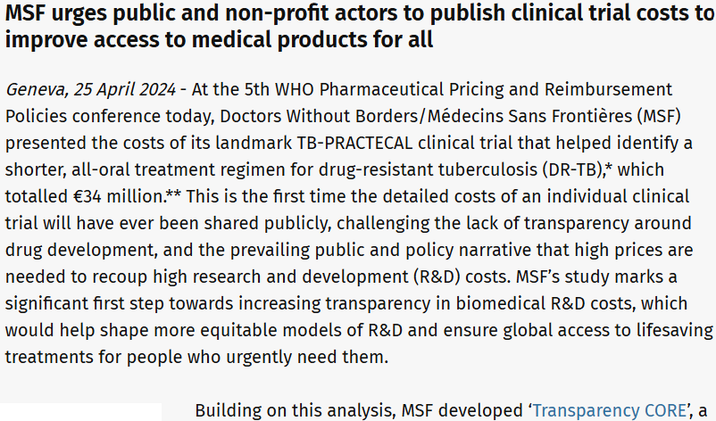
Clinical Trials Costs Transparency
Insurance design for failures: detailed trial costs can be valuable
Ideas: enforce better and more standardized clinical trial costs reporting under failure insurance (clear guidelines, ideally audited)
Accurate cost reporting can be made as a pre-requisite for receiving insurance

Slide 6
Ideas for Empirical Follow-ups
Observational tests associate current sub-optimality with outcomes?
Can we measure the current sub-optimality w disease-specific policies?
Ideas: (1) associate policy distance to optimality with R&D success rate over time and via a pooled scatter plot; (2) variations in new policies as quasi-experiments (e.g., new pulls, e.g., PRVs, absent of push changes)
Survey experiments among major funders and some recipients?
Failure funding (insurance) is v new & exciting, but hard to think about
Ideas: (1) Survey global health funders with vignettes that vary a candidate’s success probability and commercial value. (2) Ask them to choose among hypothetical funding mechanisms (push, pull, insurance). (3) Calculate how close their choices are aligned with model predictions. (4) Associate the distance with each funder’s success rate
(similar ideas for recipients, w/ variation in questions)

Slide 7
Minor suggestions
May be worthwhile to account for competition beyond HIV/AIDS
In an extension? Effective policy can induce competition among NTDs
How to deal with boundary cases?
For marginal cases in the border of two policy Rx regions, randomize?
Assume the take-it-or-leave-it contracts renegotiation proof?
Or would renegotiation be allowed, if firms updated private info as testing go, and the optional policy region may change as more precise info occurs?
Minor clarifications of values in Tables
Table 5, worth clarifying values reported, e.g., “Present value of profits for drugs are reported, rounded to the nearest $1 million”

Slide 8
Final thoughts
Very interesting topic, lots of fruit for thought
Key takeaway: a mix of (2/3) push, pull, and insurance (failure $) should be used to maximize global health policy impact.
Main thoughts: Great work, cool theory and policy Rx, and many promises for additional empirical/experimental tests.
Looking forward to see how this paper make a real impact!

