Slide 1
Institutional Innovation for Neglected Diseases: The Case of the Priority Review Voucher
Emma Dean¹ and Lucy Xiaolu Wang^{2,3,4}
¹ The Dartmouth Institute, Dartmouth College
² Dept of Resource Economics, University of Massachusetts Amherst
³ Max Planck Institute for Innovation and Competition
⁴ Canadian Centre for Health Economics
14th Annual Conference of the American Society of Health Economists
Nashville, TN 2025.6.24

Slide 2
Challenges of Incentivizing Innovation for LMIC
Innovation is critical to economic development, but R&D capacity is limited in low- and middle-income countries (LMICs)
Limited resources and capacity for R&D, but large disease burdens
Diseases prevalent in LMICs (e.g., neglected tropical diseases, NTDs) are increasingly relevant to high-income countries (HICs)
Push (can be insufficient) vs. Pull (may not be sustainable)
This paper: focus on a pull policy linking NTDs with US market
Q: How does the U.S. Priority Review Voucher (PRV) affect innovation activities in neglected disease (NTDs) globally?

Slide 3
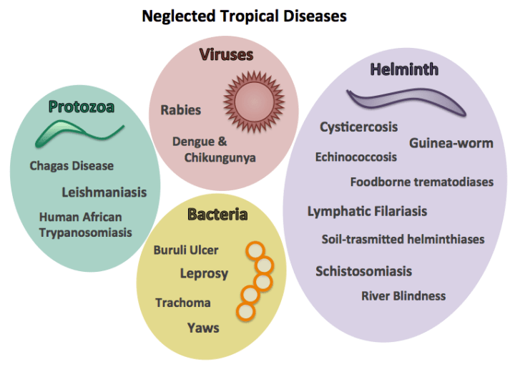
Disease setting: neglected tropical diseases (NTDs)
A diverse group of conditions caused by a variety of pathogens
Complex epidemiology, often related to environmental conditions
Annual: affect 1+ B people, ~200,000 deaths, 19M DALYS
Notes:
Mayo v. Prometheus (2012): adjust drug dosage based on metabolite levels – not patent-eligible;
Association for Molecular Pathology v. Myriad Genetics, Inc. (2013): naturally occur genes are not patent eligible.

Slide 4

Policy: the US Priority Review Voucher (PRV)
Eff. in 2007 (Ridley et al., 2006): a firm that obtains FDA approval for a designated NTD drug receives a PRV for priority review of another drug; can use or auction the PRV for $ ($100-350M)
16 PRV-eligible diseases on the 2007 initial list by Congress
Blinding trachoma, Buruli ulcer, Cholera, Dengue, Dracunculiasis, Fascioliasis, Human African trypanosomiasis, Leishmaniasis, Leprosy, Lymphatic filariasis, Malaria, Onchocerciasis, Schistosomiasis, Soil transmitted helminthiasis, Tuberculosis, Yaws
8 addition in later years (by 2019) by Congress or FDA(*)
2014 Filoviruses/Ebola; 2015 Chagas*, Neurocysticercosis*; 2016 Zika;
2018* Chikungunya virus disease, Cryptococcal meningitis, Lassa fever, Rabies
Ex ante: unclear whether PRV can effectively spur NTD R&D

Slide 5




Data Construction
PRV eligibility dates: 2007-2019
PRV-eligible diseases and dates added to the list (by Congress or FDA)
Source: https://priorityreviewvoucher.org/eligibility/index.html & FDA sites
G-FINDER survey data: Policy Cures Research’s Global Funding of Innovation for Neglected Diseases (G-FINDER) survey, 2007-2019
Annual data on global funding into R&D for NTD from various sources
WHO Intl. Clinical Trials Registry Platform (WHO ICTRP), 2000-2019
Sourced from various national clinical trials registries across the globe
Searched by each PRV-eligible conditions, then extensive RA check by trial
Clarivate Analytics’ Cortellis Clinical trials Data: supplementary data
World Development Indicators, etc: country income levels and controls
Sample: exploratory analysis with G-Finder 2007-2019 and disease-year panel level clinical trials (by income, phase, drugs, $-value) in 2000-2019

Slide 6
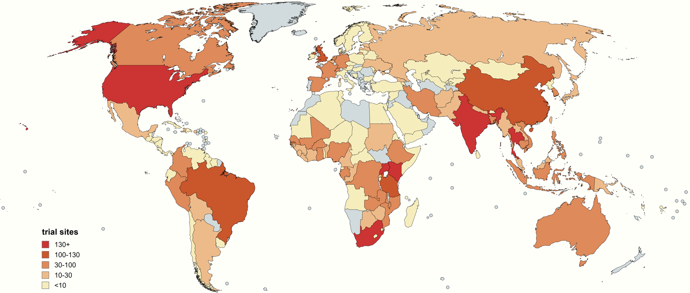
Geographic distribution by clinical trial site locations
If a trial has multiple main clinical sites across countries, each country is counted once.

Slide 7
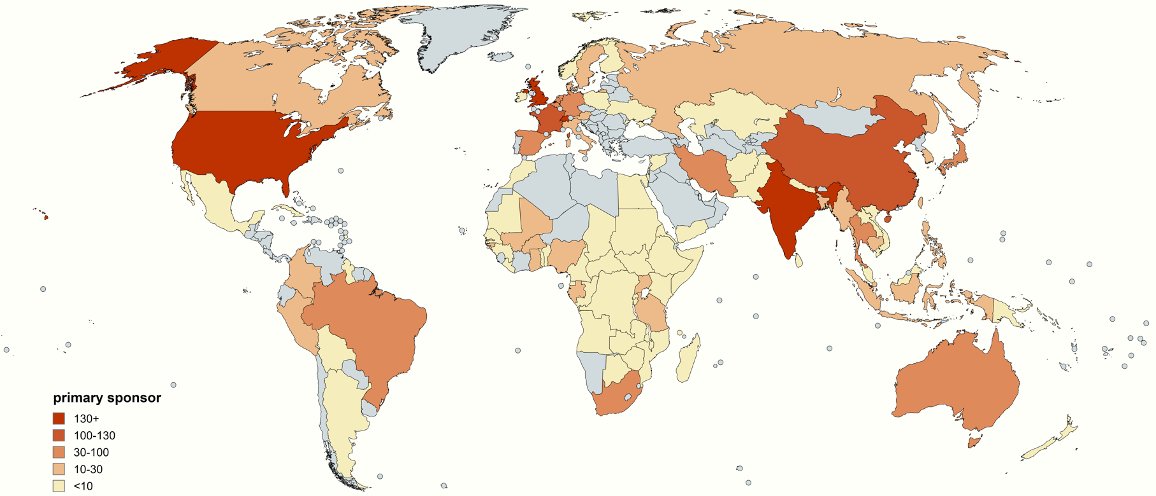
Geographic distribution by primary sponsor locations
The primary sponsor location is usually tied with a unique major sponsor, with a few cases where two equally important primary sponsors are designated and counted.

Slide 8
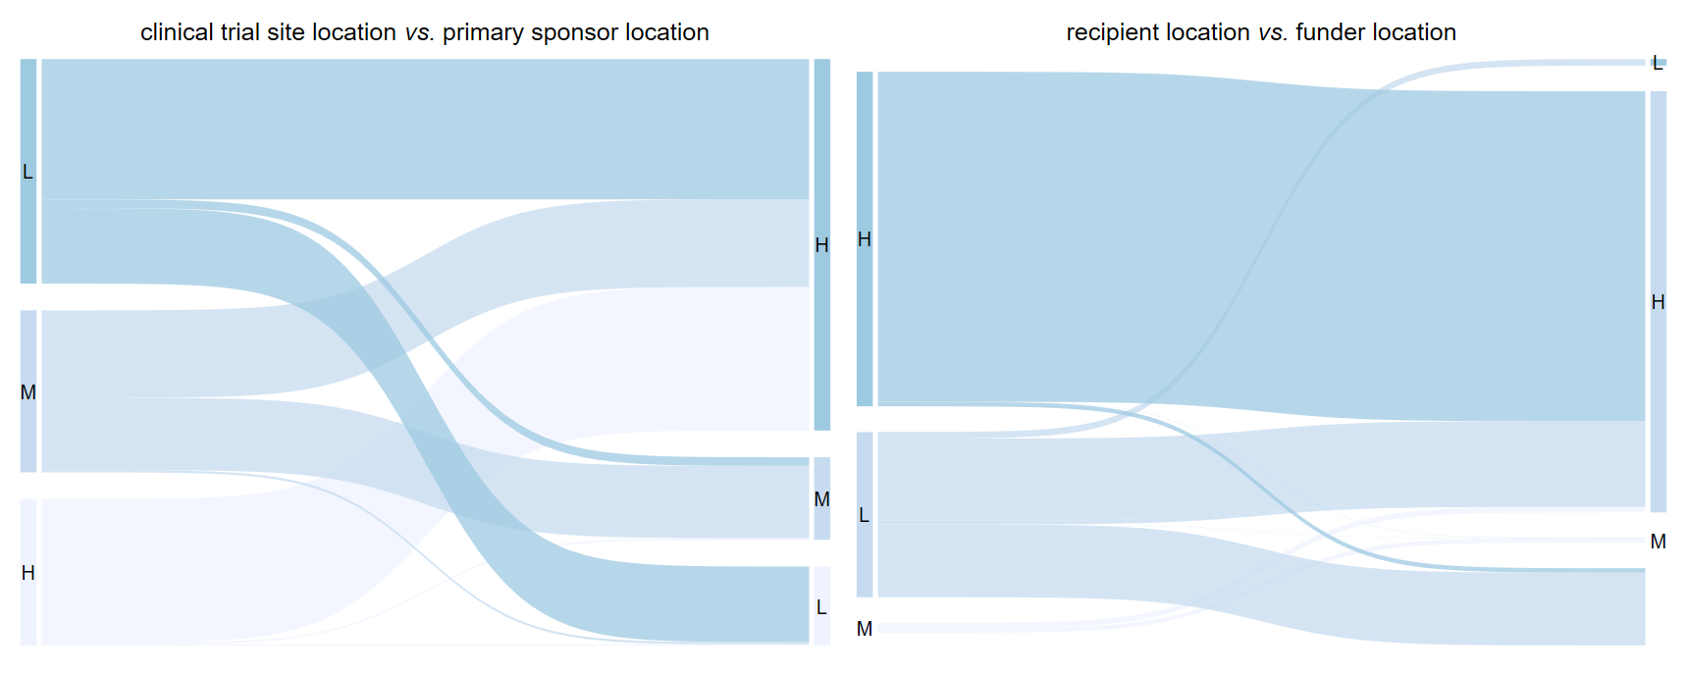
Sankey plots on NTD clinical trials & funding flows
by institution type
Notes:
Median time-to-approval in our sample: 10 years

Slide 9
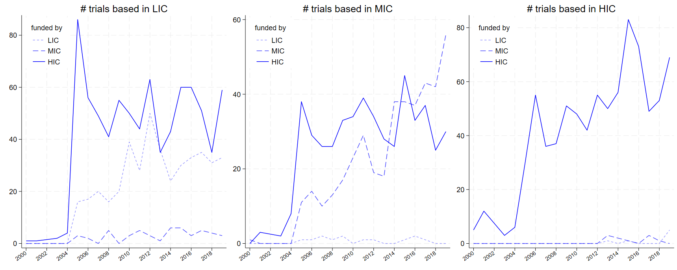
Trends of PRV-relevant trials by site-funder pairs
trend in total grant $

Slide 10
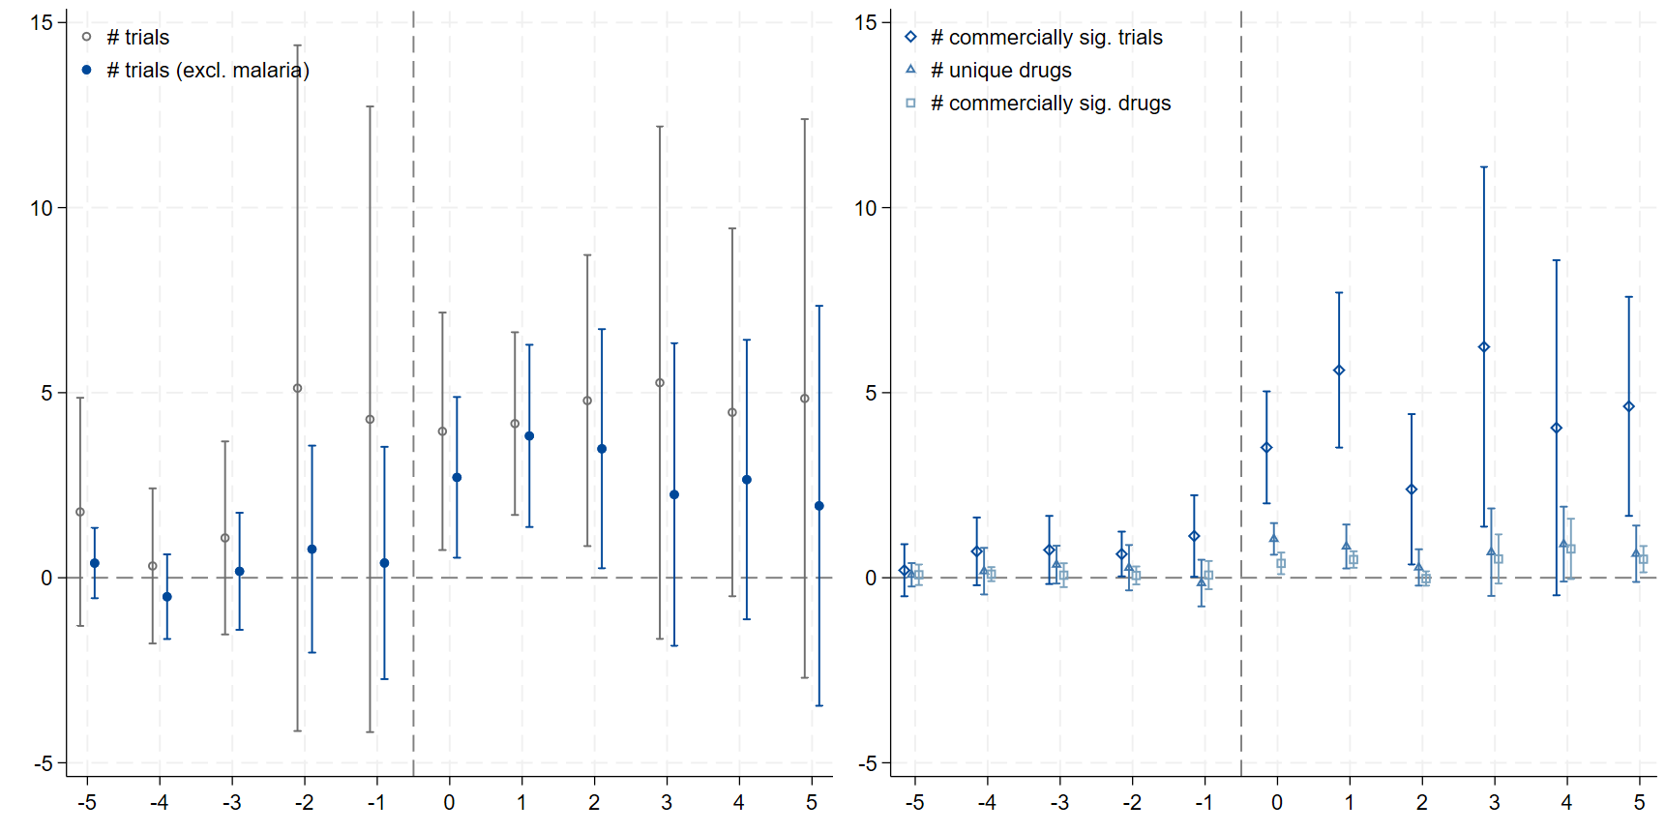
Empirical Methods and Main Results
Exploit the staggered inclusion of PRV-eligible conditions
Condition-year level panel analysis, # trials and by stratified trials
Staggered event studies & DiD w/ imputation (à la Borusyak et al., 2024)

Slide 11
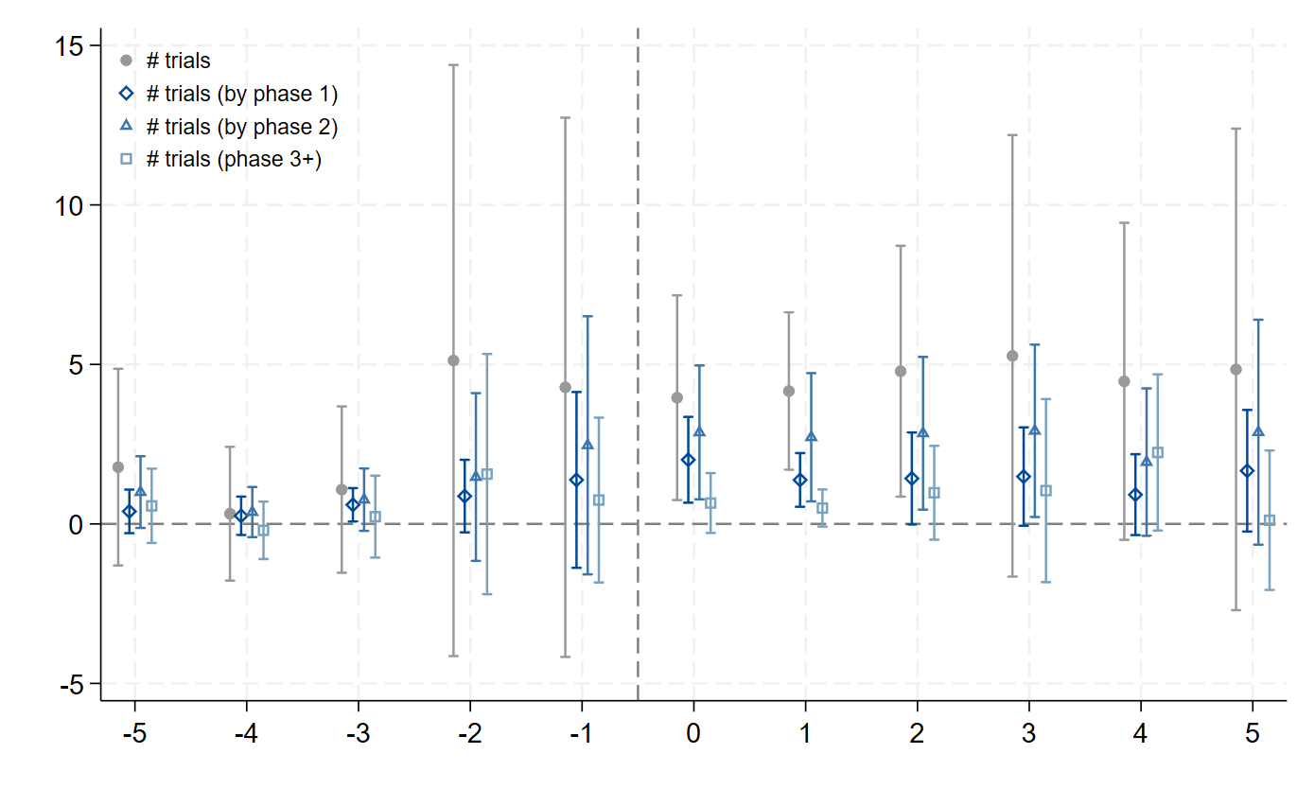
PRV inclusion and new clinical trials by phase

Slide 12
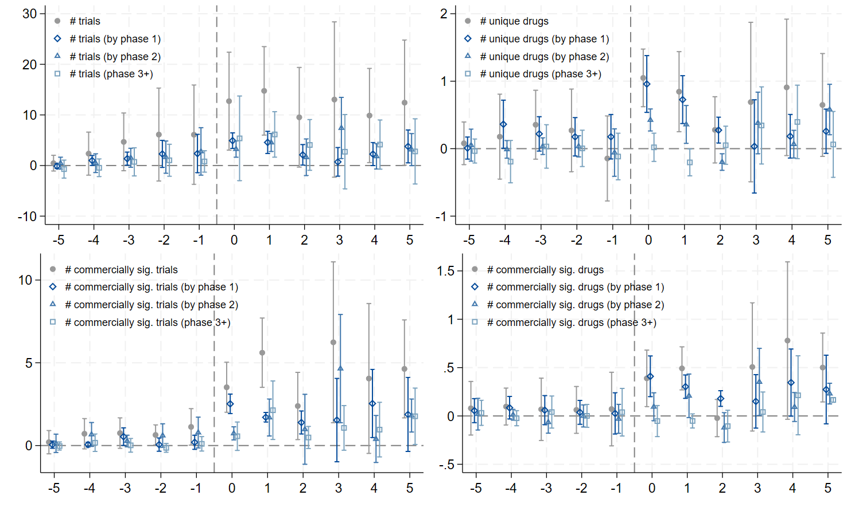
PRV addition on trials & unique drugs (Cortellis)

Slide 13
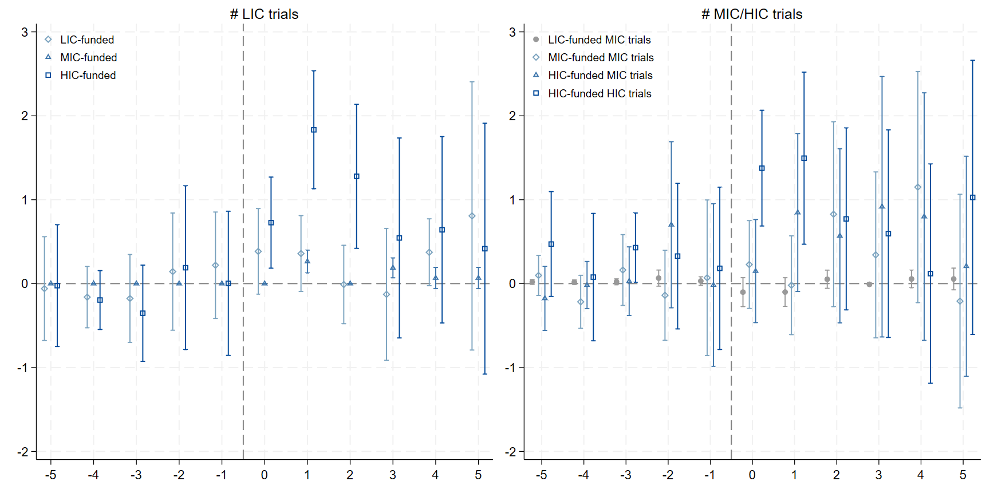
# trials, by site and funder country income group

Slide 14
Conclusion & Discussion
We find meaningful but limited increase in trials after PRV addition
More trial initiations, esp. commercially significant trials, unique drugs
Concentrated among HIC sponsors, in LICs and HICs, and early-stage
Late-stage trial increases are increased in limited subsamples
Consistent w/ case studies (e.g., bedaquiline) that extra help is needed
Policy implication: PRV is a novel design w promises & boundary
Good impact & address concerns on geo relevant & regulatory gaming
But limited in supporting complete therapeutic development
Need mixture of policy interventions (push, pull, and insurance?)
See Ridley, Sun, Xu (2025 WP) “Optimal push, pull, and failure funding for global health”

Slide 15

Emma Dean (The Dartmouth Institute), Lucy Xiaolu Wang (UMass Amherst; MPI; CCHE)
Emails: Emma.C.B.Dean@dartmouth.edu, xiaoluwang@umass.edu

Slide 17
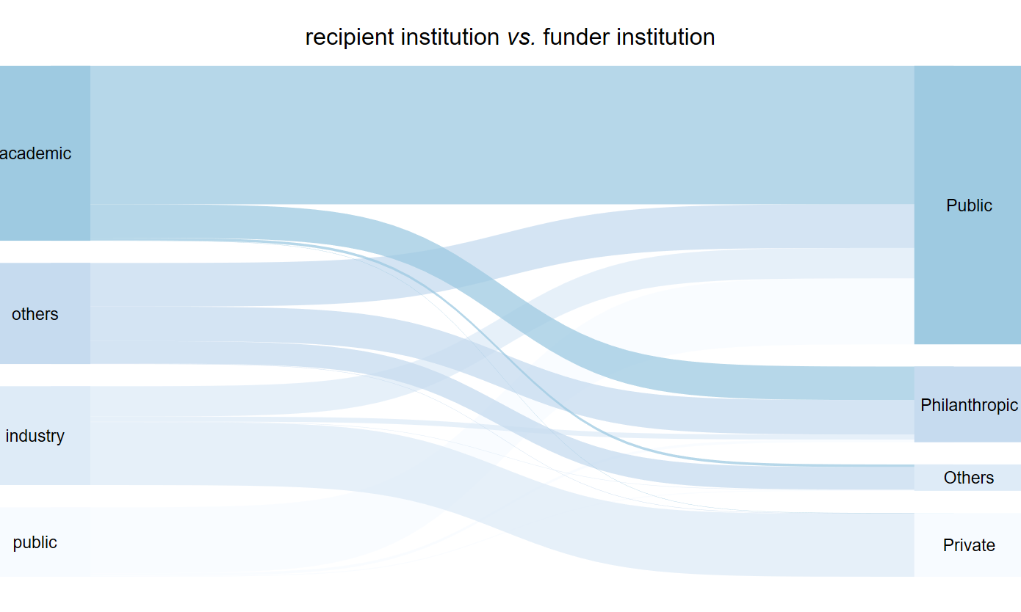
Sankey plot on funding flow by institution types
back

Slide 18
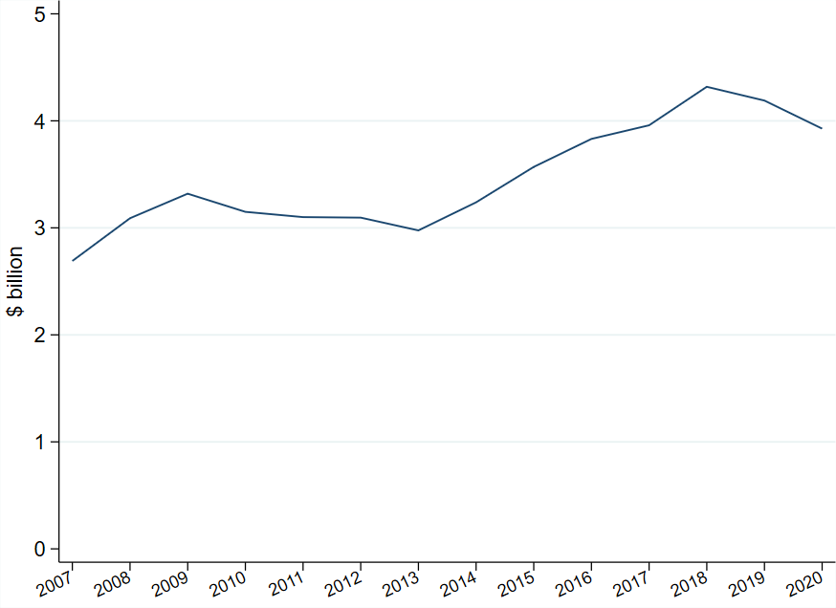
Trend in total grant money (G-Finder data)
back

