Slide 1
Megaprojects, Digital Platforms, & Productivity: Evidence from the Human Brain Project
Ann-Christin Kreyer¹ and Lucy Xiaolu Wang^{2,1,3}
¹ Max Planck Institute for Innovation and Competition
² University of Massachusetts Amherst
³ Canadian Centre for Health Economics
ASHEcon 2024, San Diego, 2024.6.17

Slide 2

Productivity slowdown, institutions, and rising AI
Declining productivity in (biomedical) science & increasing challenge to reach the knowledge frontier (Jones 2009; Bloom et al. 2020)
Important to create non-market incentives to accelerate long-term, large-scale R&D in multi-disciplinary research
Particularly relevant & urgent for advancing neurosciences
Leading causes of death/disability, expensive treatment, lack of cure
AI showed potential in life science & gained rising interests. But integrating AI with lab science is not always natural/easy
This paper: how does a ten-year megaproject affect AI-brain sciences?

Slide 3
This paper: the Human Brain Project (HBP)
EU’s “Future & Emerging Technology Flagship” project
10-year (2013.10-2023.9), €1B megaproject, ramp-up & 3 main phases
Goal: advance brain science with computational tools (e.g., AI platforms)
Build digital platforms & give grants; public/private access areas to resources within project infrastructure
Broad areas: study the brain (empirical data, brain simulation, ML); apply the knowledge (medical applications); sharing data, tools & resources (build digital research infrastructure)
Ramp-up Phase (€ 54M)
112 HBP Core Partners
Phase 1 (€ 89M)
117 HBP Core Partners
Phase 2 (€ 88M)
130 HBP Core Partners
Phase 3 (€ 150M)
120 HBP Core Partners
2013.10
2016.3
2018.3
2020.3
2023.9
2016: digital
platform operational
2018: transition to EBRAINS
2014-2015: HBP revamp
Notes:
One half goes directly to universities and the other half goes to infrastructure building

Slide 4
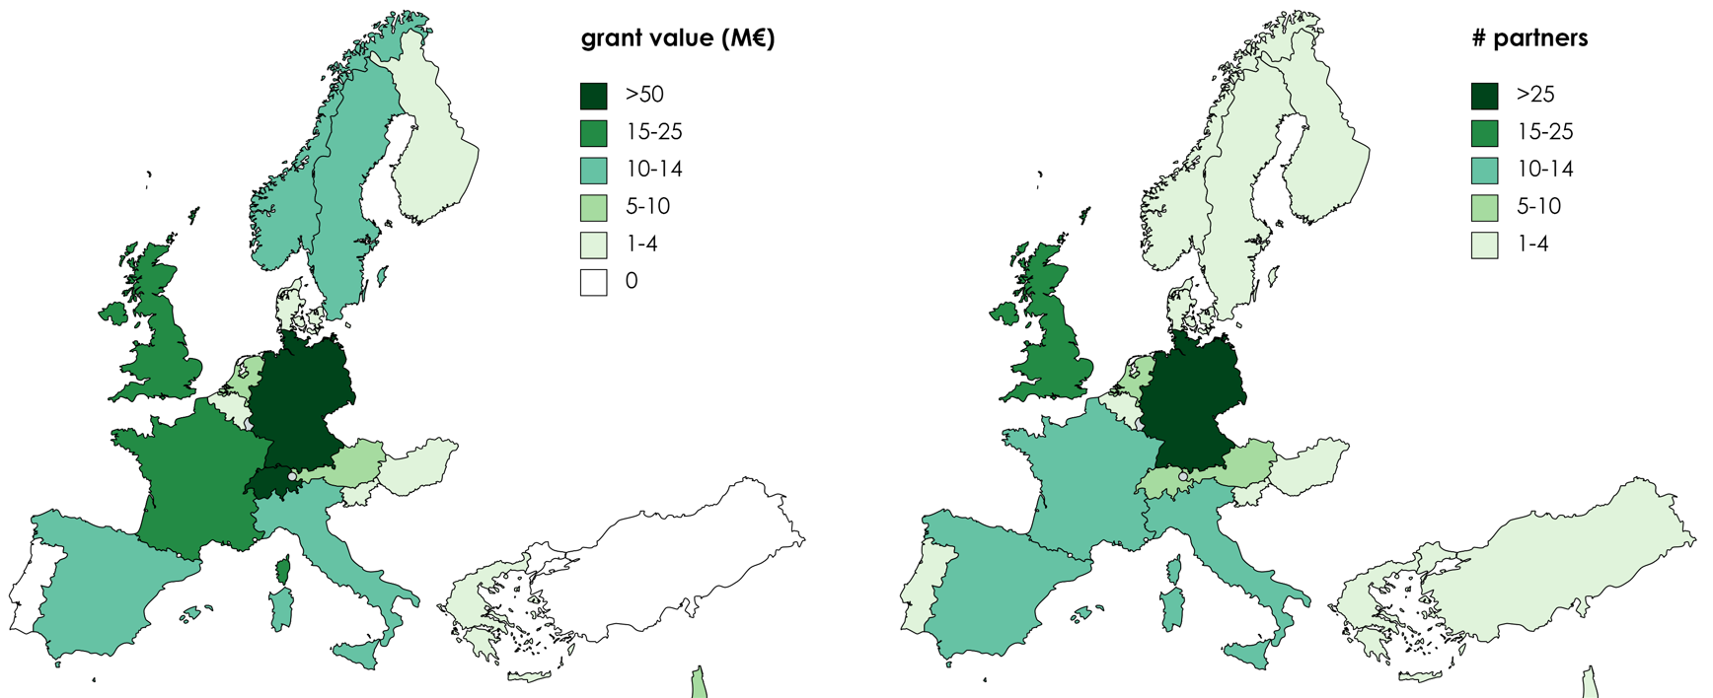
HBP overview: geographic distribution of partners
By the end of phase 2 (2020.3.31): 130 partners in 19 countries
Note: Authors’ graph. 5 countries only participated in phase 0 are excluded (# partners, €): Canada (1), China (1, 187.5k €),Cyprus (1, 106.2k €), Japan (2), United States (4)

Slide 5
Research Question:
Q: How does the HBP affect the rate and direction of R&D in neuroscience research (publications)?
Intuitively, productivity can go different ways (an empirical Q):
More: “Time to explore new areas and expand the network!”
Less: “Time to take more risks and invest in new yet slower areas!”
Similar: “Time to change $ source, but I still only have 24 hours/day!”
Document the progress and development in the HBP (phases 0-2)
Do researchers actively engaged in the HBP produce more, higher-quality, and/or more interdisciplinary work?
How does the impact of HBP differ across researchers’ career stage, gender, and sub-fields within neuroscience and computer sciences?
Notes:
Less pubs bc (1) adjustment time to learn new knowledge , (2) multidisciplinary teams require more coordination Systematically capturing brain simulation and other topics w/ pubs as immediately shareable knowledge

Slide 6
Conceptual Considerations
Innovation gets harder with the expanding knowledge frontier
Need large research teams w/ complementary skills (Jones 2009)
More resources and knowledge recombination cross-fields
But large teams can be inefficient & non-creative
Moral hazard with credit sharing (Che & Yoo 2001)
Most innovation projects are risky, unpredictable, long-term
Large spillover effects from public R&D and long-term projects (Williams 2013; Myers & Lanahan 2022),
but firms/grants underinvestment in long-term projects (Azoulay et al. 2011; Budish et al. 2015)
Megaprojects are on the rise in numbers & controversy
… often involve infrastructure building, large teams, long term; many underperform (Denicol et al. 2020)
Notes:
Large teams develop while small teams disrupt

Slide 7
Data: Institutions, individuals, and publications
Individuals: details on 639 active individuals (phases 0-2)
HBP involvement (phase active, role), demographic info (gender, affiliation, seniority), research field, highest degree areas, Scopus ID
Publications and citations: Scopus
Publication history of individuals, N=39,524 (2008-2022)
Core project partners: details on 173 core project partners by phase 3
Department/unit involved, timing of engagement, grants
Phase-specific data: funding amounts, reports, and deliverables
Sources: HBP websites and YouTube channels, deliverables and reports, framework partnership agreements and amendments, Community Research and Development Information Service (CORDIS, European Commission maintained EU research results), HBP PLUS, search on Google Scholar, LinkedIn, and individual/institution websites
HBP partner structure
Notes:
We have collected all this information, a large share manually, and tried different angles but have not used all data that is shown here yet. So, we are thankful for any suggestions

Slide 8
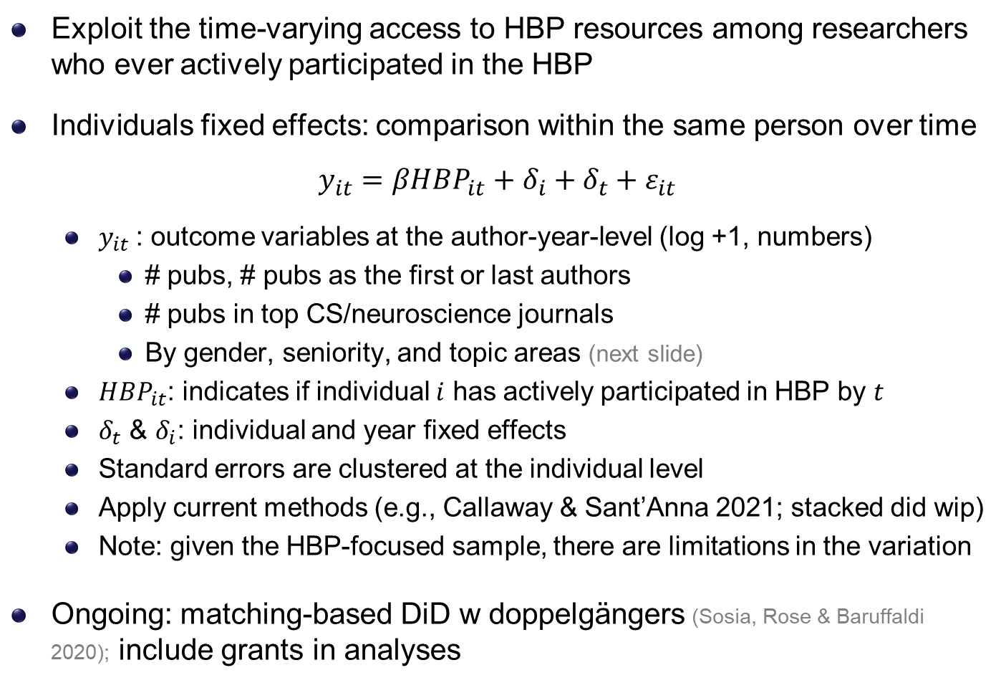
Empirical Strategy: staggered Diff-in-Diff (DiD)
Exploit the time-varying access to HBP resources among researchers who ever actively participated in the HBP
Individuals fixed effects: comparison within the same person over time
$$y_{it}=βHBP_{it}+δ_{i}+δ_{t}+ε_{it}$$
$y_{it}$: outcome variables at the author-year-level (log +1, numbers)
# pubs, # pubs as the first or last authors
# pubs in top CS/neuroscience journals
By gender, seniority, and topic areas (next slide)
$HBP_{it}$: indicates if individual $i$ has actively participated in HBP by $t$
$δ_{t}$ & $δ_{i}$: individual and year fixed effects
Standard errors are clustered at the individual level
Apply current methods (e.g., Callaway & Sant’Anna 2021; stacked did wip)
Note: given the HBP-focused sample, there are limitations in the variation
Ongoing: matching-based DiD w doppelgängers (Sosia, Rose & Baruffaldi 2020); include grants in analyses
mDiD
Notes:
Lag in pubs:
the fields we are talking about are very fast (you will see that later, 4 pubs per year on averge)
Lags would underestimate the effect
We are doing the standard approach of the literature
No additional controls for the benchmark model b/c new DID lit cautions against additional controls as they may be affected by the policy -> standard strategy is not to control any X but do so later in robustness checks
Pub-level: we want to know how individuals are affected and thus what the direct effect of such a project is
- Inidviduals w/ more pubs get more weights in estimation results and we would not want that

Slide 9
Matching-based DiD
Employ mDiD methods using propensity score matching to create control group (Hainmueller,2012; Hainmueller & Xu, 2013)
List of observable characteristics used in sosia-identified Scopus-“doppelgänger” with the following similarity parameters:
first_year: the year of the first recorded publication (+/- 5 years)
#co-authors, #publications, #citations (up to the year of treatment)
Another researcher is similar if her characteristics fall within the margin around the original’s characteristics. If all characteristics are similar, and the other researcher is not a co-author, she is deemed a match
(default margins: 2 for year of 1st pub, 20% for other three #s)
In progress; we then use different methods to restraint the control group (e.g., geo-location, main fields of publication, gender, /random…)
We search for matches in each 5 years before the treatment (2009-2012) & relaxed the margins to 30% (can relax further if no matches)
Caveat: very computationally intensive (even on high-performance server) as the search goes through the entire Scopus database

Slide 10
Measuring direction: paper topic classifications
Publication counts may not capture nuances in novelty/disruptiveness nor direction. Impactful interdisciplinary work may have limited initial citations, then with exponential growth in citations later (Wang et al. 2015)
Use neural, prompt-based, LLMs (GPT3.5turbo/4) to classify topics
Significant advantage in few-shot classification tasks (Brown et al. 2020; Chae & Davidson 2023; Clavie et al. 2023; Korinek 2023; Loukas et al. 2023; Stathoulopoulos 2023)
Provide task prompt & 31 keywords for probabilistic assignment and grouping them into four upper-level topics:
Fundamental neuroscience and neurobiology (“neurobiology”)
e.g., behavioral neuroscience; cellular neuroscience; clinical neuroscience
Neurotechnology, simulation, and computational tools (“neurotechnology”)
e.g., SpiNNaker; brain simulation; cognitive architecture; computational biology
Artificial intelligence and robotics (“ai-robotics”)
e.g., artificial intelligence; machine learning; neurorobotics
Clinical applications, treatment, and care management (“clinical research”)
e.g., brain atlas; clinical trial; management; medical device; neuroethics
Notes:
the probabilities we measure are used as 0/1 and not as probabilities themselves
If asked: After mDiD we want to rerun GPT adding category „Other“

Slide 11
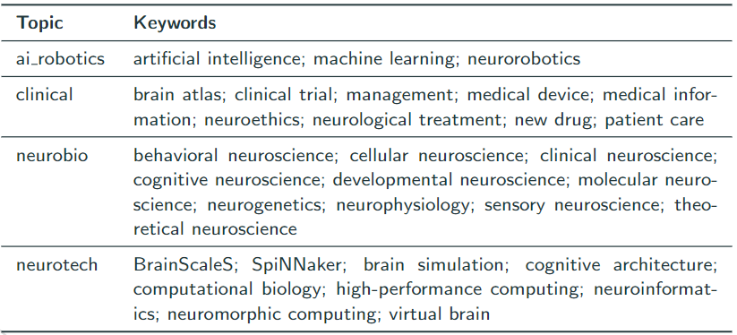
GPT-3.5turbo/GPT4 prompt & keywords
The model assigns weights to each keyword for every abstract-title combination, w/ cumulative weights per article sum up to one
Ex: (“cognitive neuroscience”: 0.4, “virtual reality”: 0.3, “neuroethics”: 0.15, “behavioral neuroscience”: 0.15); we then aggregate to topics
Example of a prompt:
Here's the paper's title and abstract:
Title: Navigating virtual reality by thought: What is it like?
Abstract: We have set up a brain-computer interface (BCI) to be used as an input device to a highly immersive virtual reality CAVE-like system. We have carried out two navigation experiments: three subjects were required to rotate in a virtual bar room by imagining left or right hand movement, and to walk along a single axis in a virtual street by imagining foot or hand movement. In this paper we focus on the subjective experience of navigating virtual reality "by thought," and on the interrelations between BCI and presence.
The list of possible topics is:
brain atlas
medical information
neurological treatment
… [omit here for simplicity]
Classify the topic of the paper. Output in the following format with topics and corresponding weights that sum to 1:
{"topic 1": weight 1,
"topic 2": weight 2,
...
"topic n": weight n}
Response to the prompt:
{"artificial intelligence": 0.2,
"cognitive neuroscience": 0.3,
"neuroinformatics": 0.2,
"virtual brain": 0.3}

Slide 12
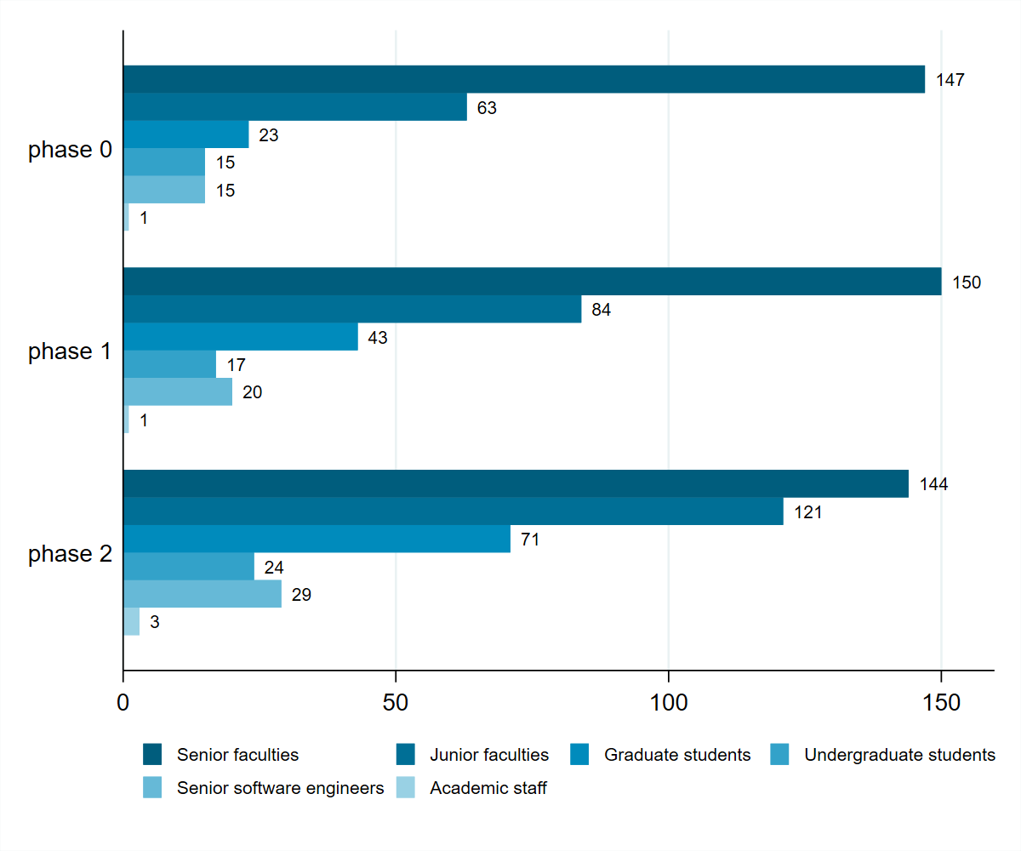
Descriptive: participants by phase & seniority level
Notes:
Manually collected!

Slide 13
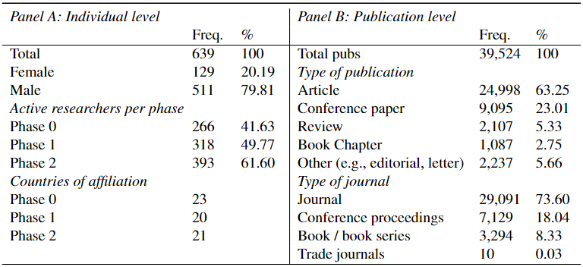
Summary statistics: unique individuals & papers

Slide 14
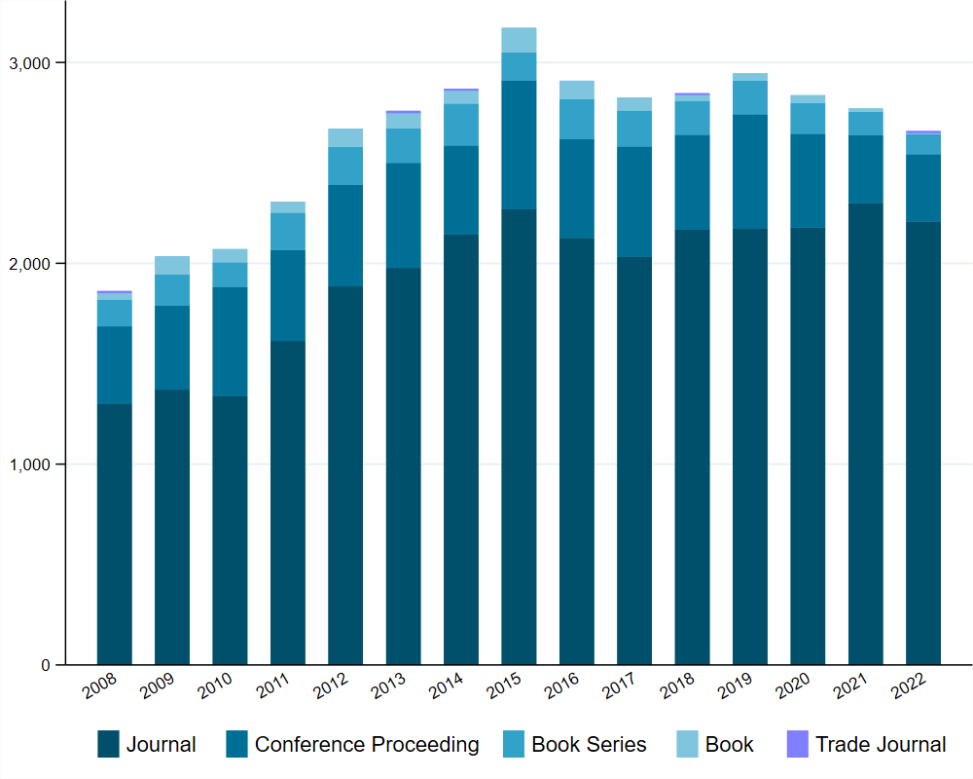
Histogram of publications by ever-HBP individuals
Our full sample: 2008-2022
(to stay relevant for the focal periods)
Results stay similar if we expand the T

Slide 15
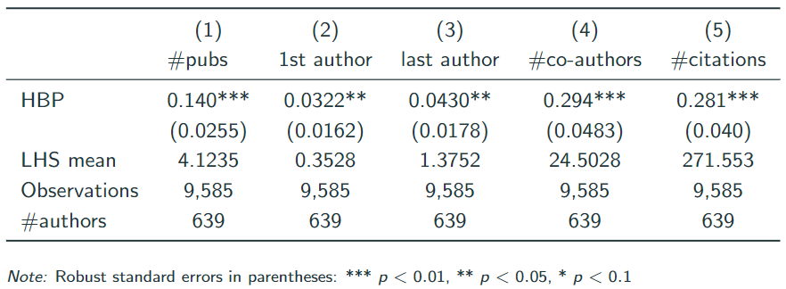
Results: author-year panel, log DV
Do researchers actively engaged in the HBP produce more work?
Researchers show a higher productivity and receive more citations after HBP participation (note: w/ individual fixed effects)
Participation in the HBP expands researchers’ networks (# of distinct co-authors per author-year in revealed publications)

Slide 16
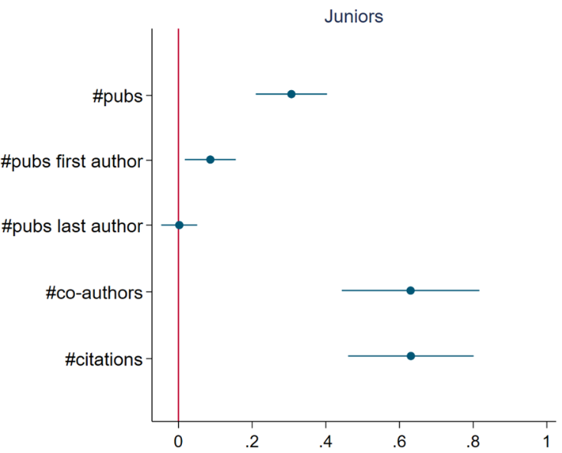
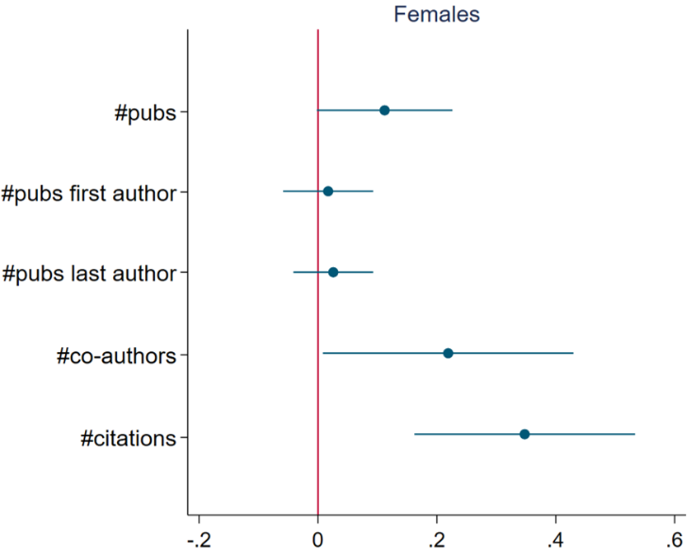

Junior/female subsample: author-year, 2008-2022
Does the HBP’s impact differ by researchers’ career stage and gender
Juniors (junior faculties and graduate students) derive great benefit from the HBP research infrastructure and collaboration
Female researchers experience a significant productivity increase
Notes:
Juniors when starting in HBP
If asked
When looking at seniors we see that they also publish more but the coeff. Is much smaller.

Slide 17
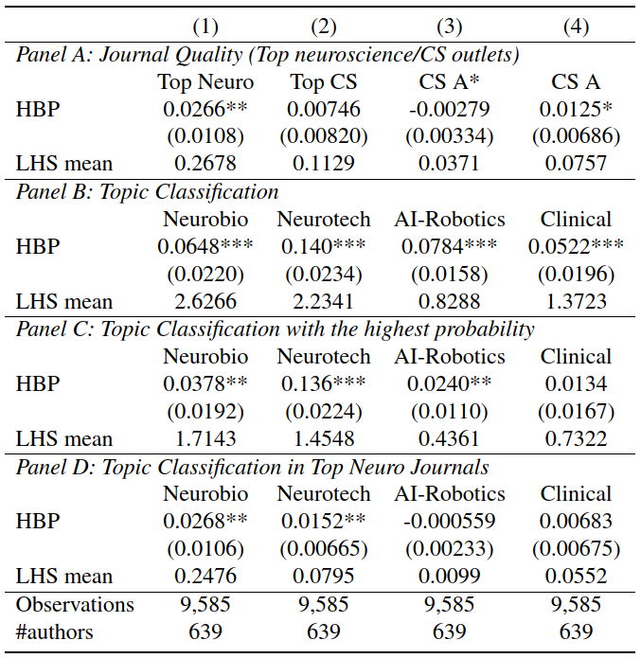
Results by journal quality and topic areas
Do researchers actively engaged in the HBP produce higher-quality work after HBP participation?
Higher probability of publishing in top neuroscience journals.
Increased probability of publishing esp. in topics of neurotechnology.

Slide 18
Results: leading topics in top journals
For researchers actively engaged in the HBP with top-quality work, what are the topics in top neuro journals?

Slide 19
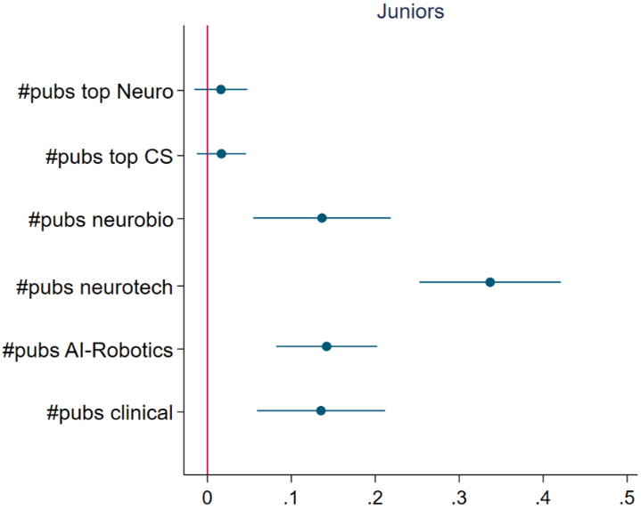
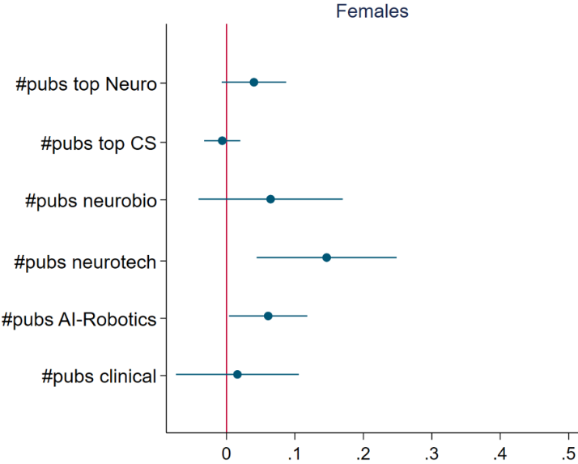
Junior/female quality: author-year, 2008-2022
Do junior/female researchers produce more top-quality work, or more works in certain topic areas?
Juniors increases research across topics, especially neurotech areas
Female yield more top neuro research, & more in neurotech/AI areas

Slide 20
Conclusion & Discussion
The HBP appear to yield positive synergy among AI-neuroscience scholars, and pushed more high-quality interdisciplinary research
Active involvement in the HBP induces productivity and increased citations, esp. for juniors. Female researchers also boost productivity.
Researchers have a higher likelihood of publishing in top neuro journals, esp. within the areas of neurobiology and neurotechnology
Scholars benefit regardless of their affiliated country at the beginning of HBP participation, more for German, Italian, & Belgian-based scholars
Some evidence that a combination of training and expanded network at the beginning of one’s career is most crucial for productivity gains
Work-in-progress: robustness check using a matching-based DiD w/ doppelgängers; finalizing event studies and various related estimates

Slide 21
Back up slides

Slide 22
Preview of Methods & Results
Exploit the individual-level active participation in the HBP, with extensive individual fixed effects to partly account for selection
Benchmark model: diff-in-diff with staggered timing & NLP
In-progress: matching-based diff-in-diff with various criteria
Treatment: time-varying access to HBP resources/network among researchers who ever actively participated (vs mDiD control group)
Participation in the HBP leads to …
(+) Increased individual productivity in publications (esp. juniors)
(+) Expanded coauthor network, and more citations
(+) A higher likelihood of publishing in top neuroscience journals
(+) Increased productivity esp. in neurotech topic areas
Notes:
4 topics using NLP to capture different directions of pubs

Slide 23
Literature and Contribution
Institutions and long-term research: institutions complement market incentives in encouraging valuable innovation, how to better design one
(Arrow 1962; Boudreau 2010; Furman & Stern 2011; Azoulay et al. 2011; Williams 2013; Budish et al. 2015; Murray et al. 2016; Huang et al. 2022; Myers & Lanahan 2022)
Science of sciences: knowledge complementarity and creation within and cross-organizational teams, we focus on a large complex project
(Nelson & Winter 1985; Cockburn & Henderson 1994; Hagedoorn 2002; Agrawal et al. 2006; Colombo et al. 2006; Melero & Palomeras 2015; Tortoriello et al. 2015)
Digitization in health care: limited evidence and mixed results, mostly on downstream health, and we focus on upstream R&D for future health
(Lou & Wu 2021; Miller & Tucker 2011; McCullough et al. 2016; Agha 2014; Freedman et al. 2017; Goldfarb et al. 2020; Wang 2021)
Goal: 1st empirical analysis on a contemporary long-term science megaproject (in brain-AI) with digital infrastructure and grants

Slide 24
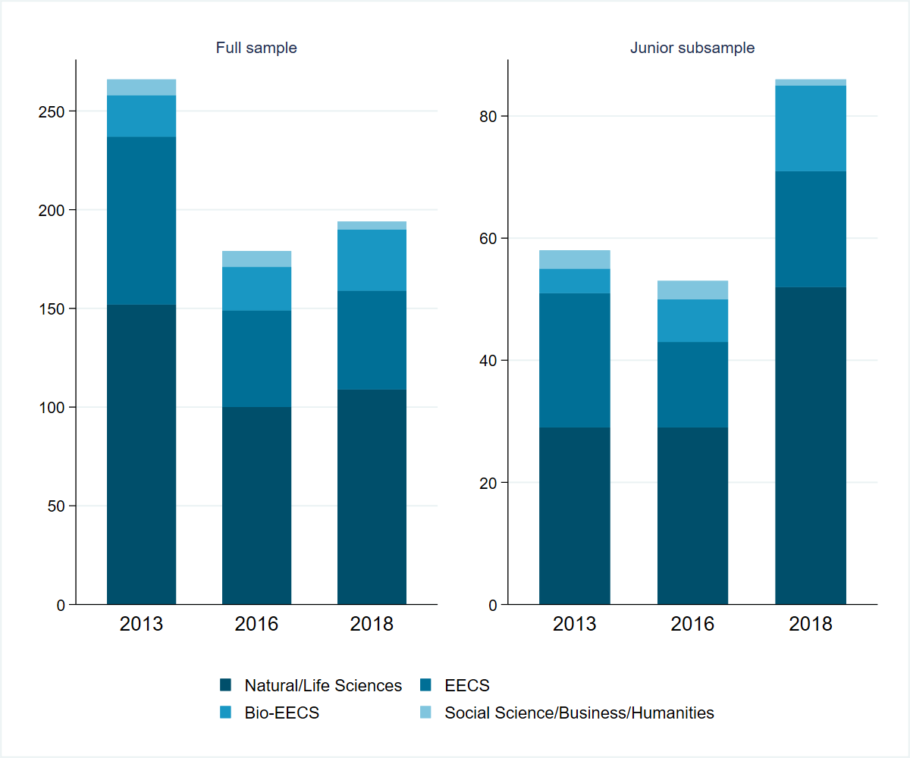
Highest degree fields by individual entering phase
Notes:
What field of training did the researchers have before they joined HBP? For this we collected the highest degree fields of each individual. and here you see the graphs showing the different trainings by entering phase

Slide 25
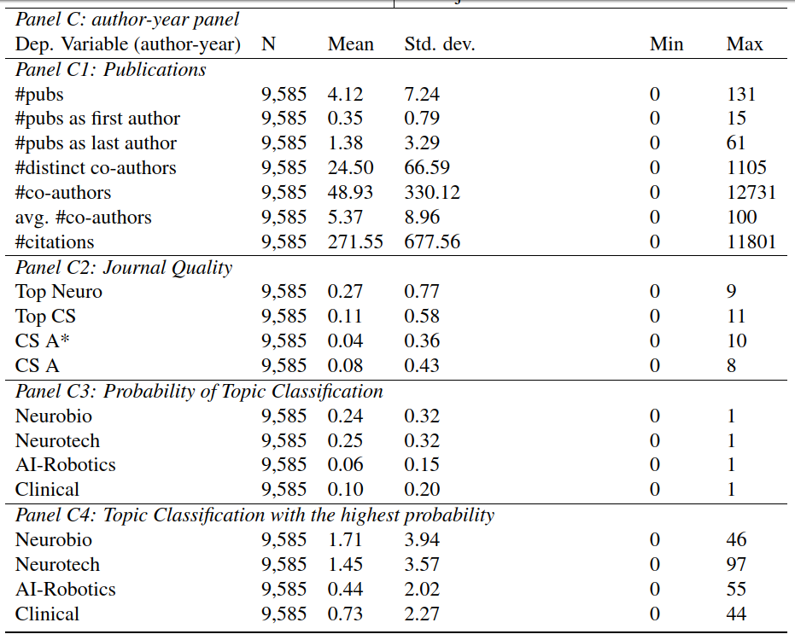
Summary statistics: analytic sample (panel)
Notes:
Unique vs co-authors: e.g. if you and I publish two projects together, you would be counted as one in the distinct co-author variable. In the total number of co-authors we would count you double, once for each paper published with me
If asked:
Active co-authors:
Probably not all of them work equally on projects
Our Expectation is not equal contribution – are also looking at the academic network that might be refelcted by the co-authors
Using first and last author we try to capture the contributions to a certain degree – in these fields the first author is the one with the highest contribution, and the last author is the one with the money
Indeed, no one can truly measure how active co-authors are, so we follow the literature and do the best we can

Slide 26
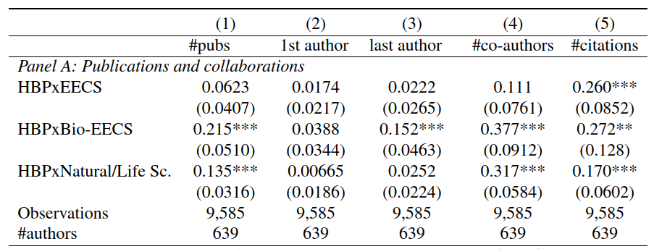

Results by field of highest degree
Training vs. collaboration: HBP interacted w scholars’ highest degree
$$y_{it}=βHBP_{it}×field_{i}+δ_{i}+δ_{t}+ε_{it}$$
Note: the base category includes "business, social sciences, and humanities".
Positive & significant correlation btw the #pubs, #co-authors, #citations & highest degree in natural and life sciences or bio-EECS
Much stronger results for junior researchers.
Suggestive evidence that training and network expansion early in one's career are crucial for productivity gains
juniors
Notes:
o what extent does the observed difference reflect HBP-active researchers trained in different
areas contributing more to the productivity gain, as opposed to the platform provided encouraging
collaboration? The former emphasizes the importance of training, and the latter stresses the im-
portance of learning and knowledge-sharing. Ideally, we aim to capture details on all co-authors
to gain insights into team composition and potential learning effects. However, since this is not
feasible, we provide a proxy by utilizing hand-collected data on the highest degree of training of
HBP-active authors. We included the highest-degree fields of training in the regression, using the
field group of "business, social sciences, and humanities" as the baseline category.

Slide 27
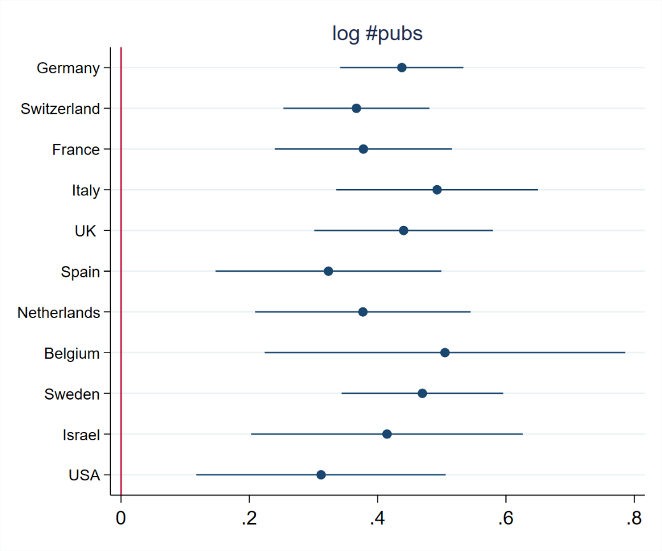
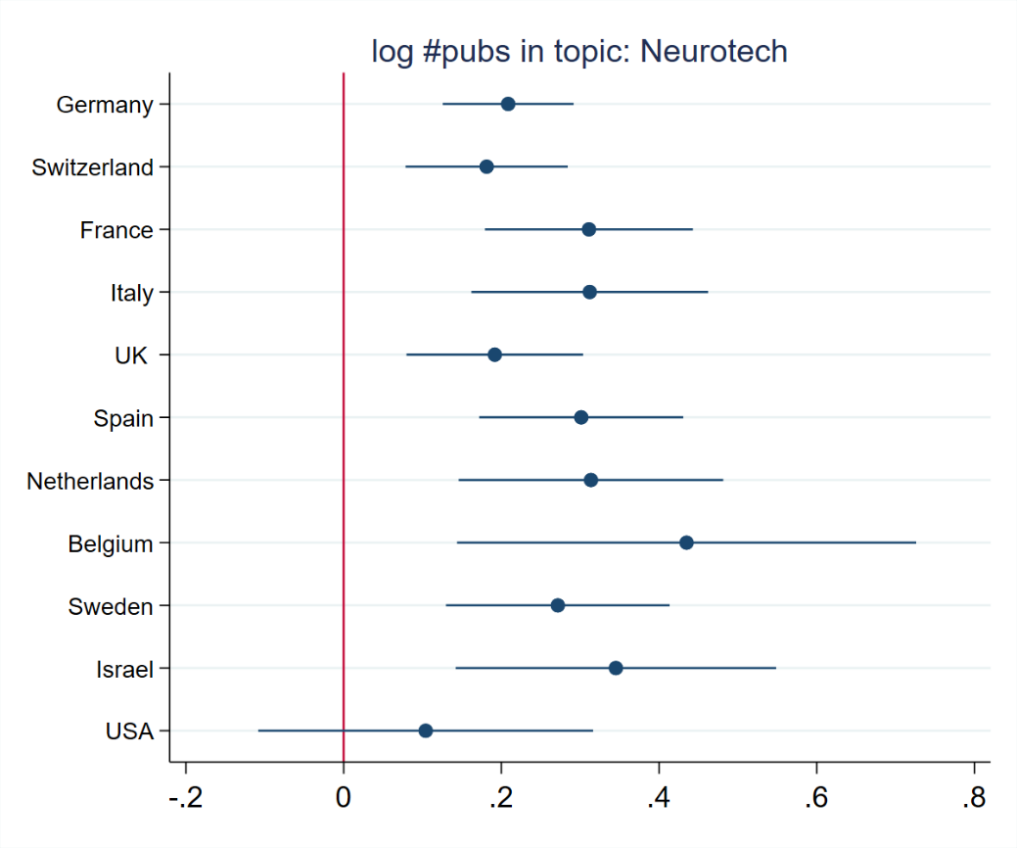

Log results: full sample – country heterogeneity
Country-level heterogeneity: HBP interacted w scholars’ base country
$$y_{it}=βHBP_{it}×country_{i}+δ_{i}+δ_{t}+ε_{it}$$
Note: the base category includes 17 countries w/ <400 obs.
Positive & significant correlation btw the #pubs & all countries
Scholars in Germany, Italy, Sweden and Belgium showed significant publication increases, especially in neuroscience & AI-robotics research

Slide 28
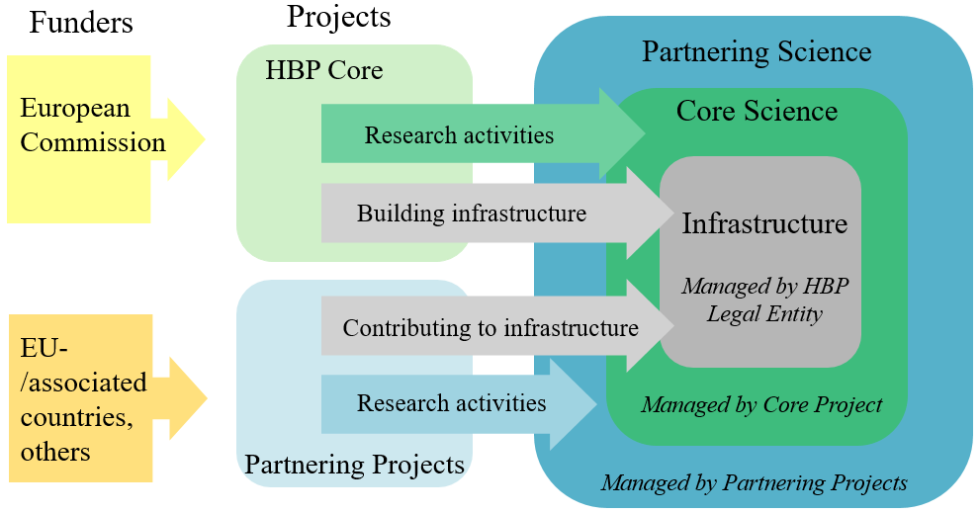
HBP structure: core vs partnering project partners
HBP Core Project Partners:
Sign a partnering agreement w/ EC (incl. grant) each phase
Are responsible for coordinating & executing the research plan & infrastructure development
HBP Partnering Projects Partners:
Have existing projects w/ own funding
Sign an agreement w/ Core Project Partners for selected tasks Form the creative and unrestrained component of the research and infrastructure-building process
back
criteria

Slide 29
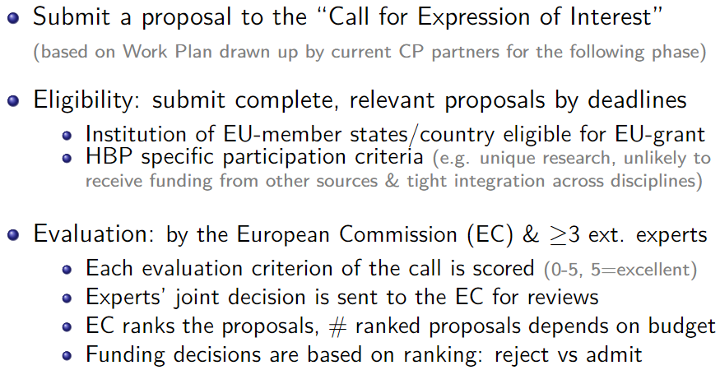
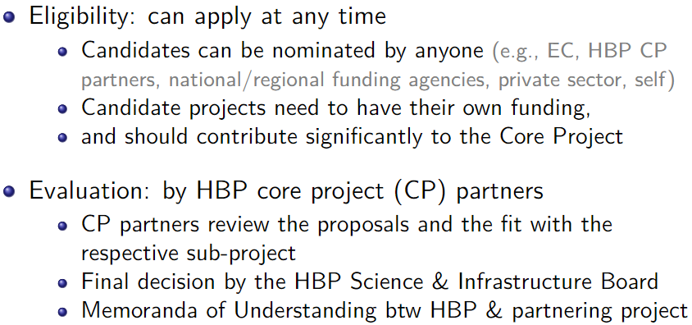
HBP core project (CP) vs partnering projects
Core project partner application process
Partnering project partner application process
back
Sources: framework partnership agreements & amendments, EC online portal for funding and tender opportunities

Slide 30
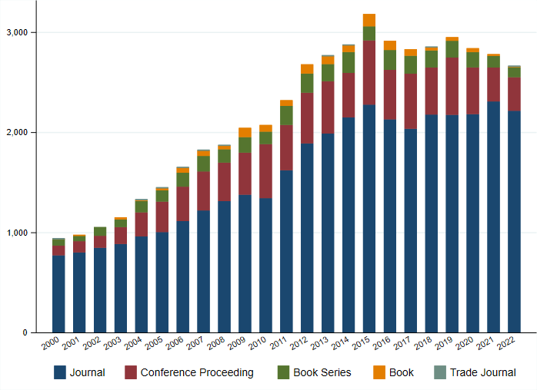
Histogram of publications by ever-HBP individuals
Our full sample: 2008-2022
(to stay relevant for the focal periods)
Results stay similar if we expand the T

Slide 31
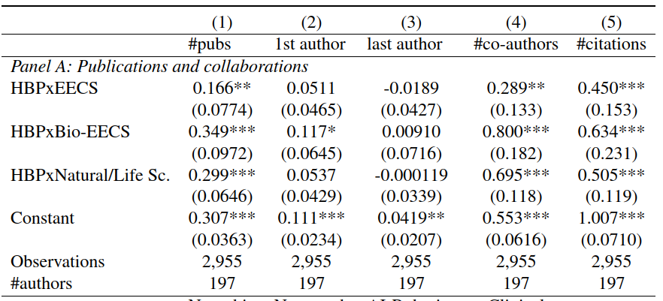
Junior subsample: field of highest degree
back

Slide 32
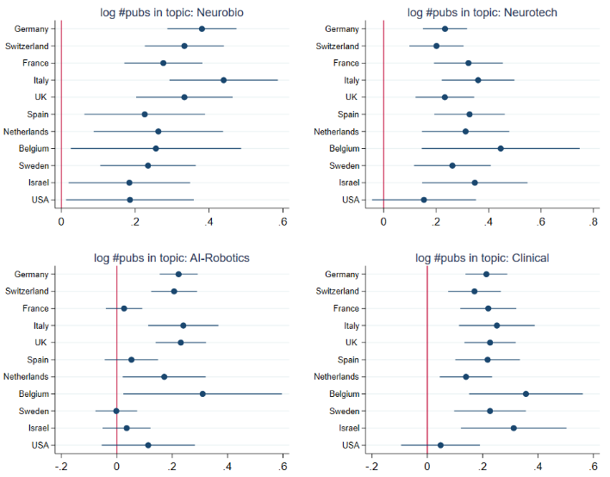
Results: full sample country-level heterogeneity

Slide 33
Matching-based DiD with entropy balancing
Employ mDiD methods using propensity score matching to create control group (Hainmueller,2012; Hainmueller & Xu, 2013)
Entropy-balancing to adjust for remaining differences in distribution of covariates btw the groups (Zhao & Percival, 2016)
List of observable characteristics used in sosia-identified Scopus-“doppelgänger” with the following similarity parameters:
first_year: the year of the first recorded publication (+/- 2 years)
#coauthors, #publications, #citations (up to the year of treatment)
Another researcher is similar if her characteristics fall within the margin around the original’s characteristics. If all characteristics are similar, and the other researcher is not a co-author, she is deemed a match
(default margins: 2 for year of 1st pub, 20% for other three #s)
Caveat: very computationally intensive (even on high-performance server) as the search goes through the entire Scopus database
Work-in-progress: relax the margins (to +/- 2.5 years and +/-25%)
back

