Slide 1
Marketing Authorization and Strategic Patenting: Evidence from Pharmaceuticals
Dennis Byrski¹ and Lucy Xiaolu Wang^{2,1,3}
¹ Max Planck Institute for Innovation and Competition
² University of Massachusetts Amherst
³ Canadian Centre for Health Economics
CES NA Pharmaceutical Markets and Innovation Session 2025.3.22

Slide 2
Drugs save lives, but too costly with many patents!
Patent systems are designed to promote innovation (Mansfield 1986; Lakdawalla 2018), but strategic patenting limits drug access (EC 2009)
E.g., evergreening (extends length) and fencing (extends breadth)
Trade-off: static efficiency vs. R&D incentives -> debates on patentability
US Supreme Court cases: Mayo 2012, Myriad Genetics 2013
This paper: how info disclosure in market authorization (MA) affect follow-on patenting (Trial docs disclosed can function as new “prior arts”)
Patent B
Innovation B
Innovation A
Patent A
Product A
cited by
(forward citation)
Patent C
Innovation C
?
EPO “gold standard” examination quality (Chien 2018), patent citation: follow-on patenting
Notes:
Mayo v. Prometheus (2012): adjust drug dosage based on metabolite levels – not patent-eligible;
Association for Molecular Pathology v. Myriad Genetics, Inc. (2013): naturally occur genes are not patent eligible.

Slide 3
Research Question:
Q: How does marketing authorization of a new drug (new NME) affect follow-on innovation building upon focal drug?
Intuitively, follow-on patenting can go either way (an empirical Q):
More: “Time to explore other new indications and expand the market!”
Less: “Time to lay flat and relax, as profit is coming in our way!”
Same: “I cannot decide, so maybe just good to patent as usual?”
Exploit the authorization of new drugs to the (EU/EEA) market, utilize the variation in approval lags (that do not differ by ex-ante patent char.)
Examine how a drug’s marketing authorization affects the rate & direction on follow-on patenting by firms (selves, related parties, others)
Notes:
EEA = European Union member states, Iceland, Liechtenstein, and Norway.

Slide 4
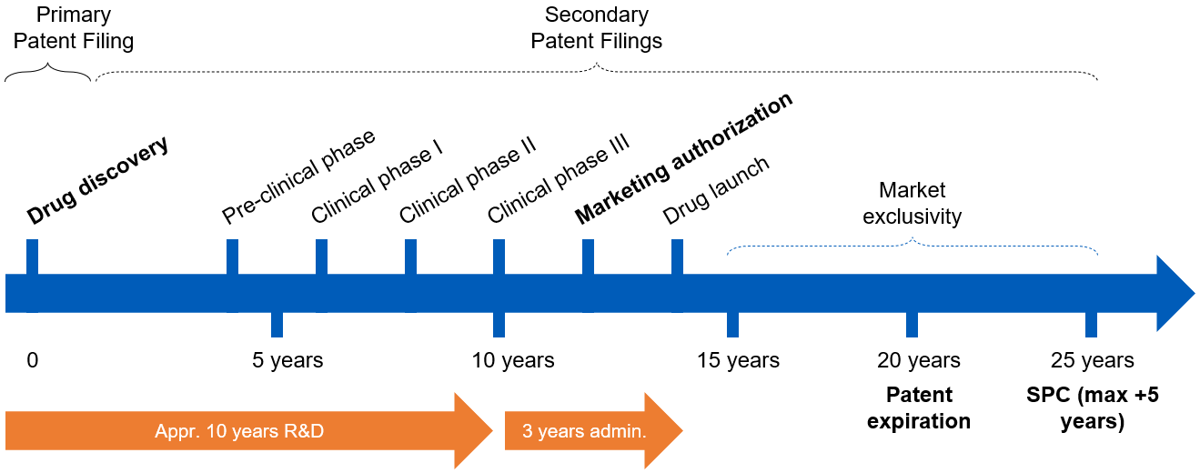

The Drug Development Process in EU (EEA)
In European Economic Area (EU+Iceland, Liechtenstein, Norway), originators submit applications for market authorization to European Medicines Agency (/national)
verifies safety, efficacy, quality; drugs can then be sold for approved indications
Market exclusivity: firms hold exclusive right to market/sell a patented drug

Slide 5
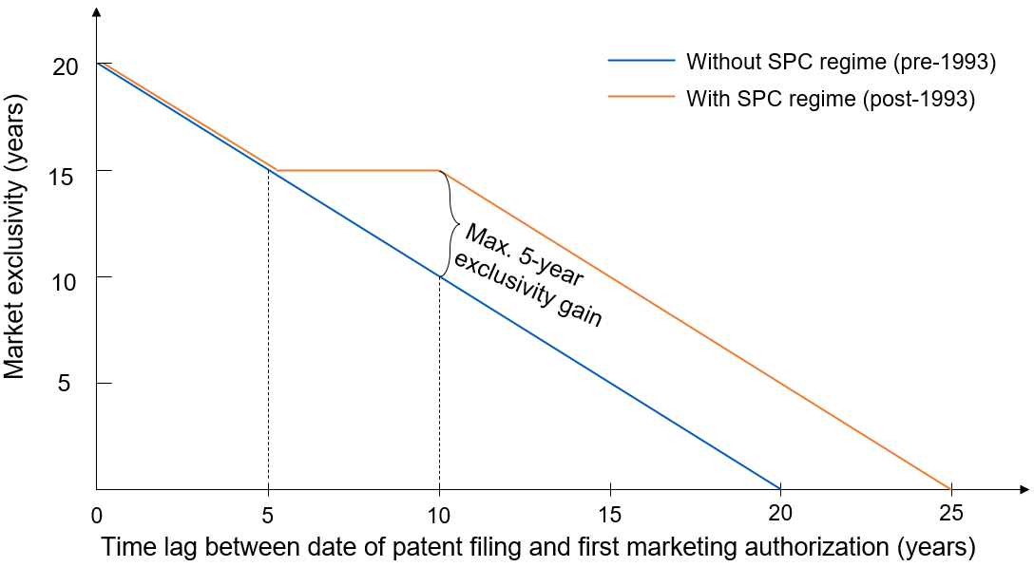
EU Patent Term Extension (SPC Regime)
Supplementary Protection Certificates (SPC) regime, 1993- : extension capped at 5 years; market exclusivity constant for patents w/ 5-10 years’ approval lag
SPC term (≤5 years)= date of 1st MA in EEA – filing date of basic patent – 5
analysis

Slide 6
It takes a long & uncertain time to develop a drug…
Pre-clinical phase
Market authorization
Clinical phase III
Clinical phase II
Patent filing
Clinical phase I
Drug launch
Late MA
(long lag)
0
5 years
10 years
15 years
20 years
Early MA
(short lag)
0
5 years
10 years
15 years
20 years
Approval lag cannot be predicted perfectly at the time of the patent ﬁling: whether/when the drug will be on the market (à la Gilchrist 2016)
Scientific uncertainty & organizational factors: finance, M&A, $, licensing, …
Data: 1) patent-drug linkage: SPC data from DPMA; 2) patent data on primary patents from EPO PATSTAT, family level patent info; 3) drug data: Cortellis, link by family id; 4) crosswalk diseases w WHO ICD-9.

Slide 7
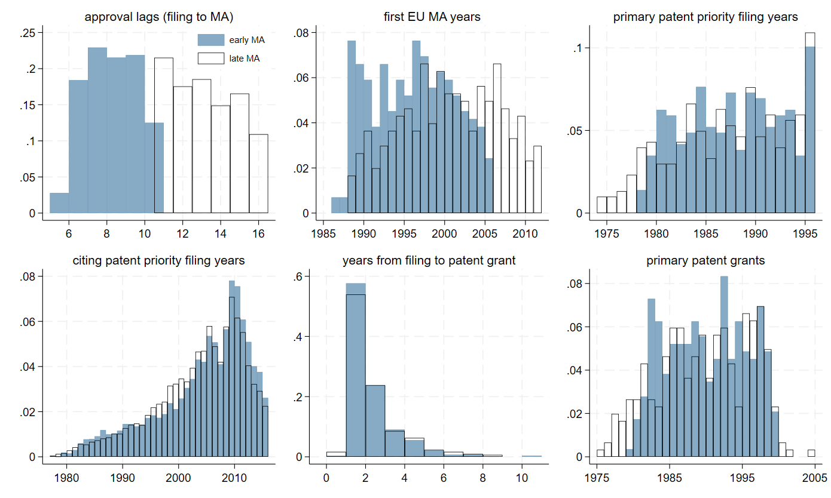
Distribution of characteristics (split by median MA)
Patents with early vs. late MA (split approval lag at median: 10 years) are similar regarding priority time, time span at the patent offices (time to patent grant), similar technological nature (e.g., ICD-9, complexity, resubmissions), and similar ex-ante drug, disease, and patent characteristics (t-test across many metrics).

Slide 8
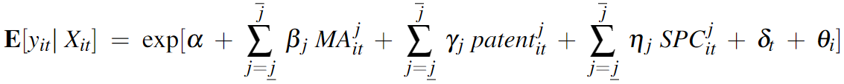
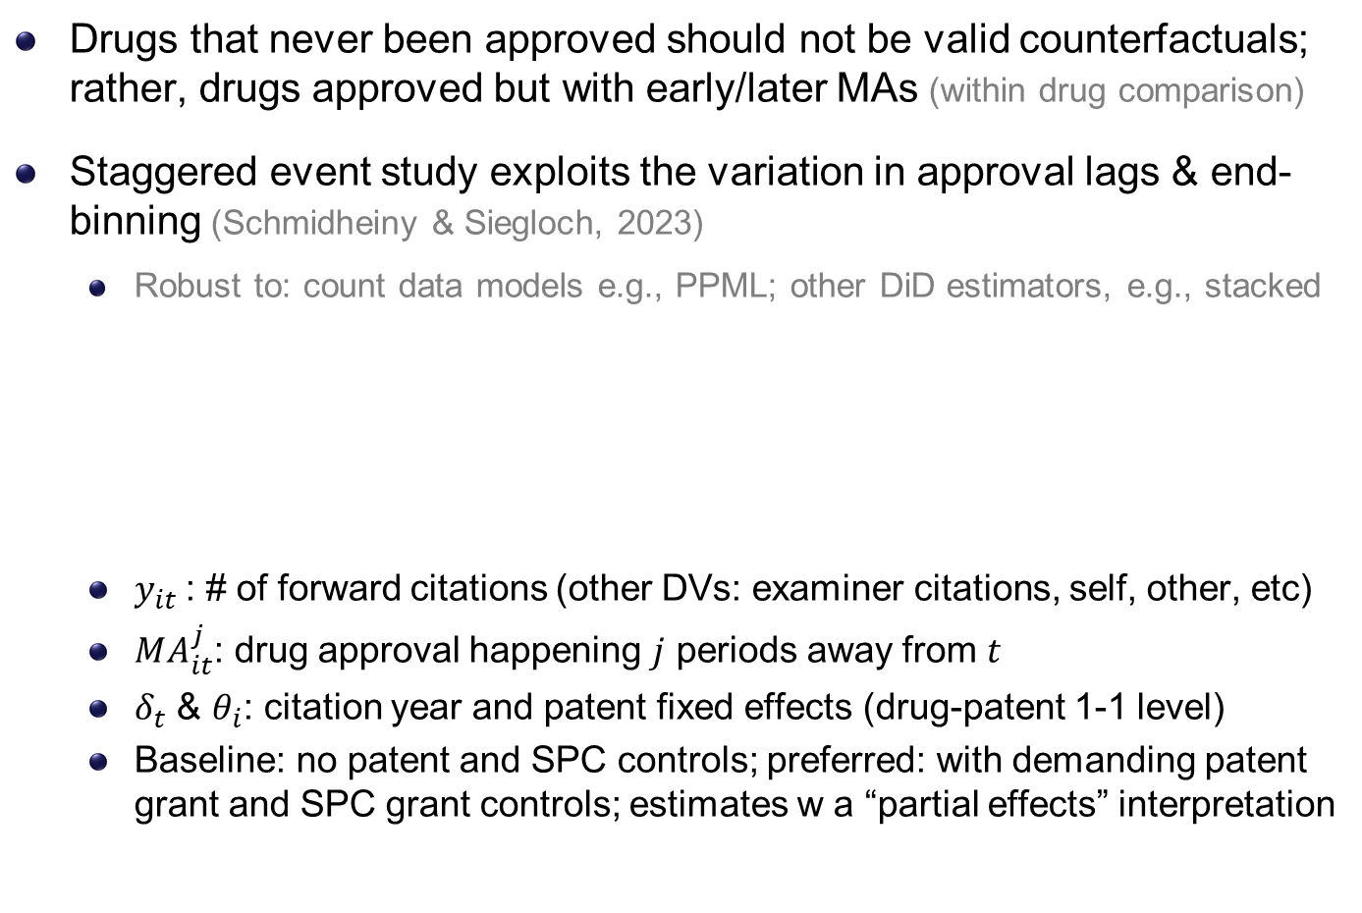
Empirical Strategy: Event Studies (à la S&S 2023)
Drugs that never been approved should not be valid counterfactuals; rather, drugs approved but with early/later MAs (within drug comparison)
Staggered event study exploits the variation in approval lags & end-binning (Schmidheiny & Siegloch, 2023)
Robust to: count data models e.g., PPML; other DiD estimators, e.g., stacked
$y_{it}$: # of forward citations (other DVs: examiner citations, self, other, etc)
$MA_{it}^{j}$: drug approval happening $j$ periods away from $t$
$δ_{t}$ & $θ_{i}$: citation year and patent fixed effects (drug-patent 1-1 level)
Baseline: no patent and SPC controls; preferred: with demanding patent grant and SPC grant controls; estimates w a “partial effects” interpretation

Slide 9
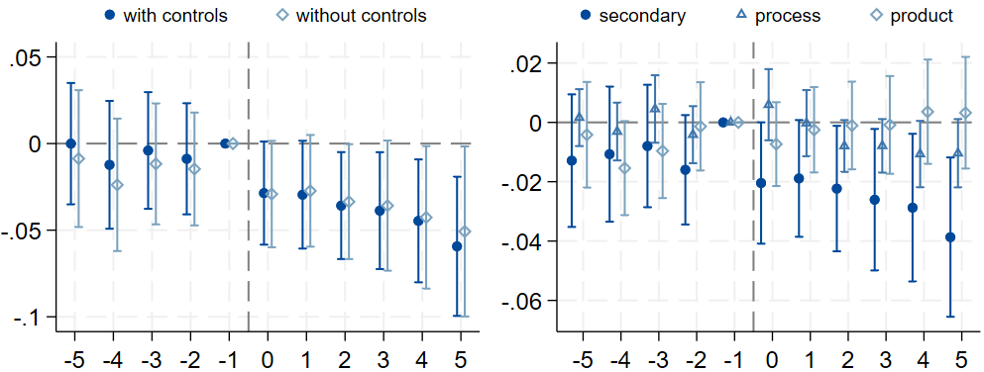
Market Authorization & self-citations: by type of patent
Secondary: e.g., new formulations, dosage forms, combinations, or use.
Process: e.g., new manufacturing process.
Product: e.g., new products, macromolecule.

Slide 10
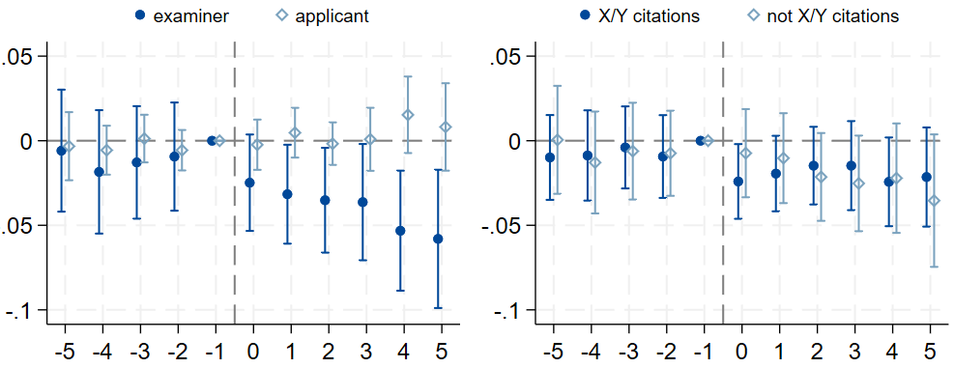
Marketing authorization & self-citations: by source/type
Self-citations added by examiners (high quality, majority of EP citations)
Self-citations added by applicants
X/Y-ref.: suggest legally “weak” patents as they increase the likelihood of a post-grant validity challenge (Wagner & Wakeman, 2016)
(X: a single prior patent doc can undermine the novelty/inventiveness of claimed invention; Y: do so in combination w/ other docs)

Slide 11
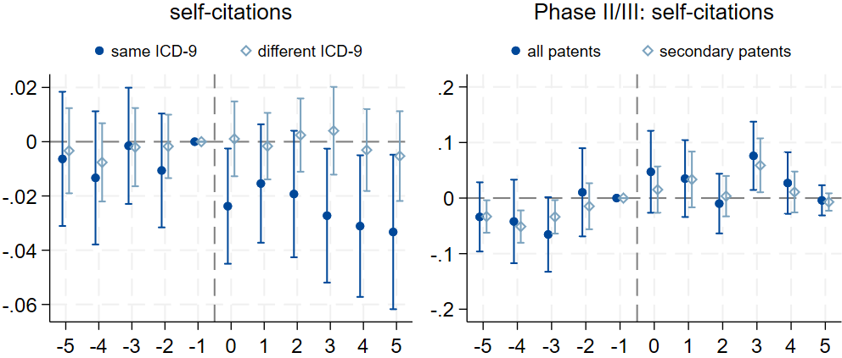
MA & self-citations: by disease; & placebo events
Same disease area as the approved drug
Different disease areas from the focal drug
Use end of phase II/start of phase III as a major (placebo) milestone event to test the mechanism (disclosure/enforceability)

Slide 12
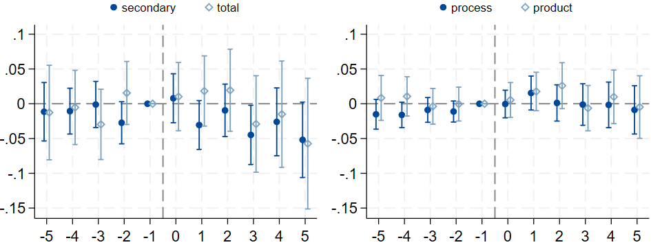
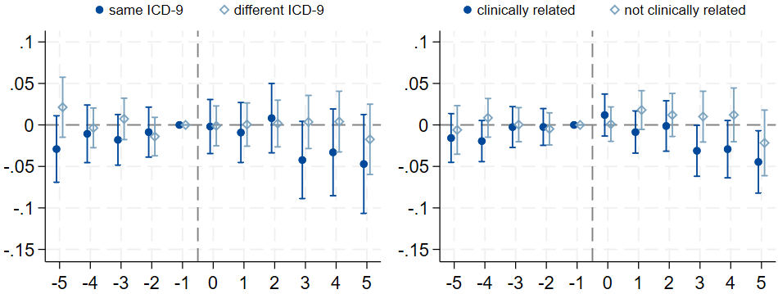
MA & other parties’ forward citations: big picture

Slide 13
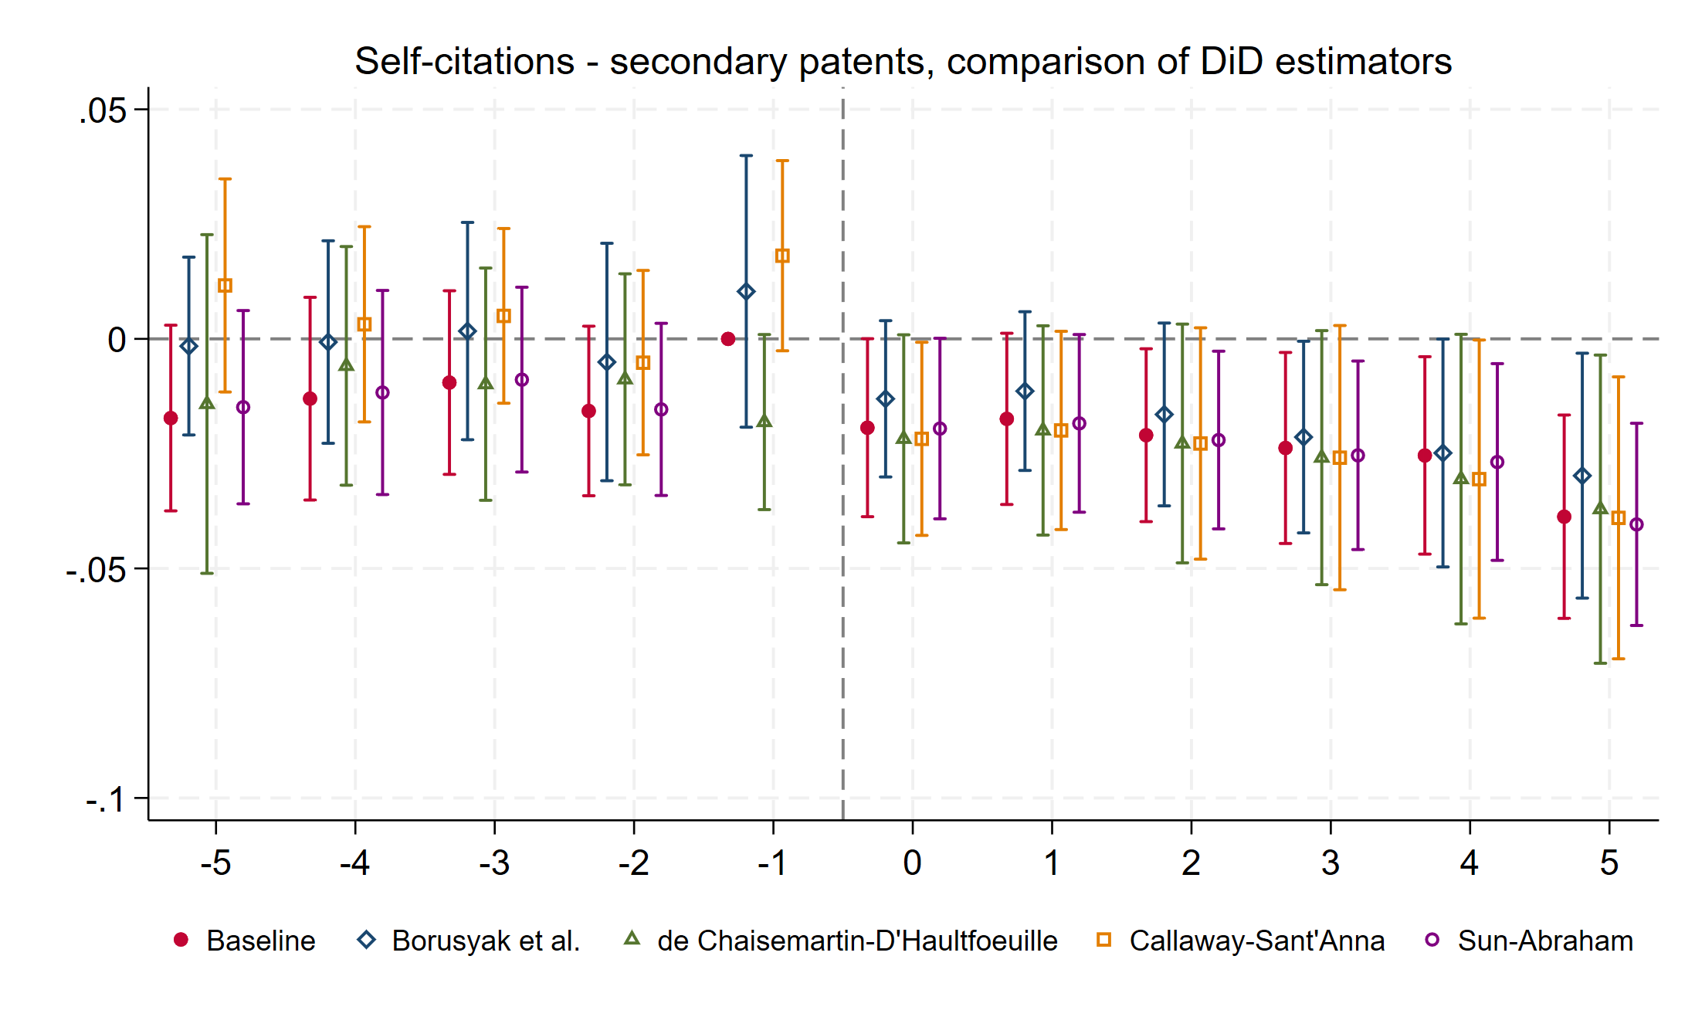
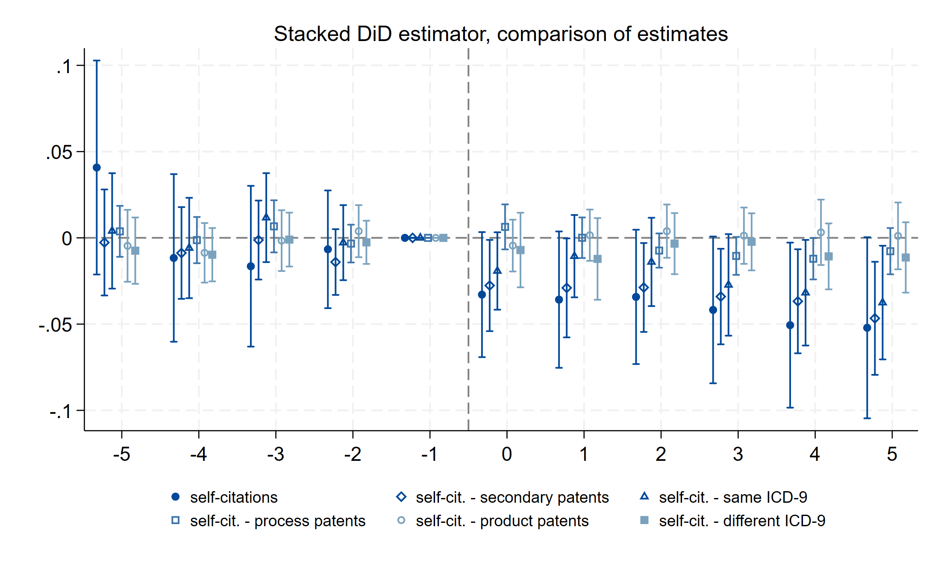
Robustness Checks: Alternative DiD Estimators

Slide 14
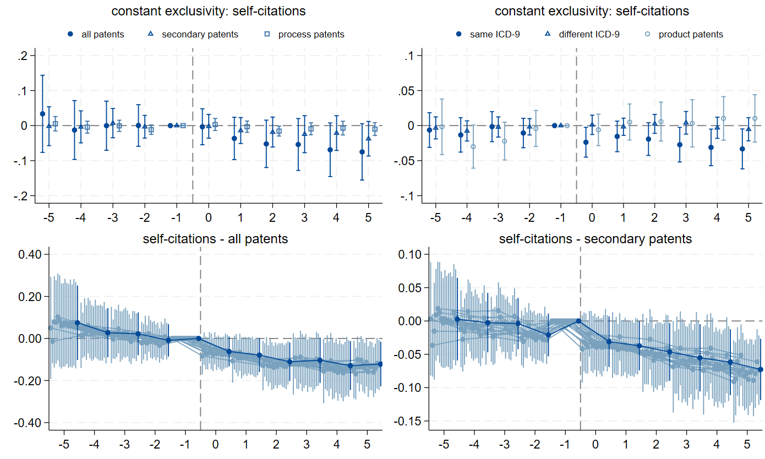
Robustness: Short Approval Lags & Leave-1-out
To isolate MA effects (focus on the event) from potential confounding effects from approval lags (periods)
Additional analyses account for non-European market incentives, firm-specific factors, and IV for delays.

Slide 15
Conclusion, & Discussion
We find that strategic follow-on patenting decreases after a drug’s market authorization, when follow-on drug patents are harder to obtain
More drop for less novel patents; No change in meaningful patents
Both originators and other firms adjust similarly, at different speeds
Empirical test indicates it’s harder to obtain enforceable patents post-MA
Policy implications: leveraging existing regulatory disclosure requirements may provide a practical approach to improving patent quality without changing formal patentability standards
Thank you! (contact: Lucy Xiaolu Wang at xiaoluwang@umass.edu)
Full paper: https://ssrn.com/abstract=4638115

Slide 16
Backup slides

Slide 17
Literature and Contribution
Secondary patents: examine the relationship btw market authorization and follow-on patenting (of different types & by different parties)
(Lemley & Moore 2004; Amin & Kesselheim 2012; Sampat & Shadlen 2017; Hemphill & Sampat 2011; Frakes & Wasserman 2023; Gupta 2023)
Intellectual property institutions and follow-on innovation: leverage novel European institutional details and rich drug-patent dyadic data
(European Commission 2009; Hemphill & Sampat 2013; Sternitzke 2013; Galasso & Schankerman 2015; Gaessler et al. 2023; Sampat & Williams 2019)
Firm innovation strategies: how downstream product events intertwine with upstream patenting behaviors in a heavily regulated industry
(Acemoglu & Linn 2004; Arcidiacono et al 2013; Budish et al. 2015; Dubois et al 2015; Gaessler & Wagner 2020; Kyle & McGahan 2012; Wang 2022)
Policy implication: ex ante regulation, self-adjustment, & patent quality

Slide 18
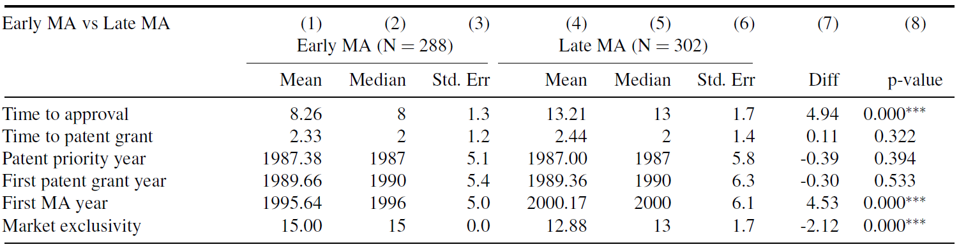
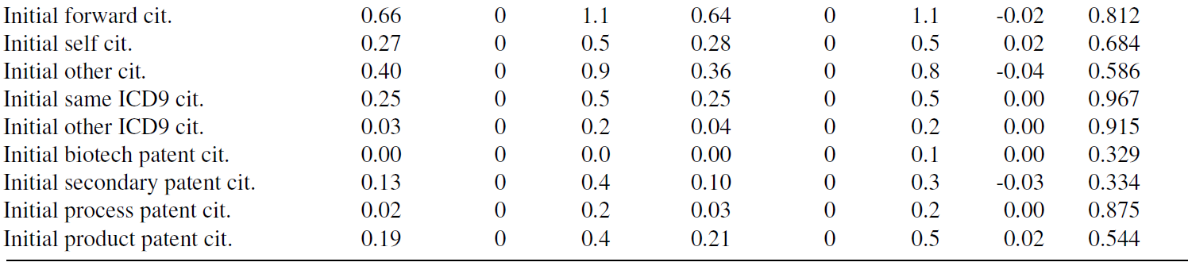
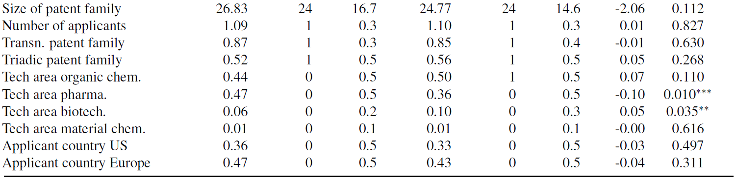
Similar Ex-Ante Drug & Patent Characteristics

Slide 19
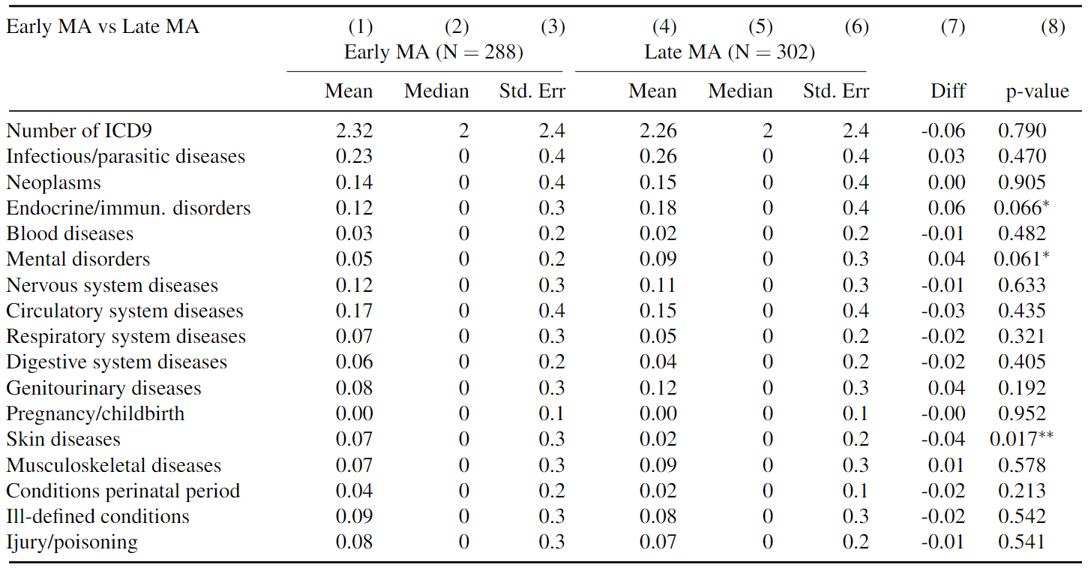
Mean comparison – similar disease characteristics
Similar early/late MA mean by ICD-9 categories (& leave-one-out analyses)
Small size diff in 1) early: endocrine/immun. & mental disorders; 2) *late: skin diseases
Notes:
Our primary patents do not fall into one ICD-9 disease category: congenital anomalies

Slide 20
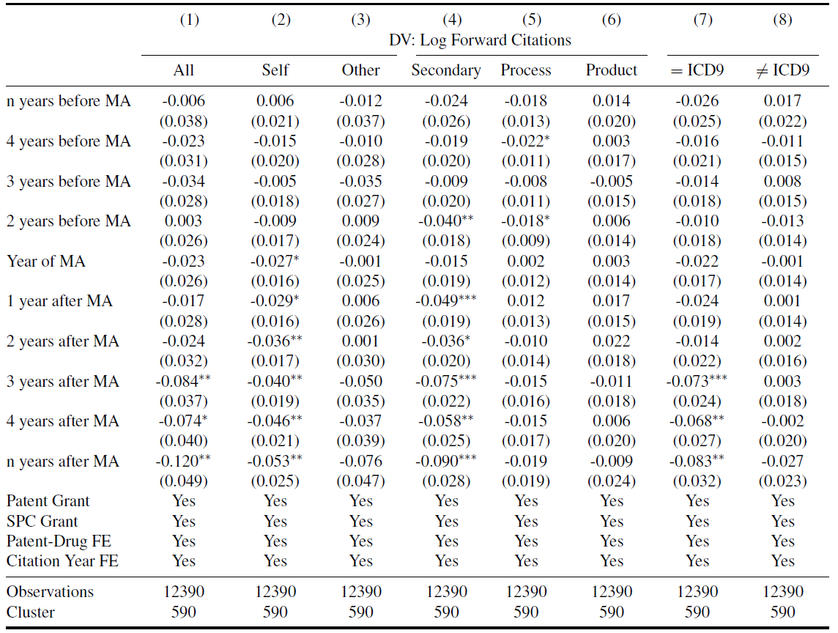
MA and forward citations: results summary

