Slide 1
Marketing Authorization and Strategic Patenting: Evidence from Pharmaceuticals
Dennis Byrski¹ and Lucy Xiaolu Wang^{2,1,3}
¹ Max Planck Institute for Innovation and Competition
² University of Massachusetts Amherst
³ Canadian Centre for Health Economics
Equal contribution and alphabetical order
Flash talk, IHEA 2024 World Congress, Bali Indonesia
Freshly out in Journal of Public Economics, July 2025

Slide 2
Drugs save lives, but too costly with many patents!
Patents incentivize innovation, but strategic patenting limits drug access
Trade-off: static efficiency vs. R&D incentives -> debates on patentability
Patent B
Innovation B
Innovation A
Patent A
Product A
cited by
(forward citation)
Patent C
Innovation C
?

Slide 3
Research question
Q: How does marketing authorization of a new drug (new NME) affect follow-on innovation building upon focal drug?
Intuitively, follow-on patenting can go either way (an empirical Q):
More: “Time to explore other new indications and expand the market!”
Less: “Time to lay flat and relax, as profit is coming in our way!”
Same: “I cannot decide, so maybe just good to patent as usual?”

Slide 4
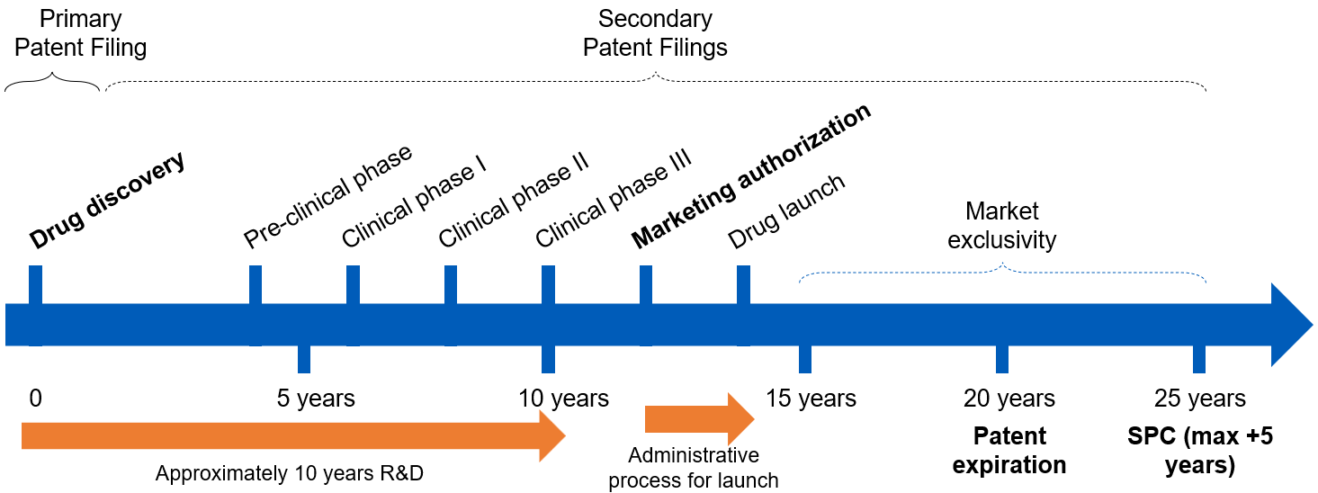
The drug development process in EU (EEA)

Slide 5
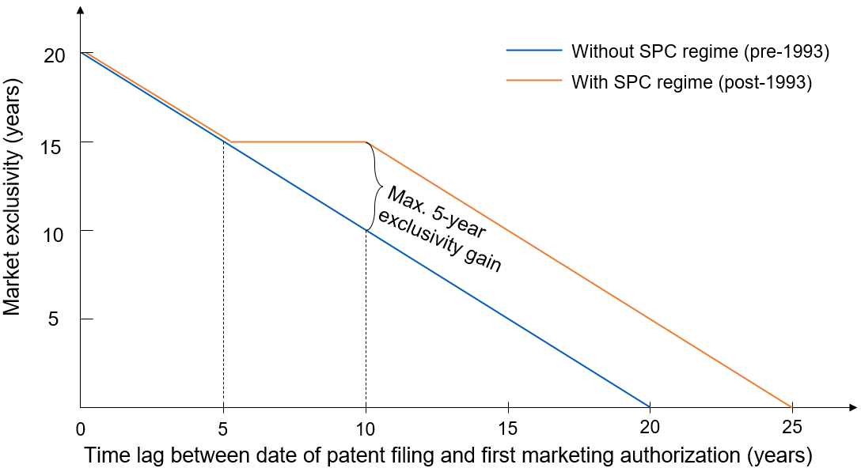
EU patent term extension (SPC regime)
Supplementary Protection Certificates (SPC) regime, 1993-: extend ≤ 5 years

Slide 6
It takes a long & uncertain time to develop a drug
Pre-clinical phase
Market authorization
Clinical phase III
Clinical phase II
Patent filing
Clinical phase I
Drug launch
Late MA
(long lag)
0
5 years
10 years
15 years
20 years
Early MA
(short lag)
0
5 years
10 years
15 years
20 years
Approval lag cannot be predicted perfectly at the time of the patent ﬁling: whether/when the drug will be on the market (à la Gilchrist 2016) for scientific and organizational factors

Slide 7
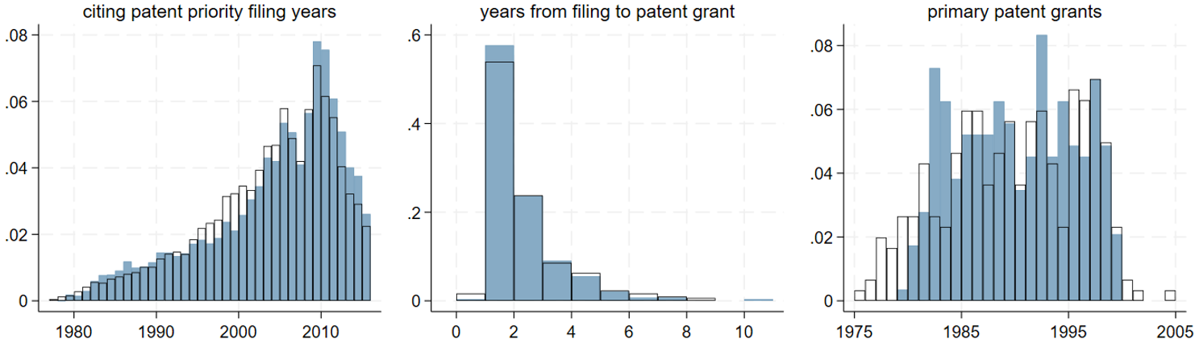
Distribution of timing-related variables & Methods
Split sample by median approval lag: similar in ex-ante drug/disease/patent characteristics
Method: staggered DiD and event studies; ctrl for a set of FEs: MA_{it}, patent_{it}, SPC_{it}

Slide 8
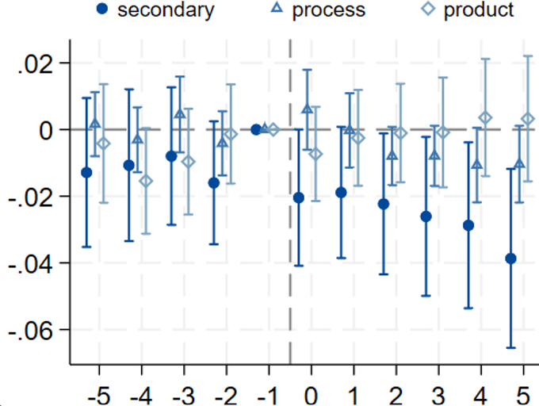
Marketing authorization & self-citations
Product: e.g., new products, macromolecule.
Process: e.g., new manufacturing process.
Secondary: e.g., new formulations, dosage forms, combinations, or use.

Slide 9
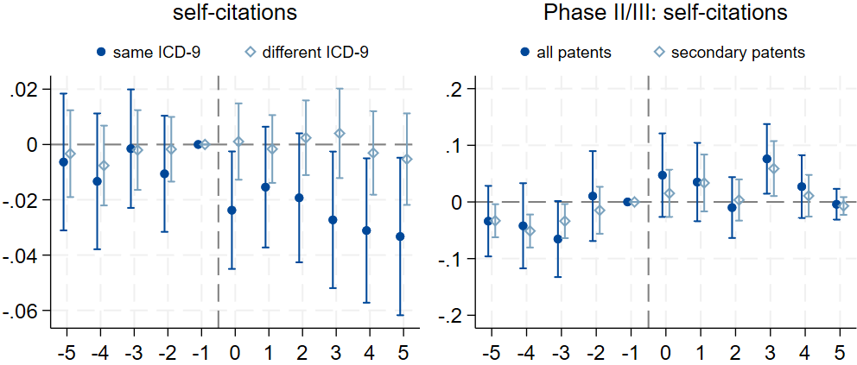
Marketing authorization & self-cit.: by disease & placebo
Same disease area as the approved drug
Different disease areas from the focal drug
Use end of phase II/start of phase III as a major (placebo) milestone event

Slide 10
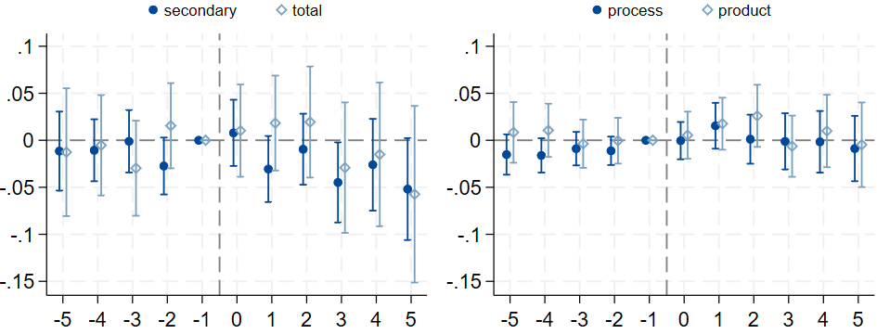
Marketing authorization & other parties’ fwd citations
Similar patterns, slower response

Slide 11
Robustness checks
Robustness across other DiD estimators: similar across 6 DiD estimators
Short approval lags in constant market exclusivity region: robust
Leave-one-out: results are not driven by a few disease areas
Non-European market incentives (e.g., from US) cannot explain results
Firm-specific factors: robust to firm fixed effects or observable controls
Robust to IV estimation using unpredictable delays by start of phase I

Slide 12
Conclusion and discussion
We find that strategic follow-on patenting drops after a drug’s market authorization, when follow-on patents are harder to obtain
Improving regulatory data transparency may provide a practical approach to improving patent quality
Thank you! (paper: https://doi.org/10.1016/j.jpubeco.2025.105415)
Contact author: Lucy Xiaolu Wang (xiaoluwang@umass.edu)

