Slide 1
Procurement Institutions and Essential Drug Supply in Low and Middle-Income Countries
Lucy Xiaolu Wang (University of Massachusetts Amherst, Max Planck Institute for Innovation and Competition, Canadian Centre for Health Economics) Nahim Bin Zahur (Queen’s University)

Slide 2
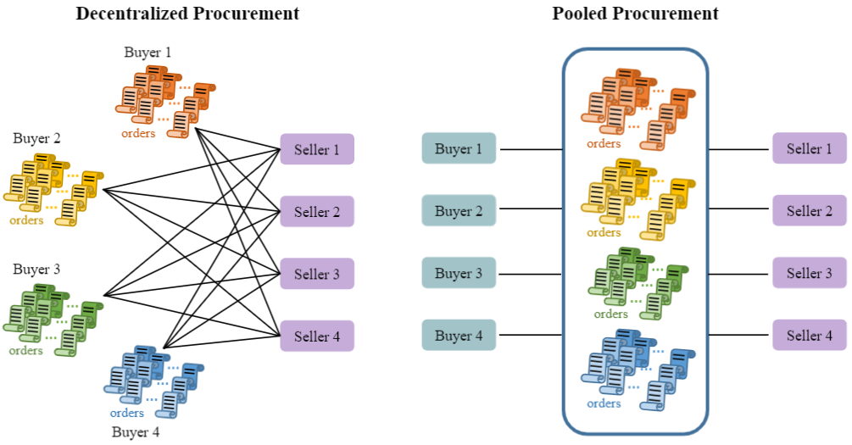
Challenges in drug access & procurement institutions
Slow drug diffusion in low and middle-income countries (LMIC)
Both patent and non-patent barriers
Key role of procurement institutions
But we know little about how well they work
Price and non-price outcomes

Slide 3
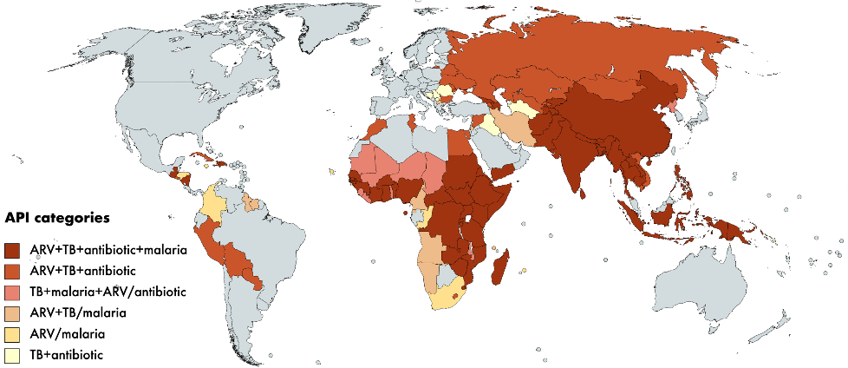
Data and Empirical Model
Data: LMIC drug procurement transactions, Global Fund, 2007-2017
drug level: disease categories, approval year, and drug classes
drug-country-year level: patent status & IP licensing institution (Medicines Patent Pool)
country-year level: demographics, income, disease portfolios, institutional factors, …
Empirical Model (baseline): Panel and transaction-level regressions saturated with fixed effects
y_{jct}: price, delivery delay, procurement lead time
S_{jct}: % transactions using procurement institution m (5 categories)
X_{jct}: income, disease prevalence & incidence, demographics, patents, IP licensing, etc.
ẟ_{cj} + ẟ_{t}: drug-country & year fixed effects

Slide 4
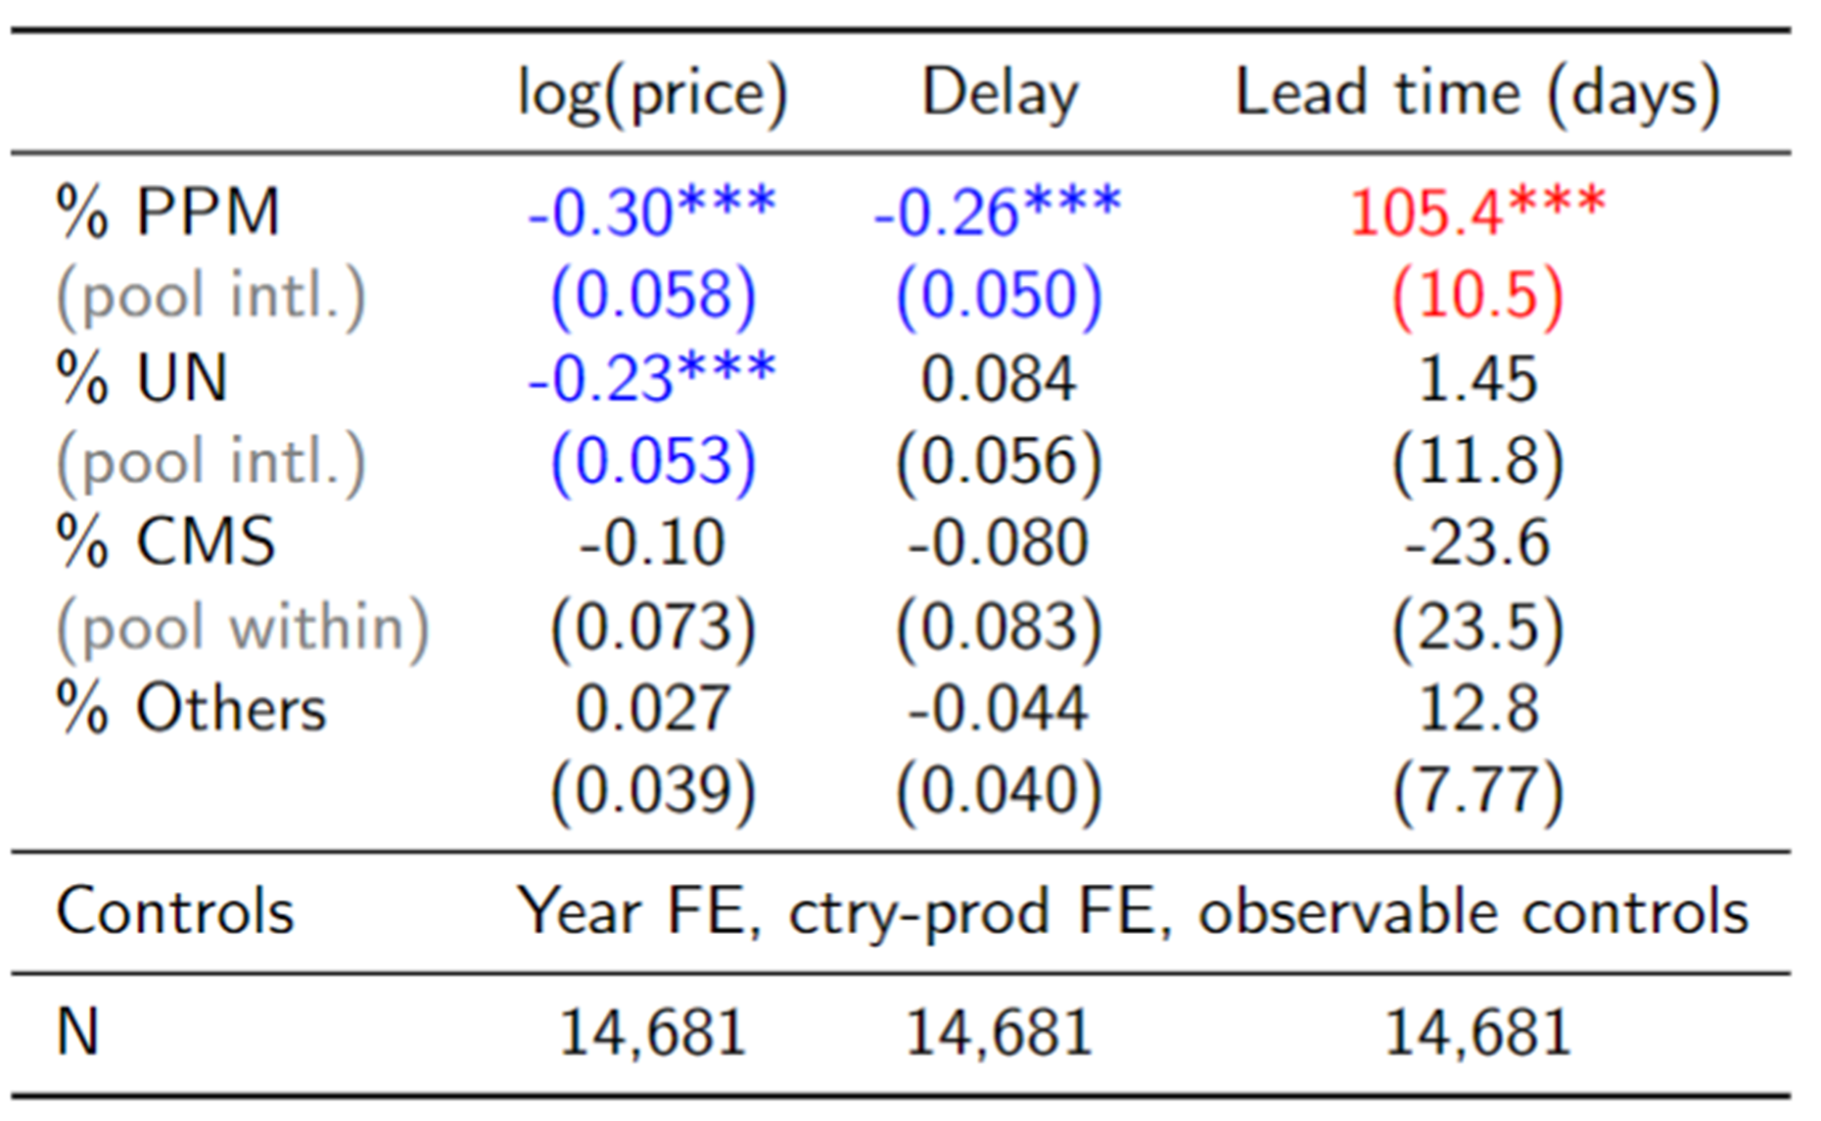
Pooled procurement reduces prices with tradeoffs
Cross-country pooling lowers prices: 30% for PPM (pooled procurement mechanism), 23% for UN
Cross-country pooling by PPM lowers delays by 26%, but longer procurement lead time by 105 days
Buyers thus trade off greater reliability, lower prices against lower flexibility (longer anticipated wait)
Panel level baseline results.

Slide 5
Heterogeneity and additional analyses
Cross-country pooling reduces prices more for older drugs
In contrast, Medicines Patent Pool (IP licensing) reduces prices for newer, patented drugs
Pool internationally is most effective if: (1) buyers small; (2) market more concentrated
Pool within-country is most effective if: (1) buyers large; (2) market less concentrated
Additional analyses: Instrumental variable approach; Altonji-Elder-Taber-Oster (AET-O) boundary estimates; demend estimation; other institutions, managerial practices, …
Overall: no one-size-fits-all institution wrt price & non-price outcomes; countries may consider using a mix of institutions for various scenarios (regular vs emergency)
(Draft available at: https://ssrn.com/abstract=3926761)

