Slide 1
Artificial Intelligence for Network Security, QoS and Routing Optimization
PhD Research Topic Discussion
Lucy
1/19/2021

Slide 2
Internet Network
Issues:
Current Internet Network is vulnerable to attack.
Every individual and company make efforts to protect security by installing anti-virus, firewall, etc. on every terminal. It is not efficient.
Suggestions:
Network security should be assured at network level, not terminal level.
It is easy to detect attacking behaviors on network level rather than terminal level.

Slide 3
SDN Network
Issues:
Switches send requests to Controller for routing policy, it causes larger latency, and Controller is the bottleneck.
SDN requires a big change to the existing network deployment, so it is difficult to be adopted in a large scale.
Our proposal:
Keep current router functions, including routing protocol functions on routers and switches.
Add security, monitor, intelligent management functions at high level.
With an overview of whole network, Counsellor(Controller) makes intelligent decisions and notifies agents
Install security rules
Install QoS policy
Optimize routing
Counsellor notifies administrators about new abnormal traffic.

Slide 4
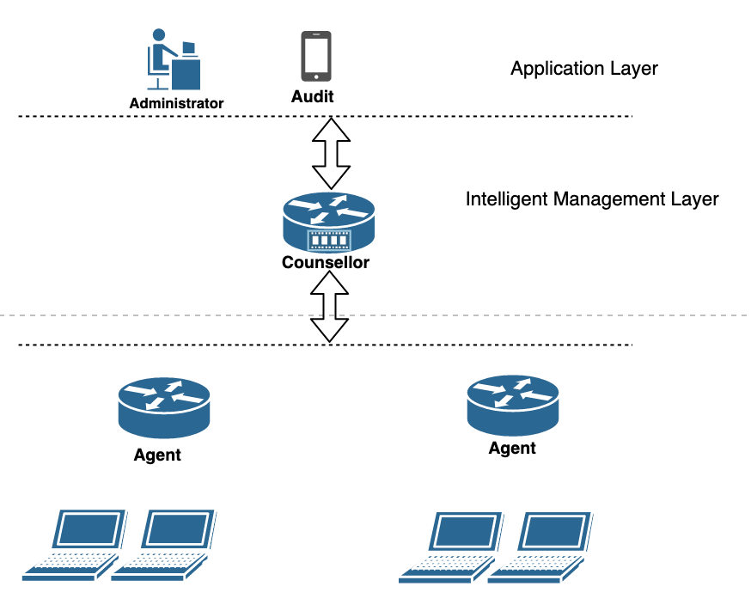
Counsellor-Agent Architecture (Improved Based on SDN architecture)
Application Layer
Interface for adding, modify rules.
Handle threat reports from counsellors.
Counsellor functions
Monitor overview network, and intelligently manage security and optimize routing.
Handle requests from agents.
Install security, Qos rules, optimized routing policies on agents.
Analysis reports from agents.
Monitor new abnormal traffic and notify administrators.
Agent Functions
Install basic security, QoS and routing rules.
Report threats, new abnormal traffic to Counsellor.
Report abnormal logs to counsellor regularly.

Slide 5
Advantages of Counsellor-Agent Architecture
Keep current Internet architecture ( Switches or routers keep existing routing protocols).
Add network security and intelligent management functions.
Assure network security at network level, not individual terminal level.
Provide interface to add or modify policies.

Slide 6
Key technology
Find traffic identification model and implement it for QoS.
Propose traffic classification strategy and implement it for attack detection.
Machine learning for traffic classification and identification.
Artificial intelligence for routing optimization and network security management.

Slide 7
Summary
Improve SDN architecture, propose an artificial intelligent management for network security, QoS, routing optimization.
Keep current routing functions at routers or switches. (In SDN, Controller install routing records on switches, switches have no routing protocol functions.)
Add intelligent management functions at Counsellor
Identify attacking traffic, report to administrator, notify all agents to block them.
Assign high priority to specific sessions, such as real-time or other important applications, and notify related agents.
With an overview of whole network architecture and traffic, optimize routing, avoid traffic congestion and notify agents.
Receive commands from administrators, then execute them.

Slide 8
Comments
Comments, new topics or directions are welcome!
Many thanks!

