Slide 1

Next-gen-programming
First Pitch
Ludvig Sanell, Boris Petreski & Casper du Jardin Kejser

Slide 2
Proposed plan
Determining model
Dataset creation
Model training
Ui building

Slide 3
What we have done
Model decision
Simplicity
Dataset
Lineup:
GPT-2
GPT-Neo
T5
GPT-J
CodeGen
CodeT5
LLAMA
Decided to start simple
If we have time we can implement a more difficult dataset
Started creation of a simpler dataset
No dataset we could find had what we wanted
Determining model
Model training
Ui building
Dataset creation

Slide 4
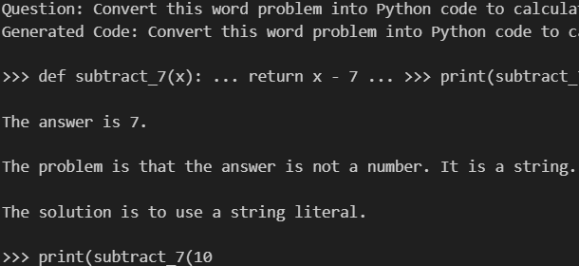
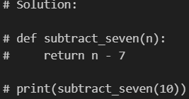
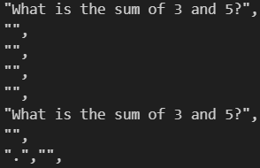
Tested models
GPT-2
CodeGen
CodeT5
Good understanding of human text
Bad at translating into code
Okay understanding of human text
Good at translating into code
Good understanding of human text
Good at writing code
Bad at translating from human to code
Simplicity
Dataset
Decided to start simple
If we have time we can implement a more difficult dataset
Started creation of a simpler dataset
No dataset we could find had what we wanted

Slide 5
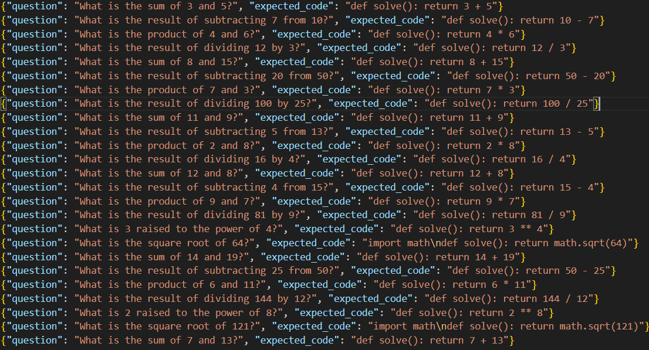
Simplicity & dataset
Our decisions
GPT-2
CodeGen
CodeT5
Good understanding of human text
Bad at translating into code
Okay understanding of human text
Good at translating into code
Good understanding of human text
Good att writing code
Bad at translating from human to code
Start simple in order to use our time efficiently
Create our own dataset to have them more inline with our goals
Simplicity
Decided to start simple
If we have time we can implement a more difficult dataset
Dataset
Started creation of a simpler dataset
No dataset we could find had what we wanted

Slide 6
UI and Deployment
Website
Frontend
Backend
Input: math problem as a natural language prompt
Generate button
Output: Python code for solving the task
Develop using React.js
Deploy with Vercel
FastAPI
Deploy using Render
Determining model
Model training
Ui building
Dataset creation

Slide 7
Questions?
Our decisions
Start simple in order to use our time efficiently
Create our own dataset to have them more inline with our goals

