Slide 1


Toward a programmable CIM accelerator based on memristor devices
Mahdi Zahedi Li Ou Hu
Delft University of Technology
The Netherlands

Slide 2
Motivation
Logic (XOR, AND, OR)
Memristor-based Computation-In-Memory (CIM) has great potential to accelerate different applications.
CIM potentially improves performance and energy in orders of magnitude.
Only limited operations in a certain fashion are supported inside the memory array.
These operations are compute-intensive parts of many applications.
...
SA/ADC
Matrix-Matrix Multiplication
...
...
SA/ADC

Slide 3



Motivation
However, other operations are usually needed for the complete execution of applications.
Neural Network
Bioinformatics
Graph processing
…
Different Activation functions
Mul/Div in Batch normalization
Min/Max/Avg in Pooling
…
Shifting
Thresholding
…
Min/Max operations
Comparator
…

Slide 4
Motivation
Problem Statement:
Flexibility:
How can a CIM accelerator target one or a few application domains but different algorithms with different required operations and dataflows?
Scalability:
How do we achieve scalability when we deal with different problem sizes, even for a single algorithm (e.g., different sizes of feedforward networks)?

Slide 5
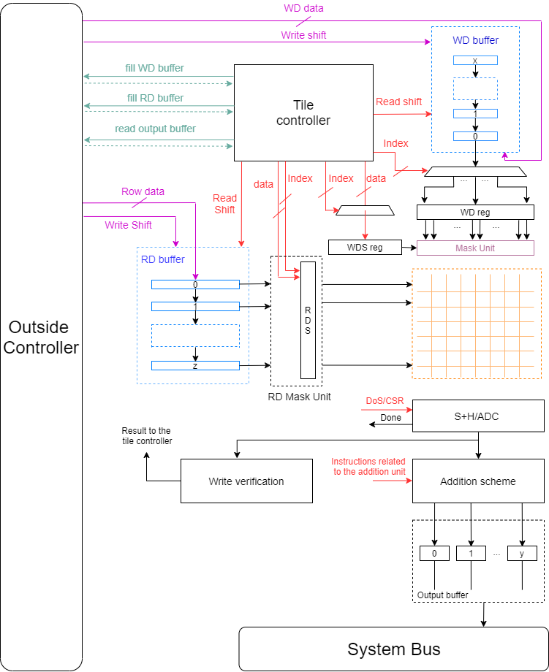
Potential Solutions
Naive approach:
Integrate all the necessary components required for the target application domain(s) into the periphery of a memory array (within a CIM-Tile)
CIM-Tile
Increasing the complexity of a CIM-Tile
Reducing the resource utilization
Reducing the energy/performance/area efficiency
Demand for these resources may not be the same across the CIM-tiles

Slide 6
Potential Solutions
CPU-based approach:
Relying on a CPU to perform post- and pre-processing of data for CIM-Tiles
High Flexibility in supporting a wide range of operation
High Contention between CIM-Tile over CPU
High complexity in synchronization
CPU
CIM-Tile
R
R
CIM-Tile
CIM-Tile
R
R

Slide 7
Potential Solutions
Reconfigurable-based approach:
CIM-Tile
CIM-Tile
High Flexibility in supporting a wide range of operation
Flexible allocation of resources to CIM-Tiles
High resource utilization
Low contention between CIM-Tile over Rec
Low complexity in synchronization
Rec
CIM-Tile
CIM-Tile
This project investigates the third solution, the marriage of CIM and Rec.

Slide 8
Overview of dataflow
Consider the ‘Conceptual’ implementation:
CIM-Tiles with Parallel Execution
CIM-Tiles with Parallel Execution
…
…
RD
Xbar
RD
Xbar
RD
Xbar
3
RD
Xbar
3
…
Out
Out
2
Out
2
Out
…
…
…
…
1
Control & Function
1
Control & Function
…
Input buffer 1
Input buffer 2
Reconfigurable Platform

Slide 9
Interface Signals
Stage 1: Fill Input buffer
if (Busy == 0) -> Start = 1
Busy = 1
Start = 0 when data is transferred
Stage 3: Activate Tiles
if (Output buffer is empty) -> T_start = 1
T_done = 0
Stage 1: Consume output buffer, processing on FPGA, and Fill input buffer
T_done = 1
if (Next_Layer_Busy == 0) -> Next_Layer_Start = 1
Next_Layer_Busy= 1
Next_Layer_Start = 0 when data is transferred
Output buffer is empty
Stage 2: Send data to Tiles ( filling RD buffers)
if (T_done == 1) -> Send the data to Tiles
Busy = 0 when data is transferred
Pipeline diagram of stages:
Layer 1
Layer 2
Stage 1
Stage 2
Stage 3
Stage 1
Stage 2
Stage 3
Stage 1
Layer 1
Stage 1
Stage 2
Stage 3
Stage 1
Stage 2
Layer 1
Stage 1
Stage 2
Stage 3

Slide 10
Interface Signals (modeling the interface and bandwidth limitation)
CIM-Tile 1
…
CIM-Tile n
…
RD_En
T_Start
RD_Addr
WD_En
OB_Data
T_done
RD/WD_Data
OB_Addr
Write_En
Data
Control & Function
Write_En
Data
Control & Function
Write_En
Data
Data
Data
Data
Address
Input buffer 1
Input buffer 2
Address
Input buffer n
Addr
Address
Addr
Address
Start
Next_layer_Start
Start
Busy
Next_layer_Busy
Busy
Reconfigurable Platform
RD/WD_Data
WD_En
RD_Addr
T_Start
OB_Data
T_done
RD_En
OB_Addr
CIM-Tile 2
…
CIM-Tile n+1
…

Slide 11
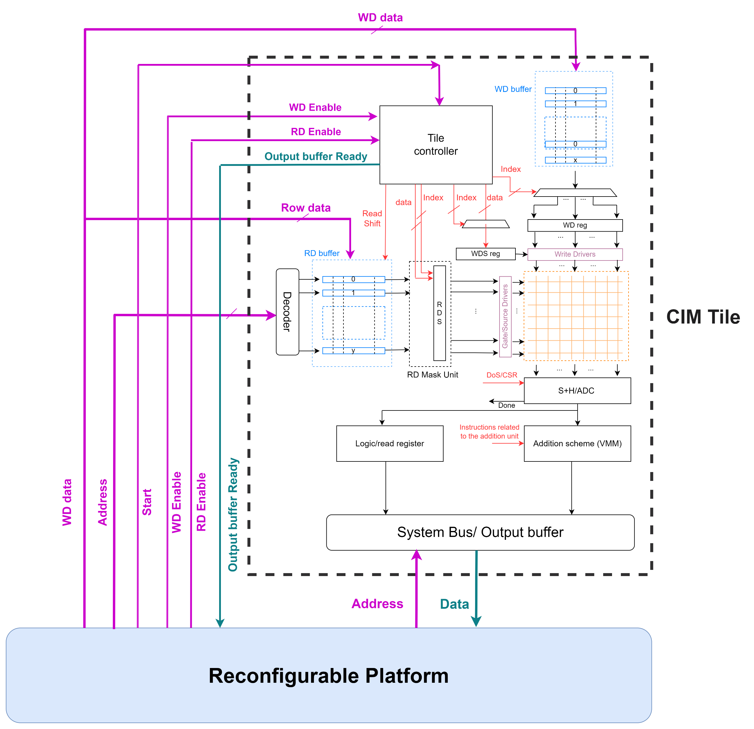
Interface Signals

Slide 12
FPGA I/O signals limitation
In the case of using off-the-shelf FPGAs as IPs in our design:
We are bound to the number of available I/Os
Virtex-5 FPGA Family Members
Device | Max User I/O
XC5VLX30 | 400
XC5VLX110 | 800
XC5VLX155 | 800
XC5VLX330 | 1200
XC5VLX30T | 360
XC5VLX50T | 480
XC5VLX110T | 680
XC5VLX155T | 680
XC5VLX330T | 960
Light implementation
High-performance implementation
Notes:
High-performance: The data width from the output buffer to the FPGA is equal to the datatype size of the final output generated by the CIM-Tile
Light: The data width from the output buffer to the FPGA is equal to the datatype size of system

Slide 13
General directions
We follow two approaches at the same time based on resource and I/O limitations:
Conceptual: the infinite size of FPGA and I/O signals
CIM-Tile 1
CIM-Tile 3
…
CIM-Tile n
FPGA
CIM-Tile 2
CIM-Tile 4
…
CIM-Tile n+1

Slide 14
General directions
2) Factual: considering the limitations of available FPGAs I/Os and size
CIM-Tile 1
CIM-Tile 3
…
CIM-Tile 15
CIM-Tile 1
CIM-Tile 3
…
CIM-Tile 15
CIM Bank
FPGA
CIM Bank
FPGA
CIM-Tile 2
CIM-Tile 4
…
CIM-Tile 16
CIM-Tile 2
CIM-Tile 4
…
CIM-Tile 16
R
R
CIM-Tile 1
CIM-Tile 3
…
CIM-Tile 15
CIM-Tile 1
CIM-Tile 3
…
CIM-Tile 15
CIM Bank
CIM Bank
FPGA
FPGA
CIM-Tile 2
CIM-Tile 4
…
CIM-Tile 16
CIM-Tile 2
CIM-Tile 4
…
CIM-Tile 16
R
R

Slide 15
Performance Estimation
List of parameters in Multi CIM-Tile Simulator:
1
Latency of data transfer to a CIM-Tile
Data bus width (equal or less than DT)
Minimum size of data to be transferred
Degree of parallel data read from the input buffer and sent to the CIM-Tile RD buffer
Degree of parallel CIM-Tiles’ connection to FPGA (In this approach, we are not bound to available I/O ports)
2
All the parameters in the CIM-Tile Simulator
3
Latency of data transfer to FPGA
Data bus width
FPGA clock frequency
Minimum size of data to be transferred
Degree of hardware parallelism in FPGA
Degrees of parallel CIM-Tiles’ connection to FPGA (In this approach we are not bound to available I/O ports)
Notes:
If we want to share some ports with several CIM-Tiles, the interface should be updated.

Slide 16
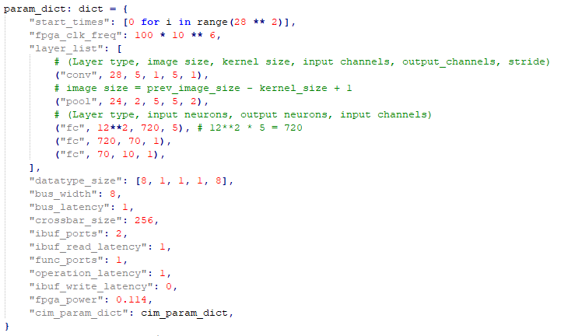
Python-based behavioral simulation platform
Layer configuration
Specification of a CIM Tile from low-level simulator

Slide 17
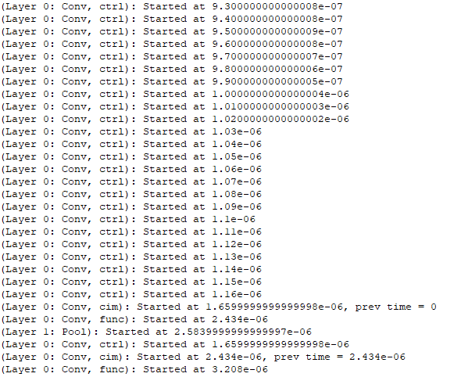
Python-based simulation platform
The log file generated by the simulator:
…
Sending a new data to fill in the input buffer
CIM is activated
FPGA latency depends on the hardware implementation
(i.e., the number of connected tiles, bandwidth, clock frequency, …)
…

Slide 18
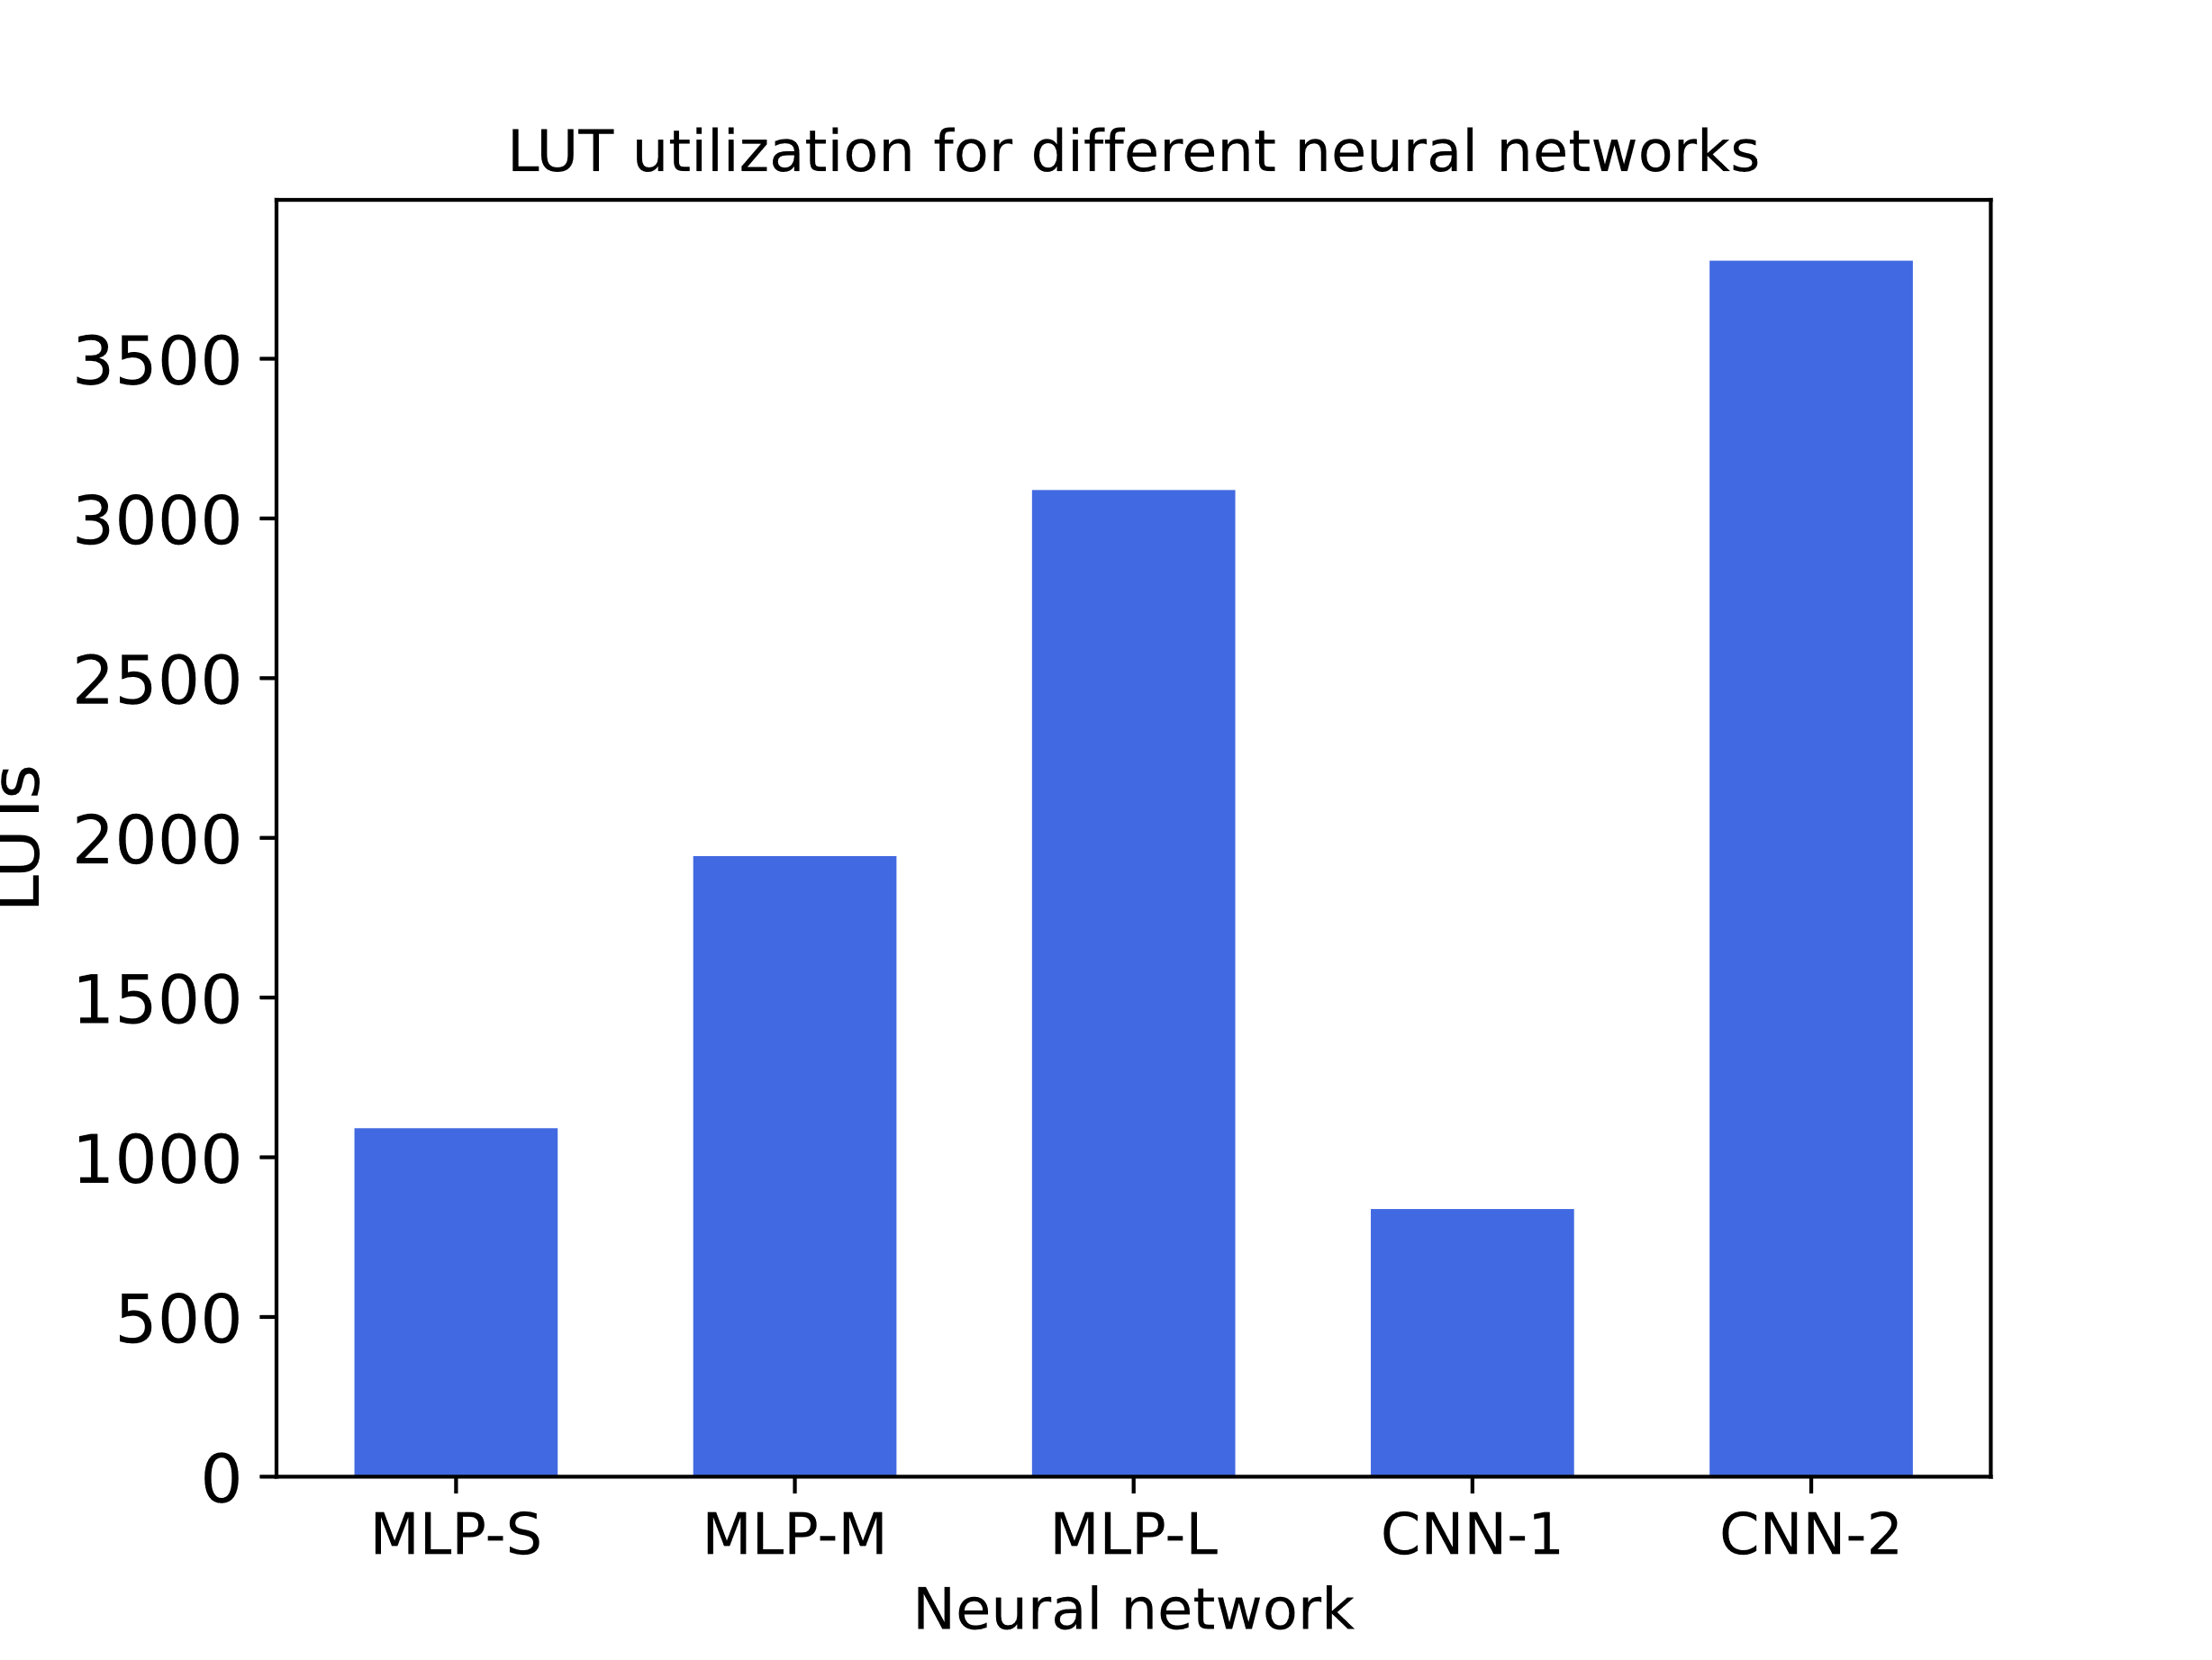
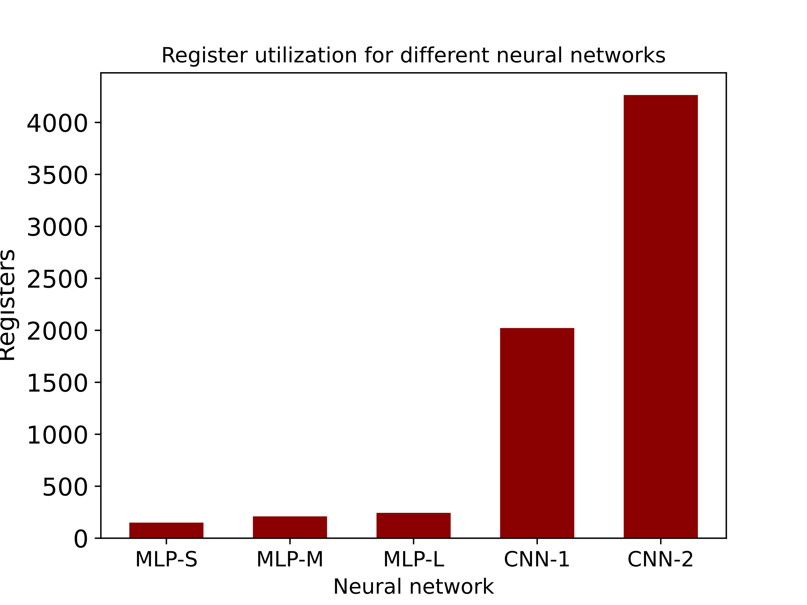

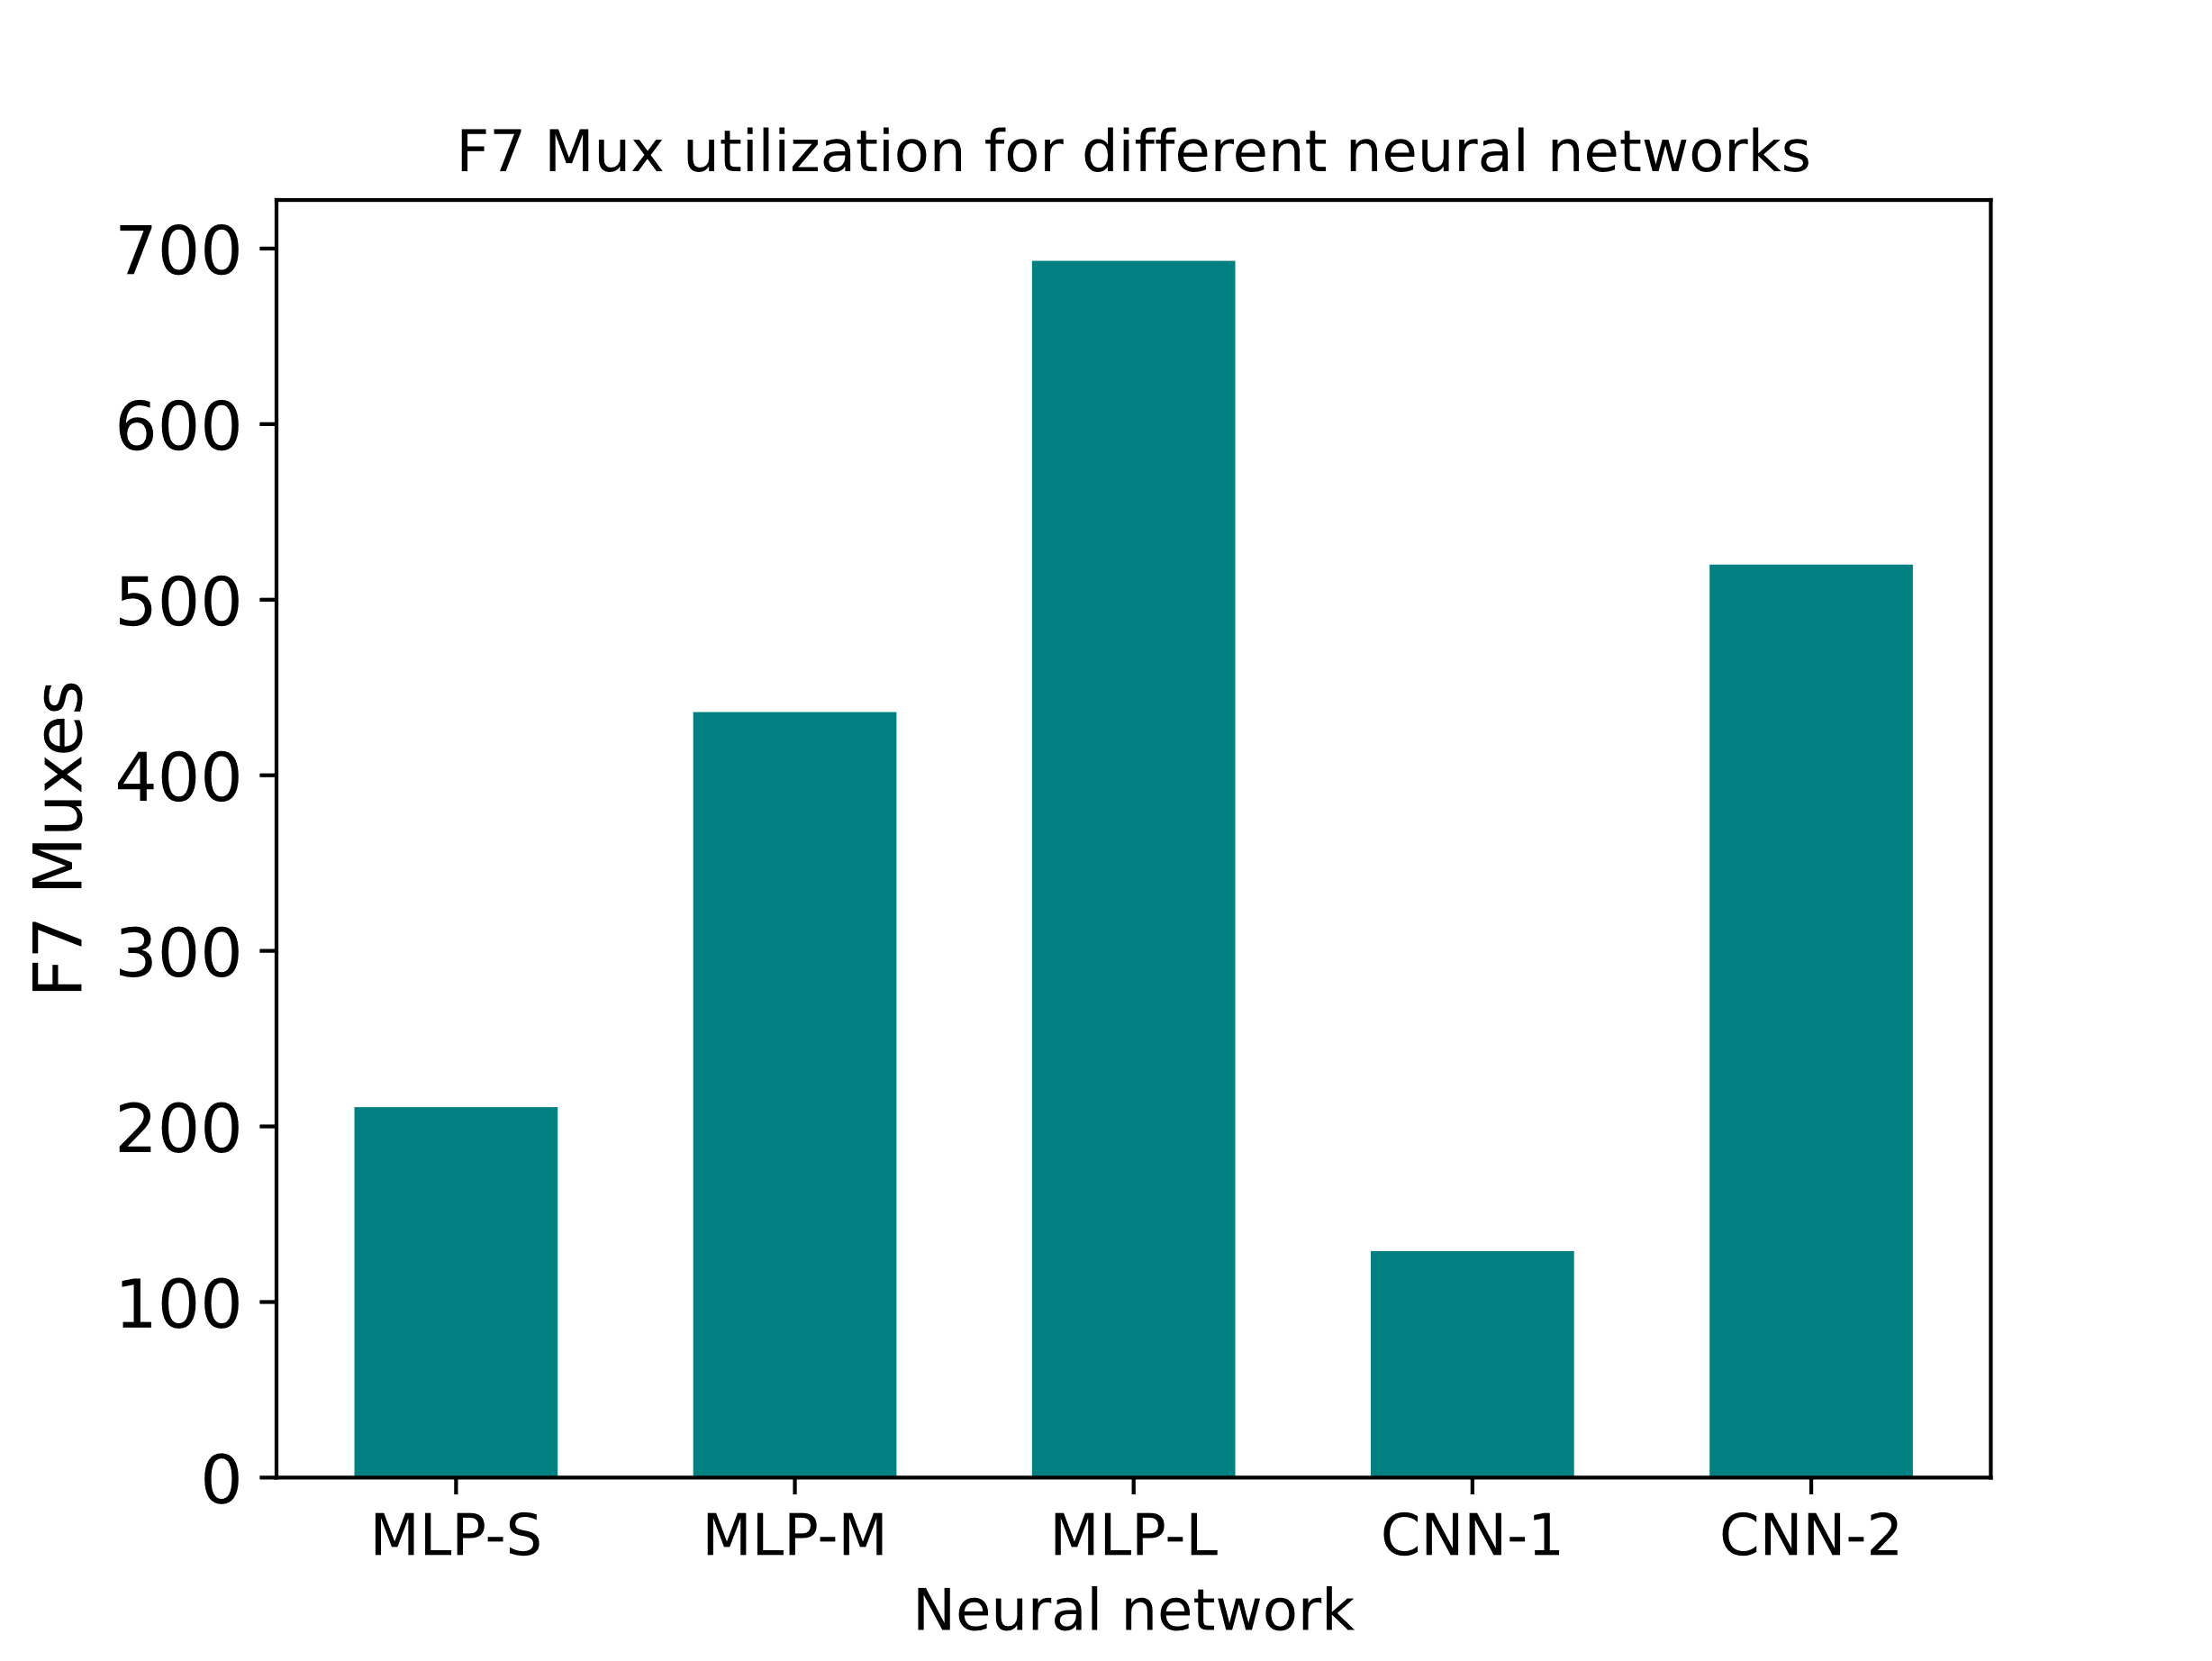
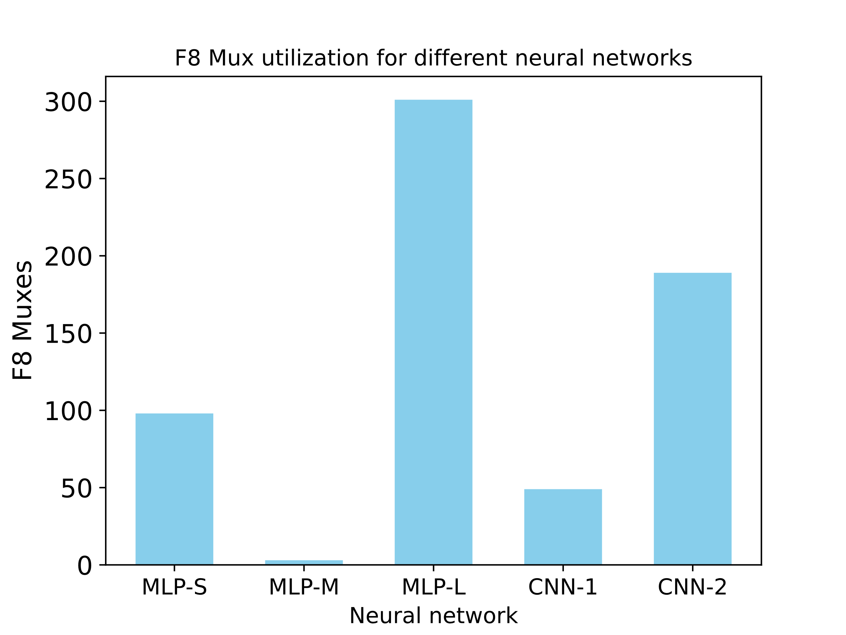
Preliminary results
FPGA clock frequency = 100 MHz
CIM digital circuit clock frequency = 500 MHz

Slide 19
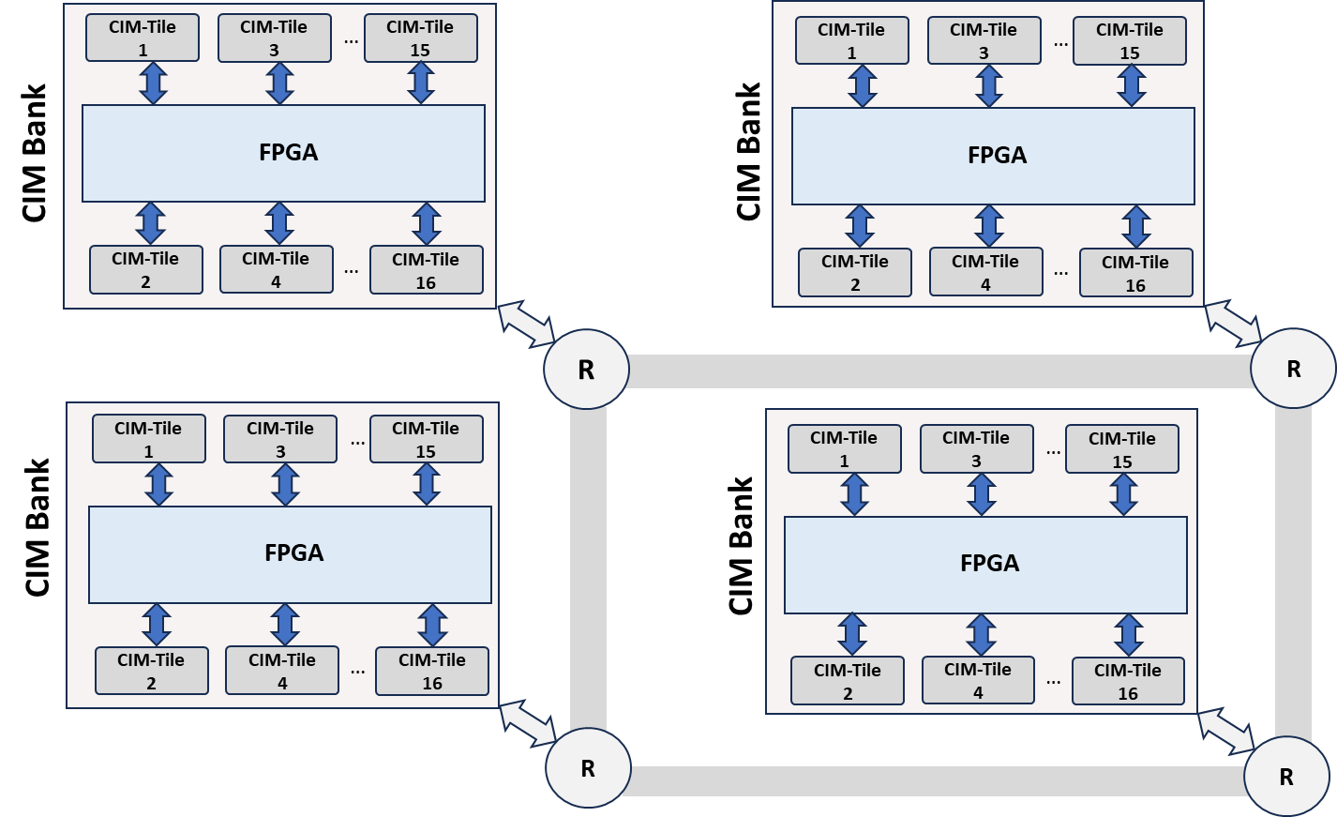
Future Direction
Considering the impact of device programming and initialization
Considering the impact of the number of available CIM-Tiles
Considering the realistic implementation where we have a design hierarchy!
- Mapping and scheduling of different workloads
- Modeling the traffic on the network

