Slide 1
Software Project
MULTILINGUAL TEXT-TO-SPEECH SYSTEM
Alena YAKAVETS
Cécile MACAIRE
Chanoudom PRACH
Ludivine ROBERT
M2 NLP 2020-2021
October 27, 2020
Notes:
CECILE

Slide 2
Presentation Overview
Quick project recap
Done
In progress
To do
Timeline
Notes:
CECILE

Slide 3
Project Recap
Multilingual TTS, based on Tacotron
Tacotron: end-to-end generative TTS model based on the sequence-to-sequence with attention paradigm
Multilingual: able to generate speech according to a selected language model
Speech generation + emotional contour transfer
Language/Corpus:
English: EmoV-DB, LJSpeech (new!)
French: SIWIS
Notes:
CECILE

Slide 4
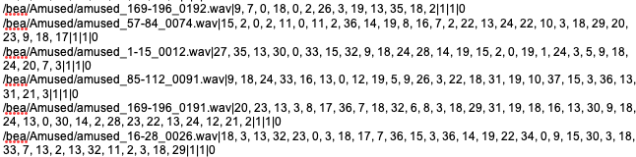
Items Done
Corpora pre-processing
New English corpus: graphemes > phonemes > phoneme ID
Metadata file created – ready for model training!
<filepath wav>|<phonemesid>|<speakerid>|<emotions>|<languageid>
Subjective evaluation tests of French speech samples, produced by the base model (thanks for your participation!)
Notes:
CECILE

Slide 5
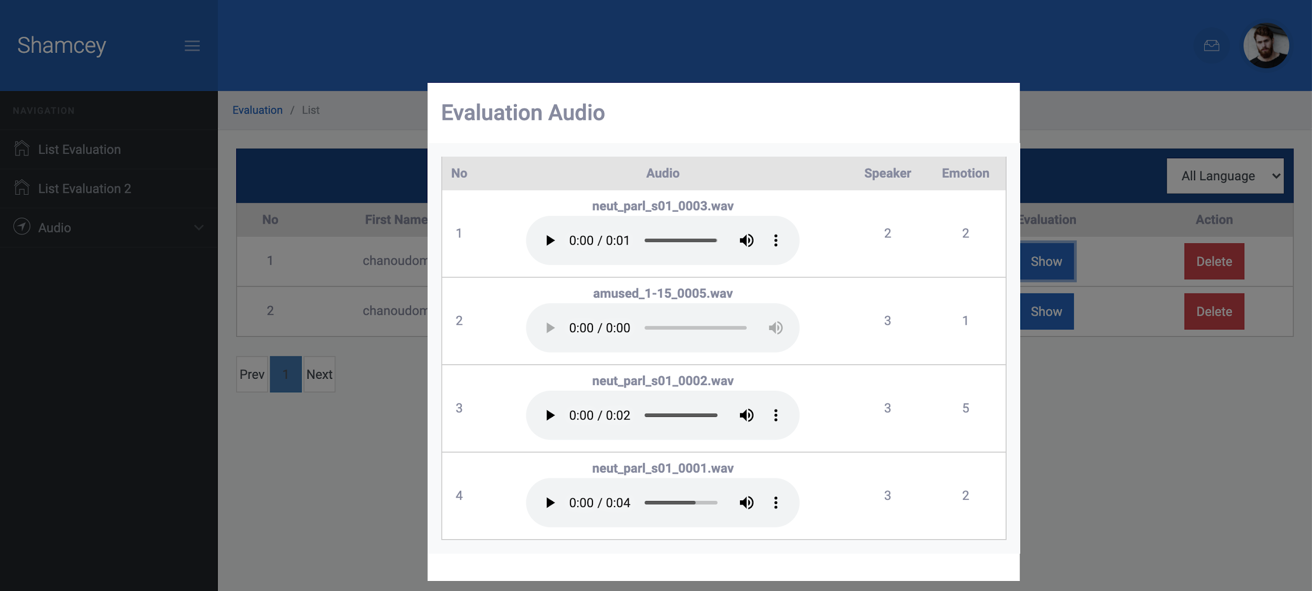
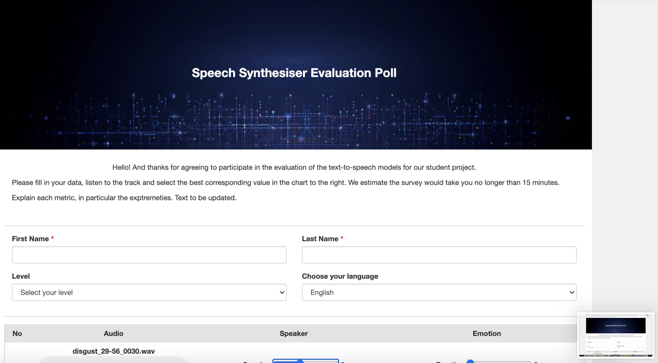
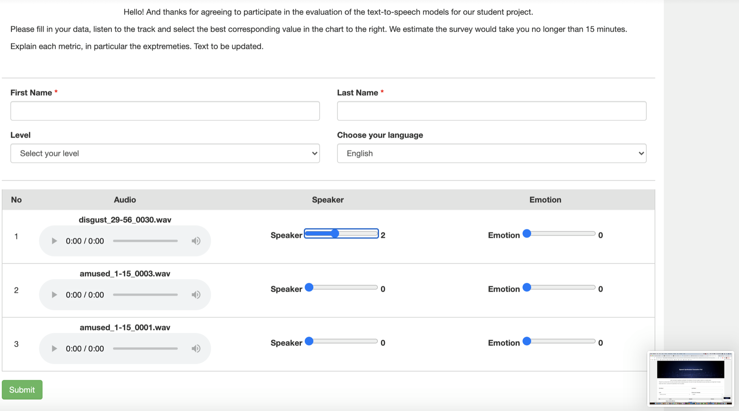
Items Done
Website draft for further evaluation tests
Notes:
CHANOUDOM

Slide 6




Technologies
Notes:
CHANOUDOM

Slide 7
Items In Progress
TTS-related reading
Grid5000 account
Access to a large-scale and flexible testbed for experiment-driven research
Has computational resource to train the neural network models for TTS
Evaluation approach:
Type: subjective
Participants: target min 12 people per lg
Languages: EN, FR
Modules to evaluate: speech generation, emotional contour transfer
Subtitles: yes for speech generation module
Evaluation metrics: MOS
Models to evaluate: 2-3
Time estimation: 20 min
Notes:
ALENA

Slide 8
Items To Do
Run Mellotron locally with pre-trained model
Get acquainted with the new library and the source code
Add multilingual module
Train model
Evaluate synthesized speech
Results analysis
Writing
Project report
Paper for Interspeech conference
Notes:
Ludivine

Slide 9
Timeline
Knowledge build-up
Data preprocessing
Synthesis
Multilingual module
Library ready
Access to source code
Report
1/10
25/10
3/11
27/11
15/12
15/10
23/11
5/12
25/01
Draft webpage for evaluation survey
Model training
Models
evaluation,
results analysis
Defense
Notes:
LUDIVINE

Slide 10
Thank you for your attention!
DO YOU HAVE ANY QUESTIONS?
Notes:
LUDIVINE

