Slide 1
hASHING

Slide 2
What is a hash function?
A hash function takes an input and does some maths and gives a not-quite-but-nearly unique output.
If the output of the hash function was an 8 digit hex string there would be 16*16*16*16*16*16*16*16 (or 16⁸ which is 4’294’967’296) possible outputs.
So eventually the output from 2 different inputs would be the same.
Hence not-quite-but-nearly unique output.

Slide 3
Some hash functions…
MD5
SHA-1
SHA-2
NTLM
LANMAN
SHA256
SHA512
At time of writing, you should probably use bcrypt
Hashing functions go out of date. Why?

Slide 4
Collisions
When 2 inputs have same output from hash functions.
Bad
Mitigation?
Linear probing or chaining can lead to linear search situation
Happens less in SHA512 than SHA256
No surprises there

Slide 5
Hash… how?
Out of scope, sorry!
But it’s maths that’s hard to reverse
It may use powers and big prime numbers and stuff
To me it’s a magical black box, and I’m looking for the following…?
One way
Few collisions
Efficiency

Slide 6
So what?
3 major uses:
Hash tables for dictionaries
Cryptographic hash functions
Password storage and checking
Checking things haven’t been messed with/corrupted

Slide 7
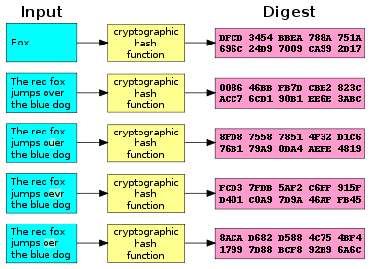
Crypto Hash function
Note how one char changing produces a totally different output!
This is why you get hashes with files you download: you know if a single bit has been corrupted. ☺

Slide 8
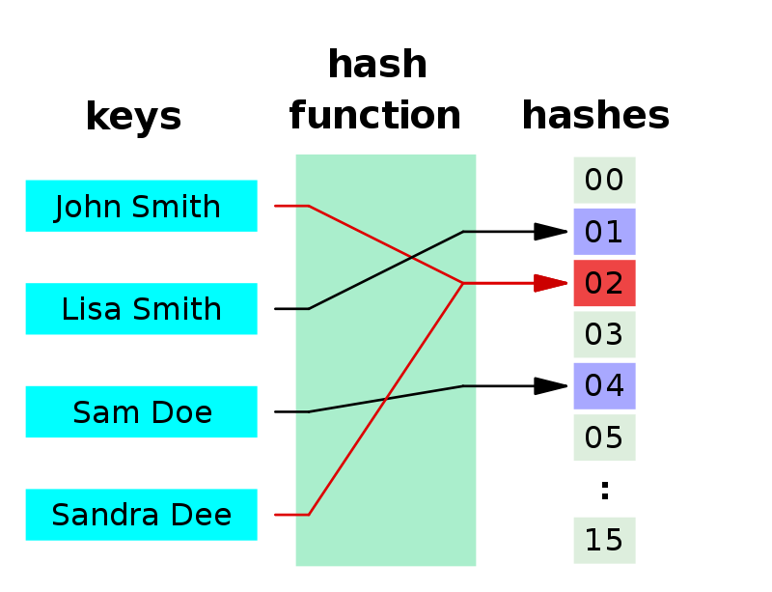
Hashing for Hash tables (dictionaries)
Hash tells you which RAM location to look in.
Much faster than iterating through a huge list or array.
This is why dictionaries are often quicker than arrays!
Any problems in diagram?

