Slide 1




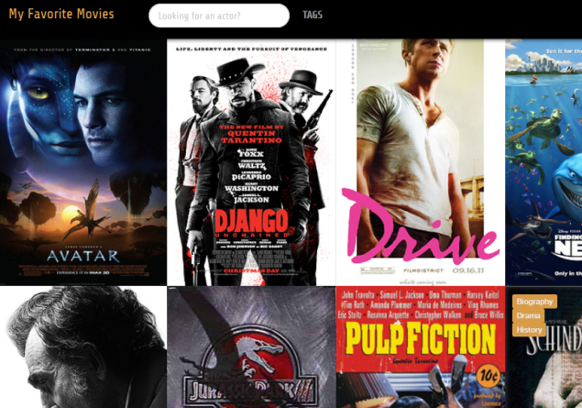
Application
Movies
API
REST
My Favorite Movies
http://.../rest/movies
[
{
"title": "Avatar",
"genres": [ "Action","Adventure",...],
"imdb_id": "tt0499549",
"directors": ["James Cameron"],
"actors": ["Sam Worthington","Zoe Saldana", ...],
...
},
{
"title": "Django Unchained",
"genres": ["Adventure","Drama",...],
"imdb_id": "tt1853728",
"directors": ["Quentin Tarantino"],
"actors": ["Jamie Foxx","Leonardo DiCaprio",...],
...
},
...
]

Slide 2


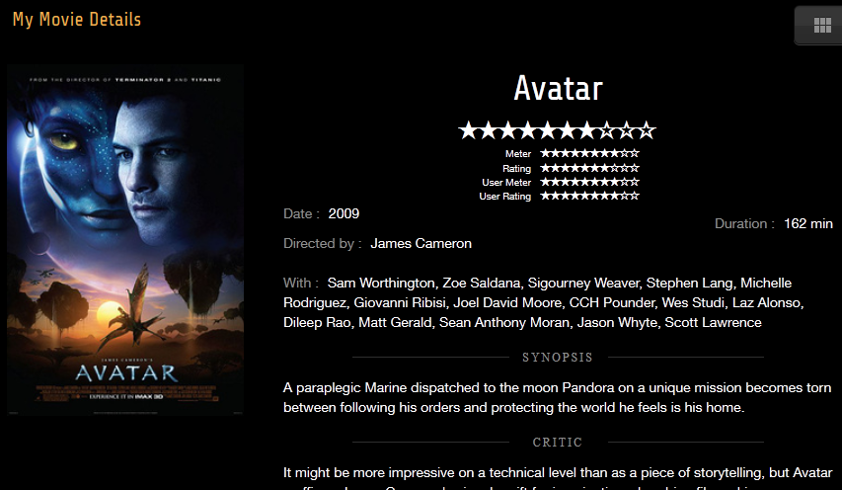
routage
(defaut)
Movies List
click
Movie Details (tt049954)

Slide 3
routage
<html ng-app="mymoviesApp">
mymoviesControllers
.controller('MovieListCtrl', [ '$scope', 'Movie',
function($scope, Movie) {
…
}
<body>
<section ng-view>
</section>
index.html
MovieListCtrl
mymoviesApp
routeProvider
/movie
<section class="movies">
<!--Body content-->
<ul>
<li ng-repeat="movie in movies" class="movie">
…
mymoviesApp.config(['$routeProvider',
function($routeProvider) {
$routeProvider.
when('/movies', {
templateUrl: 'views/movie-list.html',
controller: 'MovieListCtrl'
}).
…
otherwise({
redirectTo: '/movies'
});
}]);
views/movie-list.html
App

Slide 4
Binding / scope
<html ng-app="mymoviesApp">
mymoviesApp
<body>
<section ng-view>
$rootScope
<section class="movies">
<span class="title">{{pageTitle}}</span>
<ul>
<li ng-repeat="movie in movies">
<h3>{{movie.title}}</h3>
…
MovieListCtrl
$scope
pageTitle : ‘My Favorite Movies’
movies : Array
Repeater
scope
views/movie-list.html
movie : { title : ‘…’ }
</section>
index.html

Slide 5

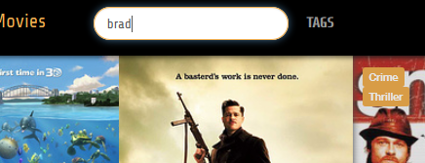
Binding bi-directionnel
<section class="movies">
<input ng-model="actor"
placeholder="Looking for an actor?“
class="form-control"></input>
…
<ul>
<li ng-repeat="movie in movies | actorSearch:actor ">
<h3>{{movie.title}}</h3>
…
MovieListCtrl
$scope
écriture
actor : String
utilisation
MovieListCtrl
views/movie-list.html

