Slide 1
DB2 Project
Gamified marketing application
Group Members:
Ludovico Righi
Enrico Gherardi
Arslan Ali
Academic Year 2020/2021

Slide 2
Entity Relationship Diagram

Slide 3
ID
timestamp
related
ID
question_text
Log
0:N
Question
ID
name,
photoimage
1:1
1:1
1:1
ID
response
Answer
0:N
Product
1:1
composed
logging
0:N
0:N
0:N
regarding
describing
ID
username
password
email
banned,
daily_points
User
ID
date
1:1
User
has
Questionnaire
0:N
0:N
1:1
ID
text
Review
filling in
0:N
corresponding
FilledForm
1:1
1:1
ID
date,
score,
sex,
age,
expertice
ID
username
password
email
ID
Word
Admin
OffensiveWords

Slide 4
Motivations
We have decided to use a one-to-many relationship between product and questionnaire, so that a product can be related to different questionnaires in different days; using a one-to-one would have been good anyway, but more restrictive.
We have inserted the fields sex, age and expertice into the FilledForm, so that a user can modify his choices everytime that he fills in a form, as required in the specifications. Since the number of these field is fixed to three, we decided to insert them into the FilledForm table, instead of using another one-to-one relationship with FilledForm.

Slide 5
SQL Data Definition Language

Slide 6
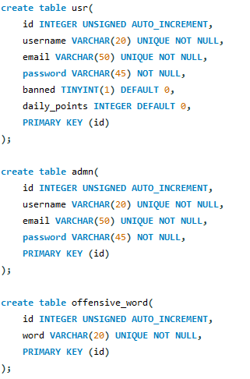

Slide 7
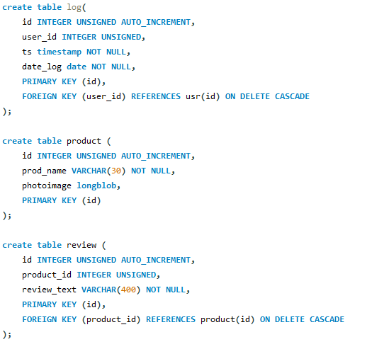

Slide 8
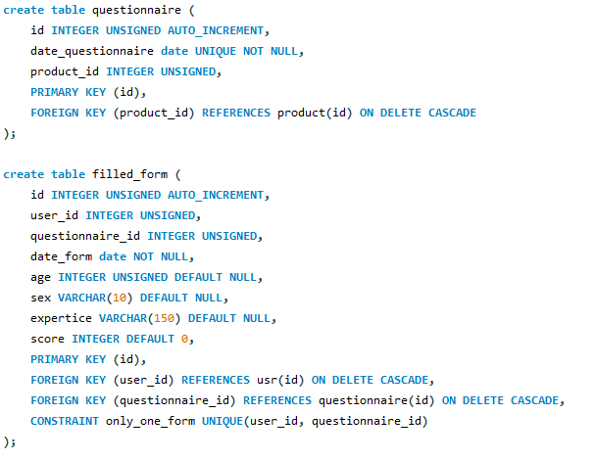

Slide 9
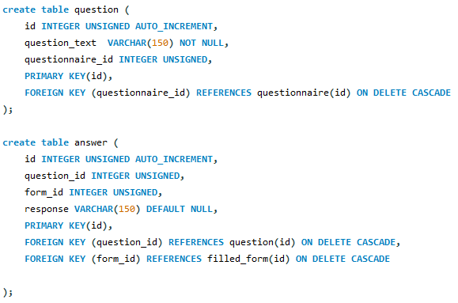

Slide 10
Logical Model

Slide 11
offensive_word(ID, word)
admn(ID, username, email, password)
log(ID, user_id, ts)
usr(ID, username, email, password, banned, daily_points)
filled_form(ID, user_id, questionnaire_id, date_form, age, sex, expertice, score)
answer(ID, question_id, form_id, response)
question(ID, question_text, questionnaire_id)
questionnaire(ID, date_questionnaire, product_id)
product(ID, prod_name, photoimage)
review(ID, product_id, review_text)

Slide 12
Relationship “logging”
logging
User
Log
User → Log: @OneToMany not required, mapped for simplicity
Log → User: @ManyToOne necessary for retrieving the users who logged in a certain date
Owner: entity Log
0:N
1:1
User
*
Log
1
User
Log

Slide 13
Relationship “filling in”
filling in
User
FilledForm
User → FilledForm: @OneToMany not required, mapped for simplicity
FilledForm → User: @ManyToOne necessary for retrieving the users who filled in the Form in a certain date
Owner: entity FilledForm
0:N
1:1
User
*
FilledForm
1
User
FilledForm

Slide 14
Relationship “has”
has
FilledForm
Answer
FilledForm → Answer: @OneToMany, fetchType.EAGER for retrieving all the answers of a given FilledForm
CascadeType.PERSIST, CascadeType.REMOVE
Answer → FilledForm: @ManyToOne not necessary, mapped for simplicity
Owner: entity Answer
0:N
1:1
FilledForm
*
Answer
1
FilledForm
Answer

Slide 15
Relationship “corresponding”
corresponding
Questionnaire
FilledForm
Questionnaire → FilledForm: @OneToMany for removing all the forms related to a specific deleted questionnaire with CascadeType.REMOVE
FilledForm → Questionnaire: @ManyToOne not necessary, mapped for simplicity
Owner: entity FilledForm
0:N
1:1
Questionnaire
*
FilledForm
1
Questionnaire
FilledForm

Slide 16
Relationship “related”
related
Question
Answer
Question → Answer: @OneToMany not necessary, mapped for simplicity. Could be used in future extentions for printing all the answer of a specific question.
Answer → Question : @ManyToOne not necessary, mapped for simplicity. Could be used in future extentions for printing the question of a given answer
Owner: entity Answer
0:N
1:1
Question
*
Answer
1
Question
Answer

Slide 17
Relationship “composed”
composed
Questionnaire
Question
Questionnaire → Question: @OneToMany, fetchType.EAGER for retrieving all the questions of a specific questionnaire
CascadeType.PERSIST, CascadeType.REMOVE
Question → Questionnaire : @ManyToOne not necessary, mapped for simplicity
Owner: entity Question
0:N
1:1
Questionnaire
*
Question
1
Questionnaire
Question

Slide 18
Relationship “regarding”
regarding
Product
Questionnaire
Product → Questionnaire : @OneToMany not necessary, mapped for simplicity
Questionnaire → Product : @ManyToOne for retrieving the product of the questionnaire of the day
Owner: entity Questionnaire
0:N
1:1
Product
*
Questionnaire
1
Product
Questionnaire

Slide 19
Relationship “describing”
describing
Product
Review
Product → Review : @OneToMan, fetchType.EAGER for retrieving all the reviews of the product of the day
Review → Product : @ManyToOne not necessary, mapped for simplicity
Owner: entity Review
0:N
1:1
Product
*
Review
1
Product
Review

Slide 20
Components (1/2)
Client (User)
CheckLogin
GoToHomePage
GoToLeaderboardPage
GoToQuestionnairePage
GoToRegistrationPage
GoToStatisticsPage
GoToThanksPage
Logout
UserRegistration
index.html
Home.html
LeaderboardPage.html
QuestionnairePage.html
RegistrationPage.html
StatisticsPage.html
ThanksPage.html
Client (Admin)
CheckLogin
CreateQuestionnaire
DeleteQuestionnaire
GetStatistics
GoToCreationPage
GoToDeletionPage
GoToHomePage
GoToInspectionPage
Logout
PrintQuestions
index.html
CreationPage.html
DeletionPage.html
Home.html
InspectionPage.html

Slide 21
Components: Business Tier (2/2)
UserService
checkCredentials(String usrn, String pwd)
checkIfBanned(Integer userId)
hasDoneDailyQuestionnaire(Integer userId)
hasDoneQuestionnaireByDate(Date date)
saveLog(User user)
registerUser(String usrn, String email, String pwd)
getLeaderboard(Integer userId)
hasOpenedQuestionnaireByDate(Date date)
QuestionnaireService
getQuestionnaireOfToday()
saveQuestionnaire(Date date, Product product, List<Question> questions)
deleteQuestionnaire(Date date)
FilledFormService
saveFilledForm(User user, Questionnaire questionnaire, List<Answer> answers, Integer age, String sex, String expertice)
retrieveByDate(Date date)
deleteFilledForm(Integer formId)
AnswerService
saveAnswers(List<String> answers, List<Question> questions)
ProductService
getProductOfToday()
createProduct(byte[] photoimage, String name)
AdminService
checkCredentials(String usrn, String pwd)
QuestionService
saveQuestions(List<String> questions)

