Slide 1
DB2 Project
Gamified marketing application
Group Members:
Ludovico Righi
Enrico Gherardi
Arslan Ali
Academic Year 2020/2021

Slide 2
Entity Relationship Diagram

Slide 3
ID
timestamp
related
ID
question_text
Log
0:N
Question
ID
name,
photoimage
1:1
1:1
1:1
ID
response
Answer
0:N
Product
1:1
composed
logging
0:N
0:N
0:N
regarding
describing
ID
username
password
email
banned,
daily_points
User
ID
date
1:1
User
has
Questionnaire
0:N
0:N
1:1
ID
text
Review
filling in
0:N
corresponding
FilledForm
1:1
1:1
ID
date,
score,
sex,
age,
expertice
ID
username
password
email
ID
Word
Admin
OffensiveWords

Slide 4
Motivations
We have decided to use a one-to-many relationship between product and questionnaire, so that a product can be related to different questionnaires in different days; using a one-to-one would have been good anyway, but more restrictive.
We have inserted the fields sex, age and expertice into the FilledForm, so that a user can modify his choices everytime that he fills in a form, as required in the specifications. Since the number of these field is fixed to three, we decided to insert them into the FilledForm table, instead of using another one-to-one relationship with FilledForm.

Slide 5
SQL Data Definition Language

Slide 6
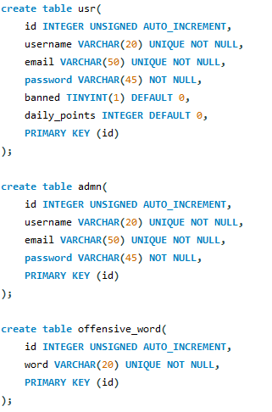

Slide 7
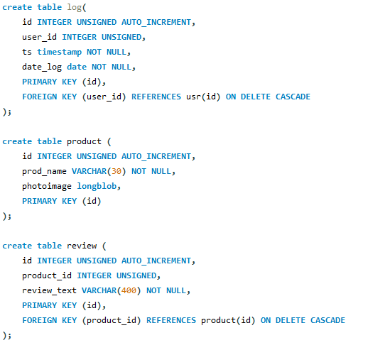

Slide 8
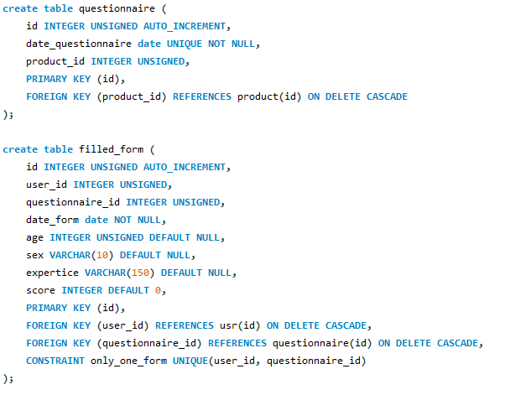

Slide 9
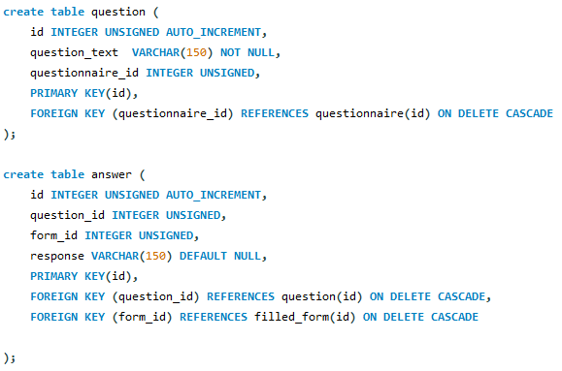

Slide 10
Logical Model

Slide 11
offensive_word(ID, word)
admn(ID, username, email, password)
log(ID, user_id, ts)
usr(ID, username, email, password, banned, daily_points)
filled_form(ID, user_id, questionnaire_id, date_form, age, sex, expertice, score)
answer(ID, question_id, form_id, response)
question(ID, question_text, questionnaire_id)
questionnaire(ID, date_questionnaire, product_id)
product(ID, prod_name, photoimage)
review(ID, product_id, review_text)

Slide 12
Relationship “logging”
logging
User
Log
User → Log: @OneToMany not required, mapped for simplicity
Log → User: @ManyToOne necessary for retrieving the users who logged in a certain date
Owner: entity Log
0:N
1:1
User
*
Log
1
User
Log

Slide 13
Relationship “filling in”
filling in
User
FilledForm
User → FilledForm: @OneToMany not required, mapped for simplicity
FilledForm → User: @ManyToOne necessary for retrieving the users who filled in the Form in a certain date
Owner: entity FilledForm
0:N
1:1
User
*
FilledForm
1
User
FilledForm

Slide 14
Relationship “has”
has
FilledForm
Answer
FilledForm → Answer: @OneToMany, fetchType.EAGER for retrieving all the answers of a given FilledForm
CascadeType.PERSIST, CascadeType.REMOVE
Answer → FilledForm: @ManyToOne not necessary, mapped for simplicity
Owner: entity Answer
0:N
1:1
FilledForm
*
Answer
1
FilledForm
Answer

Slide 15
Relationship “corresponding”
corresponding
Questionnaire
FilledForm
Questionnaire → FilledForm: @OneToMany for removing all the forms related to a specific deleted questionnaire with CascadeType.REMOVE
FilledForm → Questionnaire: @ManyToOne not necessary, mapped for simplicity
Owner: entity FilledForm
0:N
1:1
Questionnaire
*
FilledForm
1
Questionnaire
FilledForm

Slide 16
Relationship “related”
related
Question
Answer
Question → Answer: @OneToMany not necessary, mapped for simplicity. Could be used in future extentions for printing all the answer of a specific question.
Answer → Question : @ManyToOne not necessary, mapped for simplicity. Could be used in future extentions for printing the question of a given answer
Owner: entity Answer
0:N
1:1
Question
*
Answer
1
Question
Answer

Slide 17
Relationship “composed”
composed
Questionnaire
Question
Questionnaire → Question: @OneToMany, fetchType.EAGER for retrieving all the questions of a specific questionnaire
CascadeType.PERSIST, CascadeType.REMOVE
Question → Questionnaire : @ManyToOne not necessary, mapped for simplicity
Owner: entity Question
0:N
1:1
Questionnaire
*
Question
1
Questionnaire
Question

Slide 18
Relationship “regarding”
regarding
Product
Questionnaire
Product → Questionnaire : @OneToMany not necessary, mapped for simplicity
Questionnaire → Product : @ManyToOne for retrieving the product of the questionnaire of the day
Owner: entity Questionnaire
0:N
1:1
Product
*
Questionnaire
1
Product
Questionnaire

Slide 19
Relationship “describing”
describing
Product
Review
Product → Review : @OneToMan, fetchType.EAGER for retrieving all the reviews of the product of the day
Review → Product : @ManyToOne not necessary, mapped for simplicity
Owner: entity Review
0:N
1:1
Product
*
Review
1
Product
Review

Slide 20
Entities
In the following slides are reported the Entities that have been used with the motivations of the NamedQueries and their main methods.
All the Entities have been mapped exactly as just described in the preceding slides.

Slide 21
Admin
@Entity
@Table(name = "admn", schema = "db_easyr")
@NamedQuery(name = "Admin.checkCredentials",
query = "SELECT a FROM Admin a WHERE a.username = ?1 and a.password = ?2")
public class Admin implements Serializable {
private static final long serialVersionUID = 1L;
@Id
@GeneratedValue(strategy = GenerationType.IDENTITY)
private Integer id;
private String username;
private String email;
private String password;

Slide 22
Motivations
checkCredentials is used to check if exists an admin with certain username and password.

Slide 23
User
public class User implements Serializable {
private static final long serialVersionUID = 1L;
@Id
@GeneratedValue(strategy = GenerationType.IDENTITY)
private Integer id;
private String username;
private String email;
private String password;
private Boolean banned;
@Column(name = "daily_points")
private Integer points;
@OneToMany(mappedBy = "user")
private List<FilledForm> forms = new ArrayList<FilledForm>();
@OneToMany(mappedBy = "user")
private List<Log> logs;
@Entity
@Table(name = "usr", schema = "db_easyr")
@NamedQueries({
@NamedQuery(name = "User.checkCredentials", query = "SELECT u FROM User u WHERE u.username = ?1 and u.password = ?2"),
@NamedQuery(name = "User.getLeaderboard", query = "SELECT u FROM User u WHERE u.points>0 ORDER BY u.points DESC"),
@NamedQuery(name = "User.hasDoneDailyQuestionnaire", query = "SELECT u FROM User u, FilledForm f WHERE f.user = u AND f.date = CURRENT_DATE AND u.id = ?1"),
@NamedQuery(name = "User.hasDoneQuestionnaireByDate", query = "SELECT u FROM User u, FilledForm f WHERE f.user = u AND f.date = ?1"),

Slide 24
Motivations
checkCredentials is used to check if exists a user with certain username and password.
getLeaderboard is used to build the learderboard retrieving all the users orderd by descending points that have done the questionnaire of the day.
hasDoneDailyQuestionnaire: is used for checking if a specific user has done the questionnaire of the day.
hasDoneQuestionnaireByDate: is used for retrieving all the users that have done the questionnaire in a specific date.

Slide 25
Log
@Entity
@Table(name = "log", schema = "db_easyr")
@NamedQuery(name = "Log.hasOpenedQuestionnaireByDate", query = "SELECT DISTINCT l.user FROM Log l WHERE l.date = ?1 AND l.user.banned=false")
public class Log implements Serializable {
private static final long serialVersionUID = 1L;
@Id
@GeneratedValue(strategy = GenerationType.IDENTITY)
private Integer id;
@ManyToOne
@JoinColumn(name = "user_id")
private User user;
@Temporal(TemporalType.DATE)
@Column(name = "date_log")
private Date date;
@Temporal(TemporalType.TIMESTAMP)
@Column(name = "ts")
private Date timestamp;

Slide 26
Motivations
hasOpenedQuestionnaireByDate is used for retrieving all the users ( that have not been banned) that have at least opened the questionnaire in a specific date, so that then we can infer who canceled the questionnaire in the Admin inspection page.

Slide 27
Product
@Entity
@Table(name = "product", schema = "db_easyr")
@NamedQuery(name = "Product.getProdOfToday", query = "SELECT p FROM Questionnaire q JOIN q.product p WHERE q.date=CURRENT_DATE")
public class Product implements Serializable {
private static final long serialVersionUID = 1L;
@Id
@GeneratedValue(strategy = GenerationType.IDENTITY)
private Integer id;
@OneToMany(mappedBy = "product")
private List<Questionnaire> questionnaires = new ArrayList<Questionnaire>();
@OneToMany(mappedBy = "product", fetch = FetchType.EAGER)
private List<Review> reviews;
@Basic(fetch = FetchType.EAGER)
@Lob
private byte[] photoimage;
@Column(name = "prod_name")
private String name;

Slide 28
Motivations
getProdOfToday is used for retrieving the product of the day. Notice that, as already stated, the product does not have the attribute date, because we wanted to permit more questionnaires related to the same product in different dates. For this reason, we have to join the product table with the questionnaire table.
Notice also that the fecthType with the Reviews is EAGER because we want to display all the Reviews, if any, in the homepage.

Slide 29
Review
@Entity
@Table(name = "review", schema = "db_easyr")
public class Review implements Serializable {
private static final long serialVersionUID = 1L;
@Id
@GeneratedValue(strategy = GenerationType.IDENTITY)
private Integer id;
@ManyToOne
@JoinColumn(name = "product_id")
private Product product;
@Column (name="review_text")
private String text;

Slide 30
Questionnaire
@OneToMany(mappedBy = "questionnaire", cascade= CascadeType.REMOVE)
private List<FilledForm> forms;
@Temporal(TemporalType.DATE)
@Column(name = "date_questionnaire")
private Date date;
@ManyToOne
@JoinColumn(name = "product_id")
private Product product;
@OneToMany(mappedBy = "questionnaire", fetch = FetchType.EAGER, cascade = { CascadeType.PERSIST, CascadeType.REMOVE })
private List<Question> questions = new ArrayList<Question>();
public void addQuestion(Question question) {
getQuestions().add(question);
question.setQuestionnaire(this);
}
@Entity
@Table(name = "questionnaire", schema = "db_easyr")
@NamedQueries({
@NamedQuery(name = "Questionnaire.getQuestOfToday", query = "SELECT q FROM Questionnaire q WHERE q.date=CURRENT_DATE"),
@NamedQuery(name = "Questionnaire.getQuestByDate", query = "SELECT q FROM Questionnaire q WHERE q.date= ?1") })
public class Questionnaire implements Serializable {
private static final long serialVersionUID = 1L;
@Id
@GeneratedValue(strategy = GenerationType.IDENTITY)
private Integer id;

Slide 31
Motivations
getQuestOfToday is used for retrieving the questionnaire of the day.
getQuestByDate is used for retrieving a specific questionnaire of a certain date, so that then the Admin can delete it.
Notice also that the fecthType with the Questions is EAGER because we want to display all the Questions in the questionnairepage.
We have used a PERSIST and REMOVE cascading with Questions so that when a Questionnaire is either created or removed the same happens for all the related Questions.
For the same reason, we have also used REMOVE cascading with FilledForm.
The method addQuestion () is used for keeping updated both sides of the relationship between Questionnaire and Questions.

Slide 32
Question
@Entity
@Table(name = "question", schema = "db_easyr")
public class Question implements Serializable {
private static final long serialVersionUID = 1L;
@Id
@GeneratedValue(strategy = GenerationType.IDENTITY)
private Integer id;
@Column(name = "question_text")
private String text;
@OneToMany(mappedBy = "question")
private List<Answer> answers;
@ManyToOne
@JoinColumn(name = "questionnaire_id")
private Questionnaire questionnaire;

Slide 33
FilledForm
@Entity
@Table(name = "filled_form", schema = "db_easyr")
@NamedQuery(name = "FilledForm.retrieveAnswersByDate", query = "SELECT f FROM FilledForm f WHERE f.date = ?1")
public class FilledForm implements Serializable {
private static final long serialVersionUID = 1L;
@Id
@GeneratedValue(strategy = GenerationType.IDENTITY)
private Integer id;
@ManyToOne
@JoinColumn(name = "user_id")
private User user;
@ManyToOne
@JoinColumn(name = "questionnaire_id")
private Questionnaire questionnaire;
@OneToMany(mappedBy = "form", cascade = { CascadeType.PERSIST, CascadeType.REMOVE }, fetch = FetchType.EAGER)
private List<Answer> answers = new ArrayList<Answer>();
@Temporal(TemporalType.DATE)
@Column(name = "date_form")
private Date date;
private Integer age;
private String sex;
private String expertice;
private Integer score;
public void addAnswer(Answer answer) {
getAnswers().add(answer);
answer.setForm(this);
}

Slide 34
Motivations
retrieveAnswersByDate is used for retrieving all the filled forms of a specific questionnaire given its date.
Notice also that the fecthType with the Answer is EAGER because we want to display to the Admin all the Answers in the inspection page.
We have used a PERSIST and REMOVE cascading with Answer so that when a FilledForm is either created or removed the same happens for all the related Answers.
The method addAnswer() is used for keeping updated both sides of the relationship between FilledForm and Answer.

Slide 35
Answer
@Entity
@Table(name = "answer", schema = "db_easyr")
public class Answer implements Serializable {
private static final long serialVersionUID = 1L;
@Id
@GeneratedValue(strategy = GenerationType.IDENTITY)
private Integer id;
@ManyToOne
@JoinColumn(name = "question_id")
private Question question;
@ManyToOne
@JoinColumn(name="form_id")
private FilledForm form;
private String response;

Slide 36
Components (1/2)
Client (User)
CheckLogin
GoToHomePage
GoToLeaderboardPage
GoToQuestionnairePage
GoToRegistrationPage
GoToStatisticsPage
GoToThanksPage
Logout
UserRegistration
index.html
Home.html
LeaderboardPage.html
QuestionnairePage.html
RegistrationPage.html
StatisticsPage.html
ThanksPage.html
Client (Admin)
CheckLogin
CreateQuestionnaire
DeleteQuestionnaire
GetStatistics
GoToCreationPage
GoToDeletionPage
GoToHomePage
GoToInspectionPage
Logout
PrintQuestions
index.html
CreationPage.html
DeletionPage.html
Home.html
InspectionPage.html

Slide 37
Components: Business Tier (2/2)
@Stateless UserService
checkCredentials(String usrn, String pwd)
checkIfBanned(Integer userId)
hasDoneDailyQuestionnaire(Integer userId)
hasDoneQuestionnaireByDate(Date date)
saveLog(User user)
registerUser(String usrn, String email, String pwd)
getLeaderboard(Integer userId)
hasOpenedQuestionnaireByDate(Date date)
@Stateless QuestionnaireService
getQuestionnaireOfToday()
saveQuestionnaire(Date date, Product product, List<Question> questions)
deleteQuestionnaire(Date date)
@Stateless FilledFormService
saveFilledForm(User user, Questionnaire questionnaire, List<Answer> answers, Integer age, String sex, String expertice)
retrieveByDate(Date date)
deleteFilledForm(Integer formId)
@Stateless AnswerService
saveAnswers(List<String> answers, List<Question> questions)
@Stateless ProductService
getProductOfToday()
createProduct(byte[] photoimage, String name)
@Stateless AdminService
checkCredentials(String usrn, String pwd)
@Stateless QuestionService
saveQuestions(List<String> questions)
Stateless EJBs because all the method calls are independent of the session state

Slide 38
Example of business method (1/3)
public FilledForm saveFilledForm(User user, Questionnaire questionnaire, List<Answer> answers, Integer age, String sex, String expertice) throws SQLException {
FilledForm form = null;
form = new FilledForm(user, questionnaire, age, sex, expertice);
for (Answer a : answers) {
form.addAnswer(a);
}
questionnaire.addFilledForm(form);
user.getForms().add(form);
em.persist(form);
return form; }

Slide 39
Example of business method (2/3)
public void deleteQuestionnaire(Date date) throws Exception {
Questionnaire questionnaire = null;
try {
questionnaire = em.createNamedQuery("Questionnaire.getQuestByDate",
Questionnaire.class).setParameter(1, date).getSingleResult();
} catch (Exception e) {
throw new Exception("Error searching the questionnaire");
}
em.remove(questionnaire);
}

Slide 40
Example of business method (3/3)
public Product getProductOfToday() throws Exception {
List<Product> prod = null;
try {
prod = em.createNamedQuery("Product.getProdOfToday", Product.class).getResultList();
} catch (Exception e) {
throw new Exception("Could not find the product of the day");
}
if (prod.isEmpty()) {
return null;
} else {
return prod.get(0);
}
}

