Slide 1
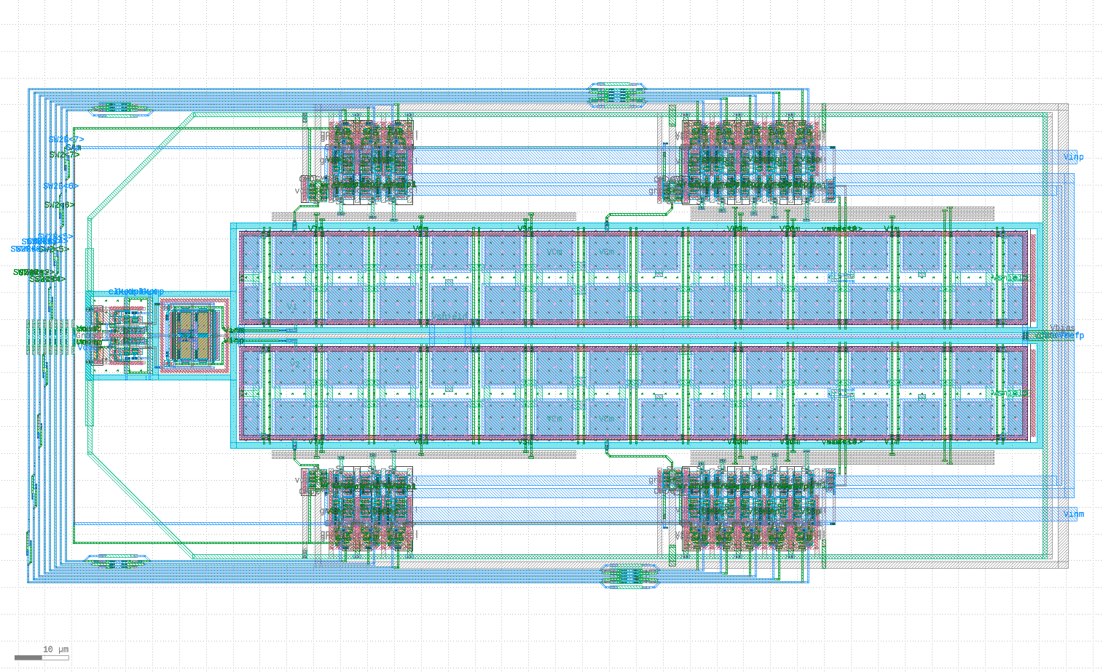
Antenna Protection
V_{inp}
V_{refp}
V_{refm}
V_{inm}
Digital Signals

