Slide 1

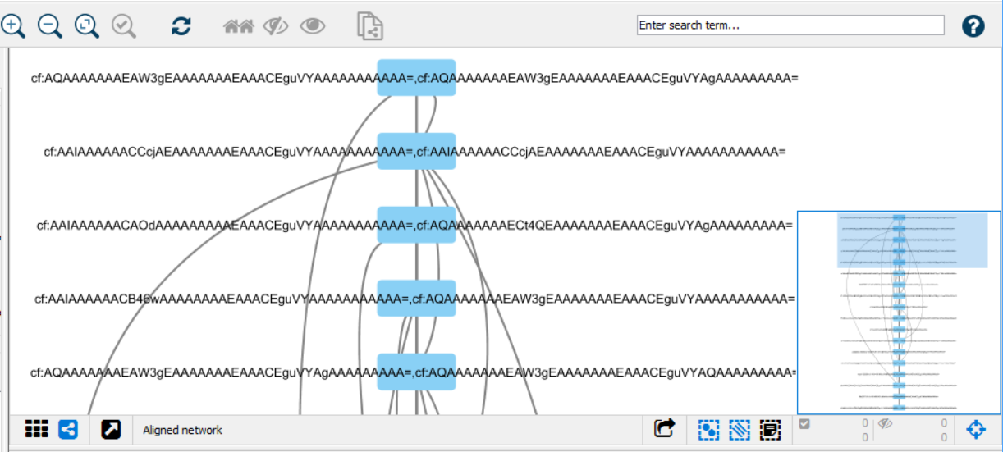
./mqttToMongo
Camflow
subscribe to /converted/
send data to DB
MQTT message broker
read data from DB
Integration.js
Acquired Provenance Data
Subscribe to /camflow/provenance/
Convert BASE64 to JSON string
Publish to /converted/
generates
msg_converter.js
Camflow
import in Cytoscape
Cytoscape network/table JSON files
Complex Network Analysis and Visualization

