Slide 1

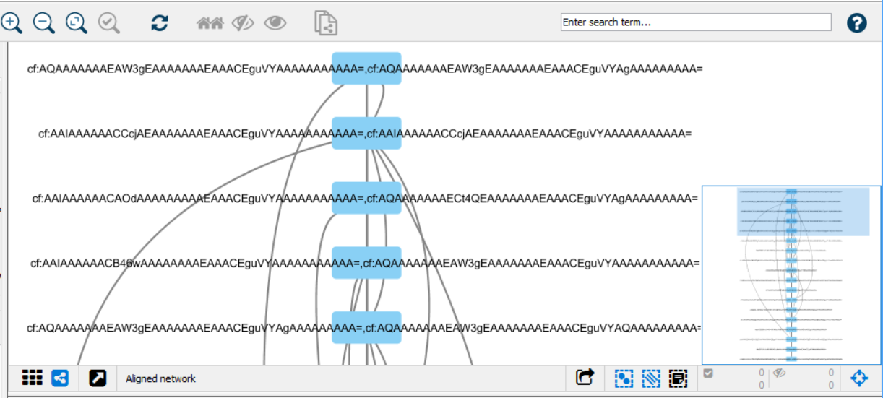
(c)
./mqttToMongo
Camflow
subscribe to /converted/
send data to DB
(a)
(d)
MQTT message broker
read data from DB
integration.js
Acquired Provenance Data
Subscribe to /camflow/provenance/
Convert BASE64 to JSON string
Publish to /converted/
generates
(b)
msg_converter.js
Camflow
(e)
import in Cytoscape
Cytoscape network/table JSON files
Complex Network Analysis and Visualization

