Slide 1

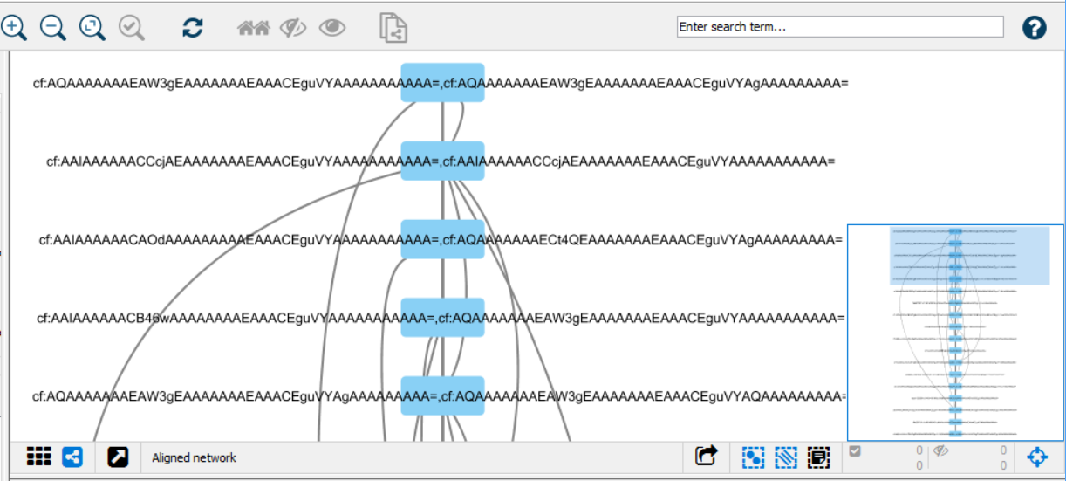
./mqttToMongo
Camflow
subscribe to topic
send data to DB
MQTT message broker
read data from DB
Integration.js
Acquired Provenance Data
generates
Camflow
import in Cytoscape
Cytoscape network/table JSON files
Complex Network Analysis and Visualization

