Slide 1
Time Series Prediction of the Tide Gauge in St. Pauli
08.01.2024 -
Janika Rhein, Ludwig Meder and Hannes Sandberg

Slide 2
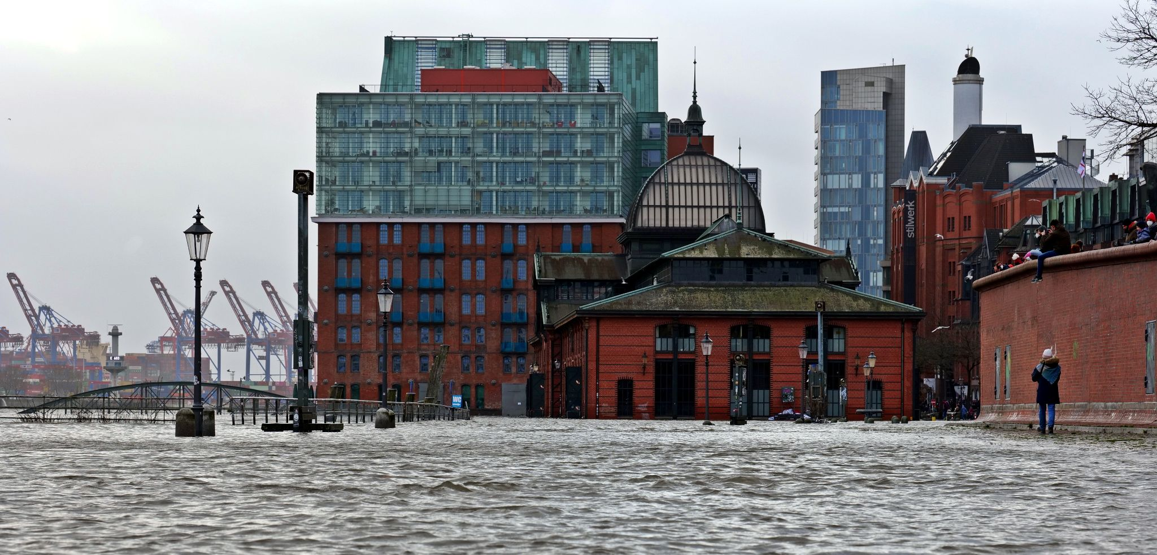
Introduction
River Elbe is affected by tides
Mean high water St. Pauli: 2.13 m > NHN
Flooded parking lot: 2.90 m > NHN
Flooded fish auction house: 3.50 m > NHN
At German Bay, water level mainly depends on
astronomical tides
wind speed
wind direction
NHN - Normal Height Null
https://commons.wikimedia.org/wiki/File:Sturmflut_Fischmarkt_Hamburg.jpg

Slide 3
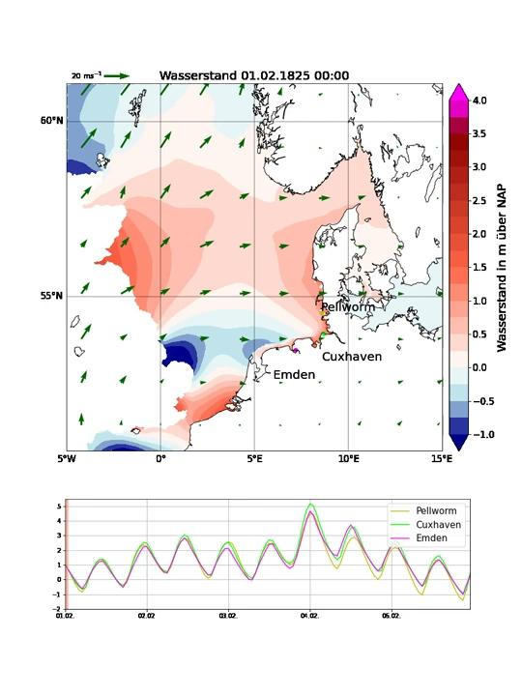
Introduction - Visualization of historical storm surge
tidal wave travels counterclockwise through North Sea
wind measurements from Helgoland are representative for German Bay
Notes:
Link oder sowas einfügen um Janikas Visualisierung abspielen zu können
Daran dann zeigen wie Windstärke und Richtung maßgebend sind

Slide 4
Literature Review
Descriptions of time series forecasts architectures by Tensor Flow
Paper:
Long Short-Term Memory Recurrent Neural Network for Tidal Level Forecasting by Yang et al. (2020)
Compares LSTM model with 6 different models
tidal water level of 21 years
LSTM had best performance with RMSE = 4.9cm for forecasting period of 30 days
RMSE = root mean square error
Notes:
Aufbau des besagten Modells waren 2 LSTM layer, 1 hidden dense layer mit dropouts, output layer
Vorhersage bezieht sich nur auf Gezeiten, nicht auf Wasserstand -> Einfluss des Luftdrucks wurde bspw abgezogen

Slide 5
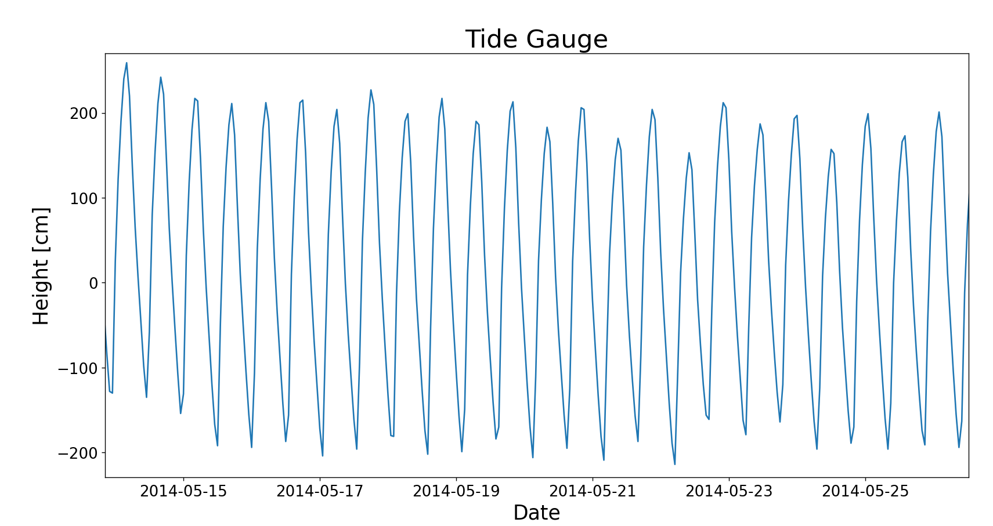
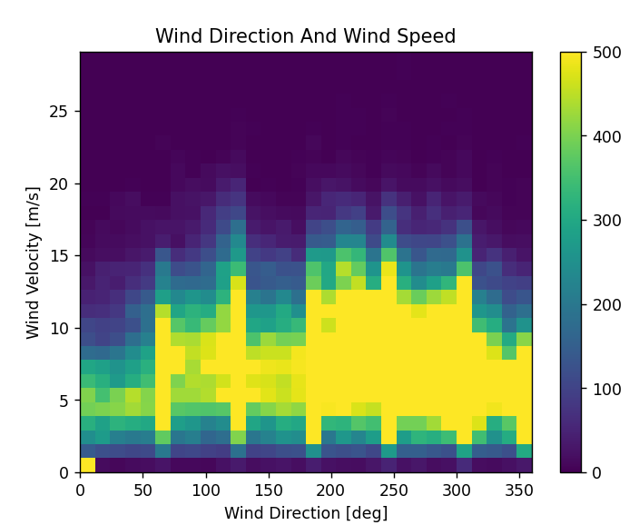
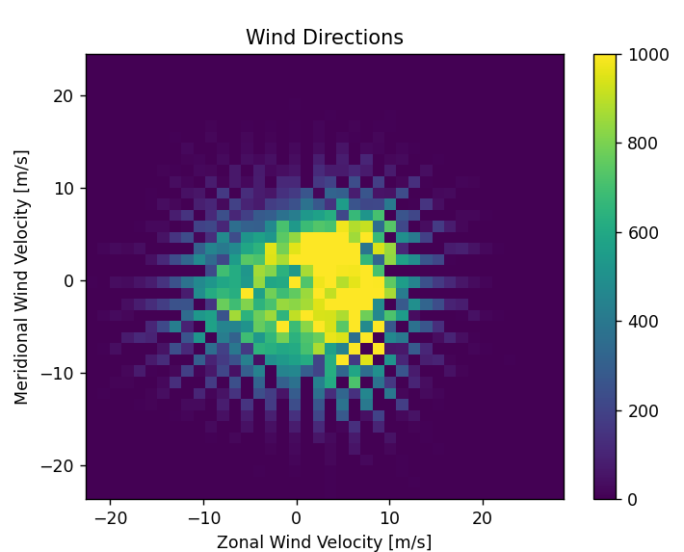
Dataset characteristics
Water Level Data
Data Availability: Continuous minutely data
Commencement: Since 1999
Accessibility: Freely accessible at hydroonline.hpanet.de
Wind Data
Data Availability: Continuous hourly data
Commencement: Since 1959
Accessibility: Freely accessible at opendata.dwd.de

Slide 6
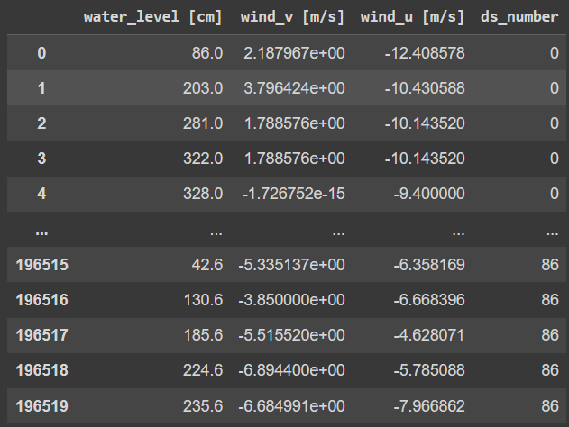
Dataset characteristics
Preprocessing:
Reduction of tide resolution from minutely to hourly
Cleaning of extreme outliers
Gradient cleaning to handle gradient outliers
Linear interpolation of gaps smaller than 6 hours
Vectorization of wind data
Combining data into continuous data frames
Result:

Slide 7
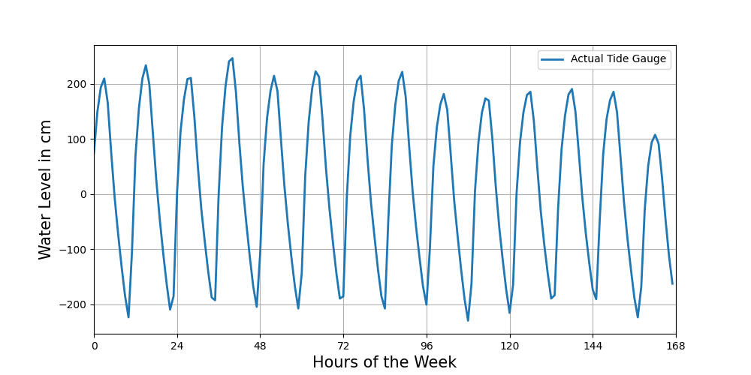
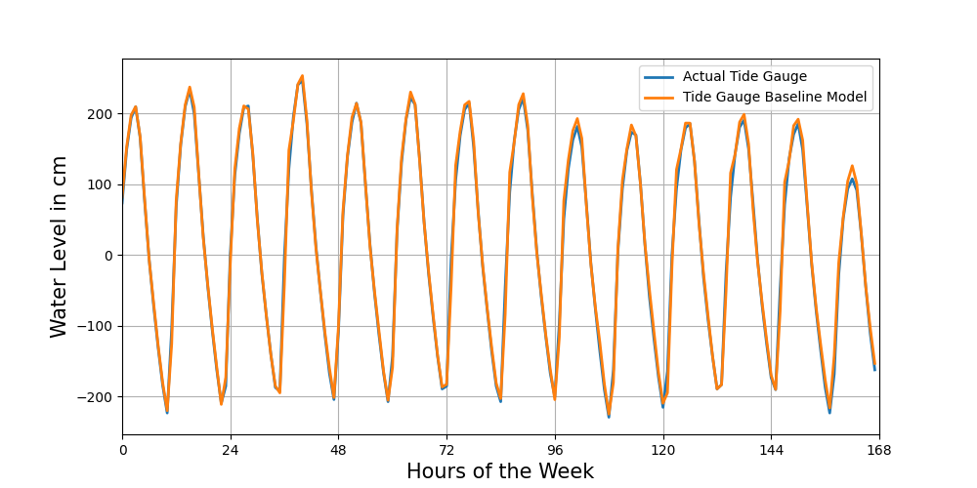
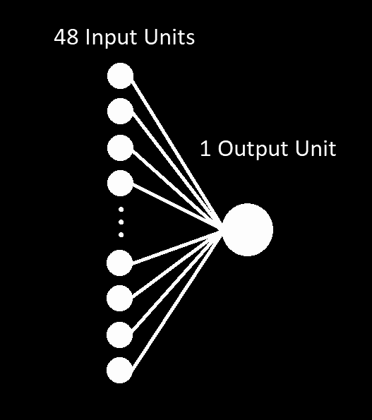
Baseline Model
RMSE_1hour = 12.32 cm
RMSE_6hour = >20 cm

Slide 8
Model Definition and Evaluation
Hyperparameter used for all models:
optimizer: Adam
loss function: mean squared error
dense layer activation function: ReLu
Input: 144 units consisting of 48 time steps
tidal water level
wind speed u
wind speed v
Output: 6 units (time steps) tidal water level activation function: linear

Slide 9
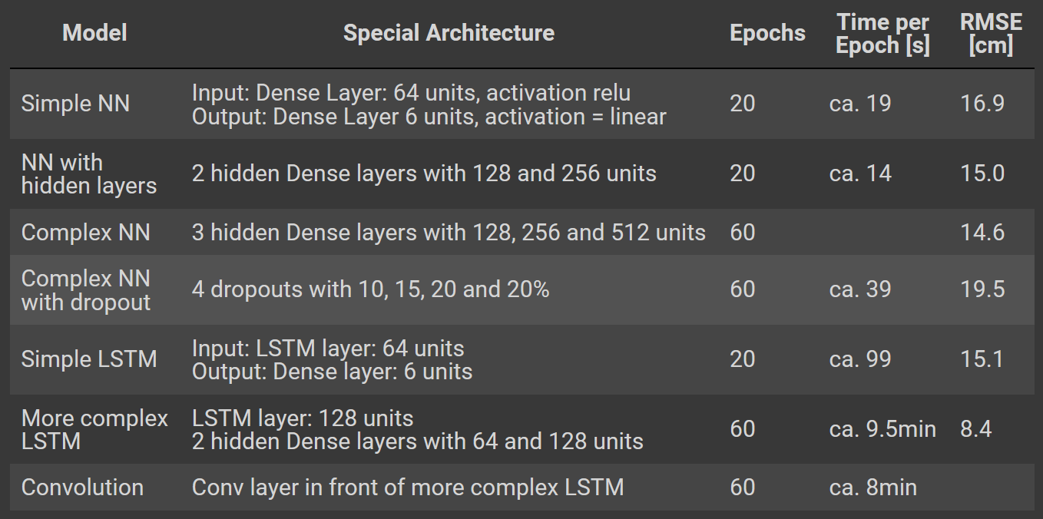
Model Definition and Evaluation
NN - Neural Network
LSTM - Long Short Term Memory
RMSE - Root Mean Square Error
8.8

Slide 10
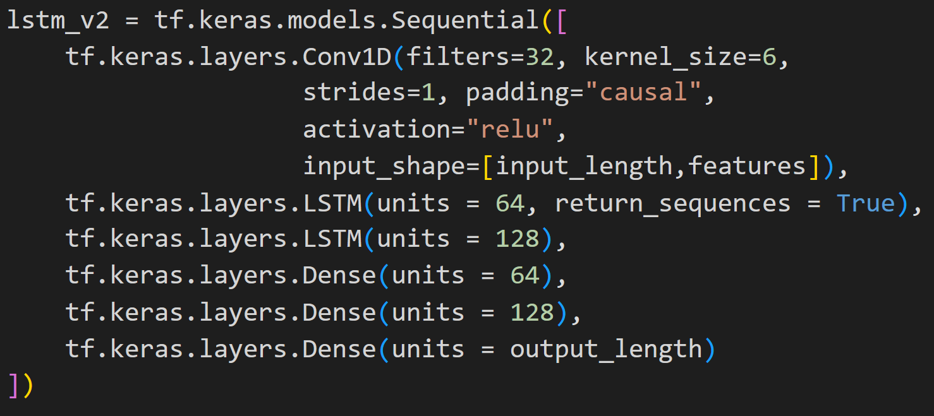
Model Definition and Evaluation
Trainable/Total parameters: 141606
Notes:
Conv: layer finds pattern
filters: number of different filters
kernel size: analyses 6 time steps
strides: shifts 1 time step and again analyses
padding=causal: adds 0 on the left of the filter -> no future time steps will be considered

Slide 11
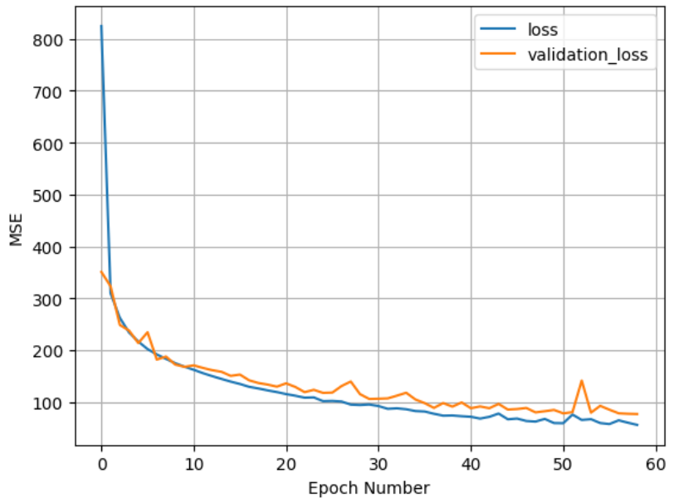
Model Definition and Evaluation
RMSE = 8.8 cm

Slide 12
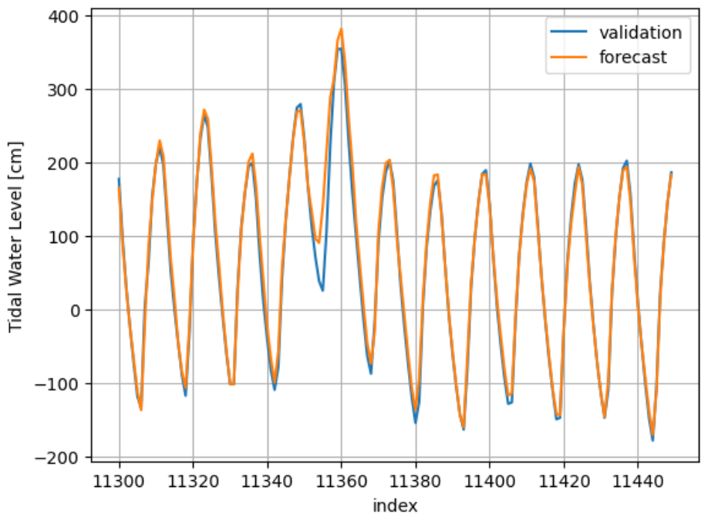
Results
Notes:
for i,j in zip(np.arange(12670,12700,6),range(12700-12670)[::6]):
plt.plot(np.arange(j,j+6,1),Y_pred[i,:],color="orange")
plt.scatter(np.arange(j,j+6,1),Y_pred[i,:],color="orange")
plt.plot(Y_test[12670:12700,0])

Slide 13
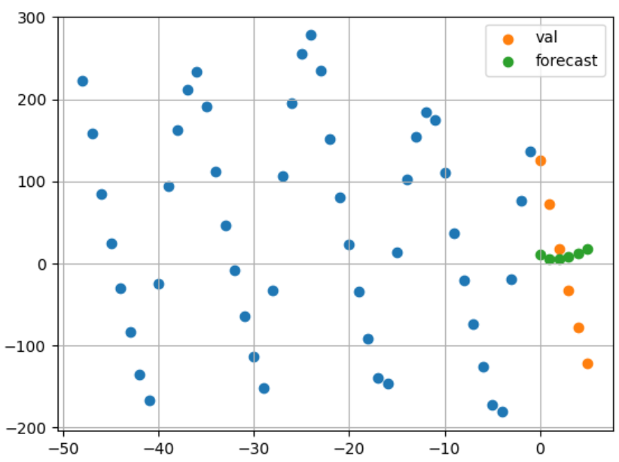
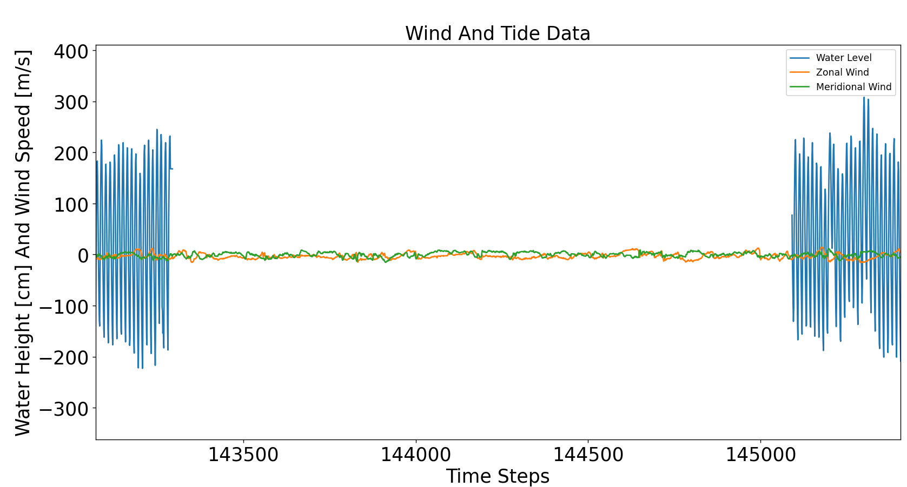
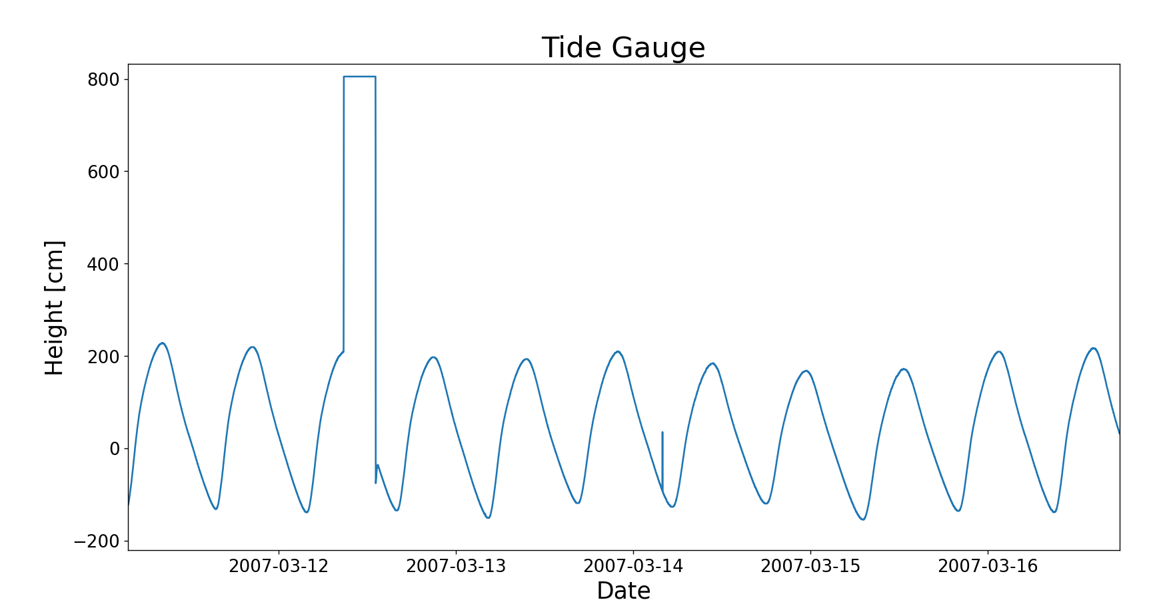
Challenges and Errors
Preprocessing dataset
Storm events - Undersampling: 2408 windows instead of 192202 RMSE: 99.4cm!
Training time

Slide 14
Discussion
Overall RMSE = 8 cm difference of mean flood water level to overflooding: 77 cm
Possible improvements - considering:
more wind locations (Shetland Islands)
precipitation and melting snow of river’s drainage area
Improving undersampling:
more overflooding events
decrease threshold of overflooding from 3.50m to 2.90m

Slide 15
Conclusion and Future Work
Considering another wind location: Shetland Islands (German Bay boundary)
Using 6h wind forecast as additional input parameters
Improving model architecture
Undersampling: Lower threshold
Notes:
promising using of NN for this “easy AI” -> maybe as application for overflooding projection

Slide 16
References
Animation: https://blogs.helmholtz.de/kuestenforschung/2023/07/28/erstmalige-rekonstruktion-der-sturmflut-vom-februar-1825/ (last access: 07.01.2024)
Paper: Yang, Cheng-Hong, Chih-Hsien Wu, and Chih-Min Hsieh. "Long short-term memory recurrent neural network for tidal level forecasting." IEEE Access 8 (2020): 159389-159401.
Other sources: Federal Maritime and Hydrographic Agency (BSH) German Weather Service (DWD)
Questions?

