Slide 1
Course Assignment Vipassana-Insight Awareness
Client-server system
IT-SDJ2-A18
Group 1:Michał Podgórni, Michał Jurewicz, Cristina Ailoaei, Dragoș Sîrbu

Slide 2
Design patterns (general solutions to commonly occurring problems)
Model-View-Controller
Separates the domain and user interface from each other;
Helps coordinate interactions;
Simplifies the code and offers readability;
Makes the code easy to reuse or maintain.
View
Controller
Model

Slide 3
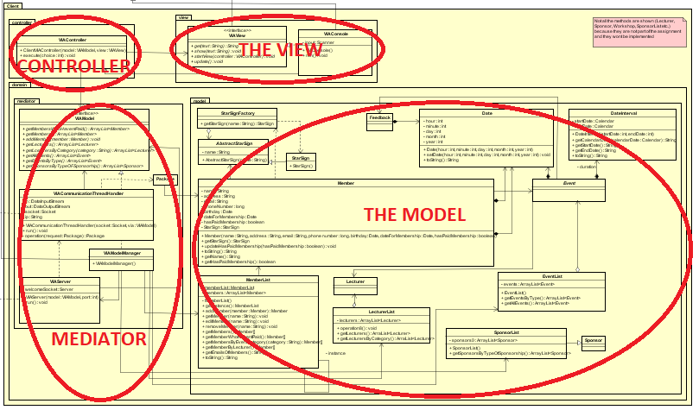

Slide 4
Design patterns (general solutions to commonly occurring problems)
Observer
Ensures that when a subject changes state, the other dependent objects are notified;
Used in the server part of the system;
The subject maintains a list of all observers and calls the method update();
The observers register themselves on a subject and update when are notified.
Subject
Observer
Observer

Slide 5
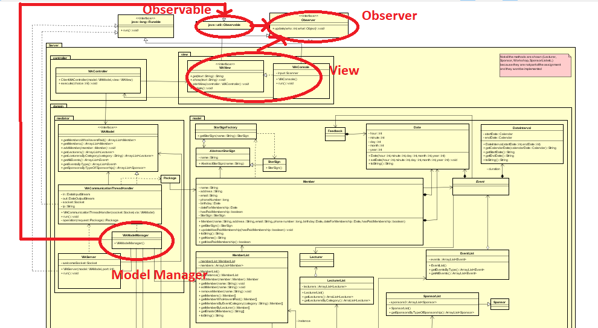
Subject: the model manager;
Observer: the view;
Every time a new member is added, the view is notified of the event and prints the new member to the console.

Slide 6
Design patterns (general solutions to commonly occurring problems)
Singleton
Restricts the instantiation of a class to one object;
Useful when exactly one object is needed;
MemberList class in Model (server side) has been represented as a singleton.
Singleton

Slide 7
Design patterns (general solutions to commonly occurring problems)
Flyweight Factory
Client
Concrete Flyweight
Flyweight
Flyweight
Used for creating a large number of similar objects
Reduces memory usage by sharing as much data as possible
Increases performance based on memory reduction

Slide 8
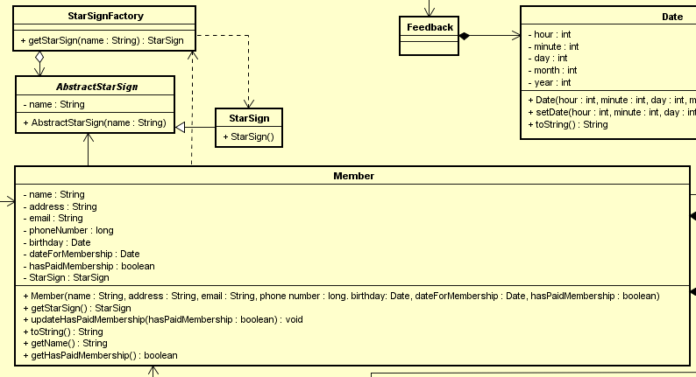

Slide 9
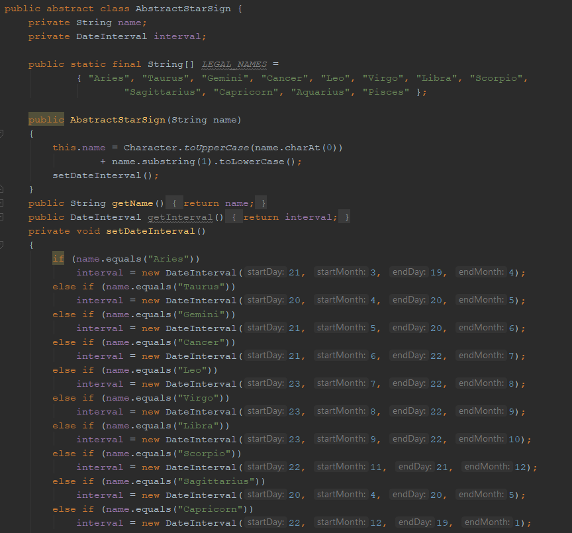
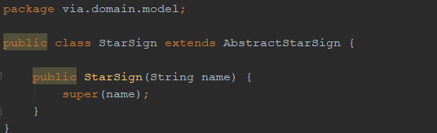
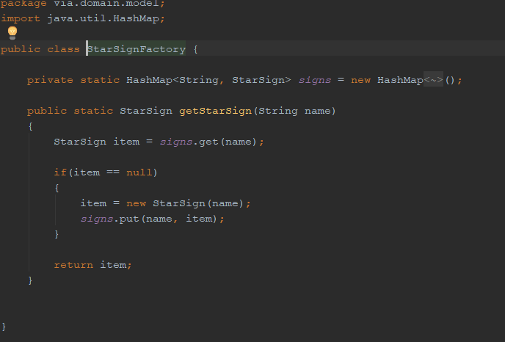

Slide 10
Description / Design patterns implemented
Proxy
Provide a class which will limit access to another class Used for security reason, because an Object is intensive to create, or is accessed from a remote location
Proxy is used in order to restrict usage of all methods on client side, so the client has access to only specified methods.
Client
Subject
Proxy
Real Subject

Slide 11
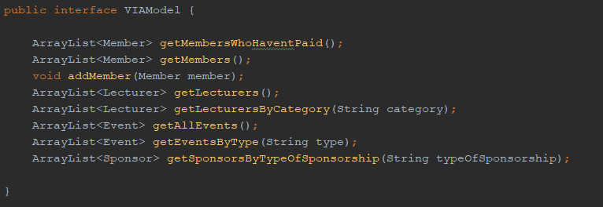
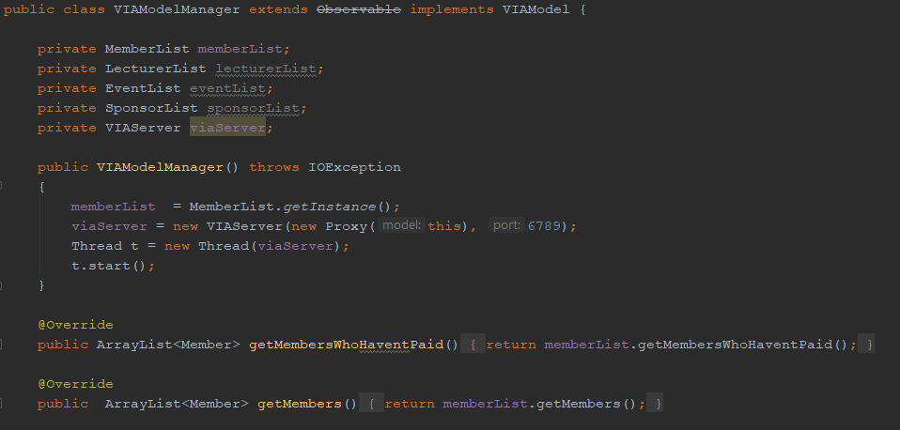
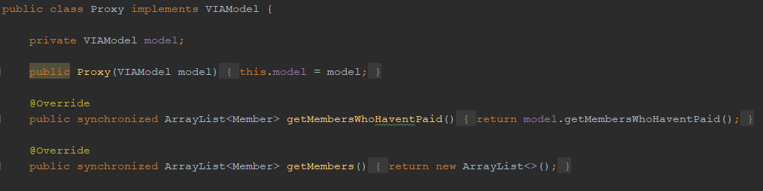

Slide 12
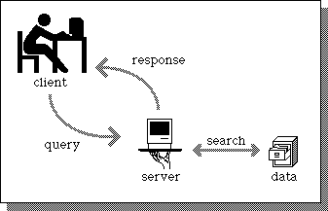
Client-server architecture
Implemented by using TCP Sockets;
Json interchanging format is used;
The server side
Creates a welcome socket with a port;
Starts waiting and accepts socket connections;
Evaluates the request and sends the reply;
The client side
Creates a socket with the host and port of the server;
Creates a json string holding the request;
Gets back the reply;

Slide 13


From Waterfall to Unified Process
Small project dimensions => tempted to use Waterfall approach
What we planned:
Sprint 1 – design
Sprint 2 – implementation
Sprint 3 - testing and documenting
What we did:
Sprint 1 – design
Sprint 2 – implementation + testing + documenting
Sprint 3 - implementation + testing + documenting
The transition from Waterfall to Unified Process was easy, since no changes in the design have been made.

