Slide 1

WDUM Milestone 3.
Ludwik Madej Szymon Kiełtyka

Slide 2
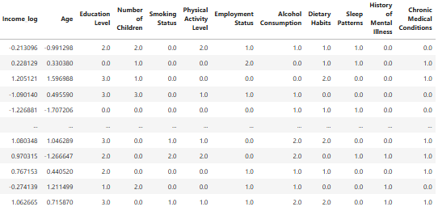
Final DataFrame

Slide 3

Modelling
https://www.erp-view.pl/it-solutions/31047-sztuczna-inteligencja-a-zaufanie.html

Slide 4
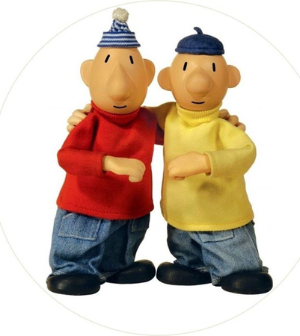
K-Nearest Neighbours
https://kiccake.pl/pl/p/Oplatek-na-tort-SASIEDZI-WZ.I/11931

Slide 5
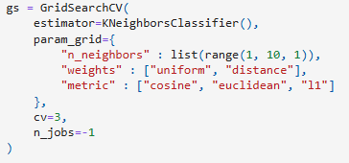
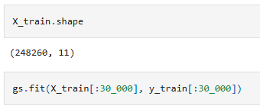
GridSearch

Slide 6
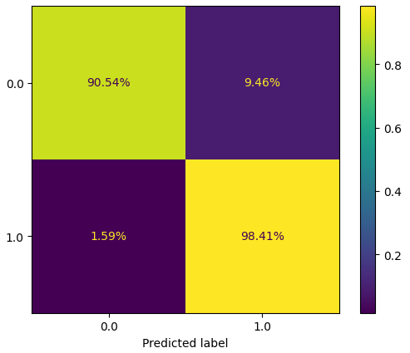
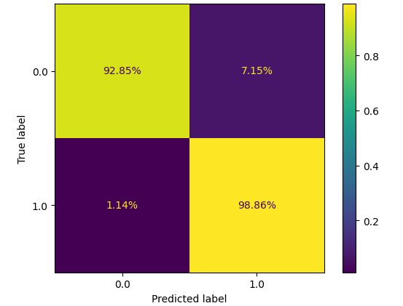
Validation set : 99,59% Accuracy
Training Set

Slide 7

Logistic Regression

Slide 8
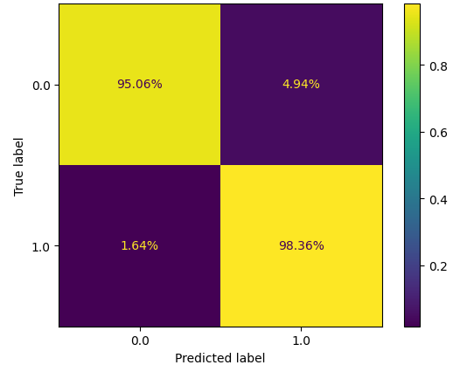
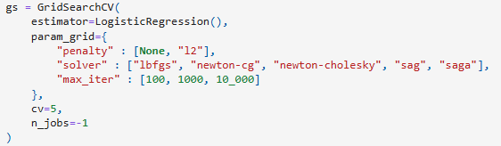
GridSearchCV
Accuracy: 97.18%

Slide 9
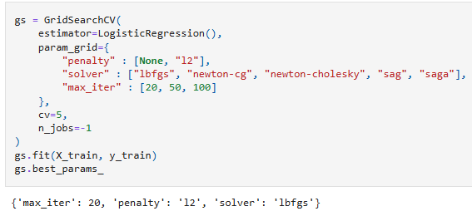
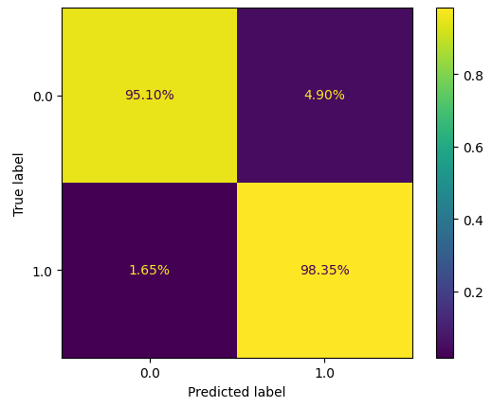
Accuracy: 97.2%

Slide 10
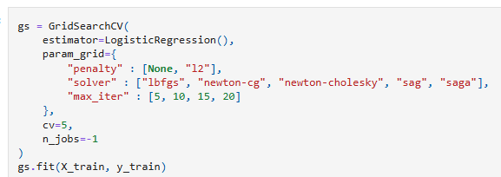
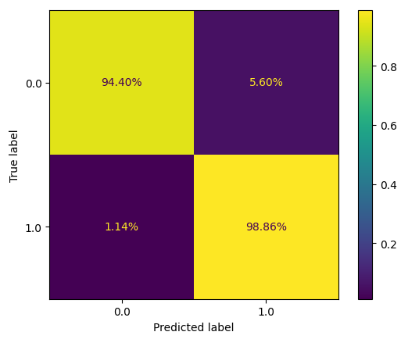

Accuracy: 97,26%

Slide 11
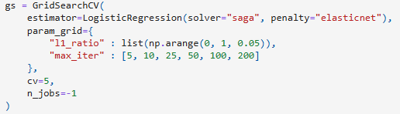
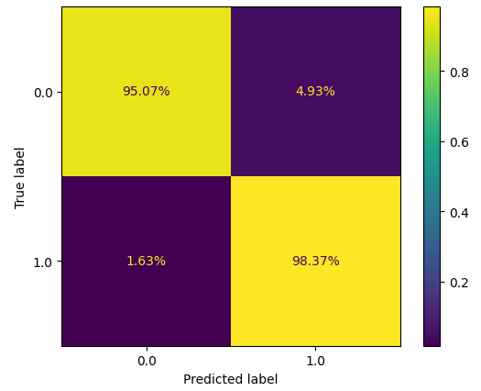
Accuracy: 97,19%

Slide 12
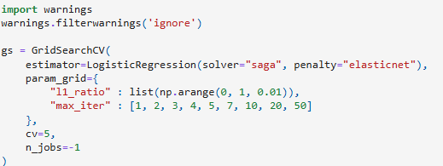
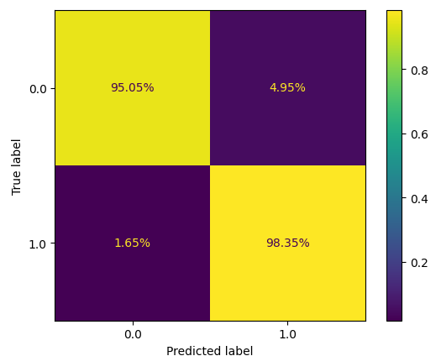
Accuracy: 97,17%

Slide 13

Decision Trees

Slide 14
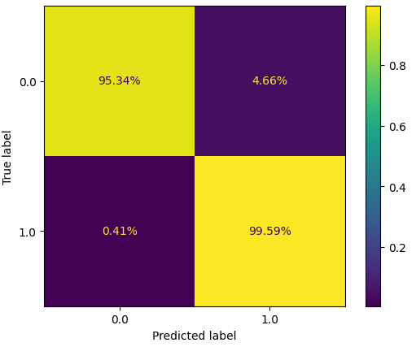
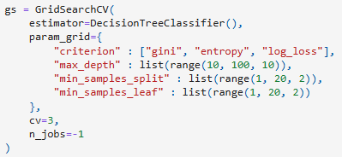
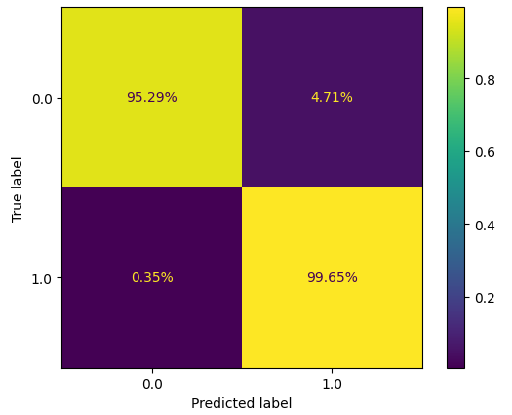
Train Accuracy: 98,09% Validation Accuracy: 98,07%

Slide 15
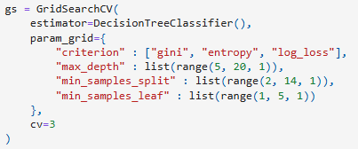
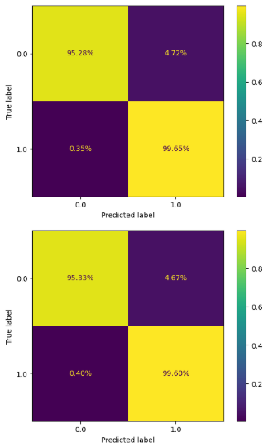
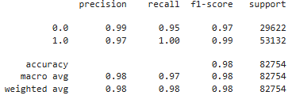

Slide 16

Deep Neural Networks

Slide 17
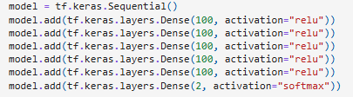

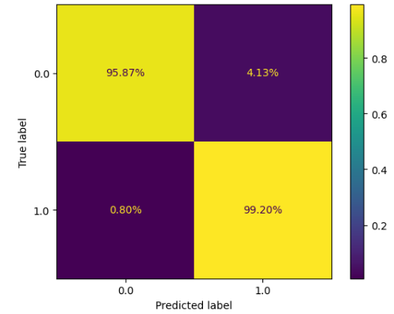
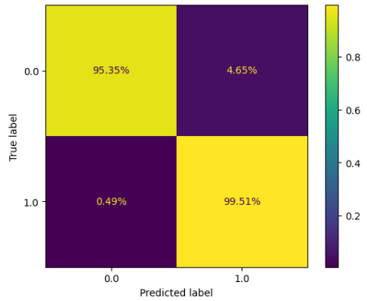
Accuracy: 98,00%
Accuracy: 98,12%

Slide 18

Random Forest Classifier

Slide 19
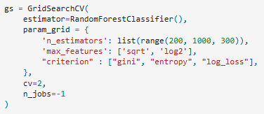
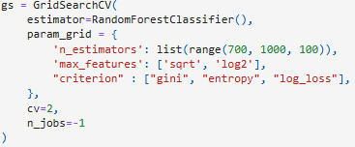
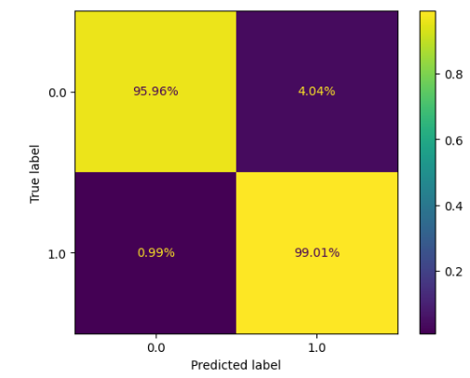
Accuracy: 97,97%
Accuracy: 97,97%

Slide 20

Thanks for your attention!

