Slide 1
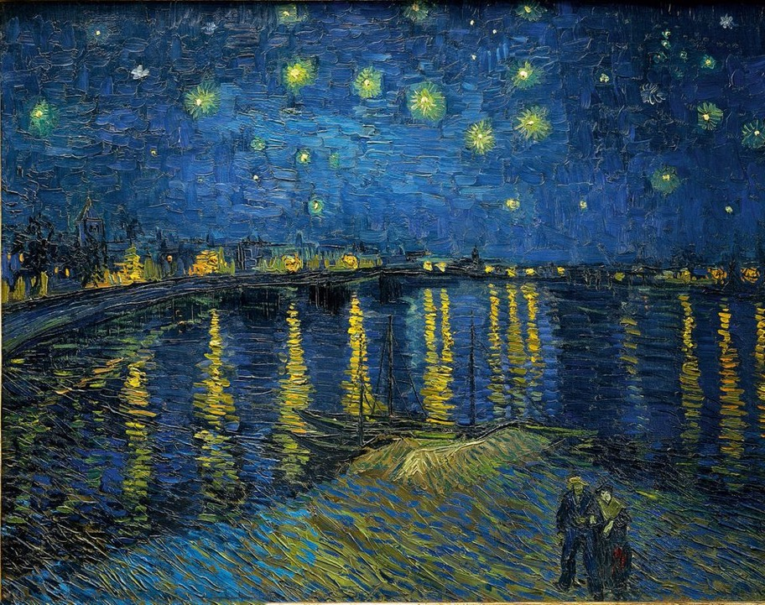
Artist recognition with computer vision
Introduction
Course: Applications of Image and Video Processing
Maastricht University
Lukas Schreiner

Slide 2
Overview
Data preprocessing
Model
Automatic categorization of art collections
Forgery detection
Neural Style Transfer

Slide 3
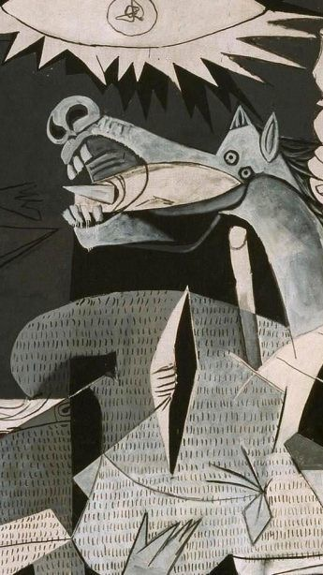
Project goal
Project Goal
Train a classifier that is able to estimate
Artist
Year
Artistic Movement
Test various models from the literature
Frequency domain filtering, sharpening filters

Slide 4
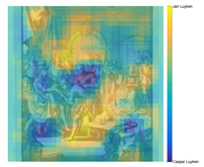
Related Work
PigeoNET¹
Recognizing Art Style Automatically
with deep learning²
Based on AlexNet
Rijksmuseum Challenge dataset²
Ability to discover dual authorship
Accuracy 52%-78%
AlexNet, ResNet
Transfer learning on ImageNet
Wikipaintings dataset⁴
Accuracy 62%
Performance varies widely between different art styles
1 Van Noord, Nanne, Ella Hendriks, and Eric Postma. "Toward discovery of the artist's style: Learning to recognize artists by their artworks." IEEE Signal Processing Magazine 32.4 (2015): 46-54.
2 Mensink, Thomas, and Jan Van Gemert. "The rijksmuseum challenge: Museum-centered visual recognition." Proceedings of International Conference on Multimedia Retrieval. 2014.
3 Lecoutre, Adrian, Benjamin Negrevergne, and Florian Yger. "Recognizing art style automatically in painting with deep learning." Asian conference on machine learning. PMLR, 2017
4 https://paperswithcode.com/dataset/wikiart

Slide 5



Approach
Data
Method
Potential Challenges
Filtering
Data augmentation
The literature suggest to use a rather deep CNN
Alex-Net
ResNet
U-Net
Dropout, Regularization
Uneven distribution of labels might become an issue
Some artistic styles are rather similar and hard to distinguish
For other styles (e.g. surrealism) each picture looks very different

Slide 6
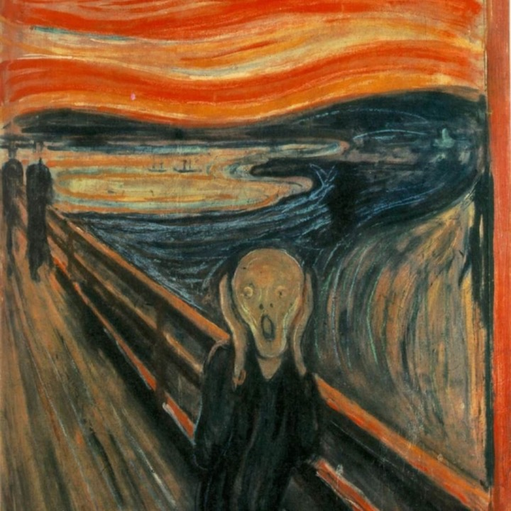
Thank you
References
Mensink, Thomas, and Jan Van Gemert. "The rijksmuseum challenge: Museum-centered visual recognition." Proceedings of International Conference on Multimedia Retrieval. 2014.
Lecoutre, Adrian, Benjamin Negrevergne, and Florian Yger. "Recognizing art style automatically in painting with deep learning." Asian conference on machine learning. PMLR, 2017.
https://paperswithcode.com/dataset/wikiart
Van Noord, Nanne, Ella Hendriks, and Eric Postma. "Toward discovery of the artist's style: Learning to recognize artists by their artworks." IEEE Signal Processing Magazine 32.4 (2015): .

