Slide 1
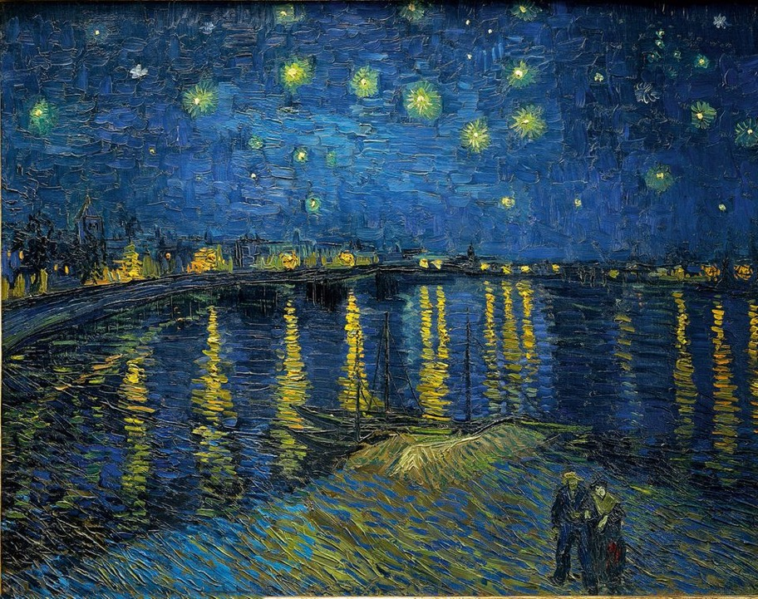
Artist recognition with computer vision
Intermediate Presentation
Course: Applications of Image and Video Processing
Maastricht University
Lukas Schreiner

Slide 2
Overview
Data
Dataset
Pre-processing
Model
Set up
ResNet50
Issues & Challenges
Outlook

Slide 3
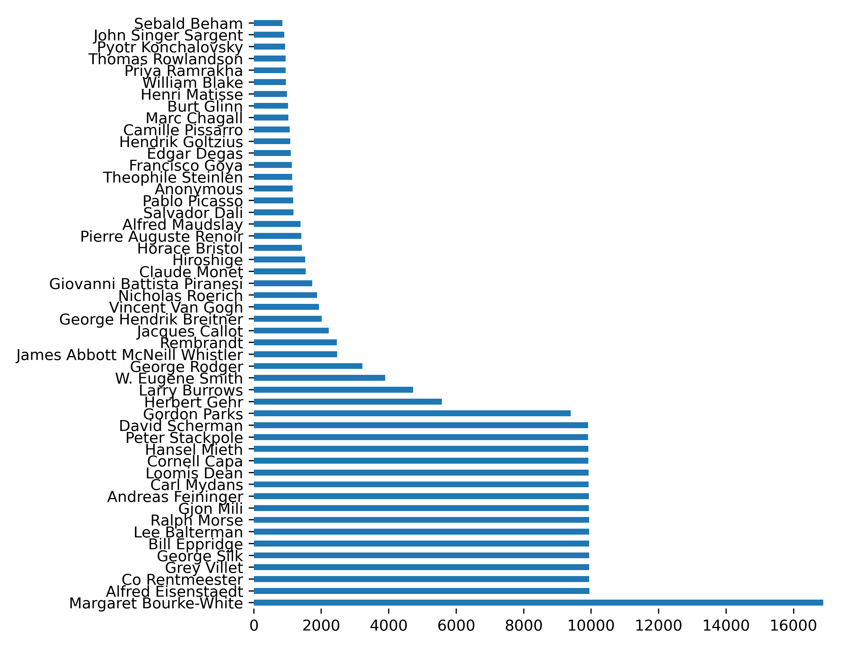
Art500k Dataset¹
Data - Dataset
The whole dataset set contains 767k artworks from 41k different artists
270k artworks from 8k artists are contained as a file (for the rest, links are provided)
The 50 artists with the most artworks are chosen
There are ~500 - ~2.5k artwork per artist
The constraint dataset includes 39’962 artworks
1: Hui Mao, Ming Cheung, and James She. Deepart: Learning joint representations of visualarts. InProceedings of the 25th ACM international conference on Multimedia, pages 1183–1191. ACM, 2017

Slide 4
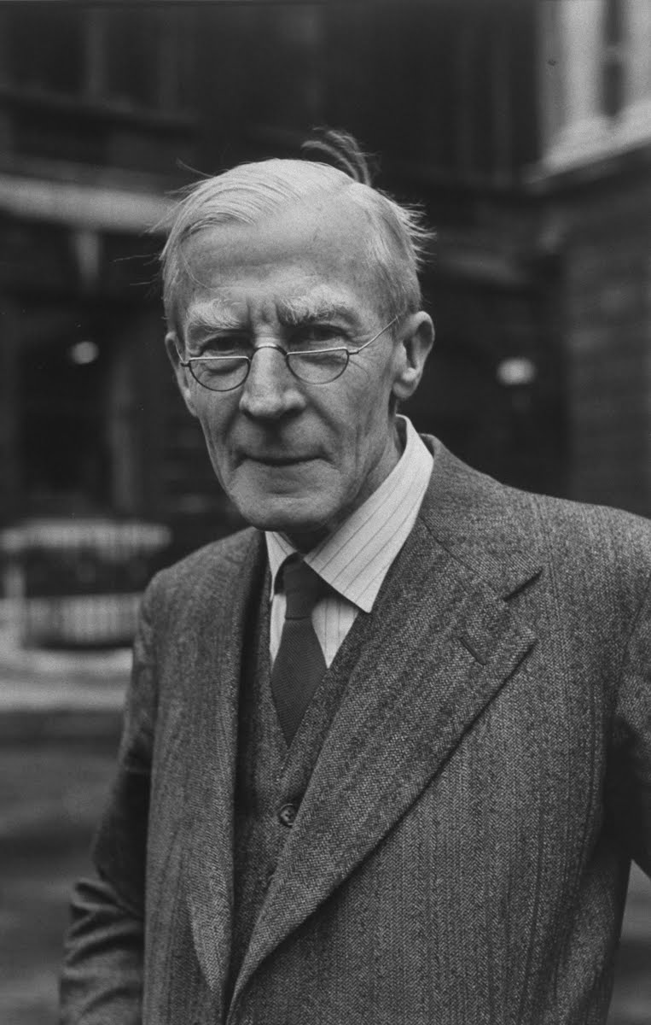
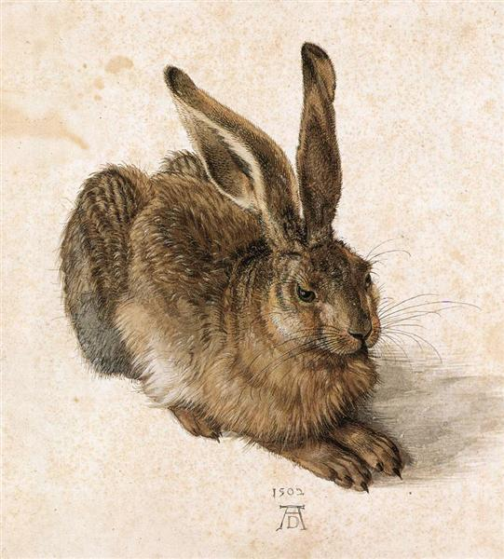
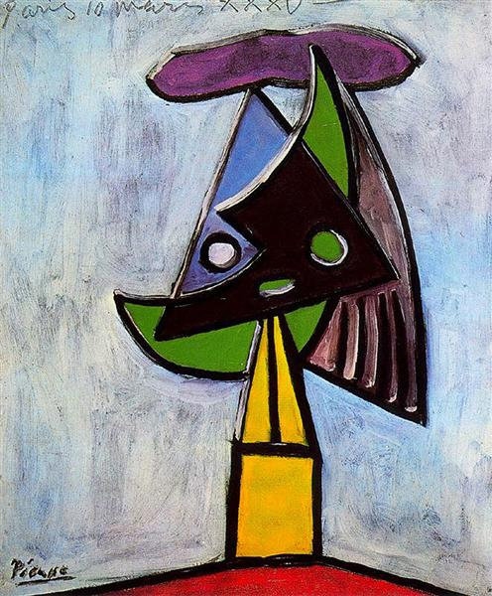
Examples
Data - Dataset
Albrecht Dürer – A young hare
Picasso – Head of a Woman
Alfred Eisenstaedt – 50S Primarily

Slide 5



Data handling
Data - Preprocessing
data augmentation
file handling
prepare data
Merge subsets of the data
Convert to JPEG
Filter out files that are damaged
Rescale images to (128, 128, 3)
Convert from RGB to BGR, each color channel is zero-centered with respect to the ImageNet dataset¹
Improve memory performance²
Ignore dataset errors³
Apply random flip
Apply random rotation
Doubles the size of the dataset
To be expanded
1: https://www.tensorflow.org/api_docs/python/tf/keras/applications/resnet50/preprocess_input
2: https://www.tensorflow.org/api_docs/python/tf/data/Dataset#prefetch
3: https://www.tensorflow.org/api_docs/python/tf/data/experimental/ignore_errors

Slide 6
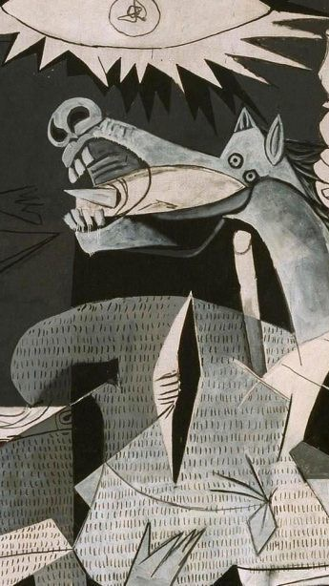
Project goal
Project goals
Train a classifier that is able to estimate
Artist
Year
Artistic Movement
Test various models from the literature
Frequency domain filtering, sharpening filters
Data augmentation

Slide 7
Model settings
Model – Set up
Adam optimizer¹
Initial learning rate: 1e-5
Categorial Cross Entropy Loss
No. Epochs: 50
Batch size: 16
Rescale images to (128, 128, 3)
90% training set, 10% test set
Data is shuffled
Call-backs:
ReduceLROnPlateau²
ModelCheckpoint³
TensorBoard⁴
1: Kingma, Diederik P., and Jimmy Ba. "Adam: A method for stochastic optimization." arXiv preprint arXiv:1412.6980 (2014)
2: https://keras.io/api/callbacks/reduce_lr_on_plateau/
3: https://www.tensorflow.org/api_docs/python/tf/keras/callbacks/ModelCheckpoint
4: https://www.tensorflow.org/tensorboard

Slide 8
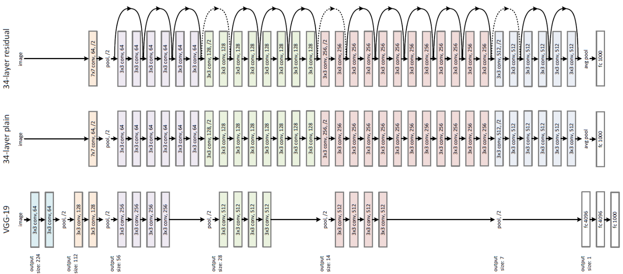
Model architecture based on ResNet50¹
ResNet50
Non trainable
Trainable
3x
Fully connected
Dropout (20%)
Batch Normalization
(128, 128, 3)
Pretrained on ImageNet²
50 Classes
Total params: 23,862,258
Trainable params: 15,250,162
Non-trainable params: 8,612,096
1: He, Kaiming, et al. "Deep residual learning for image recognition." Proceedings of the IEEE conference on computer vision and pattern recognition. 2016.2
2: https://image-net.org/

Slide 9
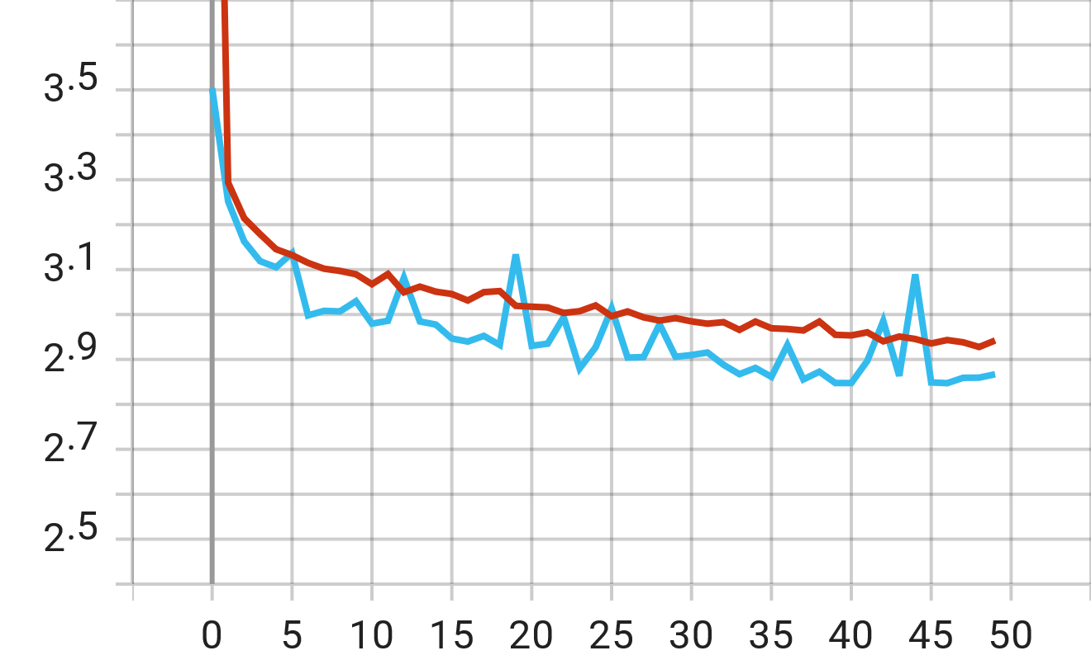
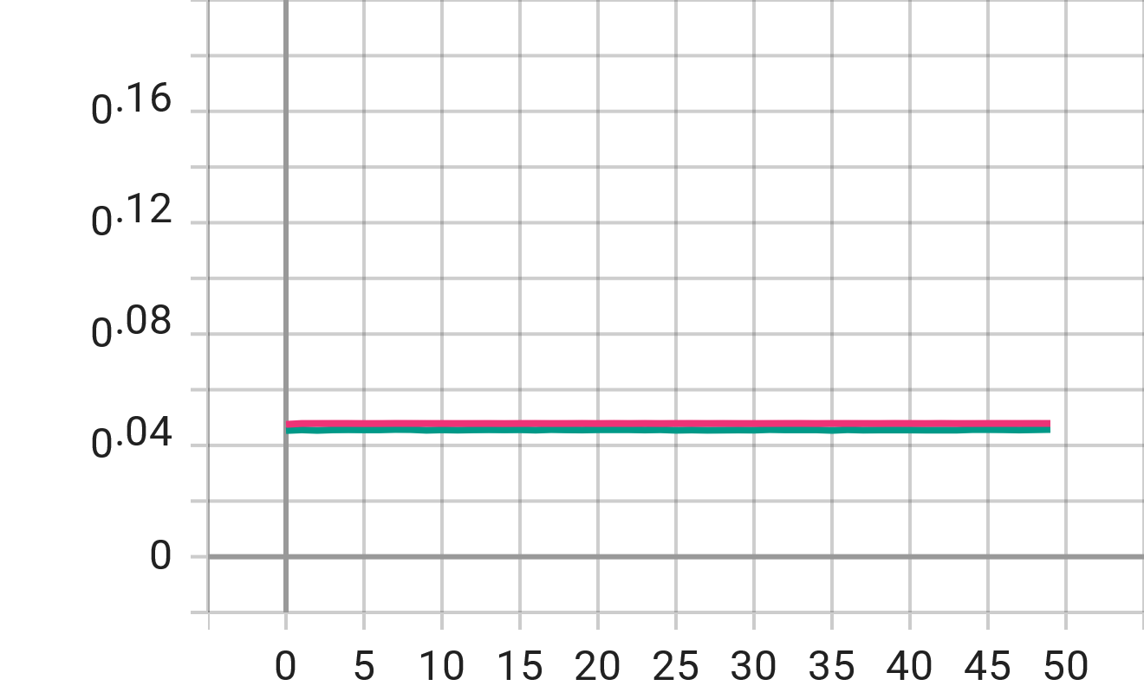

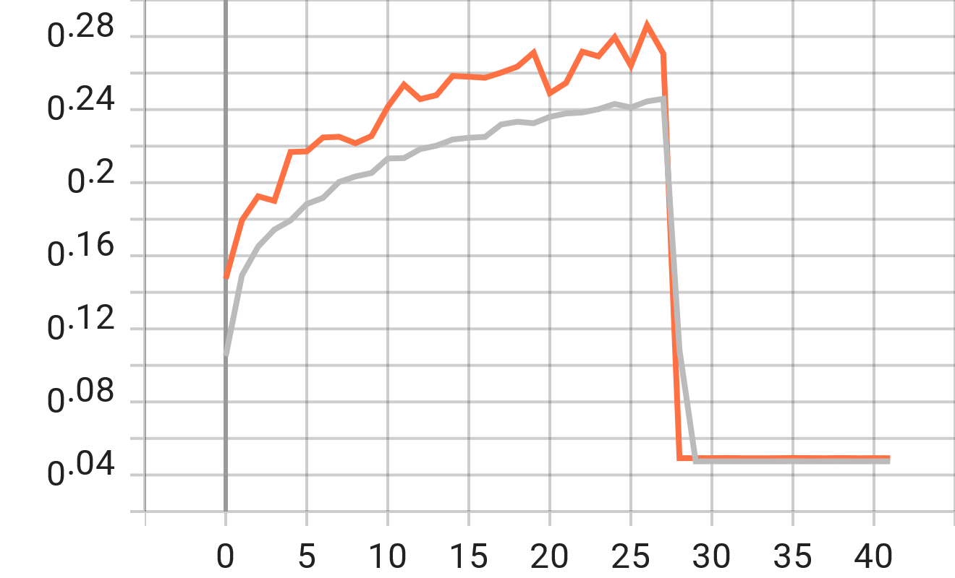
Issues & Challenges
Validation error is below training error
Validation error stays constant
1
Test set only contains very few “easy” examples
Bug in when handling the image files leads to a disproportion distribution of data classes
Use more epochs
3
Insufficient shuffling leads to the validation set consisting of only unknown artists
Hardware running out of memory
Validation error becomes NaN
2
4
Model is diverging, exploding gradients
Decrease learning rate, reduce it over time
Decrease image scaling
Decrease Batch size

Slide 10
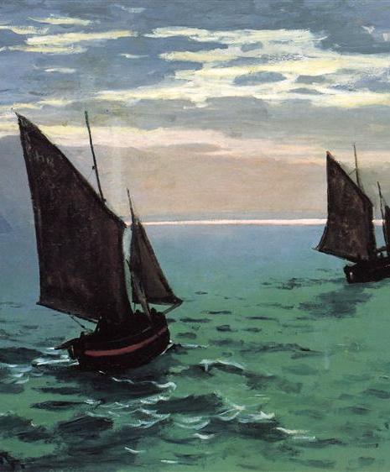
Outlook
Stabilising the model
Increase Accuracy
Try deeper models (ResNet150)
Data Augmentation, Filtering
Include more Information in the labels (year, art epoch)
Analyse confusion matrix

