Slide 1

Data Lake Value Proposition
Medical Data Processing Company
Jeffrey Lueken
Udacity IPS Version 1.0

Slide 2
Agenda
What is a Data Lake
Components of a Data Lake
Data Lake vs Data Warehouse
Business Value of Data Lake Solution
Proposed Data Lake Architecture for Medical Data Processing system
Udacity IPS Ver. 1 2/2020

Slide 3
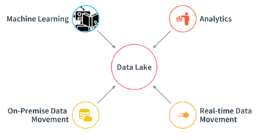
What is a Data Lake
Executive summary
A data lake is a centralized repository that allows you to store all your structured and unstructured data at any scale.

Slide 4

Components of Data Lake

Slide 5

Components of Data Lake
Data Ingestion allows connectors to get data from different data sources and load data into the data lake.

Slide 6
Components of Data Lake
Data Processing where the purpose is to transform the source data to a data model that is ready for analysis and reporting.

Slide 7


Components of Data Lake
Data Storage must be scalable, cost-effective, allow fast access to data, and support various data formats

Slide 8
Components of Data Lake
Data Governance is a process of managing the availability, usability, security, and integrity of the data in an organization.

Slide 9
Data Lake vs Data Warehouse
Characteristics | Data Lake | Data Warehouse
Data | Non-relational and relational IoT devices, web sites, mobile apps, social media, and corporate applications | Relational from transactional systems, operational databases, and line of business applications
Schema | Written at the time of analysis (schema-on-read) | Designed prior to the DW implementation (schema-on-write)
Price/Performance | Query results getting faster using low-cost storage | Fastest query results using higher cost storage
Data Quality | Any data that may or may not be curated (ie. raw data) | Highly curated data that serves as the central version of the truth
Users | Data scientists, Data developers, and Business analysts (using curated data) | Business analysts
Analytics | Machine Learning, Predictive analytics, data discovery and profiling | Batch reporting, BI and visualizations

Slide 10
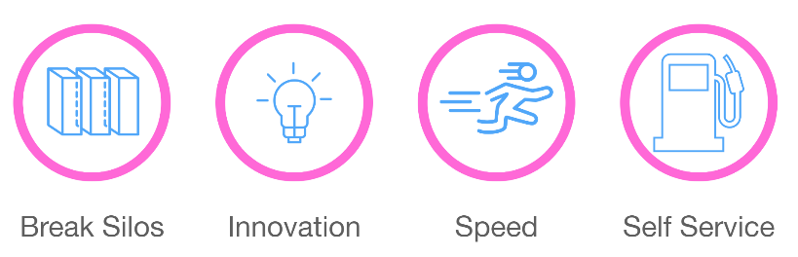
Business Value of Data Lake

Slide 11
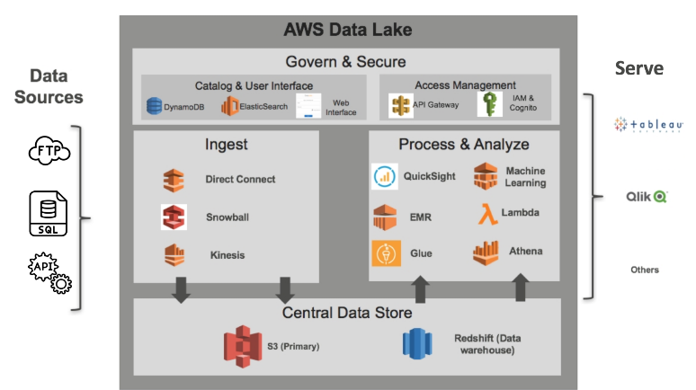
Data Lake Architecture

Slide 12
THANK YOU
Udacity IPS Version 1.0

