Slide 1

Job Search

Slide 2
Your Job search is not...

Slide 3

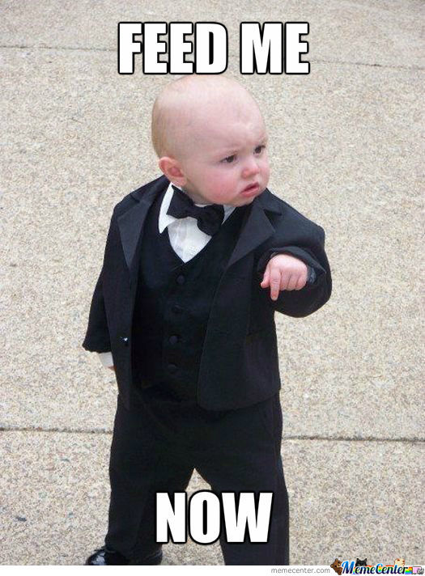


Slide 4
Your Job search is more like this...

Slide 5
this...

Slide 6
To start, Let’s Debug our Thoughts...
Nerves & adrenaline = absolutely acceptable
Internalizing fear = Hakuna Matata!
We are all in this! Pamoja! Truth!
REMEMBER: We are here to ensure your subjective reality is in line with objective reality.
Ok great. Now...let’s talk about what your job search will actually look like!

Slide 7
Stages of the Job Search
Prep Yourself
Expressing Interest/Applying
REJECTION! REJECTION!! REJECTION!!!
Phone Screen
Coding Challenge
Tech Interview/The Onsite
REJECTION! REJECTION!! REJECTION!!!
Following Up
*Receiving Offer
Negotiate Offer
*Sign Offer
Notes:
To talk about this in subsequent slides

Slide 8
Who and How - You
Your job search must be your #1 priority
AT ALL COSTS resist the urge to dive into projects and to ignore your job search - your job search will not go away until you get a job.
Do not ignore your pipeline--failure to constantly apply to jobs is the death knell of a successful job search
A job search is a big output of energy & sometimes it can be hard to see the light at the end of the tunnel--
You need to PREP YOURSELF for success-
Set the same hours every day to apply to jobs -- strategy
communicate with Outcomes -- DAILY
come to MS if you can/want
Plan time every day to relax, exercise, or see friends

Slide 9
The Basics - The Team
The most important part of the team is all of you
This is a STUDENT RUN JOB SEARCH
Only you can get yourself a job
However, to give you an extra boost with Moringa School
Outcomes Team
Cohort
Alums!

Slide 10
Who and How - Your Cohort
Use your cohort friends as “Job Search Teams”
Job searches conducted in a vacuum = isolating
Communicate daily! Use Slack!
Moringa Outcomes Staff and Use the Cohort Channel
We must all share responsibility for each other, b/c
“It’s more fun this way”
YOU are part of a community with shared experiences!

Slide 11
Who and How - Tech Mentors
Overall partners in crime
TM’s available for Mock Interviews & check ins
They thrive off being your OBJECTIVE counterpart

Slide 12
The Mechanics of a Job Search
What Does The Process Look Like?

Slide 13
The Basics: Getting in the Water
Consider: recruiting is a two way street--they are actively seeking you, and you are seeking them. Don’t let anyone tell you: “There’s no JOB!!!”
Do not fixate on one company or job
This is a common mistake...there is nothing wrong with having a couple of dream jobs, but you must be realistic and continually refill your pipeline
Do: Know that this is a numbers game! The more jobs you apply to, the greater your chances

Slide 14
The Basics: What should I know?
Consider: Sector
Startup or a big company?
Compensation?
Culture, fit, hours etc
Consider: What are others saying?
Read Tech Blogs, Research the company online, understand the in and out of the company
This is your new career and industry--become familiar with it
Consider: Where are you connected/ networked? Use it!
Consider: Moringa School developers get great jobs, and our hiring rate is high, because our grads put in the hard work -- It’s not magic, it’s determination

Slide 15
The Basics: What should I ask myself?
Front Door AND Back Door.
How do you go about locating great job opportunities?
Do: Legwork on researching opportunities and companies.
Do: pay attention to how long jobs are staying open
Do: Know who you ARE!!!
Do: Keep an eye on what products, services, & technologies you are most interested in
Do: Ask yourself what you are passionate about and what will make you happy
Do: Familiarize yourselves on several industries and learn the major players
Do: Use resources like google to build your knowledge base

Slide 16
The Basics: Where Do I Apply?
Some of the best resources for locating jobs:
iHub Jobs (https://ihub.co.ke/jobs)
Kazi+ (https://kaziplus.com)
LinkedIn (https://www.linkedin.com/job/home) - You need a strong profile. Use keywords (Nairobi, Software Developer etc)
Fuzu (https://www.fuzu.com/)
Notes:
Open the main websites for illustration e.g ihub.co.ke, brightermonday.co.ke, linkedin.com, angel.co

Slide 17
The Basics: Where Do I Apply?
Some of the best resources for locating jobs:
Shortlist (https://www.shortlist.net/ken/)
Angellist (https://angel.co/jobs) - You need a strong profile. Use keywords (Nairobi, Software Developer etc)
Brighter Monday (https://www.brightermonday.co.ke). Use keywords (Nairobi, Software Developer etc)
Summit Recruitment (http://www.summitrecruitment-search.com/jobs/). Use keywords (Nairobi, Software Developer etc)
Notes:
Open the main websites for illustration e.g ihub.co.ke, brightermonday.co.ke, linkedin.com, angel.co

Slide 18
Stages of the Job Search
Prep yourself
Expressing Interest/Applying
Phone Screen
Coding Challenge
Tech Interview/The Onsite
Following Up
*Receiving Offer
Negotiate Offer
*Sign Offer

Slide 19
Stage 1: Expressing Interest/Applying
Your first communication with a company is crucial
the resume, cover letter and portfolio serve as a movie trailer like fast and furious trailer
As a package, they should communicate why YOU are an IDEAL candidate for THAT PARTICULAR JOB
Small talk = Big Impact. Practice elevator pitch. Know your audience
Be persistent yet patient.
Be your authentic (yet polished) self (AKA Always be Prepared!)
Let them know if you have a deadline. It’s great to have other offers. It implies that you are in high demand
Make it easy for networks to help you
Be energetic, but don’t scare them away!

Slide 20
Stage 2: Phone Screen*
Immediately after applying and prior to a phone screen, you need to do some basic research about the company
Know product and their stack
Current challenges facing the company
PS’s are:
usually conducted by a tech recruiter with minimal technical skills- usually a gatekeeper to the engineers (HR PERSON)
most often behavioral interviews; coding typically not required
familiarity with stack will win points
be polite, genuine, responsive and energetic (not scary!)
Treat the interviewer as a peer
Take cues, and be prepared to ask questions - strategic ones
Notes:
* Not common but be prepared

Slide 21
Stage 3: The Onsite / Tech Interviews
Interview!
deeper dive to tech skills -- looking for role/team match
Lots of coding and problem solving.
Make sure you continue to practice toy problems, data structures, algorithms
Communicate Effectively
Ask clarifying questions
Talk through every part of the question
Code, verify, and think AUDIBLY - Listen to what the interviewers say
Positive attitude and energy

Slide 22
Stage 4: Following Up
When should I follow up? --> 5 business days max
Be visible, but not annoying
Thank you emails are great to stay on the brains of your hiring team (should be sent within 24 hrs of interview)

Slide 23
Stage 5: The Offer
Depending on the company, the offer can come in after the two interviews.
Read the offer contract well before signing.
Contact MS OUTCOMES immediately when you get your offer-- we will help you!

Slide 24
Stage 6: Negotiating Your Offer
ONLY negotiate AFTER you:
Are SURE you’d want to work at the company
Have a formal offer letter in hand
There is absolutely nothing wrong with negotiating
Every negotiation is different--what you ask for and what you can expect varies tremendously
The MS OUTCOMES team always available to assist.

Slide 25
Salary!!!
How much is too much?
How much is appropriate??
DO: Understand the company. Early stage or established company?
DO: Know your competency level. Ask yourself questions like: “Do I have a working product?” “What’s my experience level?” “What are my strengths and weaknesses?” etc
For an entry level developer (full stack or mobile), anything between 40,000 - 60,000 KSH gross salary.
HOWEVER, IF YOU HAVE OPPORTUNITY TO WORK WITH AN ORGANISATION WHERE YOU CAN GAIN ENOUGH EXPERIENCE, DO NOT LET SALARY SERVE AS A FACTOR FOR NOT ACCEPTING THE OFFER!! E.g GOOGLE!!!
GET YOUR FEET IN!

Slide 26
Dealing with Rejection
Know this, you MIGHT not get all the jobs you apply for.
In fact, probably only 60-70% will work out!!
But you must know how to deal with the rejection!
See them as an opportunity to do better.
Get feedback from recruiters. Ask them why you didn’t make it! Use those feedback to your advantage!

Slide 27
Thank You!
Any Question??

