Slide 1
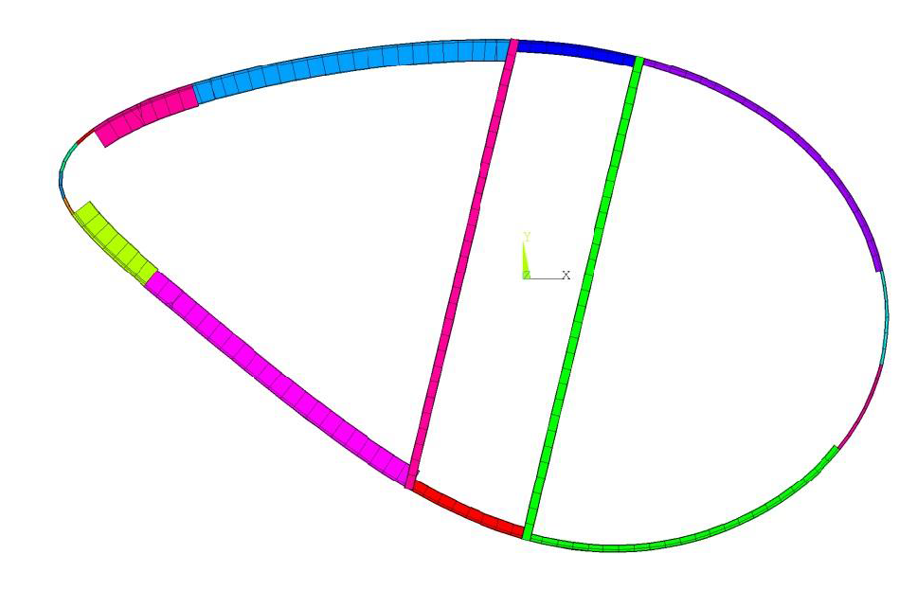
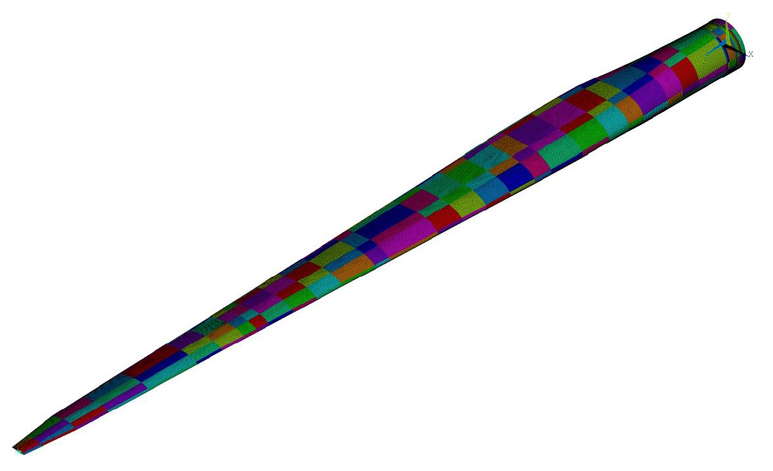
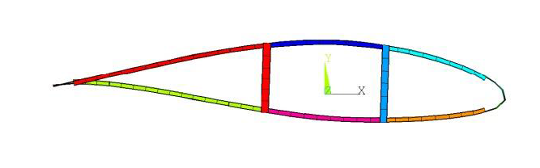
61.5 m blade layup
Intended uses for blade model
A starting point for blade design optimization or parameter studies
Blade structural design tool verifications and validations
IEC Turbine Class I-B (same as NREL 5 MW)
120 m rotor size (same as NREL 5 MW)
Not intended uses for blade model
Not a model for effective CFD simulation; Ray Chow’s 5 MW blade model is more appropriate
Not an optimal blade design; an optimized blade was created and documented in SAND2014-3136, Effects of Increasing Tip Velocity on Wind Turbine Rotor Design
Blade geometry
Replicated the chord, twist, and thickness schedule of the NREL 5 MW reference
Used the same airfoils as the NREL 5 MW reference

Slide 2
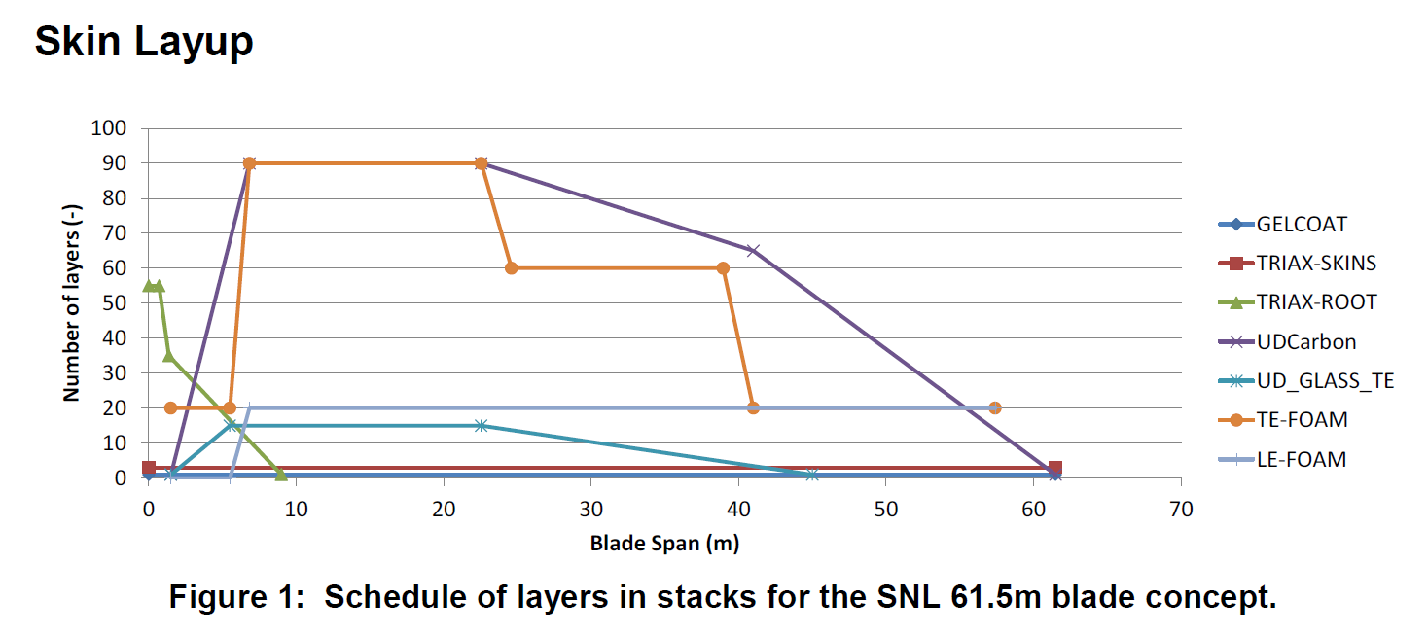
61.5 m blade layup
Materials
Materials properties were the same as the Sandia 100 m blade model; blade construction is glass fiber with carbon fiber spar caps
Blade layup design requirements
Meet or exceed a subset of basic IEC design criteria
Matched overall mass of NREL 5MW blade—17,740 kg
Safety factors for material strengths and loads were defined using a simple approach that is based on IEC
IECWind was used to generate load cases
Panel buckling, composite fatigue, and maximum blade tip deflection were used to drive the layup design
Design load cases used
IEC DLC | Desc.
DLC 1.2 | NTM
DLC 1.3 | ETM
DLC 1.4 | ECD
DLC 1.5 | EWS
DLC 6.1 | EWM50
DLC 6.2 | EEWM01

