Slide 1

Robot Path-Finding with A* Search
Single-Robot Heuristic Comparison & Cooperative Multi-Robot Planning
CSMI17 — Artificial Intelligence | Assignment 5

Slide 2






Agenda
Problem Definitions
Assumptions
Single-robot and multi-robot path-finding
Grid model, movement rules, evaluation metrics
A* & Heuristics
Multi-Robot Challenges
Manhattan, Euclidean, Chebyshev compared
Why independent A* fails as teams grow
Proposed Method
Results & Comparison
Cooperative Space-Time A*
540 + 384 experiment runs, plotted
CSMI17 — AI Assignment: Robot Path-Finding with A*
2

Slide 3
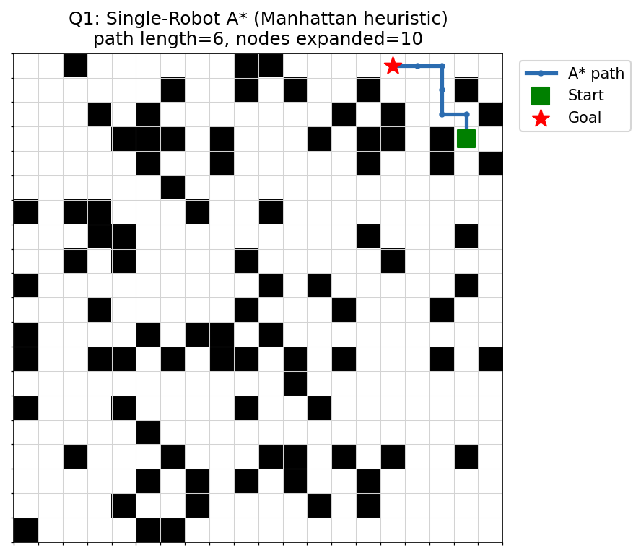
Q1: Single-Robot Path-Finding
A robot sits in one cell of a grid and must reach a goal cell.
Rules:
Grid has randomly placed static obstacles the robot cannot enter
Movement: one cell per step, 4 directions (N/E/S/W), unit cost
Goal: find the shortest path from start to goal using A* search
Compare 3+ heuristics on search efficiency, not just correctness
Example: 20×20 grid, 22% obstacle density, solved with A* (Manhattan heuristic)
CSMI17 — AI Assignment: Robot Path-Finding with A*
3

Slide 4


Assumptions & Customizations
Grid & Obstacles
Movement Model
N×N grid; obstacle density and start/goal chosen at random. Instances are verified reachable (BFS) before use.
4-connected moves, unit cost. No diagonals — matches the standard grid path-finding formulation.
Synchronized Time
Evaluation Metrics
All robots move (or wait) once per discrete timestep. A robot that reaches its goal parks there.
Nodes expanded/generated & runtime (Q1); collisions, makespan & sum-of-costs (Q2) — standard MAPF metrics.
CSMI17 — AI Assignment: Robot Path-Finding with A*
4

Slide 5
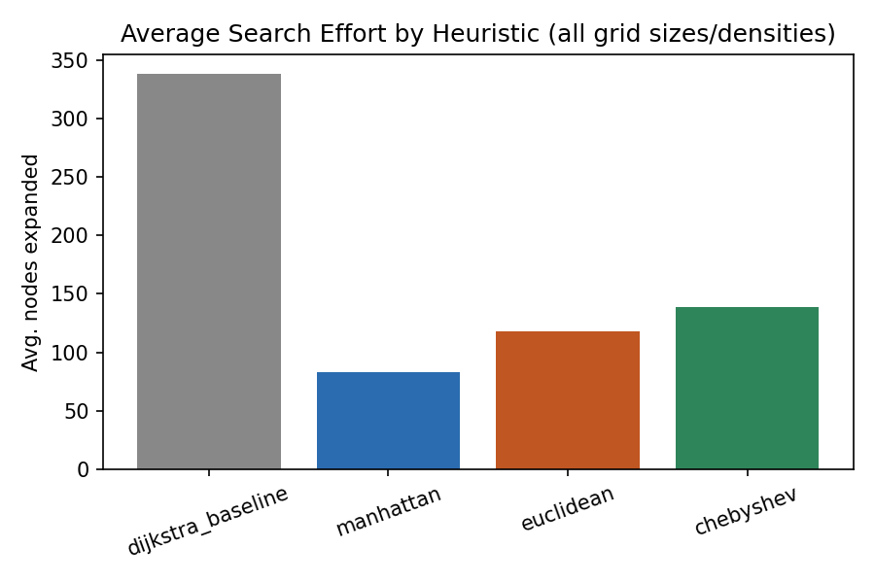
A* Search — Quick Recap
A* expands the frontier node with lowest f(n), guaranteeing an optimal path whenever h is admissible.
f(n) = g(n) + h(n)
g(n): cost so far h(n): estimated remaining cost
Admissible heuristic → never overestimates true remaining cost → optimal path guaranteed
Tighter (larger) admissible heuristic → fewer nodes expanded → faster search
h(n) = 0 everywhere → A* degenerates exactly to Dijkstra's algorithm
Dijkstra (h=0) baseline expands far more nodes than any real heuristic
CSMI17 — AI Assignment: Robot Path-Finding with A*
5

Slide 6
Three Heuristics Compared
Manhattan
Euclidean
Chebyshev
|Δrow| + |Δcol|
√(Δrow²+Δcol²)
max(|Δrow|,|Δcol|)
Exact remaining distance on an open 4-connected grid — tightest bound → fewest nodes expanded.
Straight-line distance. Always ≤ Manhattan → admissible, but a looser estimate.
Correct for 8-connected movement; on this 4-connected grid it's the loosest of the three.
All three are admissible → all return optimal paths (avg. 19.96 steps, 100% match with Dijkstra baseline). They differ only in search effort.
CSMI17 — AI Assignment: Robot Path-Finding with A*
6

Slide 7
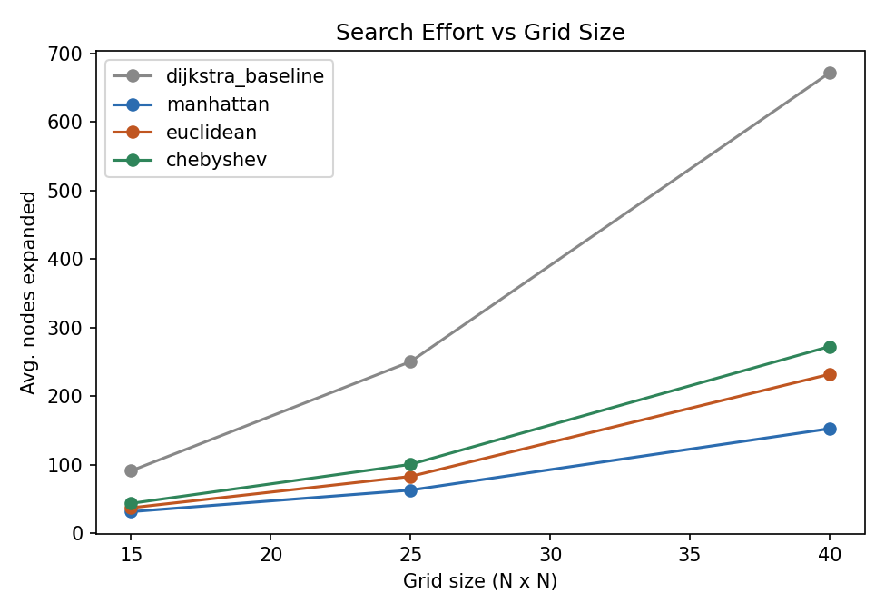
Q1: Experimental Setup
Grid sizes:
15×15, 25×25, 40×40
Obstacle densities:
10%, 20%, 30%
Trials:
15 random solvable instances per (size, density)
Total:
135 instances × 4 heuristics = 540 search runs
CSMI17 — AI Assignment: Robot Path-Finding with A*
7

Slide 8
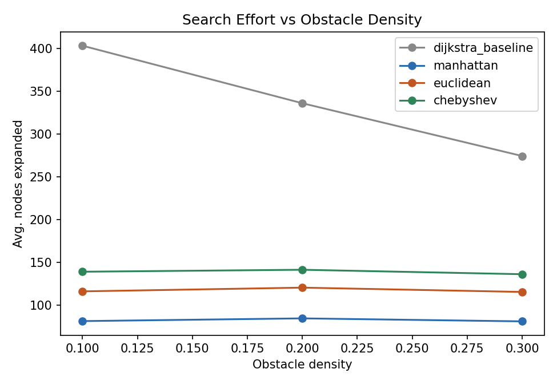
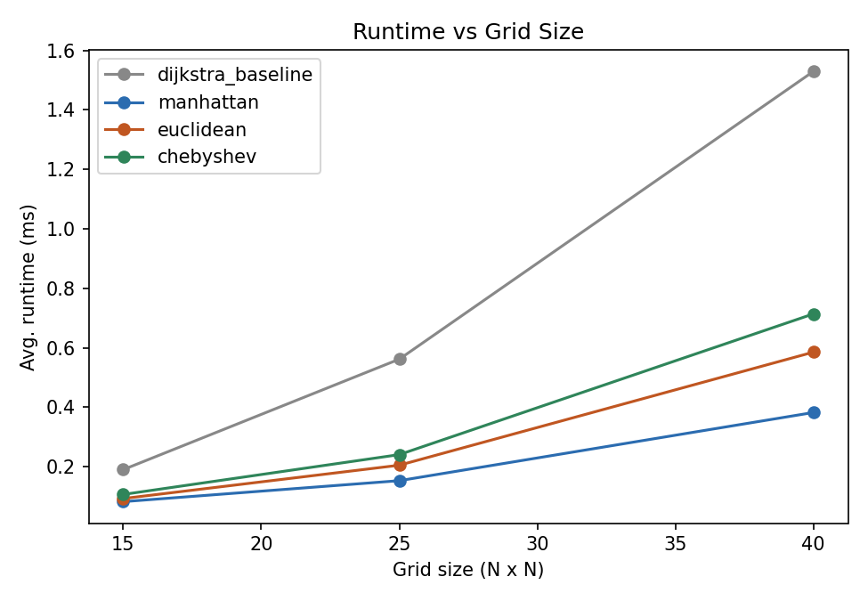
Q1: Results — Manhattan Wins
Manhattan expands ~4× fewer nodes than the h=0 baseline, and 30–40% fewer than Euclidean/Chebyshev — because it is the tightest admissible bound for 4-connected grids.
CSMI17 — AI Assignment: Robot Path-Finding with A*
8

Slide 9

Q2: Multi-Robot Path-Finding
Now many robots share the grid — each with its own start & goal, moving simultaneously.
Vertex Collisions
Edge / Swap Collisions
Combinatorial Blow-up
Two robots occupy the same cell at the same timestep.
Two robots cross the same edge in opposite directions and swap cells.
Joint state space grows as (free cells)^n — too large to search directly.
CSMI17 — AI Assignment: Robot Path-Finding with A*
9

Slide 10
Proposed Method: Cooperative Space-Time A*
Plan robots one at a time; search over (row, col, time) instead of just (row, col).
1
Priority order:
Robots are assigned an order and planned sequentially, not all at once.
2
Space-time search:
Each robot's A* state is (r, c, t); a WAIT action lets it pause for another robot.
3
Reservation table:
Every planned robot's (cell, time) path and edges are marked reserved for later robots.
4
Dynamic obstacles:
Later robots' searches treat reservations as obstacles — avoiding vertex & edge collisions.
5
Safe parking:
A robot only “arrives” if its goal cell is free for the rest of the horizon too.
CSMI17 — AI Assignment: Robot Path-Finding with A*
10

Slide 11
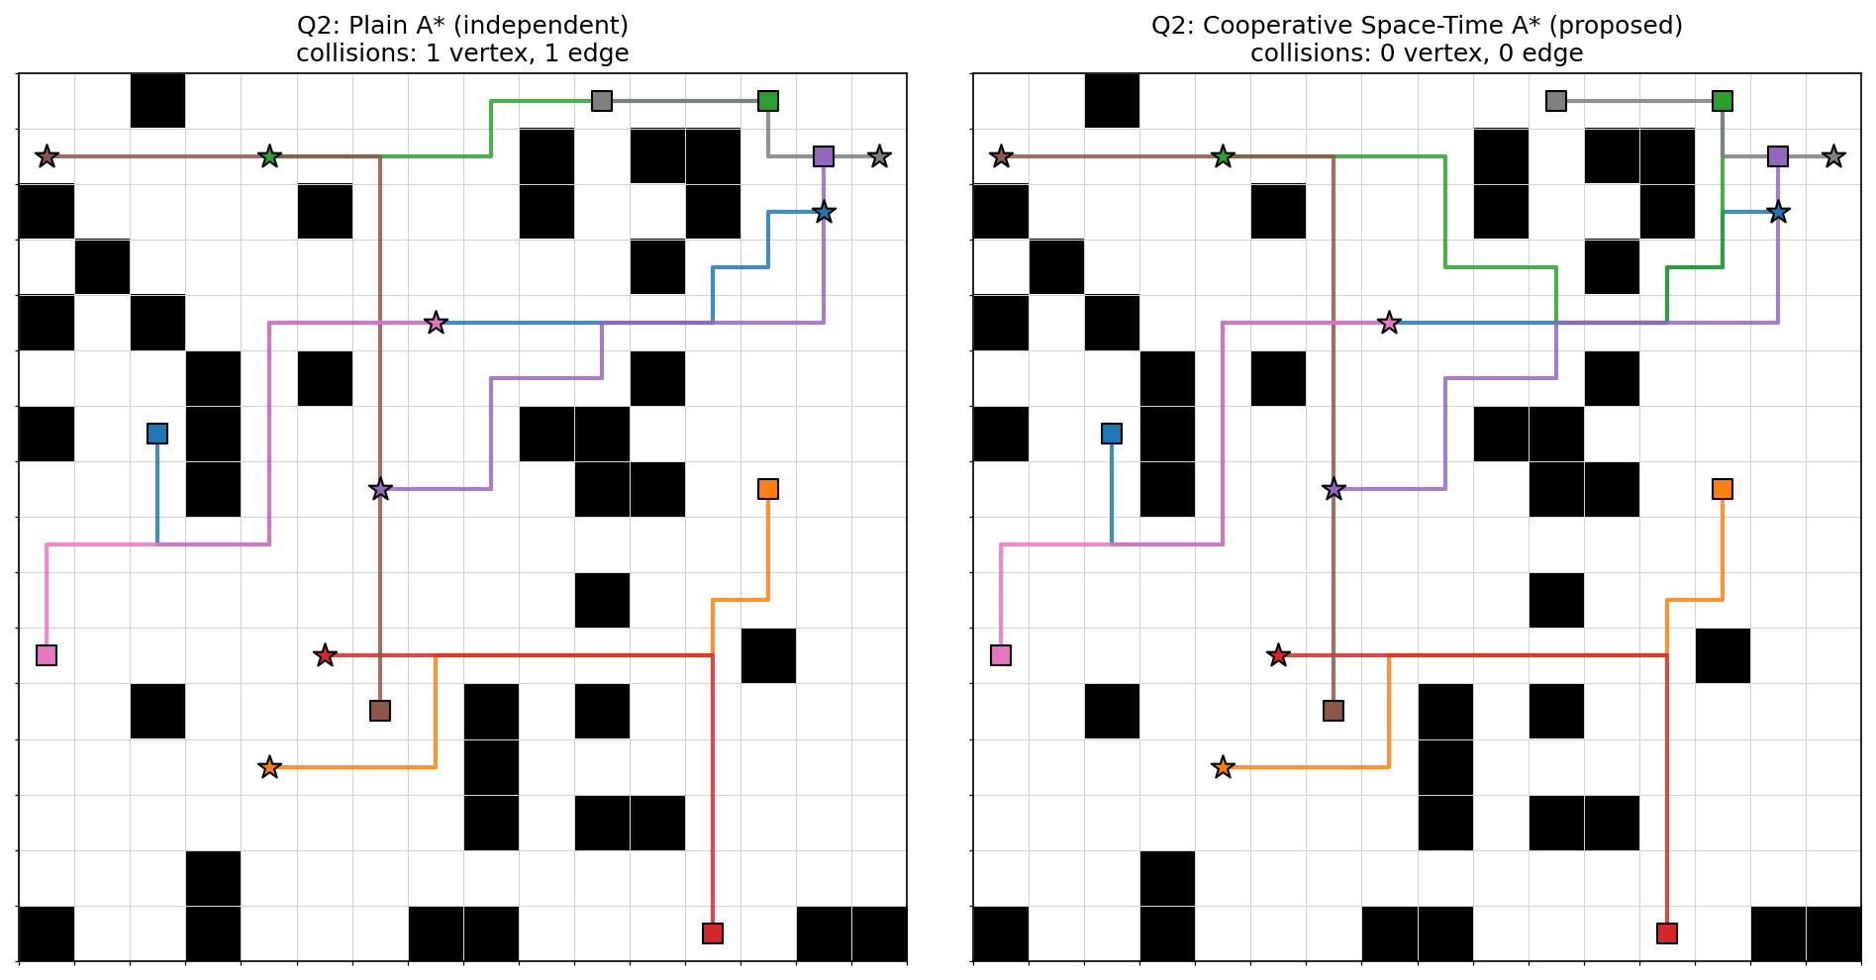
Q2: Experimental Setup
Grid sizes
Densities
Team sizes
Trials
20×20, 30×30
10%, 20%
2, 4, 6, 8, 12, 16 robots
8 per config → 192 instances
Methods compared: Plain A* (independent) vs. Cooperative Space-Time A* (proposed) → 384 total planning runs
Same 8-robot instance: plain A* (left) collides; Cooperative Space-Time A* (right) does not
CSMI17 — AI Assignment: Robot Path-Finding with A*
11

Slide 12
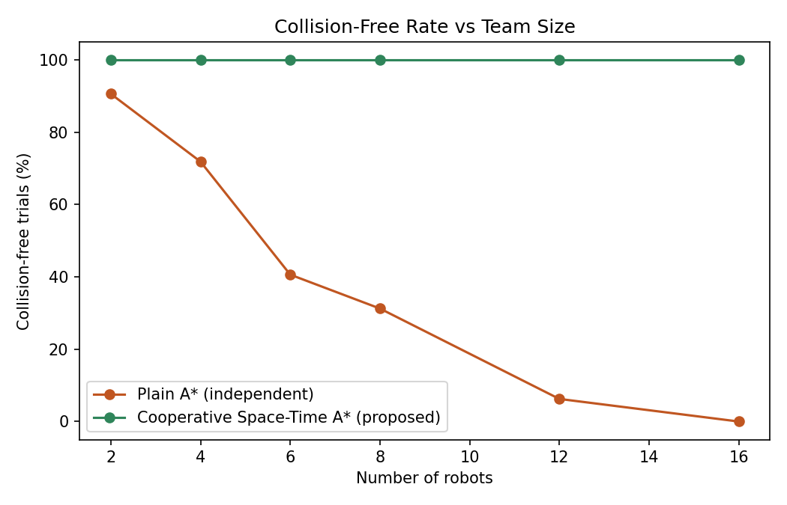
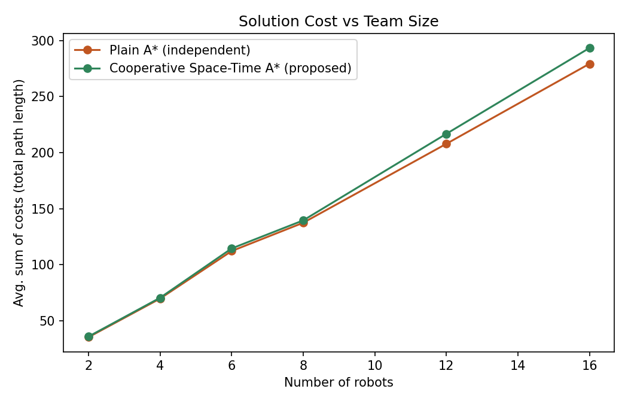
Q2: Results — 100% Collision-Free
Plain A* collapses from 91% collision-free (2 robots) to 0% (16 robots). Cooperative Space-Time A* stayed 100% collision-free across all 192 instances — for only ~2–5% more total path length.
CSMI17 — AI Assignment: Robot Path-Finding with A*
12

Slide 13


Conclusion
Q1
Manhattan is the most efficient admissible heuristic on 4-connected grids; all heuristics remain optimal.
Q2
Naive independent A* is unsafe beyond a handful of robots; collisions grow with team size and density.
Proposed fix
Cooperative Space-Time A* with a reservation table achieved 100% collision-free plans at low extra cost.
Code, results & report: <ADD YOUR GITHUB LINK HERE>

