Slide 1
v3.6 Tutorial
Folker Meyer
Argonne National Laboratory
Notes:
phyloseq

Slide 2
MG-RAST is
A system to support user-driven analysis of metagenomic data;
It offers automated quality control, annotation, comparative analysis, and archiving services;
MG-RAST provides several methods to access data and tools;
MG-RAST for data analyses and discovery!
phylogenetic reconstructions,
metabolic reconstructions,
explore annotation
compare metagenomes

Slide 3
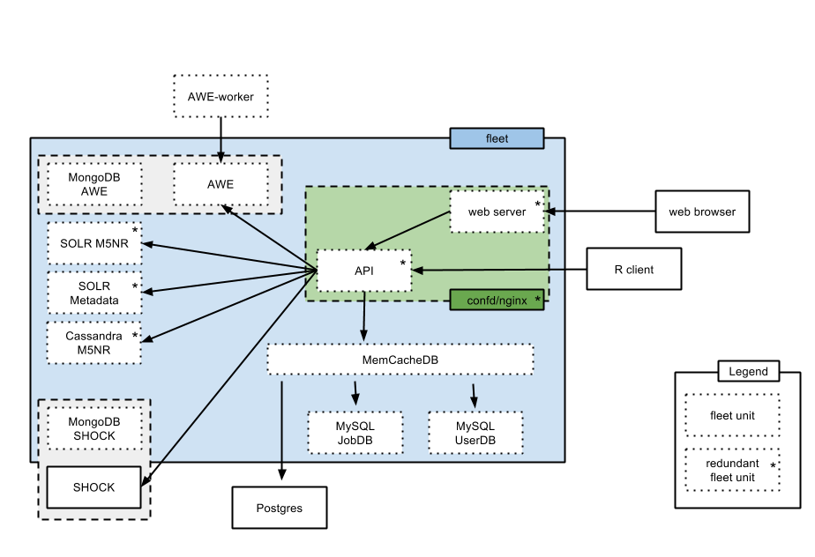
The Big Picture
MG-RAST CL Tools

Slide 4
The Big Picture
MG-RAST CL Tools
Backend infrastructure
Workflow manager
Object store
Scalable
Resource allocation
Simple stateless architecture
Cloud-based

Slide 5
The Big Picture
How is data processed and annotated?
Data submitted to MG-RAST goes through our analysis pipeline.
Composed of three conceptual steps:
quality control,
data reduction,
and analysis

Slide 6
The Big Picture
Focus on MG-RAST front-end capabilities and how to use MG-RAST to answer scientific questions.
MG-RAST CL Tools
Many ways to access and use MG-RAST
Cmd-line tools
API
Web site
R package, matR

Slide 7
Ways to interact with MG-RAST
Web interface
http://www.metagenomics.anl.gov
Most popular entry point
Rich in features for upload, search, data analysis
Limitation in number of data sets that can be compared
API
Makes all data created by the pipeline accessible.
Complements the existing MG-RAST web interface
Compatible with most programming environments
Cmd-line interface (mg-rast tools)
R statistical package (matR)

Slide 8
Now for some practical applications!
What you need to get started:
A MG-RAST account (http://metagenomics.anl.gov/?page=Register
Web
Latest version of Firefox browser
CMD-Line
Download python and install libraries (https://pip.pypa.io/en/latest/installing.html)
Download MG-RAST command-line tools (ftp://ftp.metagenomics.anl.gov/tools/upload/ )
OS Shell
R
Download and install R package (https://www.r-project.org/) AND
matR (https://github.com/MG-RAST/matR/)
MD5 sum
Need to create MD5sums for files
Download http://www.freebsd.org/ for md5sum command

Slide 9
MG-RAST fundamental concepts
service side processing
stats
late binding to parameters
Filtering data after pipeline completion
smart data structures
enable queries and fast data retrieval
controlled vocabularies
“de-noising” via CVs vs. genbank (dnaA…)

Slide 10
MG-RAST fundamental concepts - service side processing
Uses SHOCK storage system
Enables dynamic storage for server side processing.
Makes for faster generation of user defined data “views”.
A more flexible and yet powerful approach.

Slide 11
MG-RAST fundamental concepts - late binding to parameters
There is no one size fits all to annotation
We need multiple ways of viewing the similarities to protein databases.
Changing from one database (annotation source) to another or changing cutoffs - changes “the picture”.
Therefore we came up with the M5nr and provide “late binding to parameters” to allow users to make their own choices.

Slide 12
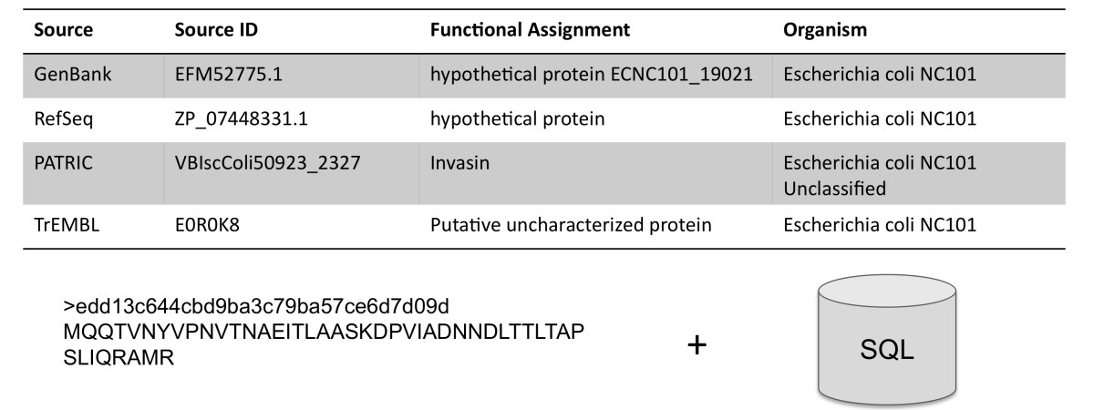
MG-RAST fundamental concepts - late binding to parameters
The M5nr
MD5-based non-redundant protein database
Common reference for sharing similarity results.
Based on databases from:
EBI
GO
JGI
KEGG
NCBI
SEED
Phantome
UniProt
VBI
eggNOG

Slide 13
MG-RAST fundamental concepts - smart data structures
MG-RAST has “smart data products” enabling the user -- at the time of analysis -- to determine the best parameters.
No need to recompute data!

Slide 14
MG-RAST fundamental concepts - controlled vocabularies
CV’s for metadata
CVs/Ontologies changing over time (http://bioportal.bioontology.org/)
Import of exsiting CVs into MG-RAST
api.metagenomics.anl.gov/metadata
Defined project wide
Support multiple versions
Default latest
Defined within a project

Slide 15
Example 1. Downloading data
Various types of data for download is available.
Dedicated Download page for:
Metadata
Submitted data – the original user submission
Analysis results -– results from EACH STEP of the MG-RAST pipeline.
Derived data – data based on annotation source and type (taxa or function)
Download from Workbench is also available
Search for metagenome 4472164.3 and download the sequence file that was provided at submission and the metadata file.
Notes:
There is another example of downloading data via the CMD-LINE in example 9.

Slide 16
Metadata
Open the metadata file you just downloaded.
Here is an example of what format the metadata is in.
Can open and edit in a text editor or excel
Data is GSC compliant
Metadata critical for analysis!
When submitting metadata - you can use an excel template we provide or use our online editor (Metazen).
Minimizes effort and reduces complexities of navigating standards.

Slide 17
Exercise 2. Upload and Submission
Typically, users will come in with their own data and/or looking to analyze public data.
You can use the data you just downloaded to try out the upload if you don’t have data of your own.
In order to analyze your data – follow some easy steps to upload and submit data.
Time needed to process data varies considerably (average 2 weeks for WGS), depending on:
the size of your data set(s),
whether you provide metadata and
if you plan to publish data on MG-RAST.

Slide 18
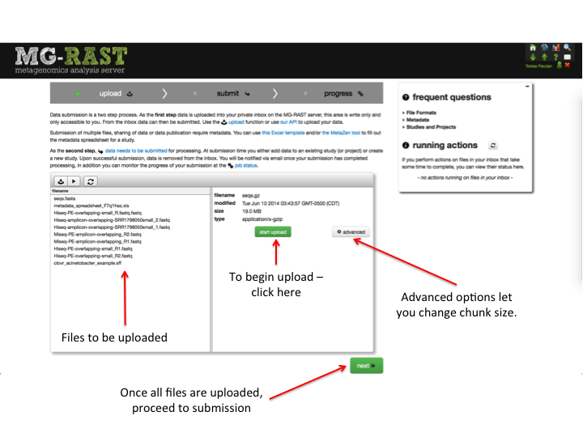
Uploading to MG-RAST
Green “up” arrow takes you to upload
Sequences can be in FASTA, FASTQ, or SFF format.
Can be compressed files.

Slide 19
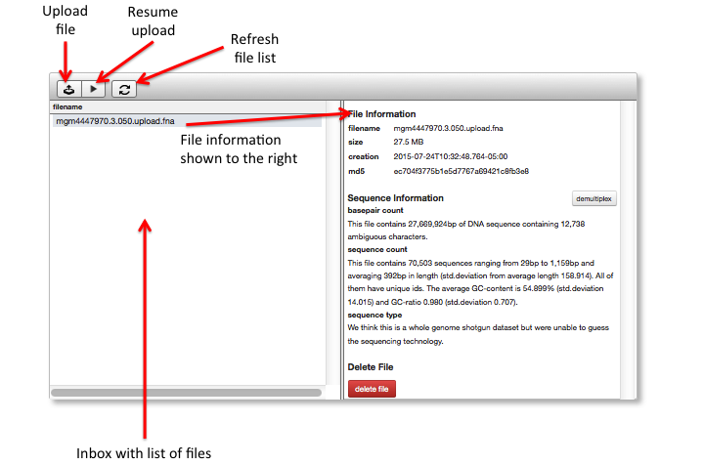
Elements of the file browser

Slide 20
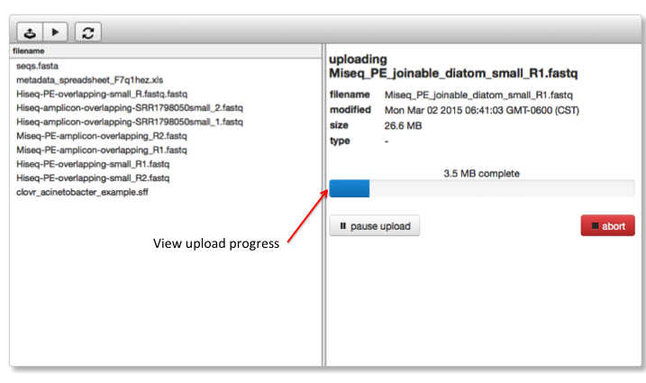
Upload progress

Slide 21
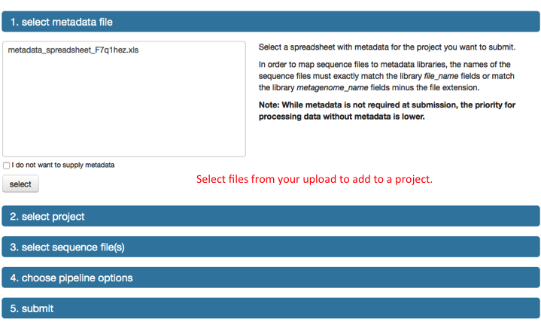
Now to submit your data
Metadata is important!
Suggested, but not required.

Slide 22
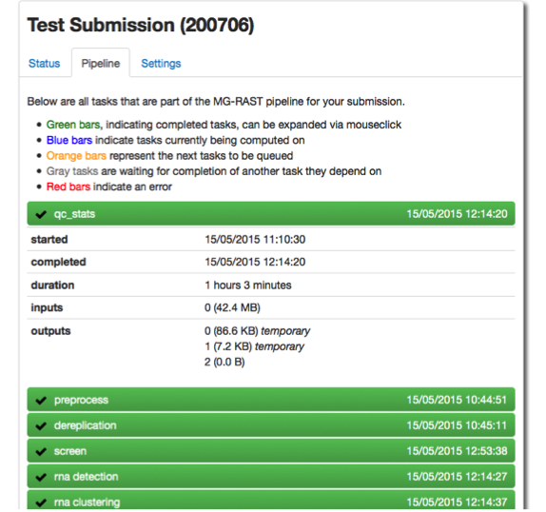
Submission is done …
when the completed sections turn green.

Slide 23
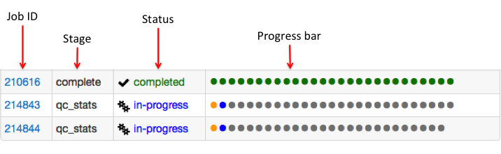
How far along has my data progressed?
Progress Bar Legend
Green = completed successfully
Blue = in progress
Orange = queued stage
Red = error
Gray = waiting for other stages to complete

Slide 24
Using MG-RAST to answer scientific questions: An example study
Feces samples from HMP (Human Microbiome Project) consortium.
Study citation:
Vital M, Howe AC, Tiedje JM. Revealing the bacterial butyrate synthesis pathways by analyzing (meta)genomic data. MBio. 2014 Apr 22;5(2):e00889. PubMed PMID: 24757212
They screened for butyrate synthesis pathways in 15 metagenomes from stool samples of healthy individuals.
Why? To understanding the role of butyrate producers in health and disease.
Used “expensive” methods to annotate – Use MG-RAST to screen to reduce compute. (e.g. Run pipeline, search and download subset and run through other tools (like Pfam).

Slide 25
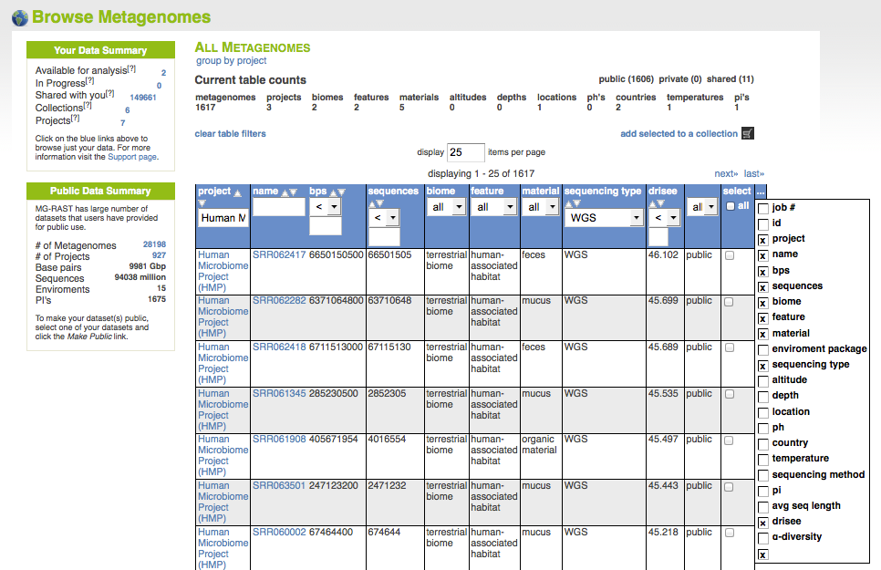
Example 3. Finding samples
The research team used 15 random stool samples from HMP healthy patients.
Go to browse page and filter table by:
Project: Human Microbiome Project
Material: Feces
Disease state: Healthy
You can use the table to filter the HMP samples based on metadata

Slide 26
Finding samples
You can add columns to the Browse table to sort or filter by.
Add in quality score: DRISEE

Slide 27
Example 4: Data Quality - Examine Samples
Sort your filtered samples by DRISEE score and see the range of quality.
Look at the one with best quality (lowest score) and the one with the worst (highest score)
Note: A DRISEE score of zero means the metagenome did not meet standards for calculation.
Clicking on the metagenome IDs takes you to the Overview page with a summary of the annotation and analysis.

Slide 28


Metagenome overviews
Provide information on:
Summary of the annotation run (annotated, unannotated)
QC
Taxonomic breakdown
(for WGS) Functional breakdown
Technical data
Links to →

Slide 29
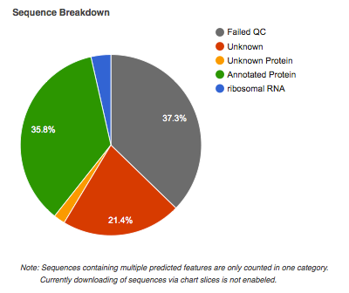
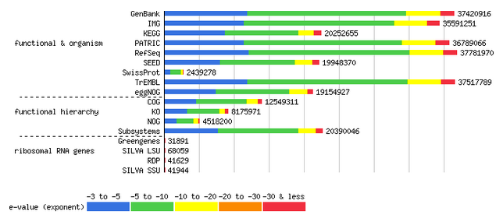
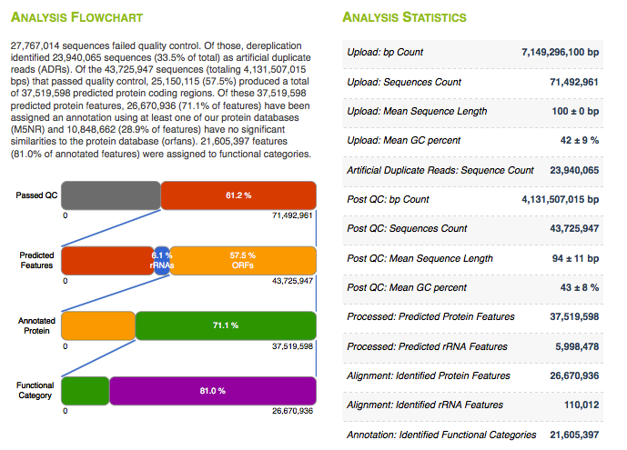
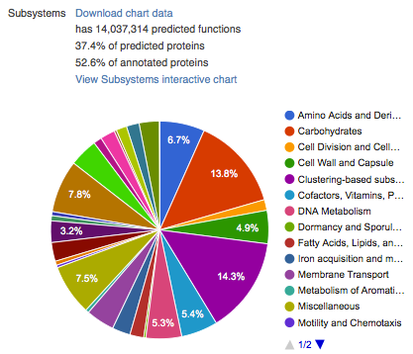
Example Sections of Overview
Notes:
Here a live browse through the Overview should be made.
Note that quality should be looked at. Segway into QC section.

Slide 30
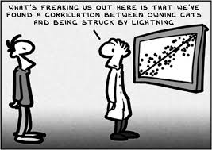
How trustworthy is my data?
The Overview provides insight into the quality of the sequence data.
Why is it so important to know?
Summaries of technical aspects of the sequence quality to enable sequence data triage:
DRISEE for estimating sequence error
Kmer spectra
Visualizations of the base caller output

Slide 31
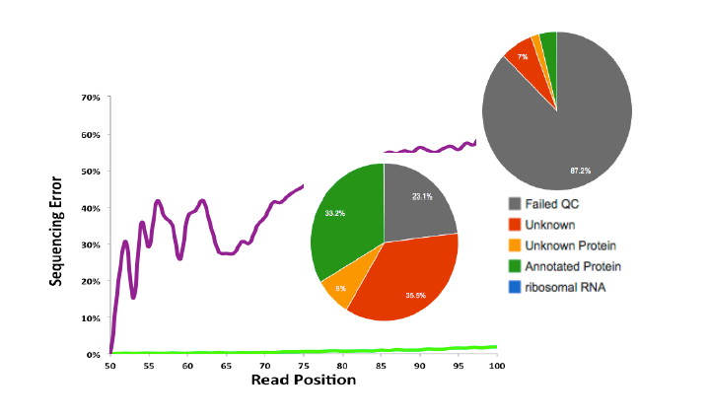
Data Quality Challenge
Data quality and our ability to analyze data is tightly correlated

Slide 32
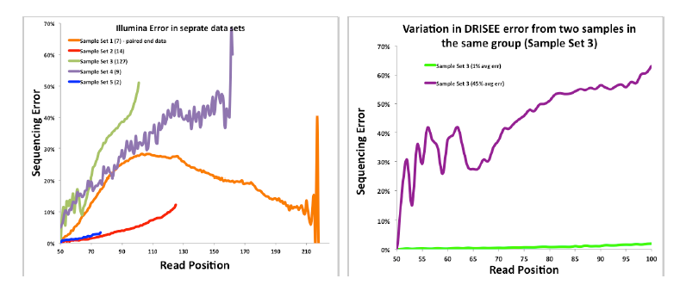
Duplicate Read Inferred Sequencing Error Estimation --- (DRISEE)
Experiments and even individual samples from a single experiment exhibit unique error profiles.

Slide 33
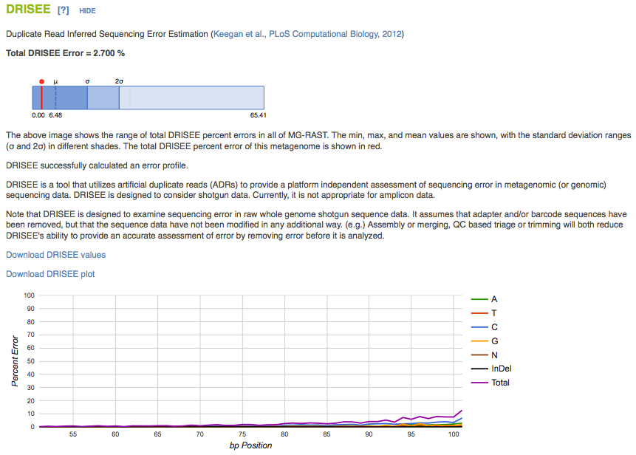
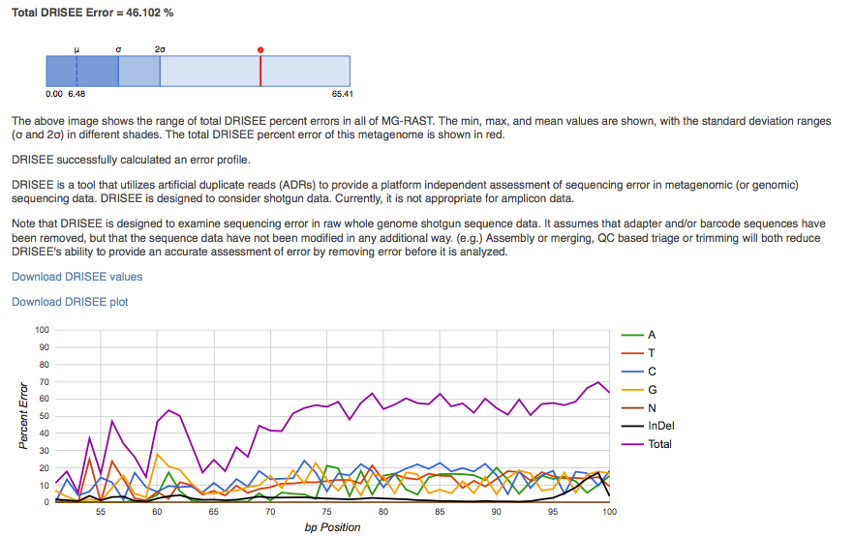
Extreme cases of quality
Good
Bad

Slide 34
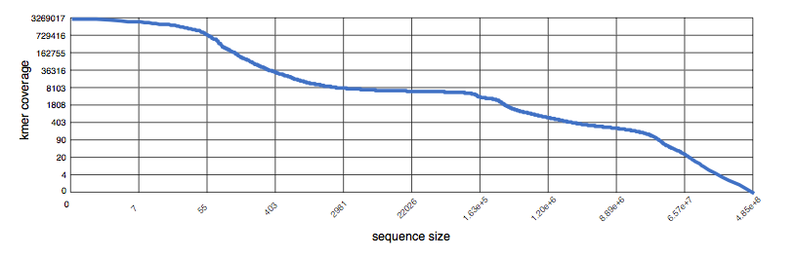
Kmer profiles
The kmer rank abundance plots the relationship between kmer coverage.
Summarizes the redundancy of sequence datasets.
Answers the question “What is the coverage of the nth most-abundant kmer?”.

Slide 35
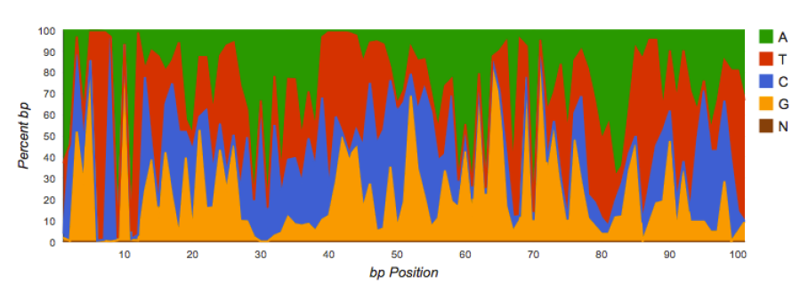
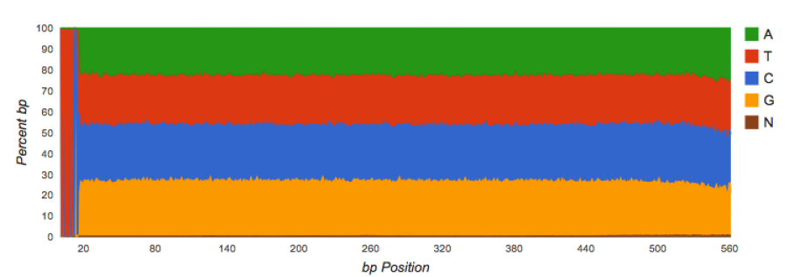
Nucleotide histogram
Amplicon datasets should show biased distributions of bases at each position.
WGS datasets should have roughly equal proportions of basecalls.
Reflects conservation and variability in the recovered sequences:
An example of untrimmed barcodes.

Slide 36
What do the samples look like?
What characteristics do two extreme HMP samples have?
What does the nucleotide profile show for the sample with greatest error?
If this was your sample, what would you do?
What data sets would you choose for your comparative analysis? How many?

Slide 37
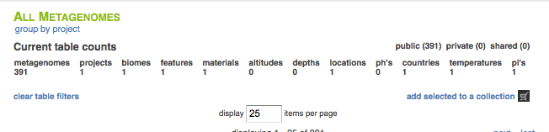
Example 5. How taxonomically diverse are your samples?
In Browse table, select some HMP fecal samples from healthy patients and add to a collection.
Select from table and add create a collection.
Go to the Analysis page
Create rarefraction curve for your collection
Create heatmap
Create table
Select on order Clostridiaceae
Subselect and add to workbench
Oops – if you can’t use MG-RAST web UI with that many features - move over to cmd-line!
Notes:
Folker – please note that they may run into a problem with the feature limit with the workspace. This may be a great time to talk about how the CLI/R tools can overcome these limits – rather than having to whittle down the data they are looking at.

Slide 38
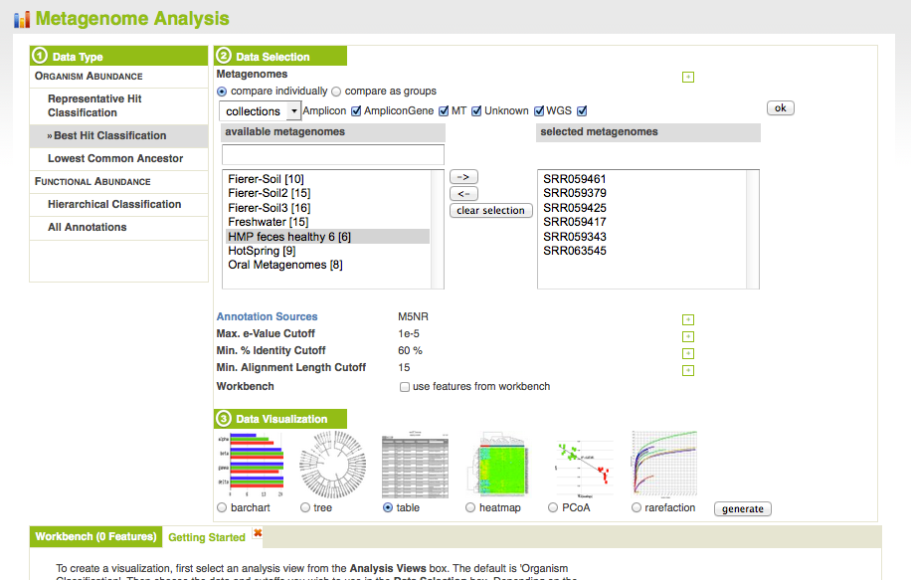
Array of analyses
Select your data
What kind of data will you analyze?
Set your parameters and annotation source
Choose your tool

Slide 39
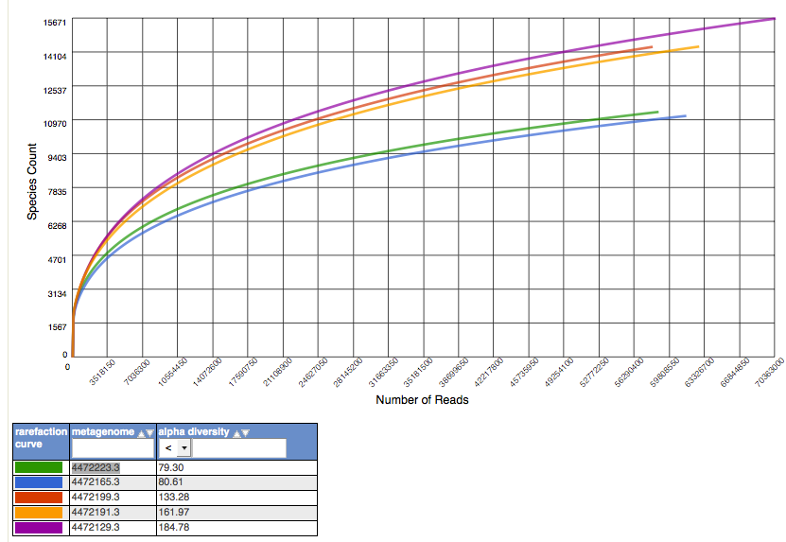
Sample diversity
Notes:
5 random healthy patient, fecal samples from HMP with DRISEE scores around 1.

Slide 40
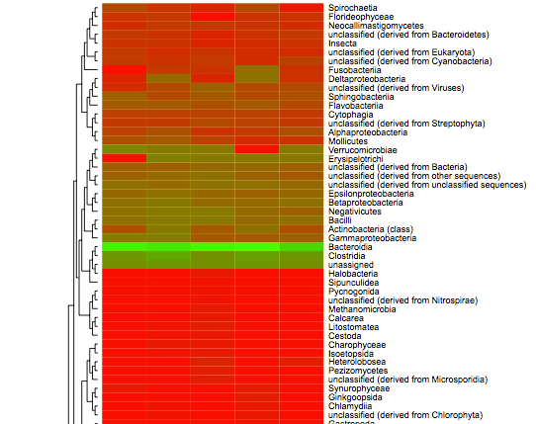
What taxa are in common?
Notes:
Check out the heatmap you created – what is the same, different in your sample? How can you more quantitative information? Create a table!

Slide 41
Are there major differences in the samples?
Comparisons of many large metagenomes can be challenging.
Out of the hundred or so HMP healthy-patient fecal samples in MG-RAST, how many did you choose?
Are we seeing different patterns based on the ones chosen?
How does subsampling impact results?

Slide 42
Example 6. Functional diversity
Switch over to using the Functional Abundance analysis selections.
Use your HMP collection
Search for enzymes involved in butyrate synthesis, like: lysine 2,3-aminomutase (EC 5.4.3.2)
How does this change with annotation source?
What annotation sources would you choose and why?
Using the KEGG mapper
How much of the pathways described by Tiedje etal are found? (Check out Butanoate metabolism and Lysine degradation –KEGG)

Slide 43
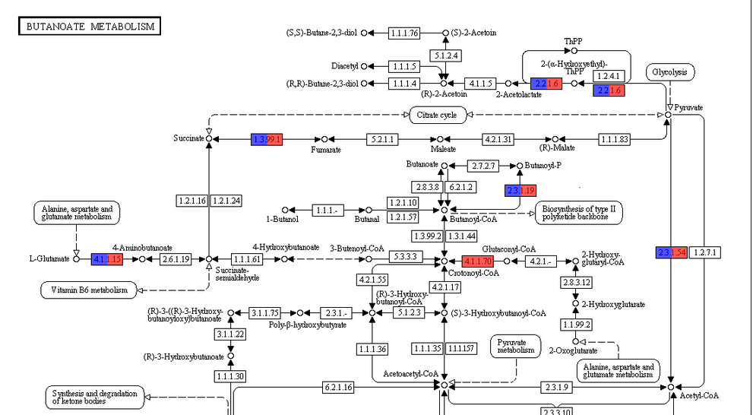
What functions did you find?
Notes:
Enzymes examined by Tiedje et al in orange rectangle.

Slide 44
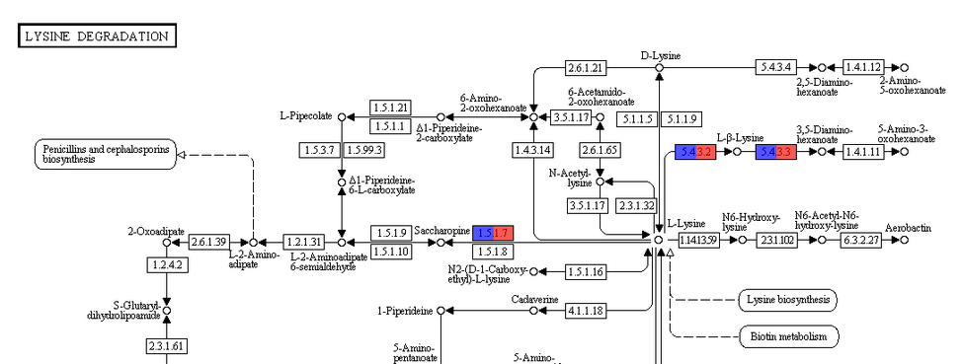
What functions did you find?
Notes:
Enzymes examined by Tiedje et al in orange rectangle.

Slide 45
Example 7. Digging deeper
What butyrate synthesis genes are present in class Clostridia in your “best” sample for HMP healthy fecal sample?
Lets look at another way to mine data via the UI!
Go back to Overview page
What Genera are present in this clade?
Limits to how much the workbench can hold! CL-tools/R tools will be better for larger analyses!
Search table for butyrate-related enzyme functions. (e.g. 5.4.3.2 in

Slide 46
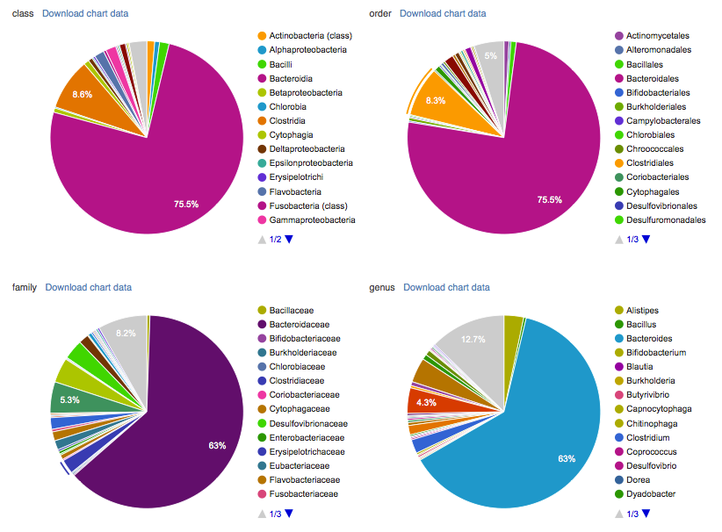
Select taxon group and move to workbench.
Metagenome 4472164.3
Family Clostridiaceae
Moved featured to workbench!

Slide 47
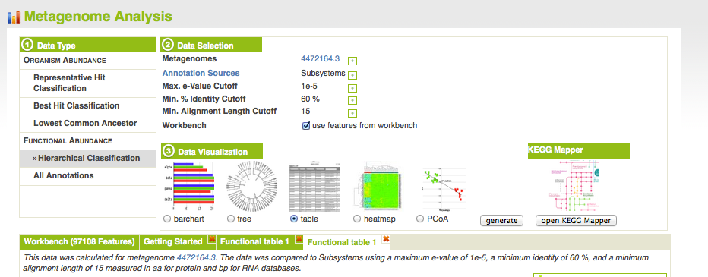
Create Function Table
Don’t forget to check that you want to use workbench data!

Slide 48
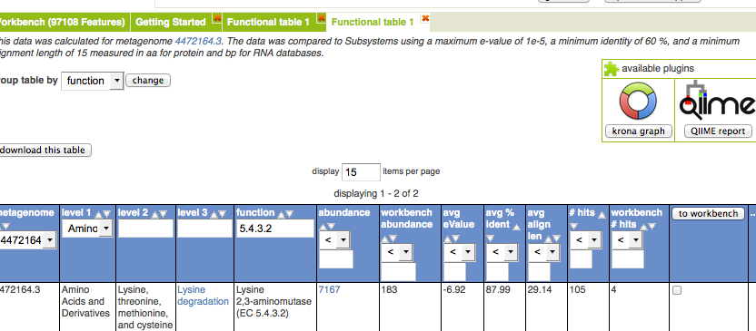
Search for function

Slide 49
Example 8. What are community functional differences among 3 HMP body locations?
Go to matR tutorial
Selecting, filtering, normalizing data
What are community functional differences among the three body sampling locations?
(see tutorial.HMP_subset.9-1-15.R)

Slide 50
Example 9: Exotic operations
Using the cmd-line tools
download all unannotated reads
download all dnaK, amoA genes from MANY metagenomes
sequence search against all/many data sets

