Slide 1
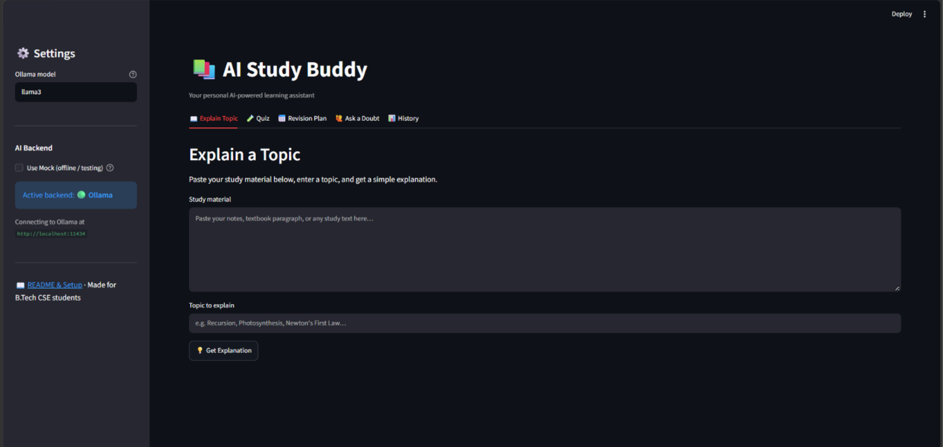
AI Study Buddy
An AI-powered study companion for clearer learning, guided practice, and organised revision
Built with development support from IBM Bob
IBM workshop project
Notes:
Source screenshots: IBM.pdf supplied by the project team. IBM Bob development-role description supplied in the project brief.

Slide 2
Problem statement
Students need more support than static notes can provide
Students often face three connected study challenges:
Understanding
Study materials alone do not adapt to the student.
01
Difficult concepts can remain unclear after reading notes or textbooks.
02
Practice
The project brings explanations, questions, revision support, and history into one study space.
Students need questions and feedback that relate to their own material.
03
Revision
Preparing a realistic plan and tracking progress can be time-consuming.

Slide 3
Solution overview
AI Study Buddy turns study material into targeted support
01
02
03
04
Explain a topic
Practice quiz
Revision plan
History
Converts notes or a topic into a simpler explanation.
Generates questions from study material and returns feedback.
Uses the material, topic, and available hours to guide revision.
Keeps quiz scores visible so students can check prior attempts.
Input: notes, text, or a question
Output: guidance that supports learning and revision

Slide 4
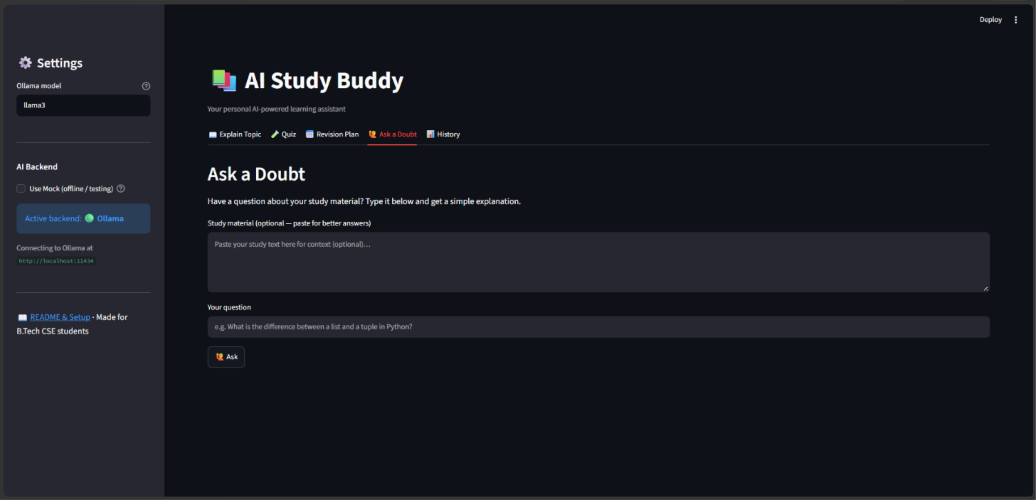
Explanations and doubt support
Students can paste material or ask a focused question
Explain a Topic
Ask a Doubt
The student enters notes or a topic and requests a simple explanation.
The student adds context if needed, then asks a question about the material.
Notes:
Source screenshots: pages 2 and 4 of IBM.pdf supplied by the project team.

Slide 5
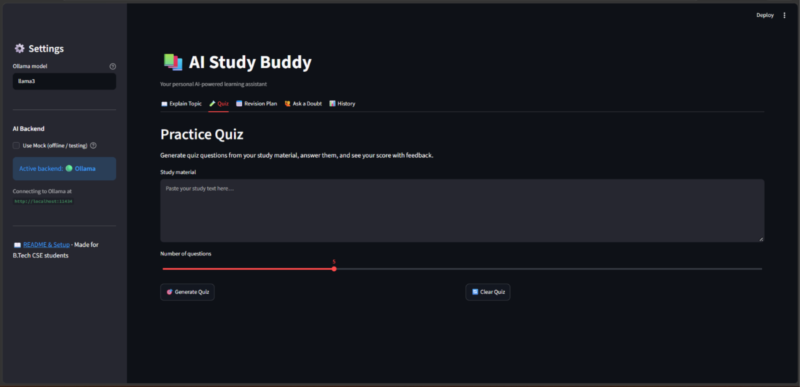
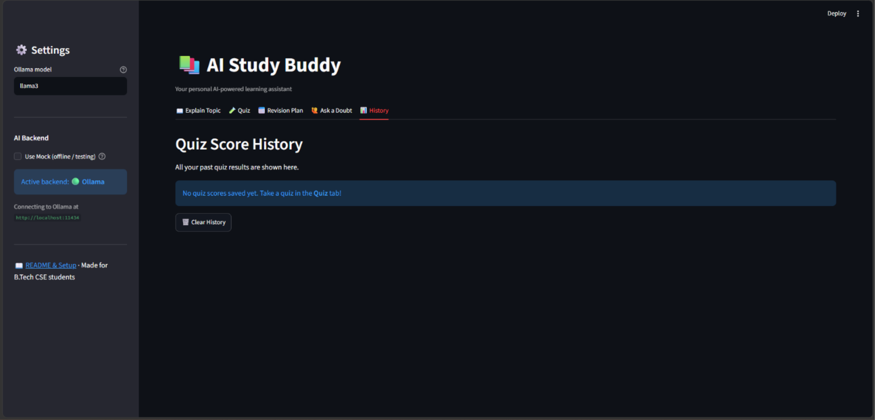
Practice and progress
Quizzes create active practice while history keeps results visible
Practice Quiz
The quiz screen accepts study material and lets the learner choose the number of questions.
Notes:
Source screenshots: pages 5 and 6 of IBM.pdf supplied by the project team.

Slide 6
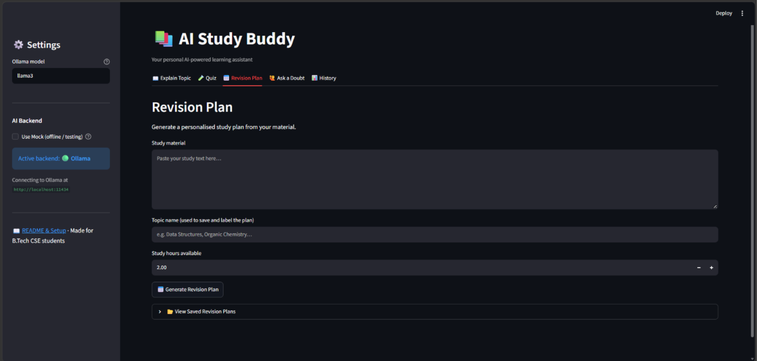
Personal revision planning
The plan begins with the material, a topic name, and available study time
Revision Plan
1
Paste the material to give the tool context.
2
Name the topic so the plan is easy to save and find.
3
Set the study hours available before generating the plan.
Notes:
Source screenshot: page 1 of IBM.pdf supplied by the project team.

Slide 7
IBM Bob in the development workflow
IBM Bob supported the team while they built and improved the application
01
02
03
04
Planning
Development
Troubleshooting
Testing
Refined the idea into features and a user journey.
Assisted with generating, explaining, and improving application code.
Helped break down issues and review possible fixes.
Supported checks of application logic and usability.
IBM Bob helped reduce repetitive development work so the team could focus on a useful student experience.
Notes:
IBM Bob development activities are based on the project description supplied by the team. The user interface screens show the AI Study Buddy product, not IBM Bob itself.

Slide 8
Project outcome
A single study space for explaining, practising, planning, and reviewing
AI Study Buddy combines the steps students usually complete across separate resources.
Expected benefit
The working interface provides places to explain a topic, take a practice quiz, build a revision plan, ask a doubt, and review quiz history.
Students can spend less time organising study tasks and more time understanding and practising their material.
AI Study Buddy

