Slide 1
CECS 326
Operating Systems
Processes
(Chapter 3, Operating system Concepts by Silberschatz, Galvin and Gagne)
Notes:
Program: file is stored on disk, no execution
Process:

Slide 2
Process Concept
Process – a program in execution; process execution must progress in sequential fashion
A process consists of an address space and current state
  Address space includes
    Program code, also called the text section
    Static data section, containing global variables
    Stack containing temporary data (function parameters, return addresses, local variables)
    Heap containing memory dynamically allocated during run time
  Current state includes
    Program counter
    Processor registers
Notes:
Process là chương trình đang được executing, bao gồm:
- Code của chương trình (text section)
- Dữ liệu của chương trình
- Stack
- Heap
- Program counter
- CPU registers
- PCB

Slide 3
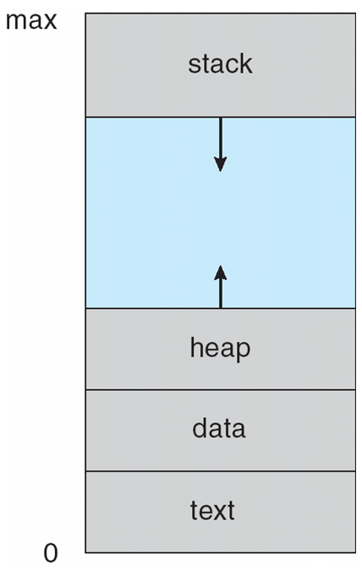
Process Concepts
Process in memory
Program is a passive entity stored on disk as an executable file, while process is active
A program becomes a process when the executable file is loaded into memory and a process control block (PCB) is created for its execution
Execution of a program can be started via GUI mouse clicks, command line entry of its name, etc.
We may have several processes executing the same program
Notes:
Multiple processes may execute the same program but independent process
=> Bạn mở 3 cửa sổ Notepad:
notepad.exe → Process 1
notepad.exe → Process 2
notepad.exe → Process 3

Slide 4

Process State
As a process execute, it changes state
  New: the process is being created
  Running: instructions are being executed
  Waiting: the process is waiting for some event to occur
  Ready: the process is waiting to be assigned a processor
  Terminated: the process has finished execution
Notes:
Ready: Process đã sẵn sàng chạy nhưng đang chờ CPU được cấp phát.
Running: Process đang sử dụng CPU.
Waiting: Process đang chờ một sự kiện khác, ví dụ chờ I/O hoàn thành.
Terminated: Process đã kết thúc.

Slide 5

Process Control Block (PCB)
A data structure created to maintain information associated with each process, including
  Process ID
  Process state
  Program counter
  Registers
  CPU scheduling information (priorities, scheduling queue pointers)
  Memory management information (memory allocated to process)
  Accounting information (CPU used, clock time elapsed since start, time limits)
  I/O status information (I/O devices allocated to process, list of open files)

Slide 6

CPU Switch From Process to Process

Slide 7
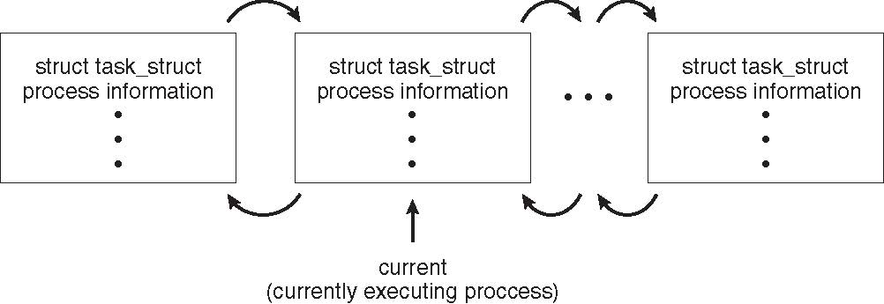
Process Representation in Linux
Represented by the C structure task_struct
pid t_pid; /* process identifier */
long state; /* state of the process */
unsigned int time_slice /* scheduling information */
struct task_struct *parent; /* this process’s parent */
struct list_head children; /* this process’s children */
struct files_struct *files; /* list of open files */
struct mm_struct *mm; /* address space of this process */
Notes:
Linux kernel: phần lõi giữa hardware va software để quản lí tài nguyên của máy tính

Slide 8
Process Scheduling
Maximize CPU use, quickly switch processes onto CPU for time sharing
Process scheduler selects among available processes for next execution on CPU
Maintains scheduling queues of processes
  Job queue – set of all processes in the system
  Ready queue – set of all processes residing in main memory, ready and waiting to execute
  Device queues – set of processes waiting for an I/O device
  Processes move among the various queues
Notes:
CPU ko nên ngồi rảnh. Nếu process A đang chờ I/O thì scheduler đổi CPU qua process B
CPU không thể chạy cùng lúc nhiều process nên OS sẽ để vào hàng đợi

Slide 9
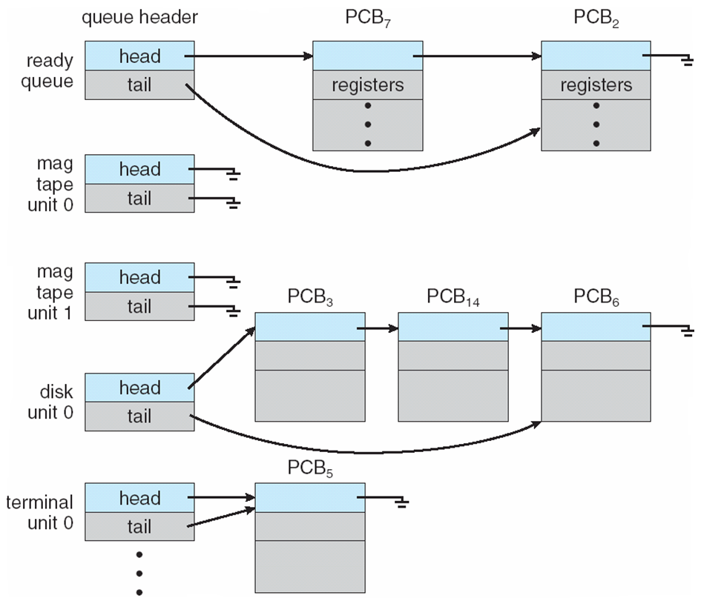
Ready Queue & Various I/O Device Queues

Slide 10
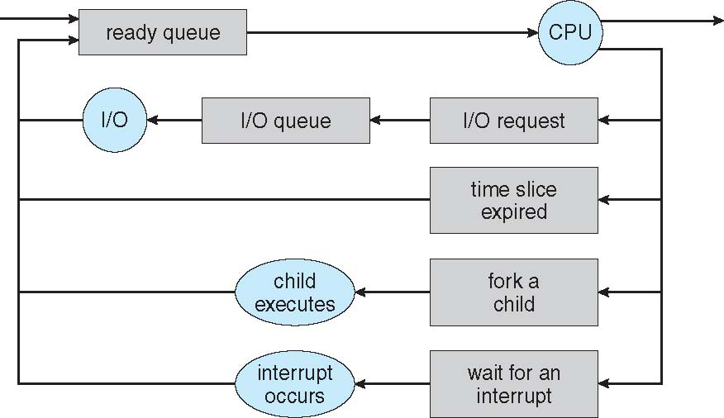
Representation of Process Scheduling

Slide 11
Context Switch
When CPU switches to another process, the system must save the state of the old process and load the saved state for the new process via a context switch
Context of a process is represented in the PCB(Process Control Block)
Context switch time is overhead; the system does no useful work while switching. The more complex the OS and the PCB, the longer the context switch
Time in context switch highly dependent on hardware support. Some processors (e.g., Sun UltraSPARC) provide multiple sets of registers. In this case context switch often requires just changing the pointer to a different register set.
Notes:
Khi CPU đang chạy 1 process này thì đổi sang process khác bởi “Process scheduler” => đỡ tốn tài nguyên
CPU đang chạy Process A
↓
OS muốn chuyển sang Process B
↓
OS lưu context của Process A vào PCB của A
↓
OS lấy context của Process B từ PCB của B
↓
CPU chạy Process B

Slide 12
Operations on Processes
OS must provide mechanisms for
  Process creation
  Process termination
  Interprocess communication

Slide 13
Process Creation
Parent process create child processes, which, in turn, create other processes, forming a tree of processes
A process is identified and managed via a process id (pid)
Resource sharing options
  Parent and children share all resources
  Children share subset of parent’s resources
  Parent and children share no resources
Execution options
  Parent and children execute concurrently
  Parent waits until children terminate
Address space
  Child duplicate of parent
  Child has a program loaded into it

Slide 14
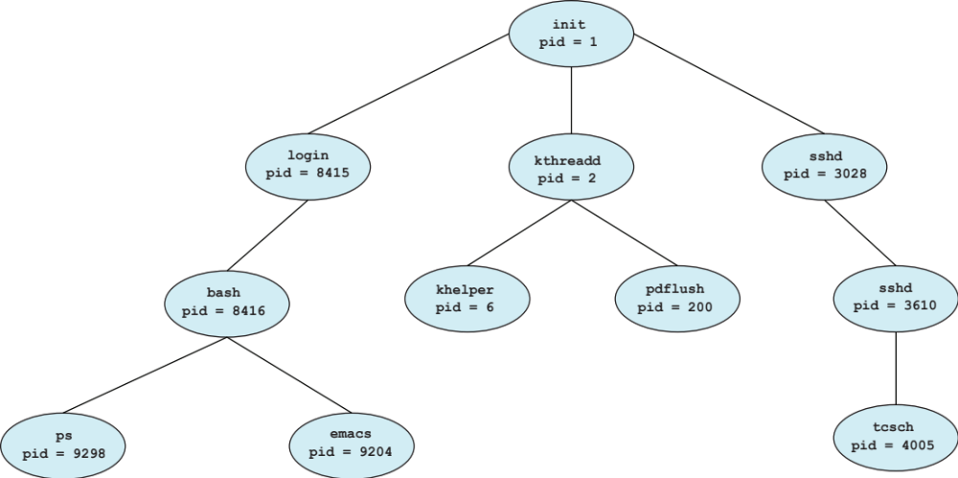
A Tree of Processes in Linux

Slide 15
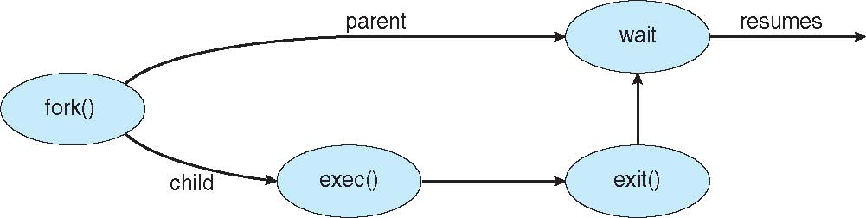
Process Creation
UNIX/Linux example
  fork() system call creates new process
  exec() system call used after a fork() to replace the process’ address space with a new program
Notes:
Exec(): cho process đó chạy program khác

Slide 16
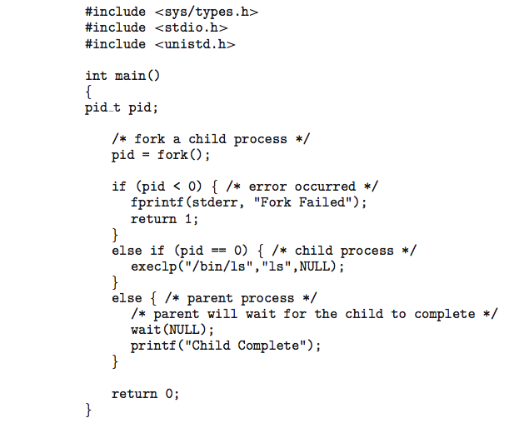
C Program calling fork() and exec()

Slide 17
Process Termination
Process executes last statement, then asks OS to delete it using the exit() system call
  Returns status data from child to the waiting parent (via wait())
  Process’ resources are deallocated by OS
Parent may terminate the execution of a child process using the abort() system call. Some reasons for doing so:
  Child has exceeded allocated resources or time
  Task assigned to child is no longer required
  Parent is exiting and the OS does not allow a child to continue if its parent terminates
Notes:
Process vẫn kết thúc mà ko cần exit() và vẫn trả về exit status
Dùng wait() để chở child process kết thúc và lấy status

Slide 18
Process Termination
Some operating systems do not allow child processes to continue if their parent has terminated
  If a process terminates, then a cascading termination occurs. All children, grandchildren, etc., are terminated
  The termination is initiated by the OS
Parent process may wait for termination of a child process by using a wait() system call. The call returns status information and the pid of the terminated process
pid = wait(&status);
A process that has completed its execution but its PCB has not yet removed, it becomes a zombie. A wait() system call invoked by its parent process completes this removal. If parent did not invoke wait(), the zombie will stay on
If parent did not invoke wait() and terminates, process is an orphan
Notes:
Cascading termination occurs when parent process terminate => depend on OS
Zombie process: child process is terminated but information is still in PCB because parent hasn’t had child process status

Slide 19

Multiprocess Architecture – Chrome Browser
Many web browsers ran as a single process
  If one web site causes trouble, then the entire browser can hang of crash
Google Chrome Browser uses a multiprocess architecture that runs 3 types of processes:
  Browser process manages user interface, disk and network I/O
  Renderer process renders web pages, deals with HTML, Javascript
    A new renderer is created for each website opened
    Runs in sandbox restricting disk and network I/O, minimizing effect of security exploits
  Plug-in process for each type of plug-in

Slide 20
Inter-process Communication
Processes within a system may be independent or cooperating
Cooperating process can affect or be affected by other processes (e.g., sharing data)
Reasons for cooperating processes:
  Information sharing
  Computation speedup
  Modularity
  Convenience
Cooperating processes need interprocess communication (IPC)
Two modes of IPC
  Shared memory
  Message passing
Notes:
Process independent là như notepad và calculator
Cooperating process: trong chrome có nhiều process như chrome có thể mở các tab ứng dụng khác
Those processes can affect to each other
IPC models:
+ shared memory: the processes can use the same memory space
+ message passing: truyền dữ liệu từ process A sang B thông qua kernel

Slide 21
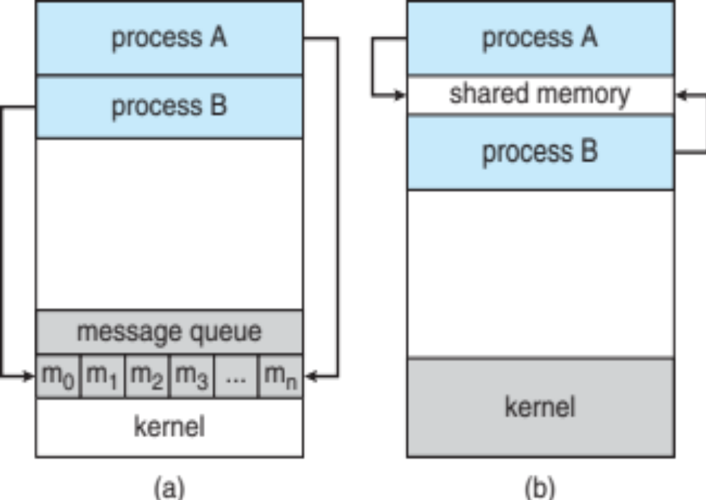
Models of IPC
(a) Message passing (b) Shared memory
Notes:
Message passing: Process A truyền dữ liệu qua Process B thông qua kernel
Kernel sẽ đưa vào kernel queue và Process B sẽ lấy data từ kernel
Shared memory: cùng lấy data từ memory chung

Slide 22
Producer-Consumer Problem
A paradigm for cooperating processes
  Producer process produces information that is consumed by a consumer process
  Cooperation via a shared buffer
    Unbounded-buffer places no practical limit on the size of the buffer
    Bounded-buffer assumes that there is a fixed buffer size
Notes:
Buffer: vùng nhớ tạm trong ram
Producer process: sản xuất và đưa dữ liệu vào buffer
Consumer process: dùng dữ liệu từ buffer
Bounded-buffer: buffer có giới hạn kích thước

Slide 23
Bounded-Buffer – A Shared-Memory Solution
Shared data
#define BUFFER_SIZE 10
typedef struct {
. . .
} item;
item buffer [BUFFER_SIZE];
int in = 0; // Points to the next free position
int out = 0; //Points to the first full position
Notes:
Concept slide này: khai báo cho bài toán Producer tạo dữ liệu -> bỏ vào buffer -> Consumer lấy dữ liệu từ buffer
Buffer_size: khay có 10 ô
Item: là biến dữ lieu mà producer tạo ra
buffer[0] buffer[1] buffer[2] ... buffer[9]: producer bỏ data vào ô buffer này và consumer lấy ra từ ô này
In: cho biết producer bỏ data vào ô nào tiếp theo
Out: cho biết consumer sẽ lấy data từ ô nào

Slide 24
Bounded-Buffer
Producer
item next_produced;
while (true) {
/* produce an item in next_produced */
while (((in + 1)%BUFFER_SIZE) == out)
; /* do nothing */
buffer[in] = next_produced;
in = (in + 1)%BUFFER_SIZE;
Consumer
item next_consumed;
while (true) {
while (in == out)
; /buffer empty, do nothing */
next_consumed = buffer[out];
out = (out + 1)%BUFFER_SIZE;
/* consume the item in next_consumed */
}
Solution is correct with one producer and one consumer, but can only use BUFFER_SIZE-1 slots in buffer
Notes:
One slot is intentionally left unused to distinguish between a full buffer and an emptybuffer.

Slide 25
IPC – Shared Memory
An area of memory shared among processes that wish to communicate
Communication is under the control of cooperating processes, not the OS
Major issue is to provide mechanism that will allow user processes to synchronize their actions when they access the shared memory
Synchronization to be covered in a later chapter
Notes:
Synchronize helps process not to mess up data while Producer process is writing and Consumer process is reading
Shared-memory không tự resolve bằng Synchronize, ta phải cung cấp thêm

Slide 26
IPC – Message Passing
Message passing - mechanism for processes to communicate and to synchronize their actions
Message system – processes communicate with each other without resorting to shared variables
IPC facility provides two operations:
  send(message)
  receive(message)
Message size may be fixed or variable
Notes:
Message passing có synchronization nên gửi và nhận message đều phải thông qua OS kernel

Slide 27
IPC – Message Passing
When two processes wish to communicate, they need to
  Establish a communication link between them
  Exchange messages via send/receive
Implementation issues:
  How are links established?
  Can a link be associated with more than two processes?
  How many links can there be between every pair of communicating processes?
  What is the capacity of a link?
  Is message size fixed or variable?
  Is the link unidirectional or bidirectional?
Notes:
Trước khi 2 process có thể gửi => cần Communication link (giống như hệ thống gửi message)
Còn message queue là nơi chứa những message đang chờ được chuyển

Slide 28
IPC – Message Passing Implementation
Implementation of communication link
  Physical:
    Shared memory
    Hardware bus
    Network
  Logical:
    Direct or indirect
    Synchronous or asynchronous
    Automatic or explicit buffering

Slide 29
Direct Communication
Processes must name each other explicitly in operation, e.g., between processes P and Q:
  send(Q, message) – send a message to process Q
  receive(P, message) – receive a message from process P
Properties of communication link
  Links are established automatically
  A link is associated with exactly one pair of communicating processes
  Between each pair there exists exactly one link
  The link may be unidirectional, but is usually bidirectional

Slide 30
Indirect Communication
Messages are directed and received from mailboxes (also referred to as ports)
  Each mailbox has a unique ID
  Processes can communicate only is they share a mailbox, using primitives as
    send(A, message) – send a message to mailbox A
    receive(A, message) – receive a message from mailbox A
Properties of communication link
  Link established only if processes share a common mailbox
  A link may be associated with many processes
  Each pair of processes may share several communication links (through several mailboxes)
  Link may be unidirectional or bidirectional
Operations:
  Create a new mailbox (port)
  Send and receive messages through mailbox
  Destroy a mailbox
Notes:
Process A ───> Mailbox ───> Process B (gửi message thông qua mailbox)

Slide 31
Indirect Communication
Mailbox sharing
  Suppose P₁, P₂, and P₃ share mailbox A
  P₁ sends, P₂ and P₃ receive
  Who gets the message?
Possible solutions
  Allow a link to be associated with at most 2 processes
  Allow only one process at a time to execute a receive operation
  Allow the system to select arbitrarily the receiver, and sender is notified who the receiver was

Slide 32
Blocking and Non-blocking Communication
Message passing may be either blocking or non-blocking
Blocking (considered synchronous)
  Blocking send – the sender is blocked until message is received
  Blocking receive – the receiver is blocked until a message is available
Non-blocking (considered asynchronous)
  Non-blocking send – the sender sends the message and continue
  Non-blocking receive – the receiver receives a valid message or a NULL message
If both send and receive are blocking, we have a rendezvous

Slide 33
Synchronized Producer-Consumer
The problem becomes trivial
/* Producer */
message next_produced;
while (true) {
/* produce an item in next_produced */
send(next_produced);
}
/* Consumer */
message next_consumed;
while (true) {
receive(next_consumed);
/* consume the item in next_consumed */
}

Slide 34
IPC – Shared Memory (POSIX Implementation)
POSIX shared memory
  Process first creates shared memory segment
  shm_fd = shm_open(name, O_CREAT | O_RDWR, 0666);
  (Also used to open an existing segment to share it)
Name: The name of shared memory object.
O_CREAT | O_RDRW: The share memory object needs to be created or is already existed and needs to be called
0666: the directory permissions of the shared memory object

Slide 35
IPC – Shared Memory (POSIX Implementation)
POSIX shared memory
  Process first creates shared memory segment
  shm_fd = shm_open(name, O_CREAT | O_RDWR, 0666);
  (Also used to open an existing segment to share it)
  Then set size of object
  ftruncate(shm_fd, 4096);
  Map shared memory segment in the address space of the process ptr = mmap(0,SIZE, PROT_READ | PROT_WRITE, MAP_SHARED, shm_fd, 0);
  Now process could write to the shared memory
  sprintf(ptr, “%s”, message);

Slide 36
IPC – Pipes
Acts as a conduit allowing two processes to communicate
Issues:
  Is communication unidirectional or bidirectional?
  In the case of two-way communication, is it half or full-duplex?
  Must there exist a relationship (i.e., parent-child) between the communicating processes?
  Can the pipes be used over a network?
Ordinary pipes – cannot be accessed from outside the process that created it. Typically, a parent process creates a pipe and uses it to communicate with a child process that it created
Named pipes – can be accessed without a parent-child relationship

Slide 37
IPC – Ordinary Pipes
Allow communication in standard producer-consumer style
  Producer writes to one end (the write-end of the pipe)
  Consumer reads from the other end (the read-end of the pipe)
  Ordinary pipes are therefore unidirectional
Require parent-child relationship between communicating processes

Slide 38
IPC – Named Pipes
More powerful than ordinary pipes
Communication is bidirectional
No parent-child relationship is necessary between communicating processes
Several processes can use the named pipe for communication
Supported on both UNIX (Linux) / Windows

