Slide 1

Understanding the Problem
and Dividing the Work

Slide 2
Topics
Labor Division vs. Expertise Division
Reducing Inter-team Communication
Decomposition by Partitioning vs. Projection
Key message:
Divide the work by the problems that you want to solve, not by the expertise in software tools:
  The problem provides the purpose of expert knowledge.
  Expert knowledge is a resource that can be managed based on the problem's needs.

Slide 3
Why We Want To
Subdivide Problems/Projects
“…main value [of social skills] lies in the relationship between colleagues: people who can divide up tasks quickly and effectively between them form more productive teams.”—David Deming (Harvard U. & NBER)
Common problem-solving strategy:
“divide-and-conquer”
Division of labor vs. division of the knowledge within the developers team
  It may be that a solution cannot be made by a single person (“hands limitation”) or cannot be comprehended by a single person (“mind limitation”)
  Different team members can focus on different sub-problems and not worry about everything
  Different ways of dividing the work—which are better or best?
    This depends on the problem, which can be discovered only by iterating creative and evaluative steps
      Therefore the developer team must be agile—ready to reconfigure and reassign the work as insights are gained from the experience of testing their ideas in practice
Support flexibility and future evolution by decoupling unrelated parts, so each can evolve separately (“separation of concerns”)
“When we think what we might have accomplished if we had been able to devote this time to experiments, we feel very sad, but it is always easier to deal with things than with men, and no one can direct his life entirely as he would choose.” —Wilbur Wright
Notes:
David J. Deming: "The Growing Importance of Social Skills in the Labor Market“, NBER Working Paper No. 21473, Issued in August 2015
http://www.nber.org/papers/w21473
Also see: The Economist, January 14th 2017 print edition/special report: “Cognition switch: What employers can do to encourage their workers to retrain”
http://www.economist.com/node/21714171/print
https://en.wikipedia.org/wiki/Wright_brothers

Slide 4
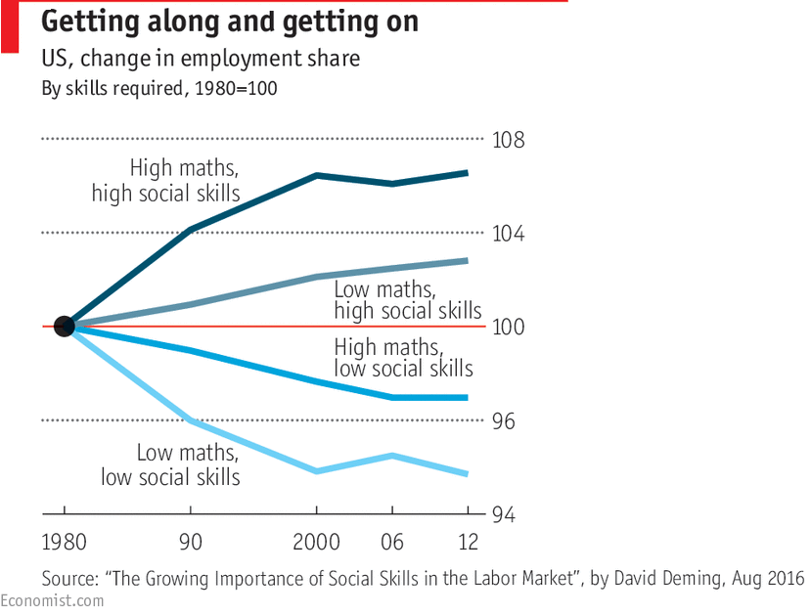

Slide 5
How Beginners Divide the Work
Contrive a solution and divide the work by parts of the solution (based on team knowledge)
Each sub-group of ≥1 is assigned a different part
  One sub-group is assigned to “write documentation”
“Chain” organization—every link is critical
If any link fails, the whole project fails
  Separation of concerns is impossible
User Interface
Business Logic
and Algorithms
Database/
Network
Documentation

Slide 6
Example: Restaurant Automation
Requirements
REQ-1: Support the work of wait & floor staff
REQ-2: Support the work of kitchen staff
REQ-3: Support the work of management

Slide 7
Example: Restaurant Automation
Decomposition by Partitioning the Solution
Developer Team α
Developer Team β
Subgroup α-RED
Subgroup α-GREEN
Subgroup α-BLUE
Subgroup α-PURPLE
User Interface
a.k.a. “Front end”
Business Logic
and Algorithms
a.k.a. “Backend”
Database/
Network
Documentation

Slide 8
Example: Restaurant Automation
Communication Overhead
Developer Team α
Developer Team β
Function-1:
{ description }
Function-2:
{ description }
…
Interface for what functions?
Tables for what data?
What to write about?
User Interface
Business Logic
and Algorithms
Database/
Network
Documentation
Notes:
“The easier it is to communicate, the faster change happens.” -- James Burke, Science Historian, in "Connections"
https://www.amazon.com/Connections-James-Burke/dp/0743299558

Slide 9

Example: Restaurant Automation
Drawbacks of Team α Approach
Original problem still undivided:
only the “tools” have been distributed with which to attack the unbroken monolith of the problem
Their “architecture” is hastily contrived to divide the work, rather than carefully designed based on problem analysis
Long feedback loop:
  The time to implementation depends on the slowest sub-group
Communication overhead:
  Most time spent in communication and “documentation writing”
  No time for creative software development
Failure-prone:
  If any sub-group doesn’t deliver, the whole project fails
Each student learns only one aspect of software development
Ownership fuzzy or one “leader”
claims all the credit
I did all coding!
Superhero

Slide 10
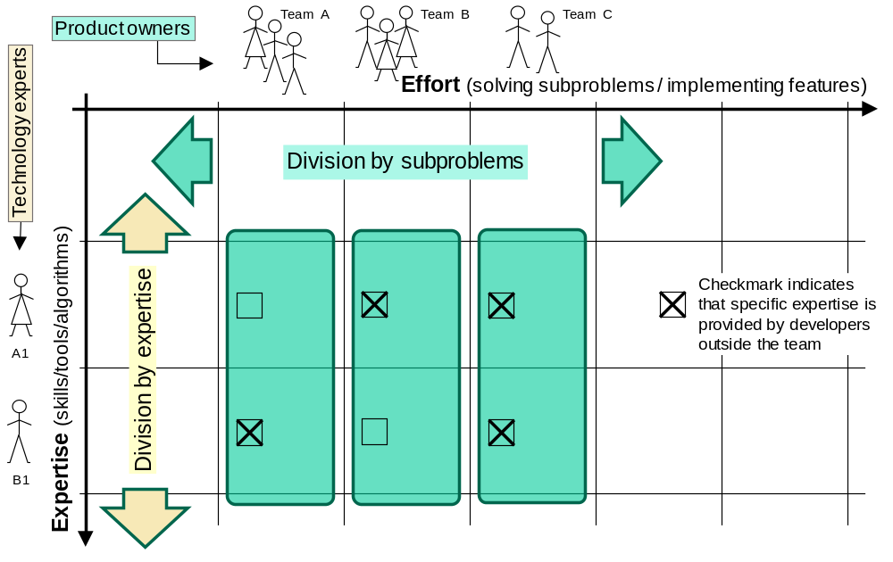
Effort Division vs. Expertise Division

Slide 11
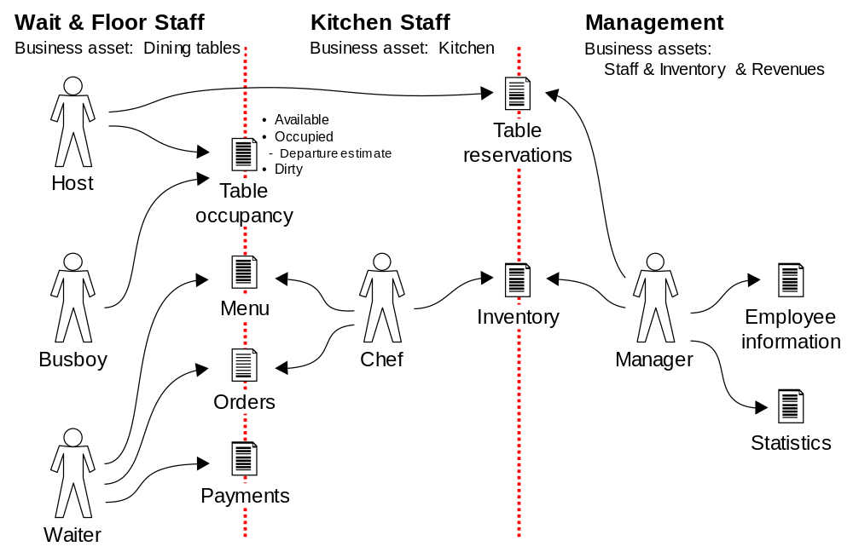
Identifying Subproblems by Managed Business Assets
Example: Restaurant Automation

Slide 12
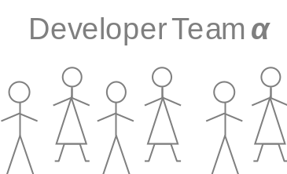
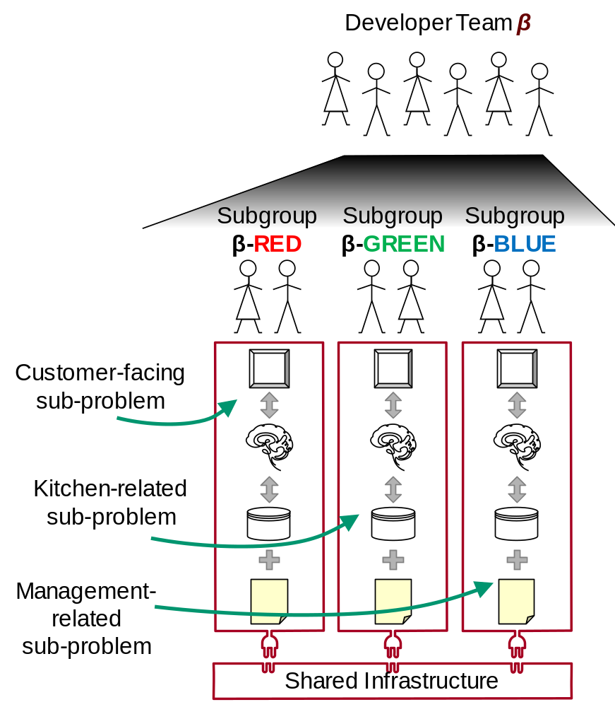
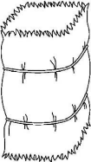
Example: Restaurant Automation
Decomposition by Projection to Sub-problems
Different way of “slicing” the project:
  Instead of horizontal slicing (by solution),
  we have vertical slicing— “stacks” (by sub-problems)
Each “stack” can be done independently of other stacks,
as a mini-project, because it solves a different sub-problem!
➔ Separation of concerns!

Slide 13
Example: Restaurant Automation
Decomposition by Projection
Developer Team β
Team communication is simple:
They only need to define shared interfaces (“APIs”) and can focus on creative software development
(sub-problem solving!)
What is inside of each “stack” is not discussed with other sub-teams
—for others, the contents of your “stack” is hidden—they see a black box with defined interface / APIs
(“information hiding”)
What do we have in common?
Subgroup
β-RED
Subgroup
β-GREEN
Subgroup
β-BLUE
Customer-facing sub-problem
Kitchen-related sub-problem
Management-related
sub-problem
Shared Infrastructure

Slide 14
Example: Restaurant Automation
Benefits of Team β Approach
Organizing a team by smaller problems that will be solved (features developed)
rather than by the solution (implementation technologies):
The problems are more likely to remain stable than the solutions
Short feedback times
  Every sub-group can have implementation feedback as soon as their part is working
Increased productivity:
Minimizes the amount of communication needed to coordinate the work
  → more time to focus on creative software development
Failure resilience:
Reduces the dependency on the rest of the team—if they fail to deliver, you can still succeed and demonstrate your mini-project
(Unlike chain-organization, where a link failure leads to project failure, each “stack” can succeed independently of others, because it solves customer’s sub-problem)
Each student learns all aspects of software development
Ownership visibility:
Each mini-project can be demonstrated alone (because it solves customer’s sub-problem)
(If the work is organized around solution expertise, who demonstrates UI, or dBase, or …?)
Customer friendly:
The customer (or class instructor) knows whom to talk about every aspect of a given functional feature (i.e., about a sub-problem that is of interest to them)
Requirements traceability, from inception to implementation

Slide 15
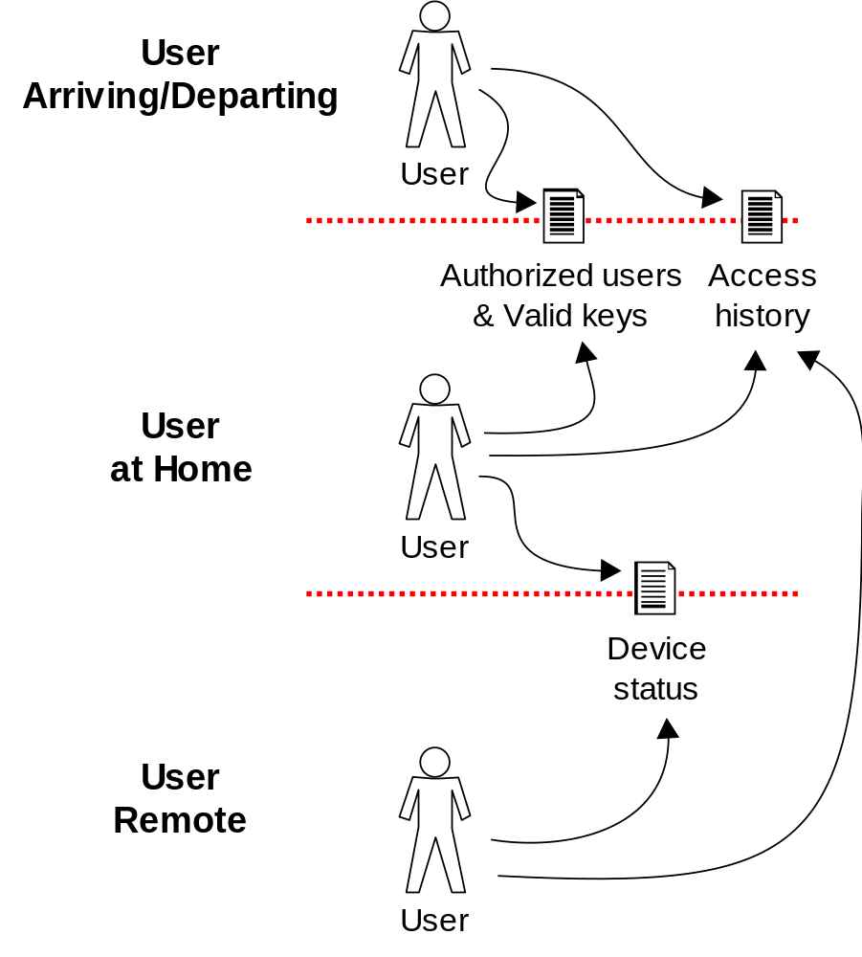
Identifying Subproblems by User Context
Example: Safe Home Access
Rationale:
If the developer team’s structure is mirroring the product structure,
then the product structure should also be mirroring the structure of the user contexts whose work this product will support

Slide 16
Identifying Subproblems by User Roles
Example: Safe Home Access
Visitor
Tenant
Landlord
Tenant
Accounts
Keycode-
to-User Map
?
Tenant
???
?
Access
History
Leasing
Records
Visitor
Landlord
Financial
Books

Slide 17
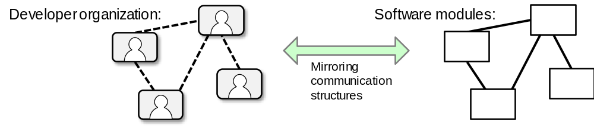
Conway's Law a.k.a. Mirroring Hypothesis
M. Conway (1968):
  “organizations which design systems ... are constrained to produce designs which are copies of the communication structures of these organizations”
Corollary for identifying subproblems/modules:
  If the developer team’s structure is mirroring the product structure,
  then the product structure should also be mirroring the structure of the user group that will use this product
    Spatial structure: different user roles and their relationships
    Temporal structure: user (or users) in different contexts over time
Notes:
A. Querbes and K. Frenken, Grounding the “mirroring hypothesis”: Towards a general theory of organization design in New Product Development,Journal of Engineering and Technology Management, vol.47, pp.81-95, Jan 2018.
M.E. Conway, “How do committees invent?” Datamation, vol. 14, no. 5, pp. 28-31, 1968.
Coplien and Harrison (July 2004). Organizational Patterns of Agile Software Development. ISBN 978-0-13-146740-8.
https://en.wikipedia.org/wiki/Conway%27s_law

Slide 18
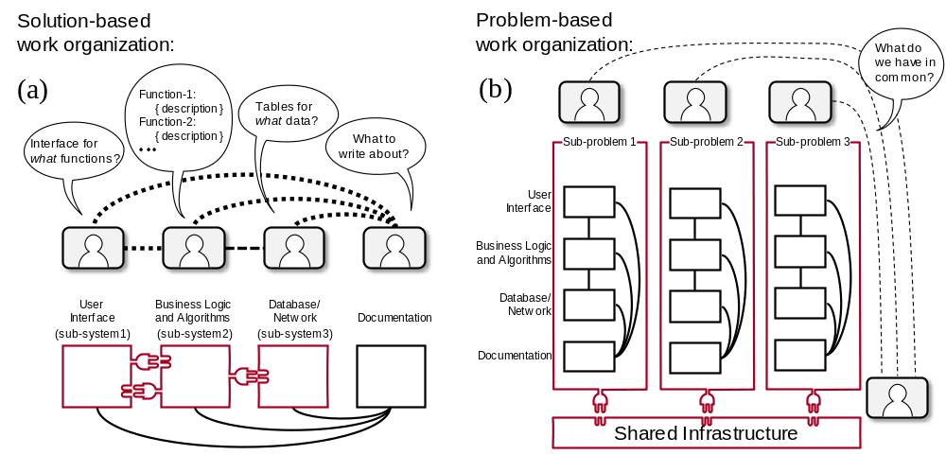
Why Communication Required by Problem-based < Solution-based ?
Recall Conway’s Law:
developer’s communication patterns and system modules’ communication patterns will mirror each other

Slide 19
What is “Shared Infrastructure”?
Needs to be discovered, as we will learn in subsequent lectures
Examples of shared infrastructure:
  A relational database, so the whole team needs to design the shared tables
  Data items communicated via messages, so the whole team needs to discuss the communication protocol and message format
  “Services” accessed by method calls, e.g., data analysis, pattern recognition, user authentication, etc.
  Software configuration management (SCM) system for the entire project

Slide 20
Divide Work by Problem vs. by Solution
By problem: Different team members are responsible to solve different sub-problems or develop different “features” of the system
  Suitable for any level of expertise, particularly if uncertain about other team members’ skills and ability to deliver on time (➔ highly recommended for novices/students)
  Advantages: Short time to feedback from implementation, mutually independent between the sub-groups
  Dependency on other team members is reduced—the development of different features can progress independently, at their own pace
  Drawback: Potential redundancies because different teammates may need to develop same/similar parts to make their “feature” work independently of others
By solution: Different team members responsible for different parts of the system
  Advantage: everyone can focus on one technology (area of expertise)
  Drawbacks:
    The original problem is still an undivided whole; the “modules” are just different aspects of the monolith
    Long time to implementation and lack of early feedback
    Developers need to know a lot about the solution (i.e., parts of the “system” and their relationships) before detailed analysis of the sub-problems.
    If solution parts are not precisely specified, there will be a great uncertainty about interfacing the parts and integrating into the whole system.
  Suitable for highly-experienced specialists, not for beginners (i.e., not for students), working on a familiar problem
  Always watch for fallback solutions in case some parts are not ready on time or problematic
  Right now, you have no “area of expertise”—otherwise you wouldn’t be a student in this class ☺ !

Slide 21
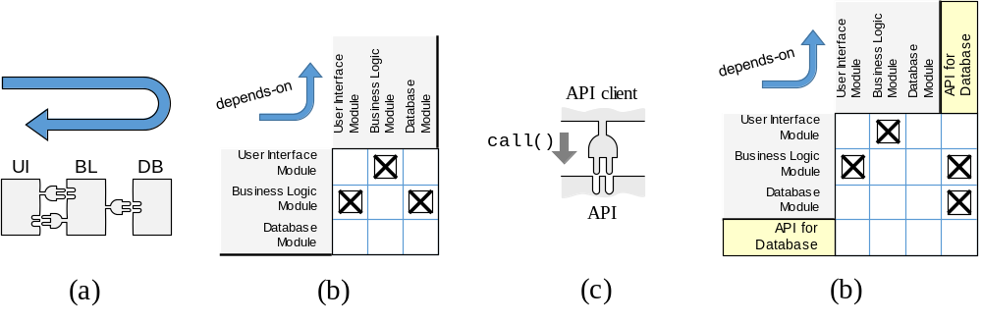
Design Parameter Dependencies
Design Structure Matrix
Design Structure Matrix (DSM)
  Shows which modules depend on
  (or, are allowed to use) which other modules
Any change in the choices for design parameters can potentially affect the dependent parameters
  It may or may not, but because different sub-teams cannot be sure, they need to communicate and find out

Slide 22
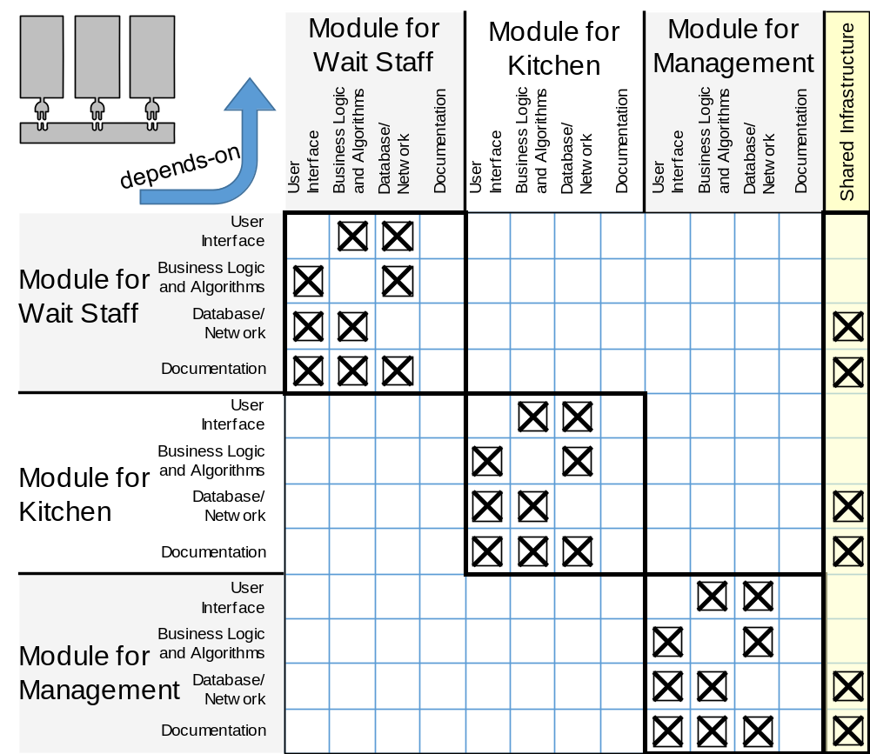
Design Parameter Dependencies
Work Assignment by Problem Parts

Slide 23
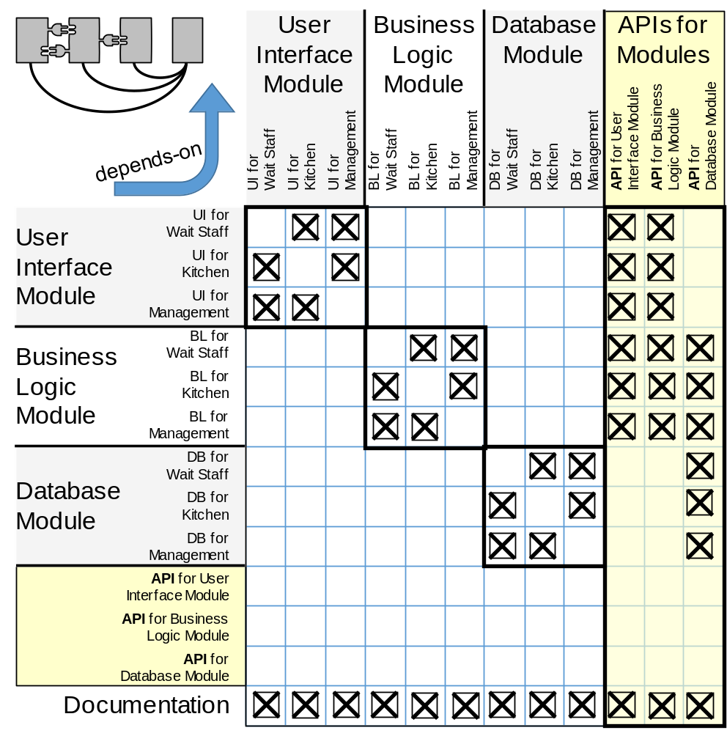
Design Parameter Dependencies
Work Assignment by Solution Parts

Slide 24
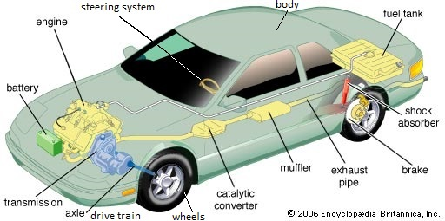
Counterexample?
Car subsystems -- different companies produce different subsystems!
Why cannot we do the same?!
Because you are not at this level of understanding of your problem
  They did all the work of analysis and design and arrived at commonly-accepted standards of subsystem designs!

Slide 25
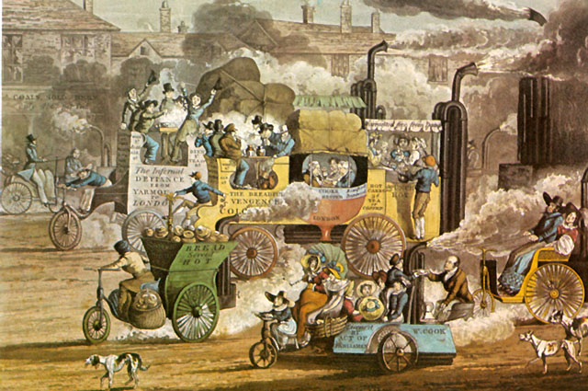
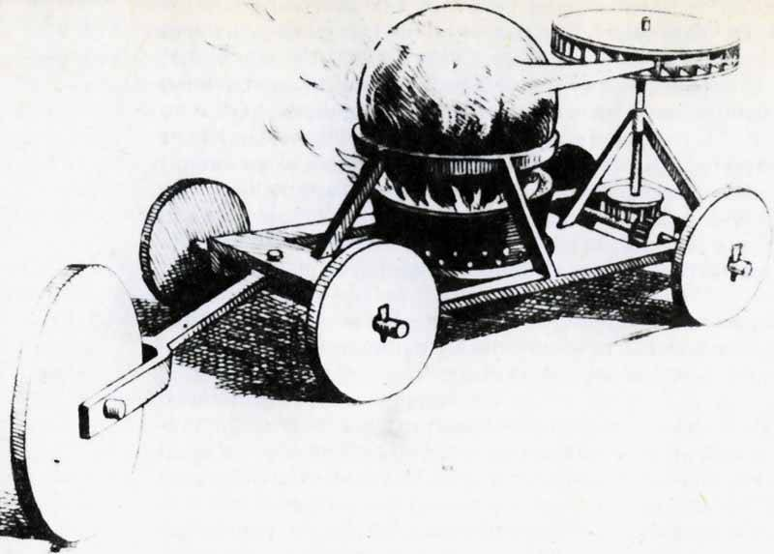
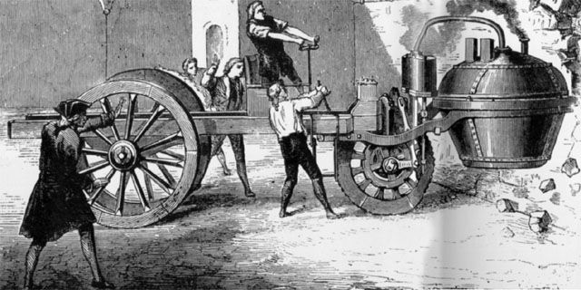
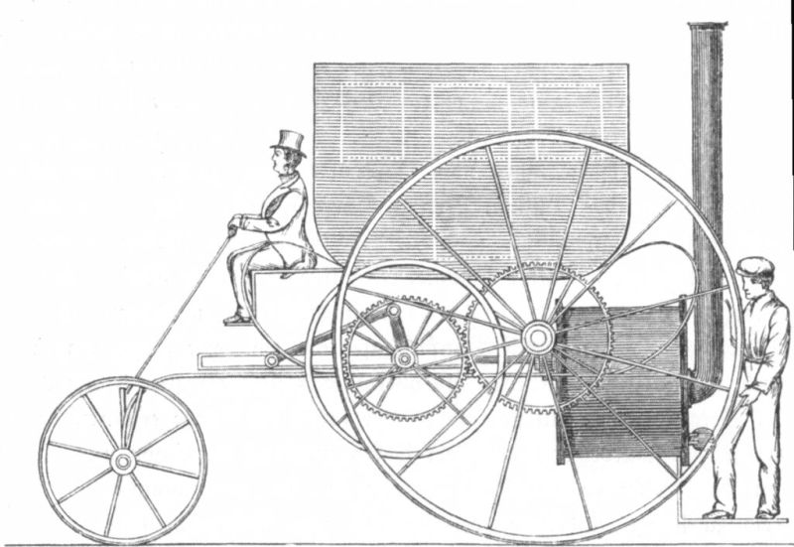
Counterexample Rebuttal (1)
Actually, you are at this level of understanding of your problem:
Notes:
https://jalopnik.com/the-first-car-in-the-world-was-hilariously-bad-and-awfu-1830075453
https://youtu.be/XsEbeCrPcA8
https://i.kinja-img.com/gawker-media/image/upload/bjmtbvnnw8spilrqmgp0.mp4

Slide 26
Counterexample Rebuttal (2)
Before we could do this…
…there was a lot of trial-and-error
and each subsystem evolved independently
to solve a different sub-problem
➔ Interfaces between the parts defined by precise industry standards
➔ Reliable 3rd-party providers of standard-defined subsystems!

Slide 27
Exercise: E-Commerce Application
Form the teams to develop an E-Commerce application.
The application has the following modules
  Products list module
  Cart management module
  Payment module

