Slide 1

Implementation

Slide 2
Topics
Coding standards typically include conventions for:
Characteristics of good implementation
Naming
Indentation
Commenting style
Error messages
Banning certain language features
Characteristics of good user interface

Slide 3
Characteristics of Good Implementations
Good implementation:
Readability
Maintainability
Performance
Traceability
Correctness
Completeness
Notes:
(khả năng truy vết: khả năng liên kết ngược Requirement ↔ Code ↔ Test ↔ Bug ↔ Commit => cho dễ debug)
(correctness: chạy đúng theo yêu cầu. I/O đúng)

Slide 4
Naming Conventions
Naming conventions including names of classes, methods, variables and other programming entities (directory and file naming conventions)
Guideline
  long names for global identifiers
  short names for local
  Consistency – ID , Id
  Separating
  C: do_something, Java: doSomething

Slide 5
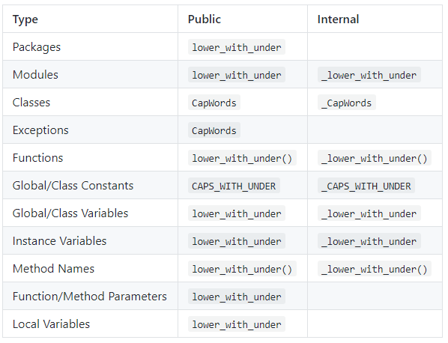
Python Naming Convention

Slide 6
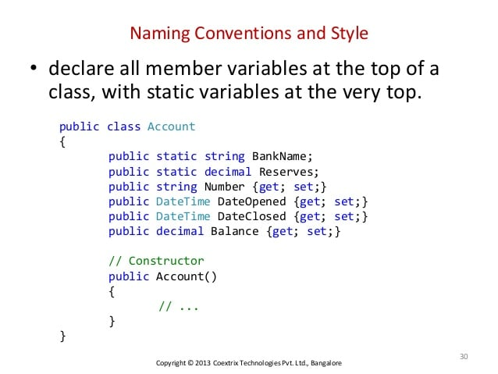
Naming Convention (Contd.)

Slide 7
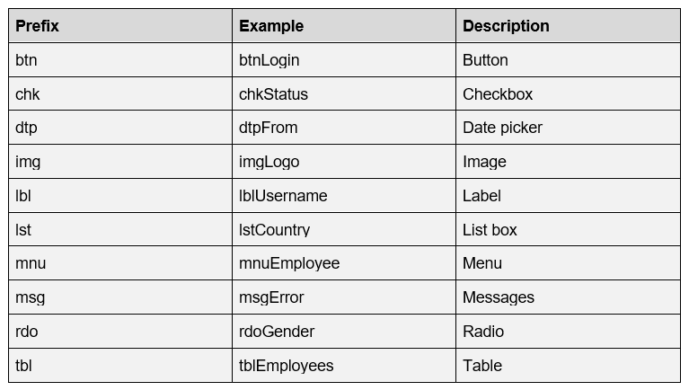
Naming Convention for GUI

Slide 8
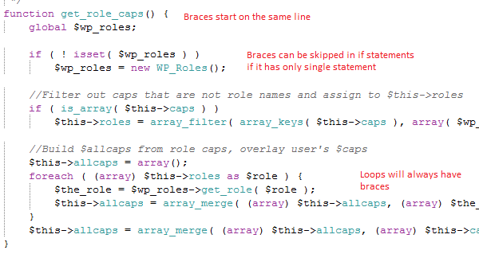
Little more on code

Slide 9
Function/ method size
Large functions or methods are statistically more error-prone than smaller ones.
Method size should be less than 50 lines whenever possible

Slide 10
File-naming issues
Having a standard for specifying how to name the files, which files to generate for each module, and how to locate a given file from a module is very advantageous.
You could have a separate document specifying what modules go in which files, but having a fine-naming convention can make things much easier.

Slide 11
File-naming issues (Contd.)
File naming best practices:
Files should be named consistently
File names should be short but descriptive (<25 characters) (Briney, 2015)
Avoid special characters or spaces in a file name
Use capitals and underscores instead of periods or spaces or slashes
Use date format ISO 8601_YYYYMMDD
Write down the naming convention in the data management plan

Slide 12
Particular programming constructs
Don’t use GOTO/ setjmp/longjmp statement
Multiple inheritance is not recommended

Slide 13
Comments
2 problems with comments:
May distract from the code and make program harder to read
May be wrong

Slide 14
Types of Comments
Repeat the code (avoid)
Explanation of the code (maybe rewrite code)
Marker in the code (incomplete, opportunities for change, who changed – use version control instead)
Summarizing the code (maybe abstract to own function and name correctly)
Description of code intent (most useful)
External references (“Implements function xyz described ….)

Slide 15
Coding Standards
Proposed:
\repo_standards
endpoint_docs.md
general.md
go.md
js.md
php.md
…

Slide 16
Coding Standards
https://golang.org/doc/effective_go.html
https://github.com/jamescooke/restapidocs/tree/master/examples

Slide 17
Debugging
4 phases of debugging:
Stabilization/reproduction (output is a minimal test case that causes the error, don’t need to look at code)
Localization (find in code)
Correction
Verification
-Source code comparator (Code Compare tool)
-Interactive debugger

Slide 18
Guideline for locating errors
Code that tends to have more errors:
Routines with >1 error
Newly created code

Slide 19
Defensive Programming
-Assertions can be used for defensive programming
-Most modern programming languages support assertions
-Performance Optimization (Profiler)

Slide 20
Refactoring Code
Refactoring – improving your code style without altering its behavior
Remove “bad smells” (Fowler, 1999)
Duplicated code
Long methods
Large classes
Switch statements
Feature envy
Inappropriate intimacy
https://www.youtube.com/watch?v=izGnXqNQeLk&ab_channel=hrshdkmtnik

Slide 21
User-Interface Design
Three “golden rules” of user-interface design:
Place user in control
Reduce the user’s memory load
Design consistent user interface

