Slide 1

Software Metrics
Notes:
http://en.wikipedia.org/wiki/Problem_Frames_Approach

Slide 2
Topics
Why Measure Software
Fundamentals of Measurement Theory
Use Case Points

Slide 3
Why Measure Software
To estimate development time and budget
To improve software quality
  If a software module shares characteristics of modules that are known often to fail, then these should be the focus of quality improvement

Slide 4
Measurement Scale (1)
Nominal scale – group subjects into categories
  Example: designate the weather condition as “sunny,” “cloudy,” “rainy,” or “snowy”
  The two key requirements for the categories: jointly exhaustive & mutually exclusive
  Minimal conditions necessary for the application of statistical analysis
Ordinal scale – subjects compared in order
  Examples: “bad,” “good,” and “excellent,” or “star” ratings
  Arithmetic operations such as addition, subtraction, multiplication cannot be applied

Slide 5
Measurement Scale (2)
Interval scale – indicates the exact differences between measurement points
  Examples: traditional temperature scale (centigrade or Fahrenheit scales)
  Arithmetic operations of addition and subtraction can be applied
Ratio scale – an interval scale for which an absolute or nonarbitrary zero point can be located
  Examples: mass, temperature in degrees Kelvin, length, and time interval
  All arithmetic operations are applicable

Slide 6
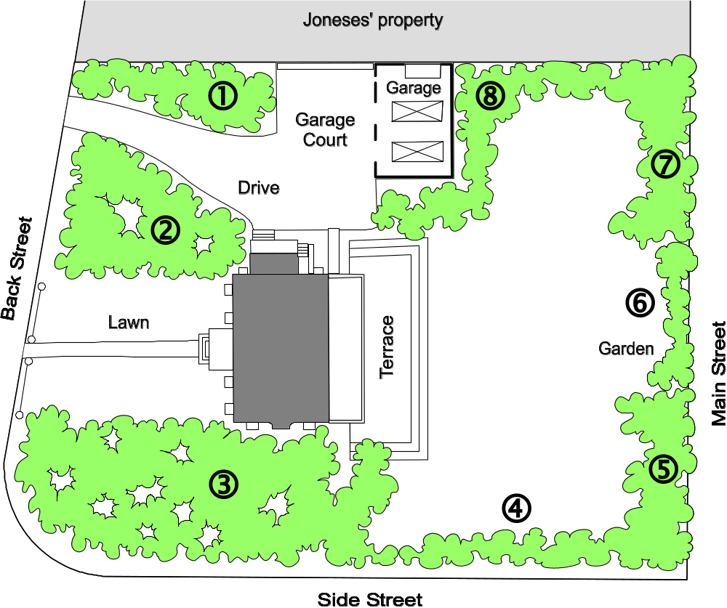
Subjective Metrics

Slide 7
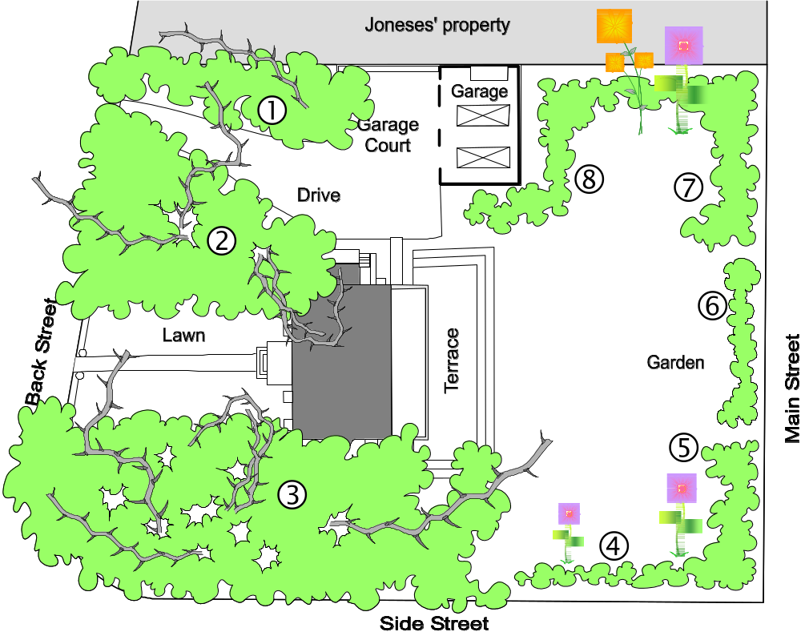
Subjective Metrics

Slide 8
Use Case Points (UCPs)
Size and effort metric
( https://en.wikipedia.org/wiki/Use_Case_Points )
Advantage: Early in the product development (after detailed use cases are available)
Drawback: Many subjective estimation steps involved
Use Case Points = function of (
  size of functional features (“unadjusted” UCPs)
  nonfunctional factors (technical complexity factors)
  environmental complexity factors (ECF)
)
Derived from Function Points — ISO/IEC 19761:2011
( https://en.wikipedia.org/wiki/Function_point )

Slide 9
Actor Classification and Weights
Actor type | Description of how to recognize the actor type | Weight
Simple | The actor is another system which interacts with our system through a defined application programming interface (API). | 1
Average | The actor is a person interacting through a text- or numeric-based user interface, or another system interacting through a protocol, such as a network communication protocol. | 2
Complex | The actor is a person interacting via a graphical user interface (GUI). | 3
Weights recommended by a standards body (panel of expert developers)

Slide 10
Example: Safe Home Access
Actor classification for the case study of home access control:
Actor name | Description of relevant characteristics | Complexity | Weight
Landlord | Landlord is interacting with the system via a graphical user interface (when managing users on the central computer). | Complex | 3
Tenant | Tenant is interacting through a text-based user interface (assuming that identification is through a keypad; for biometrics based identification methods Tenant would be a complex actor). | Average | 2
LockDevice | LockDevice is another system which interacts with our system through a defined API. | Simple | 1
LightSwitch | Same as LockDevice. | Simple | 1
AlarmBell | Same as LockDevice. | Simple | 1
Database | Database is another system interacting through a protocol. | Average | 2
Timer | Same as LockDevice. | Simple | 1
Police | Our system just sends a text notification to Police. | Simple | 1
Unadjusted Actor Weight (UAW) represents the “size” of all actors:
UAW(home access) = 5 × Simple + 2 × Average + 1 × Complex = 5×1 + 2×2 + 1×3 = 12

Slide 11
Use Case Weights
Use case category | Description of how to recognize the use-case category | Weight
Simple | Simple user interface. Up to one participating actor (plus initiating actor). Number of steps for the success scenario: ≤ 3. If presently available, its domain model includes ≤ 3 concepts. | 5
Average | Moderate interface design. Two or more participating actors. Number of steps for the success scenario: 4 to 7. If presently available, its domain model includes between 5 and 10 concepts. | 10
Complex | Complex user interface or processing. Three or more participating actors. Number of steps for the success scenario: ≥ 7. If available, its domain model includes ≥ 10 concepts. | 15
Use case weights based on the number of transactions

Slide 12
Example: Safe Home Access
Use case classification for the case study of home access control:
Use case | Description | Category | Weight
Unlock (UC‑1) | Simple user interface. 5 steps for the main success scenario. 3 participating actors (LockDevice, LightSwitch, and Timer). | Average | 10
Lock (UC‑2) | Simple user interface. 2+3=5 steps for the all scenarios. 3 participating actors (LockDevice, LightSwitch, and Timer). | Average | 10
ManageUsers (UC‑3) | Complex user interface. More than 7 steps for the main success scenario (when counting UC‑6 or UC‑7). Two participating actors (Tenant, Database). | Complex | 15
ViewAccessHistory (UC‑4) | Complex user interface. 8 steps for the main success scenario. 2 participating actors (Database, Landlord). | Complex | 15
AuthenticateUser (UC‑5) | Simple user interface. 3+1=4 steps for all scenarios. 2 participating actors (AlarmBell, Police). | Average | 10
AddUser (UC‑6) | Complex user interface. 6 steps for the main success scenario (not counting UC‑3). Two participating actors (Tenant, Database). | Average | 10
RemoveUser (UC‑7) | Complex user interface. 4 steps for the main success scenario (not counting UC‑3). One participating actor (Database). | Average | 10
Login (UC‑8) | Simple user interface. 2 steps for the main success scenario. No participating actors. | Simple | 5
UUCW(home access) = 1 × Simple + 5 × Average + 2 × Complex = 1×5 + 5×10 + 2×15 = 85

Slide 13
Technical Complexity Factors (TCFs)
Technical factor | Description | Weight
T1 | Distributed system (running on multiple machines) | 2
T2 | Performance objectives (are response time and throughput performance critical?) | 1^{(∗)}
T3 | End-user efficiency | 1
T4 | Complex internal processing | 1
T5 | Reusable design or code | 1
T6 | Easy to install (are automated conversion and installation included in the system?) | 0.5
T7 | Easy to use (including operations such as backup, startup, and recovery) | 0.5
T8 | Portable | 2
T9 | Easy to change (to add new features or modify existing ones) | 1
T10 | Concurrent use (by multiple users) | 1
T11 | Special security features | 1
T12 | Provides direct access for third parties (the system will be used from multiple sites in different organizations) | 1
T13 | Special user training facilities are required | 1

Slide 14
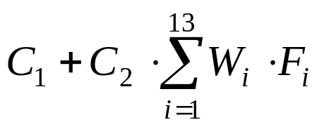
Technical Complexity Factors (TCFs)
TCF = Constant-1 + Constant-2 × Technical Factor Total =
Constant-1 (C1) = 0.6
Constant-2 (C2) = 0.01
W_{i} = weight of i^{th} technical factor
F_{i} = perceived complexity of i^{th} technical factor

Slide 15
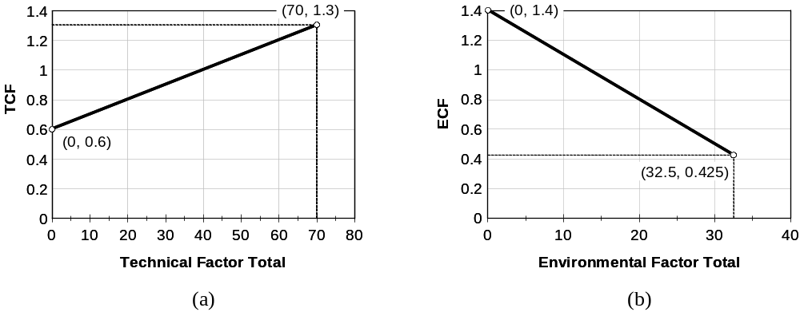
Scaling Factors for TCF & ECF

Slide 16
Example
Technical factor | Description | Weight | Perceived Complexity | Calculated Factor (Weight×Perceived Complexity)
T1 | Distributed, Web-based system, because of ViewAccessHistory (UC‑4) | 2 | 3 | 2×3 = 6
T2 | Users expect good performance but nothing exceptional | 1 | 3 | 1×3 = 3
T3 | End-user expects efficiency but there are no exceptional demands | 1 | 3 | 1×3 = 3
T4 | Internal processing is relatively simple | 1 | 1 | 1×1 = 1
T5 | No requirement for reusability | 1 | 0 | 1×0 = 0
T6 | Ease of install is moderately important (will probably be installed by technician) | 0.5 | 3 | 0.5×3 = 1.5
T7 | Ease of use is very important | 0.5 | 5 | 0.5×5 = 2.5
T8 | No portability concerns beyond a desire to keep database vendor options open | 2 | 2 | 2×2 = 4
T9 | Easy to change minimally required | 1 | 1 | 1×1 = 1
T10 | Concurrent use is required (Section 5.3) | 1 | 4 | 1×4 = 4
T11 | Security is a significant concern | 1 | 5 | 1×5 = 5
T12 | No direct access for third parties | 1 | 0 | 1×0 = 0
T13 | No unique training needs | 1 | 0 | 1×0 = 0
Technical Factor Total: |  |  |  | 31

Slide 17
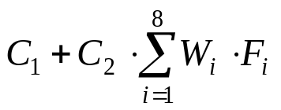
Environmental Complexity Factors (ECFs)
Environmental factor | Description | Weight
E1 | Familiar with the development process (e.g., UML-based) | 1.5
E2 | Application problem experience | 0.5
E3 | Paradigm experience (e.g., object-oriented approach) | 1
E4 | Lead analyst capability | 0.5
E5 | Motivation | 1
E6 | Stable requirements | 2
E7 | Part-time staff | −1
E8 | Difficult programming language | −1
ECF = Constant-1 + Constant-2 × Environmental Factor Total =
Constant-1 (C1) = 1.4
Constant-2 (C2) = −0.03
Wi = weight of ith environmental factor
Fi = perceived impact of ith environmental factor

Slide 18
Example
Environmental complexity factors for the case study of home access:
Environmental factor | Description | Weight | Perceived Impact | Calculated Factor (Weight× Perceived Impact)
E1 | Beginner familiarity with the UML-based development | 1.5 | 1 | 1.5×1 = 1.5
E2 | Some familiarity with application problem | 0.5 | 2 | 0.5×2 = 1
E3 | Some knowledge of object-oriented approach | 1 | 2 | 1×2 = 2
E4 | Beginner lead analyst | 0.5 | 1 | 0.5×1 = 0.5
E5 | Highly motivated, but some team members occasionally slacking | 1 | 4 | 1×4 = 4
E6 | Stable requirements expected | 2 | 5 | 2×5 = 5
E7 | No part-time staff will be involved | −1 | 0 | −1×0 = 0
E8 | Programming language of average difficulty will be used | −1 | 3 | −1×3 = −3
Environmental Factor Total: |  |  |  | 11

Slide 19
Calculating the Use Case Points (UCP)
UCP = UUCP × TCF × ECF
From the above calculations, the UCP variables have the following values:
UUCP = 97
TCF = 0.91
ECF = 1.07
For the sample case study, the final UCP is the following:
UCP = 97 × 0.91 × 1.07 = 94.45 or 94 use case points.

Slide 20
Project Duration
Productivity Factor (PF)
Duration = UCP × PF

Slide 21
The estimated number of Use Case Points (UCP) is derived:
UCP = (UAW + UUCW) × TCF × ECF
UCP = 320
Organizational average productivity = 8 UCP/pm.
Burdened labor rate = $8500 per month.
Based on the UCP estimate and the historical productivity data, total estimated project cost is $340,000 and estimated effort is 40 person-months.

Slide 22
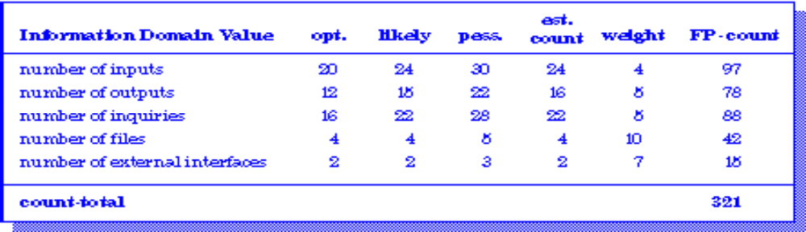
Example: FP Approach
The estimated number of FP is derived:
FP_{estimated} = count-total * [0.65 + 0.01 * Σ (F_{i})]
FP_{estimated} = 375
organizational average productivity = 6.5 FP/pm.
burdened labor rate = $8000 per month, approximately $1230/FP.
Based on the FP estimate and the historical productivity data, total estimated project cost is $461,000 and estimated effort is 58 person-months.

Slide 23
