Slide 1
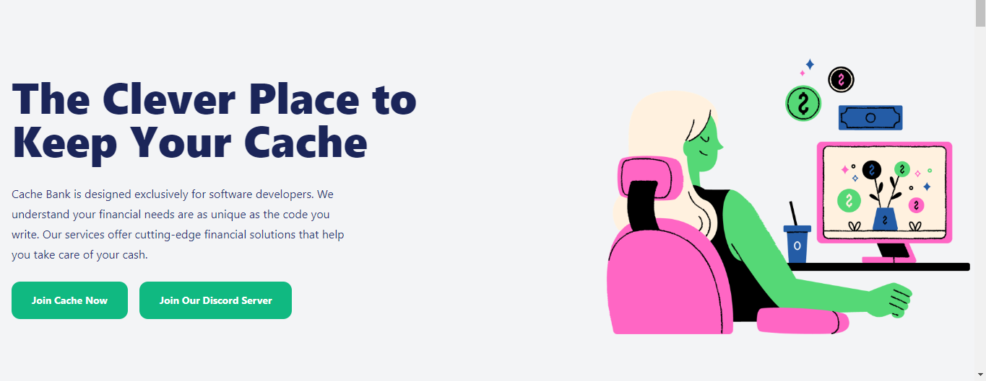
Lugan visagie
Codespace student
Responsive portfolio piece website
(HTML5,TAILWIND CSS3 & JavaScript)

Slide 2
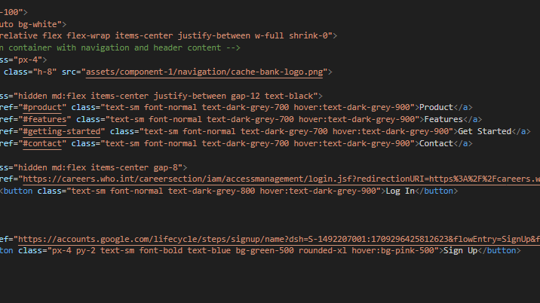

Slide 3
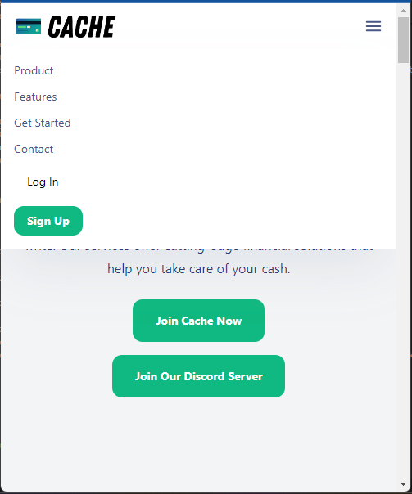
Component 1-project setup and responsive navigation
A mobile-first design approach means designing a website or application starting from the smallest screen size (like mobile devices) and then progressively enhancing it for larger screens.
The intuitive navigation toggle was made so it would be responsive on mobile devices and improve user experience across all platforms, by using an onclick Eventlistner in Javascript and drawing the svg in Tailwind css.
The use of semantic HTML5 will not go unoticed to other developers as the whole website is made of a nav bar, footer and different sections.

Slide 4
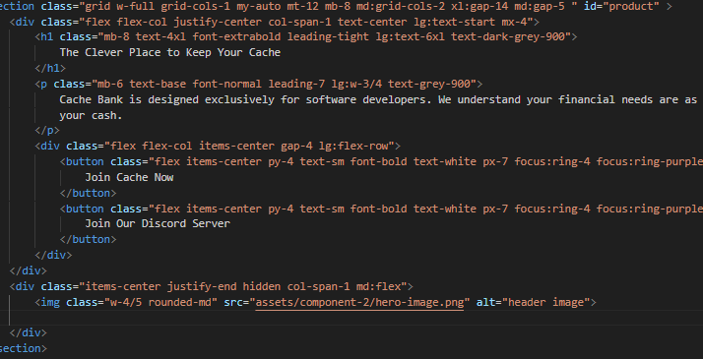

Slide 5
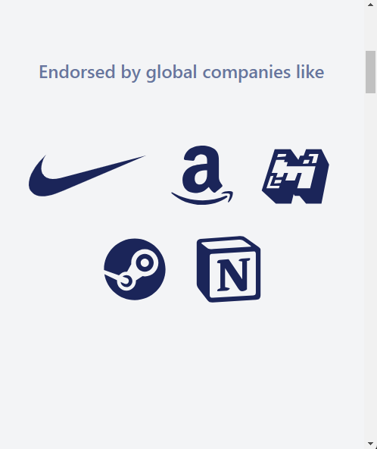
Component 2-Hero and Endorsements
Endorsements from credible sources help build trust because they show that reputable individuals or organizations support your product or service.
When users click on the hero section it will guide them to a sign up page or learn more page, to showcase that this website has some user interaction.
The hero section has grid-cols implemented and has 1 coloumn and no picture for mobile but has 2 columns and the picture for desktop.

Slide 6
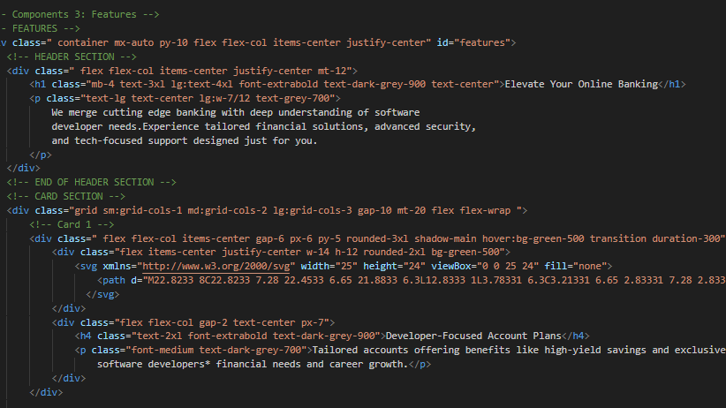

Slide 7
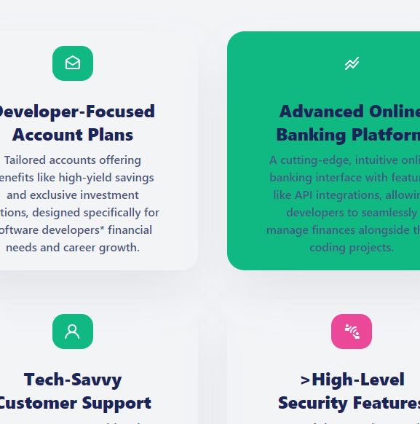
Component 3 -Features
In this component grid and flexbox is used very freqeuntly, in this section there are cards that are displayed different on mobile, tablets and desktop.
ARIA roles are used to improve accessibility for users with disabilities in feature listings by providing additional semantic information to assistive technologies.

Slide 8
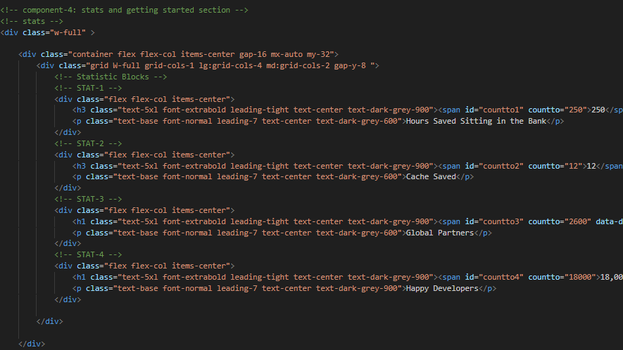

Slide 9
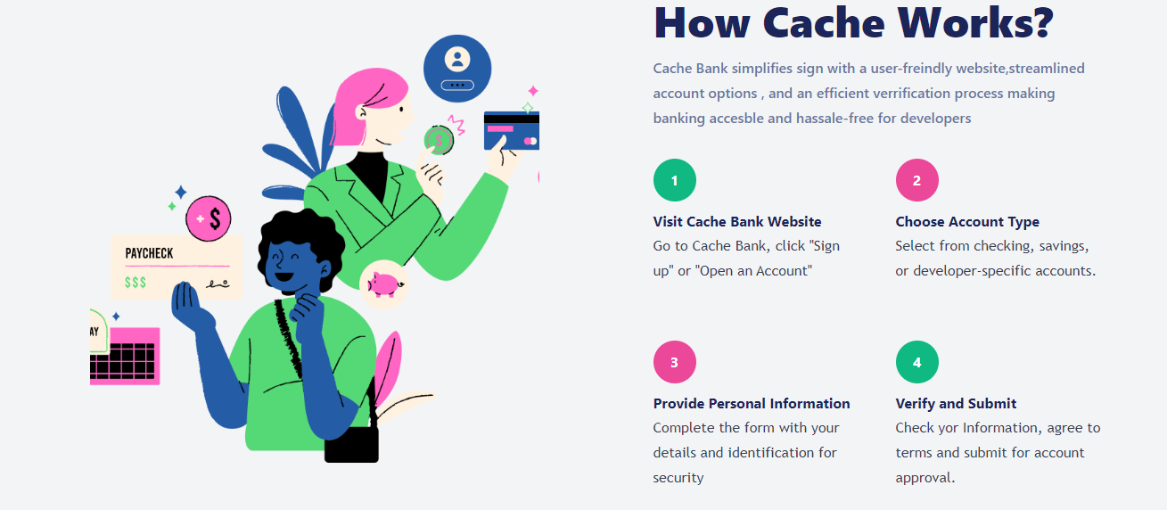
Component 4- Stats and getting Started
In ths section users are given a step by step guide on how to sign up.
The use of grid and flex is yet again very prominent in this section and also has a responsive design and it also uses a bit of JavaScript to show the visual of counting up.
The use of tailwind styling also made the layout look quite visually appealing.

Slide 10
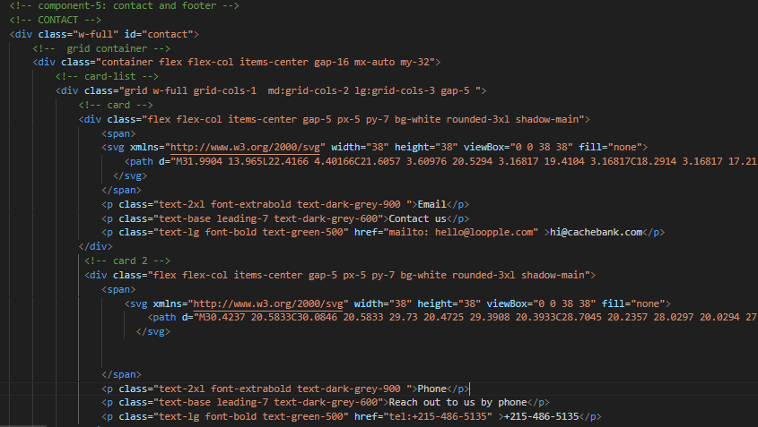

Slide 11
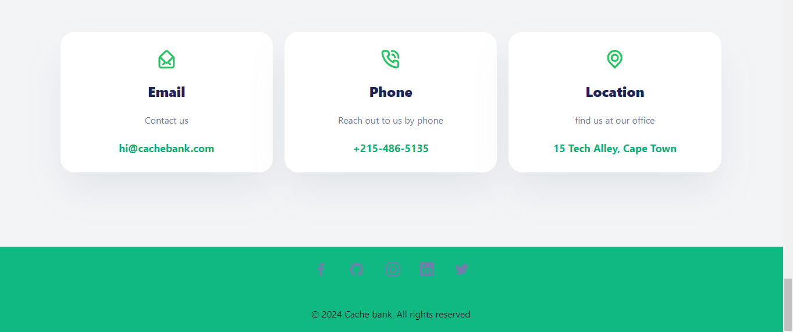
Component 5 –contact and footer
The footer complements the whole website very well by using the the same color scheme as the whole website and adding a couple of hover affects on the svg"s.
The contact has all of necessary information to get in touch with cache bank, and even providing a physical address using a href and google maps link.
The of flex box was very much prominent as it was use to align the links and center them to make to look visually appealing.

Slide 12

conclusion
The components while different each taught me something of value which I can use in future projects.
I now also have a better understanding of responsive design ,semantic HTML.
My use of tailwind has improved considerably while watching the coaches use different useful techniques.
This Photo by Unknown author is licensed under CC BY-NC.

