Slide 1

Data Structures and Algorithms
Abstract Data Type
(The Walls)

Slide 2
Acknowledgement
The contents of these slides have origin from School of Computing, National University of Singapore.
We greatly appreciate support from Mr. Aaron Tan Tuck Choy, and Dr. Low Kok Lim for kindly sharing these materials.

Slide 3
Policies for students
These contents are only used for students PERSONALLY.
Students are NOT allowed to modify or deliver these contents to anywhere or anyone for any purpose.

Slide 4
Objectives
Understanding data abstraction
Defining ADT with Java Interface
Implementing data structure given a Java Interface
[501043 Lecture 7: ADT]

Slide 5
References
Book
Chapter 4, pages 221 to 258
[501043 Lecture 7: ADT]

Slide 6
Outline
Software Engineering Issues (Motivation)
  1.1 Loose coupling
  1.2 Data abstraction
Abstract Data Type
  2.1 Data Structure
  2.2 Understanding ADT
Java Interface
  3.1 Using Java interface to define ADT
  3.2 Complex Number Interface
  3.3 Complex ADT: Cartesian Implementation
  3.4 Complex ADT: Polar Implementation
Practice Exercises: Fraction as ADT
[501043 Lecture 7: ADT]

Slide 7
1 Software Engineering Issues
Motivation

Slide 8
1. Software Engineering Issues (1/5)
Program Design Principles
  Abstraction
    Concentrate on what it can do and not how it does it
    Eg: Use of Java Interface
  Coupling
    Restrict interdependent relationship among classes to the minimum
  Cohesion
    A class should be about a single entity only
    There should be a clear logical grouping of all functionalities
  Information Hiding
    Expose only necessary information to outside
[501043 Lecture 7: ADT]

Slide 9
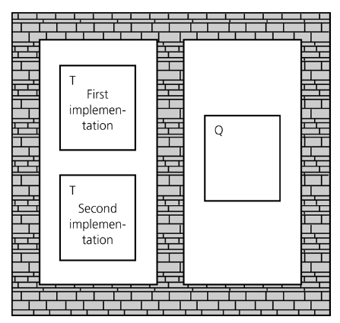
1. Software Engineering Issues (2/5)
Information Hiding
  Information hiding is like walls building around the various classes of a program.
  The wall around each class T prevents the other classes from seeing how T works.
  Thus, if class Q uses (depends on) T, and if the approach for performing T changes, class Q will not be affected.
Our textbook is called the “Walls & Mirrors”. What are the walls?
Makes it easy to substitute new,
improved versions of how to do
a task later
[501043 Lecture 7: ADT]

Slide 10
1. Software Engineering Issues (3/5)
Information Hiding is not complete isolation of the classes
  Information released is on a need-to-know basis
  Class Q does not know how class T does the work, but it needs to know how to invoke T and what T produces
    E.g: The designers of the methods of Math and Scanner classes have hidden the details of the implementations of the methods from you, but provide enough information (the method headers and explanation) to allow you to use their methods
  What goes in and comes out is governed by the terms of the method’s specifications
    If you use this method in this way, this is exactly what it will do for you (pre- and post-conditions)
[501043 Lecture 7: ADT]

Slide 11
1. Software Engineering Issues (4/5)
Pre- and post-conditions (for documentation)
  Pre-conditions
    Conditions that must be true before a method is called
    “This is what I expect from you”
    The programmer is responsible for making sure that the pre-conditions are satisfied when calling the method
  Post-conditions
    Conditions that must be true after the method is completed
    “This is what I promise to do for you”
  Example
// Pre-cond: x >= 0
// Post-cond: Return the square root of x
public static double squareRoot(double x) {
. . .
}
[501043 Lecture 7: ADT]

Slide 12
1. Software Engineering Issues (5/5)
Information Hiding CAN also apply to data
  Data abstraction asks that you think in terms of what you can do to a collection of data independently of how you do it
  Data structure is a construct that can be defined within a programming language to store a collection of data
  Abstract data type (ADT) is a collection of data & a specification on the set of operations/methods on that data
    Typical operations on data are: add, remove, and query (in general, management of data)
    Specification indicates what ADT operations do, but not how to implement them
[501043 Lecture 7: ADT]

Slide 13
2 Abstract Data Type
Collection of data + set of operations on the data

Slide 14
Data Structure
2. ADT
Data structure is a construct that can be defined within a programming language to store a collection of data
  Arrays, which are built into Java, are data structures
  We can create other data structures. For example, we want a data structure (a collection of data) to store both the names and salaries of a collection of employees
or
static final int MAX_NUMBER = 500; // defining a constant
String[] names = new String[MAX_NUMBER];
double[] salaries = new double[MAX_NUMBER];
// employee names[i] has a salary of salaries[i]
class Employee {
static final int MAX_NUMBER = 500;
private String names;
private double salaries;
}
...
Employee[] workers = new Employee[Employee.MAX_NUMBER];
(better
choice)
[501043 Lecture 7: ADT]

Slide 15
Abstract Data Type (ADT) (1/4)
2. ADT
An ADT is a collection of data together with a specification of a set of operations on the data
  Specifications indicate what ADT operations do, not how to implement them
  Data structures are part of an ADT’s implementation
Collection of data
Spec. of a set of operations
ADT
When a program needs data operations that are not directly supported by a language, you need to create your own ADT
You should first design the ADT by carefully specifying the operations before implementation
[501043 Lecture 7: ADT]

Slide 16
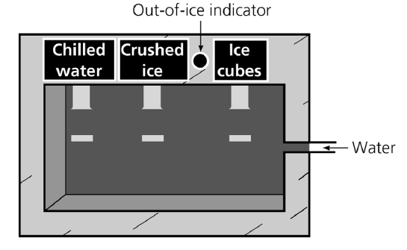
Abstract Data Type (ADT) (2/4)
2. ADT
Example: A water dispenser as an ADT
Data: water
Operations: chill, crush, cube, and isEmpty
Data structure: the internal structure of the dispenser
Walls: made of steel
  The only slits in the walls:
  Input: water
  Output: chilled water, crushed ice, or ice cubes.
Using an ADT is like using a vending machine.
Crushed ice can be made in many ways.
We don’t care how it was made
[501043 Lecture 7: ADT]
Notes:
Chill: làm lạnh
Crush: ép, vắt
Cube: đóng khối

Slide 17
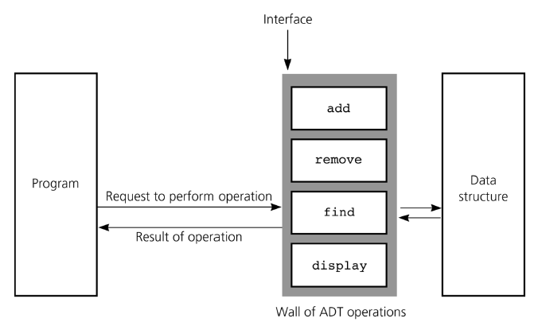
Abstract Data Type (ADT) (3/4)
2. ADT
A WALL of ADT operations isolates a data structure from the program that uses it
An interface is what a program/module/class should understand on using the ADT
[501043 Lecture 7: ADT]

Slide 18
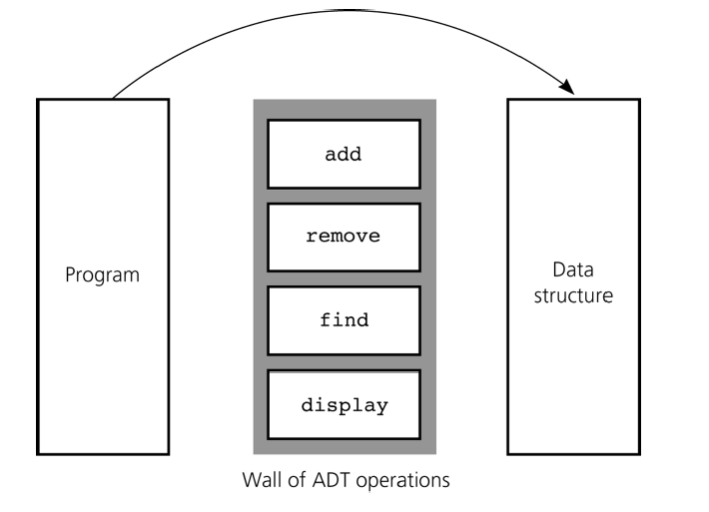
Abstract Data Type (ADT) (4/4)
2. ADT
An interface is what a program/module/class should understand on using the ADT
The following bypasses the interface to access the data structure. This violates the wall of ADT operations.
interface
[501043 Lecture 7: ADT]

Slide 19
Eg: Primitive Types as ADTs (1/2)
2. ADT
Java’s predefined data types are ADTs
Representation details are hidden which aids portability as well
Examples: int, boolean, double
--
||
–
*
int
&&
boolean
+
/
++
!
int type with the operations (e.g.: --, /) defined on it.
boolean type with the operations (e.g.: &&) defined on it.
[501043 Lecture 7: ADT]

Slide 20
Eg: Primitive Types as ADTs (2/2)
2. ADT
Broadly classified as:
(the example here uses the array ADT)
  Constructors (to add, create data)
    int[] z = new int[4];
    int[] x = { 2,4,6,8 };
  Mutators (to modify data)
    x[3] = 10;
  Accessors (to query about state/value of data)
    int y = x[3] + x[2];
[501043 Lecture 7: ADT]

Slide 21
Eg: Complex Number as ADT (1/6)
2. ADT
A complex number comprises a real part a and an imaginary part b, and is written as a + bi
i is a value such that i² = -1.
Examples: 12 + 3i, 15 – 9i, -5 + 4i, -23, 18i
A complex number can be visually represented as a pair of numbers (a, b) representing a vector on the two-dimensional complex plane (horizontal axis for real part, vertical axis for imaginary part)
Imag
b
a + bi
Real
0
a
[501043 Lecture 7: ADT]

Slide 22
Eg: Complex Number as ADT (2/6)
2. ADT
User-defined data types can also be organized as ADTs
Let’s create a “Complex” ADT for complex numbers
add(c)
Complex(r,i)
times(c)
Complex
realpart()
minus(c)
imagpart()
Note: add(c) means to add complex number object c to “this” object. Likewise for times(c) and minus(c).
[501043 Lecture 7: ADT]

Slide 23
Eg: Complex Number as ADT (3/6)
2. ADT
A possible Complex ADT class:
class Complex {
private ... // data members
public Complex(double r, double i) { ... } // create a new object
public void add(Complex c) { ... } // this = this + c
public void minus(Complex c) { ... } // this = this - c
public void times(Complex c) { ... } // this = this * c
public double realpart() { ... } // returns this.real
public double imagpart() { ... } // returns this.imag
}
Using the Complex ADT:
Complex c = new Complex(1,2); // c = (1,2)
Complex d = new Complex(3,5); // d = (3,5)
c.add(d); // c = c + d
d.minus(new Complex(1,1)); // d = d - (1,1)
c.times(d); // c = c * d
[501043 Lecture 7: ADT]

Slide 24
Eg: Complex Number as ADT (4/6)
2. ADT
One possible implementation: Cartesian
class Complex {
private double real;
private double imag;
// CONSTRUCTOR
public Complex(double r, double i) { real = r; imag = i; }
// ACCESSORS
public double realpart() { return real; }
public double imagpart() { return imag; }
// MUTATORS
public void add (Complex c) { // this = this + c
real += c.realpart();
imag += c.imagpart();
}
public void minus(Complex c) { // this = this - c
real -= c.realpart();
imag -= c.imagpart();
}
public void times(Complex c) { // this = this * c
real = real*c.realpart() - imag*c.imagpart();
imag = real*c.imagpart() + imag*c.realpart();
}
}
(a + bi) + (c + di)
= (a + c) + (b + d)i
(a + bi) – (c + di)
= (a – c) + (b – d)i
(a + bi) × (c + di)
= (ac – bd) + (ad + bc)i
[501043 Lecture 7: ADT]
Notes:
Cartesian: đề cac

Slide 25
Eg: Complex Number as ADT (5/6)
2. ADT
Another possible implementation: Polar
class Complex {
private double ang; // the angle of the vector
private double mag; // the magnitude of the vector
:
:
public times(Complex c) { // this = this * c
ang += c.angle();
mag *= c.mag();
}
:
:
}
[501043 Lecture 7: ADT]

Slide 26
Eg: Complex Number as ADT (6/6)
2. ADT
“Relationship” between Cartesian and Polar representations
From Polar to Cartesian: real = mag * cos(ang);
imag = mag * sin(ang);
From Cartesian to Polar: ang = tan⁻¹(imag/real);
mag = real / cos(ang);
or mag = sqrt(real² + imag²);
y-axis
E.g.: Complex number 2 + i
2
(real, imag)
mag = 2/cos(ang) or sqrt(2² + 1²) = 2.236
(2, 1)
real = 2
imag = 1
mag
1
ang
ang = tan⁻¹(1/2) = 0.464
x-axis
1
2
3
[501043 Lecture 7: ADT]

Slide 27
3 Java Interface
Specifying related methods

Slide 28
Java Interface
Java interfaces provide a way to specify common behaviour for a set of (possibly unrelated) classes
Java interface can be used for ADT
  It allows further abstraction/generalization
  It uses the keyword interface, rather than class
  It specifies methods to be implemented
    A Java interface is a group of related methods with empty bodies
  It can have constant definitions (which are implicitly
    public static final)
A class is said to implement the interface if it provides implementations for ALL the methods in the interface
3. Java Interface
[501043 Lecture 7: ADT]

Slide 29
Example #1
// package in java.lang;
public interface Comparable <T> {
int compareTo(T other);
}
3. Java Interface
class Shape implements Comparable <Shape> {
static final double PI = 3.14;
double area() {...};
double circumference() { ... };
int compareTo(Shape x) {
if (this.area() == x.area())
return 0;
else if (this.area() > x.area())
return 1;
else
return -1;
}
}
Implementation of compareTo()
[501043 Lecture 7: ADT]

Slide 30
Example #2: Interface for Complex
E.g. Complex ADT interface
anticipate both Cartesian and Polar implementations
3. Java Interface
Complex.java
public interface Complex {
public double realpart(); // returns this.real
public double imagpart(); // returns this.imag
public double angle(); // returns this.ang
public double mag(); // returns this.mag
public void add(Complex c); // this = this + c
public void minus(Complex c); // this = this - c
public void times(Complex c); // this = this * c
}
In Java 7 and earlier, methods in an interface only have signatures (headers) but no implementation
However, Java 8 introduces “default methods” to interfaces. They provide default implementations which can be overridden by the implementing class.
[501043 Lecture 7: ADT]

Slide 31
Example #2: ComplexCart (1/2)
Cartesian Implementation (Part 1 of 2)
3. Java Interface
ComplexCart.java
class ComplexCart implements Complex {
private double real;
private double imag;
// CONSTRUCTOR
public ComplexCart(double r, double i) { real = r; imag = i; }
// ACCESSORS
public double realpart() { return this.real; }
public double imagpart() { return this.imag; }
public double mag() { return Math.sqrt(real*real + imag*imag); }
public double angle() {
if (real != 0) {
if (real < 0) return (Math.PI + Math.atan(imag/real));
else return Math.atan(imag/real);
}
else if (imag == 0) return 0;
else if (imag > 0) return Math.PI/2;
else return –Math.PI/2;
}
[501043 Lecture 7: ADT]

Slide 32
Example #2: ComplexCart (2/2)
Cartesian Implementation (Part 2 of 2)
3. Java Interface
ComplexCart.java
// MUTATORS
public void add(Complex c) {
this.real += c.realpart();
this.imag += c.imagpart();
}
public void minus(Complex c) {
this.real -= c.realpart();
this.imag -= c.imagpart();
}
public void times(Complex c) {
double tempReal = real * c.realpart() – imag * c.imagpart();
imag = real * c.imagpart() + imag * c.realpart();
real = tempReal;
}
public String toString() {
if (imag == 0) return (real + "");
else if (imag < 0) return (real + "" + imag + "i");
else return (real + "+" + imag + "i");
}
}
Why can’t we write the following?
if (imag == 0) return (real);
[501043 Lecture 7: ADT]

Slide 33
Example #2: ComplexPolar (1/3)
Polar Implementation (Part 1 of 3)
ComplexPolar.java
3. Java Interface
class ComplexPolar implements Complex {
private double mag; // magnitude
private double ang; // angle
// CONSTRUCTOR
public ComplexPolar(double m, double a) { mag = m; ang = a; }
// ACCESSORS
public double realpart() { return mag * Math.cos(ang); }
public double imagpart() { return mag * Math.sin(ang); }
public double mag() { return mag; }
public double angle() { return ang; }
// MUTATORS
public void add(Complex c) { // this = this + c
double real = this.realpart() + c.realpart();
double imag = this.imagpart() + c.imagpart();
mag = Math.sqrt(real*real + imag*imag);
if (real != 0) {
if (real < 0) ang = (Math.PI + Math.atan(imag/real));
else ang = Math.atan(imag/real);
}
else if (imag == 0) ang = 0;
else if (imag > 0) ang = Math.PI/2;
else ang = -Math.PI/2;
}
[501043 Lecture 7: ADT]

Slide 34
Example #2: ComplexPolar (2/3)
Polar Implementation (Part 2 of 3)
3. Java Interface
ComplexPolar.java
public void minus(Complex c) { // this = this - c
double real = mag * Math.cos(ang) - c.realpart();
double imag = mag * Math.sin(ang) - c.imagpart();
mag = Math.sqrt(real*real + imag*imag);
if (real != 0) {
if (real < 0) ang = (Math.PI + Math.atan(imag/real));
else ang = Math.atan(imag/real);
}
else if (imag == 0) ang = 0;
else if (imag > 0) ang = Math.PI/2;
else ang = -Math.PI/2;
}
[501043 Lecture 7: ADT]

Slide 35
Example #2: ComplexPolar (3/3)
Polar Implementation (Part 3 of 3)
3. Java Interface
ComplexPolar.java
public void times(Complex c) { // this = this * c
mag *= c.mag();
ang += c.angle();
}
public String toString() {
if (imagpart() == 0)
return (realpart() + "");
else if (imagpart() < 0)
return (realpart() + "" + imagpart() + "i");
else
return (realpart() + "+" + imagpart() + "i");
}
}
[501043 Lecture 7: ADT]

Slide 36
Example #2: TestComplex (1/3)
Testing Complex class (Part 1 of 3)
3. Java Interface
TestComplex.java
public class TestComplex {
public static void main(String[] args) {
// Testing ComplexCart
Complex a = new ComplexCart(10.0, 12.0);
Complex b = new ComplexCart(1.0, 2.0);
System.out.println("Testing ComplexCart:");
a.add(b);
System.out.println("a=a+b is " + a);
a.minus(b);
System.out.println("a-b (which is the original a) is " + a);
System.out.println("Angle of a is " + a.angle());
a.times(b);
System.out.println("a=a*b is " + a);
Testing ComplexCart:
a=a+b is 11.0+14.0i
a-b (which is the original a) is 10.0+12.0i
Angle of a is 0.8760580505981934
a=a*b is -14.0+32.0i
[501043 Lecture 7: ADT]

Slide 37
Example #2: TestComplex (2/3)
Testing Complex class (Part 2 of 3)
3. Java Interface
TestComplex.java
// Testing ComplexPolar
Complex c = new ComplexPolar(10.0, Math.PI/6.0);
Complex d = new ComplexPolar(1.0, Math.PI/3.0);
System.out.println("\nTesting ComplexPolar:");
System.out.println("c is " + c);
System.out.println("d is " + d);
c.add(d);
System.out.println("c=c+d is " + c);
c.minus(d);
System.out.println("c-d (which is the original c) is " + c);
c.times(d);
System.out.println("c=c*d is " + c);
Testing ComplexPolar:
c is 8.660254037844387+4.999999999999999i
d is 5.000000000000001+8.660254037844386i
c=c+d is 13.660254037844393+13.660254037844387i
c-d (which is ... c) is 8.660254037844393+5.000000000000002i
c=c*d is 2.83276944823992E-14+100.00000000000007i
[501043 Lecture 7: ADT]

Slide 38
Example #2: TestComplex (3/3)
Testing Complex class (Part 3 of 3)
TestComplex.java
3. Java Interface
// Testing Combined
System.out.println("\nTesting Combined:");
System.out.println("a is " + a);
System.out.println("d is " + d);
a.minus(d);
System.out.println("a=a-d is " + a);
a.times(d);
System.out.println("a=a*d is " + a);
d.add(a);
System.out.println("d=d+a is " + d);
d.times(a);
System.out.println("d=d*a is " + d);
}
}
Testing Combined:
a is -14.0+32.0i
d is 5.000000000000001+8.660254037844386i
a=a-d is -19.0+23.339745962155614i
a=a*d is -297.1281292110204-47.84609690826524i
d=d+a is -292.12812921102045-39.18584287042089i
d=d*a is 84924.59488697552+25620.40696350589i
[501043 Lecture 7: ADT]

Slide 39
Java Interface
Each interface is compiled into a separate bytecode file, just like a regular class
  We cannot create an instance of an interface, but we can use an interface as a data type for a variable, or as a result of casting
3. Java Interface
public boolean equals (Object cl) {
if (cl instanceof Complex) {
Complex temp = (Complex) cl; // result of casting
return (Math.abs(realpart() - temp.realpart()) < EPSILON
&& Math.abs(imagpart() - temp.imagpart()) < EPSILON);
}
return false;
}
Note: EPSILON is a very small value (actual value up to programmer), defined as a constant at the beginning of the class, e.g.:
public static final double EPSILON = 0.0000001;
[501043 Lecture 7: ADT]

Slide 40
4 Fraction as ADT
Practice Exercises

Slide 41
Fraction as ADT (1/3)
4. Pract. Ex.
We are going to view Fraction as an ADT, before we proceed to provide two implementations of Fraction
Qn: What are the data members (attributes) of a fraction object (without going into its implementation)?
Qn: What are the behaviours (methods) you want to provide for this class (without going into its implementation)?
Data members
Numerator
Denominator
Behaviors
Add
Minus
Times
Simplify
We will leave out divide for the moment
[501043 Lecture 7: ADT]

Slide 42
Fraction as ADT (2/3)
4. Pract. Ex.
How do we write an Interface for Fraction? Let’s call it FractionI
  You may refer to interface Complex for idea
  But this time, we wants add(), minus(), times() and simplify() to return a fraction object
FractionI.java
public interface FractionI {
public int getNumer(); //returns numerator part
public int getDenom(); //returns denominator part
public void setNumer(int numer); //sets new numerator
public void setDenom(int denom); //sets new denominator
public FractionI add(FractionI f); //returns this + f
public FractionI minus(FractionI f); //returns this - f
public FractionI times(FractionI f); //returns this * f
public FractionI simplify(); //returns this simplified
}
[501043 Lecture 7: ADT]

Slide 43
Fraction as ADT (3/3)
4. Pract. Ex.
Now, to implement this Fraction ADT, we can try 2 approaches
  Fraction: Use 2 integer data members for numerator and denominator (you have done this in Practice Exercise #11)
    We will do this in Practice Exercise #26
  FractionArr: Use a 2-element integer array for numerator and denominator
    We will do this in Practice Exercise #27
  We want to add a toString() method and an equals() method as well
[501043 Lecture 7: ADT]

Slide 44
PracEx#26: TestFraction (1/2)
To write Fraction.java to implementation the FractionI interface.
The client program TestFraction.java is given
4. Pract. Ex.
TestFraction.java
// To test out Fraction class
import java.util.*;
public class TestFraction {
public static void main(String[] args) {
Scanner sc = new Scanner(System.in);
System.out.print("Enter 1st fraction: ");
int a = sc.nextInt();
int b = sc.nextInt();
FractionI f1 = new Fraction(a, b);
System.out.print("Enter 2nd fraction: ");
a = sc.nextInt();
b = sc.nextInt();
FractionI f2 = new Fraction(a, b);
System.out.println("1st fraction is " + f1);
System.out.println("2nd fraction is " + f2);
[501043 Lecture 7: ADT]

Slide 45
PracEx#26: TestFraction (2/2)
To write Fraction.java, an implementation of FractionI interface.
The client program TestFraction.java is given
4. Pract. Ex.
TestFraction.java
if (f1.equals(f2))
System.out.println("The fractions are the same.");
else
System.out.println("The fractions are not the same.");
FractionI sum = f1.add(f2);
System.out.println("Sum is " + sum);
FractionI diff = f1.minus(f2);
System.out.println("Difference is " + diff);
FractionI prod = f1.times(f2);
System.out.println("Product is " + prod);
}
}
Enter 1st fraction: 2 4
Enter 2nd fraction: 2 3
1st fraction is 2/4
2nd fraction is 2/3
The fractions are not the same.
Sum is 7/6
Difference is -1/6
Product is 1/3
[501043 Lecture 7: ADT]

Slide 46
PracEx#26: Fraction (1/2)
Skeleton program for Fraction.java
4. Pract. Ex.
Fraction.java
class Fraction implements FractionI {
// Data members
private int numer;
private int denom;
// Constructors
public Fraction() { this(1,1); }
public Fraction(int numer, int denom) {
setNumer(numer);
setDenom(denom);
}
// Accessors
public int getNumer() { // fill in the code }
public int getDenom() { // fill in the code }
// Mutators
public void setNumer(int numer) { // fill in the code }
public void setDenom(int denom) { // fill in the code }
[501043 Lecture 7: ADT]

Slide 47
PracEx#26: Fraction (2/2)
Fraction.java
4. Pract. Ex.
// Returns greatest common divisor of a and b
// private method as this is not accessible to clients
private static int gcd(int a, int b) {
int rem;
while (b > 0) {
rem = a%b;
a = b;
b = rem;
}
return a;
}
// Fill in the code for all the methods below
public FractionI simplify() { // fill in the code }
public FractionI add(FractionI f) { // fill in the code }
public FractionI minus(FractionI f) { // fill in the code }
public FractionI times(FractionI f) { // fill in the code }
// Overriding methods toString() and equals()
public String toString() { // fill in the code }
public boolean equals() { // fill in the code }
}
[501043 Lecture 7: ADT]

Slide 48
PracEx#27: TestFractionArr
To write FractionArr.java to implementation the FractionI interface.
The client program TestFractionArr.java is given
4. Pract. Ex.
TestFractionArr.java
// To test out FractionArr class
import java.util.*;
public class TestFractionArr {
public static void main(String[] args) {
Scanner sc = new Scanner(System.in);
System.out.print("Enter 1st fraction: ");
int a = sc.nextInt();
int b = sc.nextInt();
FractionI f1 = new FractionArr(a, b);
System.out.print("Enter 2nd fraction: ");
a = sc.nextInt();
b = sc.nextInt();
FractionI f2 = new FractionArr(a, b);
// The rest of the code is the same as TestFraction.java
}
[501043 Lecture 7: ADT]

Slide 49
PracEx#27: FractionArr
Skeleton program for FractionArr.java
4. Pract. Ex.
FractionArr.java
class FractionArr implements FractionI {
// Data members
private int[] members;
// Constructors
public FractionArr() { this(1,1); }
public FractionArr(int numer, int denom) {
members = new int[2];
setNumer(numer);
setDenom(denom);
}
// Accessors
public int getNumer() { // fill in the code }
public int getDenom() { // fill in the code }
// Mutators
public void setNumer(int numer) { // fill in the code }
public void setDenom(int denom) { // fill in the code }
// The rest are omitted here
}
[501043 Lecture 7: ADT]

Slide 50
Summary
We learn about the need of data abstraction
We learn about using Java Interface to define an ADT
With this, we will learn and define various kinds of ADTs/data structures in subsequent lectures

Slide 51
End of file

