Slide 1

Data Structures and Algorithms
Heaps

Slide 2
Acknowledgement
The contents of these slides have origin from School of Computing, National University of Singapore.
We greatly appreciate support from Dr. Steven Halim for kindly sharing these materials.

Slide 3
Policies for students
These contents are only used for students PERSONALLY.
Students are NOT allowed to modify or deliver these contents to anywhere or anyone for any purpose.

Slide 4
Recording of modifications
Currently, there are no modification on these contents.

Slide 5

CS2010 – Data Structures and Algorithms II
Lecture 02 – Heaps of Fun
stevenhalim@gmail.com

Slide 6
Outline
What are you going to learn in this lecture?
Motivation: Abstract Data Type: PriorityQueue
With major help from VisuAlgo Binary Heap Visualization
Binary Heap data structure and it’s operations
Building Heap from a set of n numbers in O(n)
Heap Sort in O(n log n)
CS2010 PS1 Overview: “Scheduling Deliveries, v2015”
Reference in CP3 book: Page 43‐47 + 148‐150

Slide 7
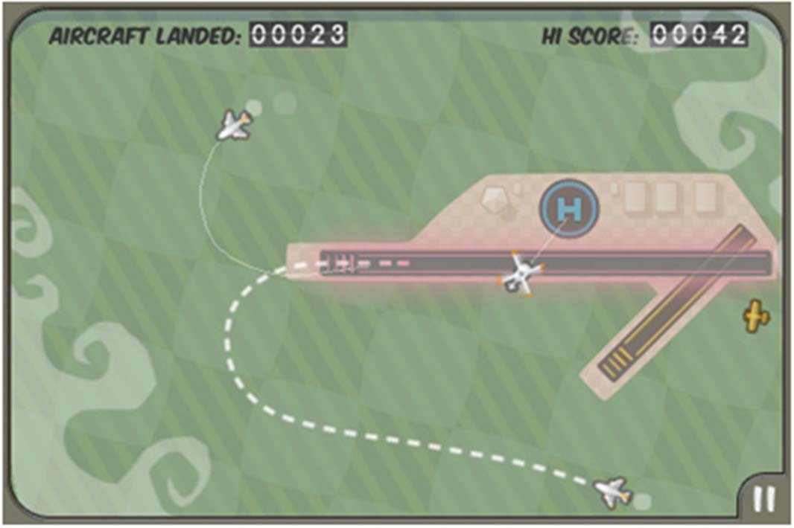



Abstract Data Type: PriorityQueue (1)
Imagine that you are the Air Traffic Controller:
You have scheduled the next aircraft X to land in the next 3 minutes, and aircraft Y to land in the next 6 minutes
Both have enough fuel for at least the next 15 minutes and both
are just 2 minutes away from your airport
Y
X

Slide 8
Abstract Data Type: PriorityQueue
Important Basic Operations:
Enqueue(x)
Put a new item x in the priority queue PQ (in some order)
y ← Dequeue()
Return an item y that has the highest priority (key) in the PQ
If there are more than one item with highest priority, return the one that is inserted first (FIFO)
Note: We can always define highest priority = higher number or it’s opposite: highest priority = lower number

Slide 9
A Few Points To Remember
Data Structure (DS) is…
A way to store and organize data in order to support efficient insertions, searches, deletions, queries, and/or updates
Most data structures have propert(ies)
Each operation on that data structure has to maintain
that propert(ies)

Slide 10
PriorityQueue Implementation (1)
The array is circular: We just manipulate front+back pointers to define the active part of array
(Circular) Array‐Based Implementation (Strategy 1)
Property: The content of array is always in correct order
Enqueue(x)
Find the correct insertion point, O(n) – recall insertion sort
y ← Dequeue()
Return the front‐most item which has the highest priority, O(1)
Index | 0 (front) | 1 (back)
Key | Aircraft X* | Aircraft Y*
Aircraft Z**
We do not need to close the gap, just advance the front pointer, O(1)
Index | 0 (front) | 1 | 2 (back)
Key | Aircraft Z** | Aircraft X* | Aircraft Y*

Slide 11
PriorityQueue Implementation (2)
(Circular) Array‐Based Implementation (Strategy 2)
Property: dequeue() operation returns the correct item
Enqueue(x)
Put the new item at the back of the queue, O(1)
y ← Dequeue()
Scan the whole queue, return first item with highest priority, O(n)
Index | 0 (front) | 1 (back)
Key | Aircraft X* | Aircraft Y*
We may need to close the gap if this operation causes it, also O(n)
Aircraft Z**
Index
0 (front)
1
2 (back)
Key
Aircraft X*
Aircraft Y*
Aircraft Z**

Slide 12

PriorityQueue Implementation (3)
If we just stop at CS1020 knowledge level:
Strategy | Enqueue | Dequeue
Circular‐Array‐Based PQ (1) | O(n) | O(1)
Circular‐Array‐Based PQ (2) | O(1) | O(n)
Can we do better? | O(?) | O(?)
If n is large, our queries are slow…

Slide 13
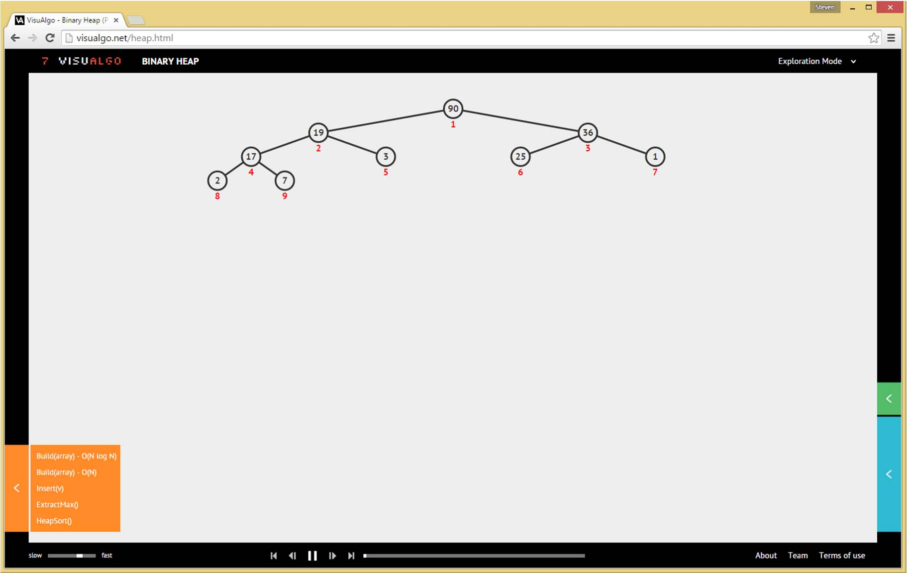
http://visualgo.net/heap.html
INTRODUCING BINARY HEAP DATA STRUCTURE

Slide 14
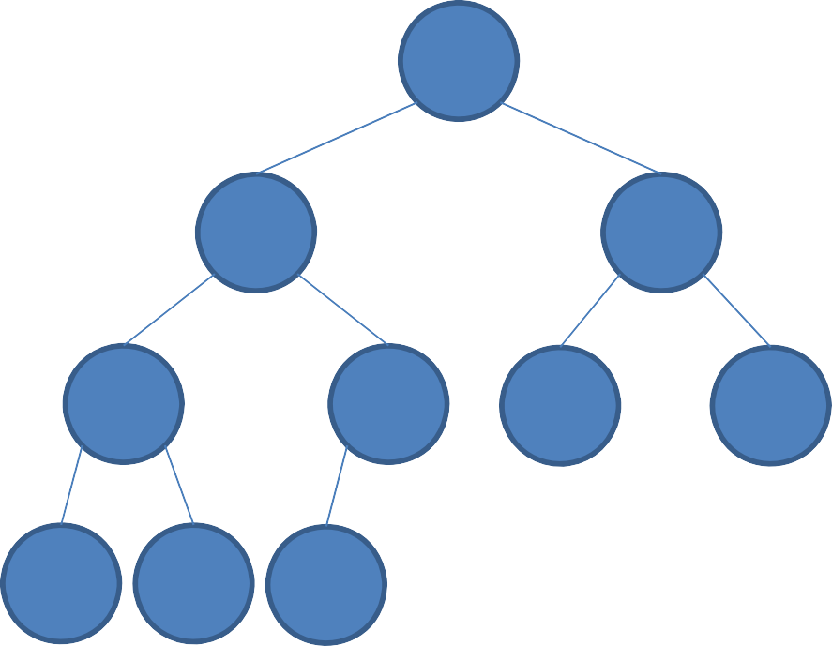
Complete Binary Tree
Introducing a few concepts:
Complete Binary Tree
– Binary tree in which every level, except possibly the last,
is completely filled, and all nodes are as far left as possible
Important Q:
If you have a complete binary tree of N items, what will be the height of it?
– Height = number of levels‐1 =
?
?
?
max edges from root to deepest leaf
?
?
?
?
?
?
?

Slide 15
The Height of a
Complete Binary Tree of N Items is...
O(N)
O(sqrt(N))
O(log N) 4. O(1)
Memorize this answer!
We will need that for nearly all time complexity analysis of binary heap operations
23
0 0 ¹
1 2 3 4

Slide 16
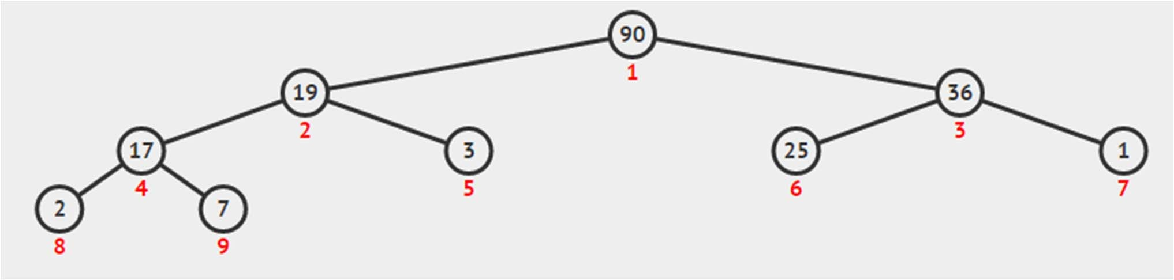
Storing a Complete Binary Tree
Q: Why not 0‐based?
As a 1‐based compact array: A[1..size(A)]
size(A)
0 | 1 | 2 | 3 | 4 | 5 | 6 | 7 | 8 | 9 | 10 | 11
NIL | 90 | 19 | 36 | 17 | 3 | 25 | 1 | 2 | 7 | ‐ | ‐
heapsize ≤
size(A)
Navigation operations:
parent(i) = floor(i/2),
•
•
except for i
= 1 (root)
left(i) = right(i)
2*i, No left child when: left(i) >
heapsize
= 2*i+1, No right child when: right(i)
> heapsize

Slide 17
Binary Heap Property
Q: Can we write Binary Max Heap property as:
Binary Heap property (except root)
A[i] | ≥ | A[left(i)]
&&
A[i] ? | ≥ | A[right(i)]
A[parent(i)]
A[parent(i)]
≥ A[i] (Max Heap)
≤ A[i] (Min Heap)
Without loss of generality, we will use (Binary Max) Heap for all examples in this lecture and we ensure that the numbers are distinct

Slide 18
The largest element
in a Binary Max Heap is stored at…
17
4
3
0
1 2 3 4
One of the leaves
One of the internal vertices
Can be anywhere in the heap
The root

Slide 19
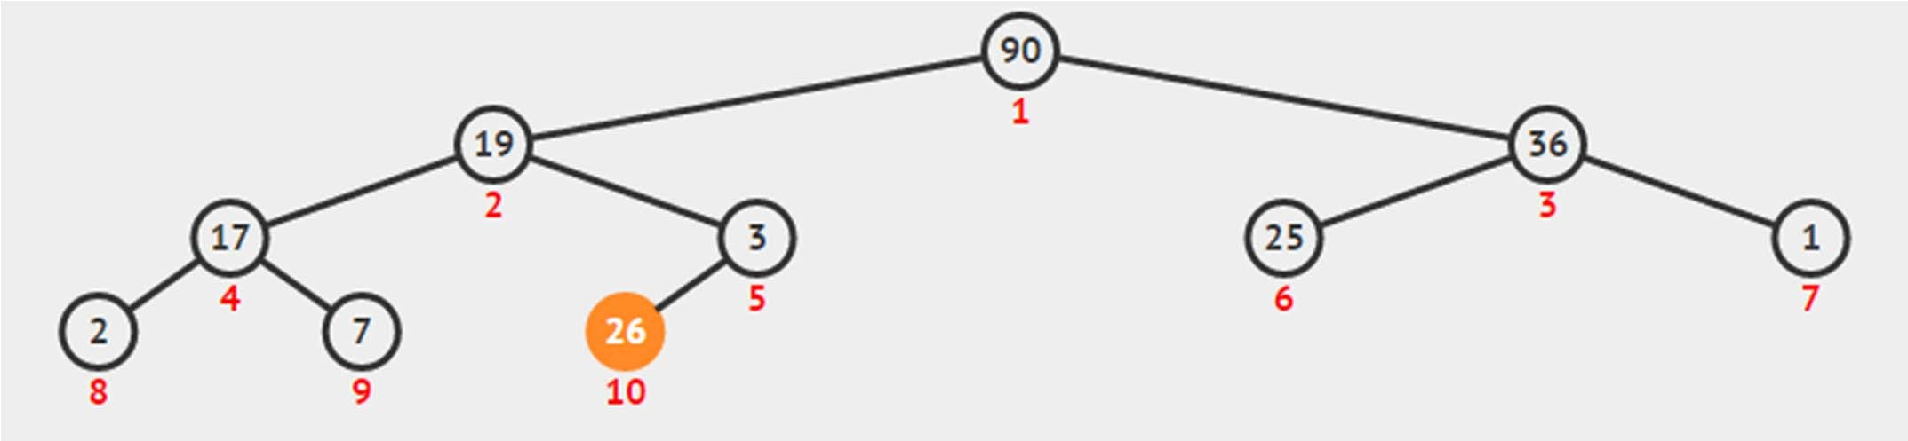
Insertion to an Existing B Max Heap
The most appropriate insertion point into an existing Binary Max Heap is at A[heapsize]
Q: Why?
A:
But Binary Max Heap property can still be violated?
– No problem, we use ShiftUp(i) to fix the heap property

Slide 20
Insert(v) – Pseudo Code
Insert(v)
heapsize = heapsize+1; // extend, O(1) A[heapsize] = v // insert at the back, O(1)
ShiftUp(heapsize) | // | fix | the | heap | property
 | // | in | O(?)
// Preliminary
//
analysis:
Insert(v)
depends on
ShiftUp(i)

Slide 21
ShiftUp – Pseudo Code
This name is not unique, the alternative names are: ShiftUp/BubbleUp/IncreaseKey/etc
ShiftUp(i) while i >
“not root” “violates max heap property”
1 and A[parent(i)] < A[i] // don't swap
swap(A[i], A[parent(i)]) i = parent(i)
// Analysis: ShiftUp() runs in

Slide 22
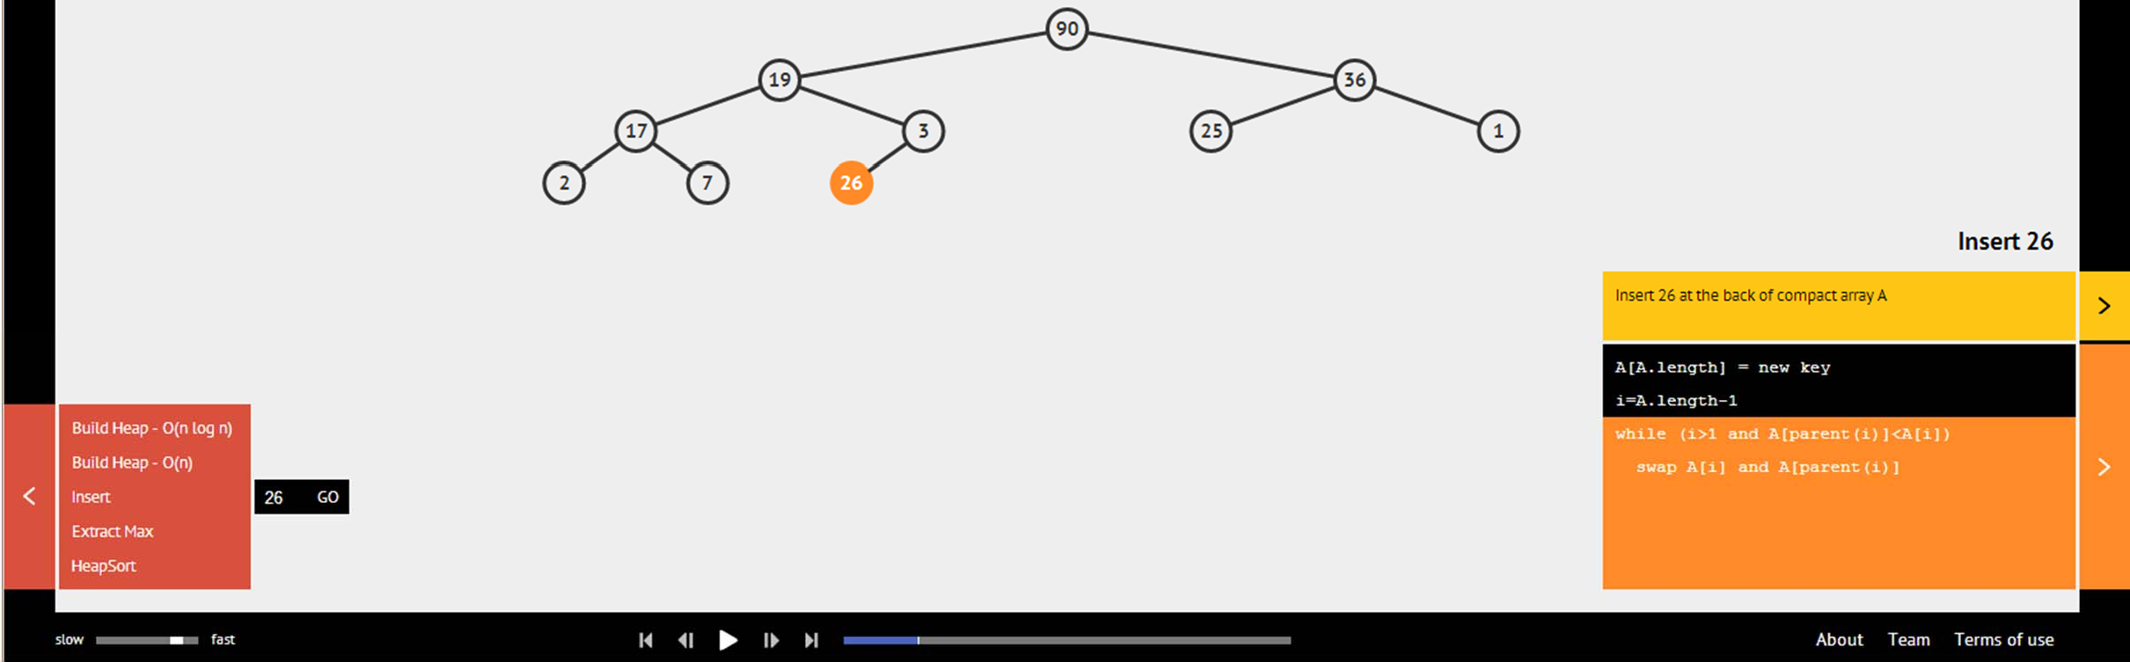
Binary Heap: Insert(v)
Ask VisuAlgo to perform various insert operations on the sample Binary (Max) Heap
In the screen shot below, we show the first step of
Insert(26)

Slide 23
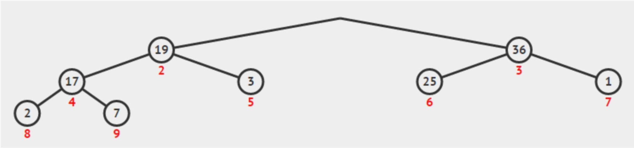
Deleting Max Element (1)
The max element of a Binary Max Heap is at the root
But simply taking the root out from a Binary Max Heap will disconnect the complete binary tree ☹
– We do not want that…
Q: Which node is the best candidate to replace the root yet still maintain the complete binary tree property?

Slide 24

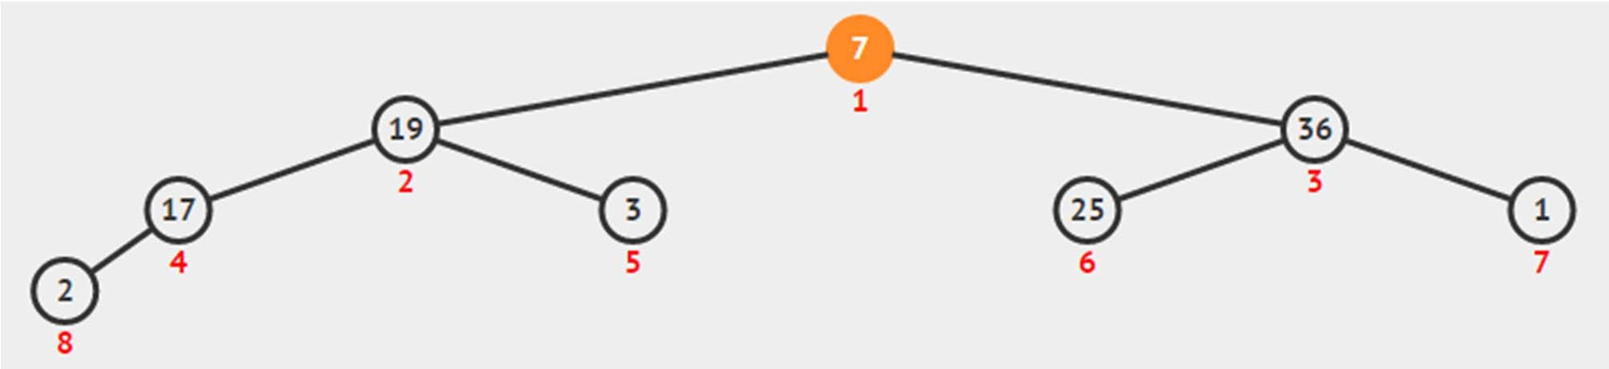
Deleting Max Element (2)
A: The leaf
Which is the last element in the compact array
But the heap property can still be violated?
No problem, this time we call ShiftDown(1)

Slide 25
ExtractMax ‐ Pseudocode
ExtractMax()
maxV ←
A[1] ←
A[1] // O(1)
A[heapsize] //
O(1)
heapsize = heapsize-1 ShiftDown(1) // O(?) return maxV
// O(1)
// Preliminary
// ExtractMax()
analysis:
depends on
ShiftDown()

Slide 26
ShiftDown – Pseudo Code
Again, the name is not unique:
ShiftDown(i)
ShiftDown/BubbleDown/Heapify/etc
while i <= heapsize
maxV ←
A[i]; max_id
← i;
and maxV
if left(i)
<= heapsize
< A[left(i)]
maxV ←
A[left(i)];
max_id ←
left(i)
if right(i) <= heapsize and maxV
< A[right(i)]
maxV ←
A[right(i)]; max_id ←
right(i)
// be
if (max_id
careful
with the
!= i)
implementation
swap(A[i],
A[max_id])
i ←
else
break;
max_id;
// Analysis:
ShiftDown()
runs in

Slide 27
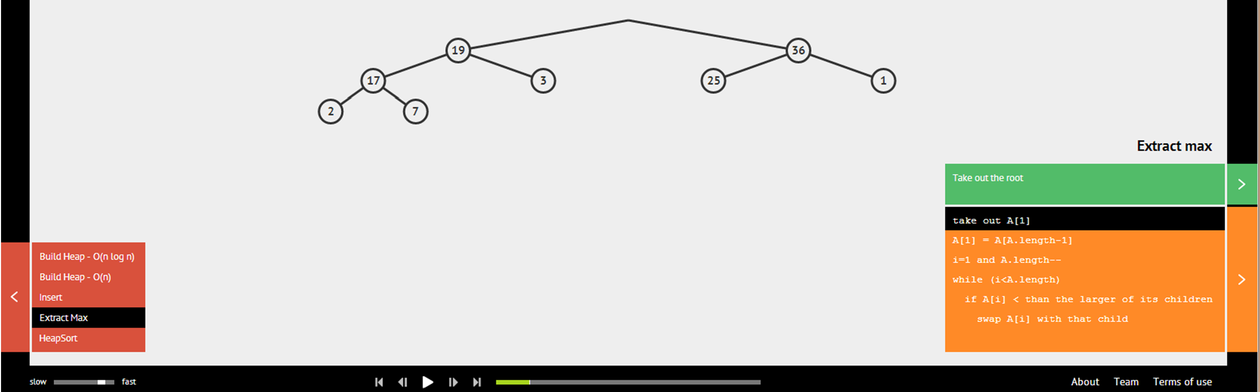
Binary Heap: ExtractMax()
Ask VisuAlgo to perform various ExtractMax() operations on the sample Binary (Max) Heap
In the screen shot below, we show the first step of
ExtractMax() from the sample Binary (Max) Heap

Slide 28
PriorityQueue Implementation (4)
Now, with knowledge of non linear DS from CS2010:
Strategy | Enqueue | Dequeue
Array‐Based PQ (1) | O(n) | O(1)
Array‐Based PQ (2) | O(1) | O(n)
Binary‐Heap (actually uses array too) | Insert(key) O(log n) | ExtractMax() O(log n)
Summary so far:
Heap data structure is an efficient data structure ‐‐ O(log n) enqueue/dequeue operations ‐‐ to implement ADT priority queue where the ‘key’ represent the ‘priority’ of each item

Slide 29
Next Items:
Building Binary Max Heap from an ordinary Array, the O(n log n) version
And the faster O(n) version
Heap Sort, O(n log n)
Java Implementation of Binary Max Heap
PS1 overview and introduction of one more Binary Max Heap operation: UpdateKey that has been purposely left out from this lecture
LECTURE BREAK

Slide 30
Review: We have seen MergeSort in
CS1020. It can sort n items in…
1. O(n²)
O(n log n)
O(n)
O(log n)
20
4
0 0
1 2 3 4

Slide 31
HeapSort Pseudo Code
With a max heap, we can do sorting too ☺
Just call ExtractMax() n times
If we do not have a max heap yet, simply build one!
HeapSort(array) BuildHeap(array)
// O(?)
n ← size(array) for
i from
1 to n // O(n)
← ExtractMax()
A[n–i+1]
// O(log n)
return A
// Preliminary
//
analysis:
HeapSort
runs in O(?
+ n log n)

Slide 32
BuildHeap, O(n log n) Version
BuildHeapSlow(array) // n ← size(array)
naïve
version
A[0] ← 0 // dummy entry for i = 1 to n
entry O(n)
Insert(array[i-1])
// O(log n)
// Analysis:
//
This clearly
runs
in O(n log n)
So HeapSort
in previous
slide
is O(n log n) ☺
Can we do better?

Slide 33
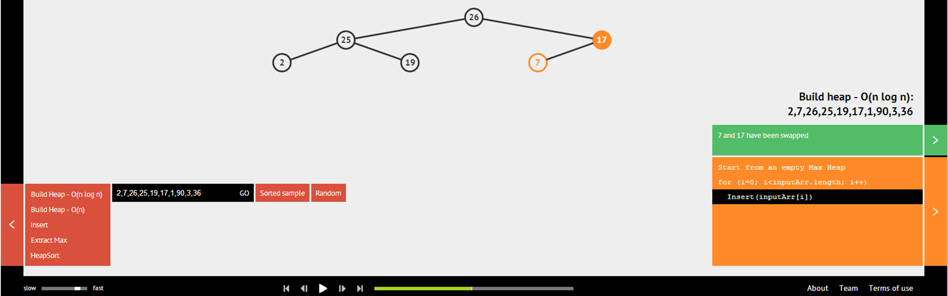
Build Binary Heap in O(n log n)
Ask VisuAlgo to build Binary (Max) Heap from an array in O(n log n) time by inserting each number one by one
In the screen shot below, the partial state of the O(n log n) Build Heap of the sample Binary (Max) Heap

Slide 34
BuildHeap, the Faster One
BuildHeap(array)
heapsize ←
size(array)
A[0] ← 0
for i = 1 A[i] ←
// dummy entry to heapsize // array[i-1]
copy
the content
O(n)
for i =
parent(heapsize)
down
to 1 // O(n/2)
ShiftDown(i) // O(log n)
// Analysis:
//
Is this
also
O(n log n) ??
is
No...
soon,
we will see
that this
just
O(n)

Slide 35
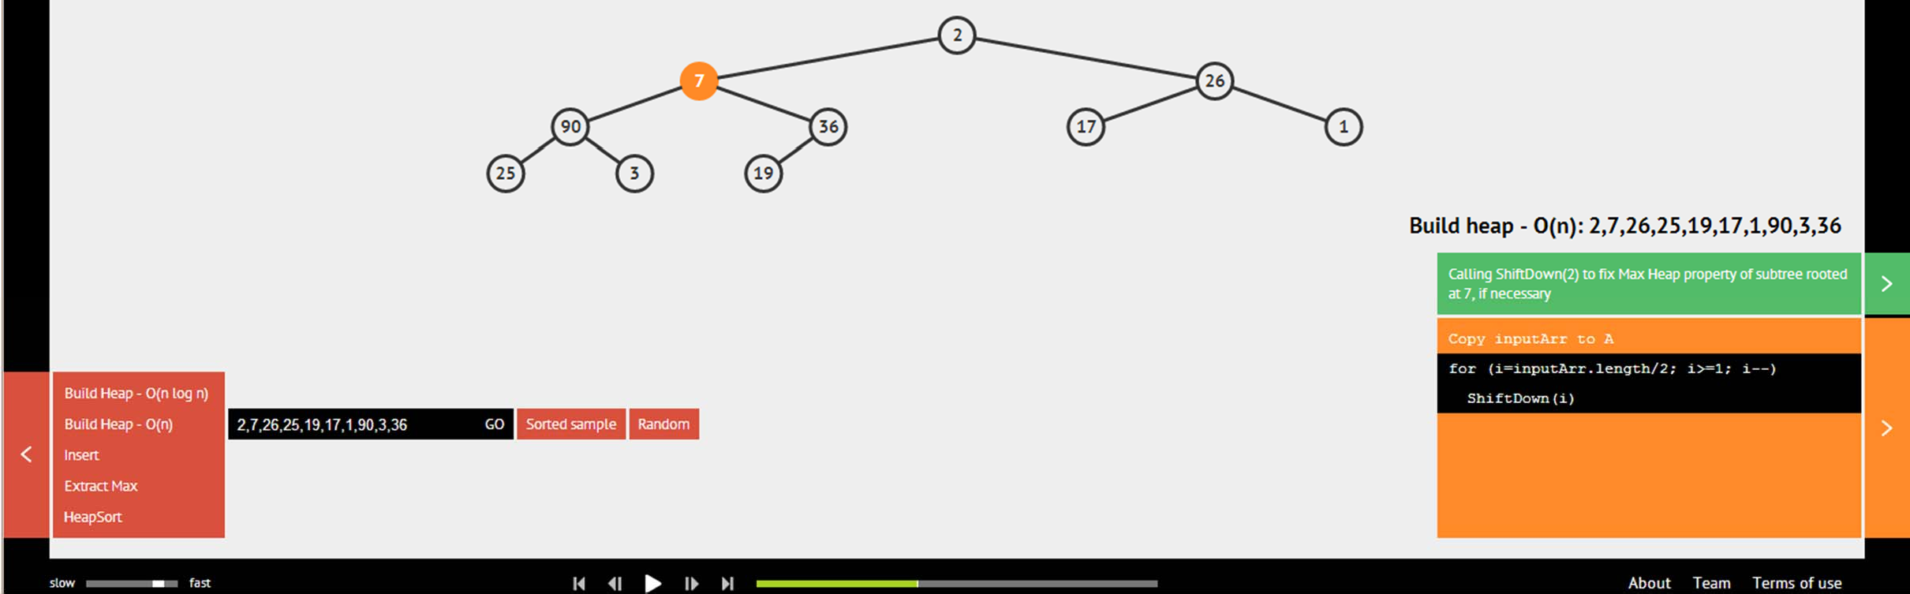
Build Binary Heap in O(n)
Ask VisuAlgo to build Binary (Max) Heap from an array in O(n) time by calling ShiftDown strategically
In the screen shot below, the partial state of the O(n) Build Heap of the sample Binary (Max) Heap

Slide 36
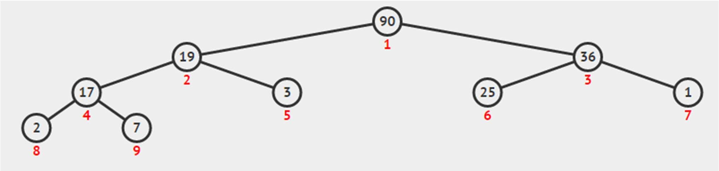
BuildHeap() Analysis… (1)
Recall: How many levels (height) are there in a complete binary tree (heap) of size n?
Recall: What is the cost to run shiftDown(i)?
Q: How many nodes are there at height h of a full binary tree?
h = 3
h = 2
h = 1
h = 0
n = 9

Slide 37
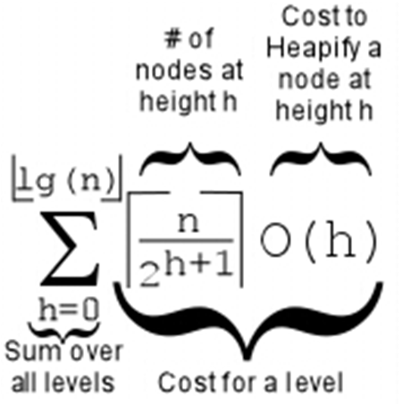
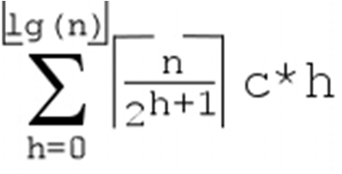
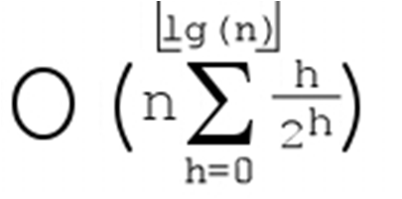
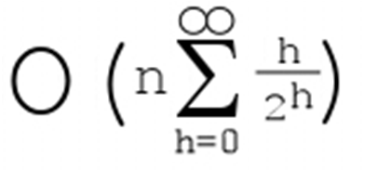
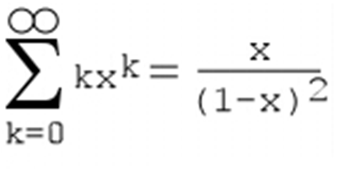
BuildHeap() Analysis… (2)
Cost of BuildHeap() is thus:
=
=
=
= O(2n) = O(n)
=2
x = 1/2
0 1 2 3 4
- + - + - + - + - ₂0 ₂1 ₂2 ₂3 ₂4
0 + 0.5 + 0.5
0 1 2 3 4
- + - + - + - + - + ...= 1 2 4 8 16
0.09375 + ... < 2
+ ... =
+ 0.375 +
0.25 + 0.15625 +

Slide 38
HeapSort Analysis
HeapSort(array)
BuildHeap(array) // The best we can do is
n ←
for i from
size(array)
1 to n // O(n)
← ExtractMax()
A[n–i+1]
return A
// O(log n)
// Analysis: Thus HeapSort
//
//
//
//
//
runs in O( ) not need extra array
Do you notice that we do
like merge sort to Thus heap sort is This
But
perform sorting?
more memory friendly.
is called "in-place
sorting"
HeapSort is not
"cache
friendly"

Slide 39
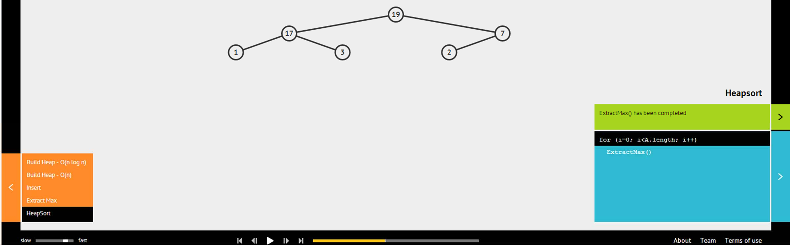
Binary Heap: HeapSort()
Ask VisuAlgo to run HeapSort() on the sample Binary (Max) Heap
In the screen shot below, the partial state of the O(n log n) HeapSort() of the sample Binary (Max) Heap

Slide 40
Java Implementation
Priority Queue ADT
Heap Class (Java file given, you can use it for PS1)
ShiftUp(i)
Insert(v)
ShiftDown(i)
ExtractMax()
BuildHeapSlow(array) and BuildHeap(array)
HeapSort()
In OOP Style ☺

Slide 41
Summary
In this lecture, we have looked at:
Heap DS and its application as efficient PriorityQueue
Storing heap as a compact array and its operations
– Remember how we always try to maintain complete binary tree and heap property in all our operations!
Building a heap from a set of numbers in O(n) time
Simple application of Heap DS: O(n log n) HeapSort
We will use PriorityQueue in the 2nd part of CS2010
If some concepts are still unclear, ask your personal tutor: http://visualgo.net/heap.html

