Slide 1
Discussion about Part I＆II
2023.2.6
Haoyu Lu

Slide 2
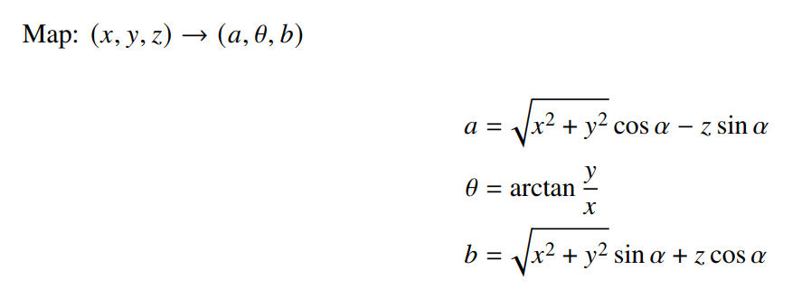
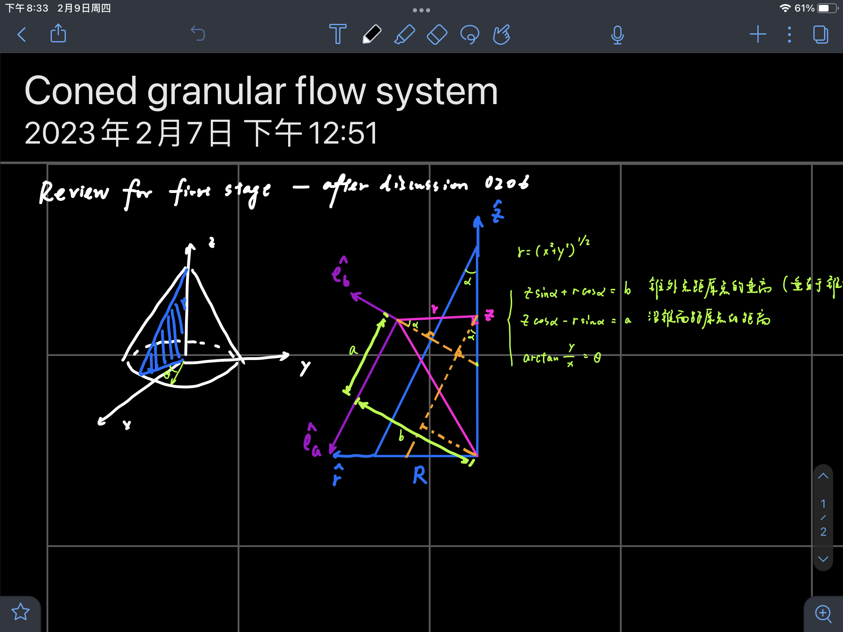
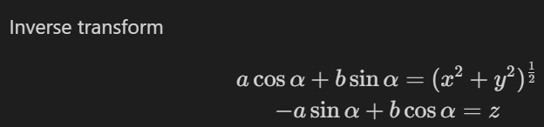
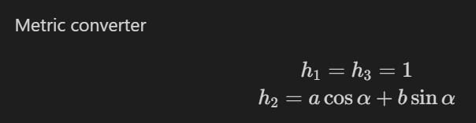





Modeling
Coned granular flow
$$Θ$$
-z
$$\hat{e_{a}}$$
ⓧ$Θ$
$$α$$
$$\hat{e_{b}}$$
y
x

Slide 3
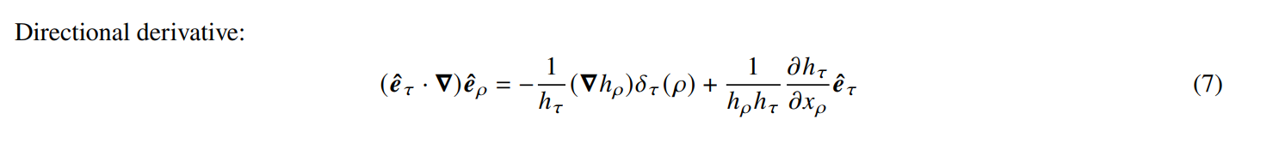
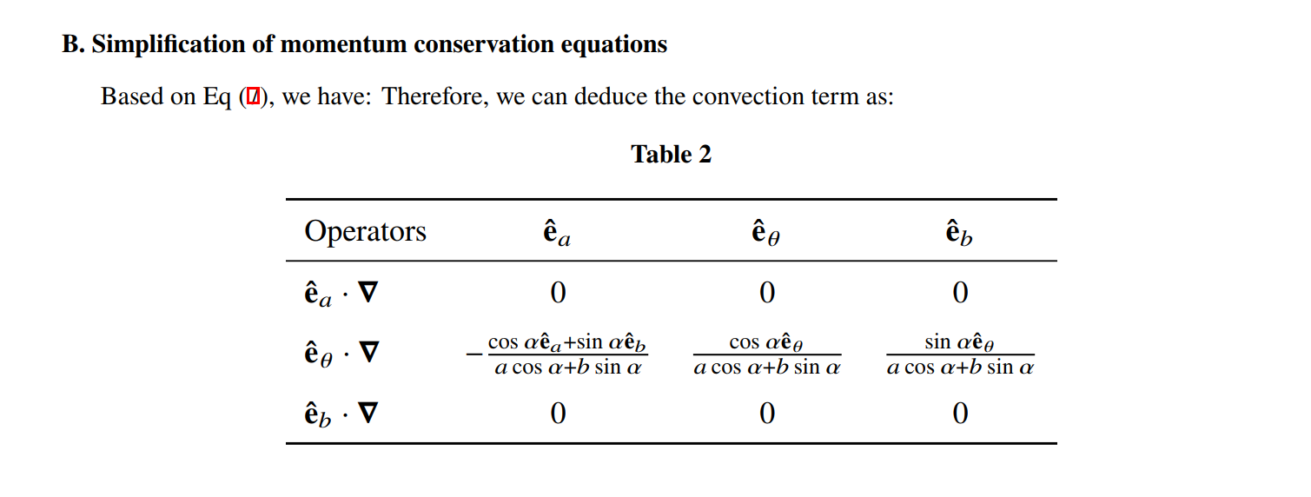
Correct errors in calculation 1

Slide 4
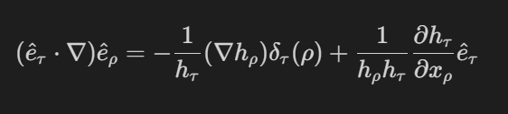
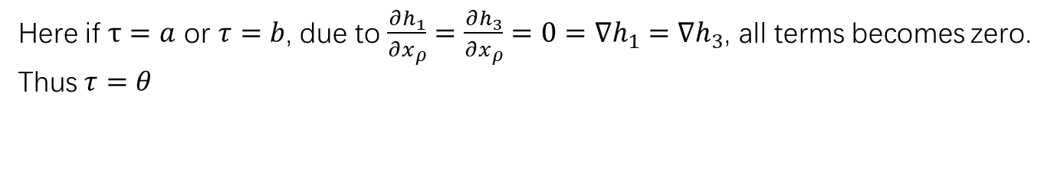
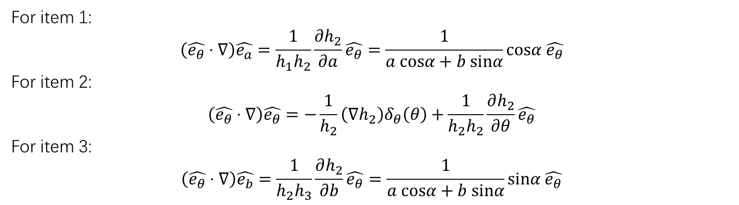
My correction
Here if $τ=a$ or $τ=b$, due to $\frac{∂h_{1}}{∂x_{ρ}}=\frac{∂h_{3}}{∂x_{ρ}}=0=∇h_{1}=∇h_{3}$, all terms becomes zero.
Thus $τ=θ$
For item 1:
$$\left(\hat{e_{θ}}⋅∇\right)\hat{e_{a}}=\frac{1}{h_{1}h_{2}}\frac{∂h_{2}}{∂a}\hat{e_{θ}}=\frac{1}{a cosα+b sinα}cosα \hat{e_{θ}}$$
For item 2:
$$\left(\hat{e_{θ}}⋅∇\right)\hat{e_{θ}}=−\frac{1}{h_{2}}\left(∇h_{2}\right)δ_{θ}\left(θ\right)+\frac{1}{h_{2}h_{2}}\frac{∂h_{2}}{∂θ}\hat{e_{θ}}$$
For item 3:
$$\left(\hat{e_{θ}}⋅∇\right)\hat{e_{b}}=\frac{1}{h_{2}h_{3}}\frac{∂h_{2}}{∂b}\hat{e_{θ}}=\frac{1}{a cosα+b sinα}sinα \hat{e_{θ}}$$

Slide 5
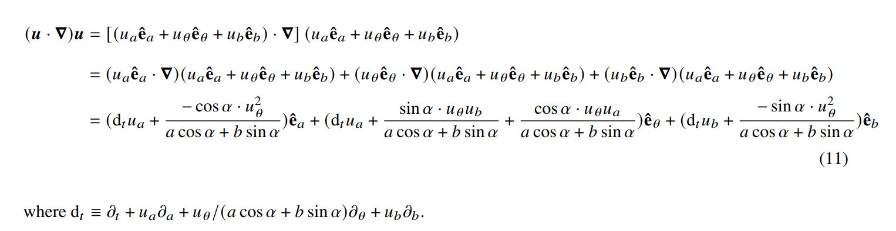
Correct errors in calculation 2
No reason, quite confused here…

Slide 6
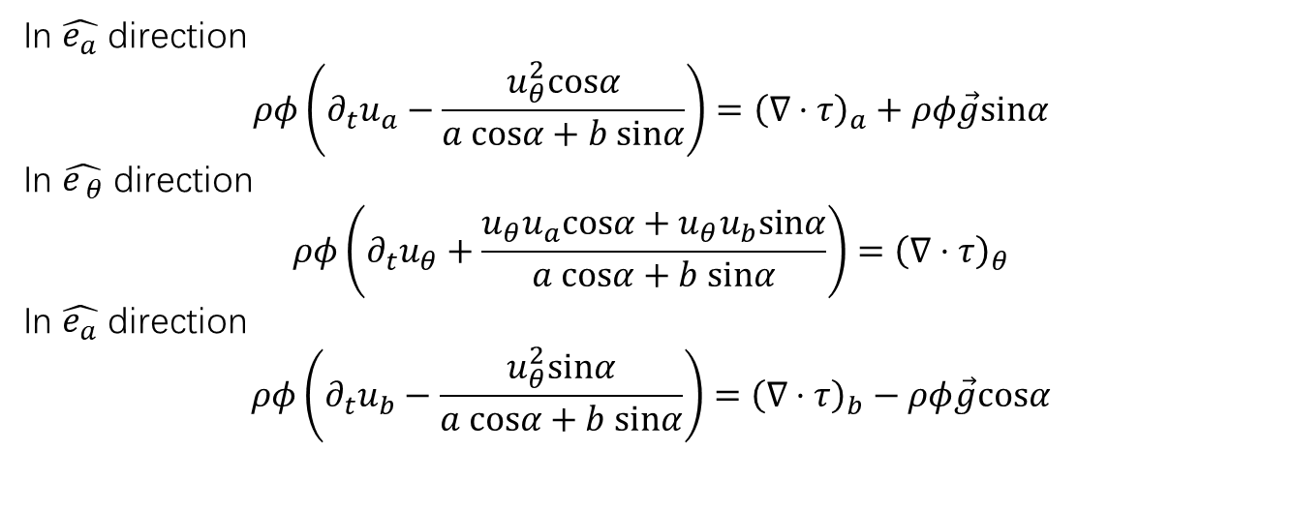

My correction
Recall Euler’s equation
$$ρφ\left(\frac{∂}{∂t}+\vec{u}⋅∇\right)\vec{u}=∇⋅τ+ρφ\vec{g}$$
In $\hat{e_{a}}$ direction
$$ρφ\left(∂_{t}u_{a}−\frac{u_{θ}^{2}cosα}{a cosα+b sinα}\right)={\left(∇⋅τ\right)}_{a}+ρφ\vec{g}sinα$$
In $\hat{e_{ θ}}$ direction
$$ρφ\left(∂_{t}u_{θ}+\frac{{u_{θ}u}_{a}cosα+{u_{θ}u}_{b}sinα}{a cosα+b sinα}\right)={\left(∇⋅τ\right)}_{θ}$$
In $\hat{e_{a}}$ direction
$$ρφ\left(∂_{t}u_{b}−\frac{u_{θ}^{2}sinα}{a cosα+b sinα}\right)={\left(∇⋅τ\right)}_{b}−ρφ\vec{g}cosα$$

Slide 7
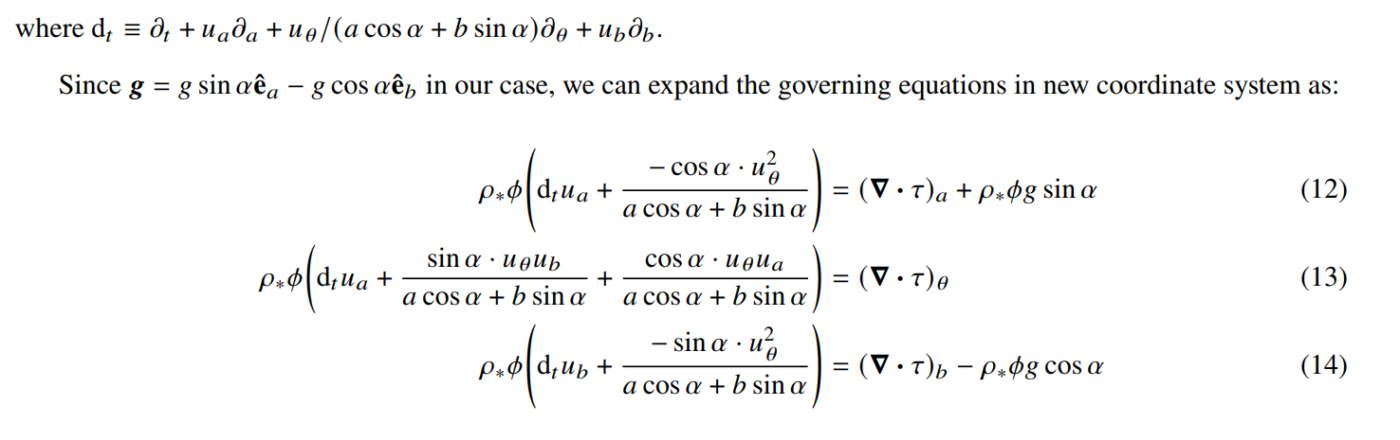
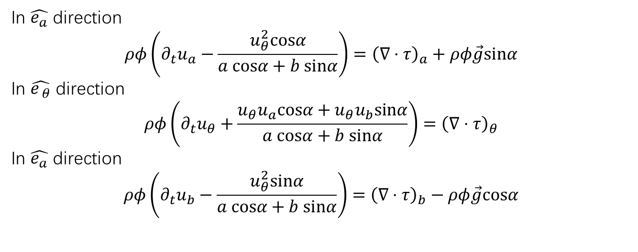
Comparison
In $\hat{e_{a}}$ direction
$$ρφ\left(∂_{t}u_{a}−\frac{u_{θ}^{2}cosα}{a cosα+b sinα}\right)={\left(∇⋅τ\right)}_{a}+ρφ\vec{g}sinα$$
In $\hat{e_{ θ}}$ direction
$$ρφ\left(∂_{t}u_{θ}+\frac{{u_{θ}u}_{a}cosα+{u_{θ}u}_{b}sinα}{a cosα+b sinα}\right)={\left(∇⋅τ\right)}_{θ}$$
In $\hat{e_{a}}$ direction
$$ρφ\left(∂_{t}u_{b}−\frac{u_{θ}^{2}sinα}{a cosα+b sinα}\right)={\left(∇⋅τ\right)}_{b}−ρφ\vec{g}cosα$$

Slide 8
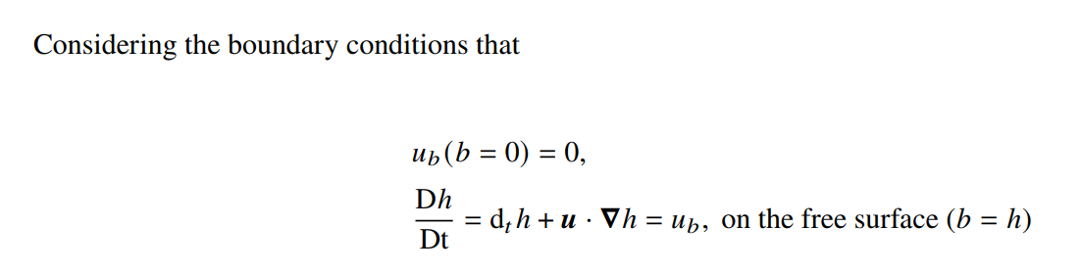
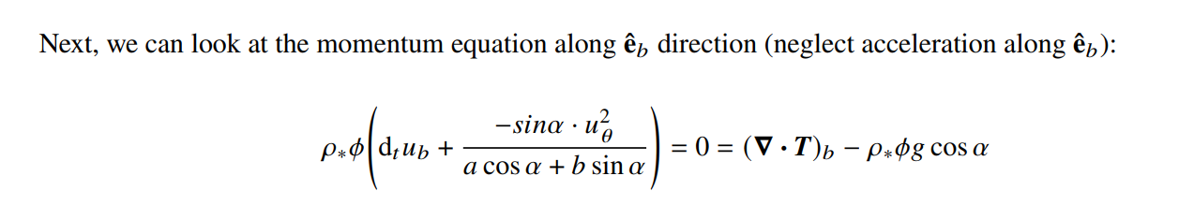
About shallow water equations
All correct, but some confuse me.

