Slide 1
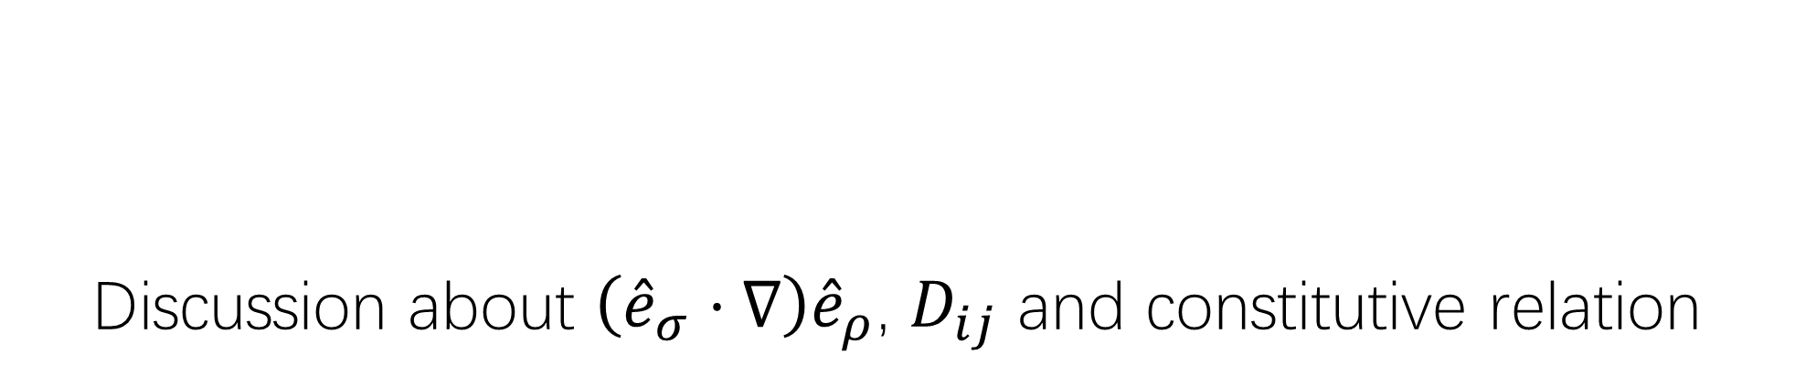
Discussion about $\left({\hat{e}}_{σ}⋅∇\right){\hat{e}}_{ρ}$, $D_{ij}$ and constitutive relation
Haoyu Lu
2023.03.28

Slide 2
Notice
To be lazy, I directly use screenshots of my own articles for some formulas.
If you want to see details about some critical derivations, here are my blog links in ZHIHU.
坐标变换那些事1：引言：简化表达而产生的标注-Lame系数 - 知乎 (zhihu.com)
坐标变换那些事2：由Lame系数导出常见微分运算的通用表达 - 知乎 (zhihu.com)
坐标变换那些事3：基矢与仿射联络 - 知乎 (zhihu.com)
坐标变换那些事4-终章：计算Lame系数格式下的对流项/方向导数 - 知乎 (zhihu.com)

Slide 3
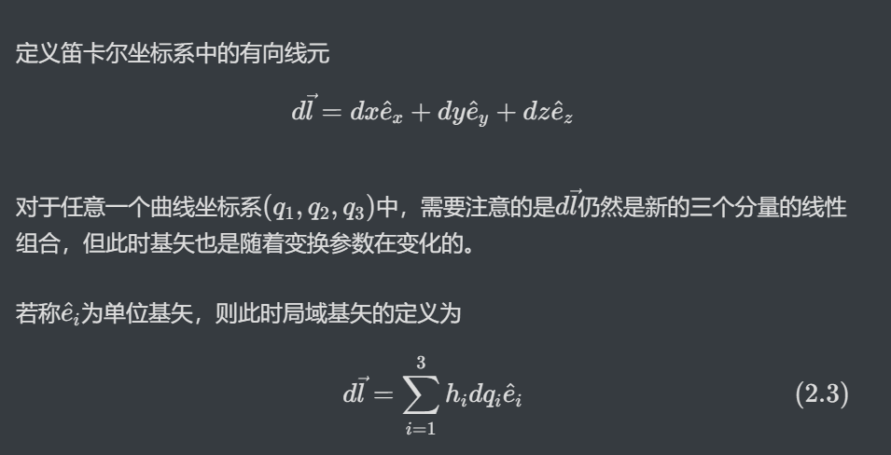
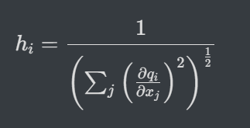
Calculating tools – Lame notation
What is Lame notation?

Slide 4
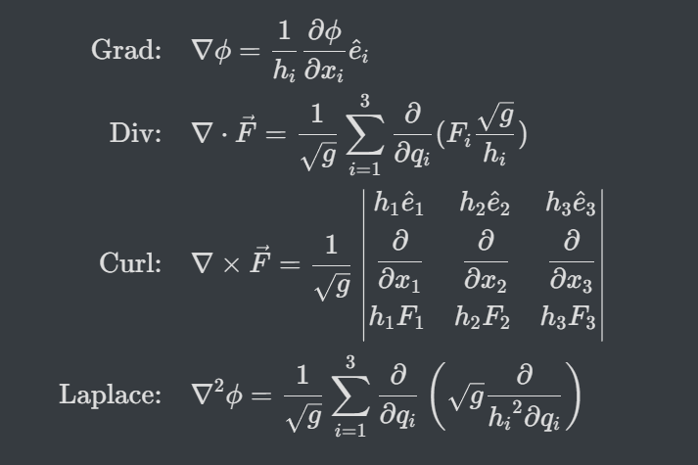



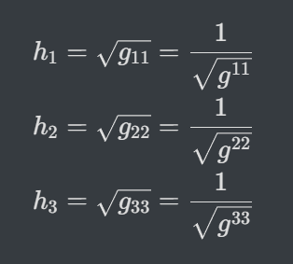



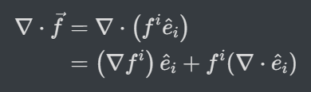
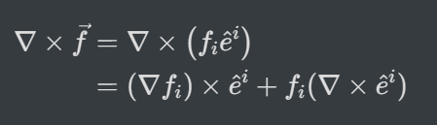
Calculating tools – Lame notation
Basic calculating ‘unit’s
Diagonal tensor expression
Vector expansion in diagonal tensors
Always zero!
or

Slide 5
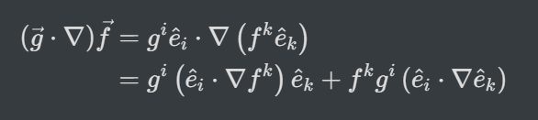
Part1: Directly calculate the convection item
Expand it in in diagonal tensors
Base vectors’ convection item
Simple directional derivative
Calculate base vectors’ convection items first

Slide 6
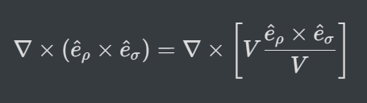
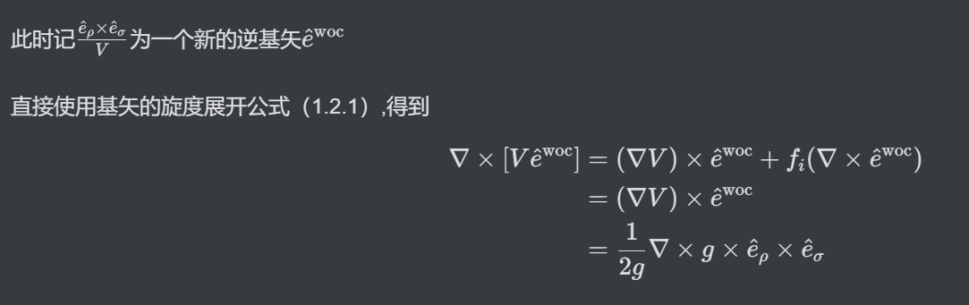
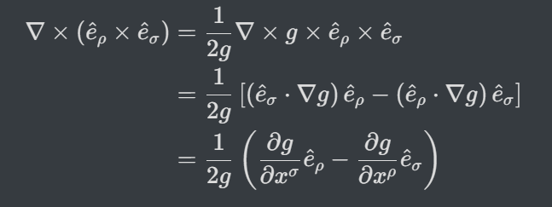
Directly calculate the convection item
In order to create a new inverse base vector, thus we can use the conclusion that ‘its curl is zero’ to simplify this term
Easily get

Slide 7

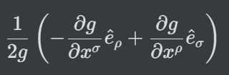

Directly calculate the convection item
From definition

Slide 8




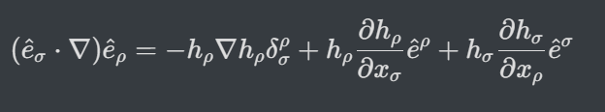
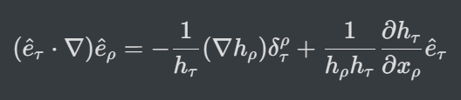
Directly calculate the convection item
We list them all, and can find
Normalize base vectors
Equ. (7)
√

Slide 9
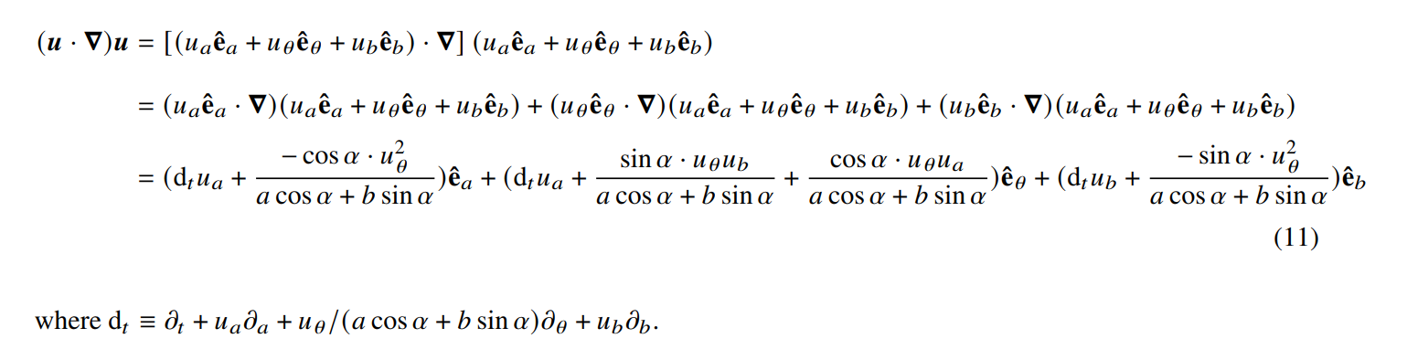
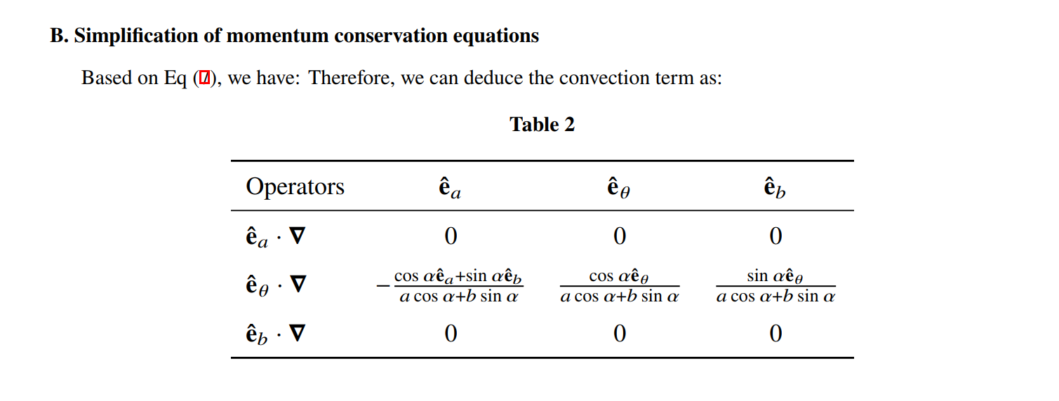
Directly calculate the convection item
Then return to the convection item
+

Slide 10
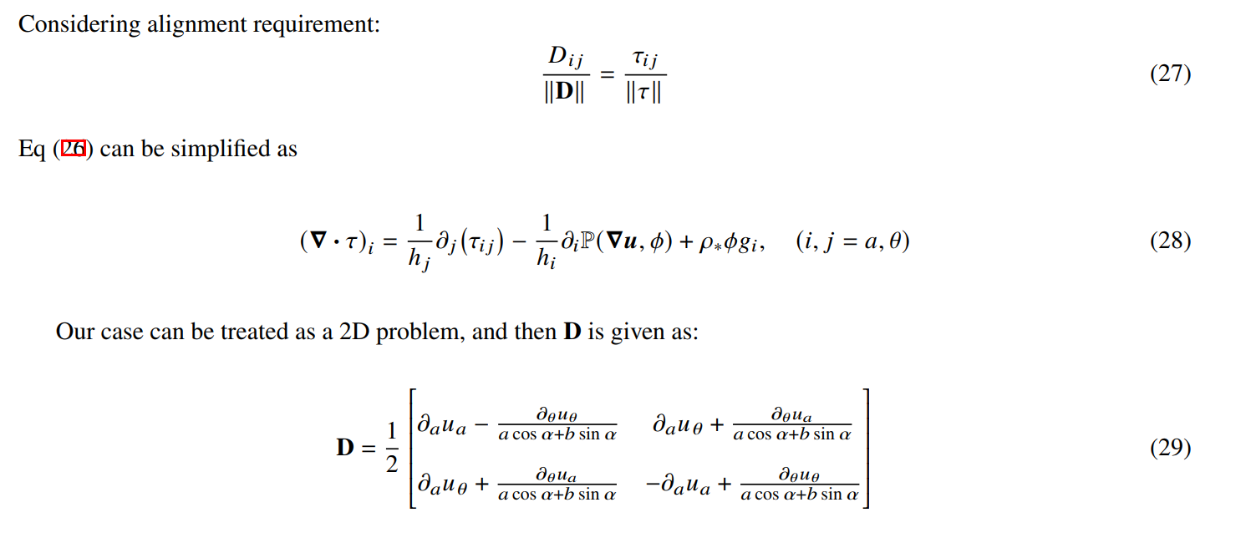

Part2: Problems in $D_{ij}$calculations
√
√
?
Perhaps taking a lot of things for granted !

Slide 11
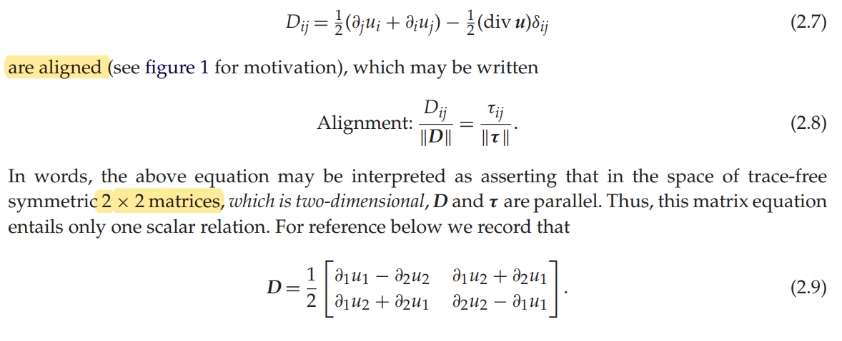


Part2: Problems in $D_{ij}$calculations
Let us see the model from beginning
Deviatoric strain tensor
$$σ_{ij}=−pδ_{ij}+τ_{ij}$$
Strain tensor
$$−\left(div \vec{u}\right)δ_{ij}$$
√
HOWEVER!
http://dx.doi.org/10.1098/rspa.2016.0846

Slide 12
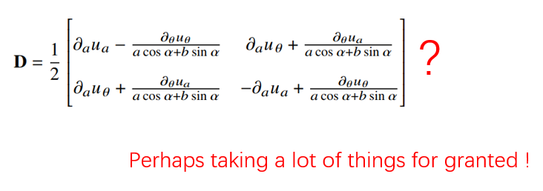

Part2: Problems in $D_{ij}$calculations
HOWEVER!
Here the writer considered this tensor in simple XOY plane
While our case is not a flat plane actually
I have two perspectives to show that this tensor is not reasonable
1. Directly calculating about the mathematical form
Using Lame notation to express
$a,θ,b$ is strongly connected even if we consider the shallow water conditions!
2. Geometry view
Extreme test: Show that if the plane is plat, what will $D_{ij}$ be like (2d)
$D_{ij}$ shall be 3x3 tensor
If we use this coordination

Slide 13
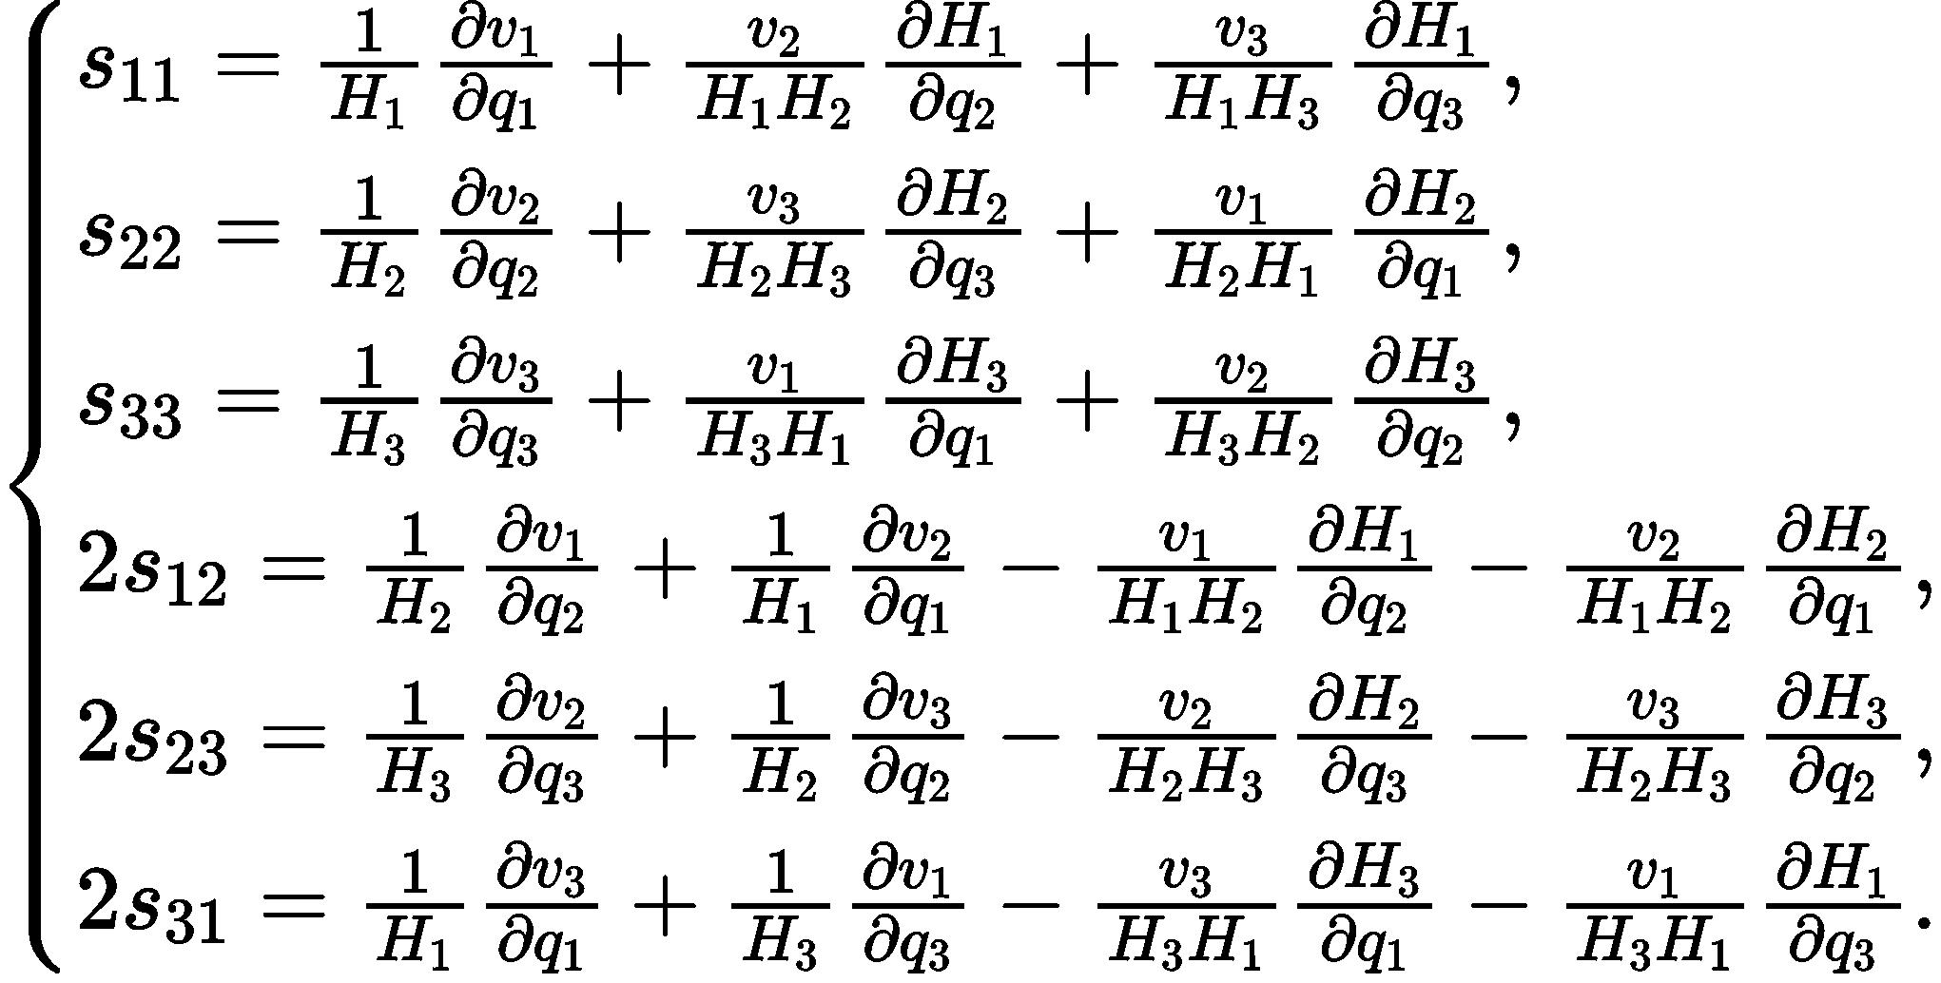
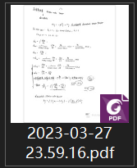

Part2: Problems in $D_{ij}$calculations
$D_{ij}$ shall be 3x3 tensor
If we use this coordination
1. Directly calculating about the mathematical form
Using Lame notation to express
$a,θ,b$ is strongly connected even if we consider the shallow water conditions!
Approx. conditions?

Slide 14
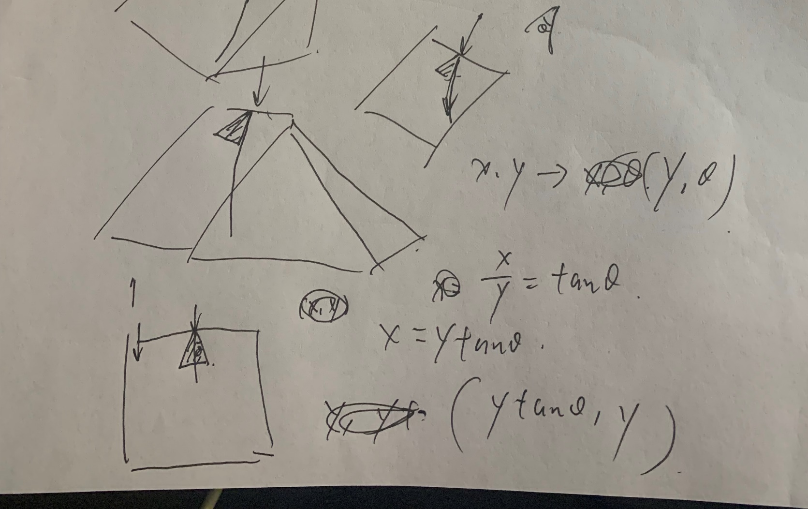
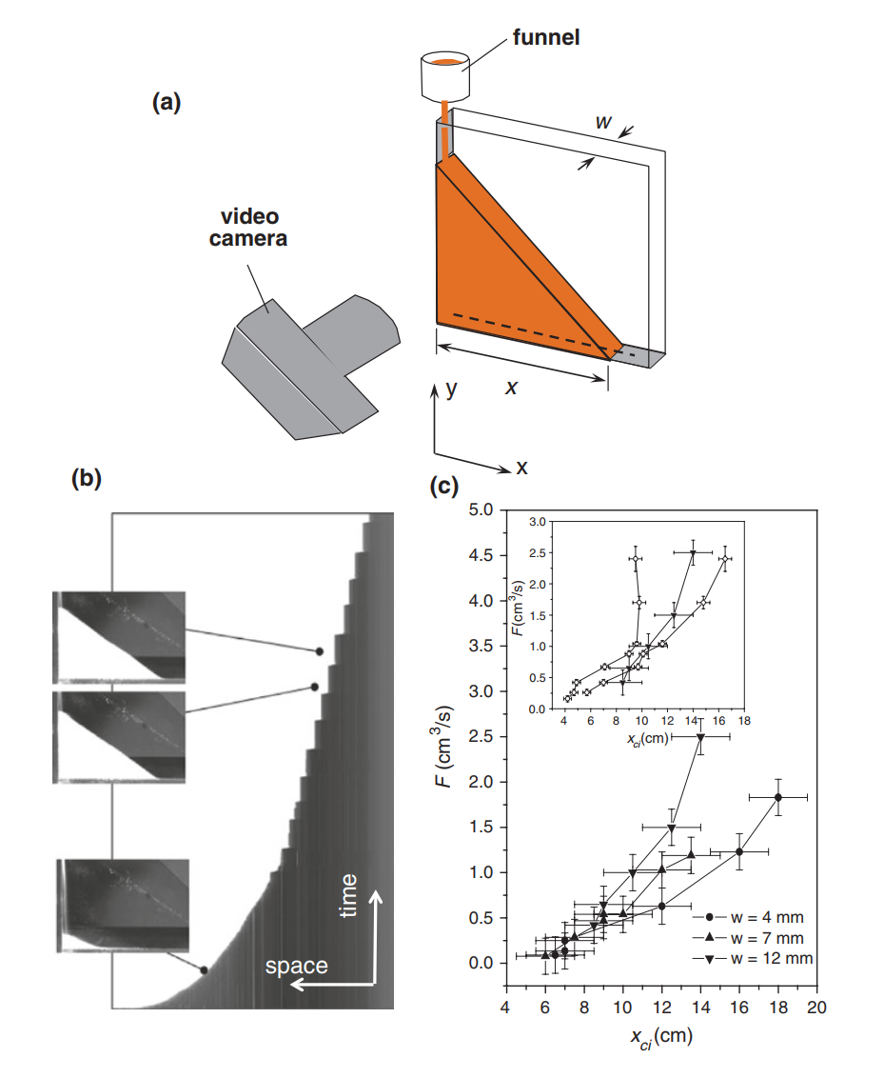

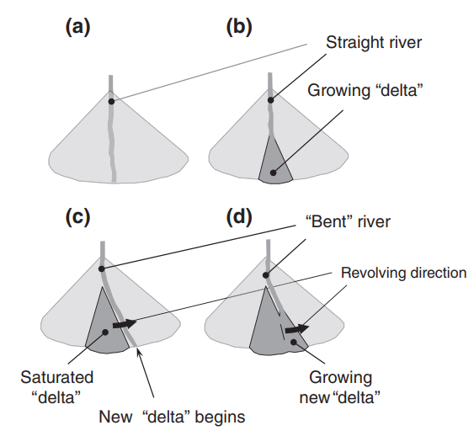
Part2: Problems in $D_{ij}$calculations
2. Geometry view
Extreme test: Show that if the plane is plat, what will $D_{ij}$ be like (2d)
DOI: 10.1007/978-3-319-51624-0 CHAPTER 3

Slide 15
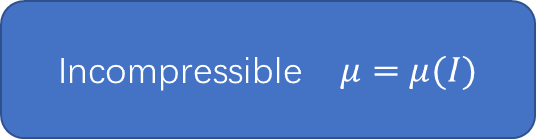


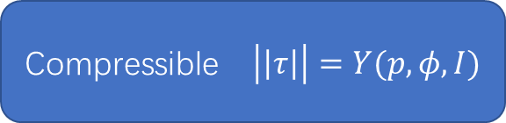
Part3: constitutive relation
I think the model can be used in this case
But still some confusions when be applied in calculating
Incompressible $μ=Const$
Incompressible $μ=μ(I)$
Compressible $\left|\left|τ\right|\right|=Y(p,φ,I)$
While we use $div \vec{u}=0$ incompressible condition in calculation

Slide 16
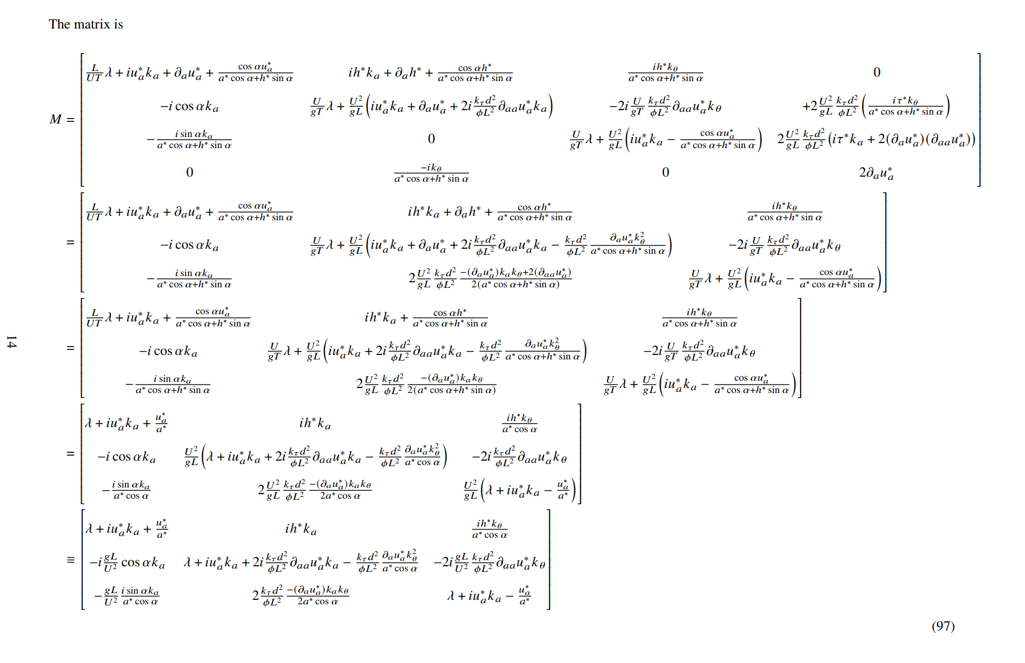
What is Result means?
IS relationship

Slide 17
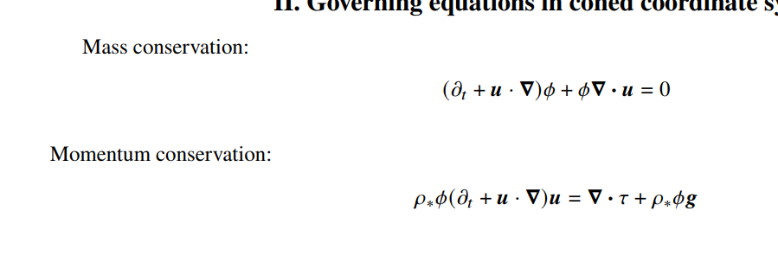

1. 确认推导
2. $∇⋅\vec{u}=0$ + 小量近似 → 半解析 →周五
浅水方程，u_theta,ua=0?主值条件

