Slide 1
扰动流 理论推导与讨论
Haoyu Lu
2023.9.27

Slide 2
Outline
1. 上次报告回顾与补充：稳定流模型的验证
2. 扰动方程的建立与推导
3. 如何引入扰动量以及扰动量的形式
4. 特征矩阵计算遇到的困惑
5. 如何验证结果的准确性

Slide 3
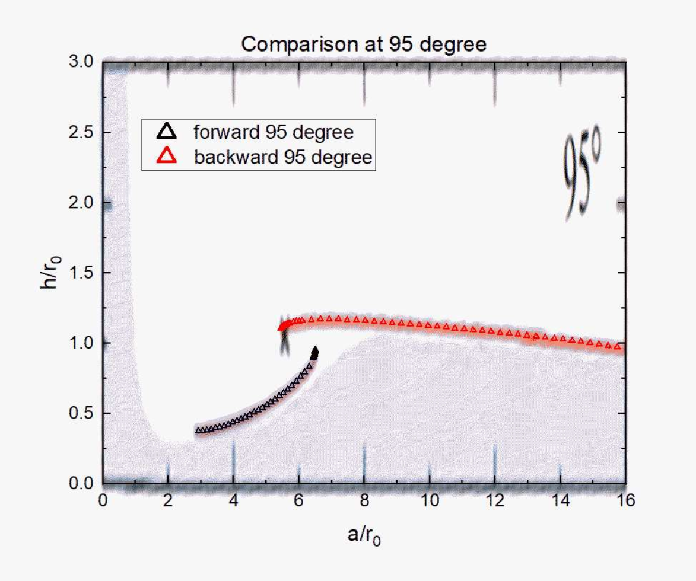
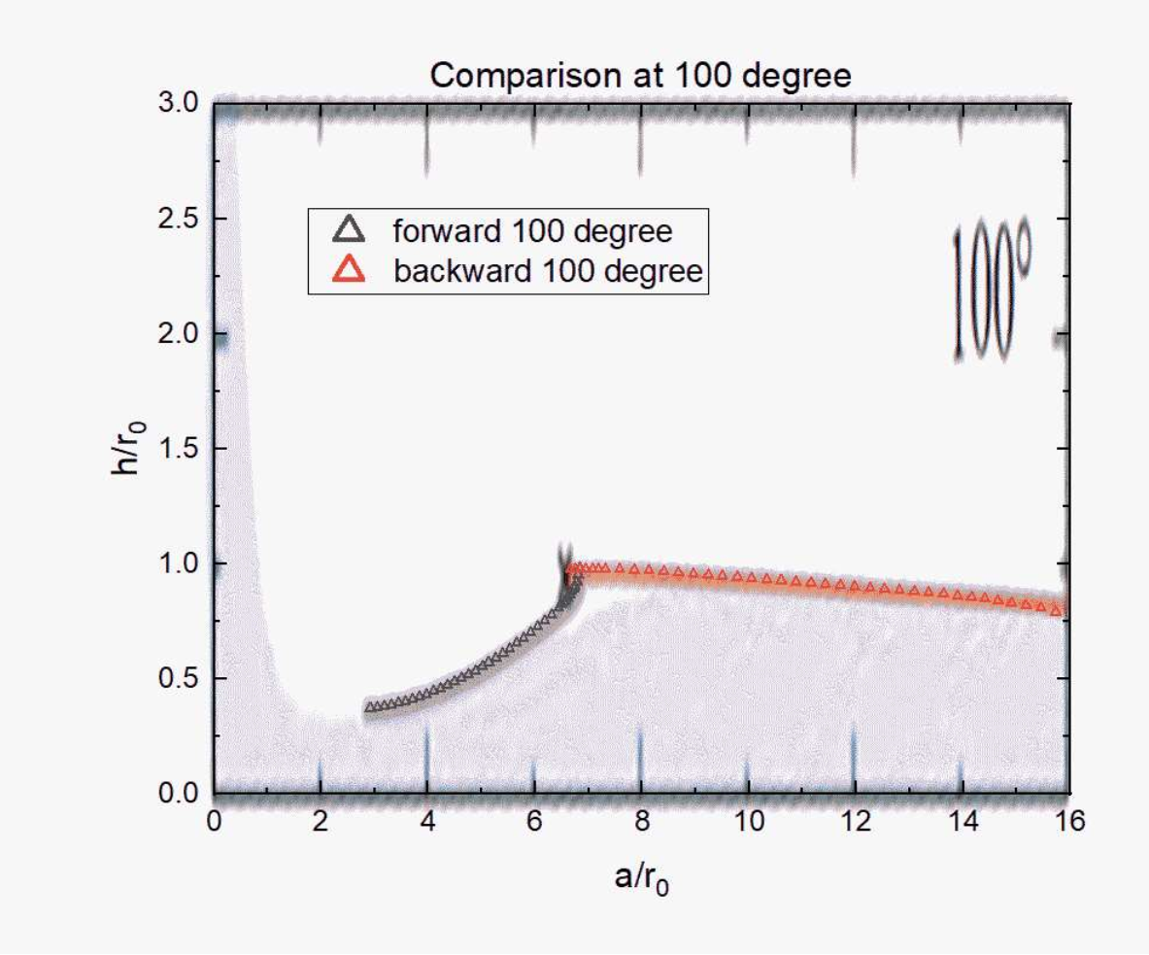
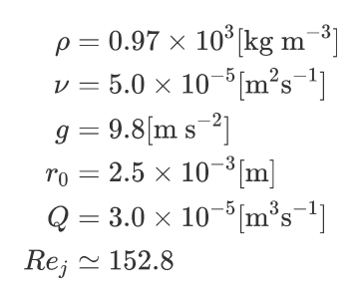
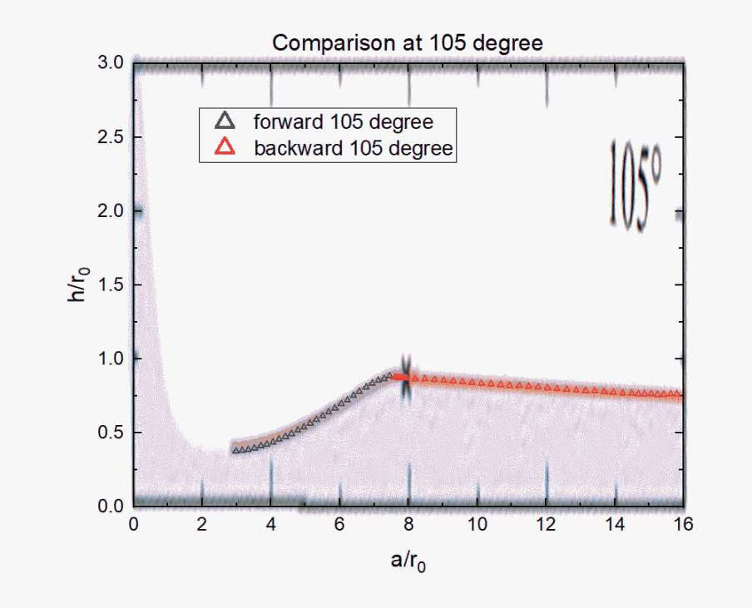
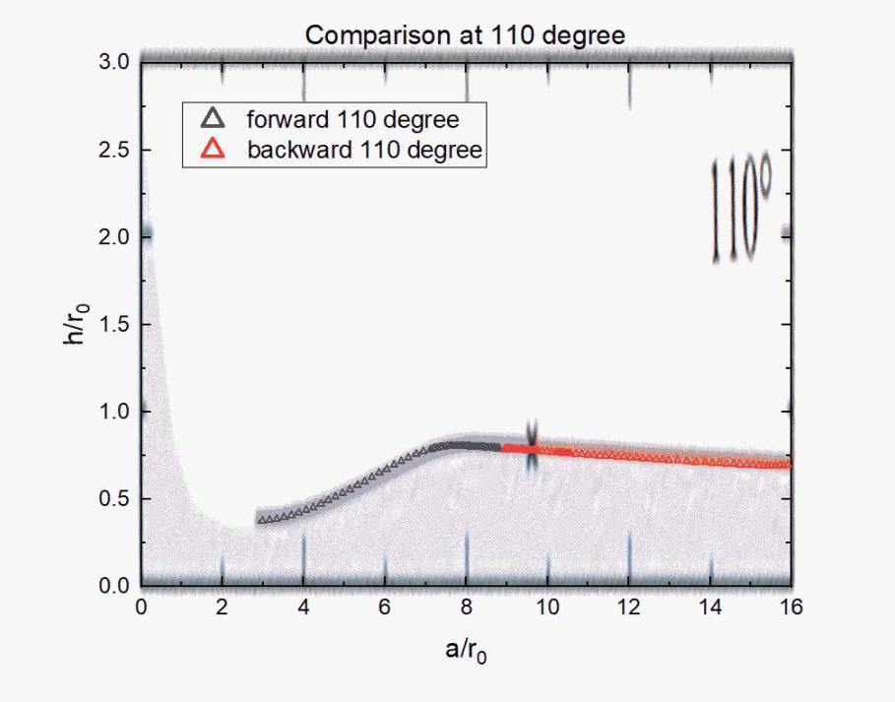
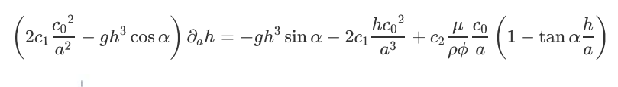

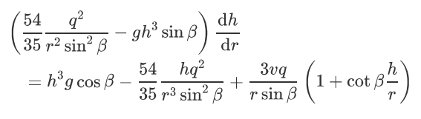

1. 稳定流模型的验证
Calculation conditions :
Ref. [1] from Guangzhao Zhou
Our $h=h\left(a\right)$ function form:

Slide 4


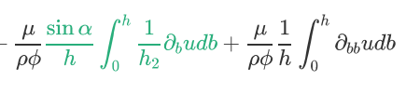
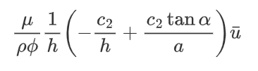
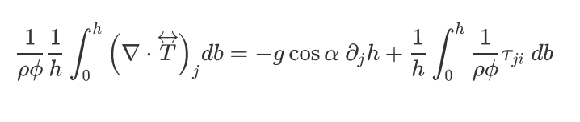
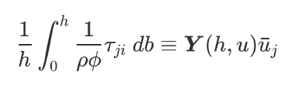


2. 扰动方程的建立与推导 – 引入记号
Still use the integration function in order to get relations among the depth-averaged quantities
For the convenient of our calculation, we introduce some notations:
Marked as $s$ means steady state results
For the stress term in the integration function, recall what we have done in the stable case
Integrate it along $b$ direction
Use parabolic velocity profile assumption
Thus here in order to express other kinds of velocity profile or constitutive relation,
we introduce a notation $Y=Y(h,\overline{u})$

Slide 5
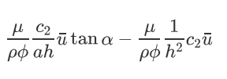
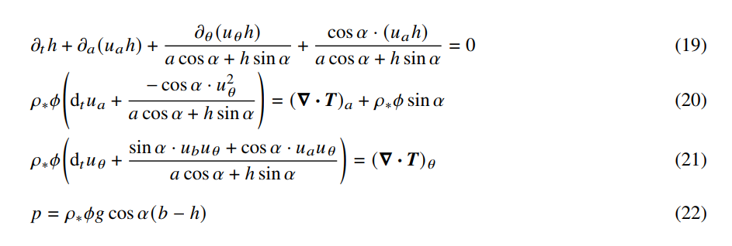
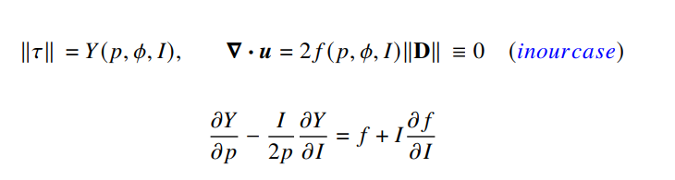



2. 扰动方程的建立与推导 –与之前的推导比较
Our work:
Integrate it along $b$ direction
Use parabolic velocity profile assumption
We introduce a notation $Y=Y(h,\overline{u})$
Shijie’s work:
Without integration but use the depth-averaged quantities to analysis
Similar but not the same
in his work $p∝h$, $I∝∇u$

Slide 6
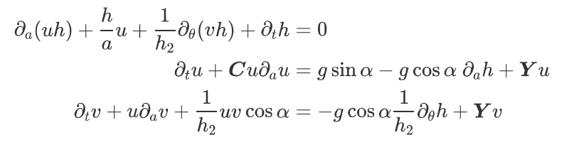

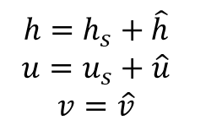
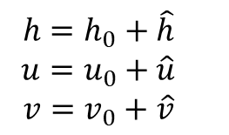
2. 扰动方程的建立与推导 – 更新后的积分方程
Shijie’s work:
Our work (after integration):
Now we can introduce the perturbation:
apply them to
Use notations
$$h=h_{s}+\hat{h}$$
$$u=u_{s}+\hat{u}$$
$$v=\hat{v}$$
$$h=h_{0}+\hat{h}$$
$$u=u_{0}+\hat{u}$$
$$v=v_{0}+\hat{v}$$
Build the perturbation on the basis of the steady flow results

Slide 7
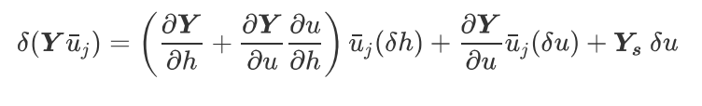



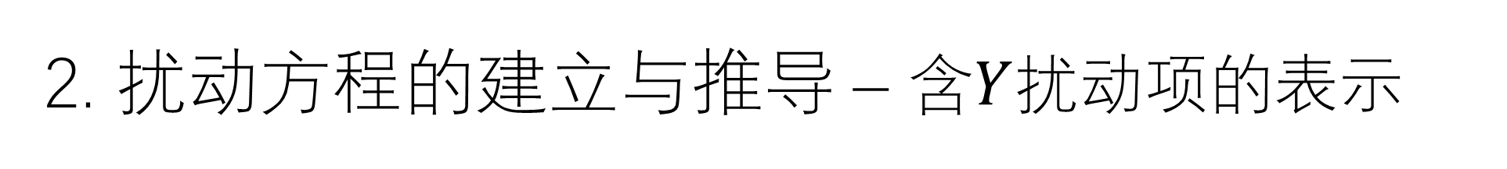
2. 扰动方程的建立与推导 – 含$Y$扰动项的表示
Our work:
Integrate it along $b$ direction
Use parabolic velocity profile assumption
We introduce a notation $Y=Y(h,\overline{u})$
Consider its perturbation form:
Because $u$ is a function of $h$, thus this term appears
Denote as $Q$
Denote as $P$

Slide 8
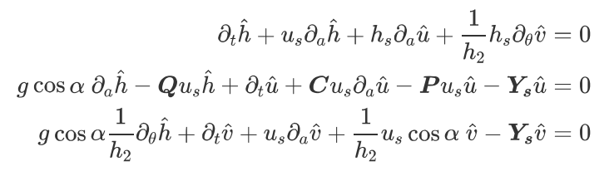
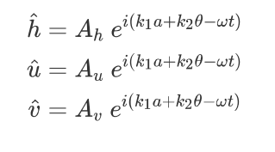

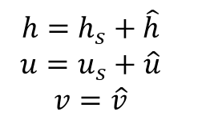
2. 扰动方程的建立与推导 – 扰动方程
$$h=h_{s}+\hat{h}$$
$$u=u_{s}+\hat{u}$$
$$v=\hat{v}$$
We assume that the perturbation happens in both $a$ and $θ$ directions

Slide 9
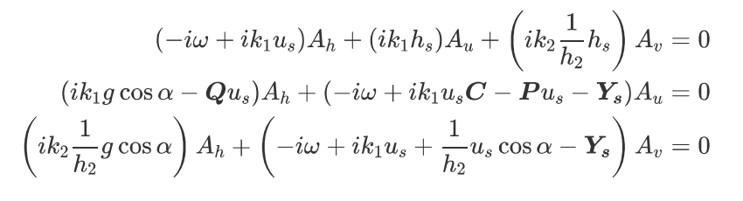
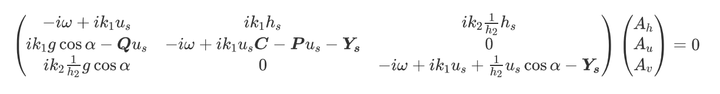



2. 扰动方程的建立与推导 – 扰动方程
Matrix form is:
Denote as:
Our goal is:
And find the relation $Im\left[ω\right]\sim (k_{1},k_{2})$

Slide 10
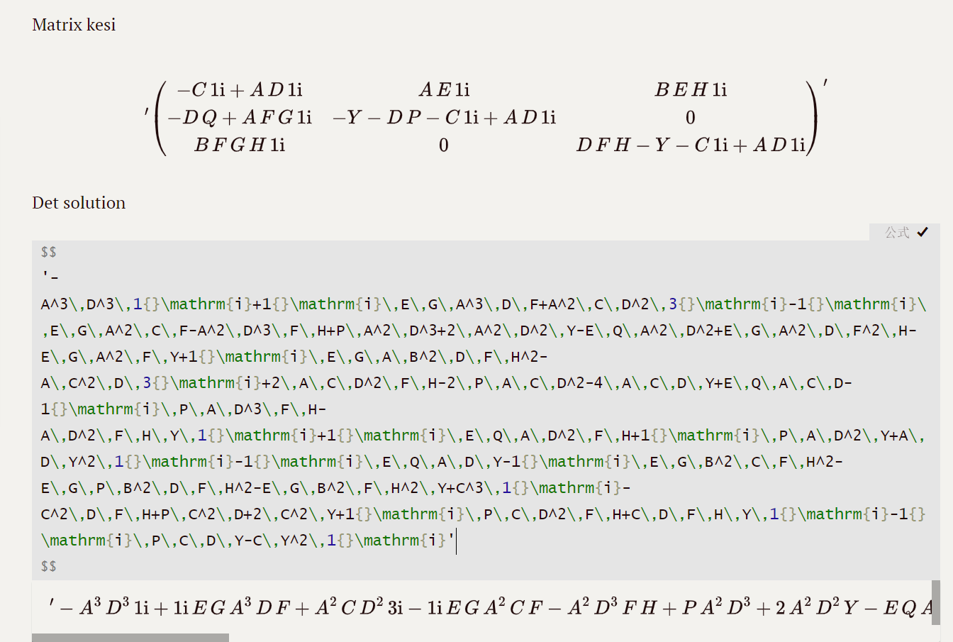
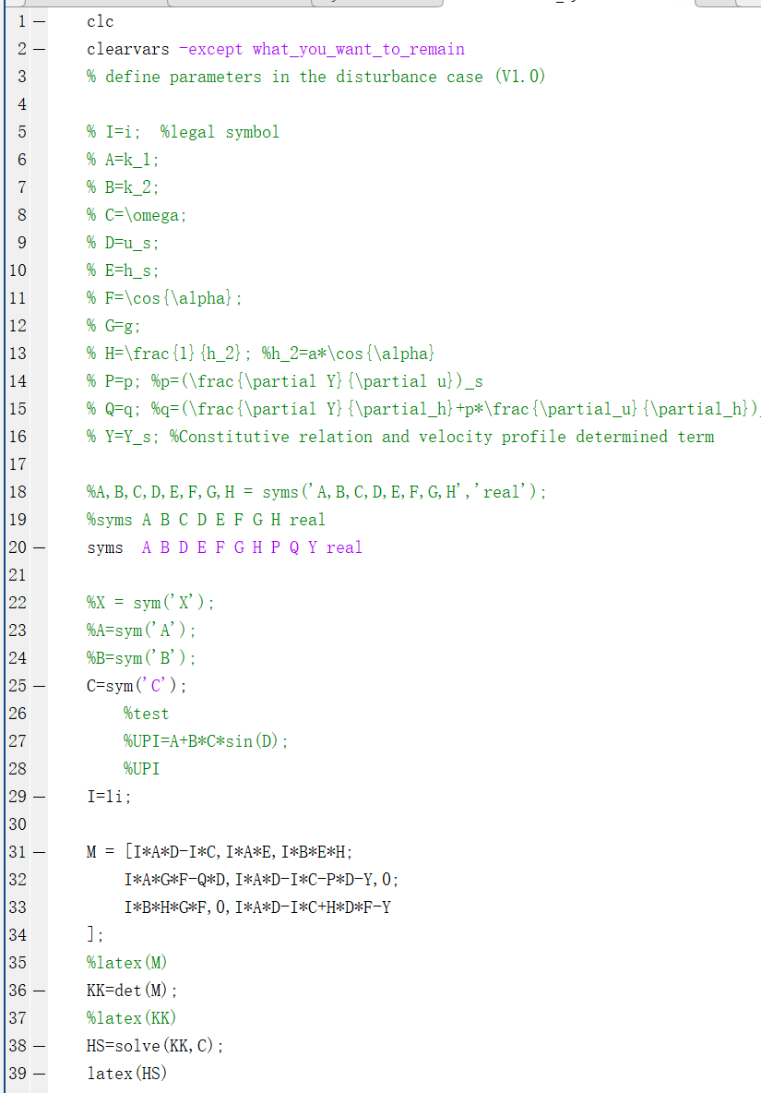
3. 特征矩阵计算遇到的困惑– 过于复杂
Matrix form is:
Our goal is:
I try to use symcal in MATLAB to get analytical solutions, but

Slide 11
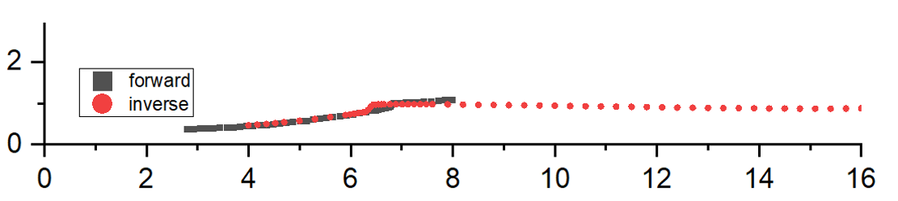





3. 特征矩阵计算遇到的困惑– 数值解可行吗？
Matrix form is:
Our goal is:
If I use the numerical calculation, so many quantities need to be determined
Unknowns: (What we need to determine before doing numerical calculation)
Fluid properties (velocity profile)
How to choose the region range
How to choose Apex Angle and initial Q-flux
Which velocity profile we choose
$$Y=Y(h,u)$$
$$C,P,Q,Y_{S}$$
$$u_{s}=u_{s}\left(a\right)$$
$$h_{s}=h_{s}\left(a\right)$$
$$\frac{1}{h_{2}}=a cos(α)$$
How to choose $a$
$cos\left(α\right)$ and $C_{0}=q$

Slide 12

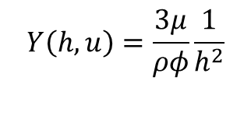
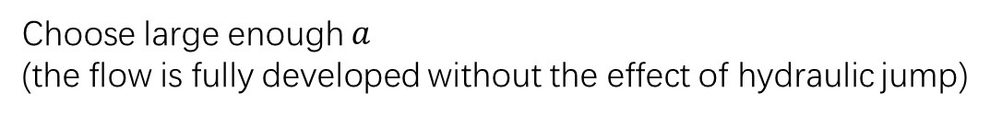


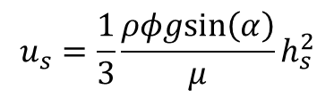

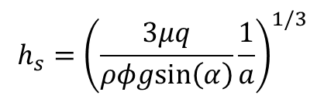


3. 特征矩阵计算遇到的困惑– 数值解可行吗？
Now I choose:
$$Y_{s}=\frac{3μ}{ρφ}\frac{1}{h_{s}^{2}}$$
$$Y\left(h,u\right)=\frac{3μ}{ρφ}\frac{1}{h^{2}}$$
Parabolic velocity profile
$$P=0$$
$$Q=−\frac{6μ}{ρφ}\frac{1}{h_{s}^{3}}$$
Choose large enough $a$
(the flow is fully developed without the effect of hydraulic jump)
$$a=30r_{0}$$
$$cos\left(α\right)={\left(\frac{3}{4}\right)}^{1/2}$$
Apex Angle $α=\frac{π}{6}$
$$h_{s}={\left(\frac{3μq}{ρφgsin\left(α\right)}\frac{1}{a}\right)}^{1/3}$$
$$u_{s}=\frac{1}{3}\frac{ρφgsin\left(α\right)}{μ}h_{s}^{2}$$

Slide 13
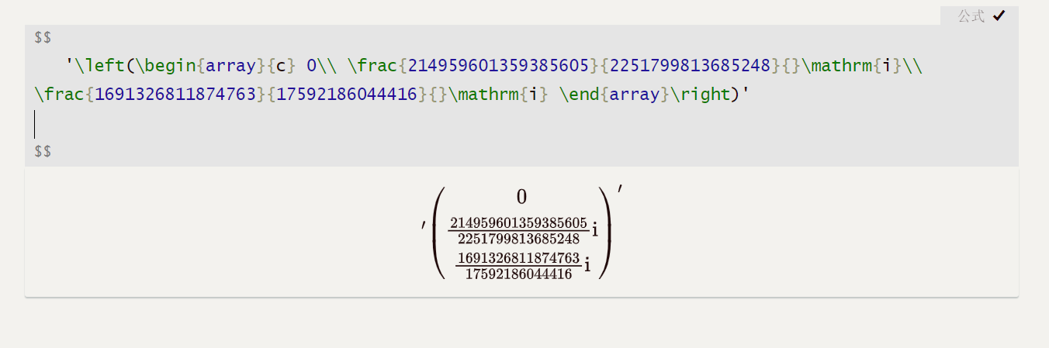
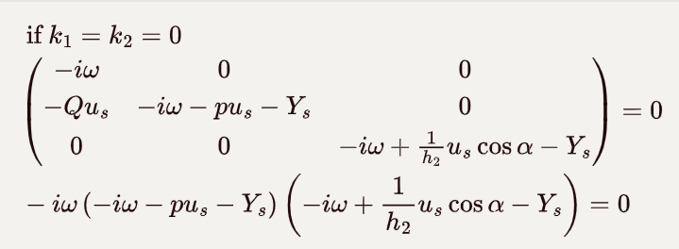

5. 如何验证结果的准确性
目前我的看法：
$Im[ω]>0$when $k>0$ (while here we several solutions?)

Slide 14
Reference
[1] Guangzhao Zhou, Andrea Prosperetti, Hydraulic jump on the surface of a cone, J. Fluid Mech. (2022), vol. 951, A20, doi:10.1017/jfm.2022.777
[2] Julia Zayko, Stability of downslope flows to two-dimensional Perturbations, Physics of Fluids 31, 086601 (2019), https://doi.org/10.1063/1.5109314
[3] David G. Schaefer, Instability in the evolution equations describing incompressible granular flow, Journal of differential equations 66, 19-50 (1987)
[4] Xiannan Meng, Formation of dry granular fronts and watery tails in debris flows, J. Fluid Mech. (2022), vol. 943, A19, doi:10.1017/jfm.2022.400

Slide 15
Thank you for listening

