Slide 1
扰动流 初步计算结果与讨论
Haoyu Lu
2023.10.19

Slide 2
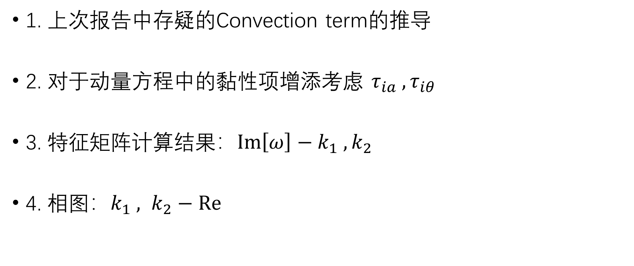
Outline
1. 上次报告中存疑的Convection term的推导
2. 对于动量方程中的黏性项增添考虑 $τ_{ia} , τ_{iθ}$
3. 特征矩阵计算结果：$Im\left[ω\right]−k_{1} , k_{2}$
4. 相图：$k_{1} , k_{2}−Re$

Slide 3
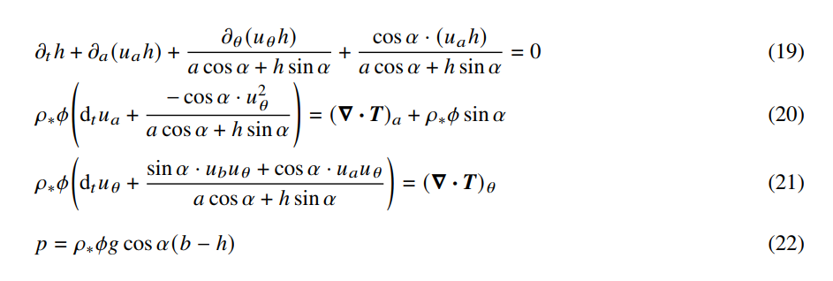
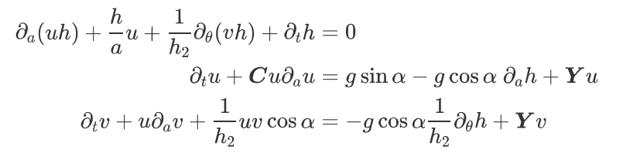


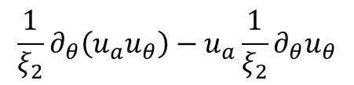

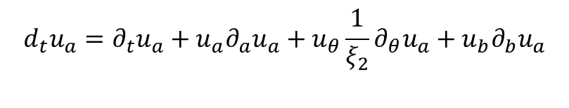
Convection term
Shijie’s work:
Our work (after integration):
$$d_{t}u_{a}=∂_{t}u_{a}+u_{a}∂_{a}u_{a}+u_{θ}\frac{1}{ξ_{2}}∂_{θ}u_{a}+u_{b}∂_{b}u_{a}$$
$$∂_{a}\left(u_{a}u_{a}\right)−u_{a}∂_{a}u_{a}$$
$$\frac{1}{ξ_{2}}∂_{θ}\left(u_{a}u_{θ}\right)−u_{a}\frac{1}{ξ_{2}}∂_{θ}u_{θ}$$
$$∂_{b}\left(u_{a}u_{b}\right)−u_{a}∂_{b}u_{b}$$

Slide 4
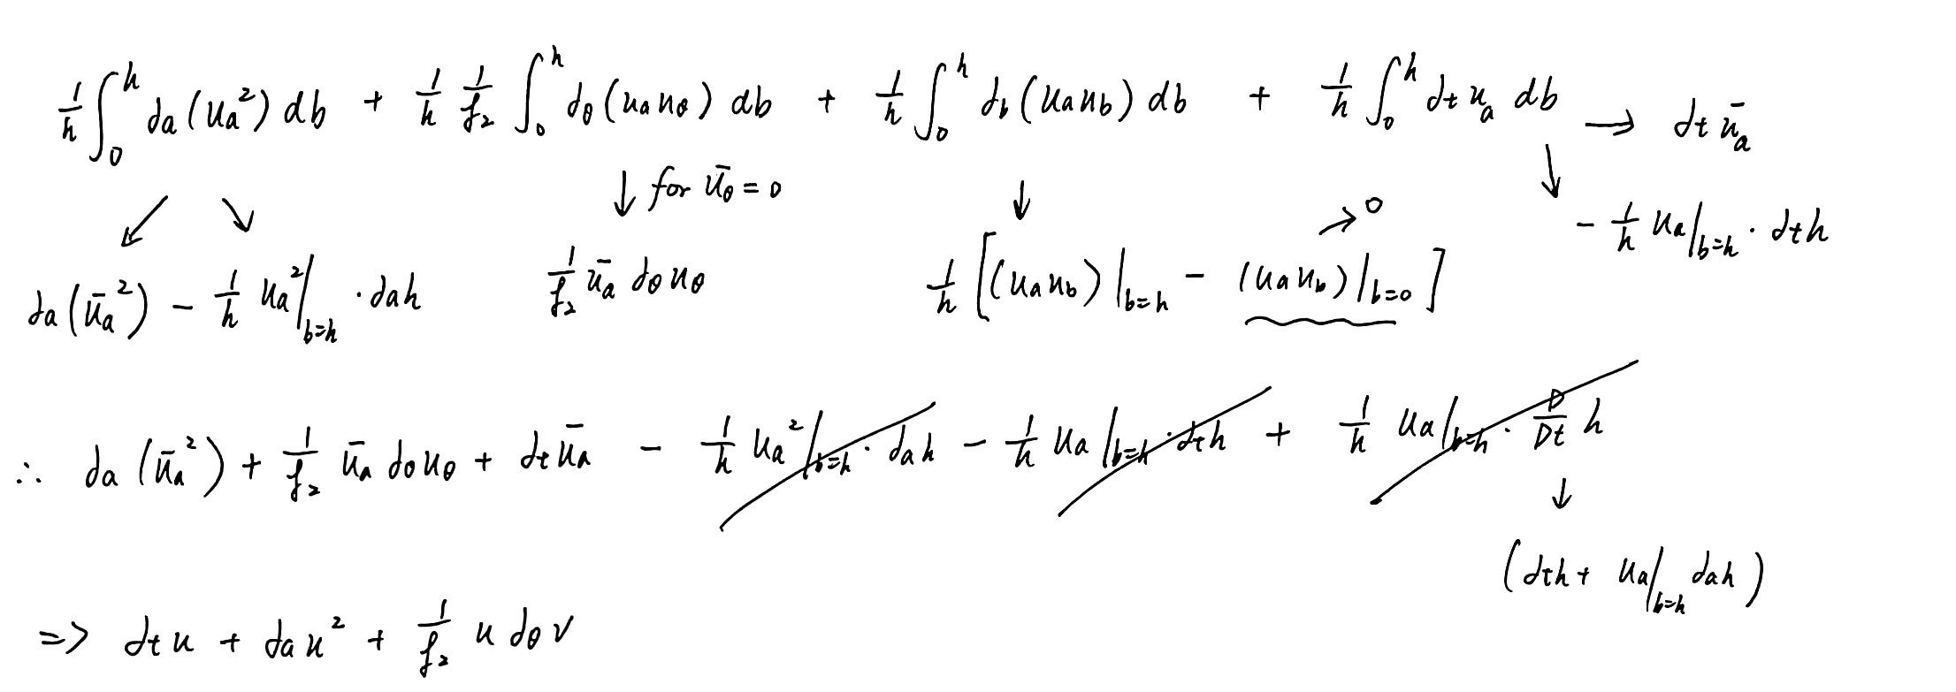
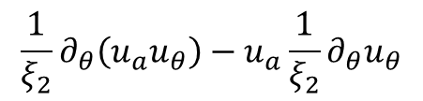

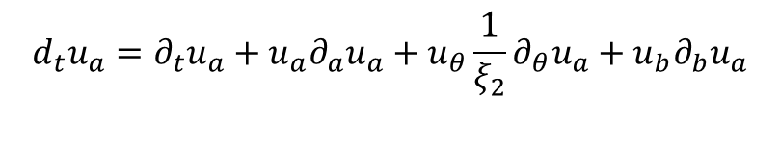


Convection term
$$d_{t}u_{a}=∂_{t}u_{a}+u_{a}∂_{a}u_{a}+u_{θ}\frac{1}{ξ_{2}}∂_{θ}u_{a}+u_{b}∂_{b}u_{a}$$
$$∂_{a}\left(u_{a}u_{a}\right)−u_{a}∂_{a}u_{a}$$
$$\frac{1}{ξ_{2}}∂_{θ}\left(u_{a}u_{θ}\right)−u_{a}\frac{1}{ξ_{2}}∂_{θ}u_{θ}$$
$$∂_{b}\left(u_{a}u_{b}\right)−u_{a}∂_{b}u_{b}$$
Integration along $\hat{b}$
Recall the continuity

Slide 5
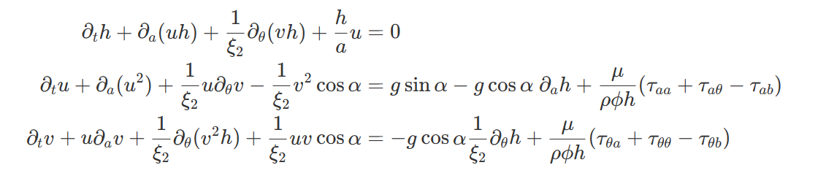
Convection term and stress term
Shijie’s work:
(Last time) Our work (after integration):
(Now after integration):

Slide 6
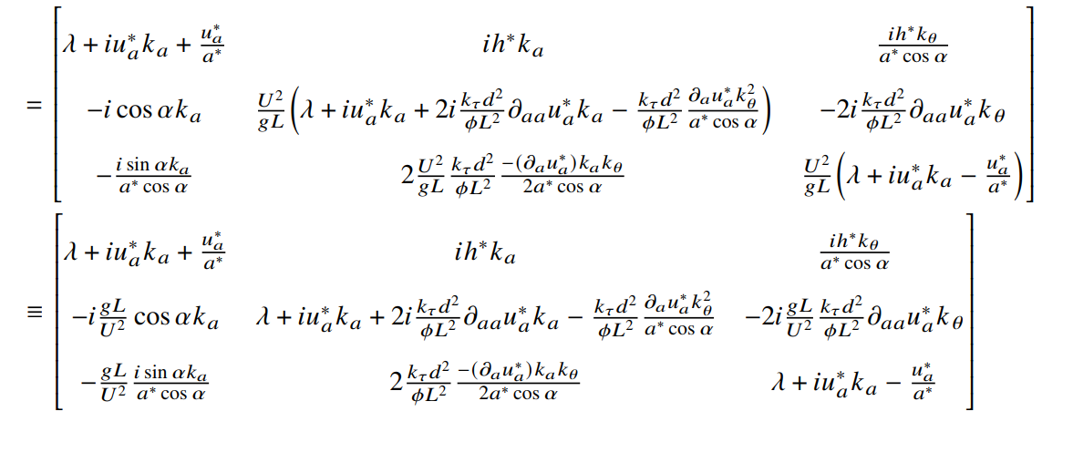
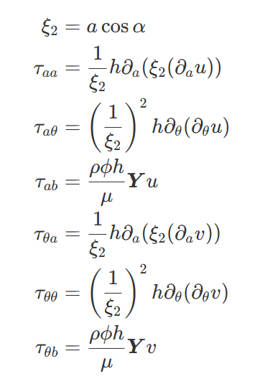
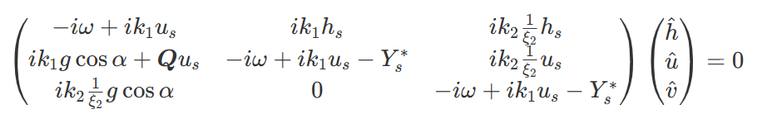
Stress term
(Now after integration):
When $k_{1}$ , $k_{2}$ is quite large, these terms becomes large after perturbation

Slide 7
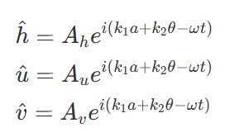
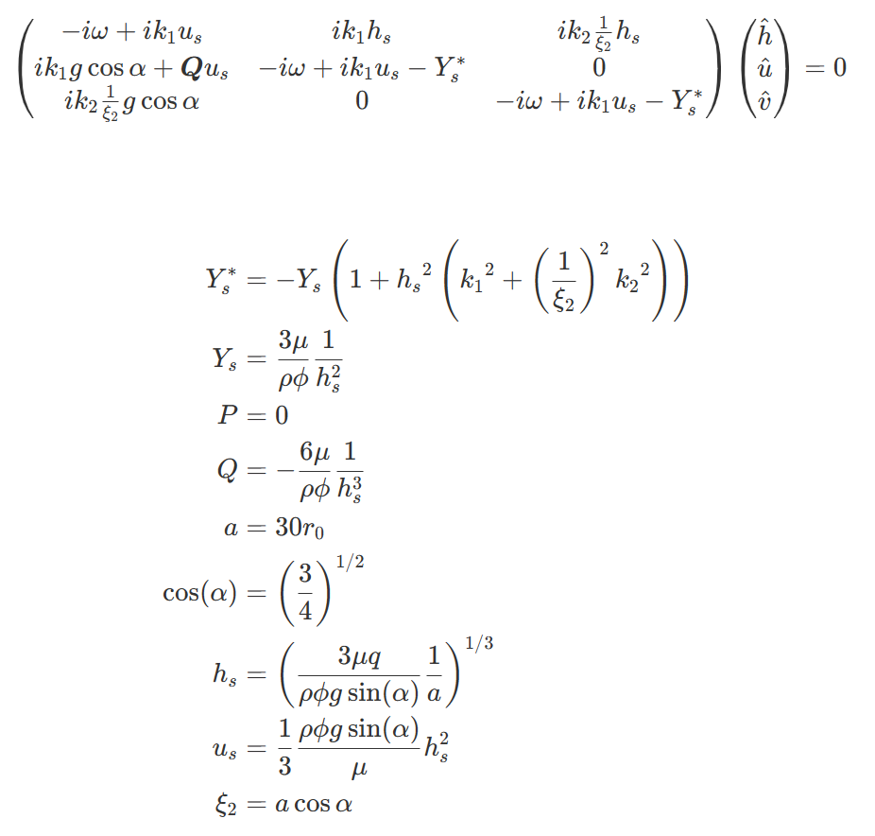
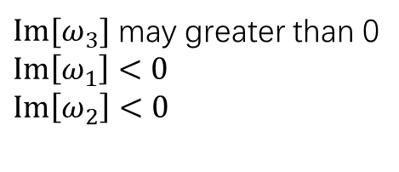


Matrix
$$\det\left(Ξ\right)=0$$
$$ω=(ω_{1},ω_{2},ω_{3})$$
$Im[ω_{3}]$ may greater than 0
$Im\left[ω_{1}\right]<0$
$Im\left[ω_{2}\right]<0$

Slide 8
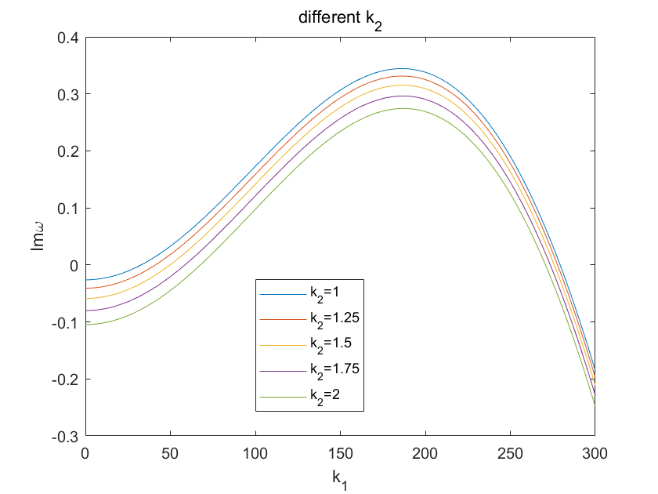
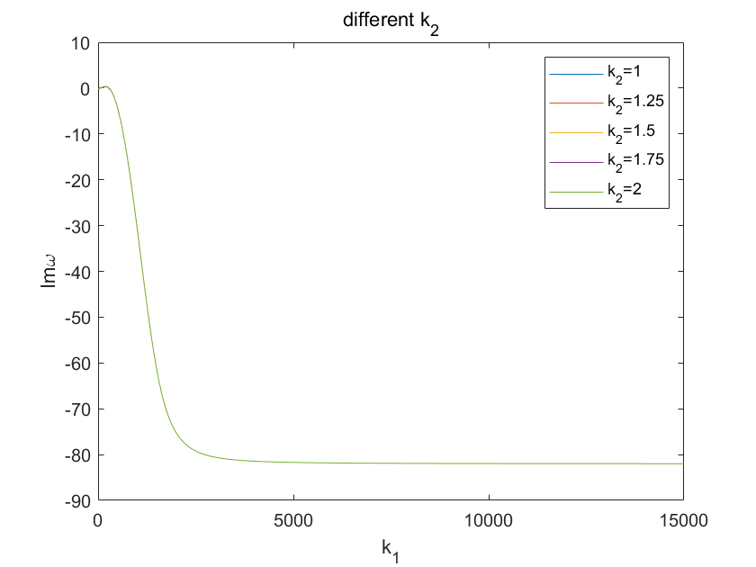
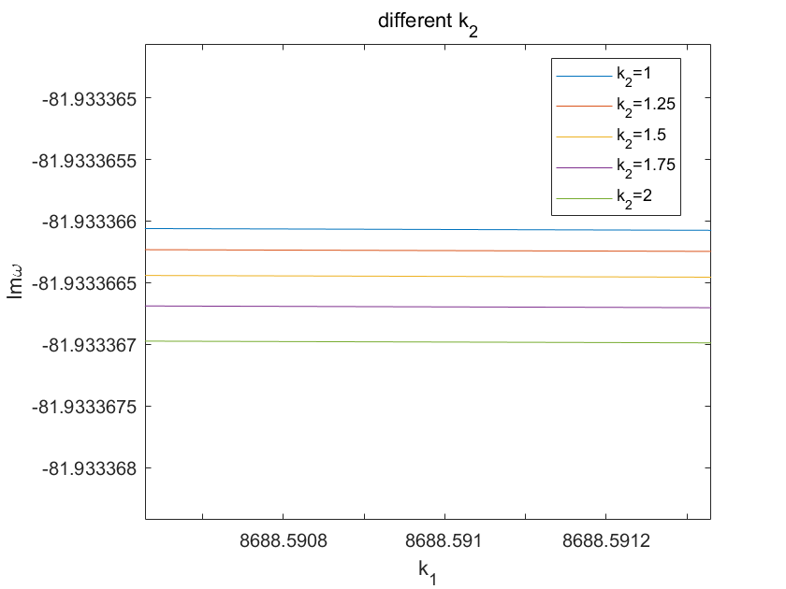

Results : $Im\left[ω\right]−k_{1} , k_{2}$

Slide 9
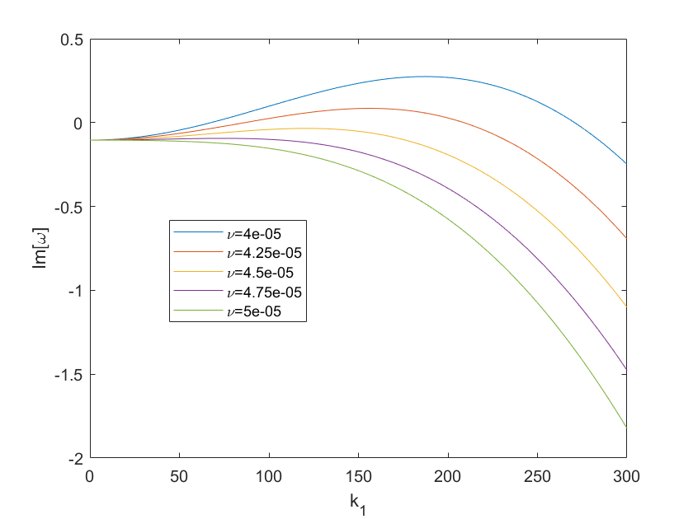
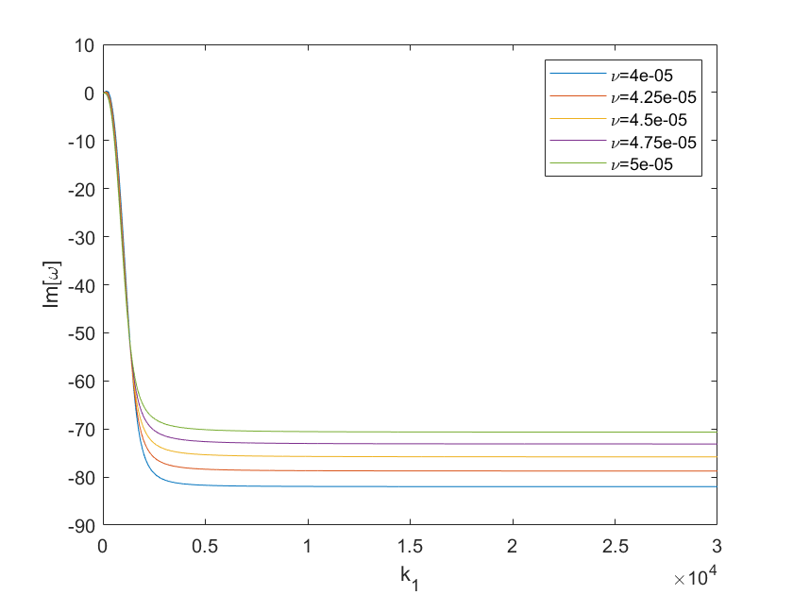
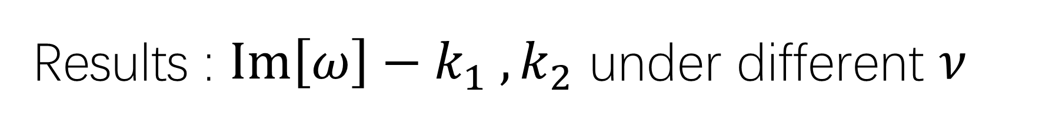
Results : $Im\left[ω\right]−k_{1} , k_{2}$ under different $ν$

Slide 10
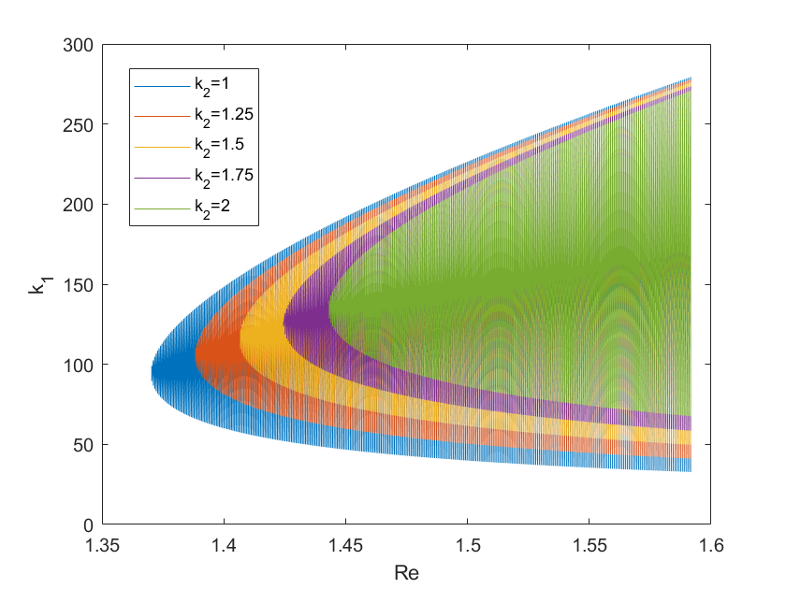

Phase diagram : $k_{1} , k_{2}−Re$
Unstable region

Slide 11
What about solid?
Constitutive model

Slide 12
备忘
1. 无量纲化（两个无量纲数Re和G的相图绘制）
2. 验证，与文献比较

Slide 13
Appendix

Slide 14
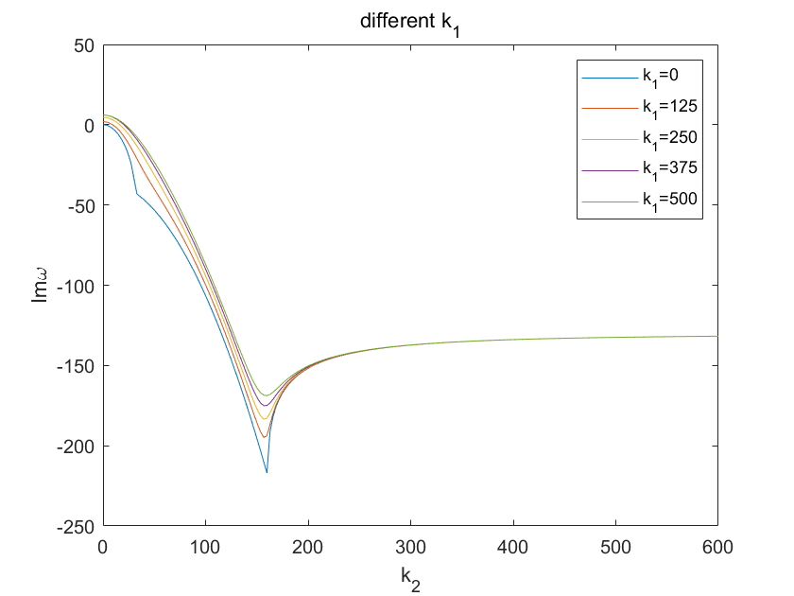
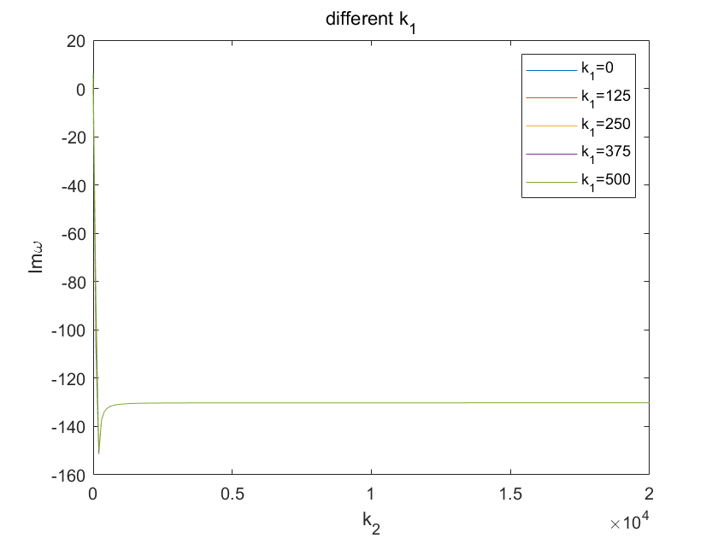
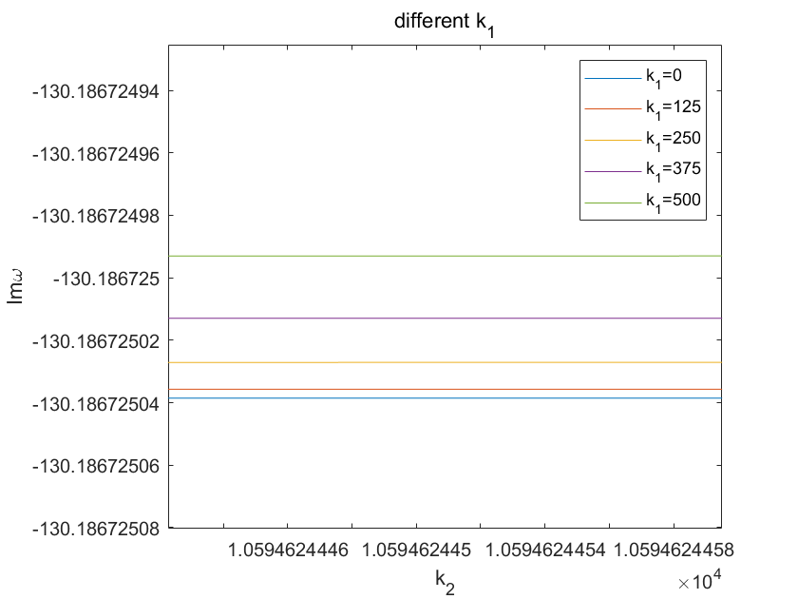

Slide 15
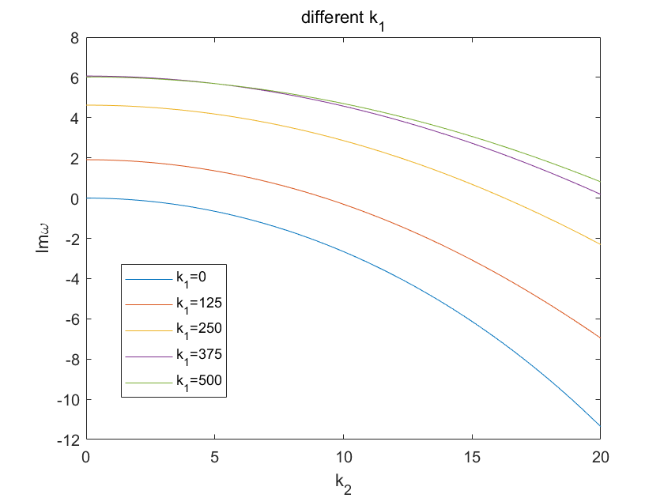
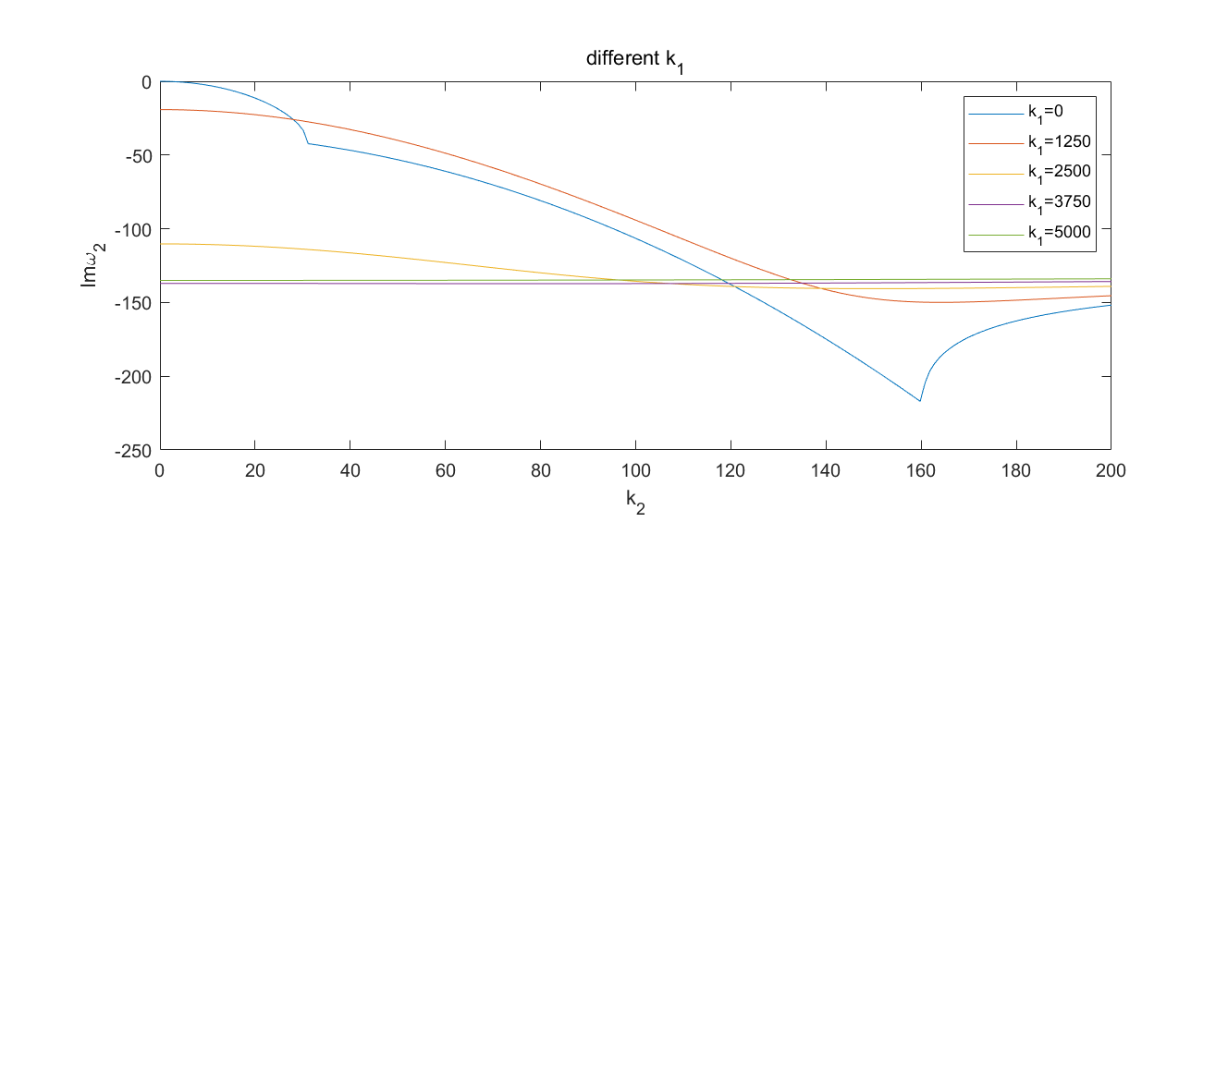

Slide 16
