Slide 1
扰动流 相图计算讨论
Haoyu Lu
2023.10.31

Slide 2
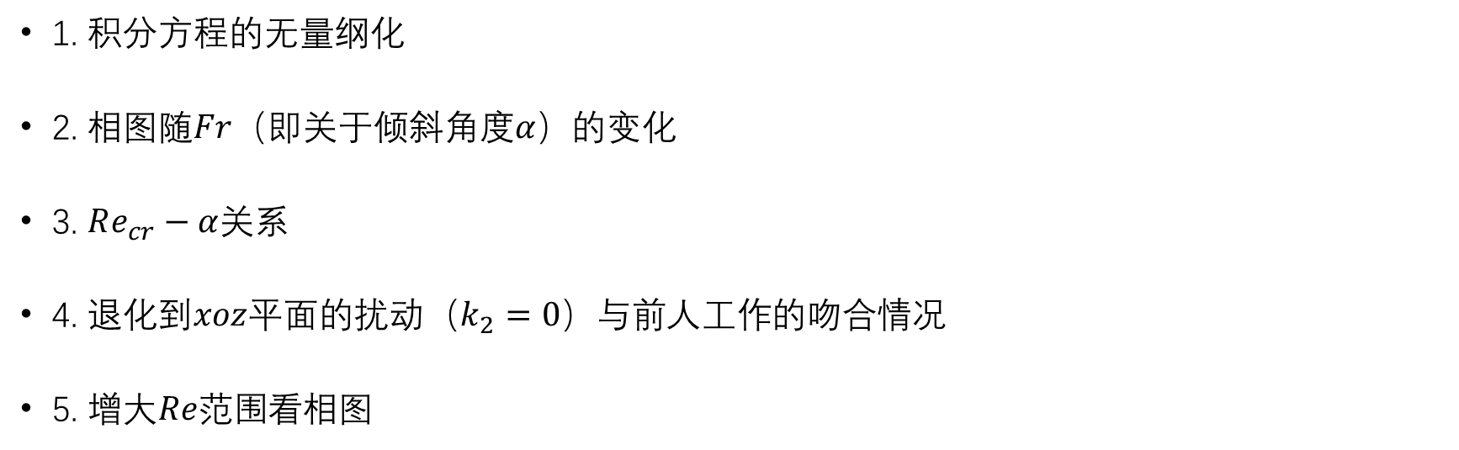
Outline
1. 积分方程的无量纲化
2. 相图随$Fr$（即关于倾斜角度$α$）的变化
3. $Re_{cr}−α$关系
4. 退化到$xoz$平面的扰动（$k_{2}=0$）与前人工作的吻合情况
5. 增大$Re范围$看相图

Slide 3
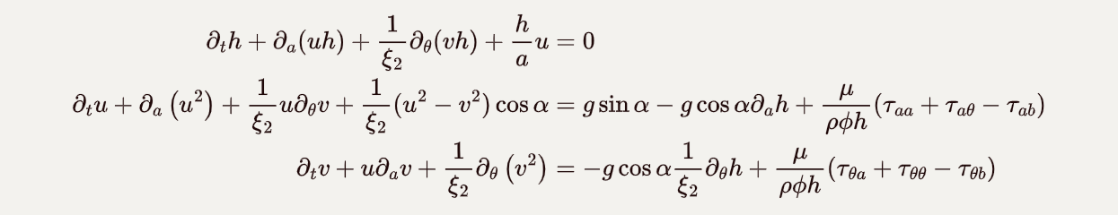

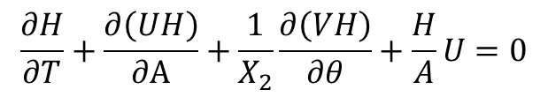
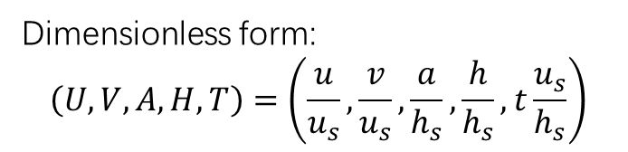
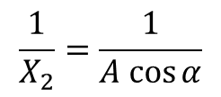
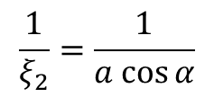

积分方程的无量纲化
Dimensionless form:
$$\left(U,V,A,H,T\right)=\left(\frac{u}{u_{s}},\frac{v}{u_{s}},\frac{a}{h_{s}},\frac{h}{h_{s}},t\frac{u_{s}}{h_{s}}\right)$$
$$\frac{1}{ξ_{2}}=\frac{1}{a cos⁡α}$$
$$\frac{1}{X_{2}}=\frac{1}{A cos⁡α}$$
$$Fr=\frac{u_{s}}{{\left(g\cos{α}h_{s} \right)}^{\frac{1}{2}}}$$
$$Re=\frac{u_{s}h_{s}}{ν}$$
Integral form of governing eqns.
$$\frac{∂H}{∂T}+\frac{∂\left(UH\right)}{∂A}+\frac{1}{X_{2}}\frac{∂\left(VH\right)}{∂θ}+\frac{H}{A}U=0$$
$$\frac{∂U}{∂T}+\frac{∂\left(U^{2}\right)}{∂A}+\frac{1}{X_{2}}\frac{∂\left(UV\right)}{∂θ}+\frac{1}{X_{2}}\left(U^{2}−V^{2}\right)\cos{α}=\frac{1}{Fr^{2}} −\frac{1}{Fr^{2}}\frac{∂H}{∂A}+\frac{1}{Re}\left(\frac{∂^{2}U}{∂A^{2}}+\frac{1}{{\left(X_{2}\right)}^{2}}\frac{∂^{2}U}{∂θ^{2}}−3\frac{U}{H^{2}}\right)$$
$$\frac{∂V}{∂T}+\frac{∂\left(UV\right)}{∂A}+\frac{1}{X_{2}}\frac{∂\left(V^{2}\right)}{∂θ}=−\frac{1}{Fr^{2}}\frac{1}{X_{2}}\frac{∂H}{∂θ}+\frac{1}{Re}\left(\frac{∂^{2}V}{∂A^{2}}+\frac{1}{{\left(X_{2}\right)}^{2}}\frac{∂^{2}V}{∂θ^{2}}−3\frac{V}{H^{2}}\right)$$

Slide 4
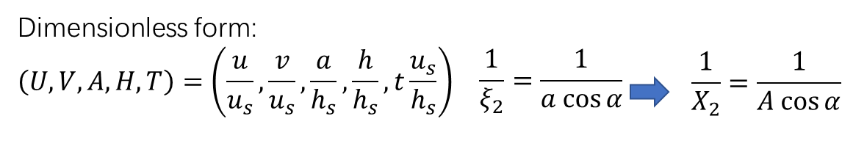
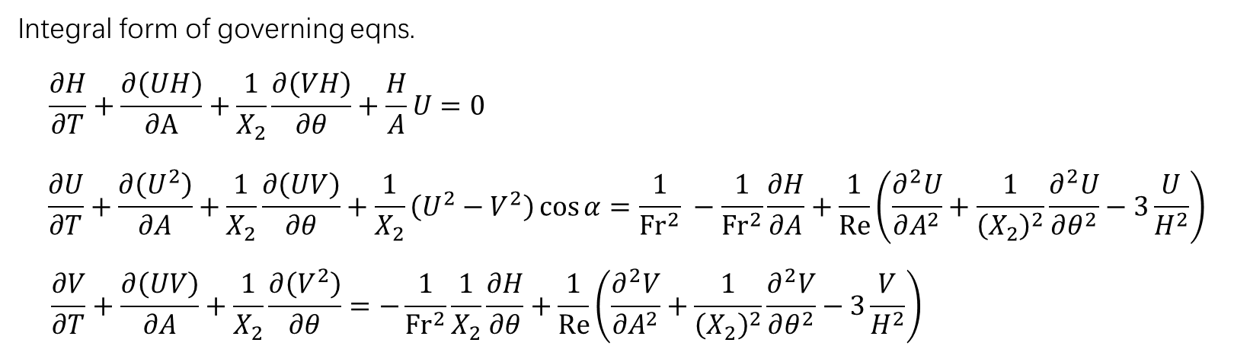

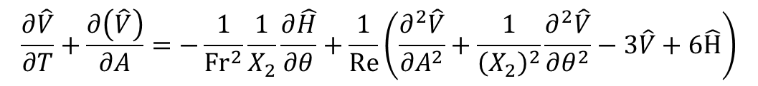
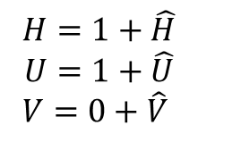
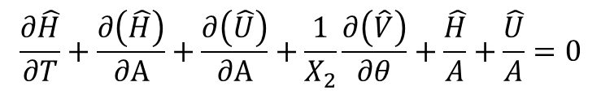

扰动方程的无量纲化
$$Fr=\frac{u_{s}}{{\left(g\cos{α}h_{s} \right)}^{\frac{1}{2}}}$$
$$Re=\frac{u_{s}h_{s}}{ν}$$
$$H=1+\hat{H}$$
$$U=1+\hat{U}$$
$$V=0+\hat{V}$$
Perturbation form of governing eqns.
$$\frac{∂\hat{H}}{∂T}+\frac{∂\left(\hat{H}\right)}{∂A}+\frac{∂\left(\hat{U}\right)}{∂A}+\frac{1}{X_{2}}\frac{∂\left(\hat{V}\right)}{∂θ}+\frac{\hat{H}}{A}+\frac{\hat{U}}{A}=0$$
$$\frac{∂\hat{U}}{∂T}+C\frac{∂\left(\hat{U}\right)}{∂A}+\frac{1}{X_{2}}\frac{∂\left(\hat{V}\right)}{∂θ}+\frac{1}{X_{2}}\left(2\hat{U}\right)\cos{α}= −\frac{1}{Fr^{2}}\frac{∂\hat{H}}{∂A}+\frac{1}{Re}\left(\frac{∂^{2}\hat{U}}{∂A^{2}}+\frac{1}{{\left(X_{2}\right)}^{2}}\frac{∂^{2}\hat{U}}{∂θ^{2}}−3\hat{U}+6\hat{H}\right)$$
$$\frac{∂\hat{V}}{∂T}+\frac{∂\left(\hat{V}\right)}{∂A}=−\frac{1}{Fr^{2}}\frac{1}{X_{2}}\frac{∂\hat{H}}{∂θ}+\frac{1}{Re}\left(\frac{∂^{2}\hat{V}}{∂A^{2}}+\frac{1}{{\left(X_{2}\right)}^{2}}\frac{∂^{2}\hat{V}}{∂θ^{2}}−3\hat{V}+6\hat{H}\right)$$

Slide 5
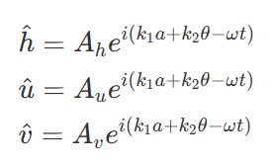
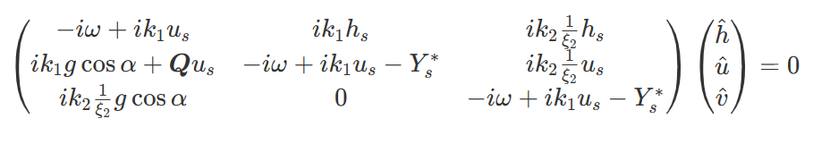
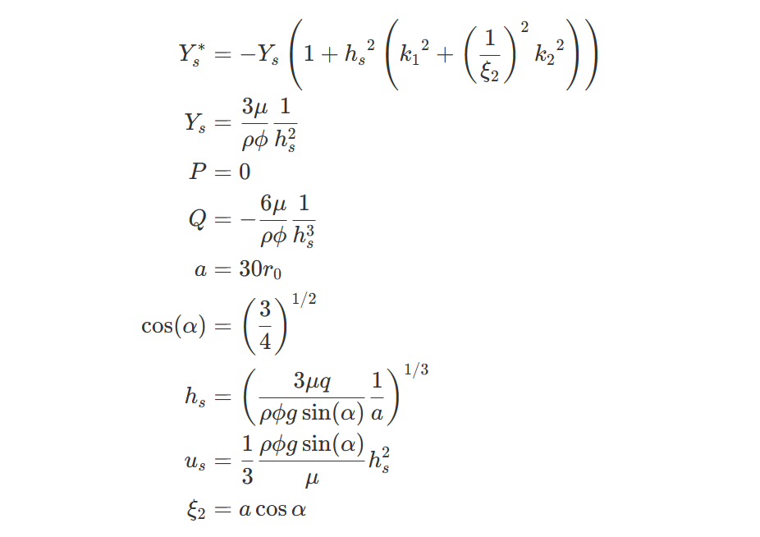
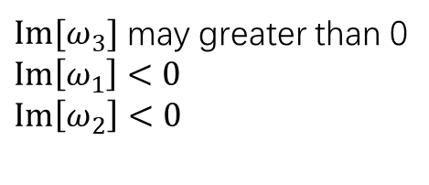


Matrix
$$\det\left(Ξ\right)=0$$
$$ω=(ω_{1},ω_{2},ω_{3})$$
$Im[ω_{3}]$ may greater than 0
$Im\left[ω_{1}\right]<0$
$Im\left[ω_{2}\right]<0$

Slide 6
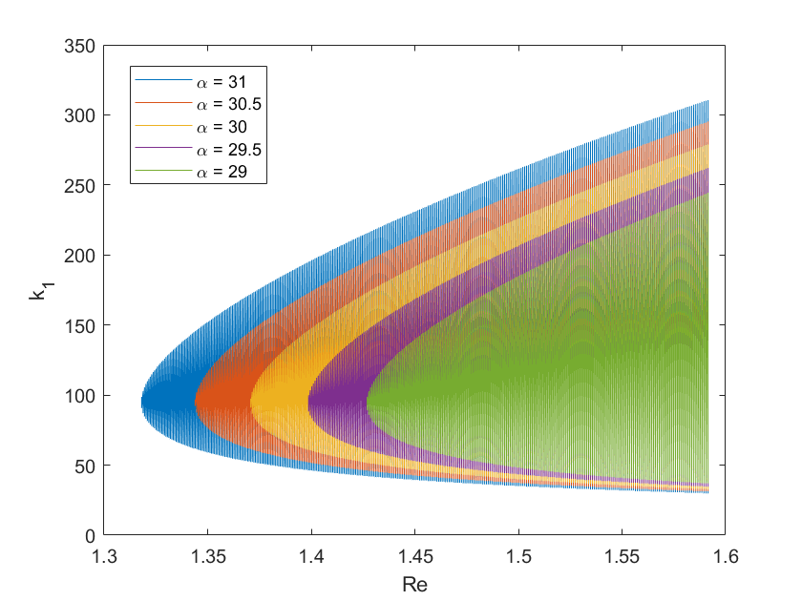
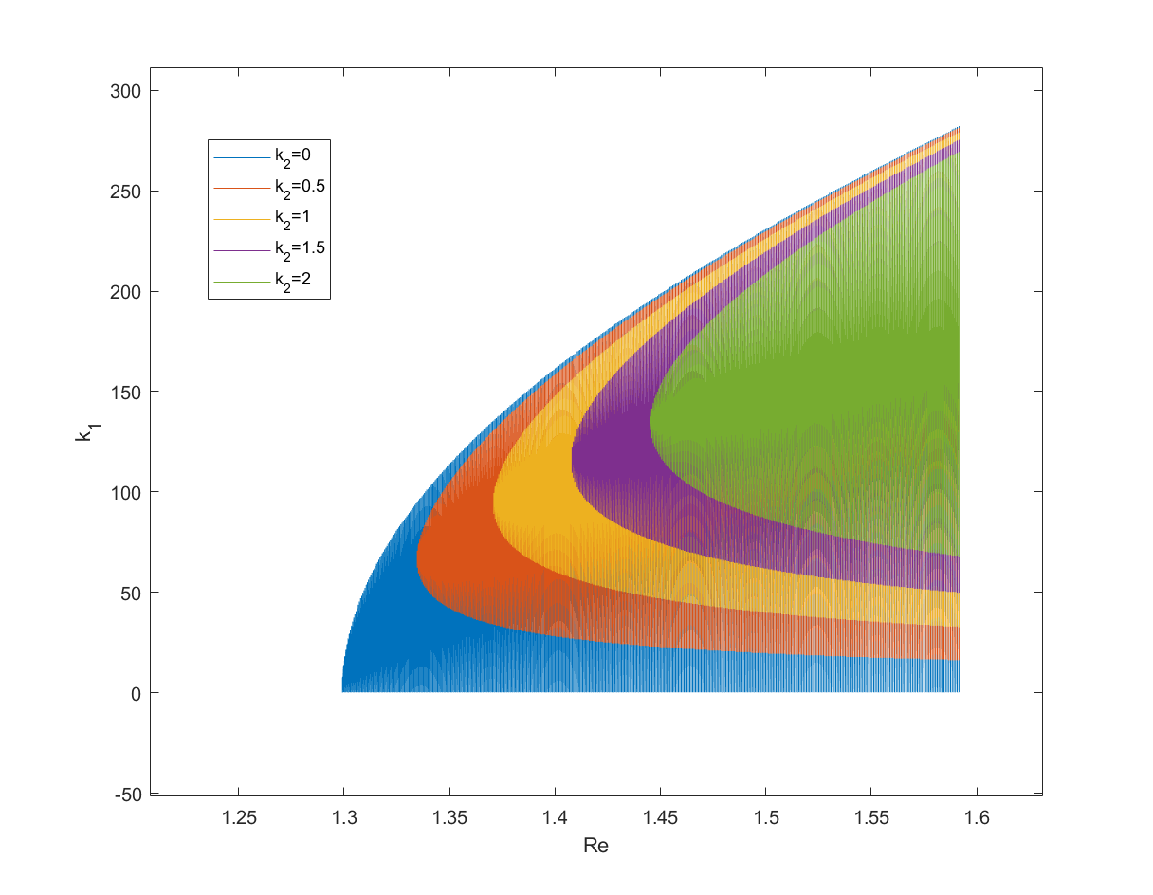




相图随倾斜角度变化（随$arccos\frac{1}{Fr^{2}}$变化）
固定$k_{2}$的情况下改变倾斜角
$$Re=\frac{u_{s}h_{s}}{ν}$$
$$Fr=\frac{u_{s}}{{\left(g\cos{α}h_{s} \right)}^{\frac{1}{2}}}$$

Slide 7
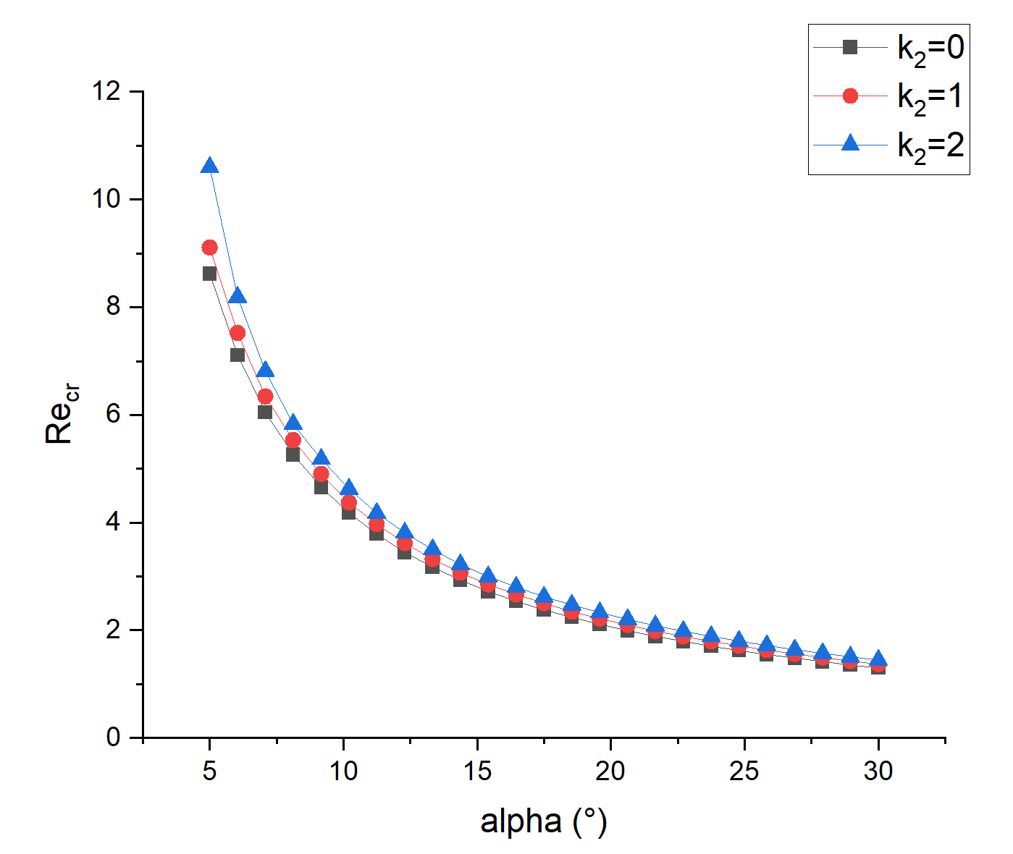
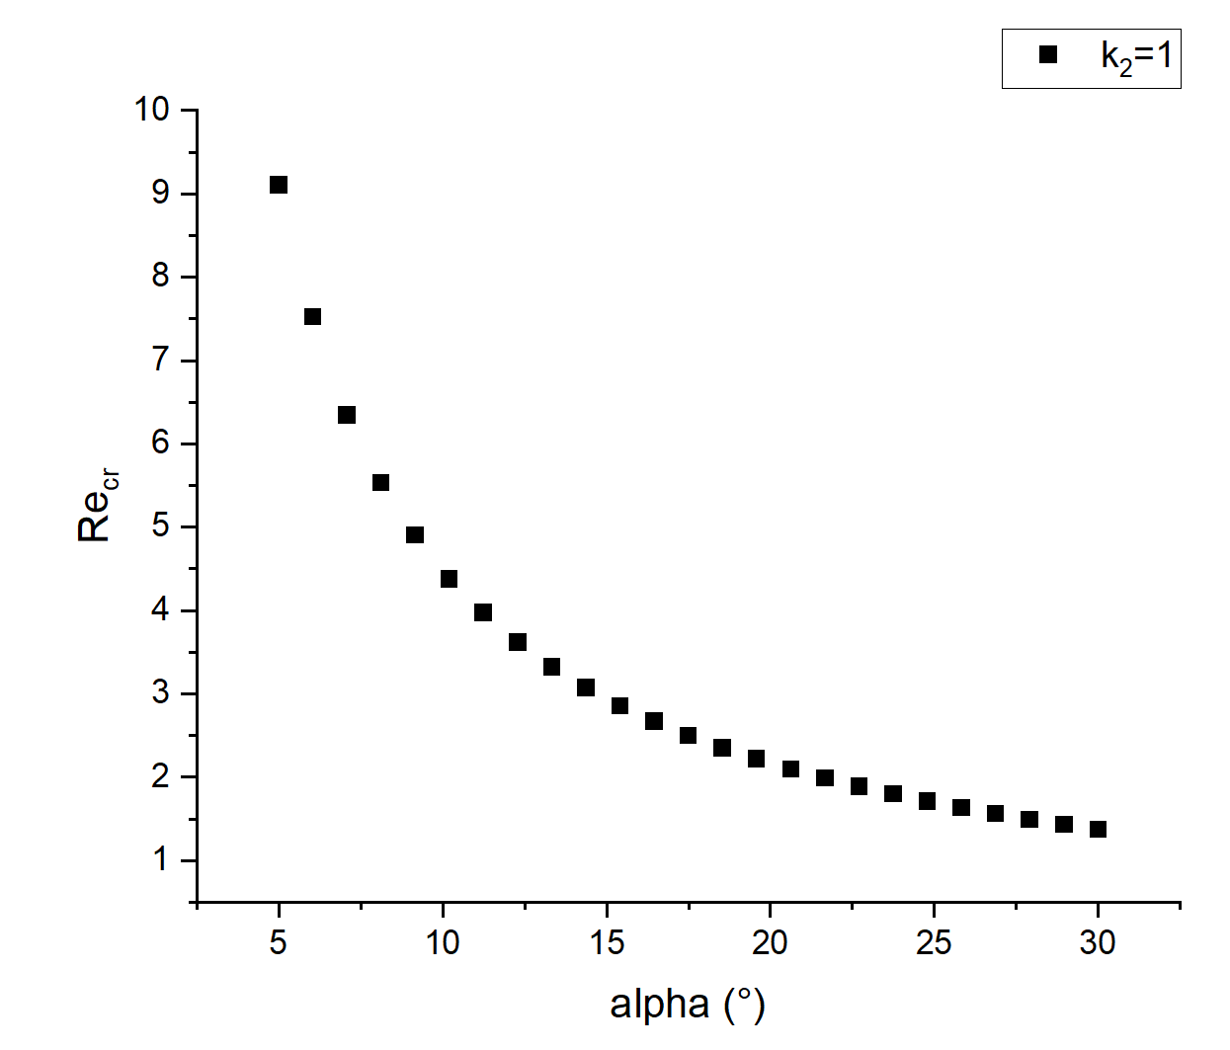
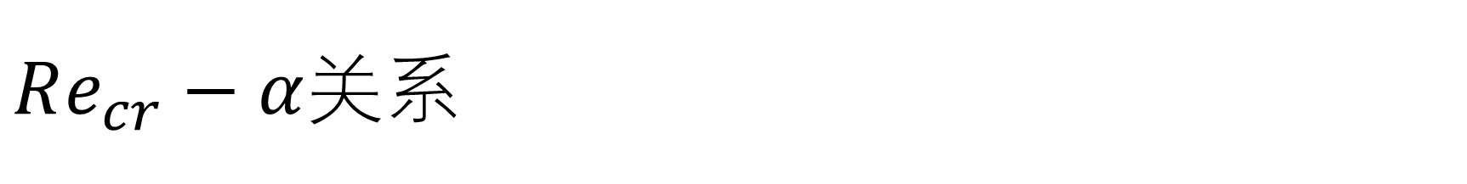
$Re_{cr}−α$关系

Slide 8
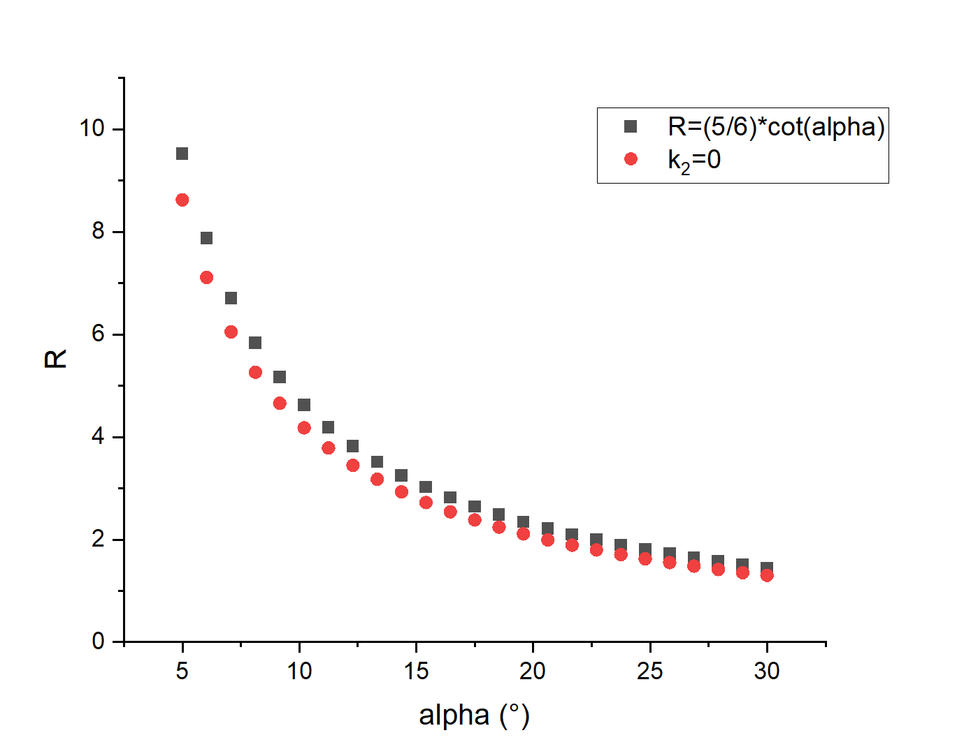
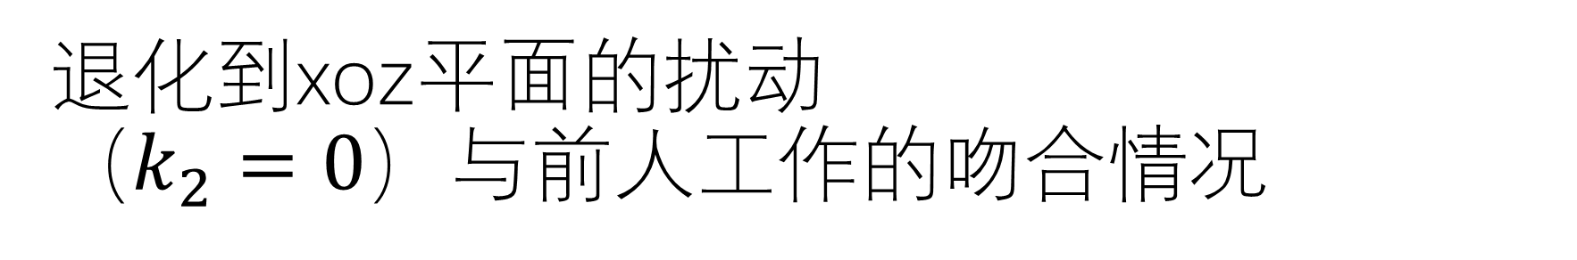
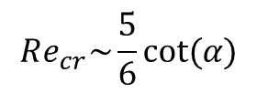
退化到xoz平面的扰动 （$k_{2}=0$）与前人工作的吻合情况
$$Re_{cr}\sim \frac{5}{6}cot⁡(α)$$
[1] T. Benjamin, “Wave formation in laminar flow down an inclined plane,” J. Fluid Mech. 2, 554–574 (1957)
[2] C.-S. Yih, “Stability of liquid flow down an inclined plane,” Phys. Fluids 6,321–333 (1963)

Slide 9
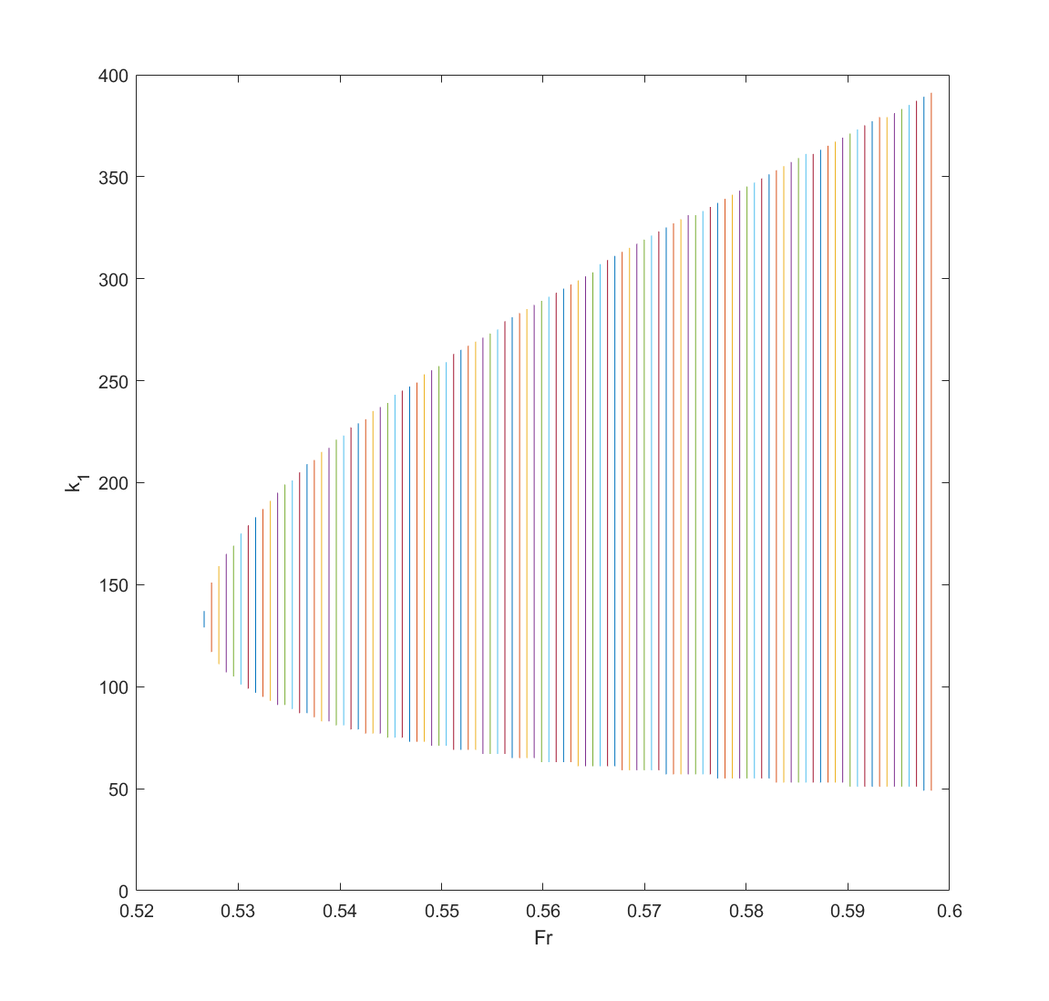
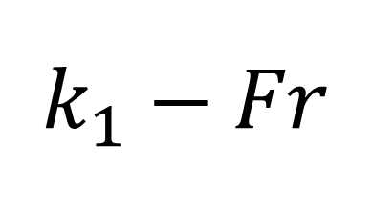

$$k_{1}−Fr$$
$$Fr_{cr}\sim 0.5$$
[1] Julia Zayko, Margarita Eglit; Stability of downslope flows to two-dimensional perturbations. Physics of Fluids 1 August 2019; 31 (8): 086601

Slide 10
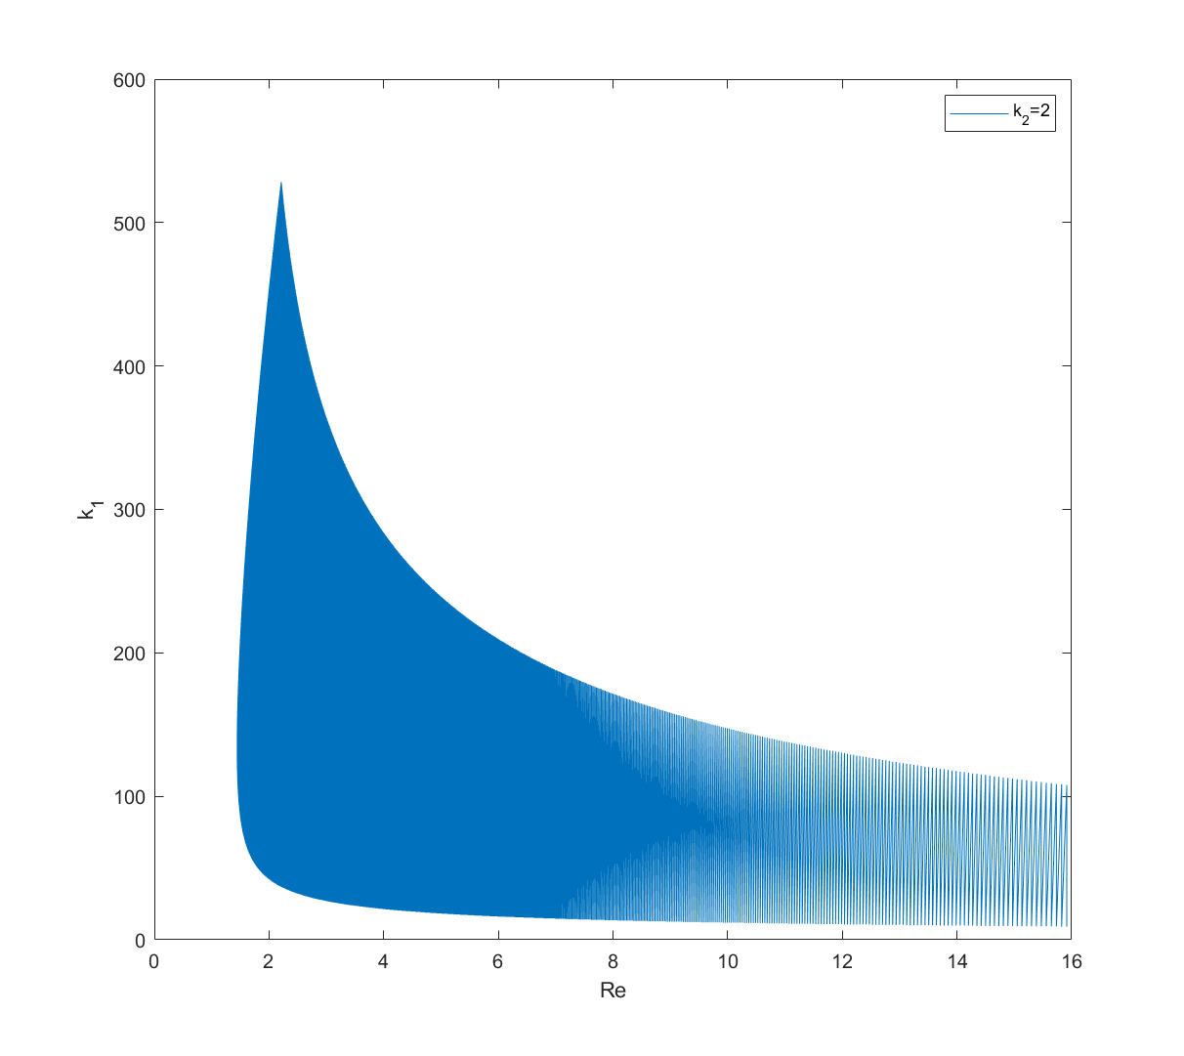

增大$Re范围$看相图

Slide 11
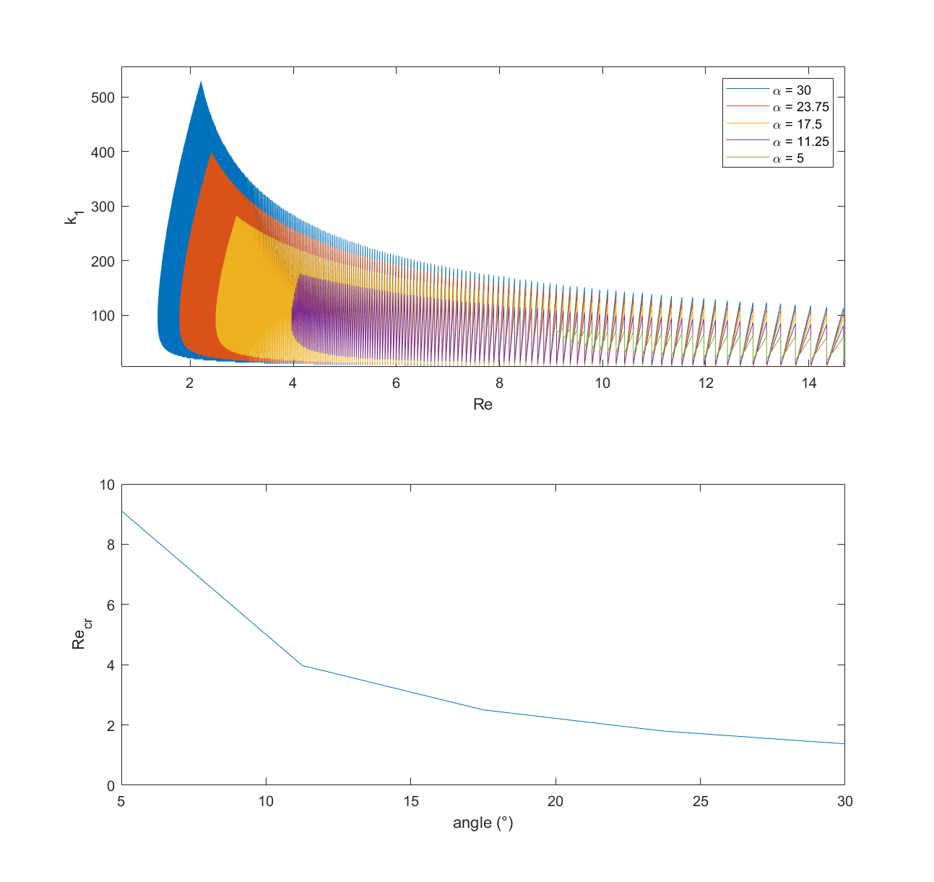
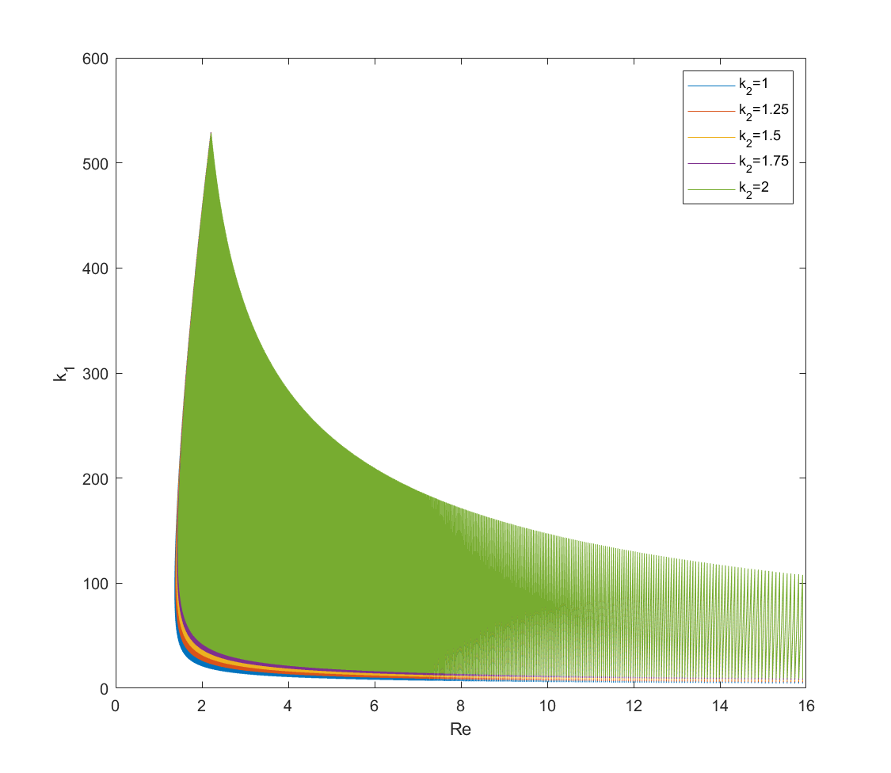

Slide 12
感谢！

Slide 13
备忘
波长短的粘性项考虑-各个项的相对大小
Re[\omega] ，相速度

