Slide 1
扰动流计算讨论
Haoyu Lu
UM-SJTU Joint Institute Shanghai Jiao Tong University
Nov. 10 ,2023

Slide 2
Outline
计算勘误
重述Instability criterion
简化到平板流动的结果比较
其他补充图像的讨论（相速度与k关系）
选取不同的位置a对于稳定性的影响
出现断点的问题（matlab演示,代码问题？）
如何对应实际物理情景（考虑空间演化）

Slide 3
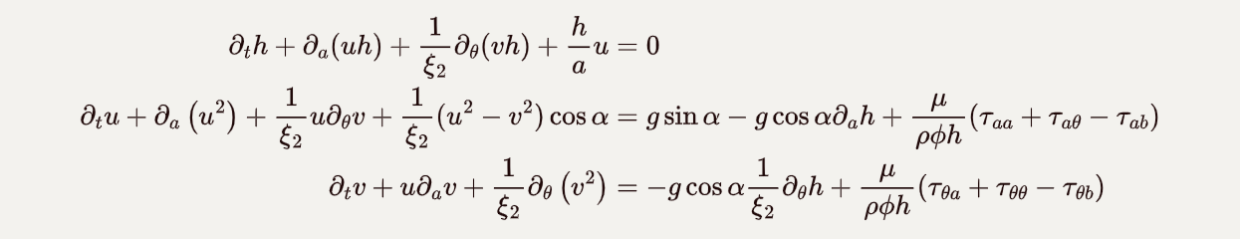
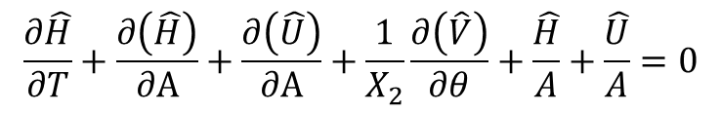
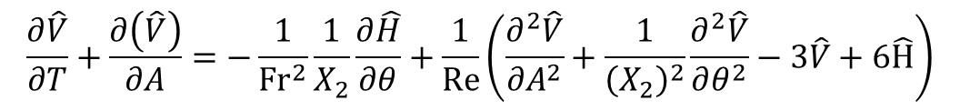
1.计算勘误-1
Perturbation form of governing eqns.
$$\frac{∂\hat{H}}{∂T}+\frac{∂\left(\hat{H}\right)}{∂A}+\frac{∂\left(\hat{U}\right)}{∂A}+\frac{1}{X_{2}}\frac{∂\left(\hat{V}\right)}{∂θ}+\frac{\hat{H}}{A}+\frac{\hat{U}}{A}=0$$
$$\frac{∂\hat{U}}{∂T}+C\frac{∂\left(\hat{U}\right)}{∂A}+\frac{1}{X_{2}}\frac{∂\left(\hat{V}\right)}{∂θ}+\frac{1}{X_{2}}\left(2\hat{U}\right)\cos{α}= −\frac{1}{Fr^{2}}\frac{∂\hat{H}}{∂A}+\frac{1}{Re}\left(\frac{∂^{2}\hat{U}}{∂A^{2}}+\frac{1}{{\left(X_{2}\right)}^{2}}\frac{∂^{2}\hat{U}}{∂θ^{2}}−3\hat{U}+6\hat{H}\right)$$
$$\frac{∂\hat{V}}{∂T}+\frac{∂\left(\hat{V}\right)}{∂A}=−\frac{1}{Fr^{2}}\frac{1}{X_{2}}\frac{∂\hat{H}}{∂θ}+\frac{1}{Re}\left(\frac{∂^{2}\hat{V}}{∂A^{2}}+\frac{1}{{\left(X_{2}\right)}^{2}}\frac{∂^{2}\hat{V}}{∂θ^{2}}−3\hat{V}+6\hat{H}\right)$$
The effect of the velocity profile after integration along the thickness of the fluid layer
C from 1 to 1.2

Slide 4
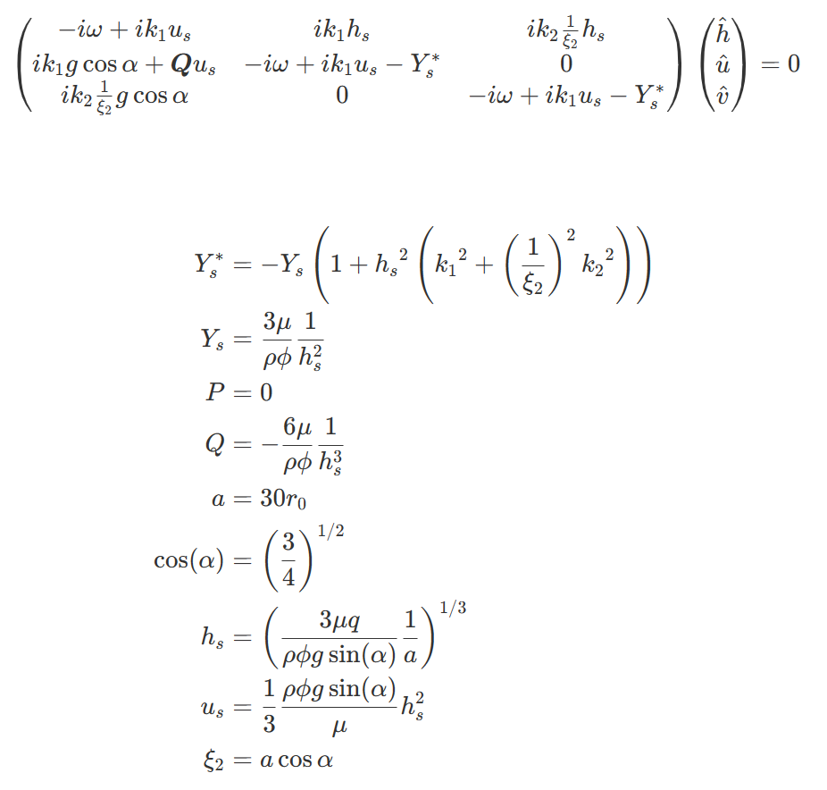
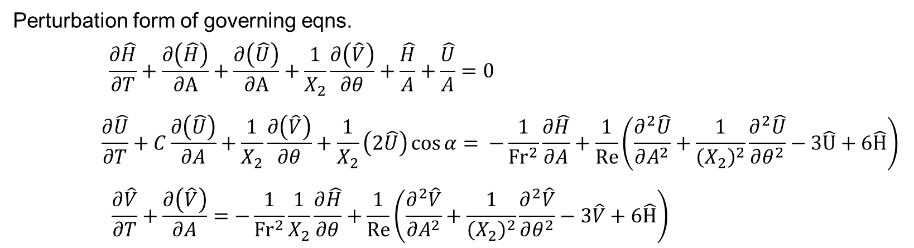
1.计算勘误-2
We need to multiply 1/3 here

Slide 5
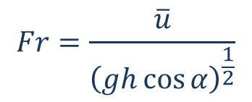
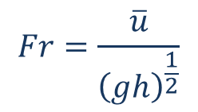
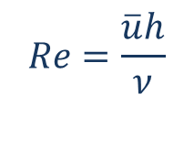

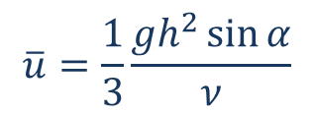

2.重述不稳定性判据
[1] T. Benjamin, “Wave formation in laminar flow down an inclined plane,” J. Fluid Mech. 2, 554–574 (1957)
[2] C.-S. Yih, “Stability of liquid flow down an inclined plane,” Phys. Fluids 6,321–333 (1963)
In these papers, Yih and Benjamin define the Reynolds number and Froude number as:
$$Re=\frac{\overline{u}h}{ν}$$
$$Fr=\frac{\overline{u}}{{\left(gh\right)}^{\frac{1}{2}}}$$
$$\overline{u}=\frac{1}{3}\frac{gh^{2}\sin{α}}{ν}$$
Here they use the average velocity of the primary flow:
$$3Fr^{2}=Re sin(α)$$
$$Re_{cr}=\frac{5}{6}\cot{α}$$
And they gave the instability criterion:
$ω_{i}=ω_{i}(Re, Fr,α)$ at certain $a$, thus it is equivalent with $Fr_{cr}=0.527$
$$Fr=\frac{\overline{u}}{{\left(gh\cos{α}\right)}^{\frac{1}{2}}}$$

Slide 6
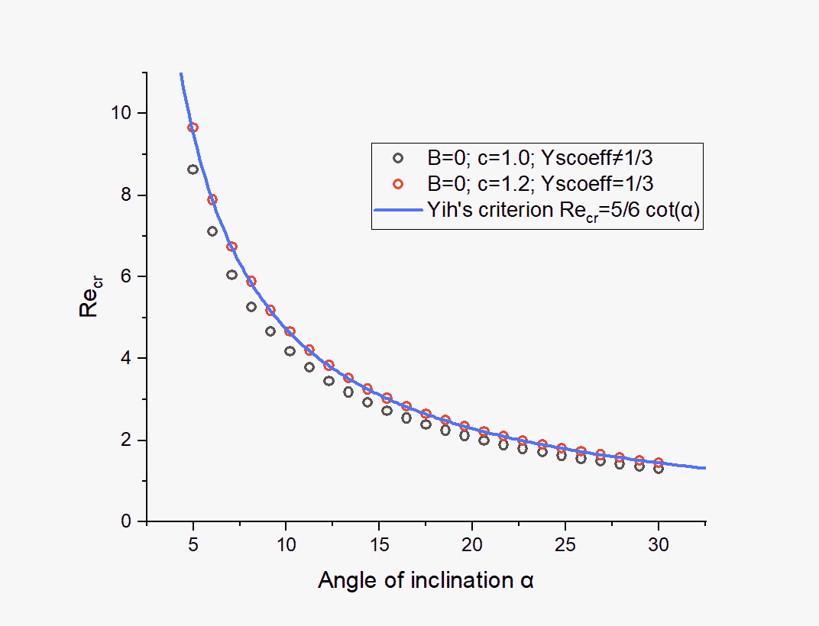
3.结果比较

Slide 7
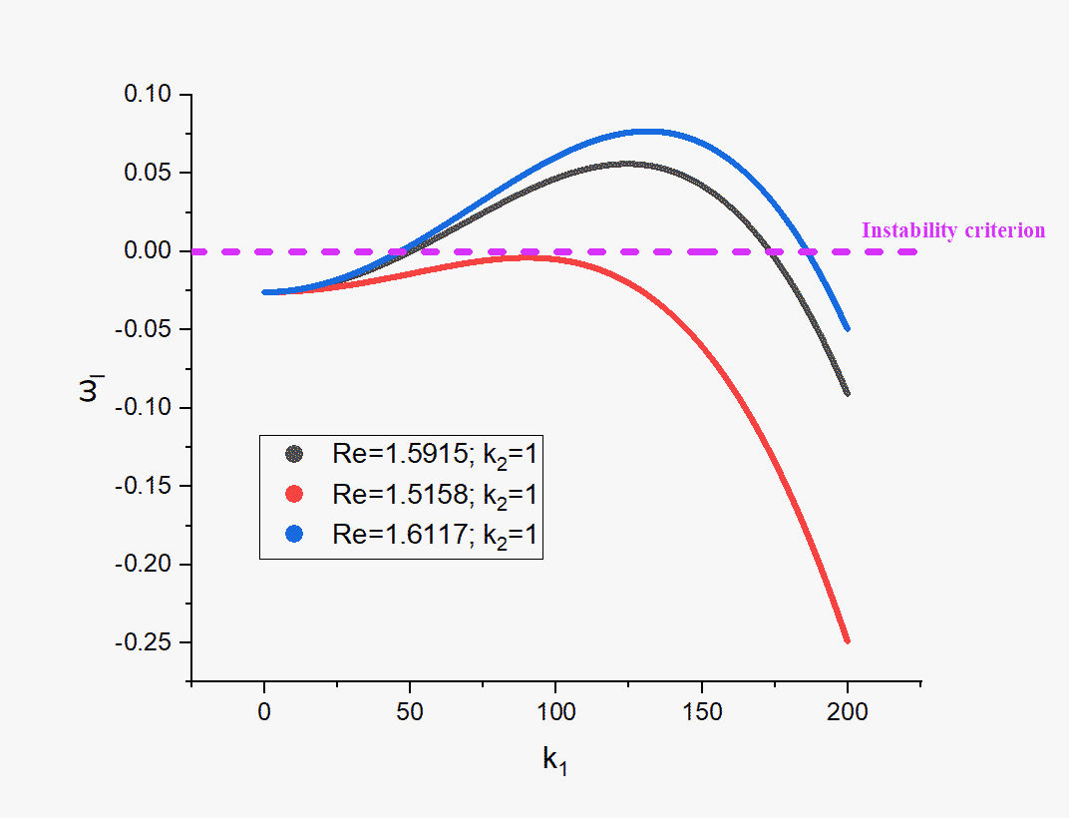
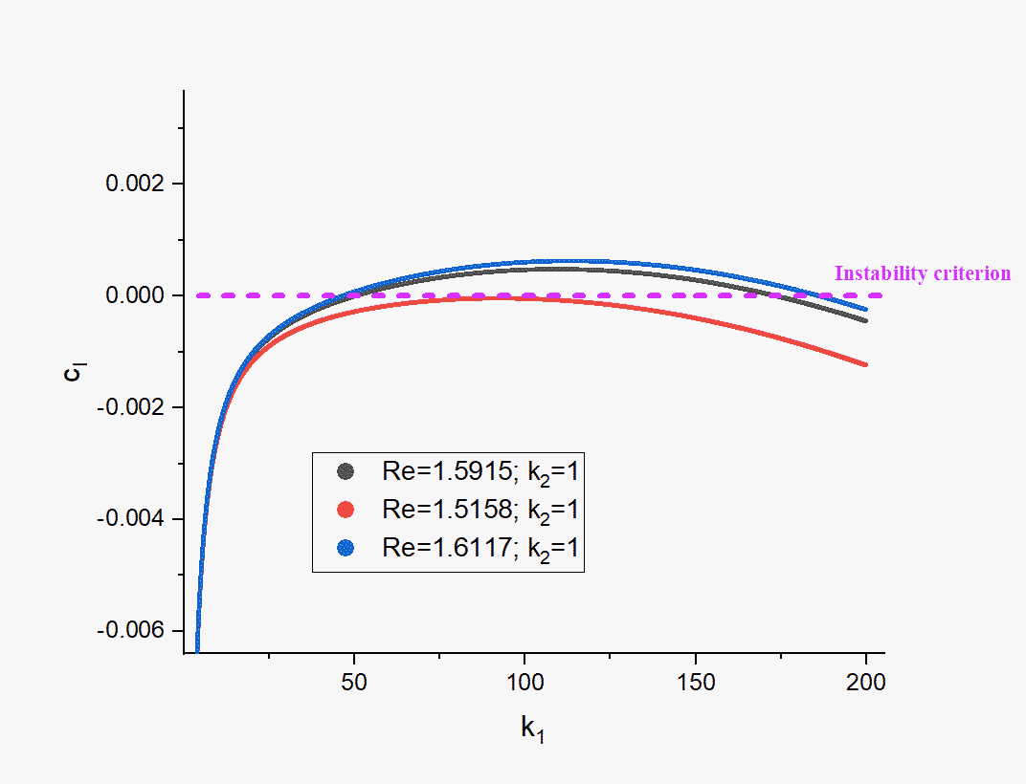
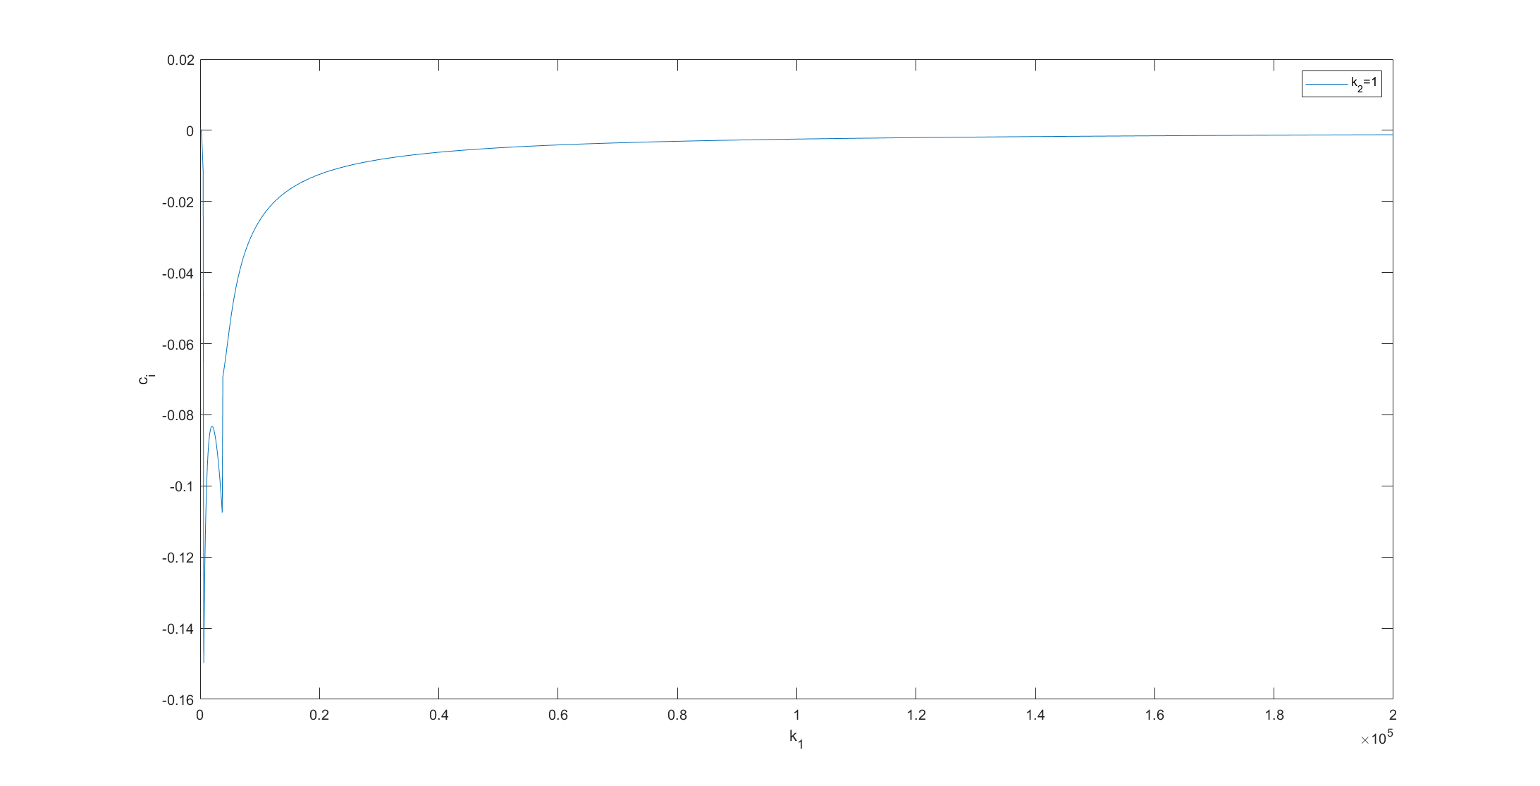
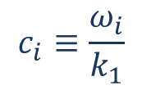
4.不同Re下相速度随$k_{1}$变化关系
$$c_{i}≡\frac{ω_{i}}{k_{1}}$$
When $k$ goes to infty, $c_{i}$ will approach zero from negative side

Slide 8
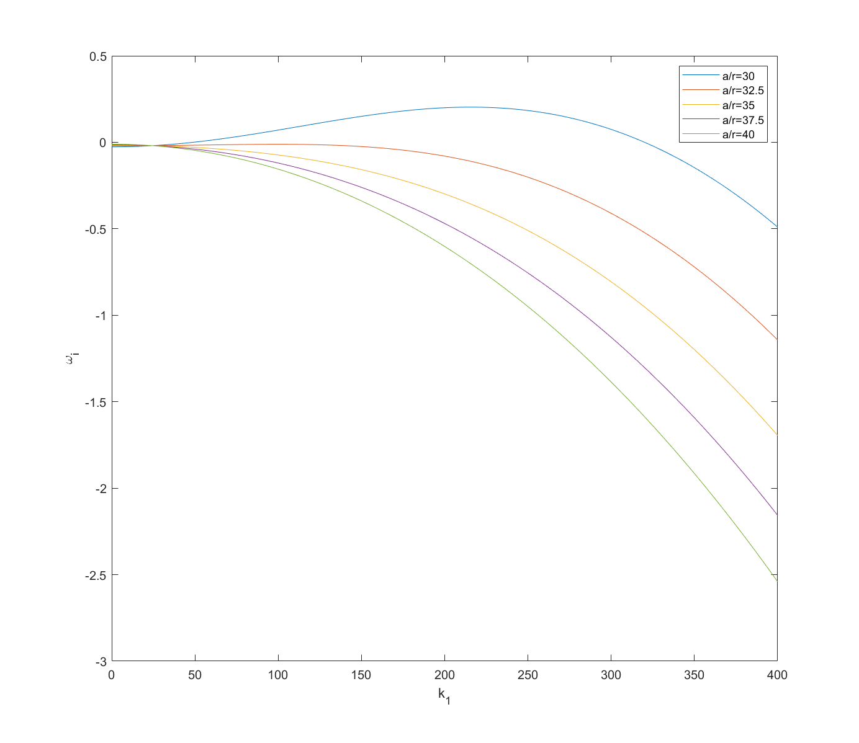
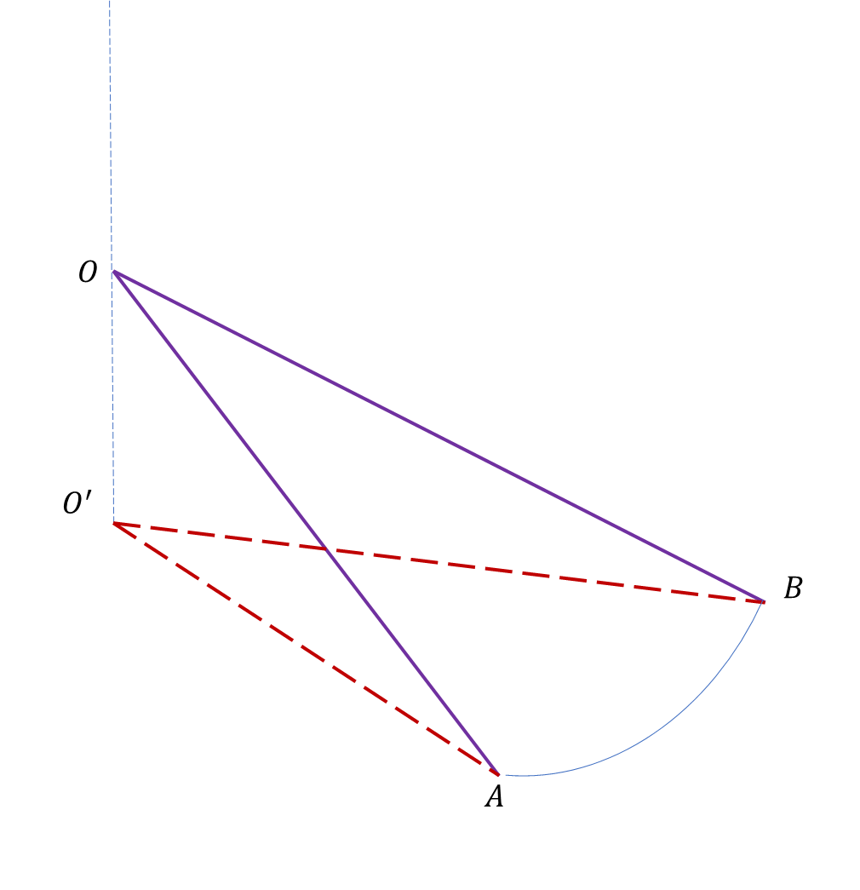
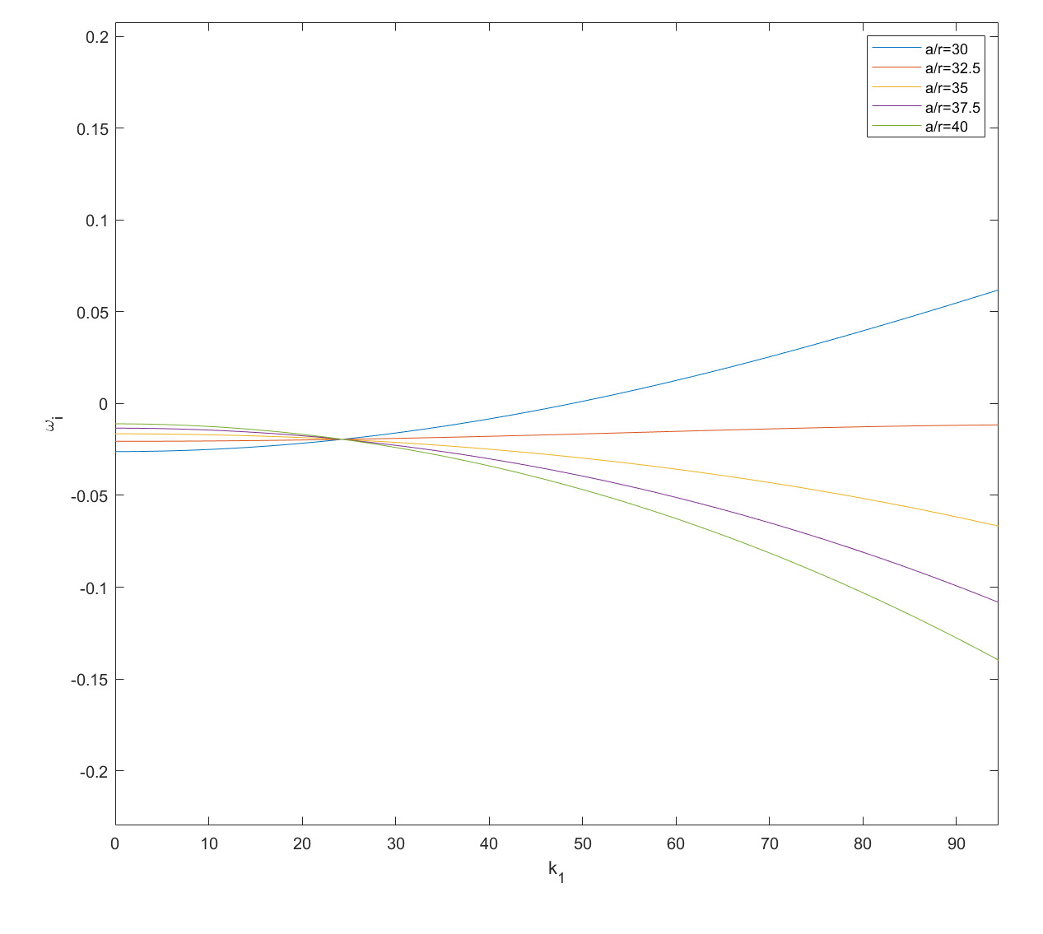



5.选取不同的a对于稳定性的影响
$$r_{0}$$
$$b$$
$$a$$
Thicker layer leads to instability

Slide 9
6.断点问题
omega_k1-fixk2.m 现场演示
When Re is small everything goes well, while when Re becomes large
不知道是因为MATLAB的浮点数精度问题
还是我的求解形式有问题 （Matlab_root 函数直接求解三次幂复数方程）
亦或是还有代码错误的地方？
亦或是怎么解释它

Slide 10
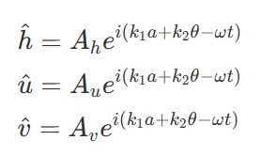

7.如何对应实际物理情景
考虑空间演化，扰动量还可以写成这个形式吗？
$k_{1}$ 能不能直接设置为复数
上次提及的反变换格式
如果让$k_{2}, ω$已知，反解出的$k_{1}也$有可能为复数，无论$此时ω$为复数与否
目前的情况是已经知道Re的判据，但最终的目的是想得到流体在锥面上如何偏移的形式

Slide 11
Thanks!

