Slide 1
扰动讨论
Haoyu Lu
2023.11.16

Slide 2
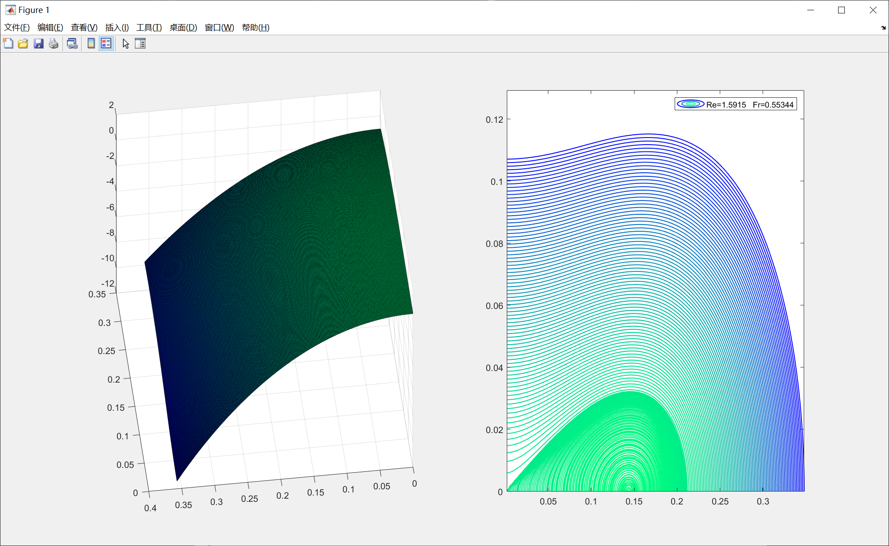






A~60 H~1
$$Ω_{I}$$
$$K_{2}$$
$$K_{1}$$
$$K_{2}$$
$$K_{1}$$

Slide 3
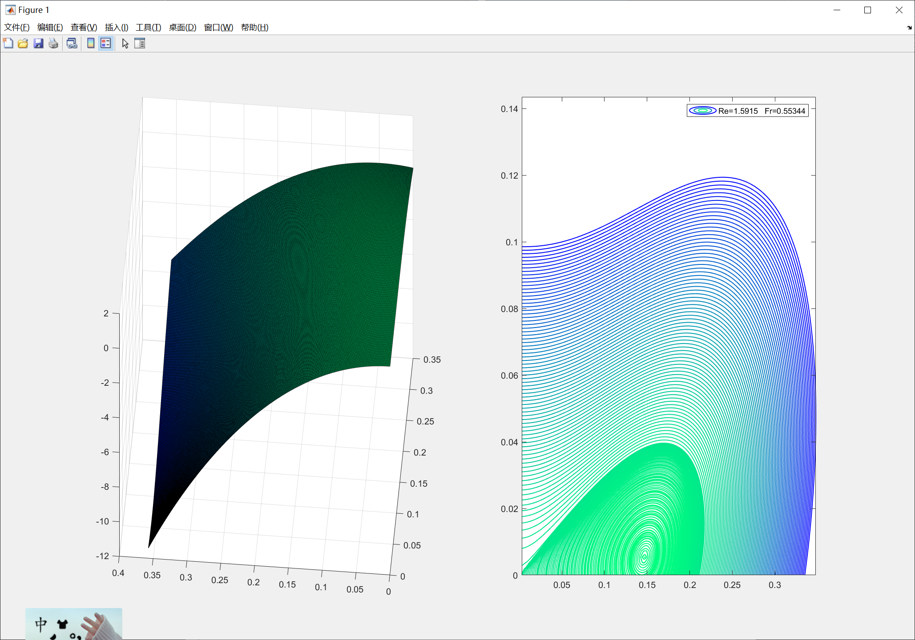
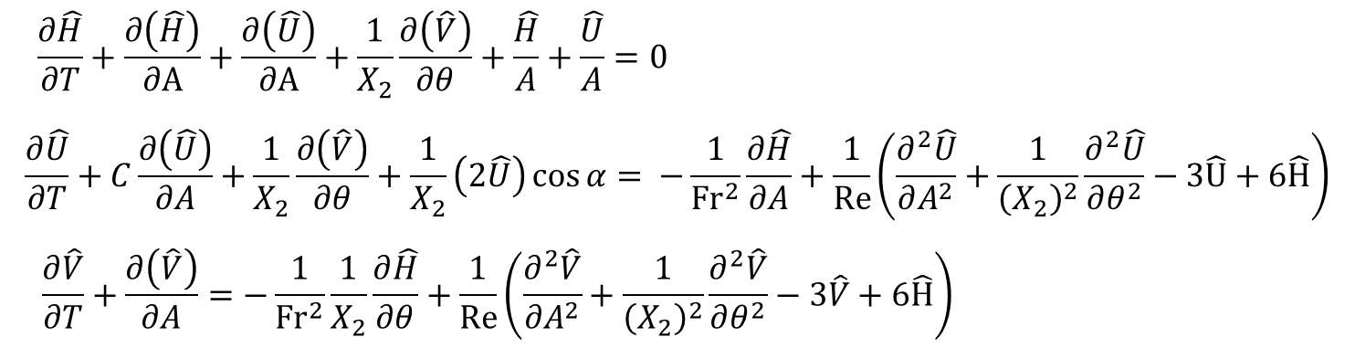



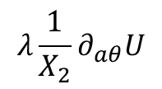

A~60 H~1
$$λ\frac{1}{X_{2}}∂_{aθ}U$$
Modify the stress term
$$K_{2}$$
$$K_{2}$$
$$K_{1}$$
$$K_{1}$$

Slide 4
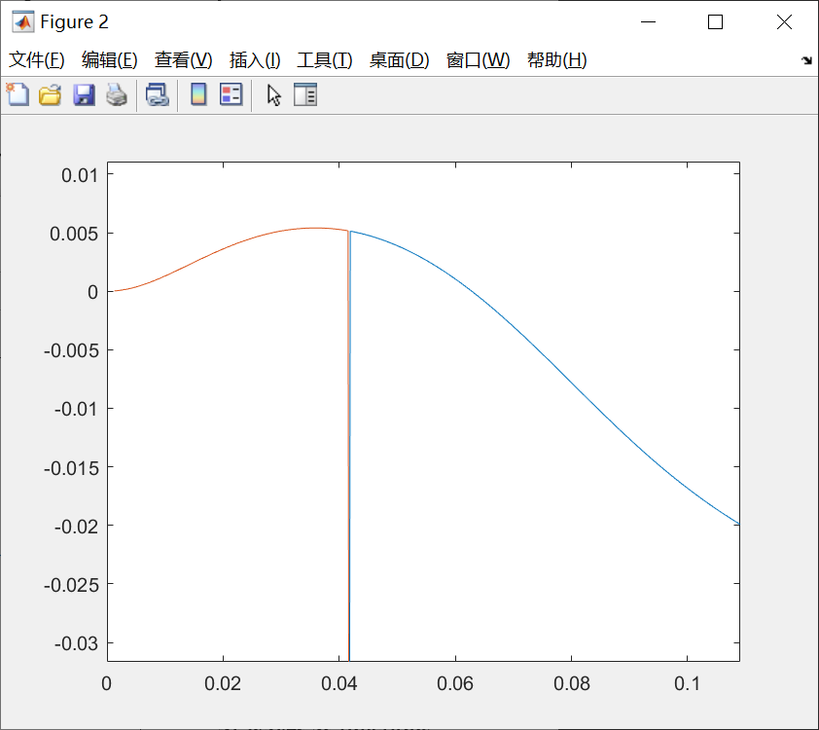
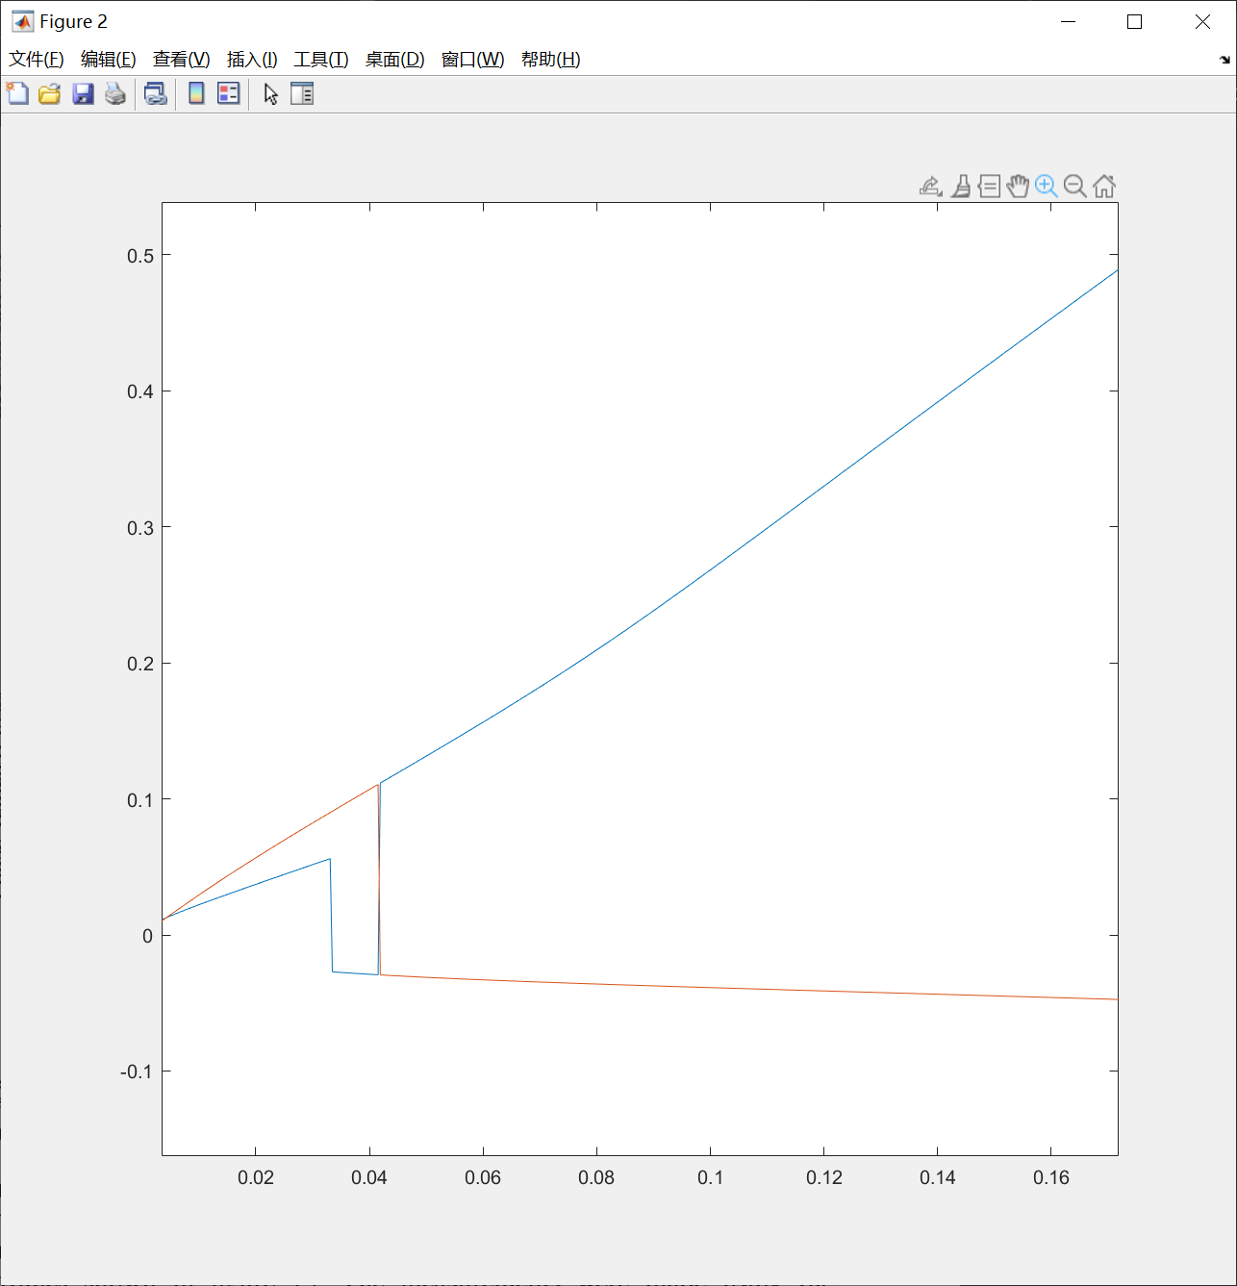
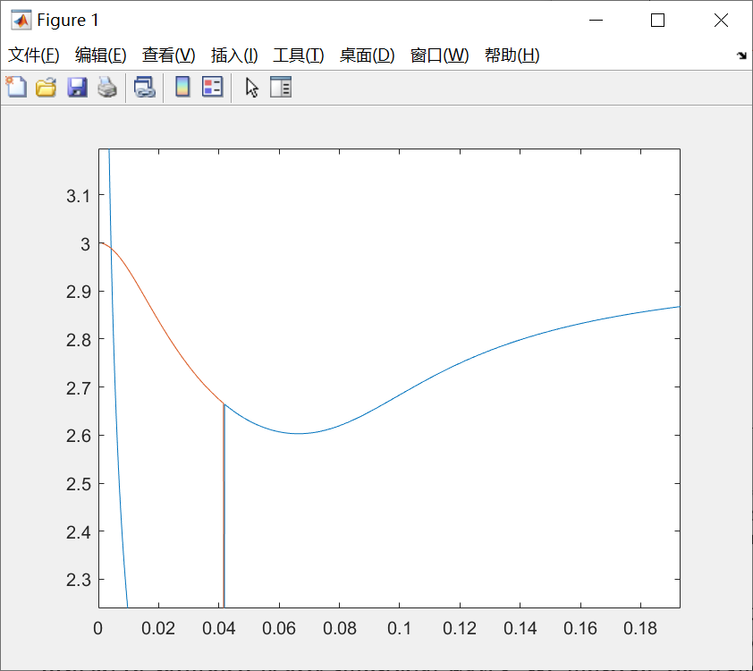







A~60 H~1
$$Ω_{I}$$
$$Ω_{R}$$
$$C_{R}$$
$$K_{1}$$
$$K_{1}$$
$$K_{1}$$
$$K_{1}=0.03$$
Nearly linear

Slide 5
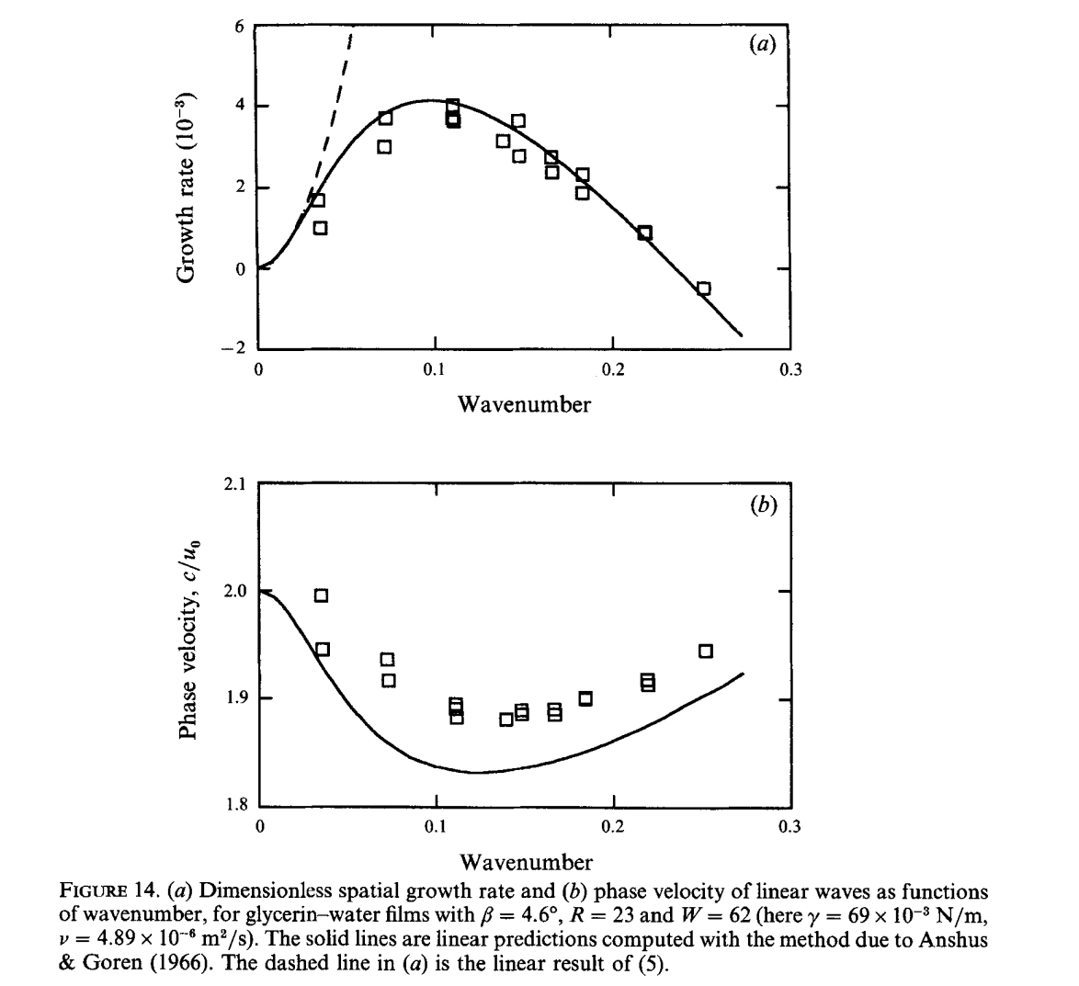


Liu, J., Paul, J., & Gollub, J. (1993). Measurements of the primary instabilities of film flows. Journal of Fluid Mechanics, 250, 69-101. doi:10.1017/S0022112093001387
$$C_{R}$$
$$K_{1}$$
Without surface tension

Slide 6
Thank you!

Slide 7
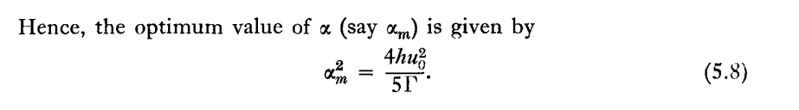
$$Ω_{I}$$
$$Ω_{R}$$
$$C_{R}$$
$$K_{1}$$
$$K_{1}$$
$$K_{1}$$
$$K_{1}=0.03$$
Nearly linear
While Benjamin’s article shows nearly 0.011

Slide 8
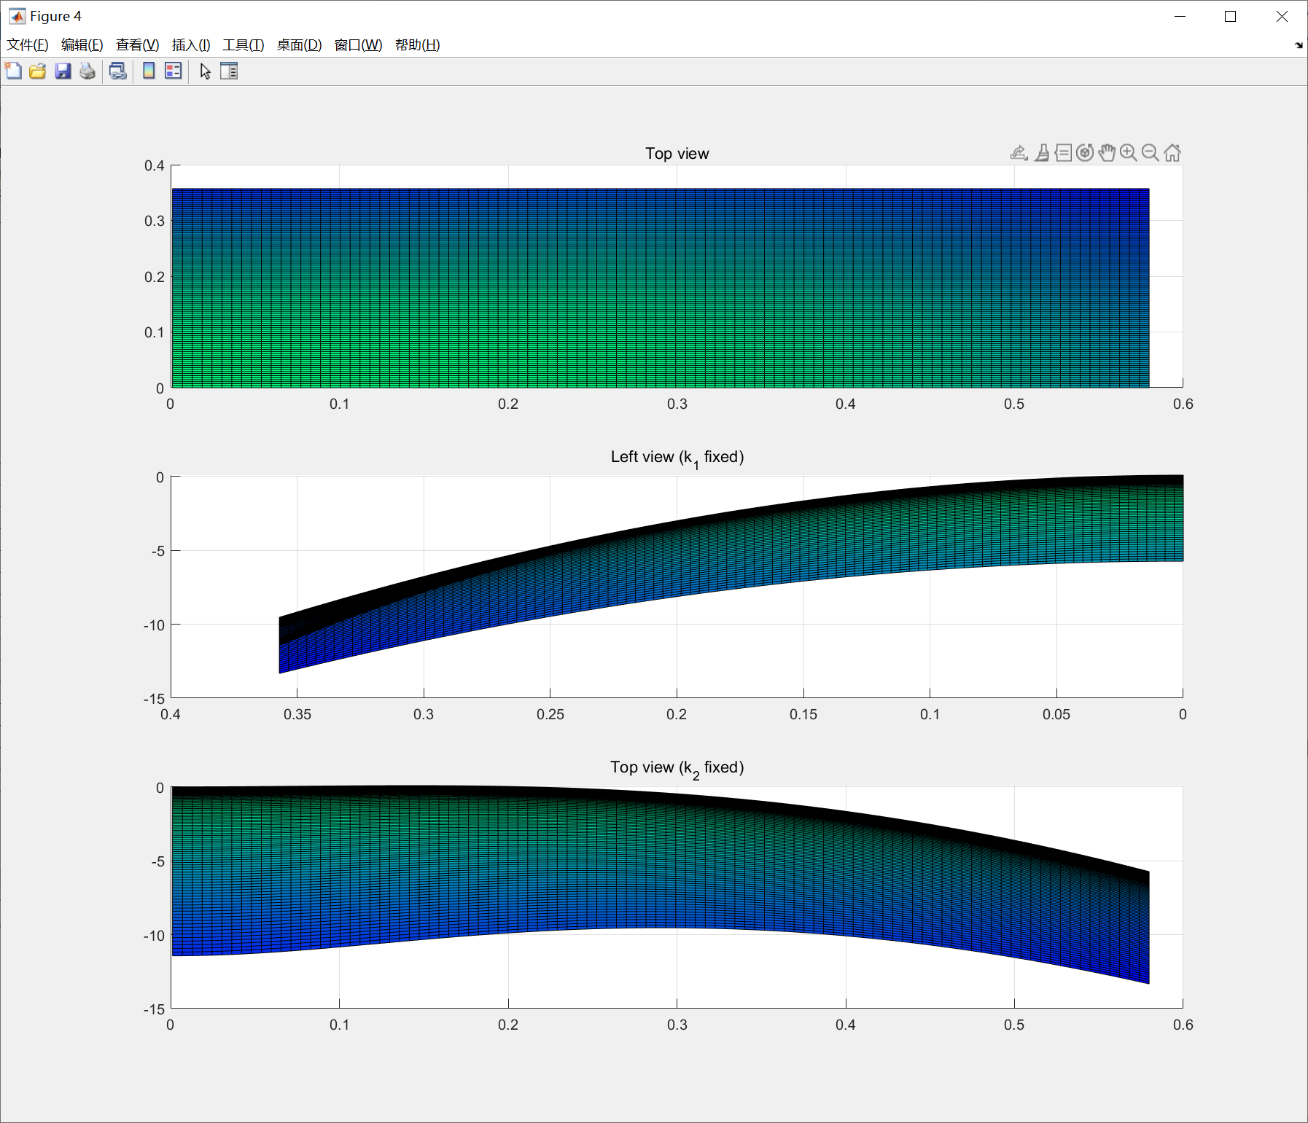
appendix

